Slide 1
Submitting a paper for publication.
Write paper → Determine where to submit paper.
Check where similar papers have been published.
Observe how quickly papers published in this journal after submission.
Check impact factor to determine if journal legitimate via https://jcr.incites.thomsonreuters.com/JCRJournalHomeAction.action
Consider submitting preprint to
lanl.arXiv.org

Slide 2
Consider first publishing in a research journal. If you don’t think your students research fits into a research journal, consider an undergraduate journal
http://curm.byu.edu/resources/journals
Journals that specifically publish undergraduate research in mathematics:
Involve “is a publication in between the extremes of purely undergraduate research journals, which in general are aimed at undergraduate audiences, and mainstream research journals.”
SIAM Undergraduate Research Online “a web-based publication devoted to undergraduate research in applied and computational mathematics.”
The Rose-Hulman Undergraduate Mathematics Journal
“is devoted entirely to papers written by undergraduates on topics related to mathematics.”
Furman University Electronic Journal of Undergraduate Mathematics
“accepts papers of significant mathematical interest written by students containing work done prior to the students' obtaining a Bachelor's degree. Papers of all types will be considered, including technical, historical, and expository papers.”

Slide 3
http://curm.byu.edu/resources/journals
Pi Mu Epsilon Journal “Pi Mu Epsilon promotes scholarship in mathematics is through the publishing of the Pi Mu Epsilon Journal. The sole purpose of this Journal is to present papers and mathematical problems by and for its members.”
Morehead Electronic Journal of Applicable Mathematics (MEJAM) “MEJAM accepts papers . . . which emphasize the applicability of mathematics while maintaining significant mathematical interest. Papers may be historical, expository, or completely original in nature but must adhere to strict academic standards and should explore some aspect of the applications of mathematics.”
Mathematical Spectrum “publishes articles from all branches of mathematics, as well as regular features on mathematics in the classroom, a computer column, letters, problems and solutions, book and software reviews. We welcome original student contributions and award annual prizes for the best ones published.”
American Journal of Undergraduate Research (AJUR) “A refereed journal for undergraduate research in the pure and applied sciences, mathematics, engineering, technology, and related area in education.”

Slide 4
Submit paper
to math journal to biology journal
Wait 6 – 12 months Wait 3 – 6 weeks
Implement reviewers’ suggestions
and respond to reviewers.
Submit revised version
If accepted, paper will (eventually or almost immediately) be published.

Slide 5
Reviewer first gives brief summary of the paper (often using authors’ wording) and motivates recommendation for or against publication
This is referee's report for the paper…
Some protein complexes interact with multiple DNA segments during biological processes.These processes can change the topology of DNA which results in knotted or linked DNA. Tangle analysis was introduced to study/model various protein actions mathematically. The protein is modeled by a 3-dimensional ball and the protein-bound DNA is modeled by strings embedded in the ball.
A protein complex bound to a circular DNA molecule at four sites can be modeled by a 4-string tangle. In this paper, the authors provide a biologically relevant 4-string tangle model of a DNA-protein complex and develop mathematics to determine the topology of DNA within the protein complex. The paper contains new and interesting results, and it is carefully written. The proofs are technical and elaborate. In referee's opinion, the paper deserves to be published in JKTR, after taking into account the corrections/suggestions given below. List of corrections/suggestions: page 2, line 8: delete the space after \DNA segments". - last paragraph in the Introduction: replace \section i" with\Section i". - Section 2: italicize the terms newly introduced: page 2, line -4: \jumping DNA" page 2, line -2:\ transposable element" page 2, line -1: \transposon" and \transposition" ...
Reviewer gives specific list of corrections that must (?) be implemented

Slide 6
Response to referee's report:
We thank the reviewer for their detailed comments ….
We have implemented their suggestions as described below:
page 2, line 8: delete the space after \DNA segments".
done, - last paragraph in the Introduction: replace \section i" with\Section i".
done - Section 2: italicize the terms newly introduced: done
Often additional explanation is needed
E.g.: We addressed the reviewers concern on new page ?, lines ??
often quote of the lines included in the report.
If you disagree with the reviewer and do not want to implement one of the suggestions, you must explain why.

Slide 7
Editing an Electronic Journal Jeffrey Shallit
http://www.ams.org/notices/201502/rnoti-p169.pdf

Slide 8
Git & Github
Timothy McRoy

Slide 9
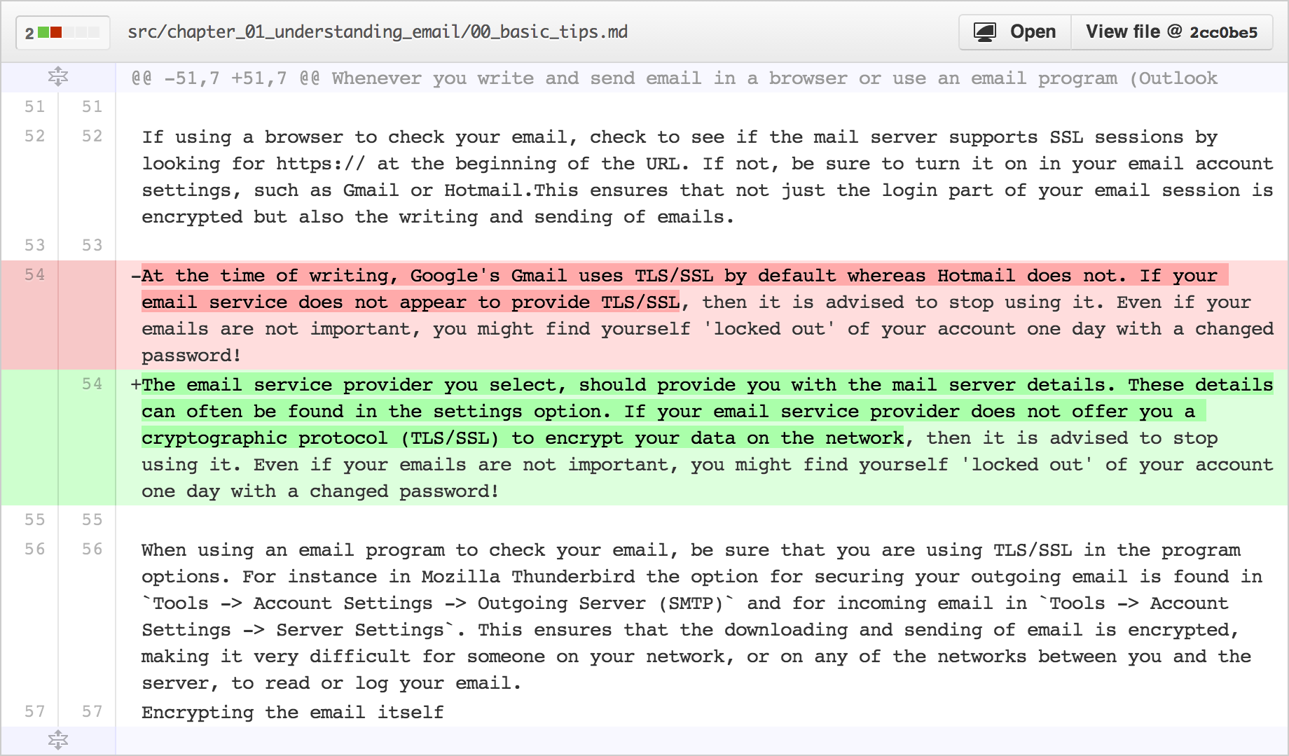
Git
Version Control System
Allows you to track changes in a project
Old Line
New Line
Modified from slides
Of Timothy McRoy
https://github.com/blog/1707-soft-wrapping-on-prose-diffs

Slide 10
Git: Can download and run on your own computer.
Not a backup system
A backup system is used to recover files in case something bad happens to the original copy
Git tracks changes locally in a directory called .git
If that directory was deleted, git would lose all of the previous versions
Modified from slides
Of Timothy McRoy

Slide 11
Github: Web-based collaboration
Github is a website which will help visualize some of the features of git
Github, like many code hosting websites, allows for public hosting of programs
This allows for interested programmers to take part in furthering development
Modified from slides
Of Timothy McRoy

Slide 12
For the free version of Github (where all repositories are public):
File and repository size limitations
We recommend repositories be kept under 1GB each. This limit is easy to stay within if large files are kept out of the repository.
If your repository exceeds 1GB, you might receive a polite email from GitHub Support requesting that you reduce the size of the repository to bring it back down.
In addition, we place a strict limit of files exceeding 100 MB in size. For more information, see "Working with large files.“
https://help.github.com/articles/what-is-my-disk-quota/

Slide 13
Github
Github will store your work, but it is not a backup system
It may be somewhere other than your computer
Limited file size (100MB)
Not part of the design of Git or Github
Encryption, distributed copies, guarantee of uptime, etc.
Modified from slides
Of Timothy McRoy

Slide 14
Share and collaborate
Easy to distribute work
clone
Easy to improve on the work of others
fork
Easy to take help from others
pull
Modified from slides
Of Timothy McRoy

Slide 15
Résumé pad
A Github profile is a great way to showcase your work
Link to LinkedIn, but it’s not a LinkedIn replacement
Modified from slides
Of Timothy McRoy

Slide 16
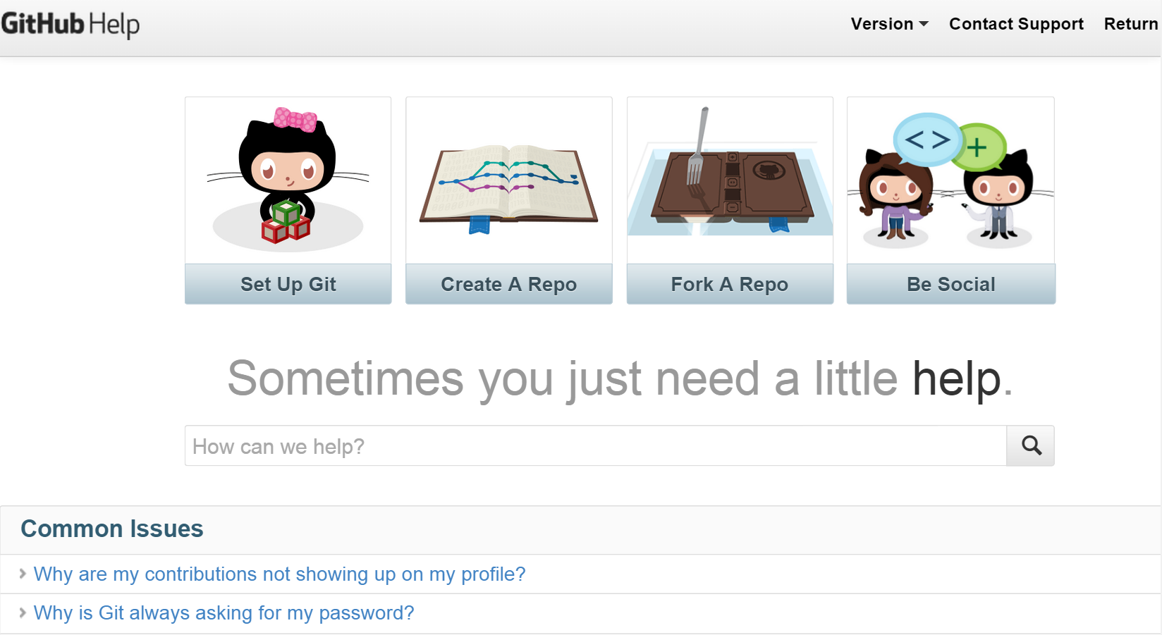
https://help.github.com/

Slide 17
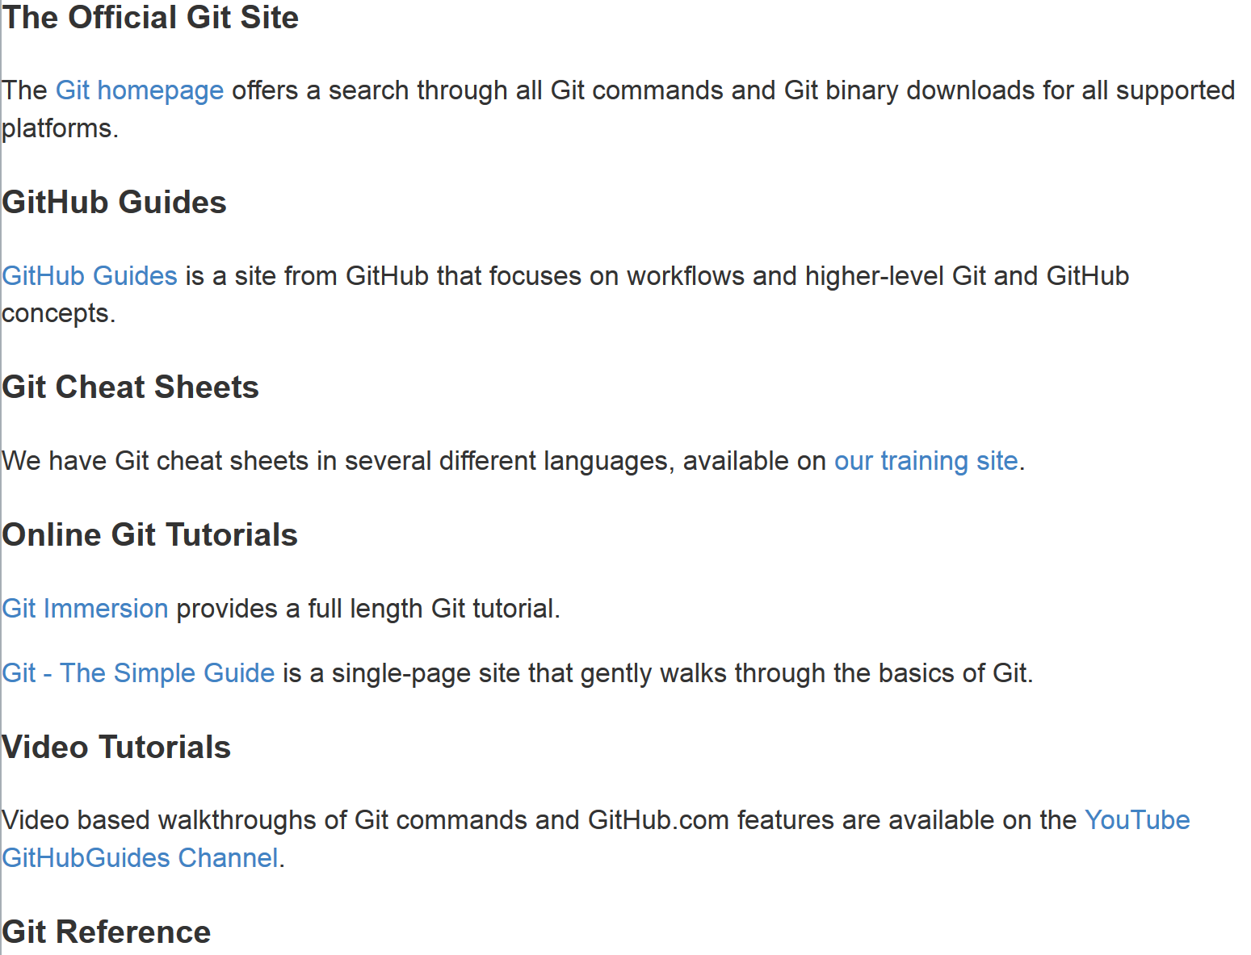
https://help.github.com/articles/good-resources-for-learning-git-and-github/

Slide 18
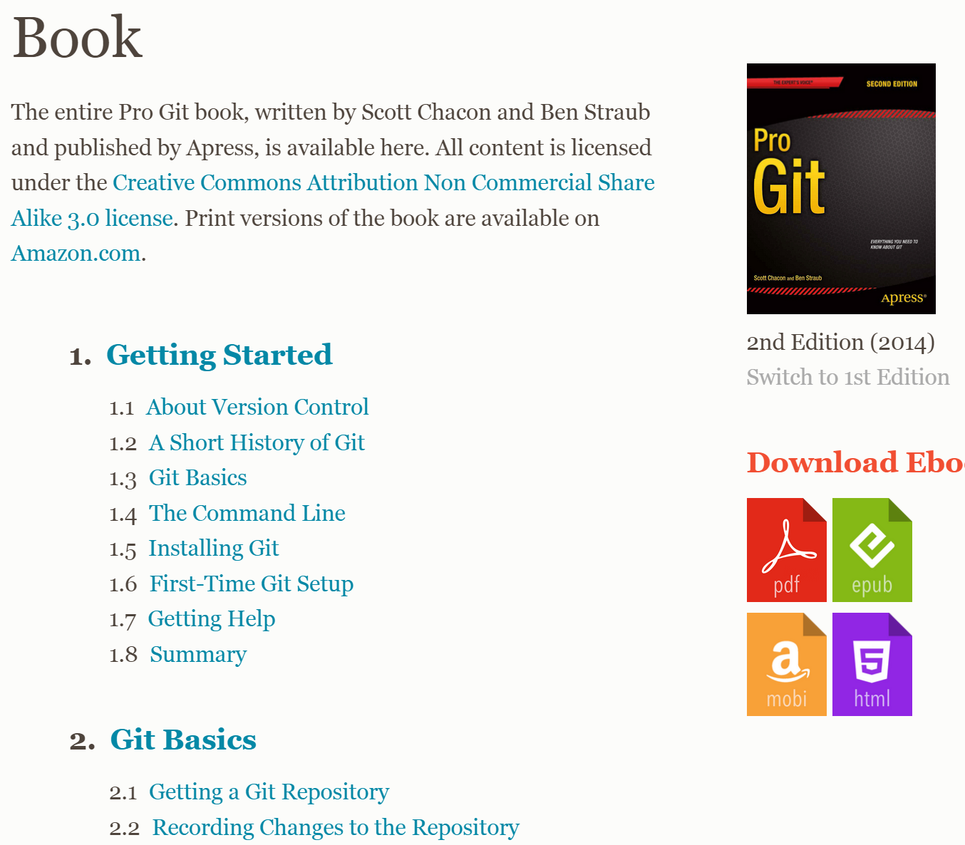
http://git-scm.com/book/en/v2

Slide 19
Getting software from Github
Open up a terminal and change your current directory to the one where you would like the repository (Program) to be saved.
Navigate to the repositories Github page in a web browser
For this example, we’ll use
https://github.com/timothy-mcroy/mapper
Modified from slides
Of Timothy McRoy

Slide 20
Getting software from Github
If you decide that you like the repository, you can
Copy the URL of the page
Type “git clone ” into the terminal
Paste the URL in to the terminal
Press enter
This will download the entire repository in a directory named after the repository. In the case of the example, the directory would be called mapper.
https://github.com/timothy-mcroy/mapper
Hosting site Author Repository
hawkid@serv1234[~]% git clone https://github.com/timothy-mcroy/mapper
Modified from slides
Of Timothy McRoy

Slide 21
Don’t forget to install it
Check the Github wiki page for installation instructions
Sometimes, a package has several dependencies that need to be installed and that won’t necessarily be mentioned
Occasionally, those instructions require administrator privileges.
For the mapper repository, the CSG administrators have already installed everything that you wouldn’t be able to install. You will still need to get the other things installed, as they work on a per-profile basis.
Modified from slides
Of Timothy McRoy

Slide 22
Another Distributed Version Control System

