Slide 1
Creating a simplicial complex
Step 0.) Start by adding 0-dimensional vertices
(0-simplices)
Notes:
Recall that to create a simplicial complex, we start by adding 0-simplices (ie 0-dimensional vertices). So our step zero will be to add 0-simplices, but in this case our 0-dimensional points will be

Slide 2

Creating a simplicial complex
1.) Adding 1-dimensional edges (1-simplices)
Add an edge between data points that are “close”
Notes:
So we can measure (or calculate) the distance between two points to determine if they are “close”. But we still need to define close.

Slide 3
Creating a simplicial complex
1.) Adding 1-dimensional edges (1-simplices)
Let T = Threshold
Connect vertices v and w with an edge iff
the distance between v and w is less than T
Notes:
Thus we will choose a threshold. We will connect a pair of vertices with an edge if and only if their distance is less then our chosen threshold.
But it is not always obvious how to choose the threshold. This problem can be dealt with by using persistence which we will briefly introduce later in this lecture. For now let’s somewhat arbitrarily choose a distance, say 1.8 cm.

Slide 4
Creating a simplicial complex
1.) Adding 1-dimensional edges (1-simplices)
Let T = Threshold =
Connect vertices v and w with an edge iff
the distance between v and w is less than T
Notes:
So we will connect every pair of vertices if their distance is less than 1.8 cm. If the center of these points represent the 0-dimensional vertices, then this distance is less than our threshold, so we add an edge. Similarly this pair of points satisfy our definition of close, so we add an edge
The distance between this pair of vertices is greater than 1.8, so we won’t connect them with an edge. Continuing to add edges between vertices whenever their distance is less than our threshold of 1.8cm, we now have

Slide 5
Creating a simplicial complex
1.) Adding 1-dimensional edges (1-simplices)
Add an edge between data points that are “close”
Note: we only need a definition of closeness between data points. The data points do not need to be actual points in R^{n}
Notes:
a one dimensional simplicial complex. Note that we have clustered our data into five disjoint connected sets. So this is one way to cluster our data – that is grouping our data points into disjoint sets based on some definition of similarity. In this case, we have 5 clusters.
We can now add higher dimensional simplices.

Slide 6
Creating the Vietoris Rips simplicial complex
2.) Add all possible simplices of dimensional > 1.
Notes:
Thus we now have the Vietoris Rips simplicial complex. Note we get the same simplex by adding one dimension at a time

Slide 7
Creating the Vietoris Rips simplicial complex
0.) Start by adding 0-dimensional data points
Use balls to measure distance (Threshold = diameter).
Two points are close if their corresponding balls intersect
Notes:
We start again by adding our 0-simplices, our data points. I can indicate the threshold using a ball centered at my data point. The diameter of the ball will be my threshold, so if two balls intersect then the distance between the vertices is less than the threshold, so we connect the pair of vertices with an edge if and only if the balls intersect, so we can get edges after which we can then add all possible higher dimensional simplices.
Note how I grew my balls. As the diameter increases, my threshold which is equal to my diameter increases.

Slide 8
Creating the Vietoris Rips simplicial complex
0.) Start by adding 0-dimensional data points
Use balls of varying radii to determine persistence of clusters.
H. Edelsbrunner, D. Letscher, and A. Zomorodian, Topological persistence and
simplication, Discrete and Computational Geometry 28, 2002, 511-533.
Notes:
We can compute the number of clusters for a variety of diameters.
We start with 17 data points, so if the diameter is 0, we have 17 clusters. Increasing the diameter, these 2 balls intersect so I now have 16 clusters.
If we continue to increase the diameter, we will eventually create the complex we saw before with 5 clusters, etc until we only have one cluster left.
Eventually this entire page will be purple, but right now, we know have one component.
To choose the threshold, one can determine how long a particular number of clusters lasts, for example for what set of radii do we have five clusters. If we have five clusters for the largest set of radii, then have gives us a good idea where to set the threshold and which simplicial complex best models our data.
I have put links to better animations on my on my YouTube site which may better illustrate this persistence concept. Next month, we will also talk much more about persistence during the live lectures for this course. This is just a preliminary introduction.

Slide 9
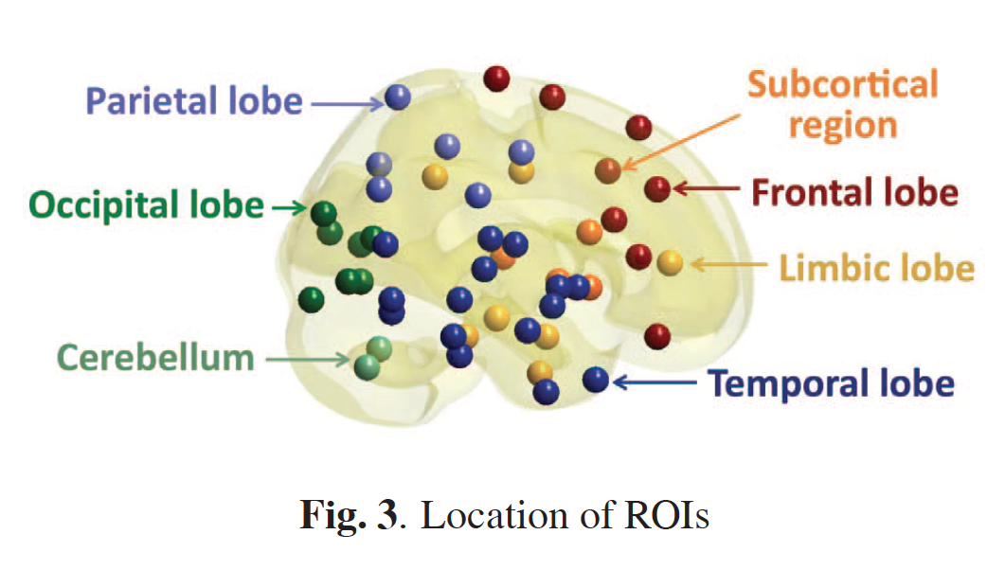
Discriminative persistent homology of brain networks, 2011 Hyekyoung Lee Chung, M.K.; Hyejin Kang; Bung-Nyun Kim;Dong Soo Lee
Constructing functional brain networks with 97 regions of interest (ROIs) extracted from FDG-PET data for
24 attention-deficit hyperactivity disorder (ADHD),
26 autism spectrum disorder (ASD) and
11 pediatric control (PedCon).
Data = measurement f_{j}
taken at region j
Graph: 97 vertices representing 97 regions of interest
edge exists between two vertices i,j if correlation
between f_{j} and f_{j} ≥ threshold
How to choose the threshold? Don’t, instead use persistent homology

Slide 10
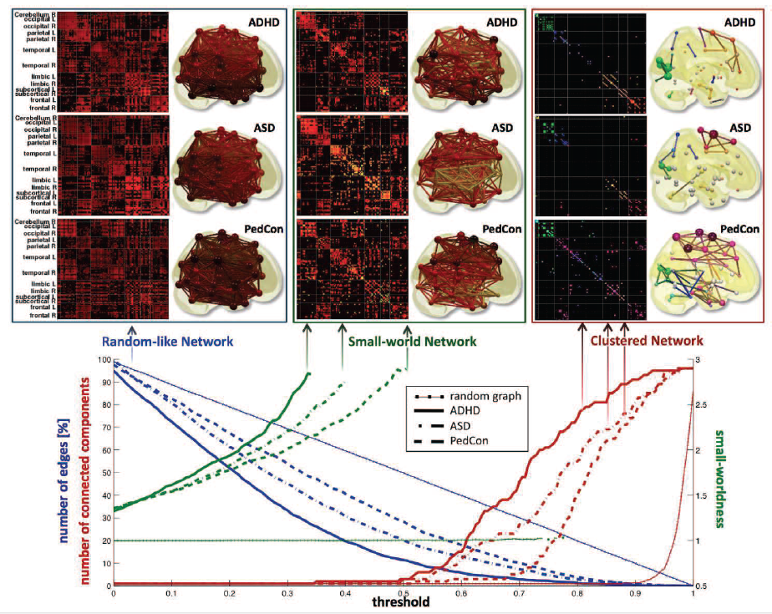

Slide 11
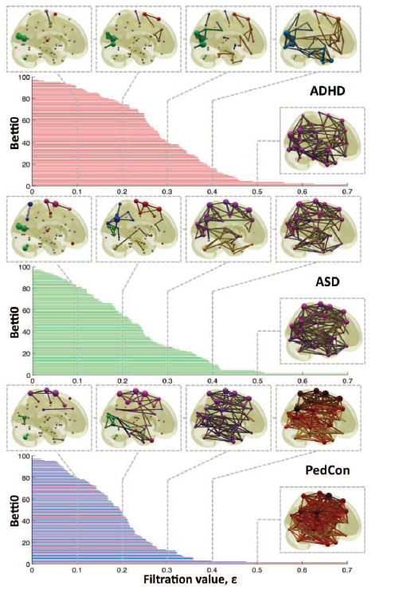

Vertices = Regions of Interest
Create Rips complex by growing epsilon balls (i.e. decreasing threshold) where distance between two vertices is given by
where f_{i} =
measurement at location i

Slide 12
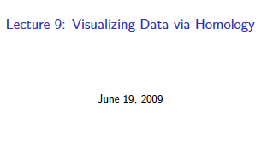
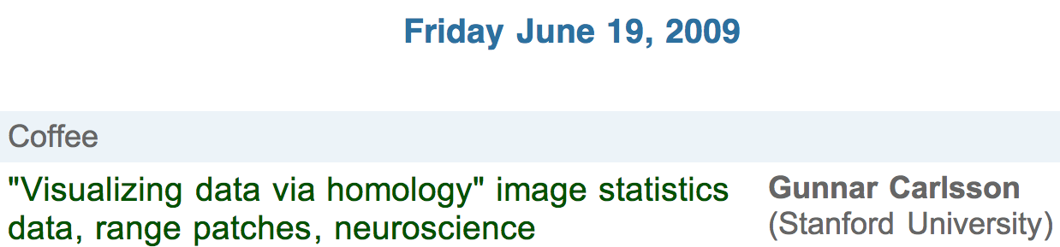
http://www.ima.umn.edu/videos/?id=856
http://ima.umn.edu/2008-2009/ND6.15-26.09/activities/Carlsson-Gunnar/imafive-handout4up.pdf

Slide 13
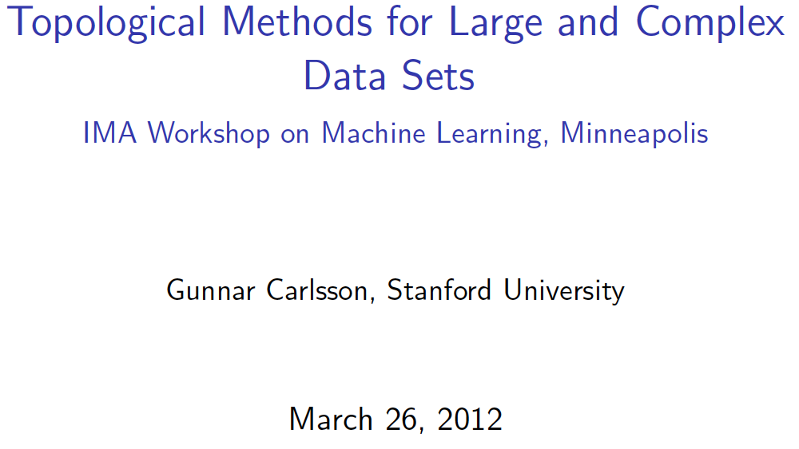
Application to Natural Image Statistics
With V. de Silva, T. Ishkanov, A. Zomorodian
http://www.ima.umn.edu/videos/?id=1846
http://www.ima.umn.edu/2011-2012/W3.26-30.12/activities/Carlsson-Gunnar/imamachinefinal.pdf

Slide 14
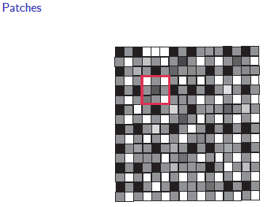
An image taken by black and white digital camera can be viewed as a vector, with one coordinate for each pixel
Each pixel has a “gray scale” value, can be thought of as a real number (in reality, takes one of 255 values)
Typical camera uses tens of thousands of pixels, so images lie in a very high dimensional space, call it pixel space, P

Slide 15
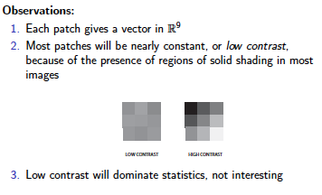
Lee-Mumford-Pedersen [LMP] study only high contrast patches.
Collection: 4.5 x 10⁶ high contrast patches from a
collection of images obtained by van Hateren and van der Schaaf
http://www.kyb.mpg.de/de/forschung/fg/bethgegroup/downloads/van-hateren-dataset.html

Slide 16
Lee-Mumford-Pedersen [LMP] study only high contrast patches.
Collection: 4.5 x 10⁶ high contrast patches from a
collection of images obtained by van Hateren and van der Schaaf
Choose how to model your data

Slide 17
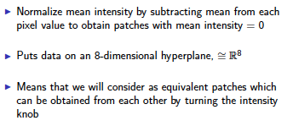
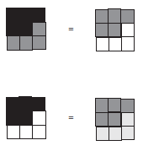

Choose how to model your data
Consult previous methods.

Slide 18
What to do if you are overwhelmed by the number of possible ways to model your data (or if you have no ideas):
Do what the experts do.
Borrow ideas.
Use what others have done.

Slide 19
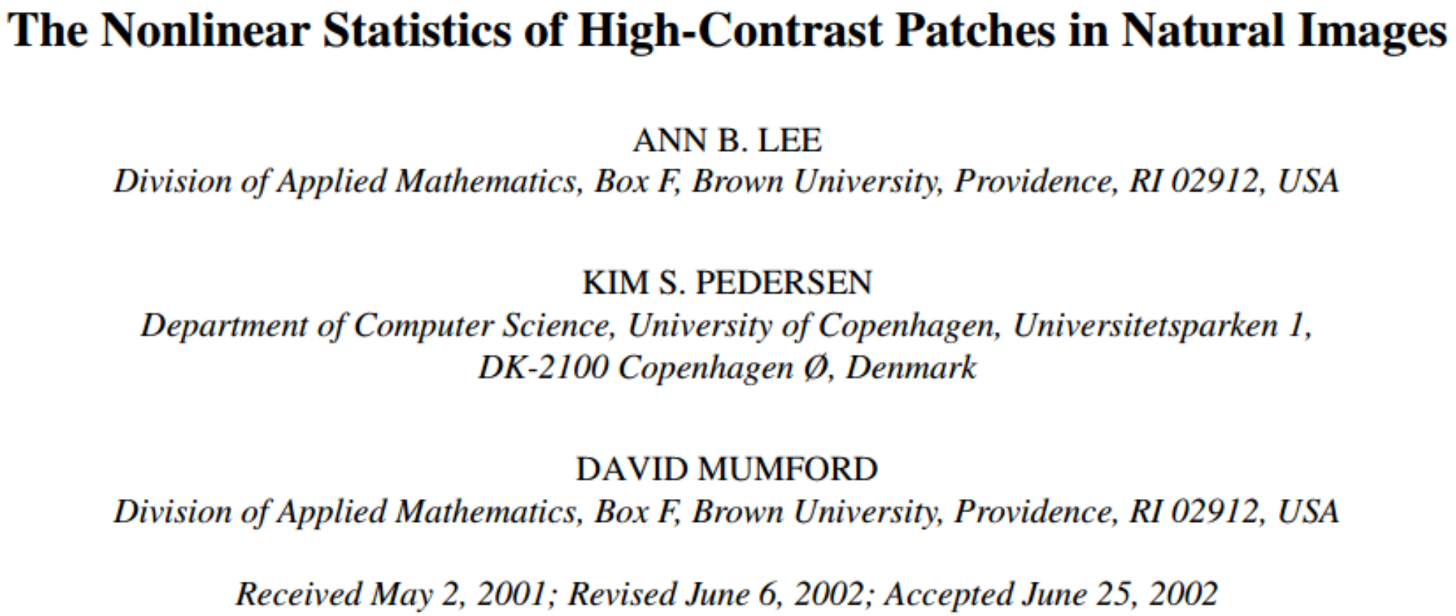
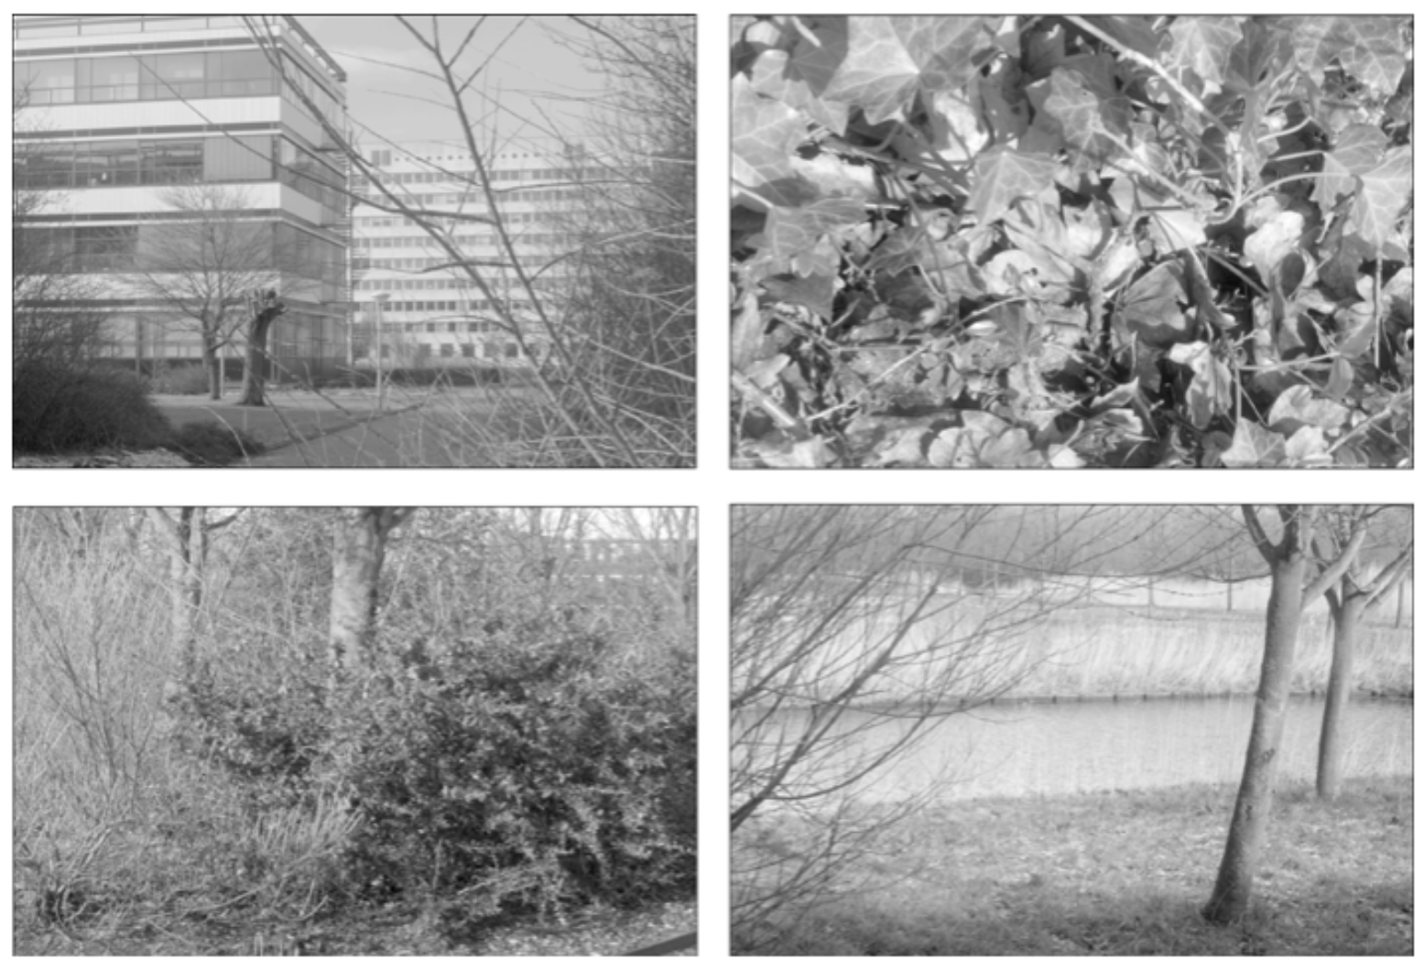
Carlsson et al used

Slide 20
Carlsson et al used
The majority of high-contrast optical patches are concentrated around a 2-dimensional C₁ submanifold
embedded in the 7-dimensional sphere.

Slide 21
Persistent Homology: Create the Rips complex
0.) Start by adding 0-dimensional data points
is a point in S⁷
Notes:
We can compute the number of clusters for a variety of diameters.
We start with 17 data points, so if the diameter is 0, we have 17 clusters. Increasing the diameter, these 2 balls intersect so I now have 16 clusters.
If we continue to increase the diameter, we will eventually create the complex we saw before with 5 clusters, etc until we only have one cluster left.
Eventually this entire page will be purple, but right now, we know have one component.
To choose the threshold, one can determine how long a particular number of clusters lasts, for example for what set of radii do we have five clusters. If we have five clusters for the largest set of radii, then have gives us a good idea where to set the threshold and which simplicial complex best models our data.
I have put links to better animations on my on my YouTube site which may better illustrate this persistence concept. Next month, we will also talk much more about persistence during the live lectures for this course. This is just a preliminary introduction.

Slide 22
For each fixed ε, create Rips complex from the data
is a point in S⁷
1.) Adding 1-dimensional edges (1-simplices)
Add an edge between data points that are close
Notes:
a one dimensional simplicial complex. Note that we have clustered our data into five disjoint connected sets. So this is one way to cluster our data – that is grouping our data points into disjoint sets based on some definition of similarity. In this case, we have 5 clusters.
We can now add higher dimensional simplices.

Slide 23
For each fixed ε, create Rips complex from the data
2.) Add all possible simplices of dimensional > 1.
is a point in S⁷
Notes:
Thus we now have the Vietoris Rips simplicial complex. Note we get the same simplex by adding one dimension at a time

Slide 24
For each fixed ε, create Rips complex from the data
In reality used Witness complex (see later slides).
2.) Add all possible simplices of dimensional > 1.
is a point in S⁷
Notes:
Thus we now have the Vietoris Rips simplicial complex. Note we get the same simplex by adding one dimension at a time

Slide 25
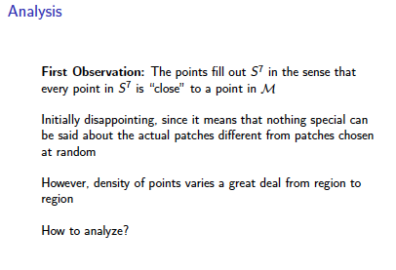
Probe the data

Slide 26
Probe the data

Slide 27
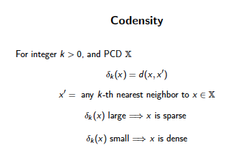
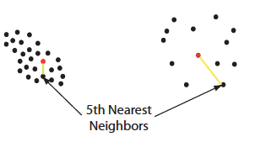

Can use function on data to probe the data

Slide 28
Large values of k:
measuring density of large neighborhoods of x,
Smaller values mean we are using smaller neighborhoods

Slide 29
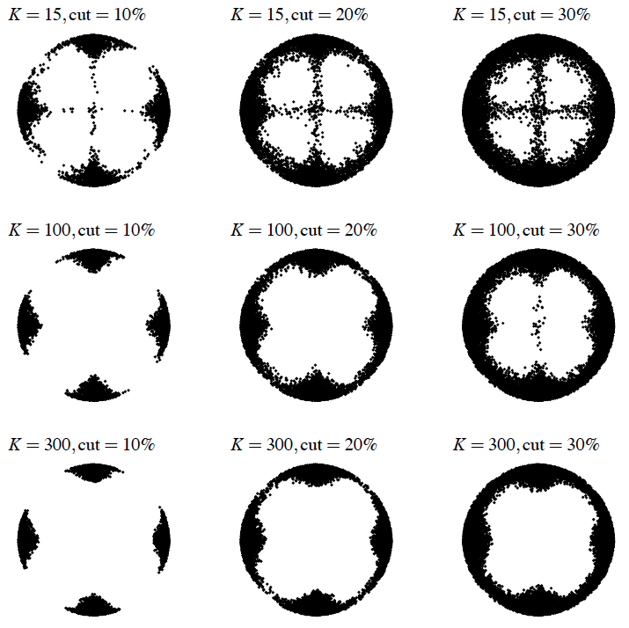
Eurographics Symposium on Point-Based Graphics (2004)
Topological estimation using witness complexes
Vin de Silva and Gunnar Carlsson

Slide 30
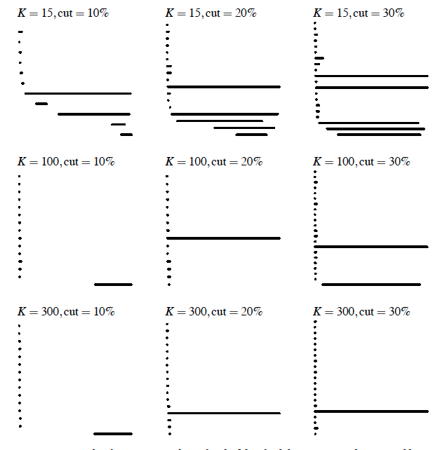
Eurographics Symposium on Point-Based Graphics (2004)
Topological estimation using witness complexes
Vin de Silva and Gunnar Carlsson

Slide 31
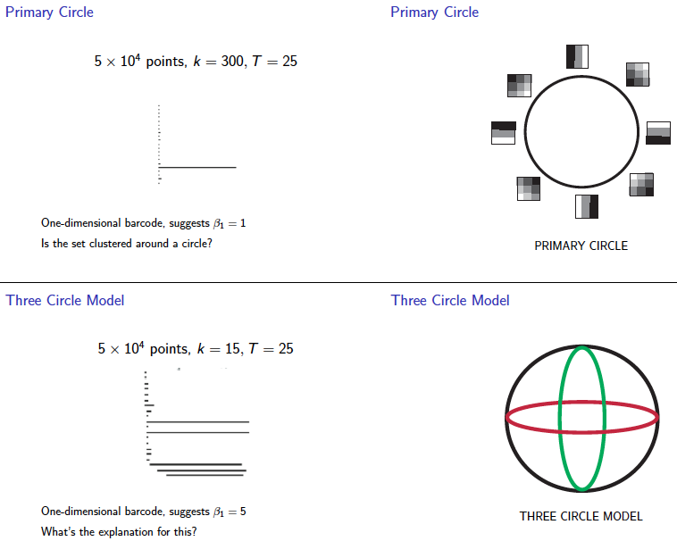
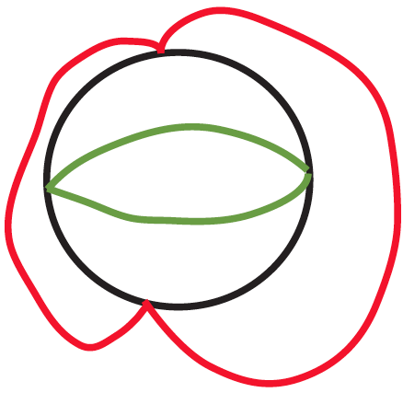

Slide 32
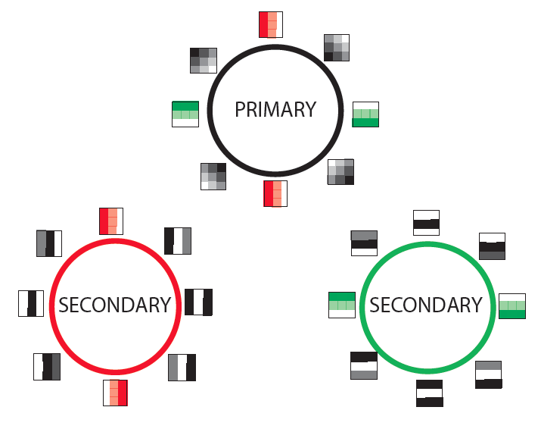

Slide 33
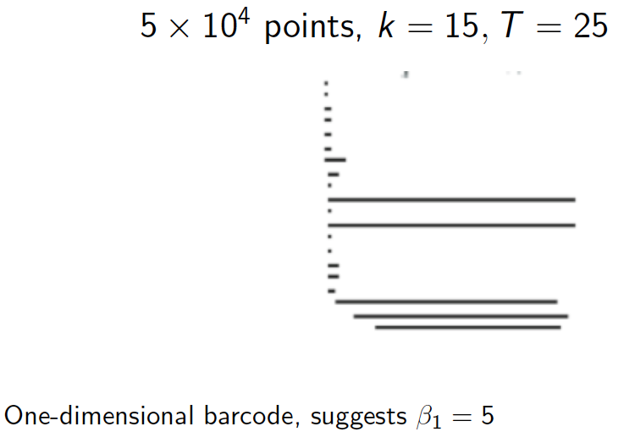

Slide 34
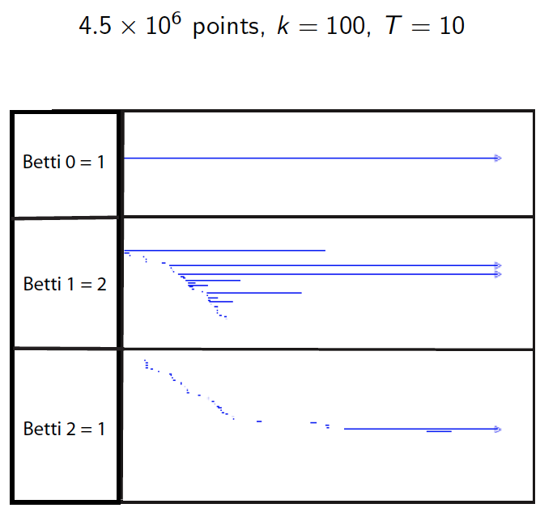

Slide 35
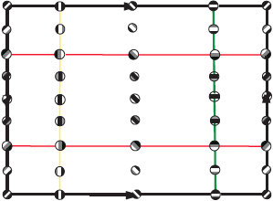

Slide 36
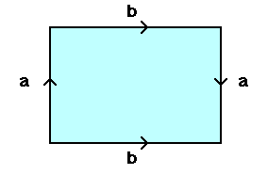
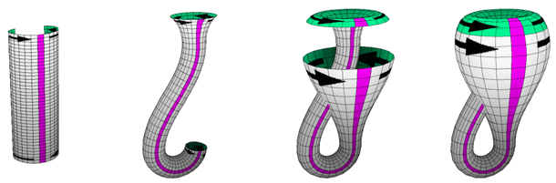
From: http://www.math.osu.edu/~fiedorowicz.1/math655/Klein2.html
Klein Bottle
From:
http://plus.maths.org/content/imaging-maths-inside-klein-bottle

Slide 37
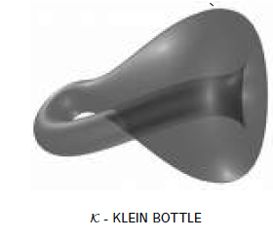
M(100, 10) U Q
where |Q| = 30
On the Local Behavior of Spaces of Natural Images, Gunnar Carlsson, Tigran Ishkhanov, Vin de Silva, Afra Zomorodian, International Journal of Computer Vision 2008, pp 1-12.

Slide 38
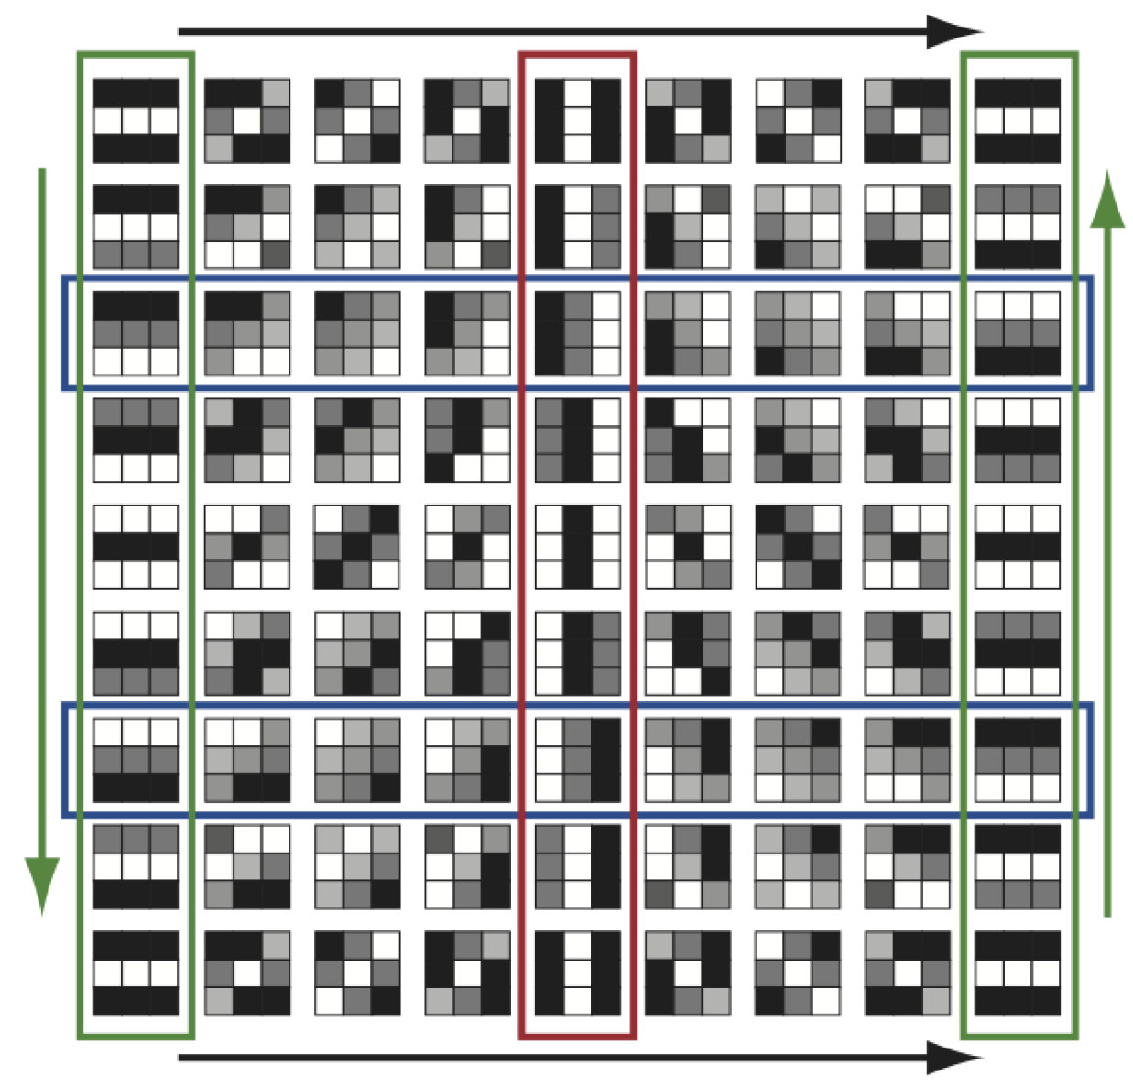
http://www.maths.ed.ac.uk/~aar/papers/ghristeat.pdf

Slide 39
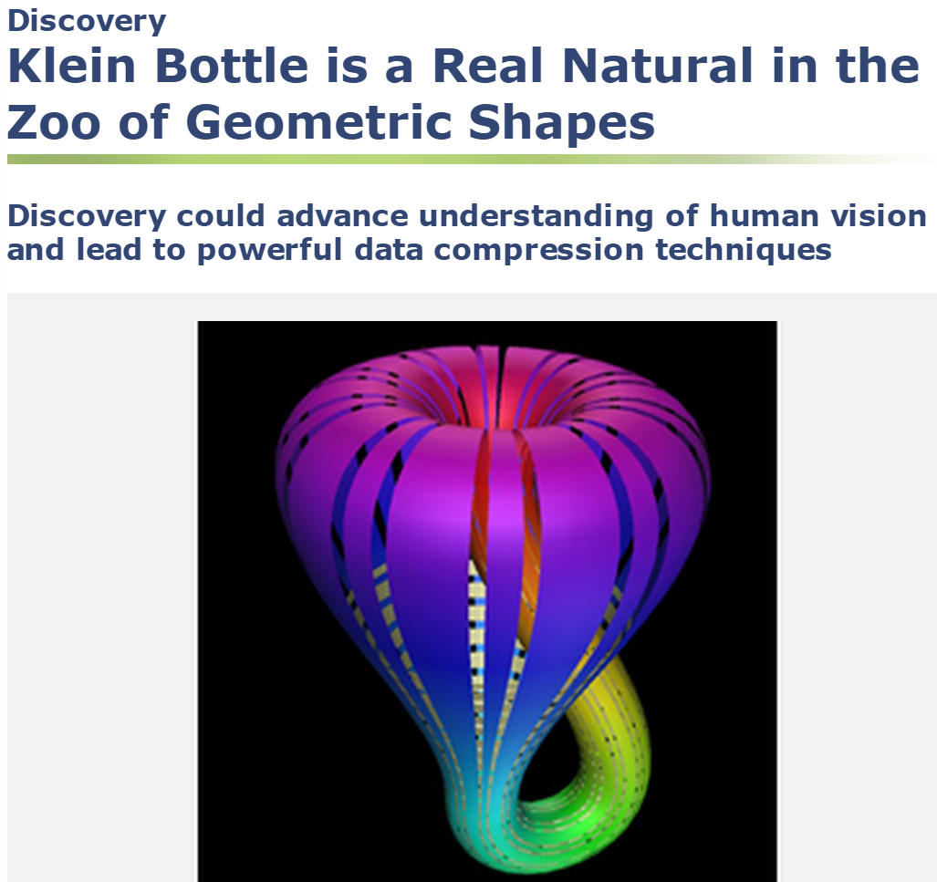
http://www.nsf.gov/discoveries/disc_summ.jsp?cntn_id=112392

Slide 40
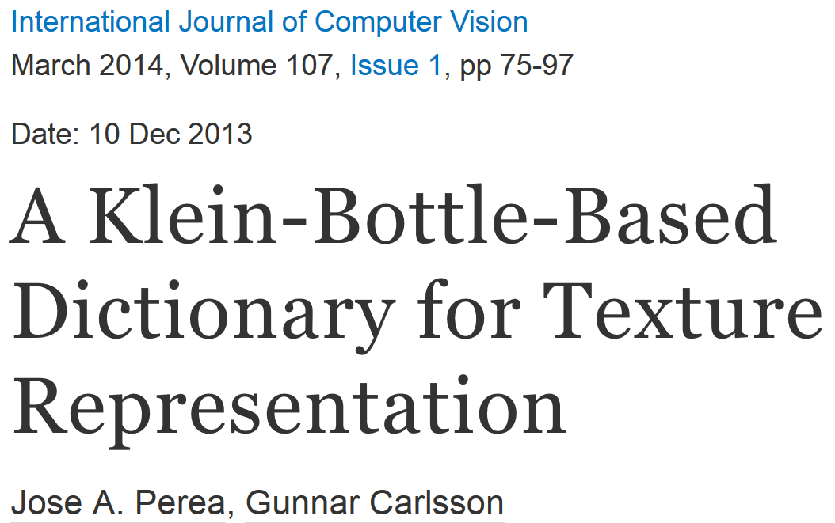
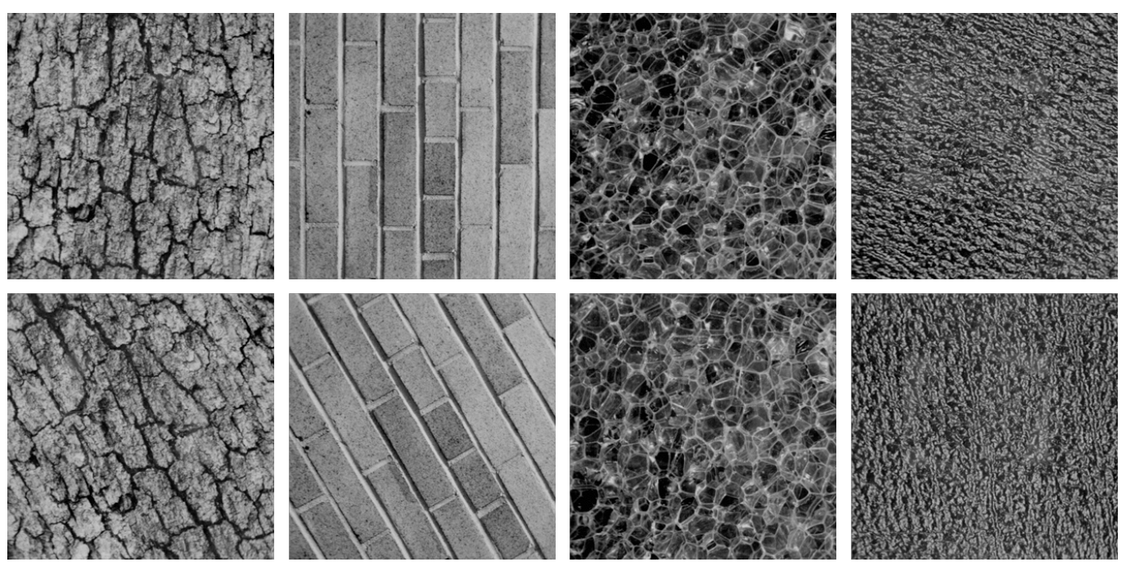
Combine your analysis with other tools

Slide 41
