Slide 1
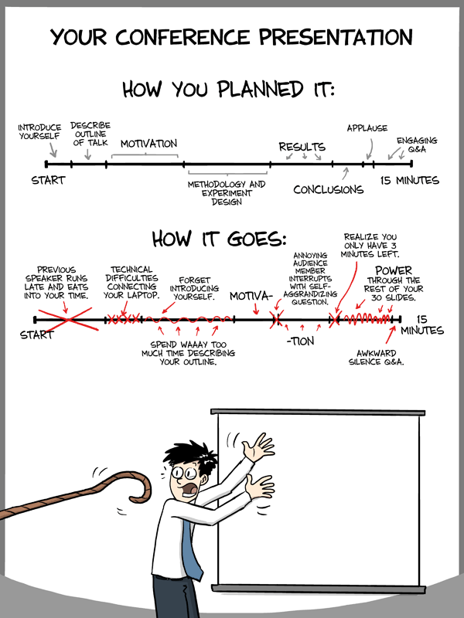
"Piled Higher and Deeper" by Jorge Cham www.phdcomics.com
http://www.phdcomics.com/comics/archive.php?comicid=1553

Slide 2
yamltoR.py: extracts R code from Swirl lesson
## yamltoR.py: extracts R code from Swirl lesson
## Author: Isabel Darcy
# open file lesson.yaml for reading, call the open file f
f = open('lesson.yaml',"r”)
data_line = f.readlines() # read in each line of the file now called f
for i in data_line: # for each line
if i[:16] == " CorrectAnswer:": # for each line check if first 16
# characters are __CorrectAnswer:
print(i[17:]) # print all characters after 16 in line i
f.close() # close file f

Slide 3
In an assertion-evidence slide, the headline is a sentence that succinctly states the slide’s main message
Photograph, drawing, diagram, or graph
supporting the headline message (no bulleted list)
Call-out(s), if needed:
no more than two lines
PowerPoint Template: http://writing.engr.psu.edu/AE_template_PSU.ppt
Notes:
3
This file presents a template for making Assertion–Evidence (A–E) slides in a technical presentation. The design advocated by this template arises from pages 113-152 of The Craft of Scientific Presentations (Springer, 2003) and from the first Google listing for “presentation slides”:
http://www.writing.engr.psu.edu/slides.html
To follow this template, make sure that you create the slide within this PowerPoint file. Working with a New Slide (under Insert in older versions or as a button on the Home tab in version 2007) , you should first craft a sentence headline that states an assertion about your topic. Having no assertion translates to having no slide. In the body of the slide, you should then support that headline assertion visually: photographs, drawings, diagrams, equations, or words arranged visually. Use supporting text only where necessary. Do not use bulleted lists, because bulleted lists do not reveal the connections between details.
This slide shows one orientation for the image and supporting text. Other orientations exist, as shown in the sample slides that follow.

Slide 4
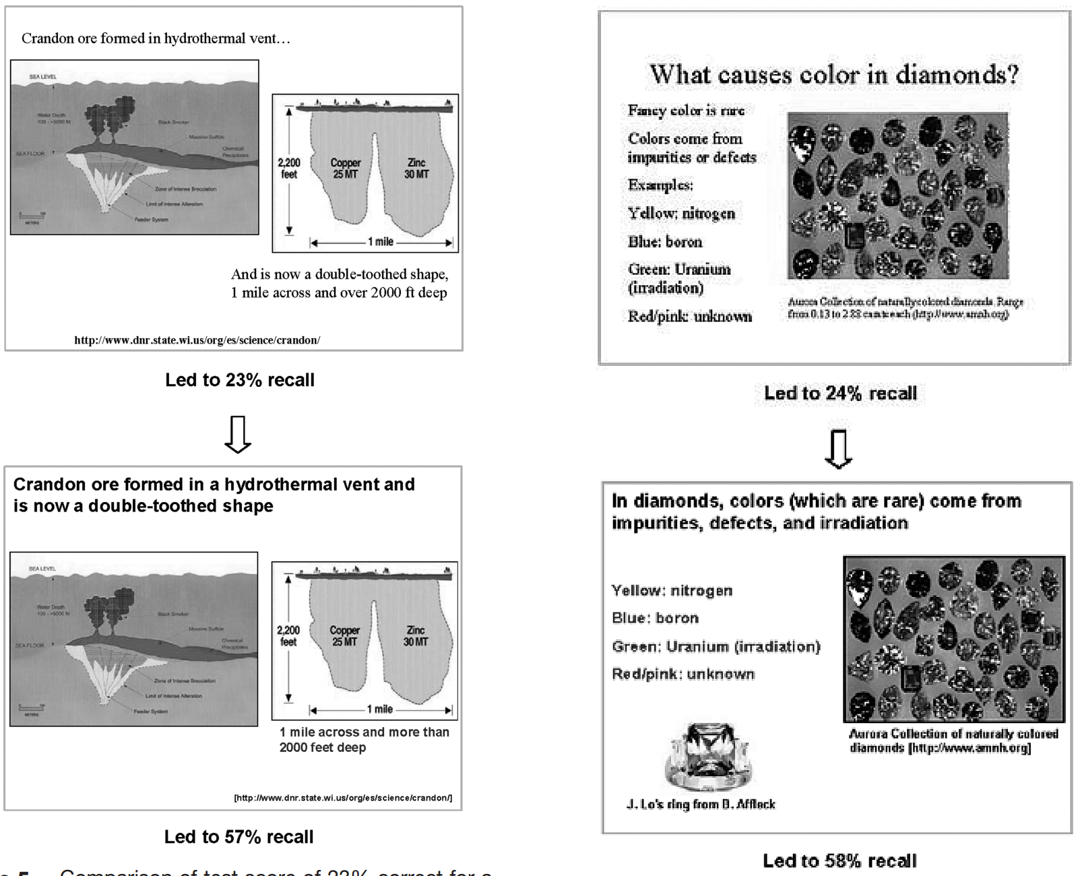
Michael Alley, Madeline Schreiber, Katrina Ramsdell, and John Muffo, Technical Communication (May 2006)
How the Design of Headlines in Presentation Slides Affects Audience Retention
http://writing.engr.psu.edu/ae_headlines.pdf

Slide 5
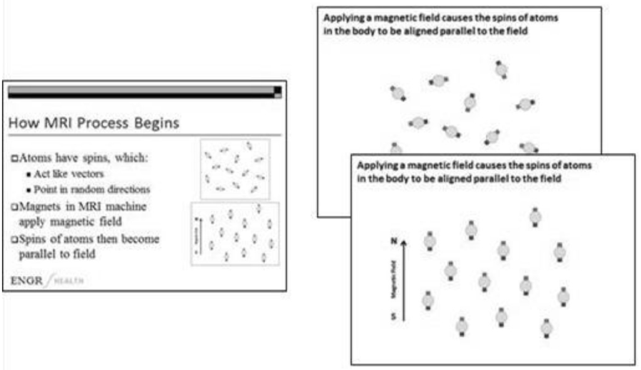
Michael Alley and Kathryn A. Neeley, Technical Communication (November 2005)
Rethinking the Design of Presentation Slides: The Assertion-Evidence Approach
http://writing.engr.psu.edu/ae_comprehension.pdf

Slide 6
Finish each sentence with a period.
This will make your slides more accessible to blind students who use a reader.

Slide 7
https://hbr.org/2013/06/how-to-give-a-killer-presentation
As hard as it may be to give a great talk, it’s really easy to blow it. Here are some common mistakes that TED advises its speakers to avoid.
1. Take a really long time to explain what your talk is about.
2. Speak slowly and dramatically. Why talk when you can orate?
3. Make sure you subtly let everyone know how important you are.
4. Refer to your book repeatedly. Even better, quote yourself from it.
5. Cram your slides with numerous text bullet points and multiple fonts.
6. Use lots of unexplained technical jargon to make yourself sound smart.
7. Speak at great length about the history of your organization and its glorious achievements.
8. Don’t bother rehearsing to check how long your talk is running.
9. Sound as if you’re reciting your talk from memory.
10. Never, ever make eye contact with anyone in the audience.

Slide 8
If you use your own laptop, use a power cord and turn off your screensaver.
Turn off wireless.
Remember you are the expert, not the audience. Just because you know it, doesn’t mean they have even heard about it.
Speak loudly. Project to people in the back.
Speak slowly.
Make eye contact.
Don’t read the slides
Repeat questions back.

Slide 9
If you use your own laptop, use a power cord and turn off your screensaver.
Turn off wireless.
Remember you are the expert, not the audience. Just because you know it, doesn’t mean they have even heard about it.
Speak loudly. Project to people in the back.
Speak slowly.
Make eye contact.
Don’t read the slides
Repeat questions back.

Slide 10
If you use your own laptop, use a power cord and turn off your screensaver.
Turn off wireless.
Remember you are the expert, not the audience. Just because you know it, doesn’t mean they have even heard about it.
Speak loudly. Project to people in the back.
Speak slowly.
Make eye contact.
Don’t read the slides
Repeat questions back.

Slide 11
https://support.office.com/en-us/article/Keyboard-shortcuts-for-use-while-delivering-a-presentation-in-PowerPoint-2010-12f0ef03-d3f4-4901-8392-e6185d1ef8d6
Go to slide number. number+ENTER
Display a blank black slide, or return to the presentation from a blank black slide.
B or PERIOD
Display a blank white slide, or return to the presentation from a blank white slide.
W or COMMA
Erase on-screen annotations. E
Go to the next slide, if the next slide is hidden. H
Change the pointer to a pen. CTRL+P
Change the pointer to an arrow. CTRL+A
Change the pointer to an eraser CTRL+E
Show or hide ink markup CTRL+M

Slide 12
Have students give informal presentations to you frequently
  Note they don’t even need to know these are presentations.
Also, have your students give formal talks.
  If there are not sufficient opportunities for your students to give talks on campus, set up such opportunities. Set a time, reserve a room, and e-mail an invite to the department (or to just the students or to just one of your classes, etc.).
Encourage your students to present at conferences.
Encourage your students to give practice talks.
  Give judicious feedback.
Remind the student that they are the expert, not the audience. Just because they know it, doesn’t mean the audience has even heard about it.

Slide 13
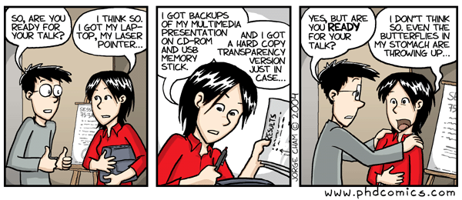
http://www.phdcomics.com/comics/archive.php?comicid=493

Slide 14
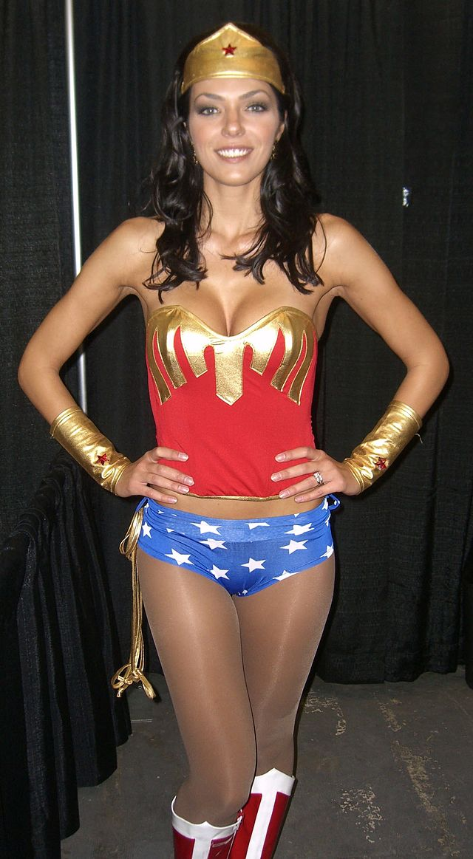
Wonder woman pose.
Photo by Luigi Novi
http://sv.wikipedia.org/wiki/Wonder_Woman#/media/File:10.18.09AdrianneCurryByLuigiNovi.jpg

Slide 15
Wonder woman pose.
Image found via google image search selecting labeled for noncommercial use under search tools
Photo by Luigi Novi
http://sv.wikipedia.org/wiki/Wonder_Woman#/media/File:10.18.09AdrianneCurryByLuigiNovi.jpg

Slide 16
Wonder woman pose.
Note: It is generally best to avoid sexist and/or sexy images – you might offend and/or distract some people
Photo by Luigi Novi
http://sv.wikipedia.org/wiki/Wonder_Woman#/media/File:10.18.09AdrianneCurryByLuigiNovi.jpg

Slide 17
Additional References
World Blind Union PowerPoint Guidelines
http://icevi.org/13thWC/pdf/Guidelines%20for%20POWERPOINT%20PRESENTATION.pdf
http://www.ifla.org/files/assets/hq/officers/documents/wbu-visual-presentations-guidelines-summary.pdf
Even a Geek Can Speak Paperback – July 1, 2006 by Joey Asher
http://research.microsoft.com/en-us/um/people/simonpj/papers/giving-a-talk/giving-a-talk.htm
http://pne.people.si.umich.edu/PDF/howtotalk.pdf

Slide 18
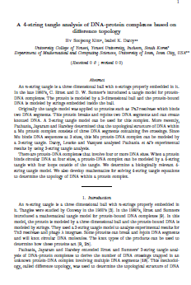
Submitting a paper for publication.
Write paper → Determine where to submit paper.
          Check where similar papers have been published.
          Observe how quickly papers published in this journal after submission.
          Check impact factor to determine if journal legitimate via https://jcr.incites.thomsonreuters.com/JCRJournalHomeAction.action
          Consider submitting preprint to
          lanl.arXiv.org

Slide 19
Consider first publishing in a research journal. If you don’t think your students research fits into a research journal, consider an undergraduate journal
http://curm.byu.edu/resources/journals
Journals that specifically publish undergraduate research in mathematics:
Involve
“is a publication in between the extremes of purely undergraduate research journals, which in general are aimed at undergraduate audiences, and mainstream research journals.”
SIAM Undergraduate Research Online
“a web-based publication devoted to undergraduate research in applied and computational mathematics.”
The Rose-Hulman Undergraduate Mathematics Journal
“is devoted entirely to papers written by undergraduates on topics related to mathematics.”
Furman University Electronic Journal of Undergraduate Mathematics
“accepts papers of significant mathematical interest written by students containing work done prior to the students' obtaining a Bachelor's degree. Papers of all types will be considered, including technical, historical, and expository papers.”

Slide 20
http://curm.byu.edu/resources/journals
Pi Mu Epsilon Journal
“Pi Mu Epsilon promotes scholarship in mathematics is through the publishing of the Pi Mu Epsilon Journal. The sole purpose of this Journal is to present papers and mathematical problems by and for its members.”
Morehead Electronic Journal of Applicable Mathematics (MEJAM)
“MEJAM accepts papers . . . which emphasize the applicability of mathematics while maintaining significant mathematical interest. Papers may be historical, expository, or completely original in nature but must adhere to strict academic standards and should explore some aspect of the applications of mathematics.”
Mathematical Spectrum
“publishes articles from all branches of mathematics, as well as regular features on mathematics in the classroom, a computer column, letters, problems and solutions, book and software reviews. We welcome original student contributions and award annual prizes for the best ones published.”
American Journal of Undergraduate Research (AJUR)
“A refereed journal for undergraduate research in the pure and applied sciences, mathematics, engineering, technology, and related area in education.”

Slide 21
Submit paper
to math journal to biology journal
Wait 6 – 12 months Wait 3 – 6 weeks
Implement reviewers’ suggestions
and respond to reviewers.
Submit revised version
If accepted, paper will (eventually or almost immediately) be published.

Slide 22
Reviewer first gives brief summary of the paper (often using authors’ wording) and motivates recommendation for or against publication
This is referee's report for the paper…
Some protein complexes interact with multiple DNA segments during
biological processes.These processes can change the topology of DNA which results in knotted or linked DNA. Tangle analysis was introduced to study/model various protein actions mathematically. The protein is modeled by a 3-dimensional ball and the protein-bound DNA is modeled by strings embedded in the ball.
A protein complex bound to a circular DNA molecule at four sites can be modeled by a 4-string tangle. In this paper, the authors provide a biologically relevant 4-string tangle model of a DNA-protein complex and develop mathematics to determine the topology of DNA within the protein complex. The paper contains new and interesting results, and it is carefully written. The proofs are technical and elaborate. In referee's opinion, the paper deserves to be published in JKTR, after taking into account the corrections/suggestions given below.
List of corrections/suggestions:
page 2, line 8: delete the space after \DNA segments".
- last paragraph in the Introduction: replace \section i" with\Section i".
- Section 2: italicize the terms newly introduced:
page 2, line -4: \jumping DNA"
page 2, line -2:\ transposable element"
page 2, line -1: \transposon" and \transposition"
...
Reviewer gives specific list of corrections that must (?) be implemented

Slide 23
Response to referee's report:
We thank the reviewer for their detailed comments ….
We have implemented their suggestions as described below:
page 2, line 8: delete the space after \DNA segments".
done,
- last paragraph in the Introduction: replace \section i" with\Section i".
done
- Section 2: italicize the terms newly introduced:
done
Often additional explanation is needed
E.g.: We addressed the reviewers concern on new page ?, lines ??
often quote of the lines included in the report.
If you disagree with the reviewer and do not want to implement one of the suggestions, you must explain why.

Slide 24
Editing an Electronic Journal Jeffrey Shallit
http://www.ams.org/notices/201502/rnoti-p169.pdf

Slide 25
Would you be interested in showing your teaching/mentoring statement to this class?
How much time would you like to have spent mentoring undergraduates outside of class?
How much non-mentoring work outside of class should I expect from future students?
What percent of mentoring vs data analysis would you like to have seen?
What would you like to see this week/next week?
(speaking, writing grants, data analysis, github,…)
Should I have requested a room in Schaeffer Hall for this class?
Other comments:

Slide 26
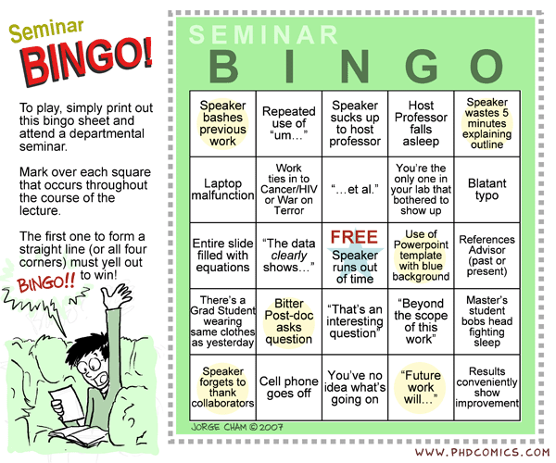
http://www.phdcomics.com/comics/archive.php?comicid=847

