Slide 1
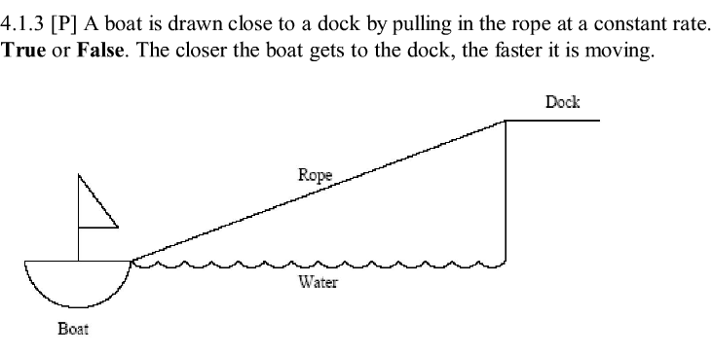
From: http://www.ilearnmath.net/help/index.php?page=apexamsmcgoodquestionscalculus

