Slide 1
http://apcentral.collegeboard.com/apc/public/repository/ap08_calculus_slopefields_worksheet.pdf

Slide 2
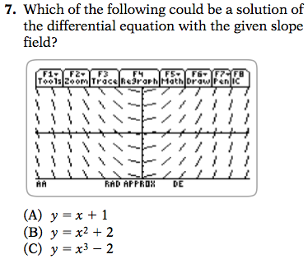

www.amscopub.com/%5Cimages%5Cfile%5CFile_8.jpg.pdf

