Slide 1
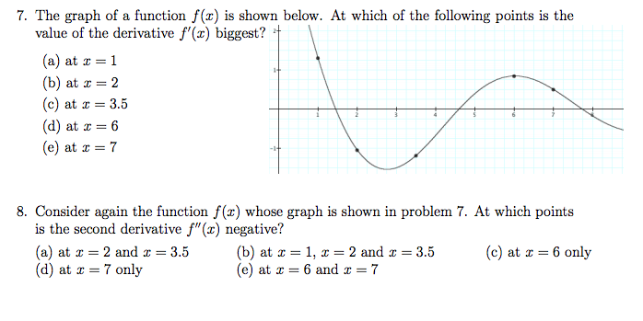
from: http://www.brandeis.edu/registrar/newstudent/docs/placement/calculus_test.pdf
From: http://www.math.cornell.edu/~GoodQuestions/JittMapleTA.pdf
a.) True b.) False

