Slide 1
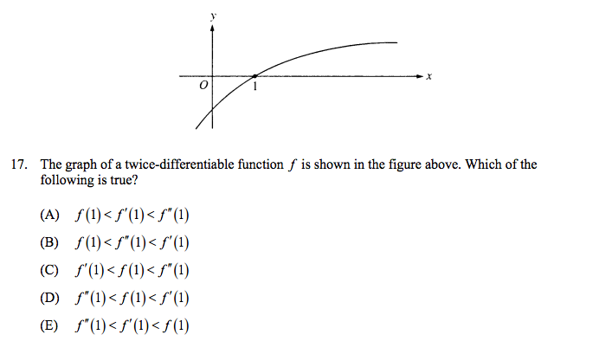
True/False
18.) If f is continuous, then f is differentiable. T F
19.) If f is differentiable, then f is continuous. T F
# 17 is from 1998 AP Calc AB http://staff.4j.lane.edu/~windom/AP/ap%20multiple%20choice.pdf

