Slide 1
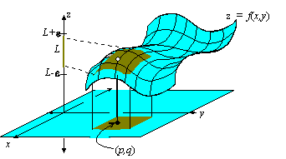
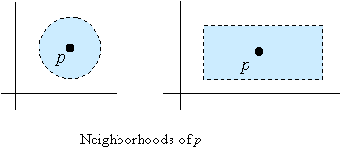
Motivation:
To begin with, let us define any connected open set that contains a point p to be a neighborhood of p. For example, an open ball of radius δ > 0 about p, which is the set of all x such that || x−p || < δ, is a neighborhood of p. Any open rectangle containing p is also a neighborhood of p.
From: http://math.etsu.edu/multicalc/Chap2/Chap2-2/index.htm

Slide 2
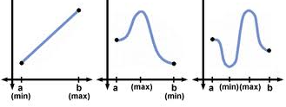
Extreme Value Thm: If f: [a, b] → R is continuous, then ∃ c, d  [a, b] s.t. f(c) ≤ f(x) ≤ f(d)  x  [a, b].
What is the minimum hypothesis such that the Extreme Value Theorem holds: Suppose f: X → Y…
__________________________________________________________________
Some common symbols:
∃ = there exists  = unique ∃ = there exists a unique
 = for all  = s.t. = such that
http://www.sparknotes.com/math/calcab/applicationsofthederivative/section3.rhtml

Slide 3
y  Y  Y :
lower case = element
Upper case = set
Caligraphy {\cal Y} = collection of sets.
_______________________________________________________________________________________________________________________
Want to learn more about point-set topology:
Do a MathSciNet search: http://www.ams.org/mathscinet/
Use MSC Primary: 54 for general topology
To find other MSC numbers: http://www.ams.org/mathscinet/searchMSC.html
If you are off-campus, you will need to log into MathSciNet via the Math Library website:
http://www.lib.uiowa.edu/math/index.html
Note most articles found by MathSciNet are research articles. Unfortunately, this class will not prepare you to read most of these articles—but don’t let that stop you if you have an interest in them.

