Slide 3
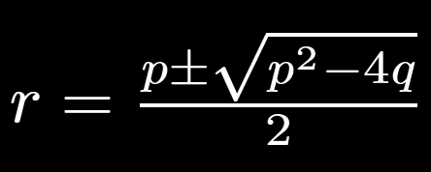
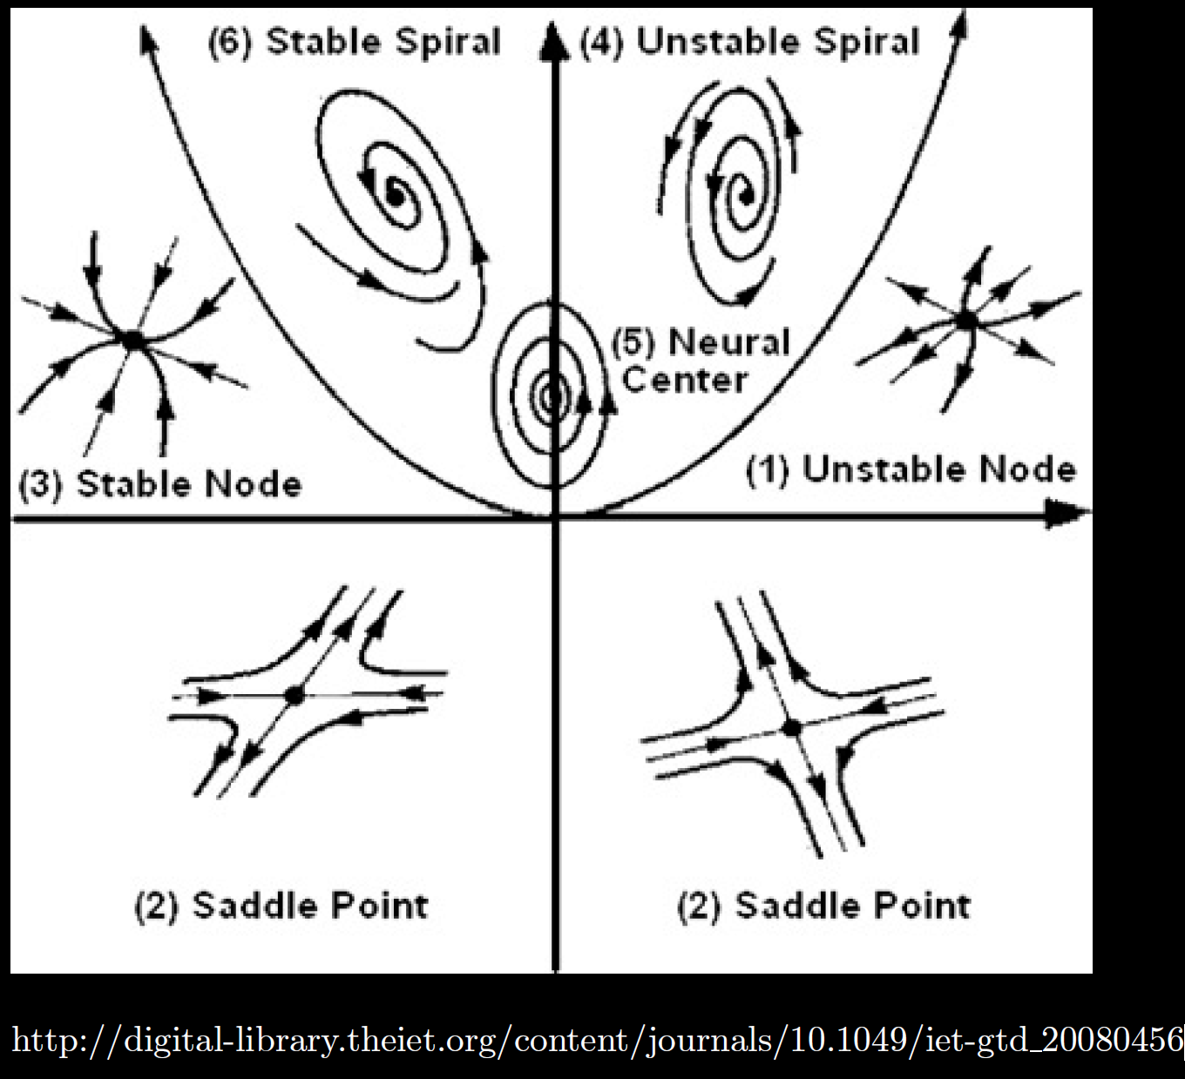
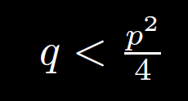
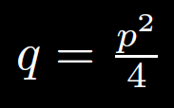
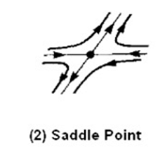
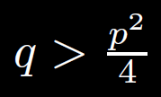
$p/2=$λ < 0
q
$p/2=$λ > 0
2 positive
eigenvalues
2 negative
eigenvalues
Two real roots
p
Repeated roots
q < 0 implies
1 positive and
1 negative
eigenvalue
Two complex roots
Unstable

Slide 4
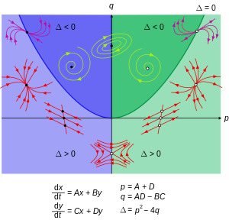
$p/2=$λ < 0
$p/2=$λ > 0
Two real roots
2 positive
eigenvalues
2 negative
eigenvalues
Repeated roots
q < 0 implies
1 positive and
1 negative
eigenvalue
Two complex roots
https://en.wikipedia.org/wiki/Phase_plane

Slide 5
$p/2=$λ < 0
$p/2=$λ > 0
Two real roots
2 negative
eigenvalues
2 positive
eigenvalues
Repeated roots
q < 0 implies
1 positive and
1 negative
eigenvalue
Two complex roots
https://en.wikipedia.org/wiki/Phase_plane

Slide 6
Center is stable, but not asymptotically stable
Asymptotically stable
Just need one positive expo-nential for
Unstable

Slide 9
(2, 0)
(1, 1)
spiral
(-2, -2)
spiral

Slide 10
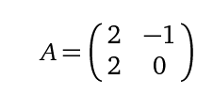
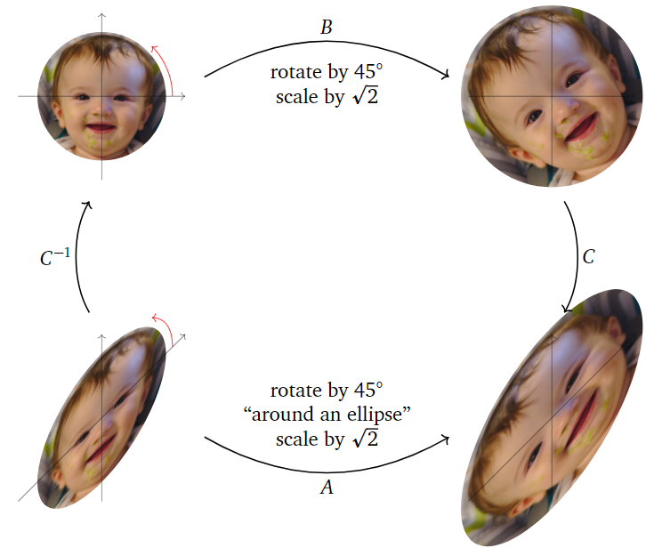
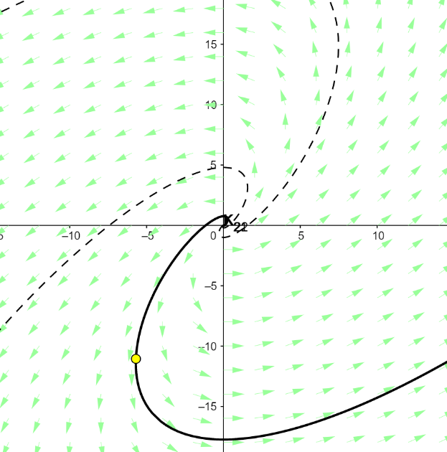
Compare chapter 7 slope field: x’ = Ax
to chapter 1/section 2.5 slope field:
Phase Plane and Portrait – GeoGebra
https://textbooks.math.gatech.edu/ila/complex-eigenvalues.html
Don’t look at this linear algebra website until after final exam
as arrows have a completely different meaning.

Slide 11
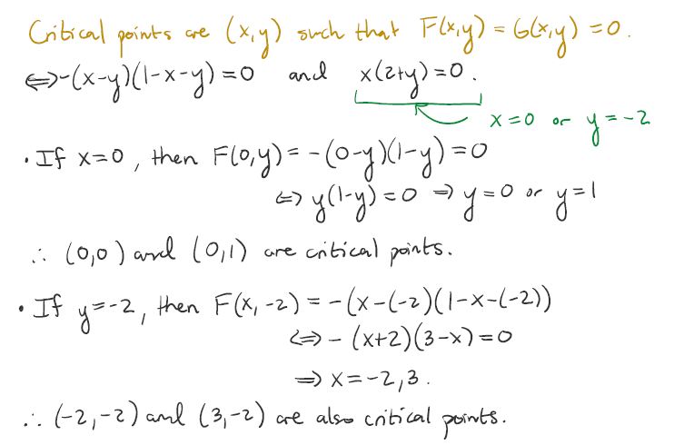
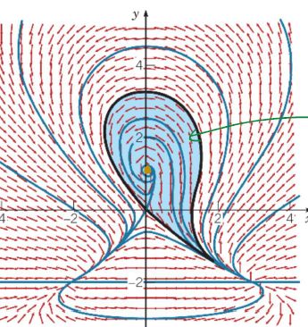

Slide 12
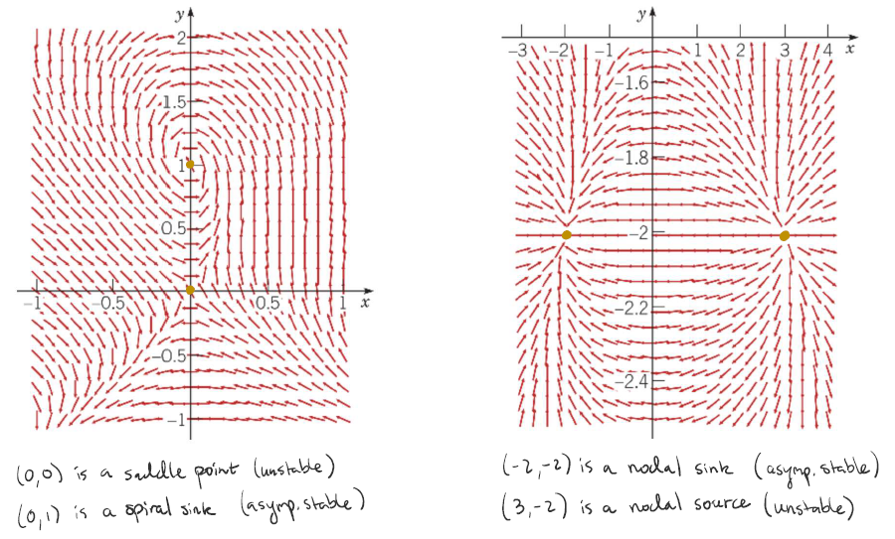

Slide 13
