Slide 1
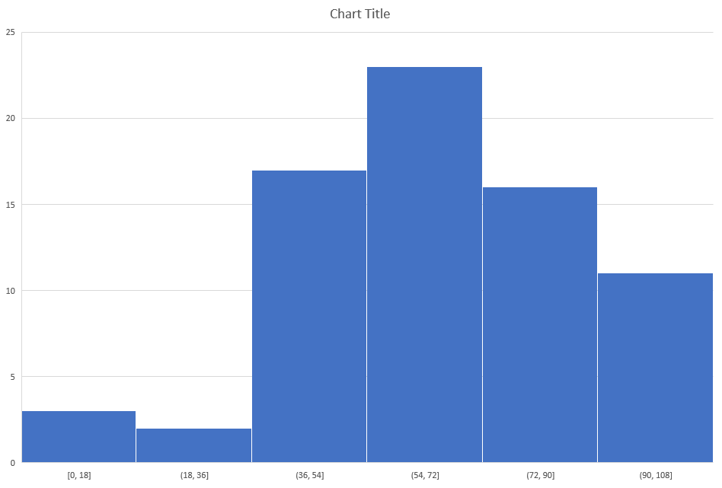
Mostly ignore first column as it includes
Test student and other grade(s) not part
of final calculation.
Excel can’t do math, highest grade is
< 100%

Slide 2
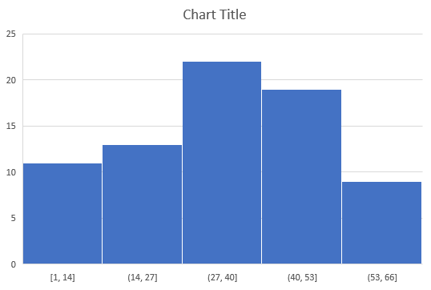
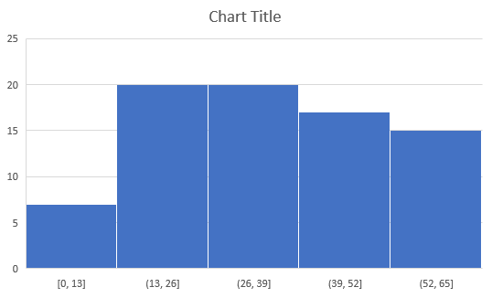
Exam 1
Exam 2

Slide 3

Mostly ignore first column as it includes
Test student and other grade(s) not part
of final calculation.
Excel can’t do math, highest grade is
< 100%

Slide 4


Exam 1
Exam 2

