Slide 1
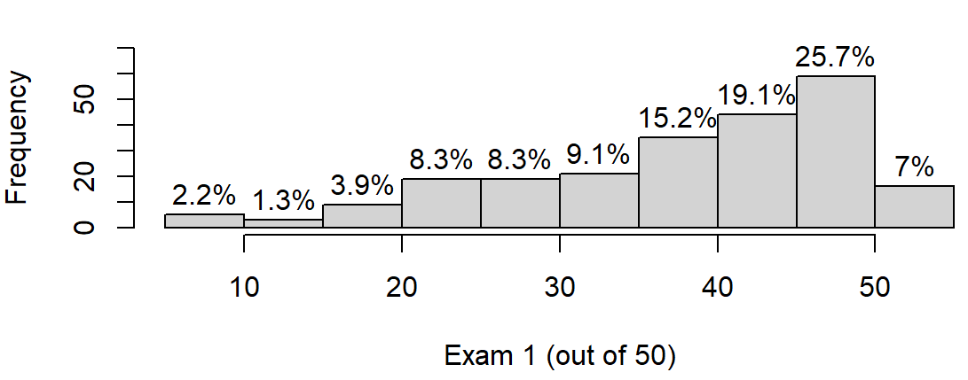

Slide 2
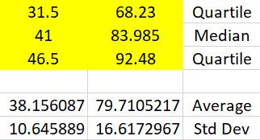
Exam 1 Current Grade
(out of 50) (out of 100%)
Warning: ICON is currently calculating Current Grade incorrectly for some sections. Thus a few current grades are higher than they should be. Thus the actual statistic for Current Grade would be lower than that stated in the table above. But the change is likely not significant for most of the above. Exam 1 statistics are correct.

Slide 3
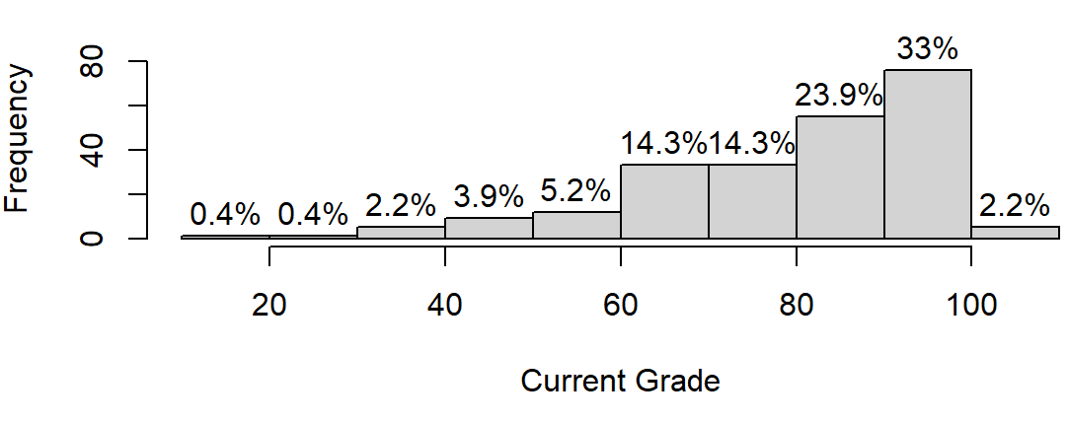
Current Grade estimation:
A, A- $≥$90
B+, B, B- $≥$ 80
C+, C, C- $≥$ 60
D $≥$45
F < 44

