Slide 1
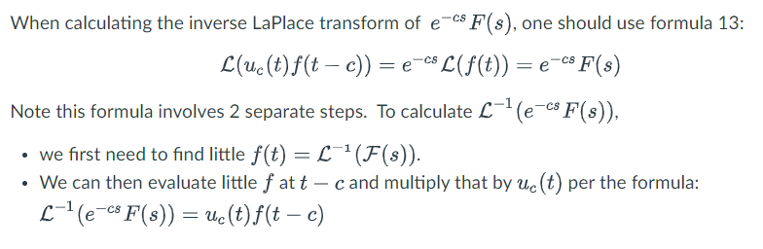
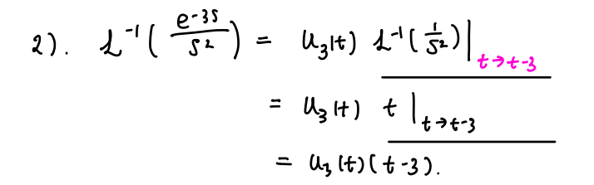

Slide 2
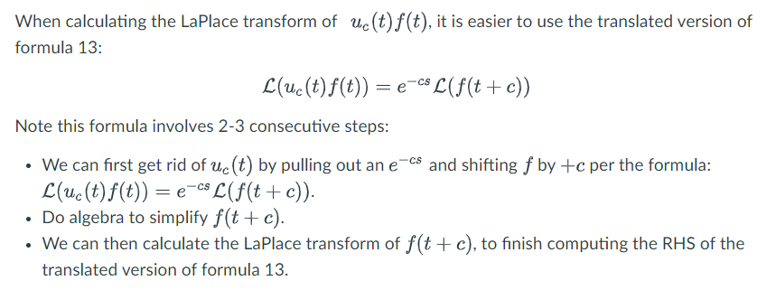

Slide 3
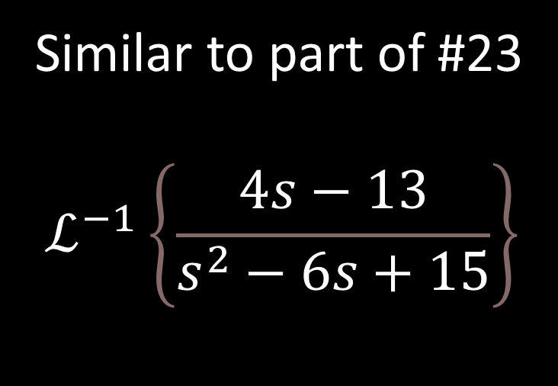
Similar to part of #23
$$ℒ^{−1}\left\{\frac{4s−13}{s^{2}−6s+15}\right\}$$

Slide 4
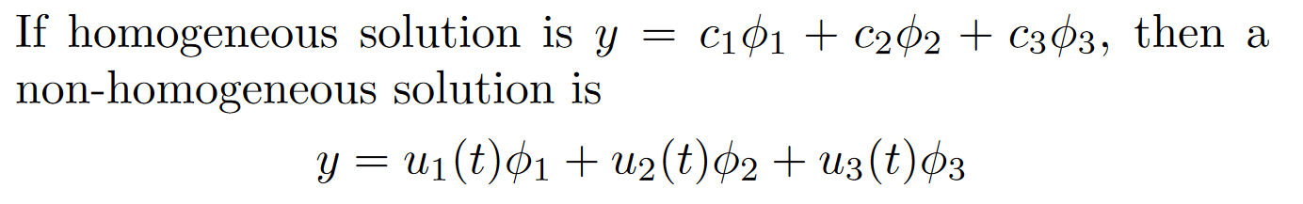
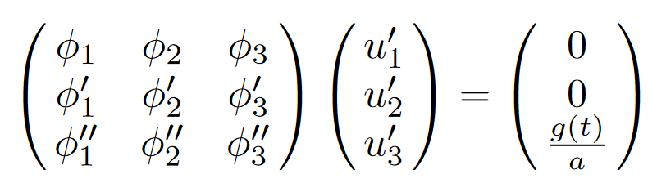
Ch 3/4:
Solve homogeneous first
Find a particular non-homogenous solution
  3.5/4.3 Undetermined coefficients is easier
    See 3.5 worksheet.
  3.6/4.4 Variation of parameters
    where
    W u’ = [0, …, 0, g(t)/a]^{T}
3. If initial value problem, plug in initial values.
Solve using Cramer’s rule or use formula

Slide 5
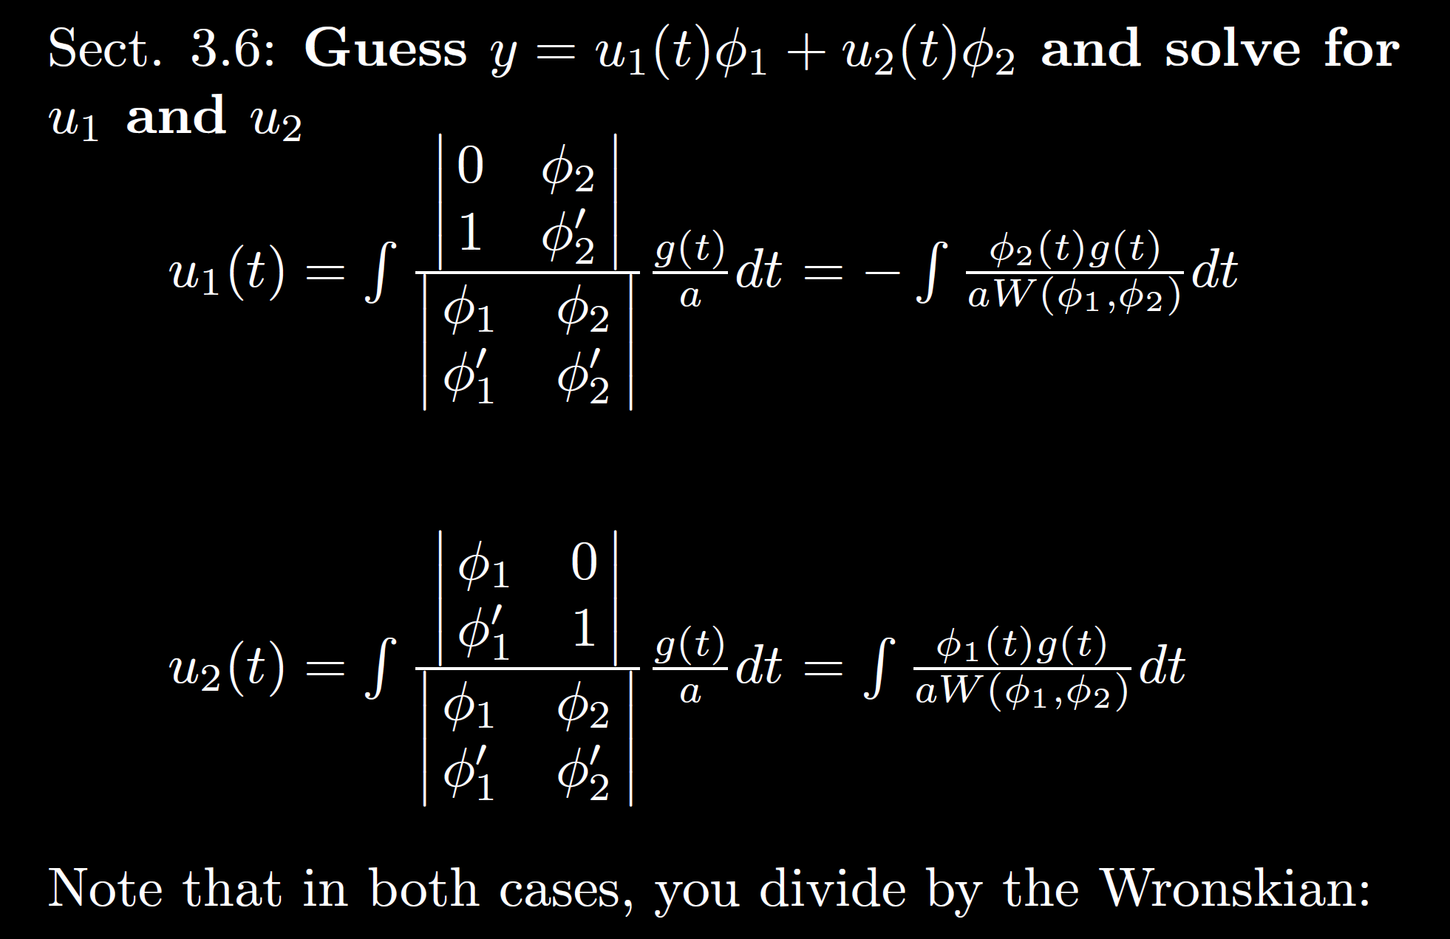

Slide 6


Note much of this exam is about whether you can use formulas.
Section 3.6: Variation of parameters to solve $ay′′ + by′ + cy = g(t)$
Suppose $y_{1}\left(t\right)$ and $y_{2}\left(t\right)$ are linearly independent solutions of
$$ay′′ + by′ + cy =0$$
Then the particular nonhomogeneous solution is given by
Ex: Solve $y′′ − y′ = 5$ using variation of parameters

Slide 7

Be able to factor the following:
$$ar4 − b = 0$$
$$ar4+ br2+ c = 0$$
$$kar3+ kbr2+ nar + nb =kr2(ar + b)+ n\left(ar + b\right)$$
$= (kr2+ n)(ar + b)$

Slide 8
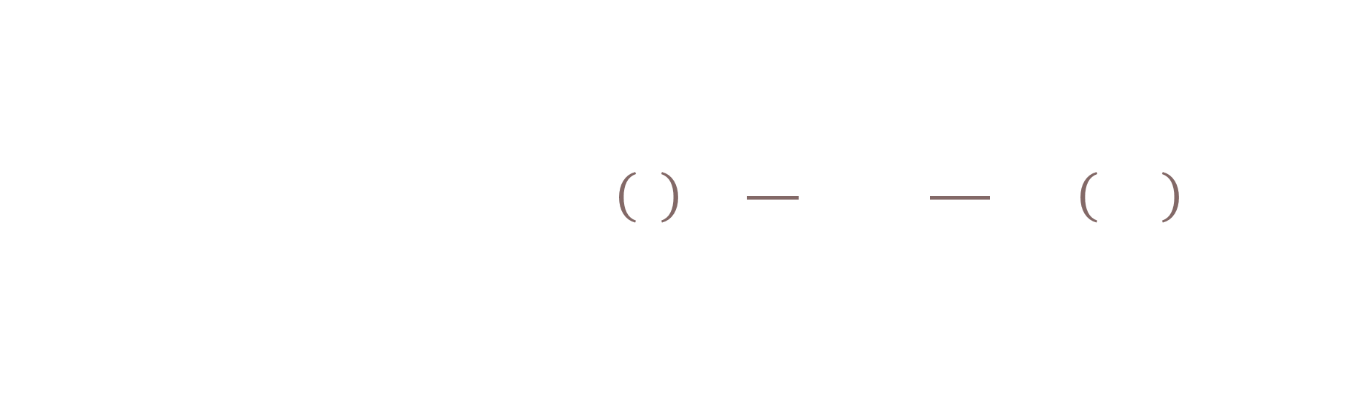
FYI: For those taking circuits
Example from circuits: $v_{c}^{′}\left(t\right)+\frac{1}{RC}v_{c}=\frac{V_{M}}{RC}\cos\left(ωt\right)$
First order linear with constant coefficients so Ch 3/4 apply

Slide 9
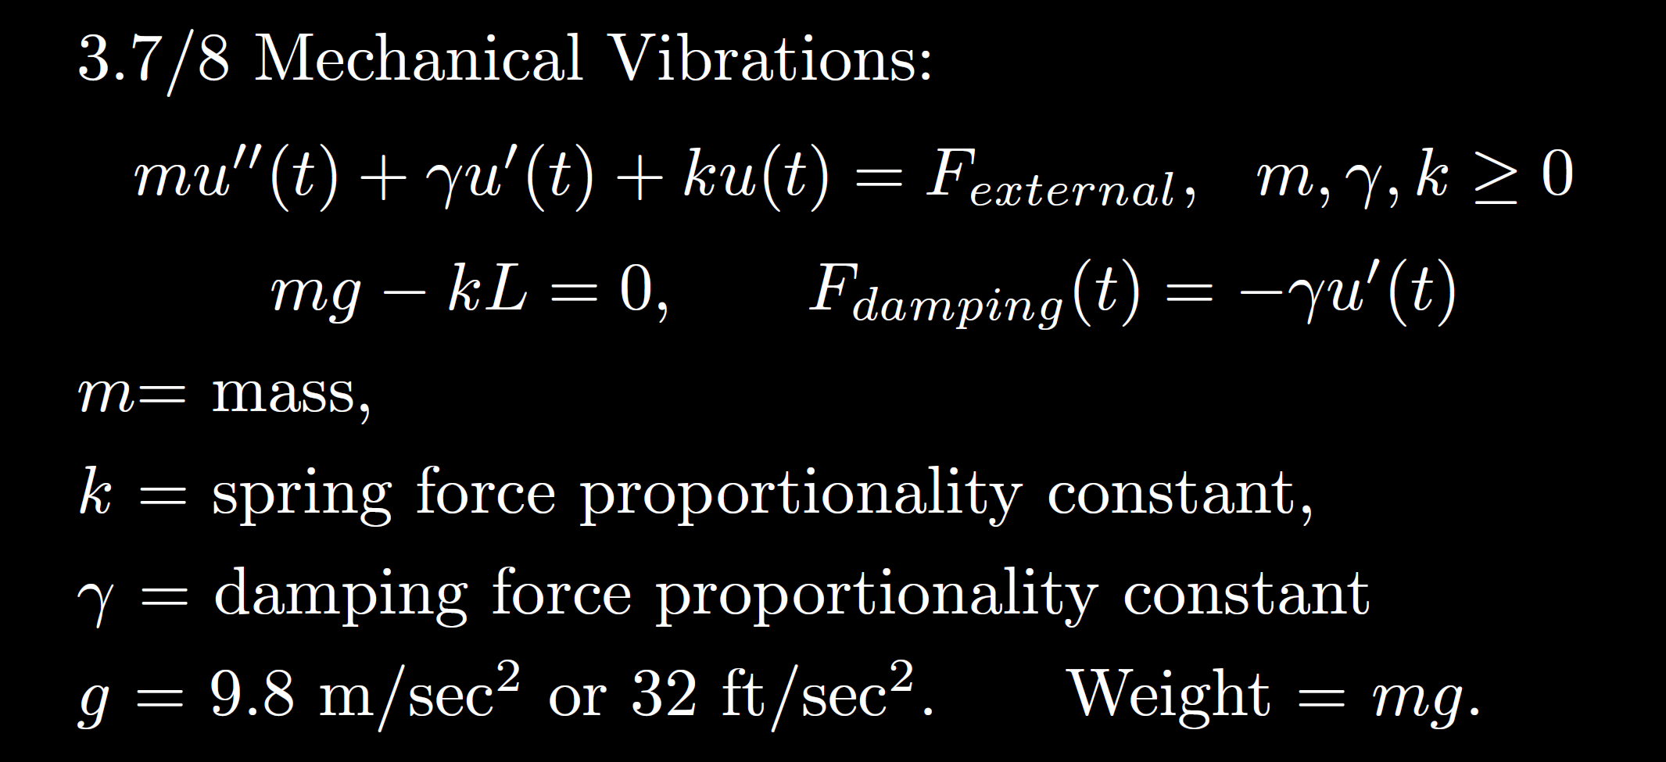
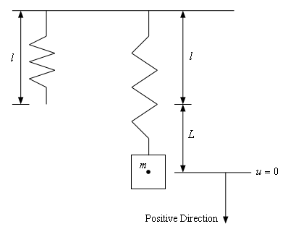
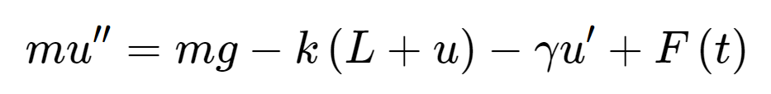
Total force
F= ma
Spring force
External force
Sec 3.8
Gravitational force
Viscous or damping force
https://tutorial.math.lamar.edu/Classes/DE/Vibrations.aspx

Slide 10






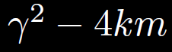




Homogeneous
No damping
oscillation
zero
3.3
Underdamping
oscillation w/decreasing amplitude
small
Critical damping
3.4
No oscillation
critical
Over- damping
3.1
No oscillation
large

Slide 11
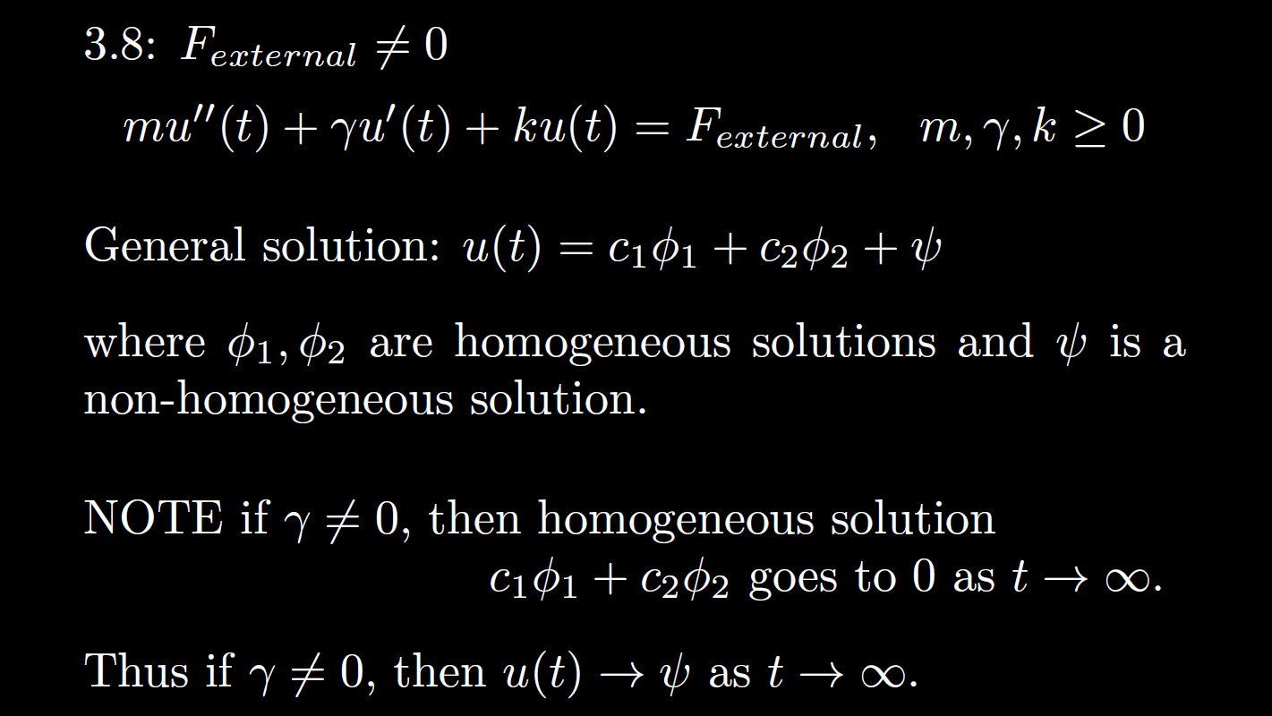


Non-Homogeneous
is the steady state response when

Slide 12


Non-Homogeneous
, then is the transient part.
is the steady state response when

Slide 13


Ch 3, 4: homogeneous soln Particular solution
3.7, 3.8 when transient soln Steady state soln
If the homogeneous solution goes to 0 as t goes to $∞$,
then the long-term behavior only depends on the steady state solution
Note in this case,
the initial values have almost no effect on the long-term behavior.
=
=

Slide 14
Homogeneous
No damping
oscillation
zero
3.3
Underdamping
oscillation w/decreasing amplitude
small
Critical damping
3.4
No oscillation
critical
Over- damping
3.1
No oscillation
large

Slide 15
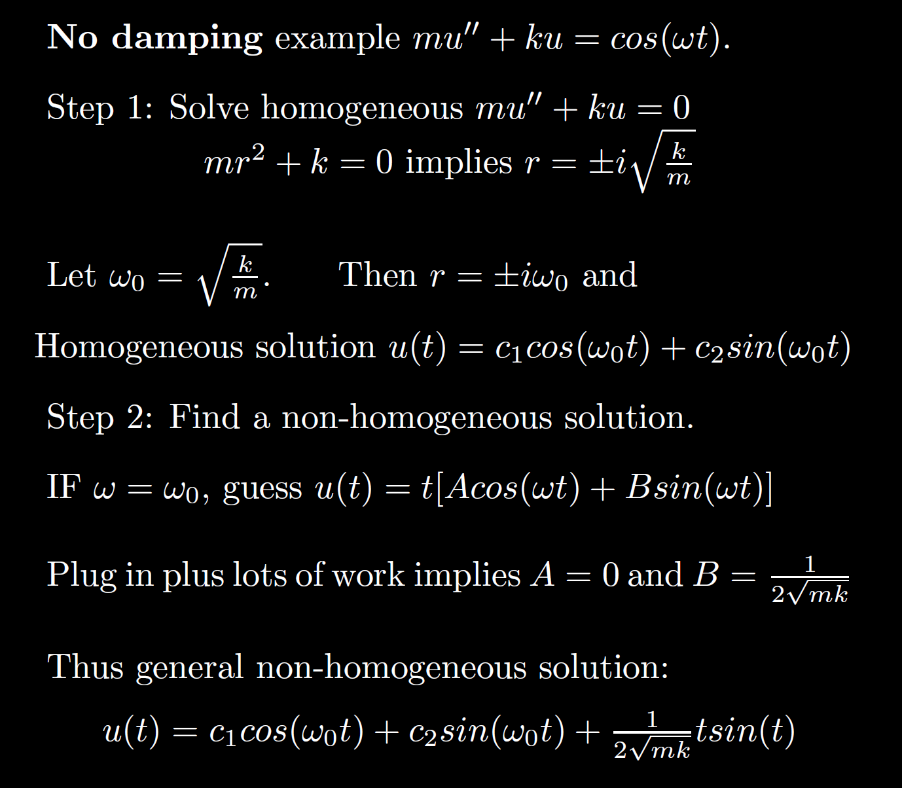
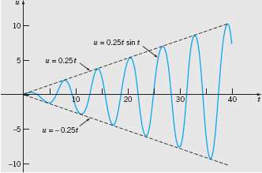

Non-Homogeneous
Boyce/DiPrima/Meade 11th ed, Ch 3.8: Forced Periodic Vibrations
Resonant frequency:
Resonance:
Note when the external force frequency matches the frequency of the homogeneous solution, we must multiply by t.
Thus the amplitude goes to infinity.

Slide 16

Non-Homogeneous
No damping case where external force = Fcos(w₀t) + Gsin(w₀t):
mu’’ + ku = Fcos(w₀t) + Gsin(w₀t):
Resonant frequency = frequency of the homogenous solution = external force frequency =
If homogeneous solution is u(t) = c₁cos(w₀t) + c₂sin(w₀t),
Then nonhomogeneous particular solution is
t[Acos(w₀t) + Bsin(w₀t)]
This same frequency is a good approximation for small damping case.
per previous slide.
Boyce/DiPrima/Meade 11th ed, Ch 3.8: Forced Periodic Vibrations

Slide 17
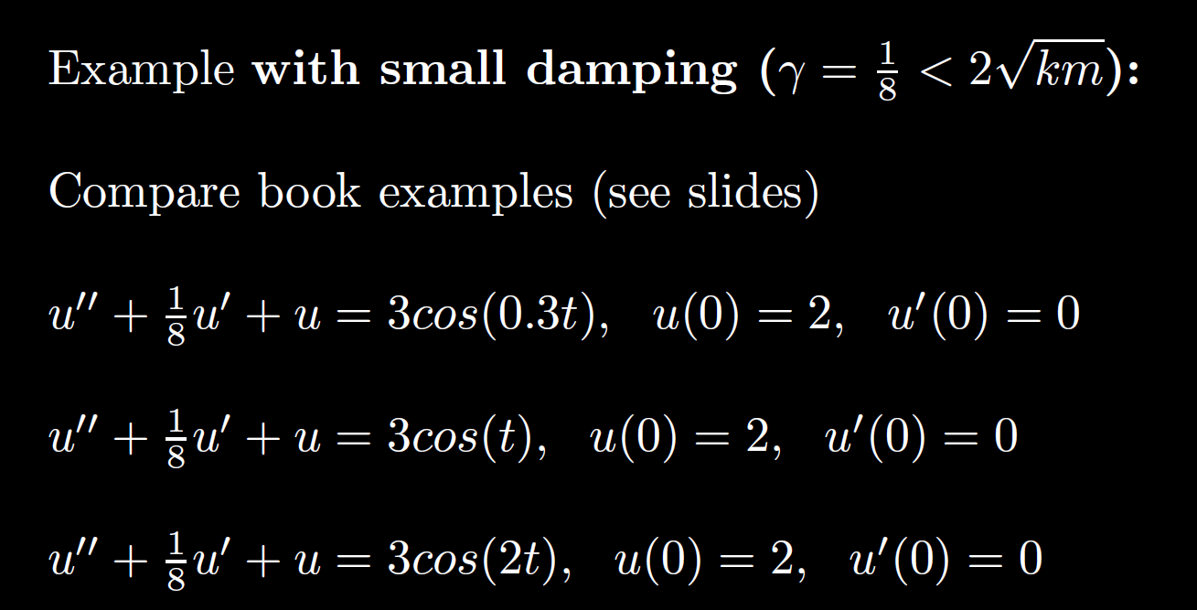
Non-Homogeneous

Slide 18
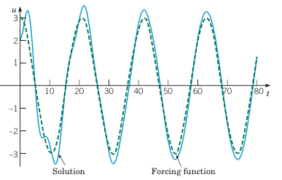
Example 2:
Forced Vibrations with Damping (2 of 4)
Graphs of the solution and external force for .
Small external force frequency results in mass moving similar to external force
Boyce/DiPrima/Meade 11th ed, Ch 3.8: Forced Periodic Vibrations

Slide 19
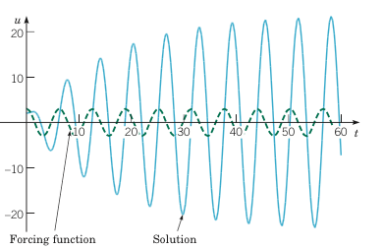
Example 2:
Forced Vibrations with Damping (3 of 4)
Graphs of the solution and external force for
If external force frequency is close to the resonant frequency, the amplitude of the response is much larger (solid blue curve) – compare to previous and next slide.
Boyce/DiPrima/Meade 11th ed, Ch 3.8: Forced Periodic Vibrations
Resonance

Slide 20
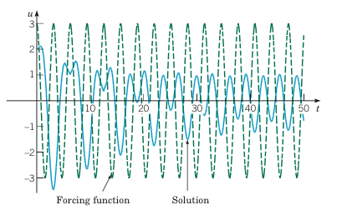
Example 2:
Forced Vibrations with Damping (4 of 4)
Graphs of the solution and external force for
Large external force frequency results in
smaller amplitude.
Note the amplitude of the external force (dashed green curve) is larger than the response (solid blue curve).
Boyce/DiPrima/Meade 11th ed, Ch 3.8: Forced Periodic Vibrations

Slide 21
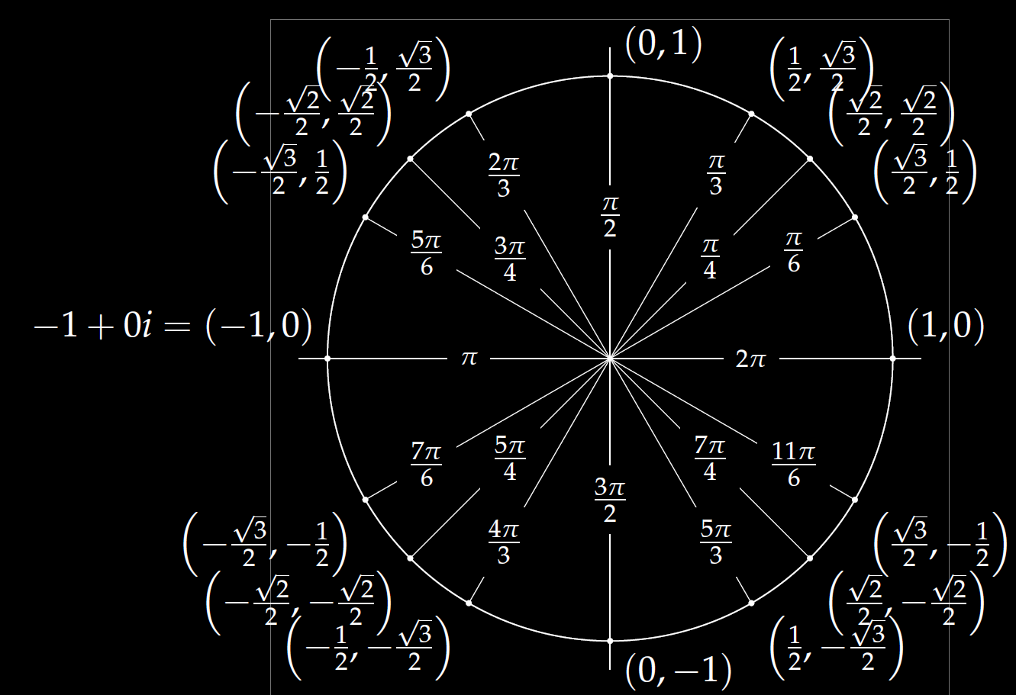

Examples:
$$1=ⅇ^{ⅈ0}$$
$$−1=ⅇ^{ⅈπ}$$
$$−2=2ⅇ^{ⅈπ}$$
$$3+3ⅈ=\sqrt{18}ⅇ^{iπ/4}$$
$$Reiδt=R\cos\left(δt\right)+ⅈR\sin\left(δt\right)$$
($R\cos\left(δt\right), R\sin\left(δt\right))$

Slide 22
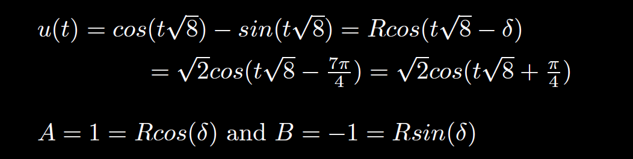
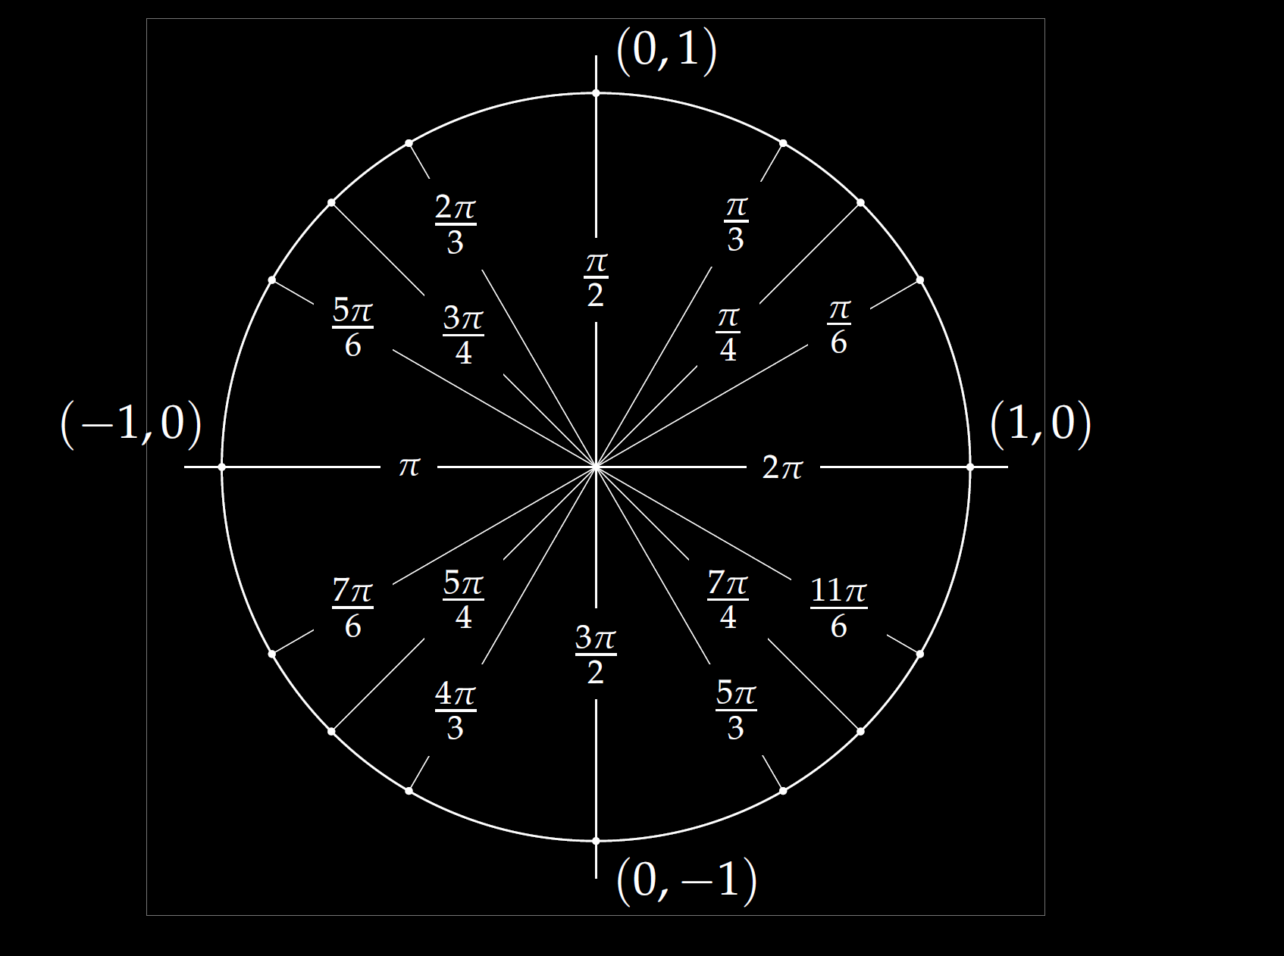
Frequency =
Period =
Amplitude =
Shift =

Slide 23
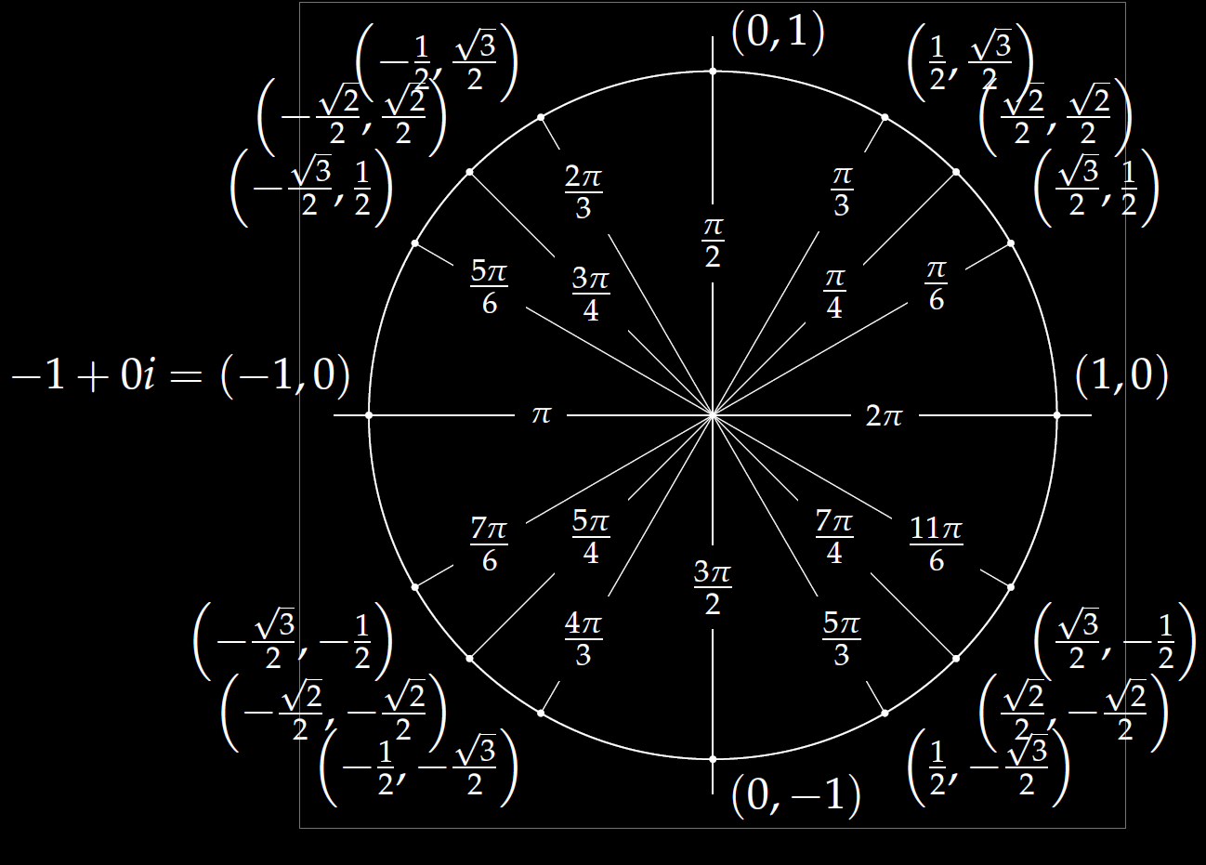
$$u\left(t\right)=−4\cos\left(7t\right)+4\sqrt{3}\sin\left(7t\right)$$
(cos δ, sin δ)

Slide 24
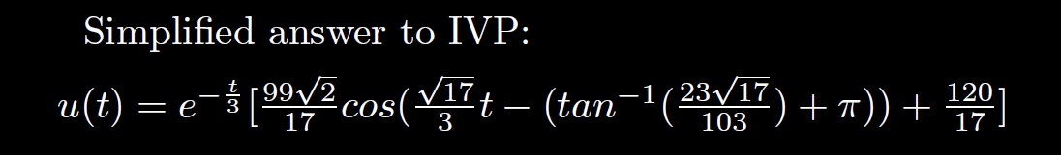

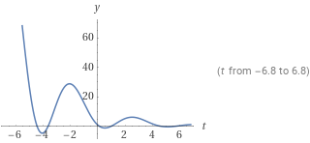
Quasi-frequency:
Quasi-period:
2 π /( )

