Slide 1
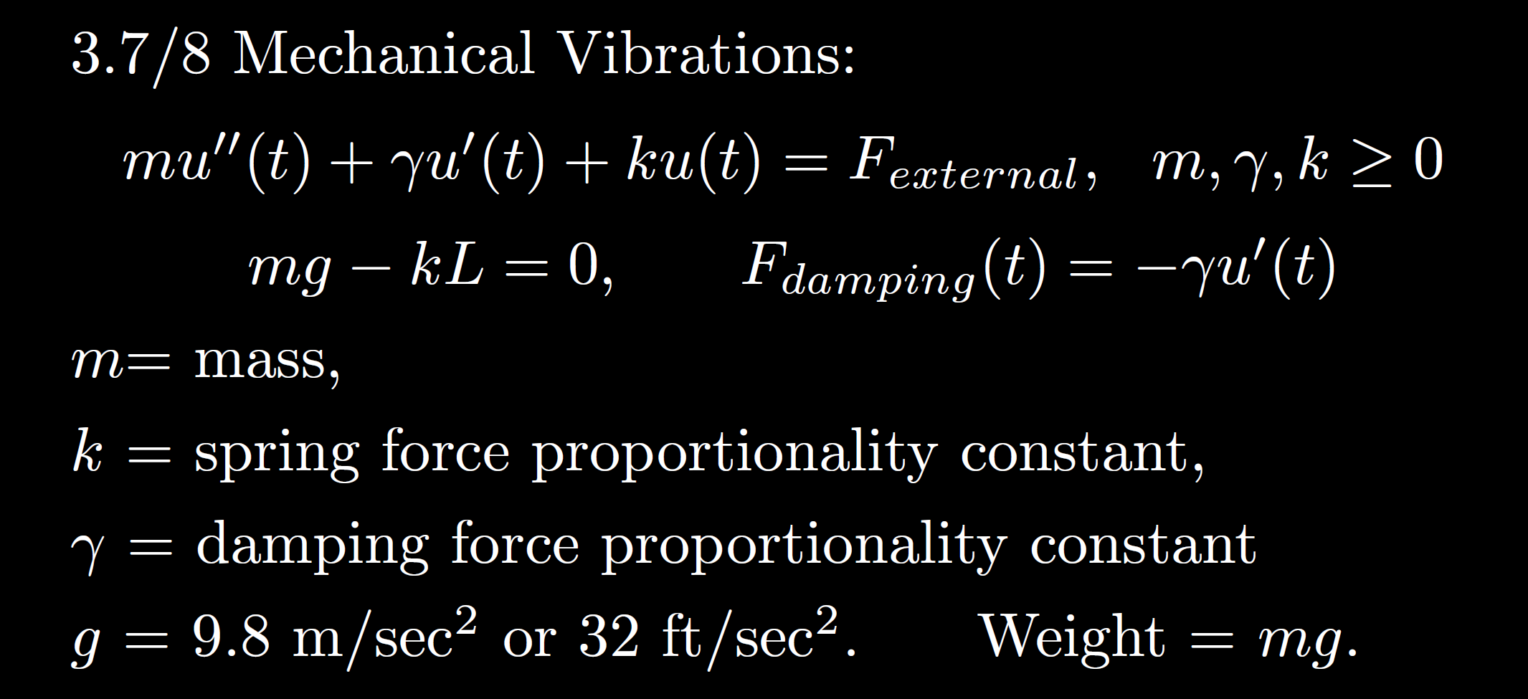
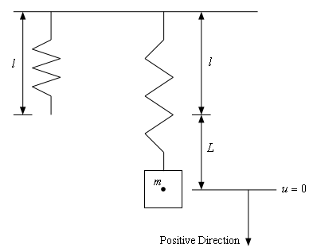
https://tutorial.math.lamar.edu/Classes/DE/Vibrations.aspx

Slide 2
Homogeneous
No damping
oscillation
zero
3.3
Underdamping
oscillation w/decreasing amplitude
small
Critical damping
3.4
No oscillation
critical
Over- damping
3.1
No oscillation
large

Slide 3
Non-Homogeneous
is the steady state response when

Slide 4
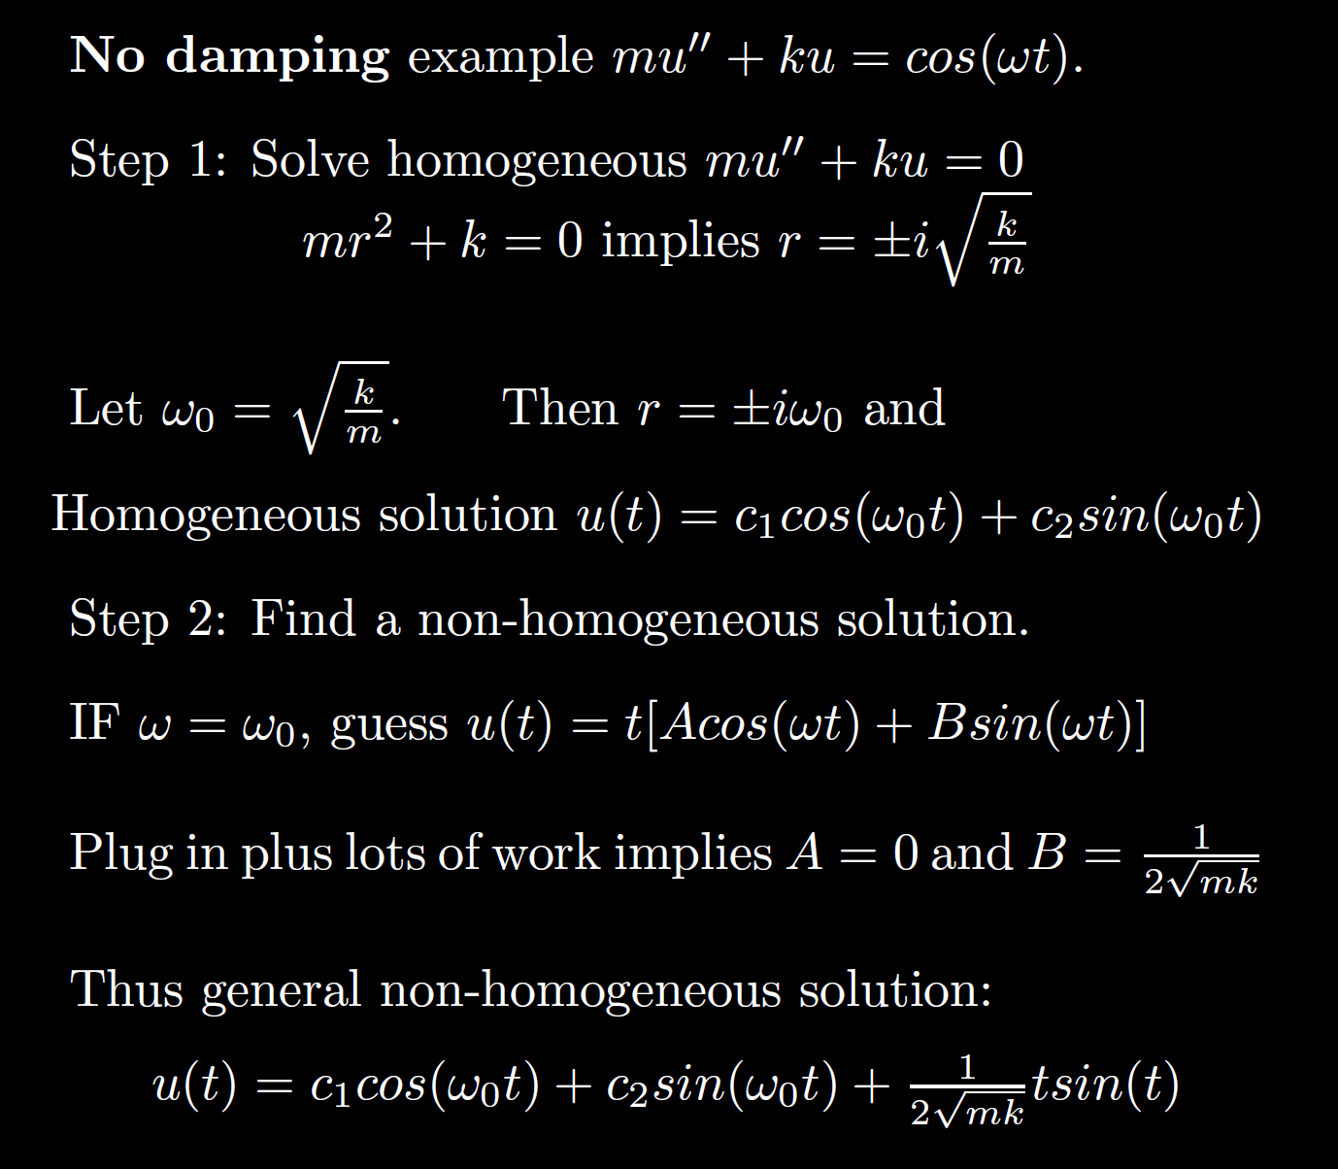
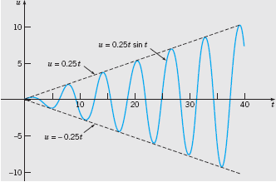
Non-Homogeneous
Boyce/DiPrima/Meade 11th ed, Ch 3.8: Forced Periodic Vibrations
Resonant frequency:
Resonance:
Note when the external force frequency matches the frequency of the homogeneous solution, we must multiply by t.
Thus the amplitude goes to infinity.

Slide 5
Non-Homogeneous
No damping case where external force = Fcos(w₀t) + Gsin(w₀t):
mu’’ + ku = Fcos(w₀t) + Gsin(w₀t):
Resonant frequency = frequency of the homogenous solution = external force frequency =
If homogeneous solution is u(t) = c₁cos(w₀t) + c₂sin(w₀t),
Then nonhomogeneous particular solution is
t[Acos(w₀t) + Bsin(w₀t)]
This same frequency is a good approximation for small damping case.
per previous slide.
Boyce/DiPrima/Meade 11th ed, Ch 3.8: Forced Periodic Vibrations

Slide 6
Non-Homogeneous

Slide 7
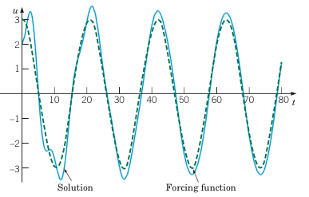
Example 2: Forced Vibrations with Damping (2 of 4)
Graphs of the solution and external force for .
Small external force frequency results in mass moving similar to external force
Boyce/DiPrima/Meade 11th ed, Ch 3.8: Forced Periodic Vibrations
Non-Homogeneous

Slide 8
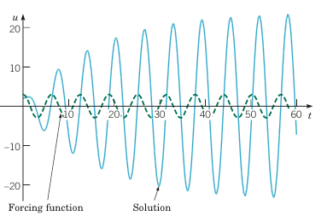
Example 2: Forced Vibrations with Damping (3 of 4)
Graphs of the solution and external force for
If external force frequency is close to the resonant frequency, the amplitude of the response is much larger (solid blue curve) – compare to previous and next slide.
Boyce/DiPrima/Meade 11th ed, Ch 3.8: Forced Periodic Vibrations
Non-Homogeneous

Slide 9
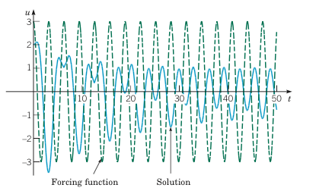
Example 2: Forced Vibrations with Damping (4 of 4)
Graphs of the solution and external force for
Large external force frequency results in
smaller amplitude.
Note the amplitude of the external force (dashed green curve) is larger than the response (solid blue curve).
Boyce/DiPrima/Meade 11th ed, Ch 3.8: Forced Periodic Vibrations
Non-Homogeneous

Slide 10
Ch 3/4:
Solve homogeneous first
Find a particular non-homogenous solution
3.5/4.3 Undetermined coefficients is easier
See 3.5 worksheet.
3.6/4.4 Variation of parameters
where
W u’ = [0, …, 0, g(t)/a]^{T}
3. If initial value problem, plug in initial values.
Solve using Cramer’s rule or use formula

Slide 12
Be able to factor the following:
$$ar4 − b = 0$$
$$ar4+ br2+ c = 0$$
$$kar3+ kbr2+ nar + nb =kr2(ar + b)+ n\left(ar + b\right)$$
$= (kr2+ n)(ar + b)$

Slide 14
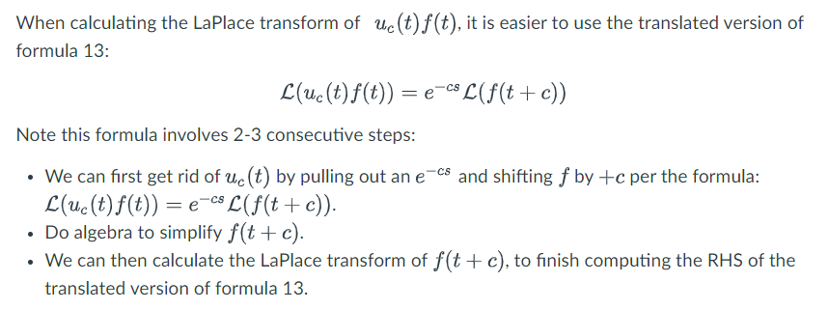

Slide 15
Similar to part of #23
$$ℒ^{−1}\left\{\frac{4s−13}{s^{2}−6s+15}\right\}$$

Slide 16
Example from circuits: $v_{c}^{′}\left(t\right)+\frac{1}{RC}v_{c}=\frac{V_{M}}{RC}\cos\left(ωt\right)$
First order linear with constant coefficients so Ch 3/4 apply

