Slide 1
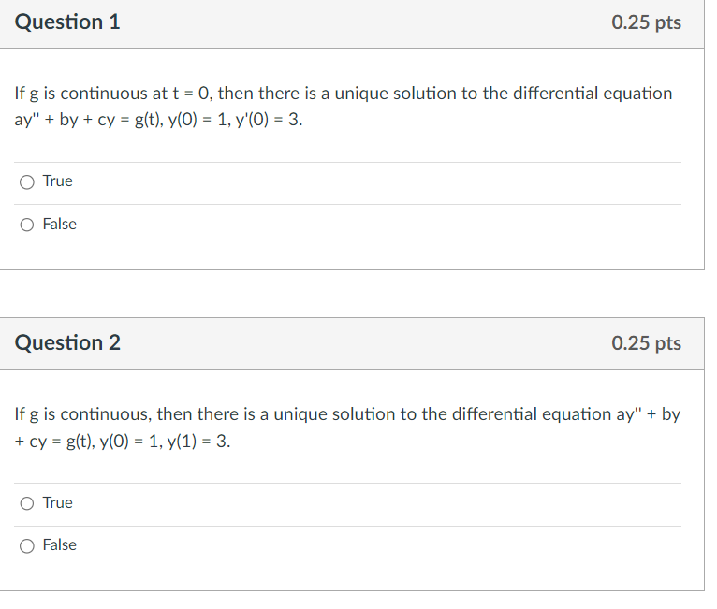
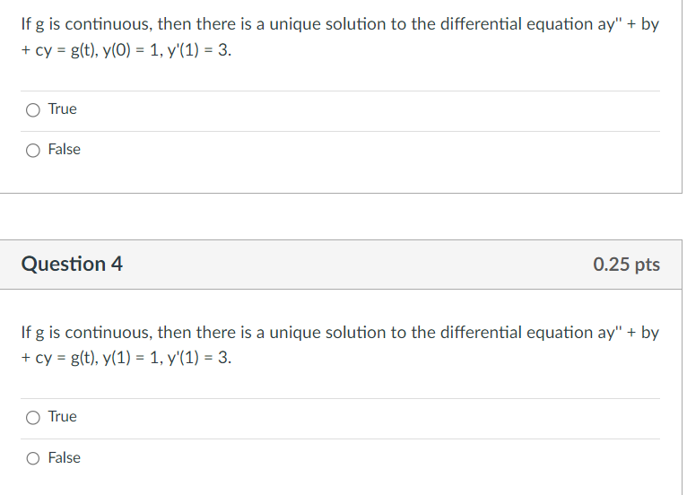
x
x
x
x
Midterm 1 will be held Thursday Feb 27, 2025 from 6:30PM - 8:00PM over Chapters 1 and 2 and 3.1-3.5 in C20 PC
Market St/Capital St (ie Walkway)
Slope at (t₀, y₀) is y (t₀) = y₁
(t₀, y₀)

Slide 2
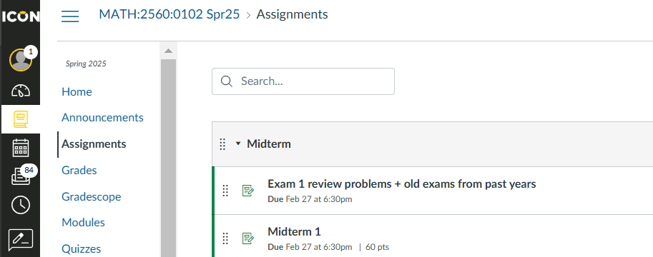
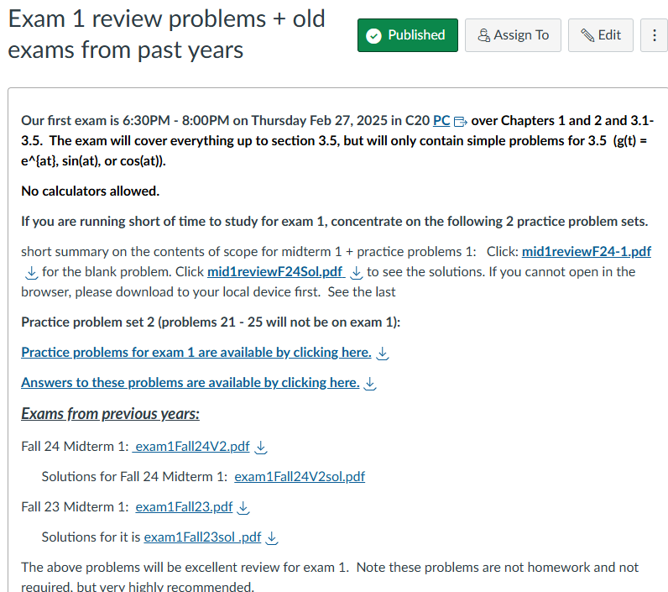
See ICON Assignment for Midterm 1 info
CHECK YOUR E-MAIL
Our first exam is 6:30PM - 8:00PM on Thursday Feb 27, 2025 in C20 PC. over Chapters 1 and 2 and 3.1-3.5. Practice problems and old exams are available at https://uiowa.instructure.com/courses/248128/assignments/2345108 . The link for the Fall 24 exam has been fixed. Advice for studying for this exam: 1.) Chapter 3.1 - 3.5 will be on exam 1, exam 2, and the final exam, so please learn it now! Note only simple questions from 3.5 will be on exam 1 per link above. 2.) Partial fractions will be on exam 1, exam 2 and the final exam, and thus make sure you know how to integrate via partial fractions by exam 1. 3.) Please over study for this exam. Many students under-study for the first exam. Getting help from your professors and tutors on the practice problems may be an efficient way to study, but save some problems to make sure you can do them on your own. You can ask the person helping you to make up similar problems, saving the old exams and some practice problems for you to do on your own. Good luck on the Math 2560 exam this Thursday 6:30pm - 8pm in C20 PC

Slide 3
Solving differential equations
1st order 2nd order LINEAR
Linear vs separable or both homogeneous: plug in e^{rt}
a(t)y’ + b(t)y = g(t) with constant coefficients
Use integrating factor Separate variables to
to create product rule create 2 calculus problems
$$\int{f\left(y\right)ⅆy}=\int{g\left(t\right)ⅆt}$$

Slide 5
From: https://tutorial.math.lamar.edu/Classes/DE/Linear.aspx

Slide 8
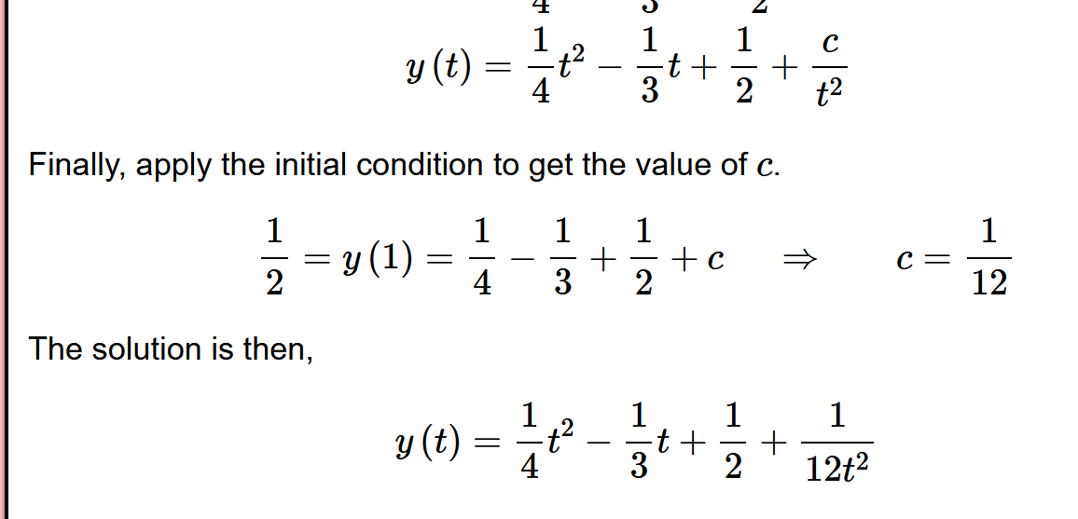

Slide 9
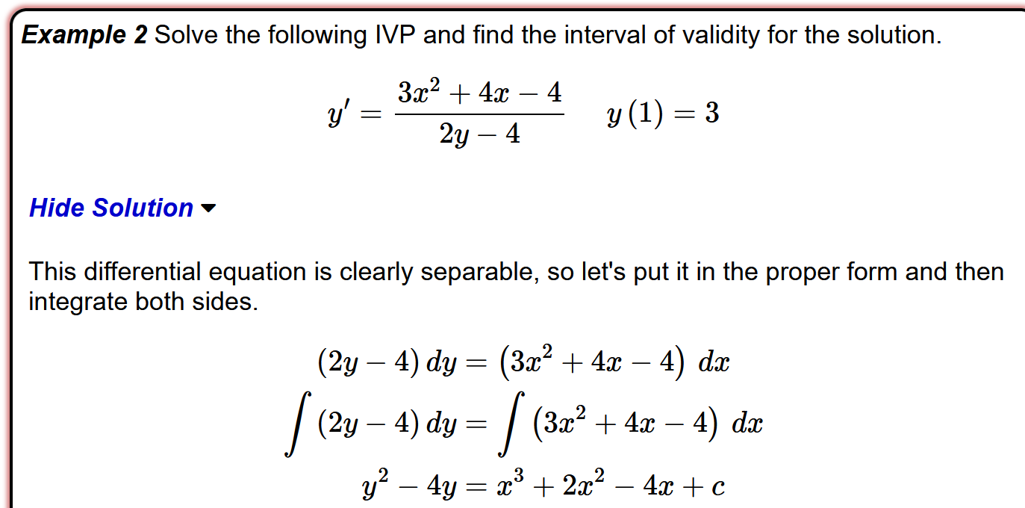
From: https://tutorial.math.lamar.edu/Classes/DE/Separable.aspx

Slide 10
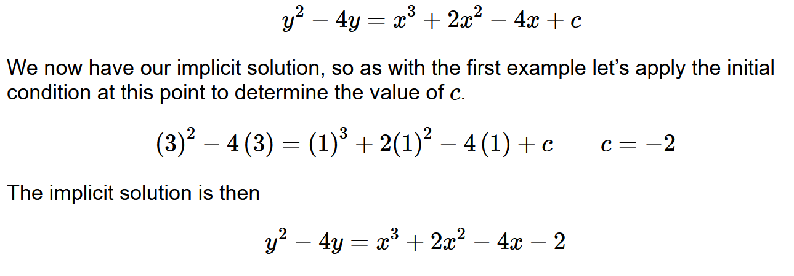

Slide 13
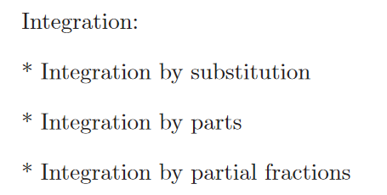
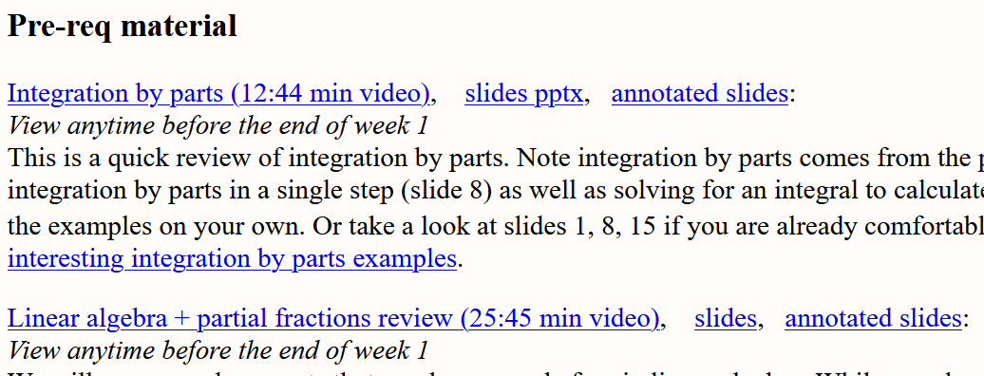
https://homepage.math.uiowa.edu/~idarcy/COURSES/100/SPRING22/videos.html

Slide 14
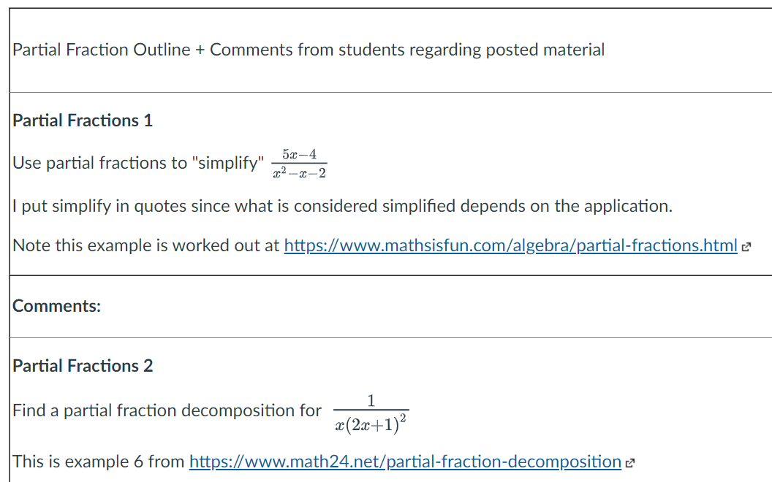

Slide 16
If rate of change is constant:

Slide 17
If rate of change proportional to S:

Slide 19
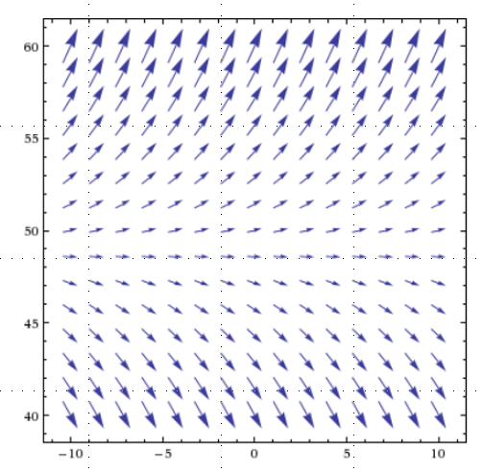

Slide 24
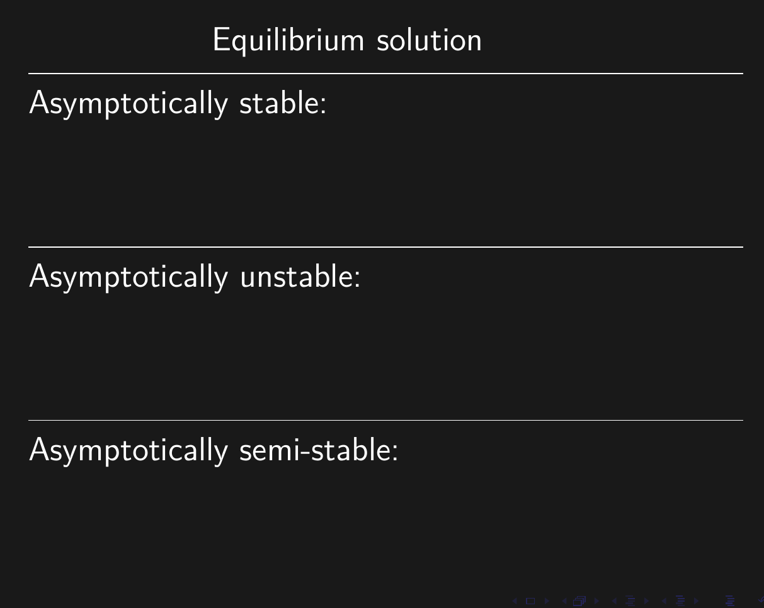

Slide 29
( )( )( )
-2 0 1 3
2
Thus unique solution exists to this IVP where the solution is defined on the interval (1, 3)

Slide 30
If DE is not linear, must solve IVP to find domain as this theorem does not give any information about the domain of the solution.

Slide 31
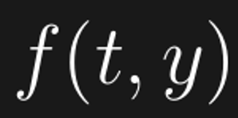
If DE is not linear, must solve IVP to find domain as this theorem does not give any information about the domain of the solution.

Slide 32
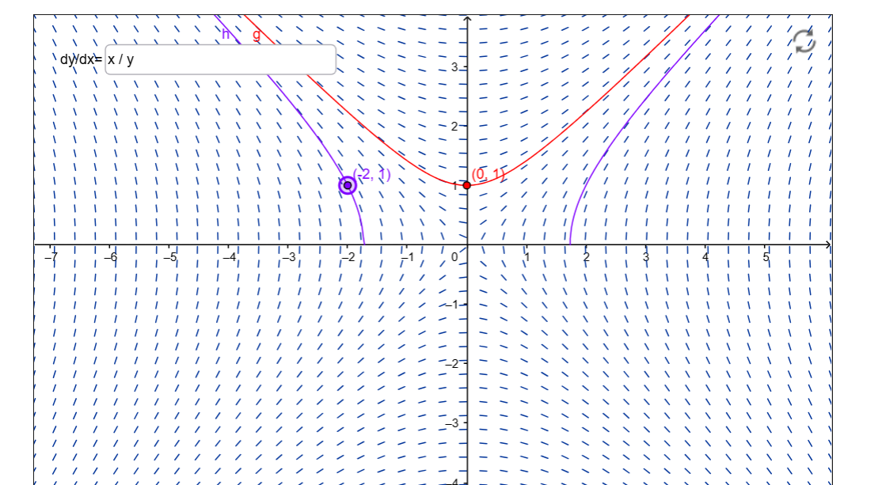
Domain is a single open interval!

Slide 33
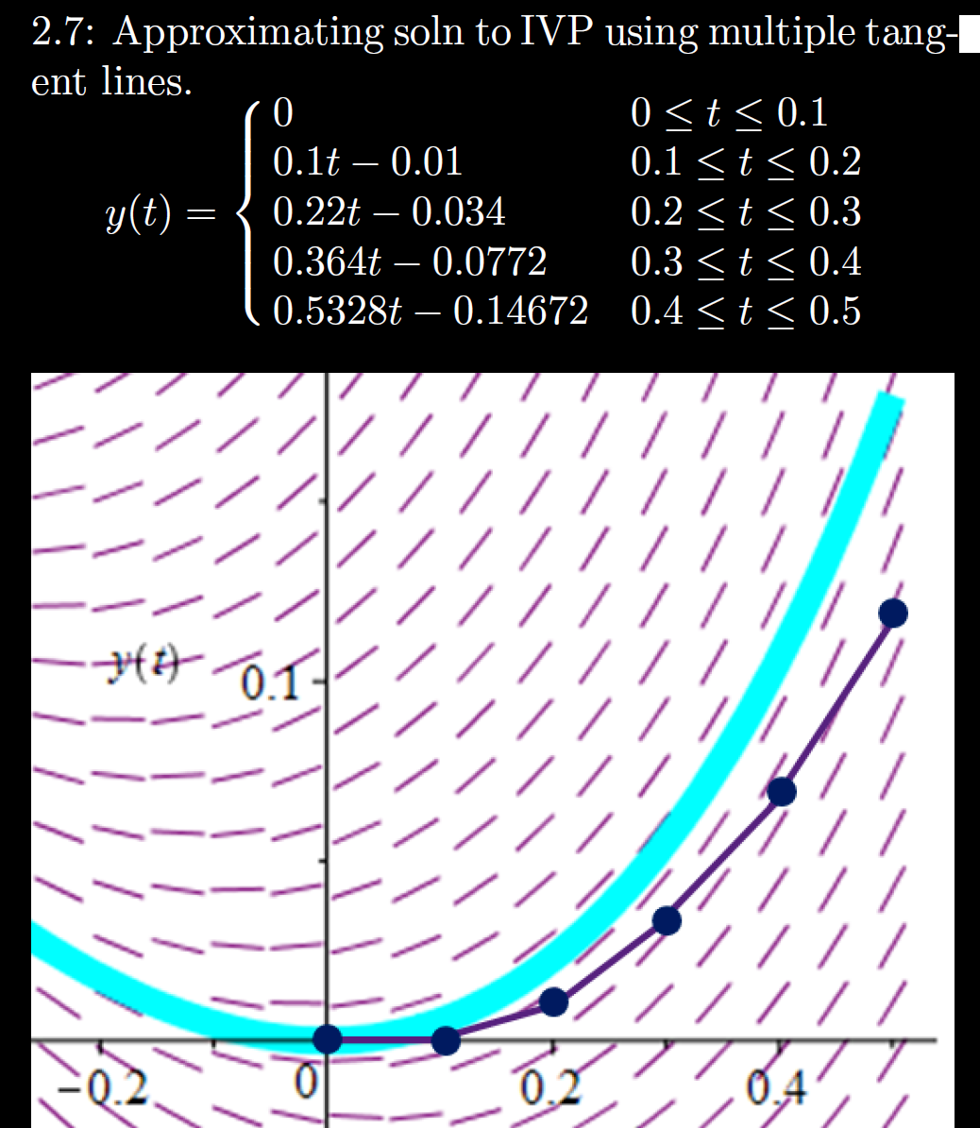
$y’ = f(t, y)$, $y(0)=0$
$$ϕ’ = f(t,ϕ)$$
h = Step size
= Δt = 0.1

Slide 34
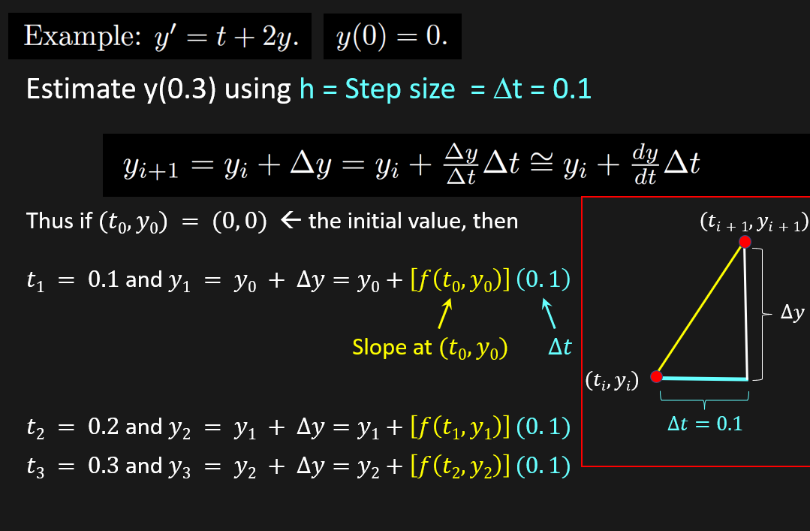

Slide 36
Note chapter 3 will appear on exam 1, exam 2, and the final exam. Learn it now!

Slide 38
3.1
3.3
3.4

Slide 39
The Wronskian evaluated at t₀ is the determinant of the coefficient matrix used to solve for the constants c_{i} for the IVP y(t₀) = y₀, y'(t₀) = y_{1.}

Slide 40
det $≠ 0$

Slide 41
3.5

Slide 42
3.5

Slide 43
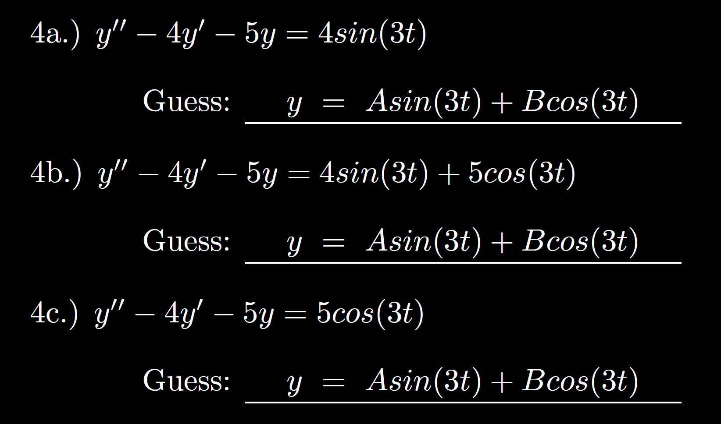
3.5

Slide 44
3.5

Slide 46
( )( )( )
-2 0 1 3
2
Thus unique solution exists to this IVP where the solution is defined on the interval (1, 3)

