Slide 1
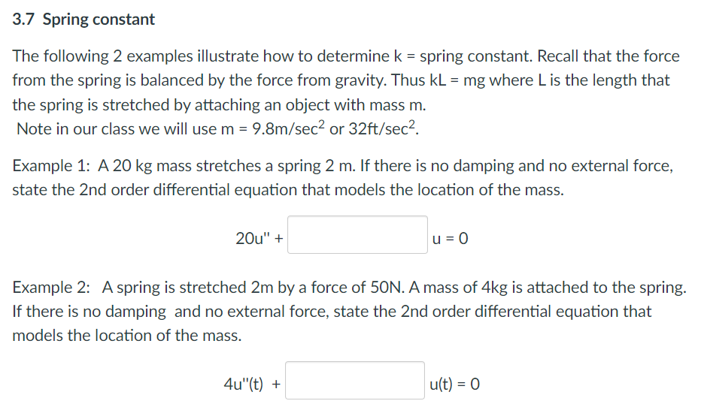

Slide 2
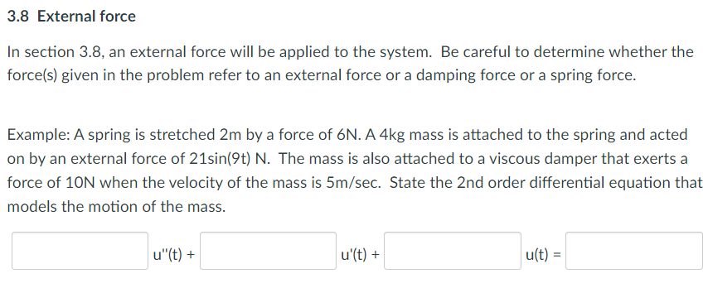

Slide 3
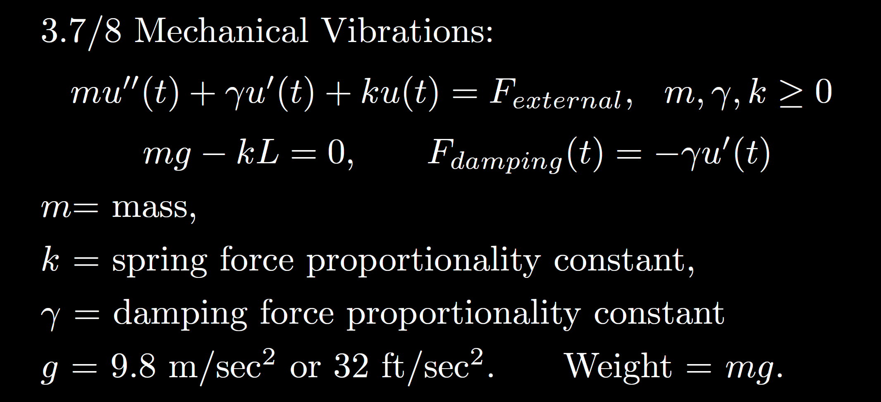
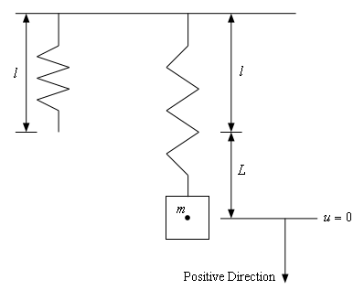
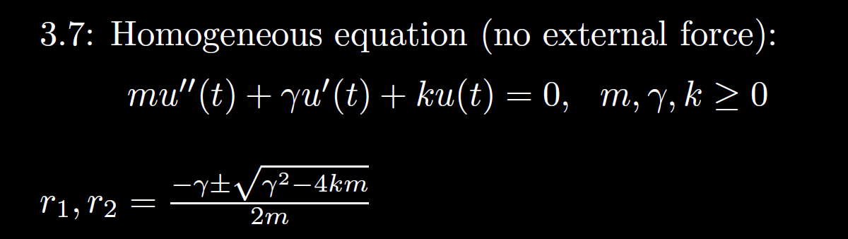
https://tutorial.math.lamar.edu/Classes/DE/Vibrations.aspx

Slide 4




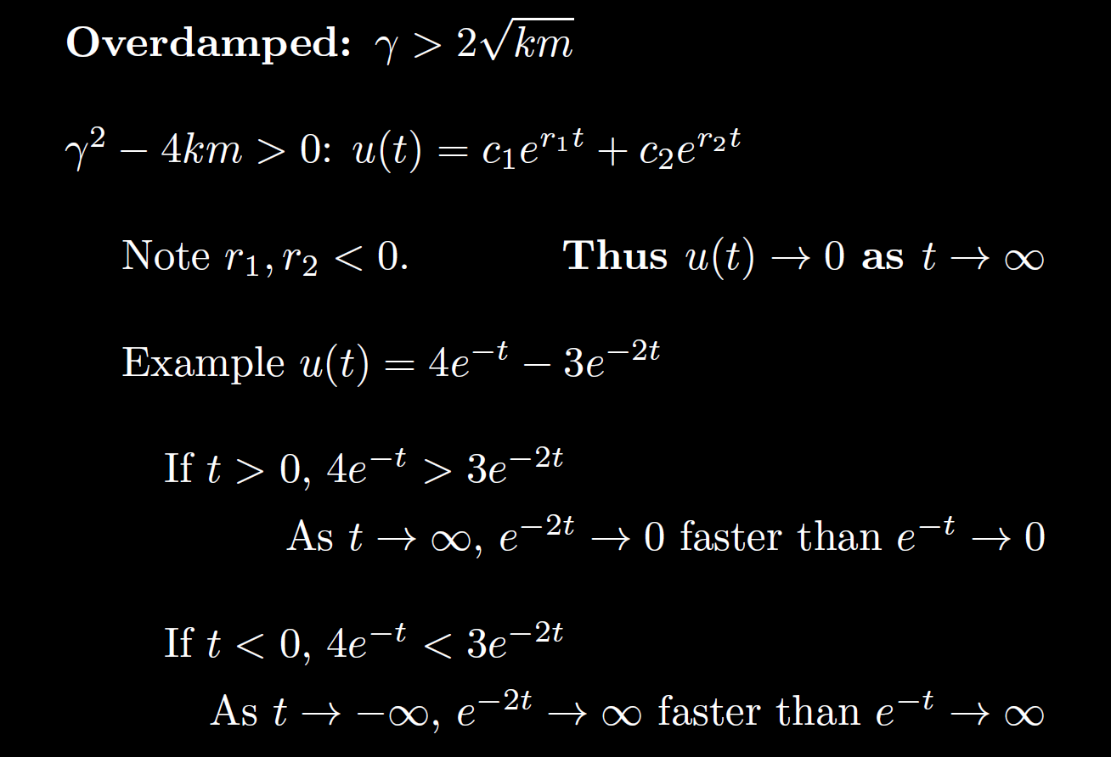





3.3
3.4
3.1

Slide 5

Homogeneous
3.3
3.4
3.1

Slide 6
Homogeneous
zero
3.3
small
critical
3.4
large
3.1

Slide 7
Homogeneous
No damping
3.3
Small damping
Critical damping
3.4
Large damping
3.1

Slide 8
Homogeneous
No damping
oscillation
zero
3.3
Underdamping
oscillation w/decreasing amplitude
small
Critical damping
3.4
No oscillation
critical
Over- damping
3.1
No oscillation
large

Slide 9
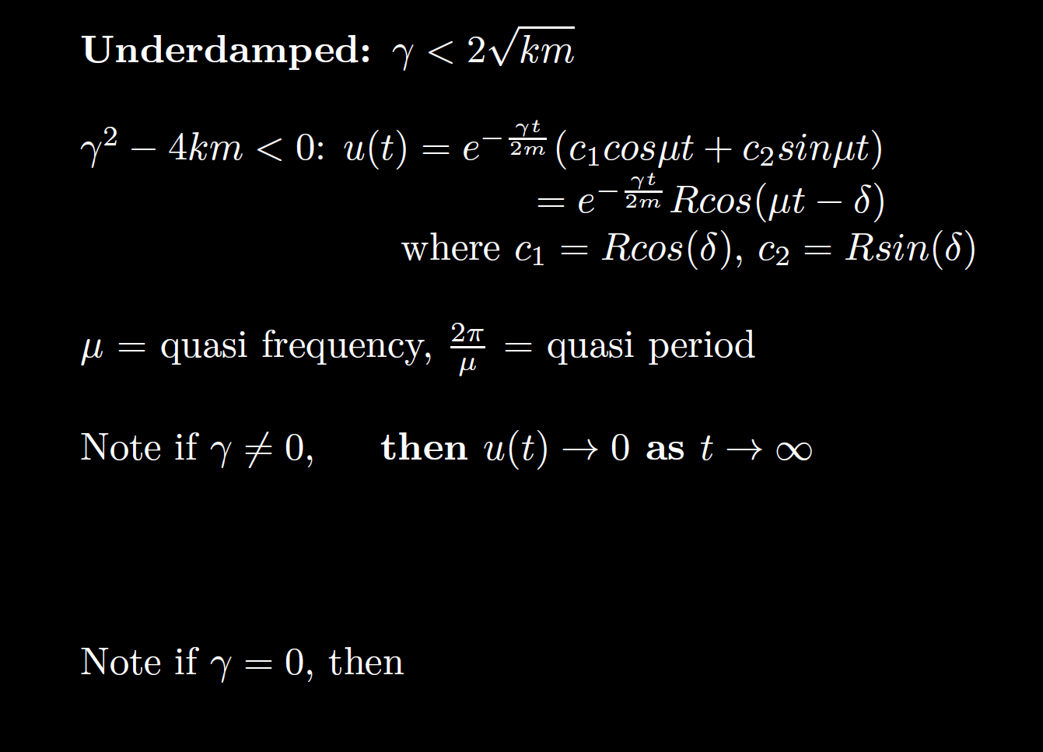
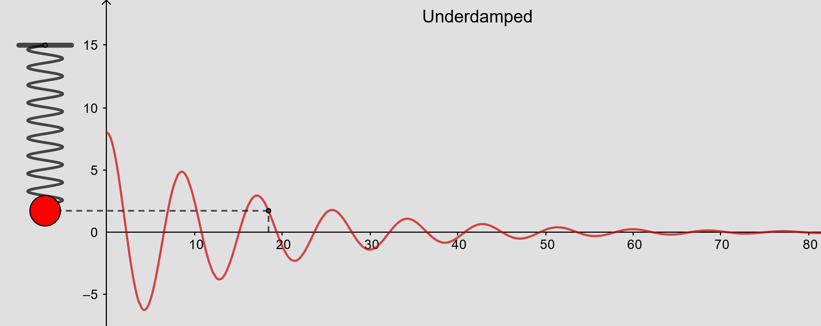
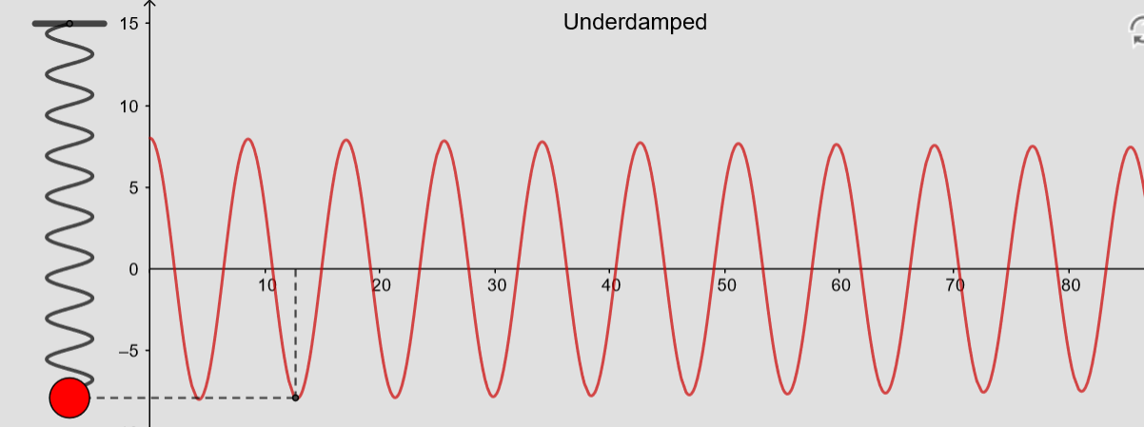
From https://www.geogebra.org/m/ZzKbkvnz
Note: Sign convention is opposite our convention

Slide 10

From https://www.geogebra.org/m/ZzKbkvnz
Note: Sign convention is opposite our convention
0.01
Homogeneous

Slide 11
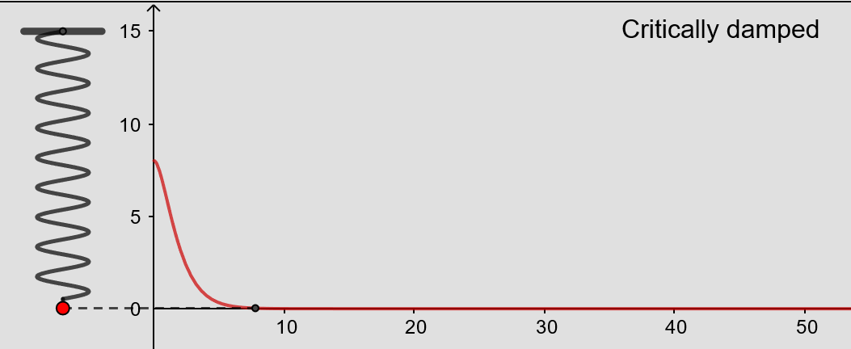
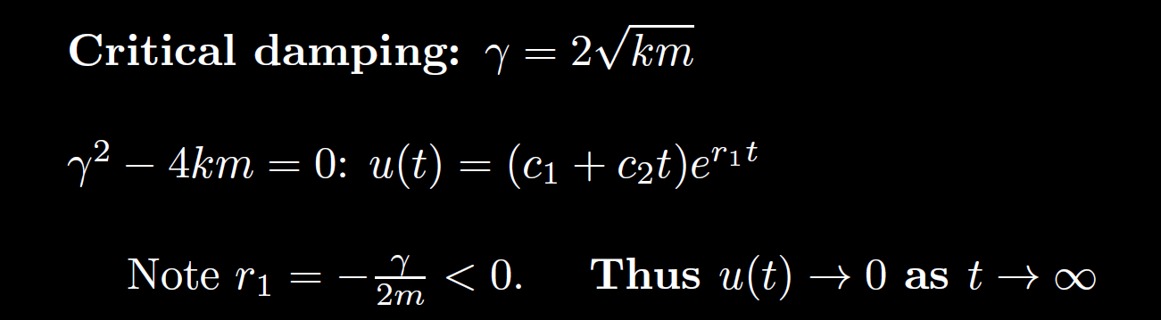
From https://www.geogebra.org/m/ZzKbkvnz
Note: Sign convention is opposite our convention
Homogeneous

Slide 12
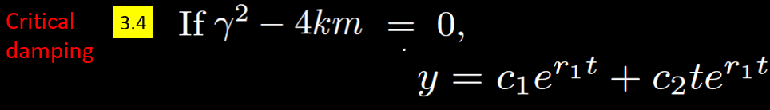
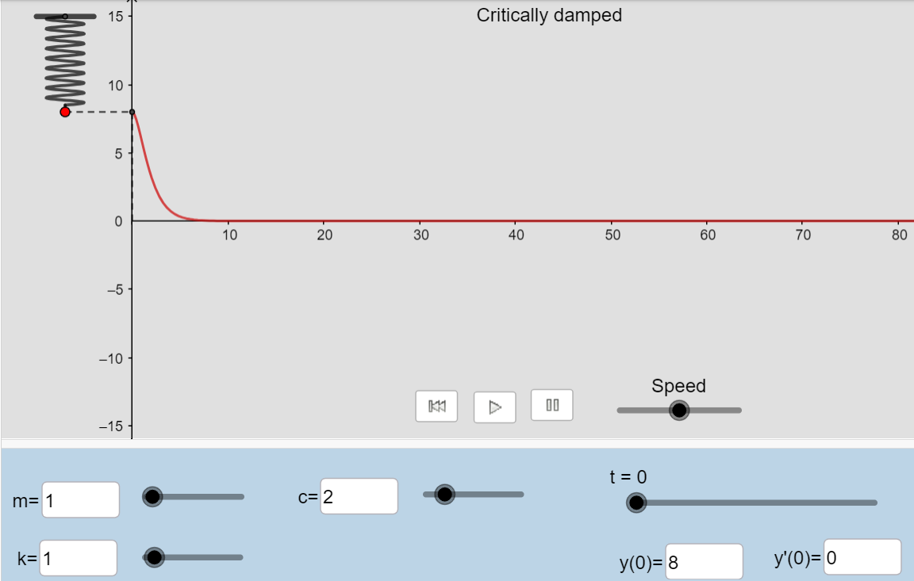
From https://www.geogebra.org/m/ZzKbkvnz
Note: Sign convention is opposite our convention
Homogeneous

Slide 13
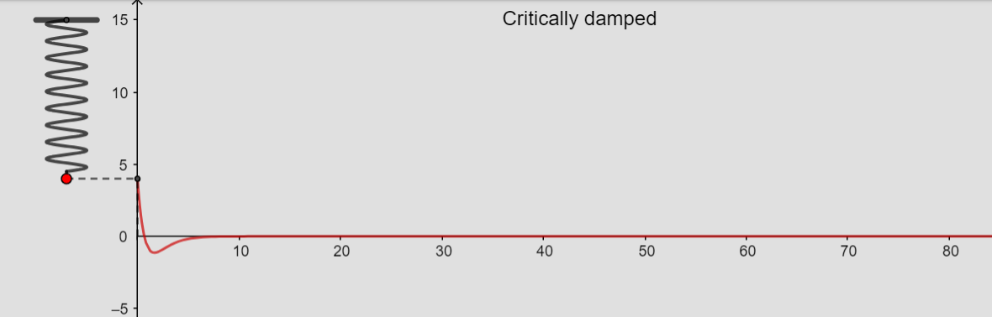
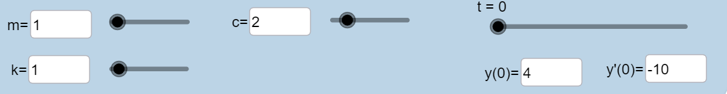

From https://www.geogebra.org/m/ZzKbkvnz
Note: Sign convention is opposite our convention
For 0 < t < 1,
$e^{r1t}$ > t $e^{r1t}$
For t > 1,
${ e}^{r1t}$ < t $e^{r1t}$
Homogeneous

Slide 14
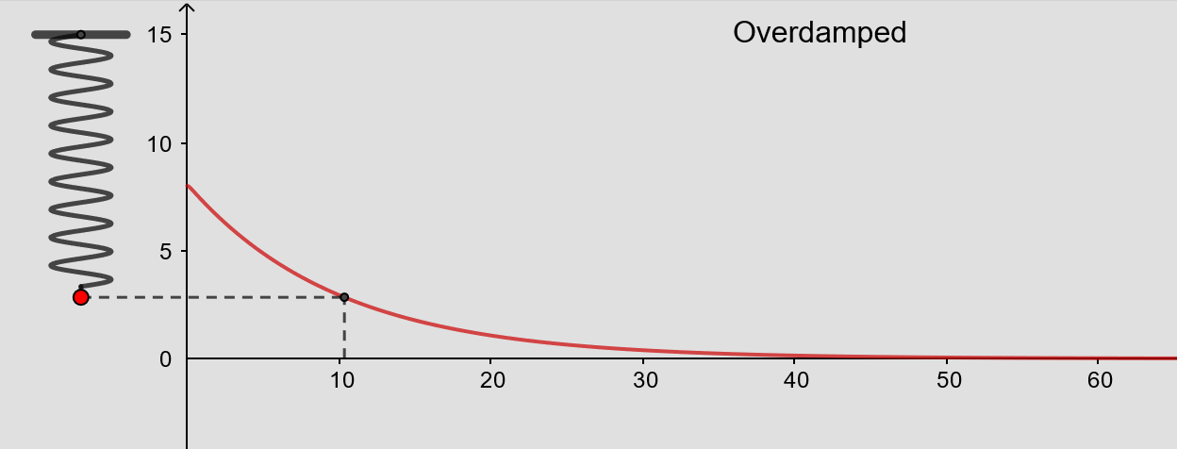
From https://www.geogebra.org/m/ZzKbkvnz
Note: Sign convention is opposite our convention
Homogeneous

Slide 15
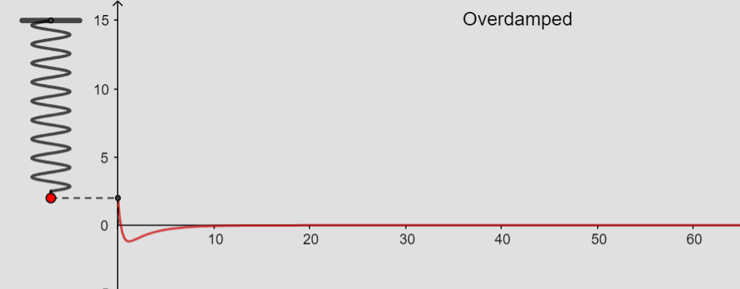
From https://www.geogebra.org/m/ZzKbkvnz
Note: Sign convention is opposite our convention
Initial behavior depends on initial conditions
Long-term behavior:
u(t) → 0
as t → ∞
Homogeneous

Slide 16
Homogeneous
No damping
oscillation
3.3
Small damping
oscillation w/decreasing amplitude
Critical damping
3.4
No oscillation
Large damping
3.1
No oscillation

Slide 17
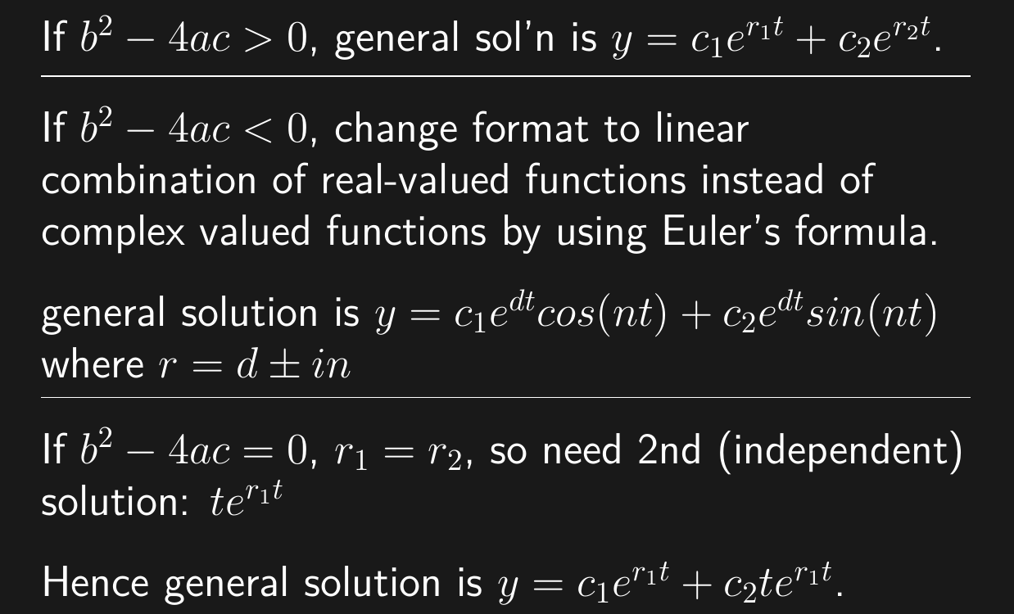
Homogeneous
Overdamped
3.1
3.3
Underdamped or no damping if d = 0
3.4
Critically damped

Slide 18
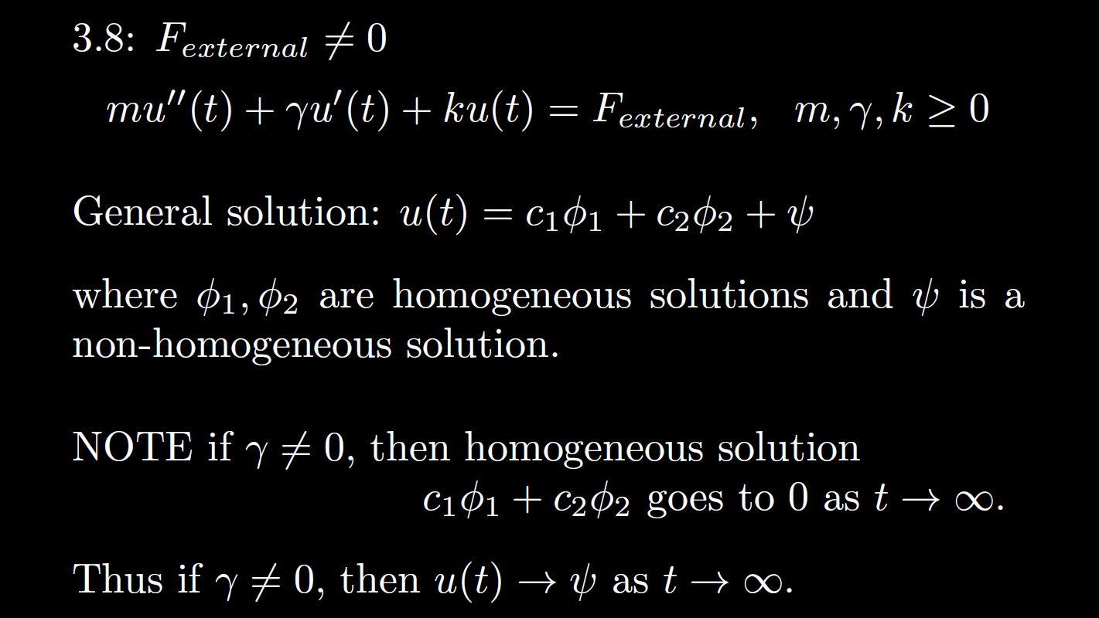


Non-Homogeneous
is the steady state response when

Slide 19


Non-Homogeneous
, then is the transient part.
is the steady state response when

Slide 20


Non-Homogeneous
Ch 3, 4: homogeneous soln Particular solution
3.7, 3.8 when transient soln Steady state soln/response
If the homogeneous solution goes to 0 as t goes to $∞$,
then the long-term behavior only depends on the steady state solution
Note in this case,
the initial values have almost no effect on the long-term behavior.
=
=

Slide 21
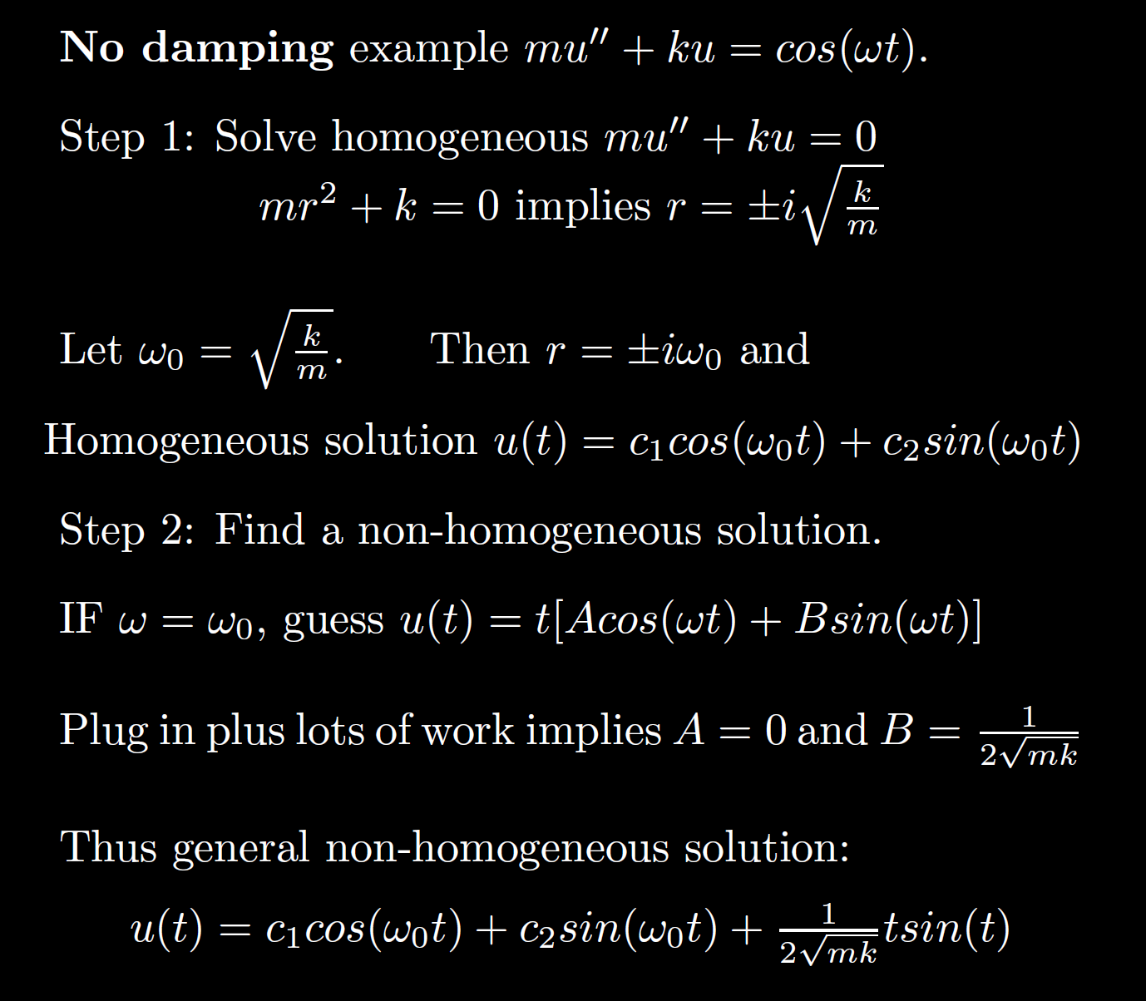
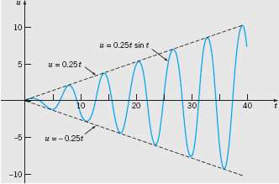
Boyce/DiPrima/Meade 11th ed, Ch 3.8: Forced Periodic Vibrations

Slide 22
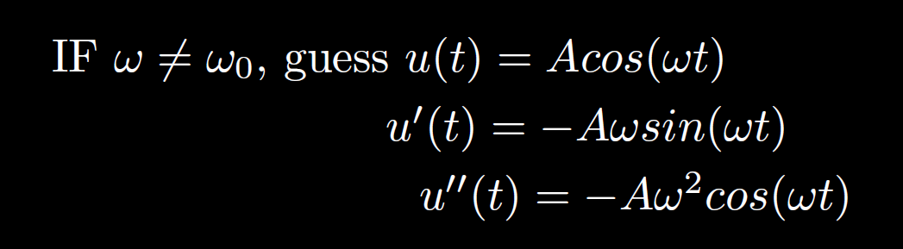

Slide 23
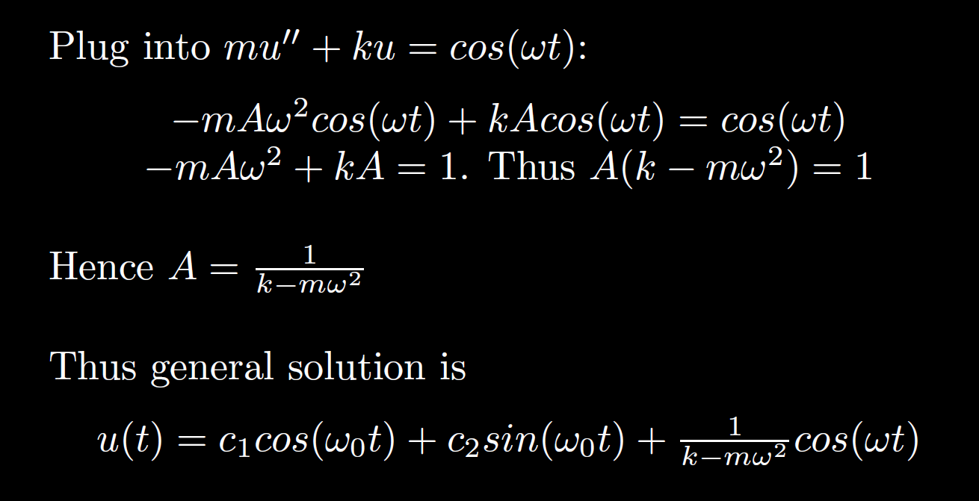

Slide 24

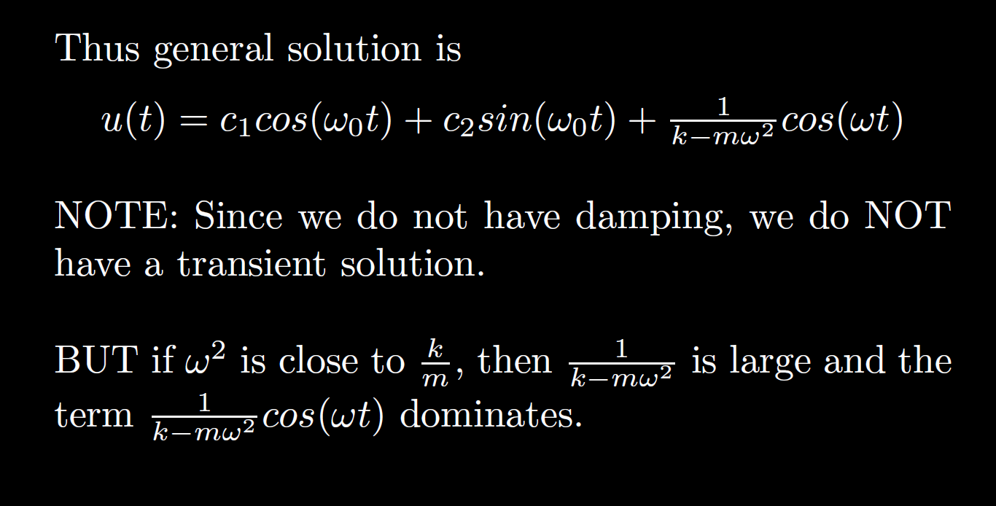

Slide 25
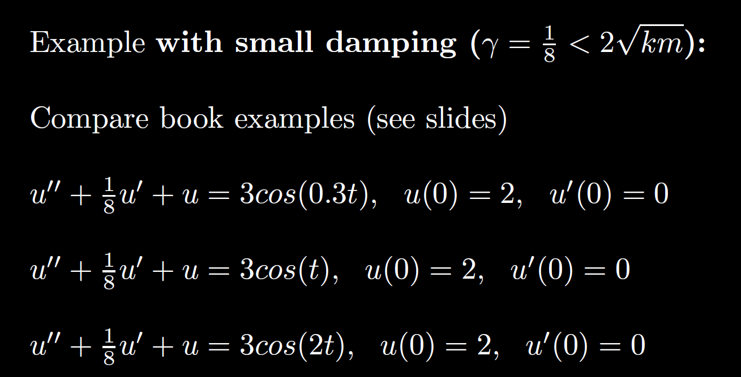

Slide 26
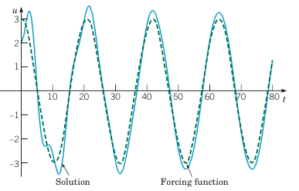
Example 2:
Forced Vibrations with Damping (2 of 4)
Graphs of the solution and external force for .
Boyce/DiPrima/Meade 11th ed, Ch 3.8: Forced Periodic Vibrations

Slide 27
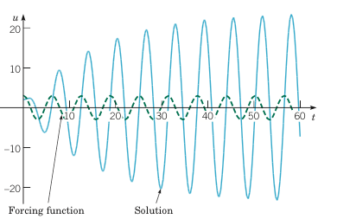
Example 2:
Forced Vibrations with Damping (3 of 4)
Graphs of the solution and external force for
Boyce/DiPrima/Meade 11th ed, Ch 3.8: Forced Periodic Vibrations

Slide 28
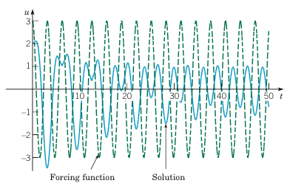
Example 2:
Forced Vibrations with Damping (4 of 4)
Graphs of the solution and external force for
Boyce/DiPrima/Meade 11th ed, Ch 3.8: Forced Periodic Vibrations

