Slide 1
Recall from matrix algebra that Ax = b is a homogeneous equation iff b = 0.
Suppose A has 2 free variables. Then the general solution to the homogenous matrix equation Ax = 0 will be of the form
x =c₁v₁ + c₂v₂.

Slide 2
Recall from matrix algebra that Ax = b is a homogeneous equation iff b = 0.
Suppose A has 2 free variables. Then the general solution to the homogenous matrix equation Ax = 0 will be of the form
x =c₁v₁ + c₂v₂.
$$a(t)$$

Slide 3
General solution of 2nd order Linear Homogenous DE is a linear combination of 2 linearly independent functions (which are solutions). If coefficients are constants:
3.1
3.3
3.4

Slide 6
Most functions are NOT linear.
For example, the square root function is NOT a linear function:
$\sqrt{8}=\sqrt{4+4}$ which does NOT equal $\sqrt{4}+\sqrt{4}$ $= 2+2$.
Similarly, the log function is NOT linear:
$ln⁡(2) = ln⁡(1+1)$which does NOT equal $ln⁡(1)+ln⁡(1) = 0 + 0$.
The function $f(x)$= $\frac{1}{x}$ is also NOT linear:
$\frac{1}{3}=\frac{1}{1+2}$ which does NOT equal $\frac{1}{1}$ + $\frac{1}{2}$ = $\frac{3}{2}$

Slide 7
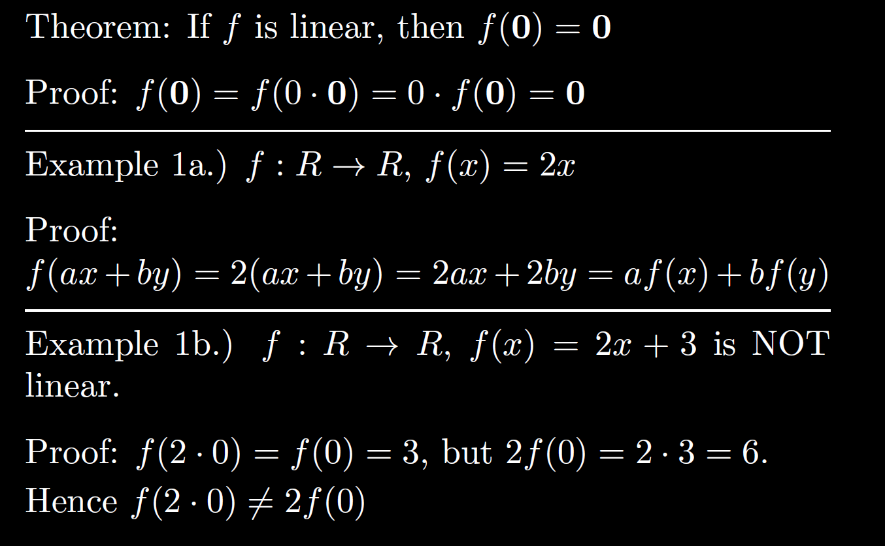

Slide 10
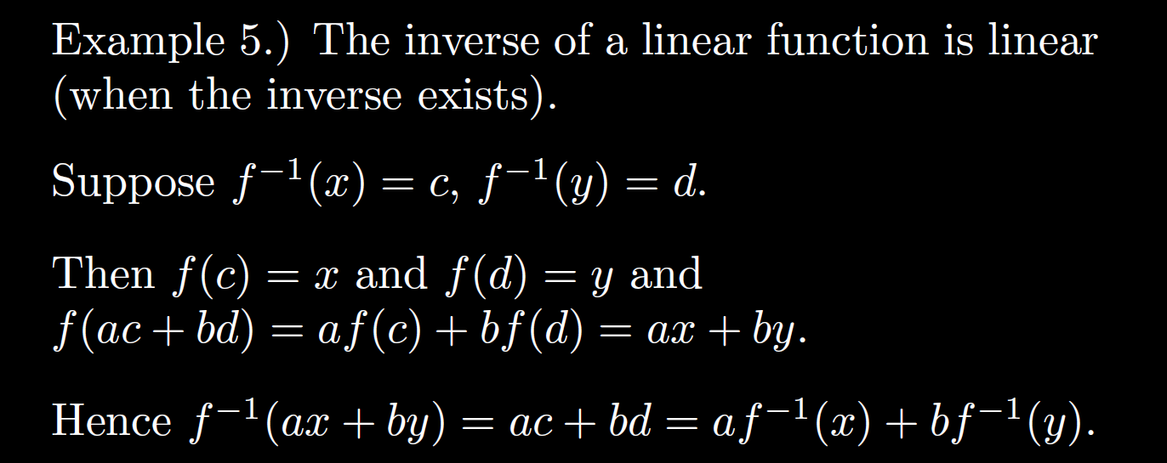

Slide 12
Ch 6: Use linearity of the LaPlace transform to turn a DE into an algebra problem

Slide 13
Note capital (not script L from previous slide stands for the left-hand side of the equation $ay’’ + by’ + cy = g(t)$

Slide 16
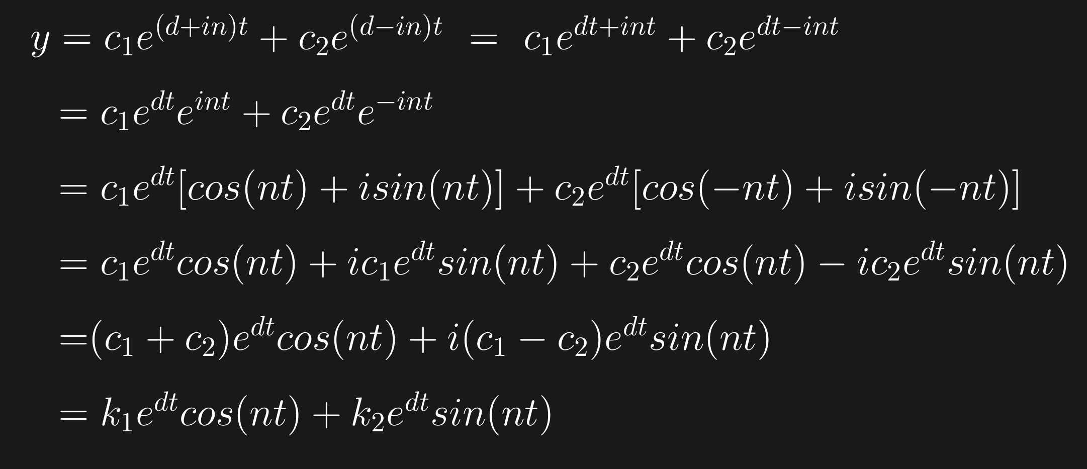

Slide 18
Multiples of these are also solutions, thus
And hence so is their linear combination:

Slide 21
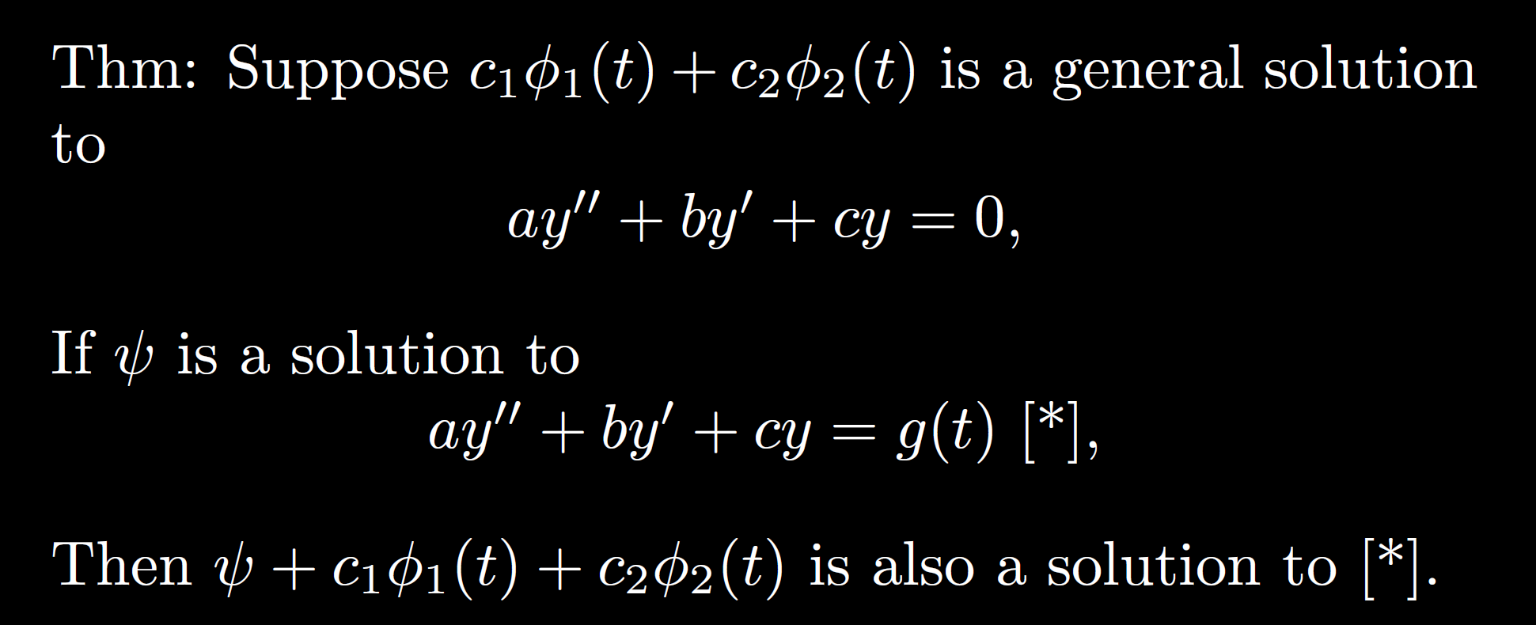

Slide 22
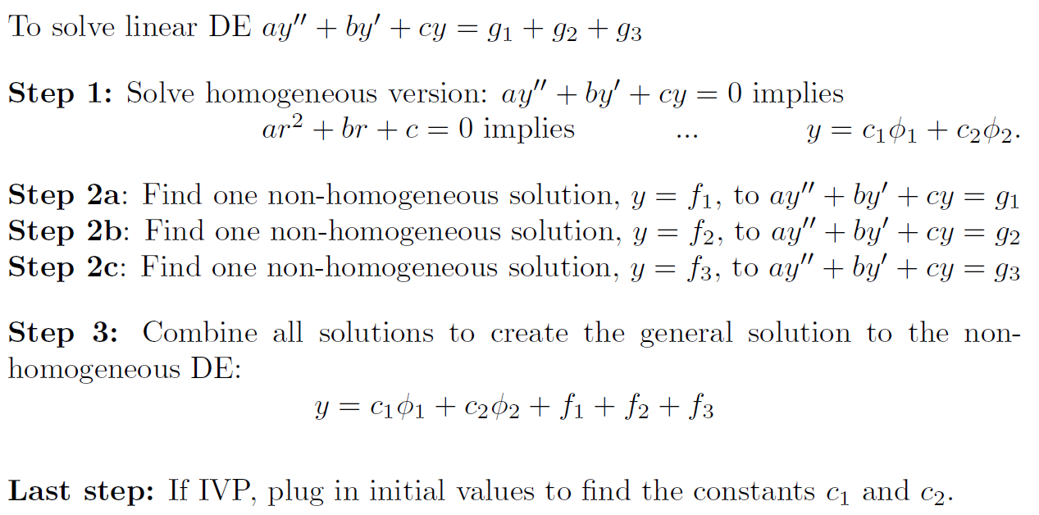
$L\left(c_{1}φ_{1}+c_{2}φ_{2}+f1+f2+f3\right)=c_{1}L\left(φ_{1}\right){+ c}_{2}L\left(φ_{2}\right)$ $+ L\left(f1\right)$ $+ L\left(f2\right)$ $+ L\left(f3\right)$
$={ c}_{1}\left(0\right){ + c}_{2}\left(0\right)$ $+ g_{1} + g_{2} + { g}_{3}$

Slide 23
Solve $y’’ + 4y’ +13y =26t$

Slide 24
Solve $y’’ + 4y’ +13y =26t$
Step 1: Solve $y’’ + 4y’ +13y =0$
for homogeneous general solution
Step 2: Find a solution to the non-homogeneous DE
$y’’ + 4y’ +13y =26t$

Slide 25
Solve $y’’ + 4y’ +13y =26t$
Step 1: Solve $y’’ + 4y’ +13y =0$
for homogeneous general solution

Slide 26
Solve $y’’ + 4y’ +13y =26t$
Step 1: Solve $y’’ + 4y’ +13y =0$
for homogeneous general solution
$$r2 + 4r + 13 = 0$$
implies $r=\frac{−4±\sqrt{4^{2}−4\left(13\right)}}{2}=\frac{−4±2\sqrt{4−13}}{2}$ = $−2±\sqrt{−9}$
Thus $r=$ $−2±3i$
Hence general homogenous solution is

Slide 27
Solve $y’’ + 4y’ +13y =26t$
Step 1: Solve $y’’ + 4y’ +13y =0$
for homogeneous general solution
$$r2 + 4r + 13 = 0$$
implies $r=\frac{−4±\sqrt{4^{2}−4\left(13\right)}}{2}=\frac{−4±2\sqrt{4−13}}{2}$ = $−2±\sqrt{−9}$
Thus $r=$ $−2±3i$
Hence general homogenous solution is
$y=c_{1}ⅇ^{−2t}\cos\left(3t\right)+c_{2}ⅇ^{−2t}\sin\left(3t\right)$

Slide 28
Solve $y’’ + 4y’ +13y =26t$
Step 2: Find a solution to the non-homogeneous DE
$y’’ + 4y’ +13y =26t$
Step 3: Combine all solutions to find general solution to nonhomogeneous differential equation
$$y=c_{1}ⅇ^{−2t}\cos\left(3t\right)+c_{2}ⅇ^{−2t}\sin\left(3t\right)+ _______________$$

Slide 29
Step 2: Find a solution to the non-homogeneous DE
$y’’ + 4y’ +13y =26t$

Slide 30
Step 2: Find a solution to the non-homogeneous DE
$y’’ + 4y’ +13y =26t$
Incorrect guess: $y = At$
Plug in: $y = At → y’ = A → y’’ = 0$
$$y’’ + 4y’ +13y =26t$$
$$0 + 4A +13At =26t$$
The constant term 4A must be zero since no constant term on RHS, but then A = 0 and
$$4\left(0\right)+13\left(0\right)t =0 ≠26t$$
Thus the above equation has no solution.
That means guess is wrong.
No solution

Slide 31
Step 2: Find a solution to the non-homogeneous DE
$y’’ + 4y’ +13y =26t$
Incorrect guess: $y = At$
Plug in: $y = At → y’ = A → y’’ = 0$
$$y’’ + 4y’ +13y =26t$$
$$4A +13At =26t$$
The constant term 4A must be zero since no constant term on RHS, but then A = 0 and
$$4\left(0\right)+13\left(0\right)t =0 ≠26t$$
Thus the above equation has no solution. That means guess is wrong.
No solution since no constant term. Thus add constant term to the guess.
No solution

Slide 32
Step 2: Find a solution to the non-homogeneous DE
$y’’ + 4y’ +13y =26t$
Correct guess: $y = At+B$

Slide 33
Step 2: Find a solution to the non-homogeneous DE
$y’’ + 4y’ +13y =26t$
Correct guess: $y = At+B$
Plug in: $y = At+B → y’ = A → y’’ = 0$
$$y’’ + 4y’ +13y =26t$$
$$0+4A +13(At+B) =26t$$
$$4A +13At+13B =26t$$
$$13At+4A+13B =26t+0$$
$$13At=26t and 4A+13B=0$$

Slide 34
Step 2: Find a solution to the non-homogeneous DE
$y’’ + 4y’ +13y =26t$
Correct guess: $y = At+B$
Plug in: $y = At+B → y’ = A → y’’ = 0$
$$y’’ + 4y’ +13y =26t$$
$$0+4A +13(At+B) =26t$$
$$4A +13At+13B =26t$$
$$13At+4A+13B =26t+0$$
$$13At=26t and 4A+13B=0$$
$13A=26$ and thus $A=2$
$4A+13B=4\left(2\right)+13B=0.$ Hence $B=\frac{−8}{13}$
Thus a nonhomogeneous solution is $y =2t−\frac{8}{13}$

Slide 35
Solve $y’’ + 4y’ +13y =26t$
Step 2: Find a solution to the non-homogeneous DE
$y’’ + 4y’ +13y =26t$
Step 3: Combine all solutions to find general solution to nonhomogeneous differential equation
$$y=c_{1}ⅇ^{−2t}\cos\left(3t\right)+c_{2}ⅇ^{−2t}\sin\left(3t\right)+ _______________$$

Slide 36
Solve $y’’ + 4y’ +13y =26t$
Step 2: Find a solution to the non-homogeneous DE
$y’’ + 4y’ +13y =26t$
Step 3: Combine all solutions to find general solution to nonhomogeneous differential equation
$$y=c_{1}ⅇ^{−2t}\cos\left(3t\right)+c_{2}ⅇ^{−2t}\sin\left(3t\right)+ 2t−\frac{8}{13}$$

Slide 37
Solve $y’’ + 4y’ +13y =26t$
Step 2: Find a solution to the non-homogeneous DE
$y’’ + 4y’ +13y =26t$
Step 3: Combine all solutions to find general solution to nonhomogeneous differential equation
If IVP: Last step, plug in initial values to general nonhomogeneous solution to find $c_{1}$and $c_{2}$
$$y=c_{1}ⅇ^{−2t}\cos\left(3t\right)+c_{2}ⅇ^{−2t}\sin\left(3t\right)+ 2t−\frac{8}{13}$$

Slide 38
Solve $4y’’ + 4y’ + y =3t2$

