Slide 1
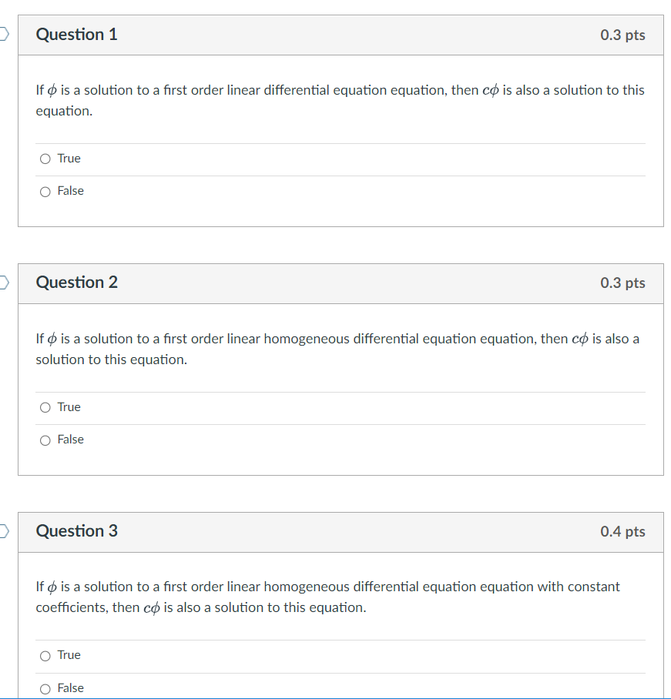

Slide 2






General solution of 2nd order Linear Homogenous DE is a linear combination of 2 linearly independent functions (which are solutions). If coefficients are constants:
3.1
3.3
3.4

Slide 3
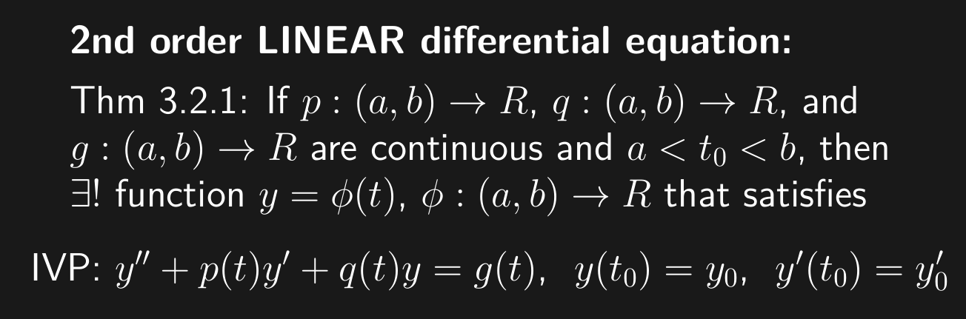
Slope at (t₀, y₀) is y₀
(t₀, y₀)
Example: y’’ – 8y’ + 15y = 0, y(0) = a, y’(0) = b

Slide 4
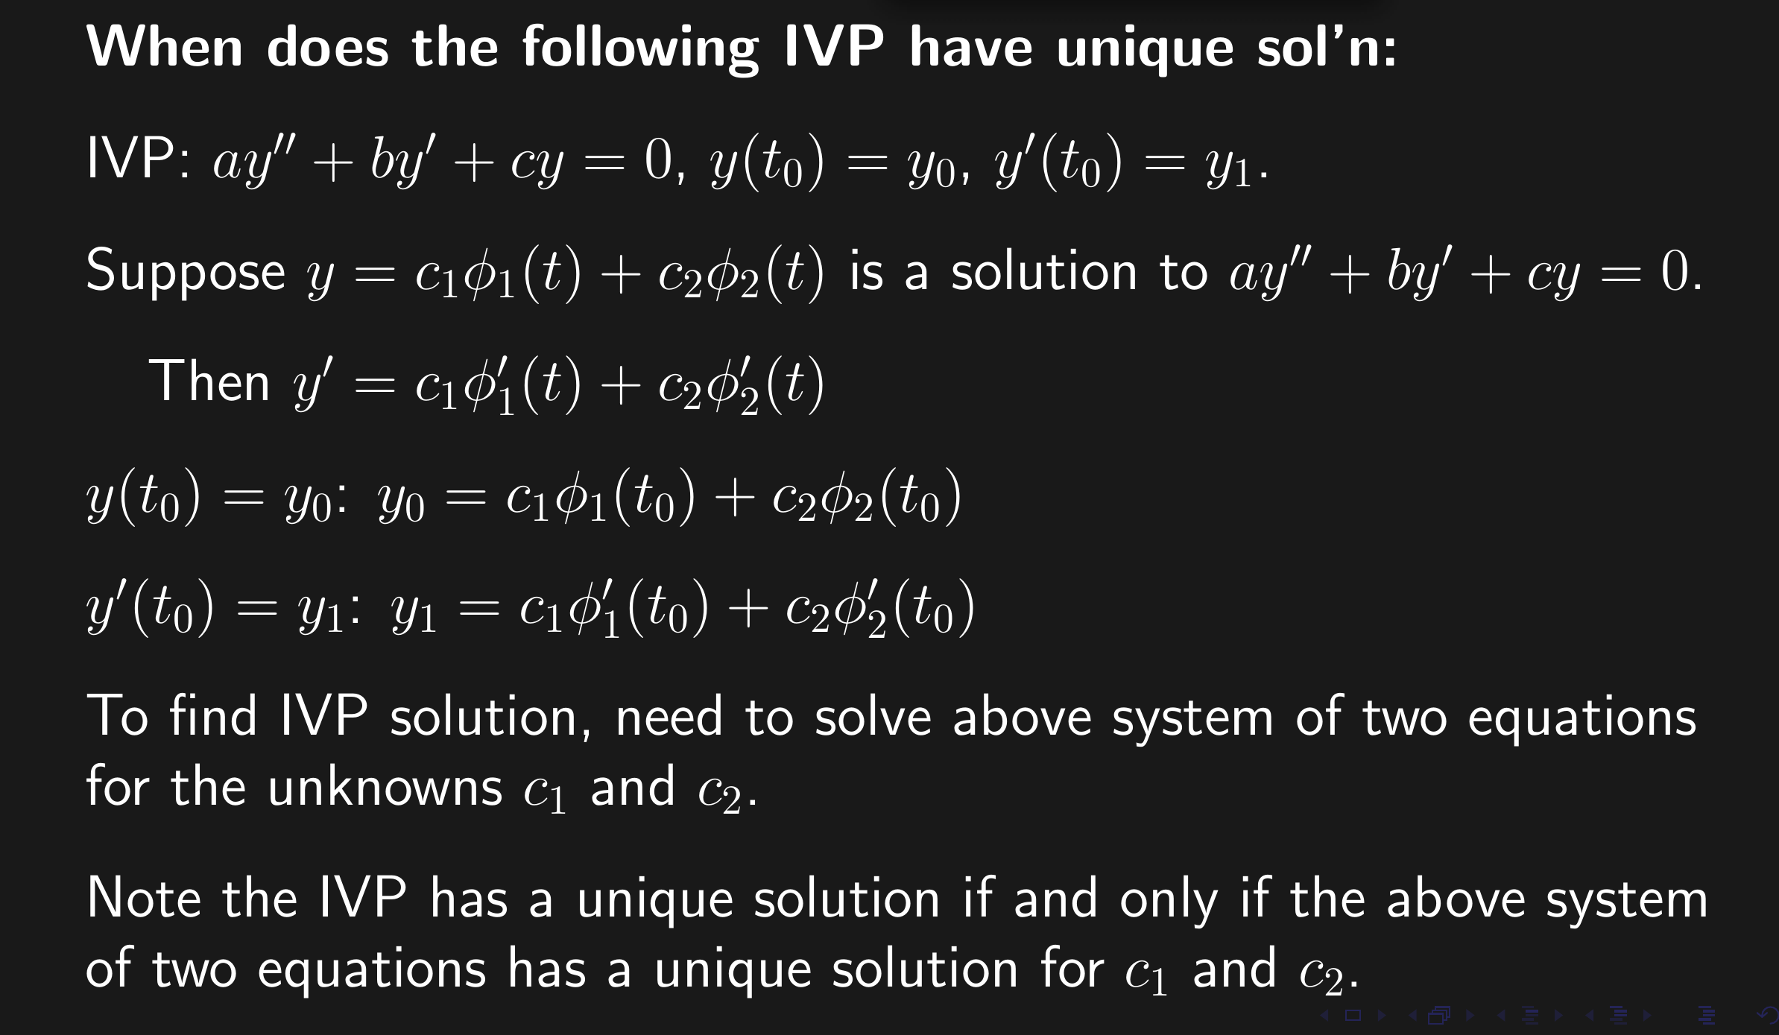

Slide 5
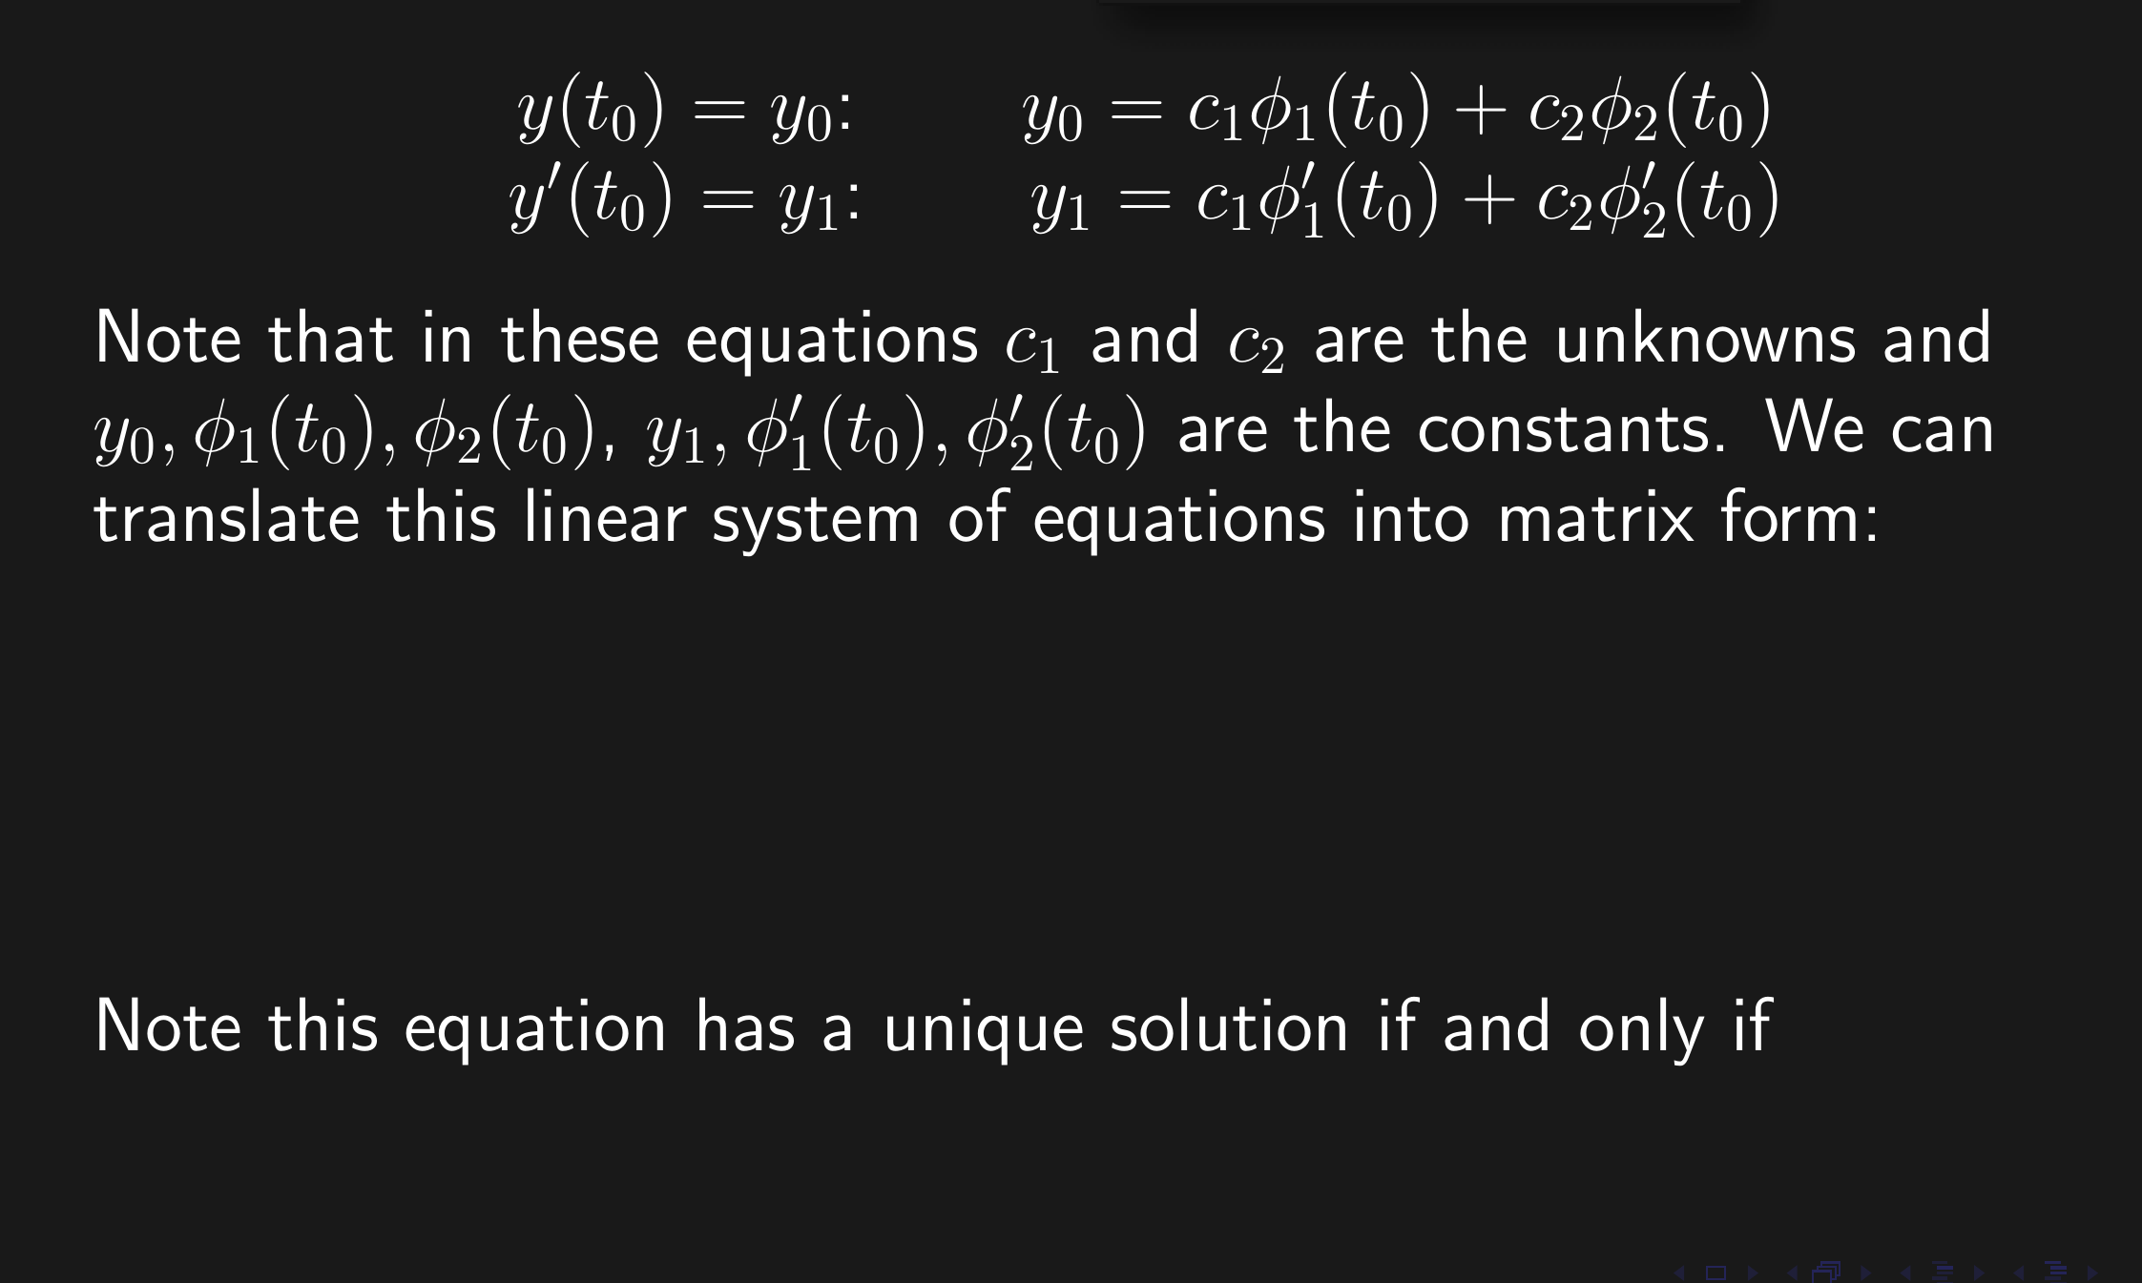

Slide 6
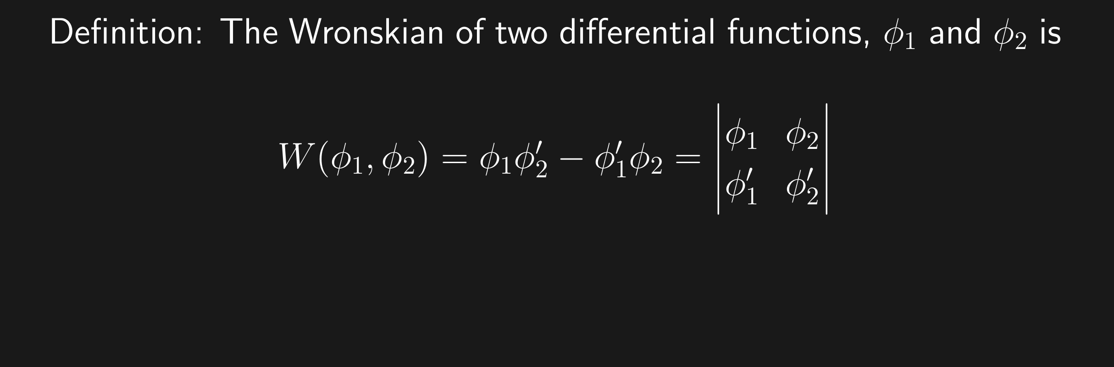
The Wronskian evaluated at t₀ is the determinant of the coefficient matrix used to solve for the constants c_{i} for the IVP y(t₀) = y₀, y'(t₀) = y_{1.}

Slide 7
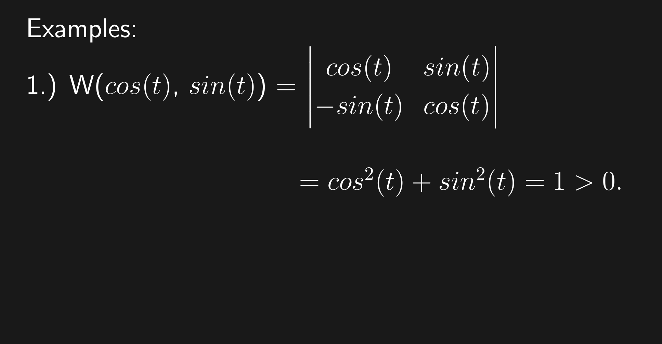

Slide 9
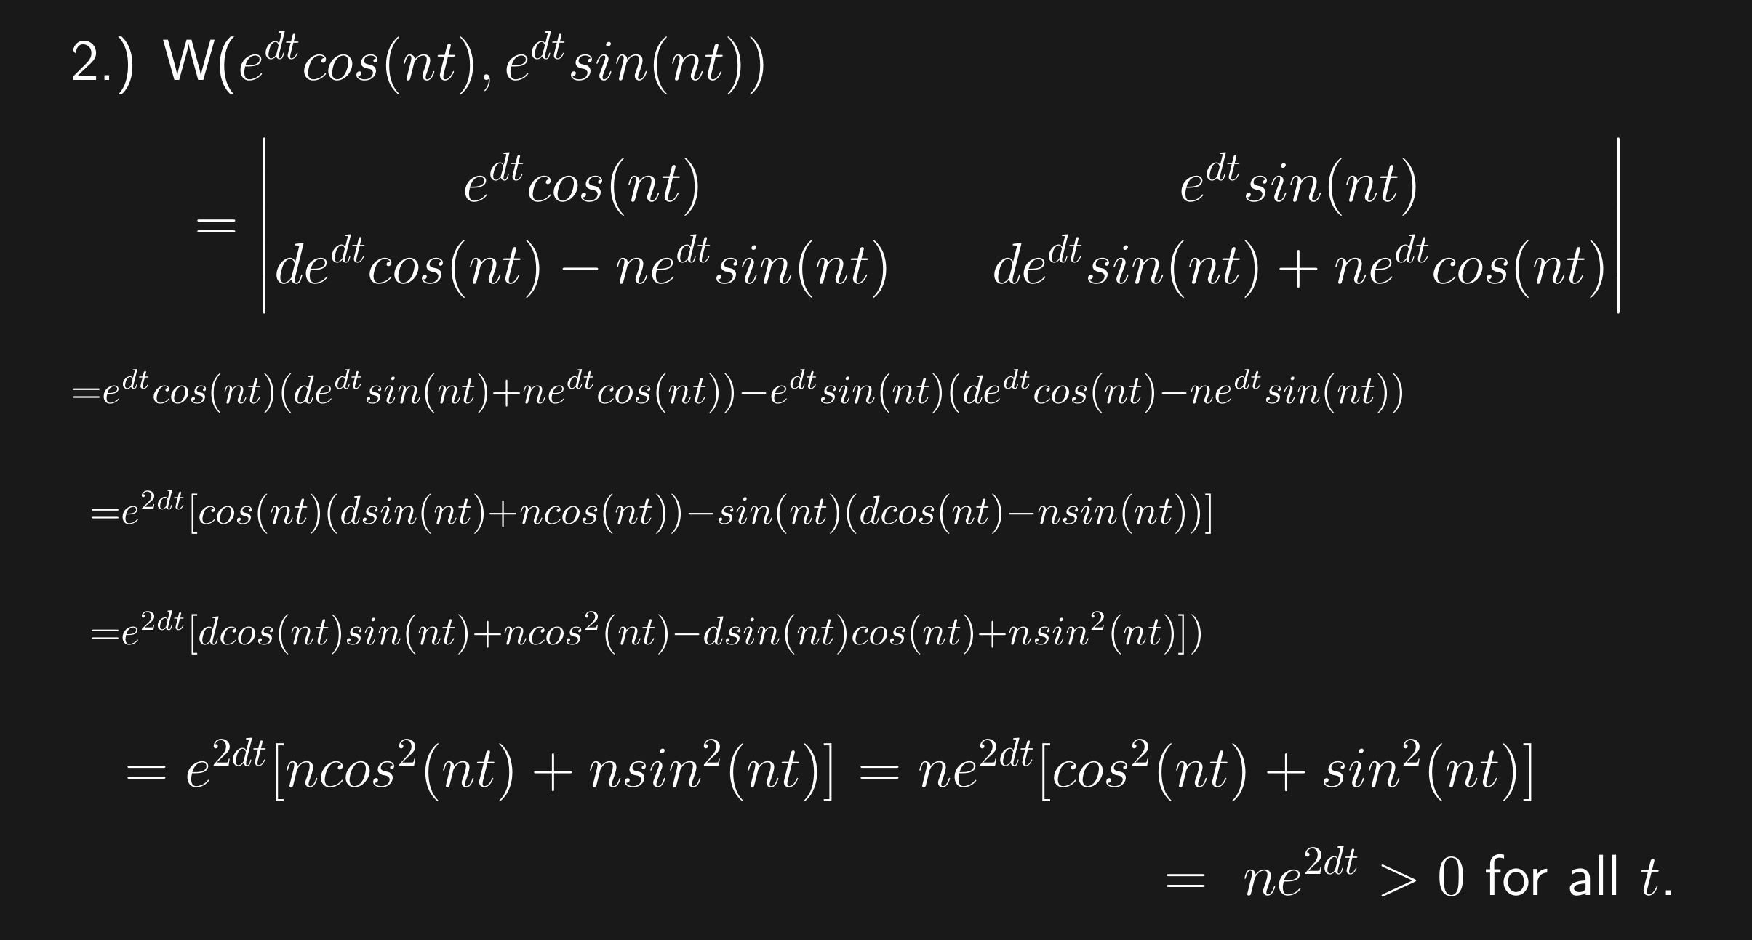

Slide 10
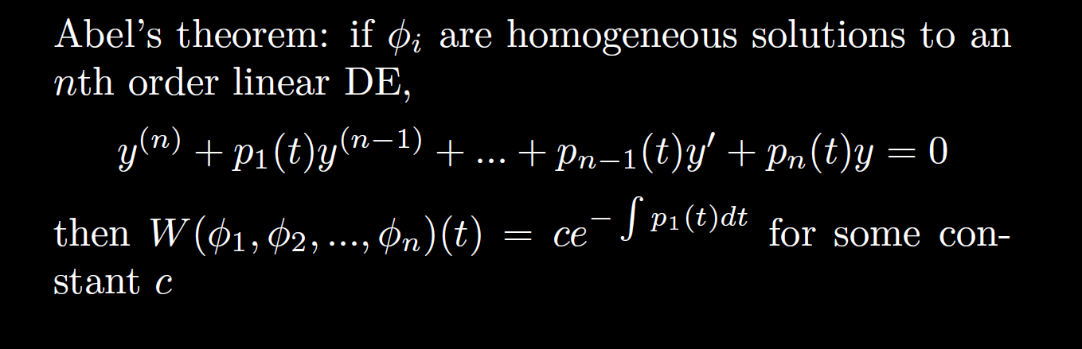

Slide 11
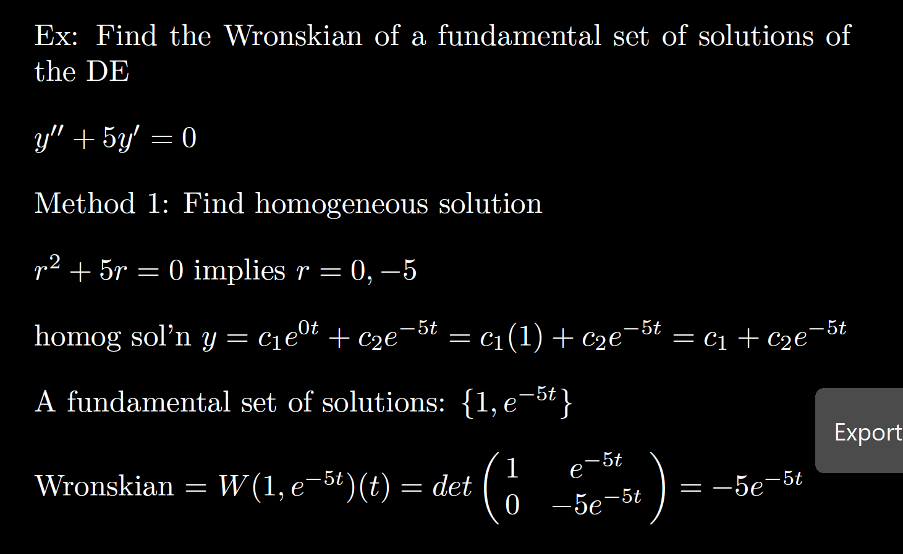

Slide 12
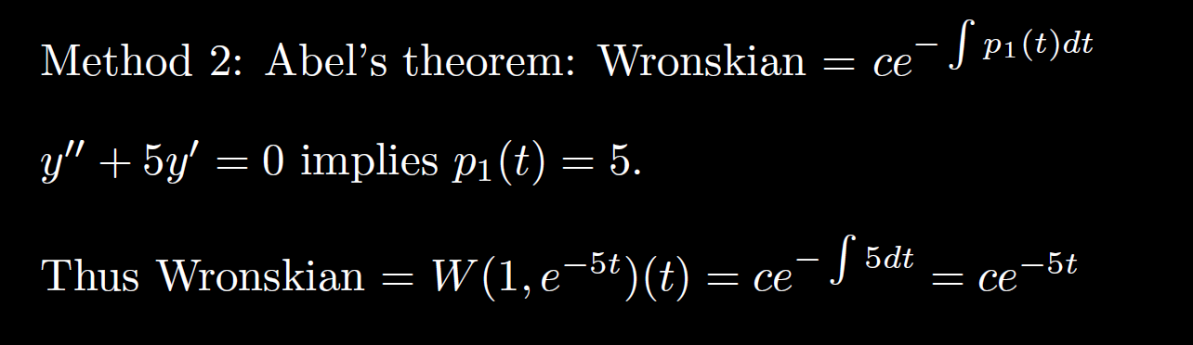

Slide 15
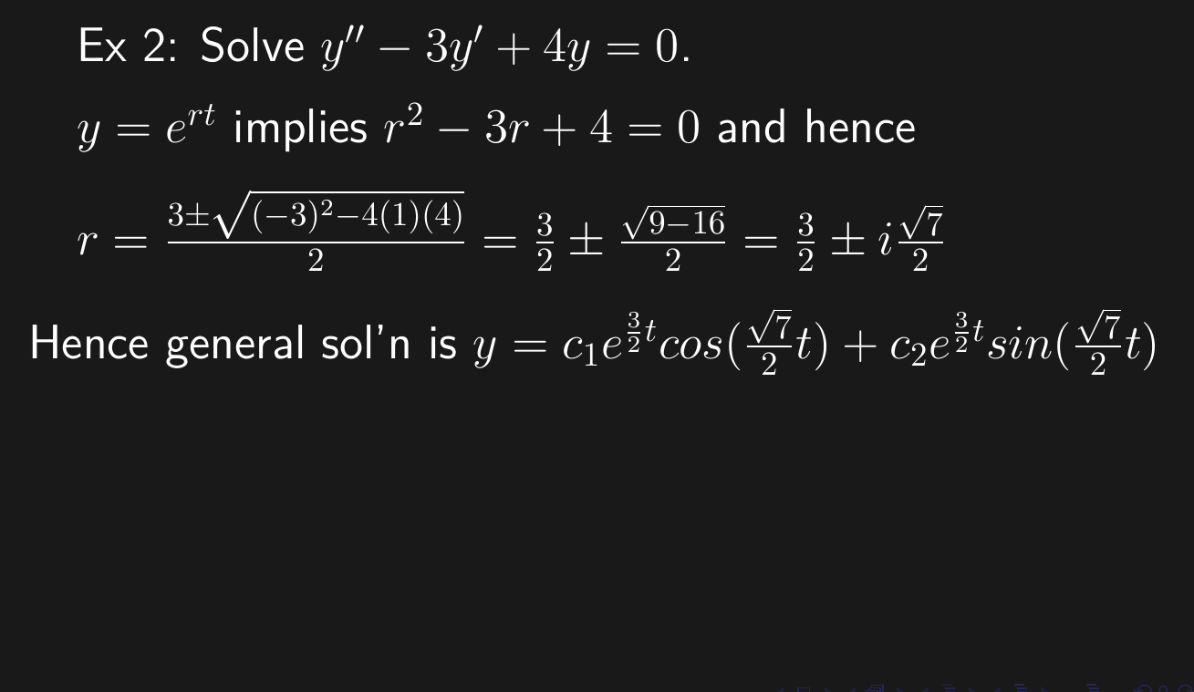

Slide 16
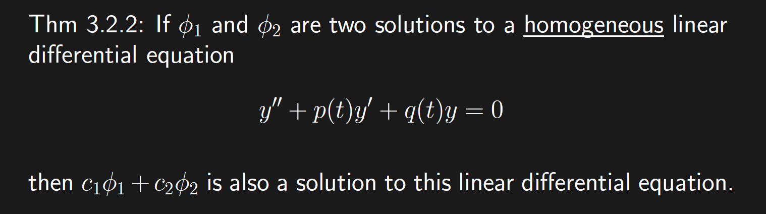
Recall from matrix algebra that Ax = b is a homogeneous equation iff b = 0.
Suppose A has 2 free variables. Then the general solution to the homogenous matrix equation Ax = 0 will be of the form
x =c₁v₁ + c₂v₂.

Slide 17
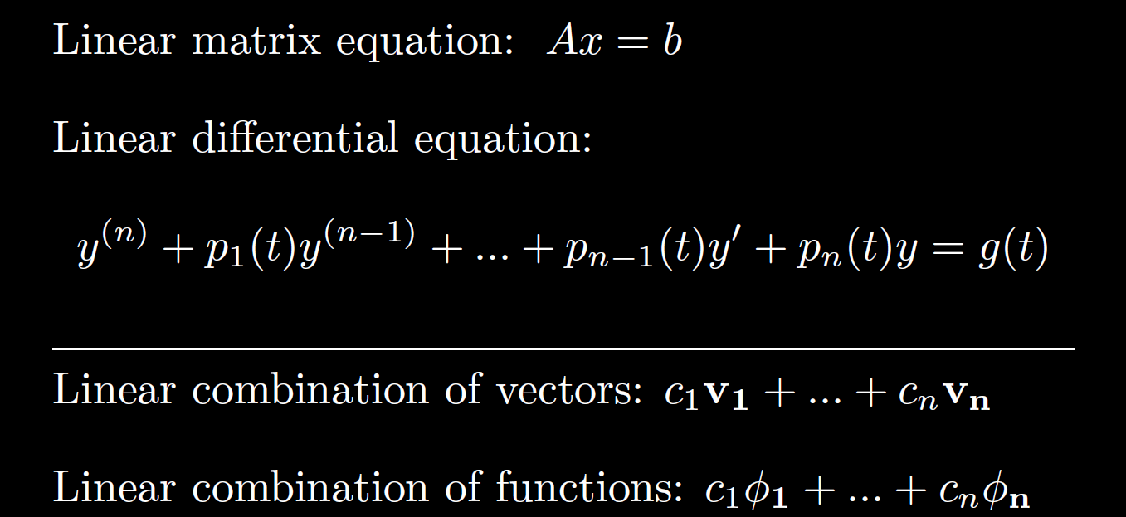

Slide 18
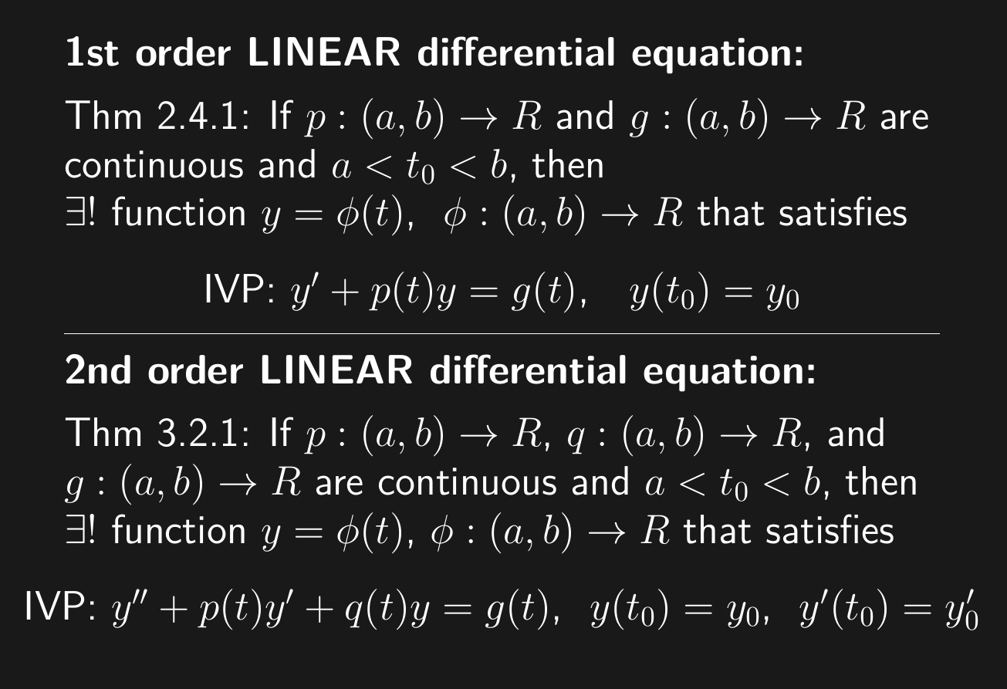

Slide 19
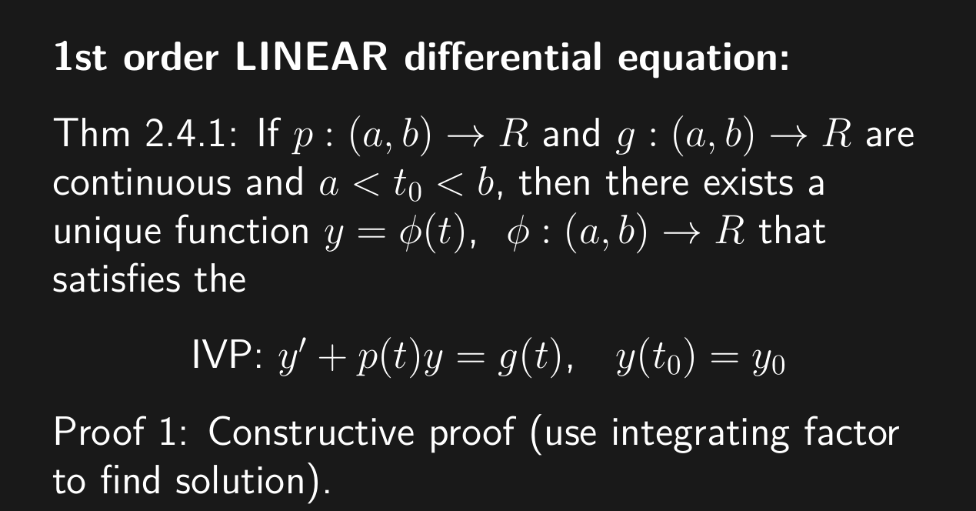

Slide 20
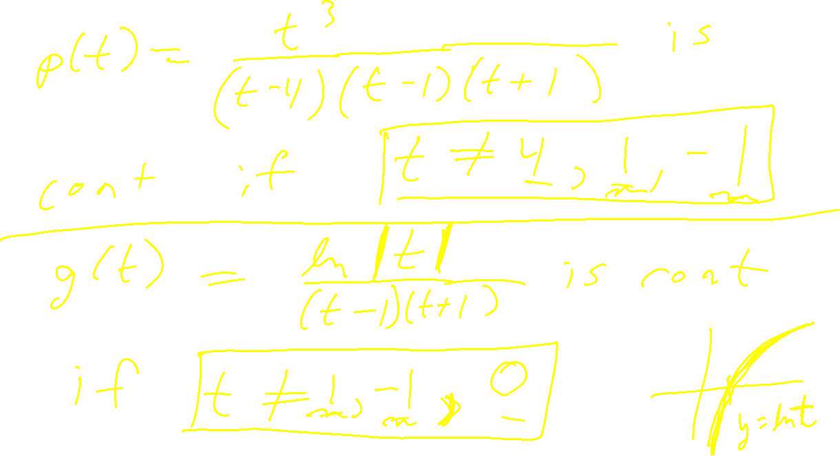

Slide 21
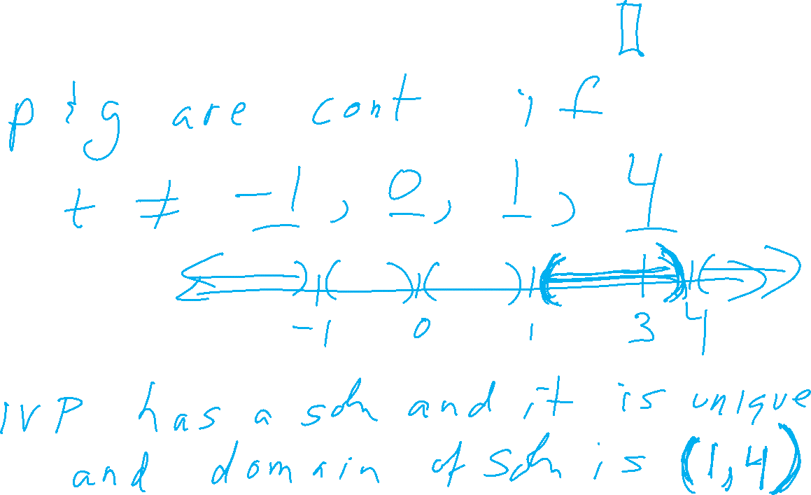

Slide 24
