Slide 1
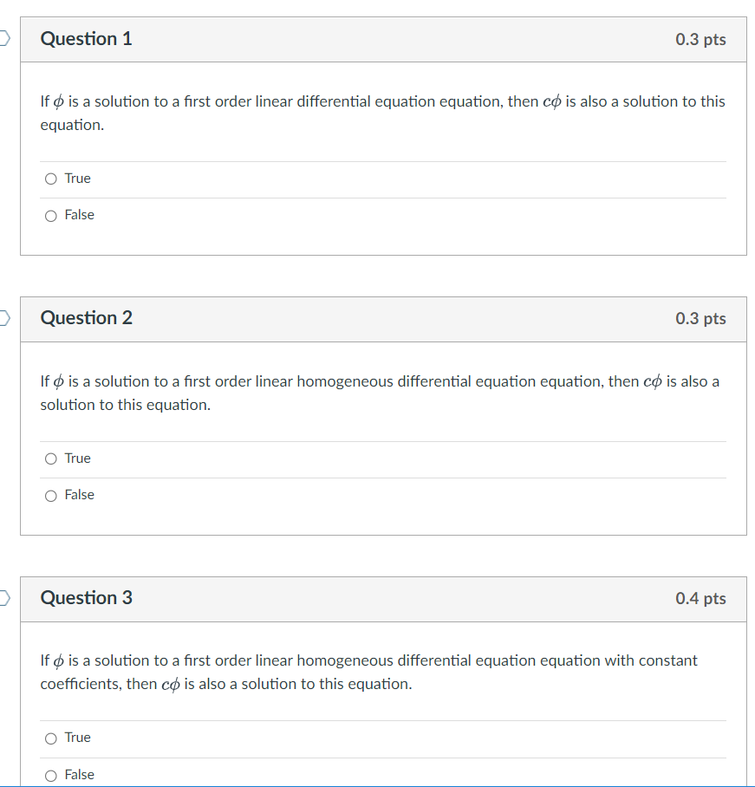

Slide 2
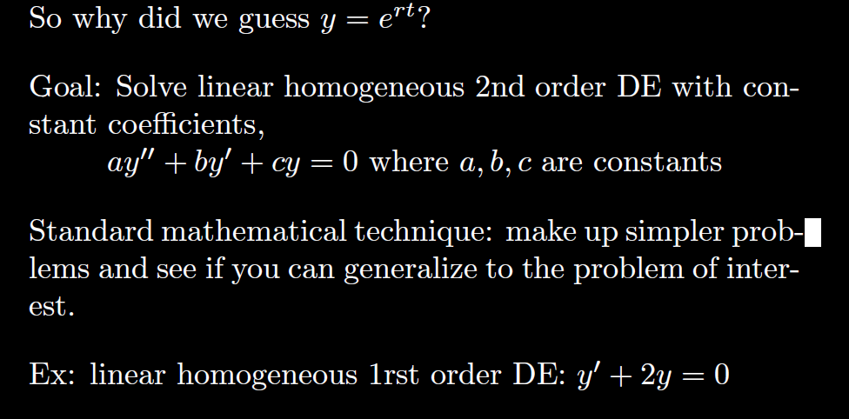

Slide 3
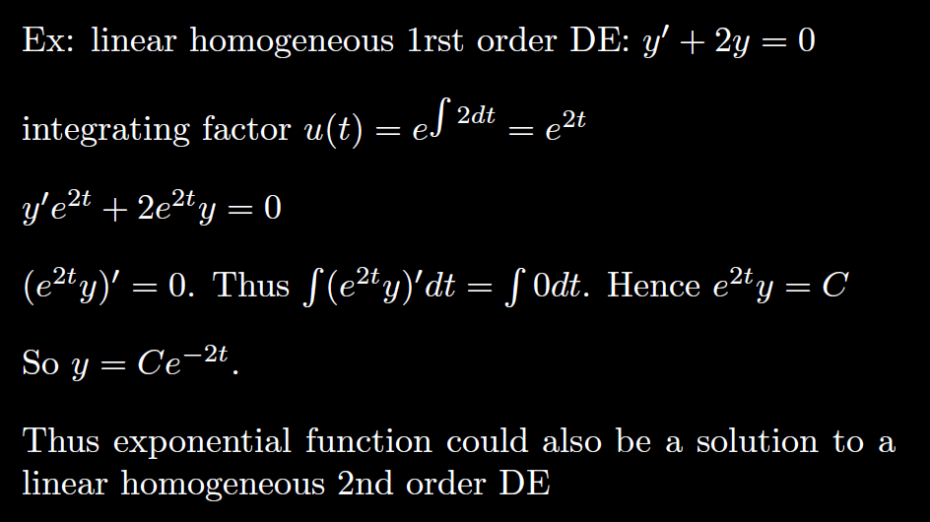

Slide 4
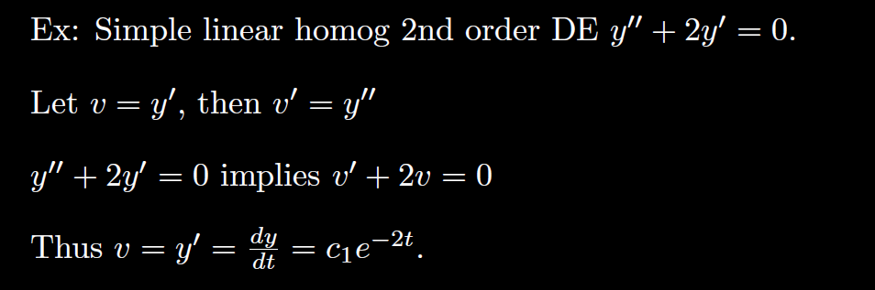
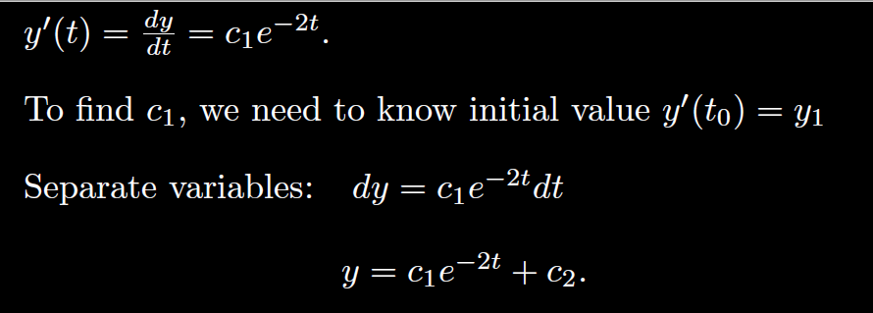

Slide 5
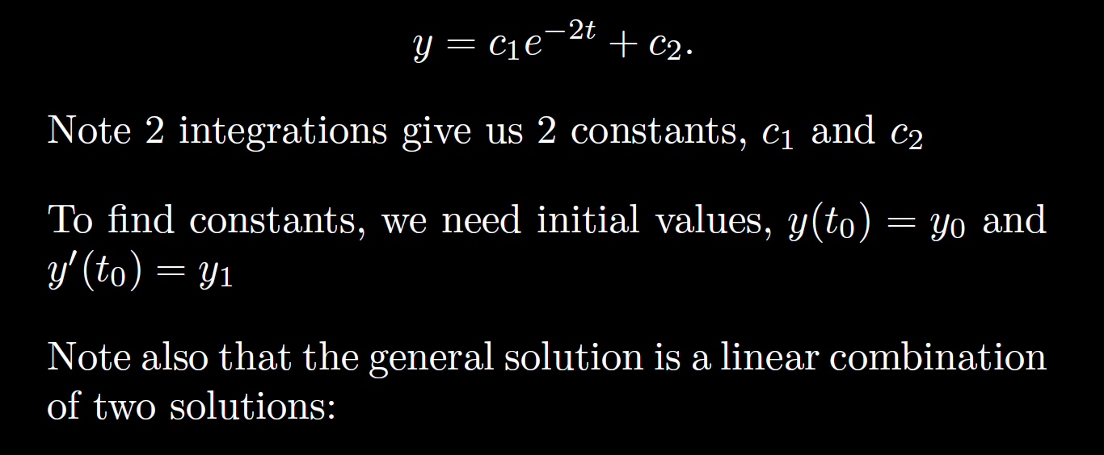
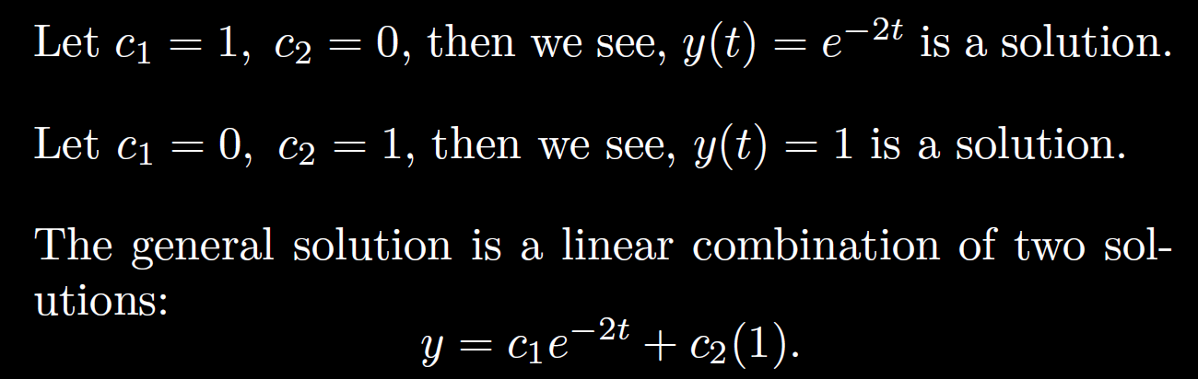

Slide 6






General solution of 2nd order Linear Homogenous DE is a linear combination of 2 linearly independent functions (which are solutions).
3.1
3.3
3.4

Slide 7
Recall from matrix algebra that Ax = b is a homogeneous equation iff b = 0.
Suppose A has 2 free variables. Then the general solution to the homogenous matrix equation Ax = 0 will be of the form
x =c₁v₁ + c₂v₂.

Slide 8
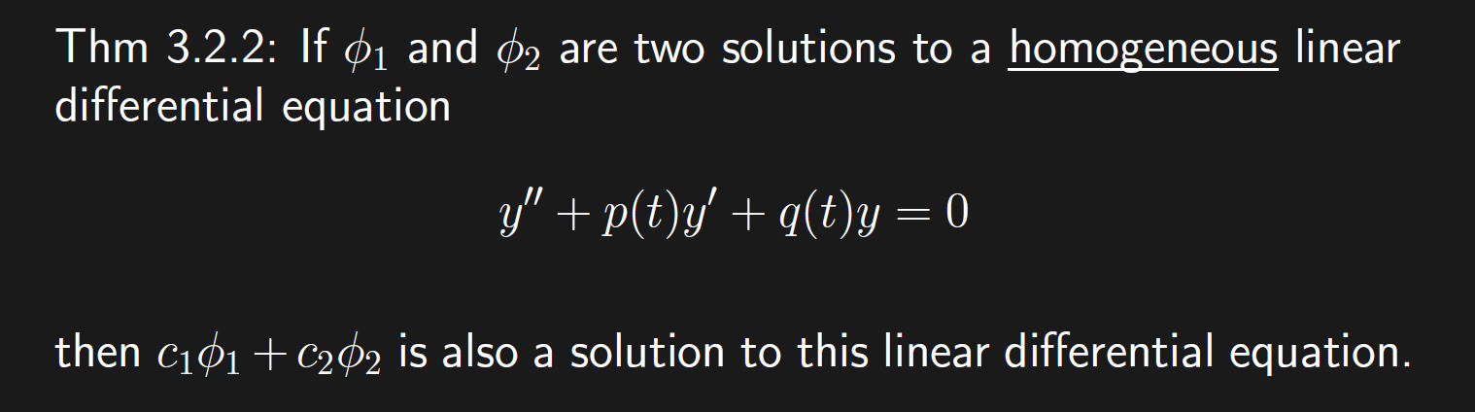
Recall from matrix algebra that Ax = b is a homogeneous equation iff b = 0.
Suppose A has 2 free variables. Then the general solution to the homogenous matrix equation Ax = 0 will be of the form
x =c₁v₁ + c₂v₂.

Slide 9
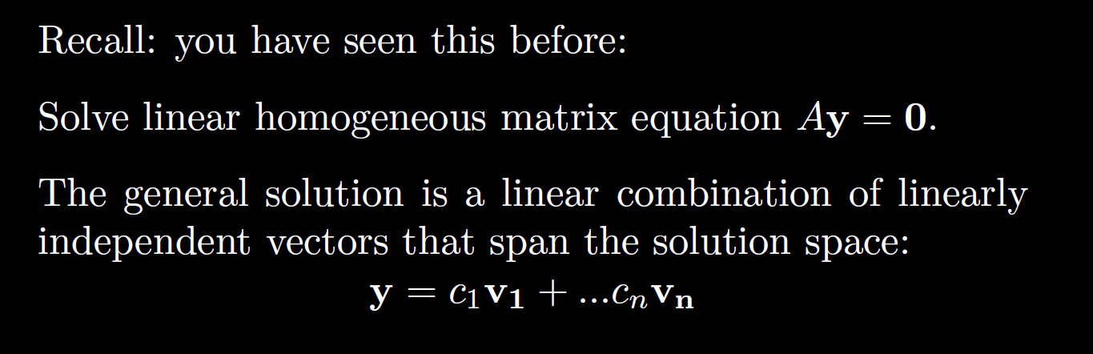

Slide 10
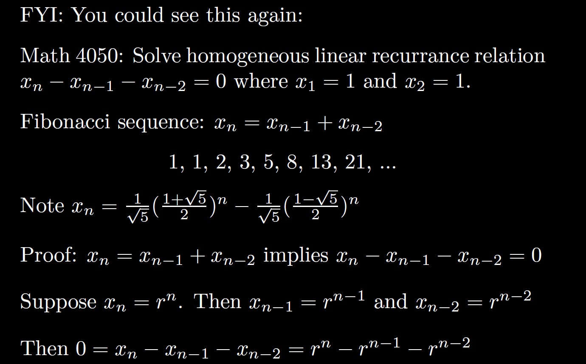

Slide 11
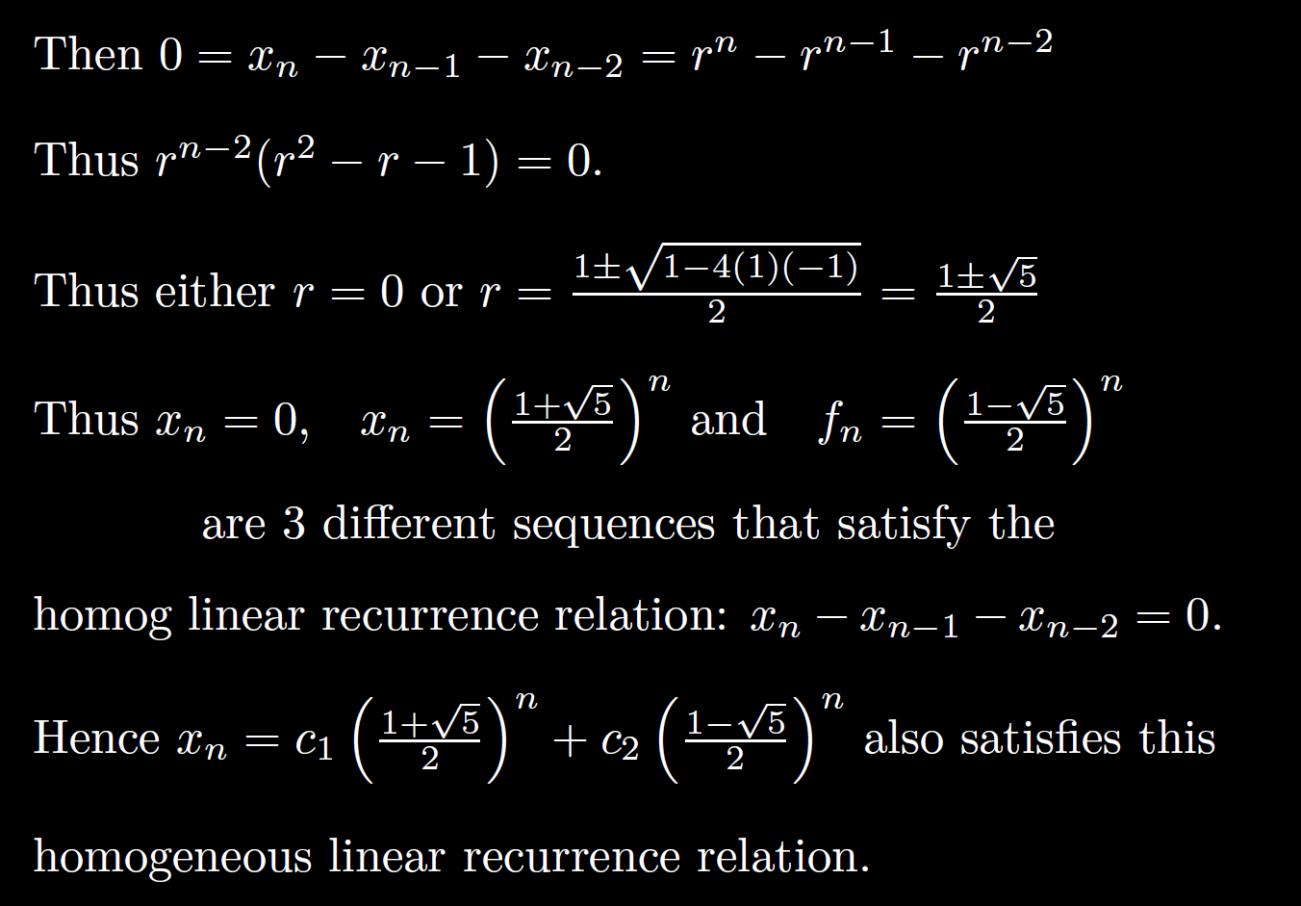

Slide 12
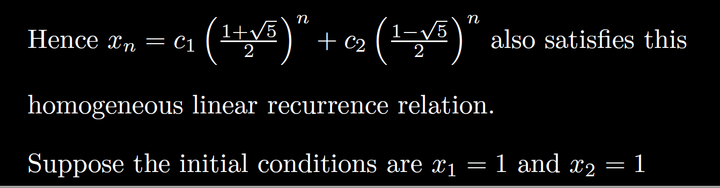
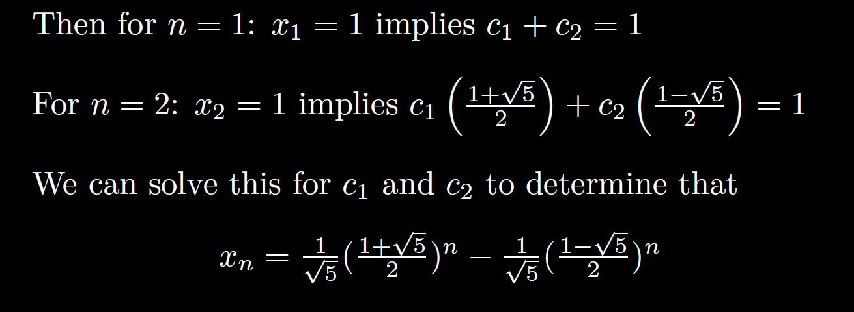

Slide 13
The previous slides were motivational.
The following slides contain material that can appear on exams

Slide 14
General solution of 2nd order Linear Homogenous DE is a linear combination of 2 linearly independent functions (which are solutions).
3.1
3.3
3.4

Slide 15
Recall from matrix algebra that Ax = b is a homogeneous equation iff b = 0.
Suppose A has 2 free variables. Then the general solution to the homogenous matrix equation Ax = 0 will be of the form
x =c₁v₁ + c₂v₂.

Slide 16
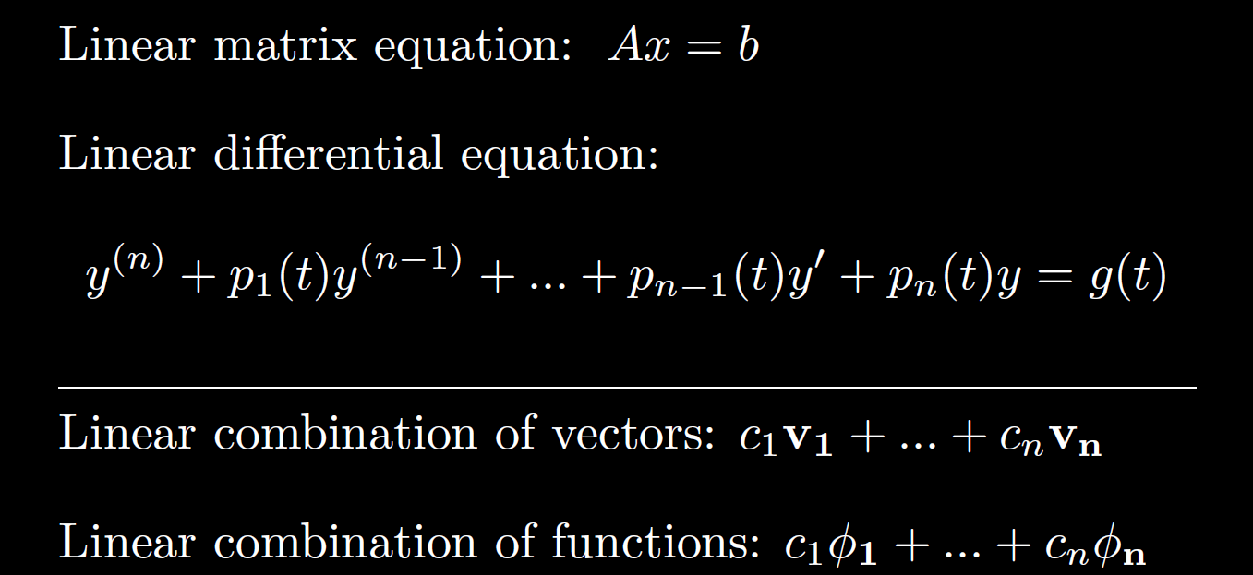

Slide 17
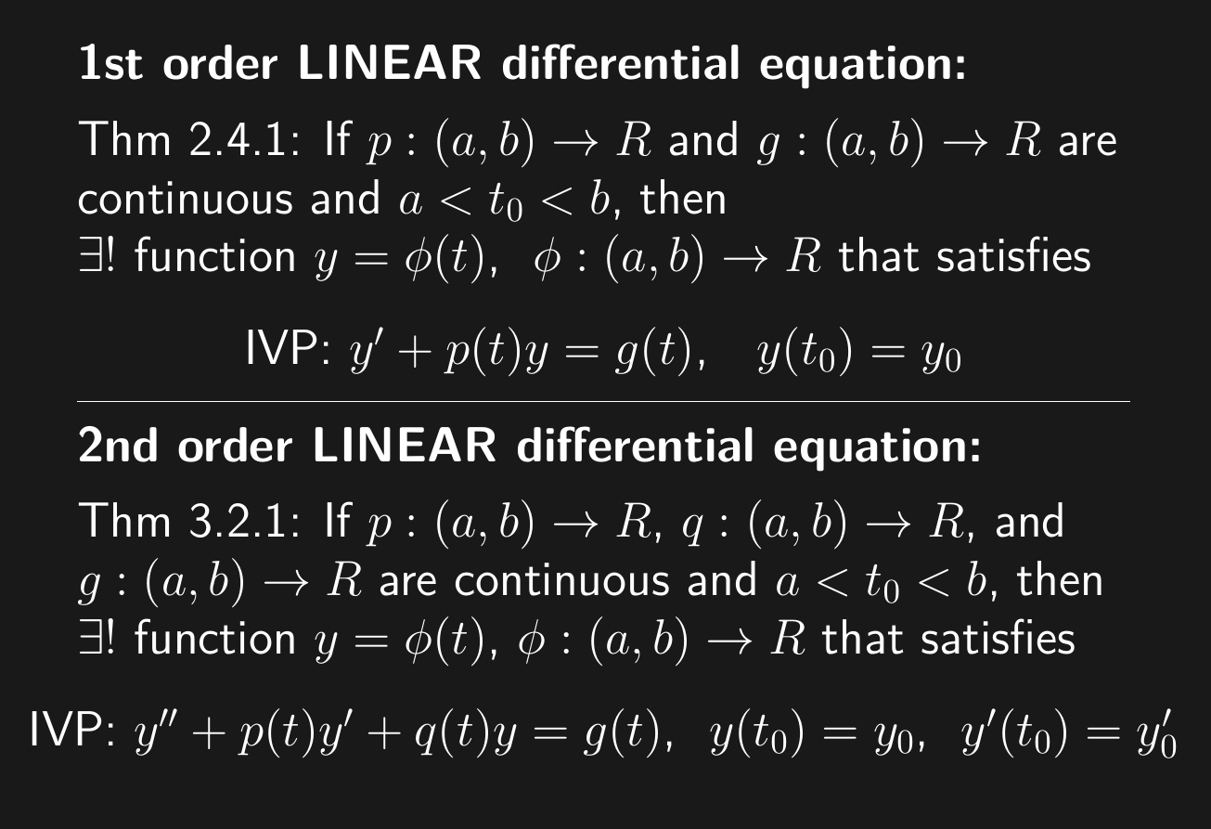

Slide 18
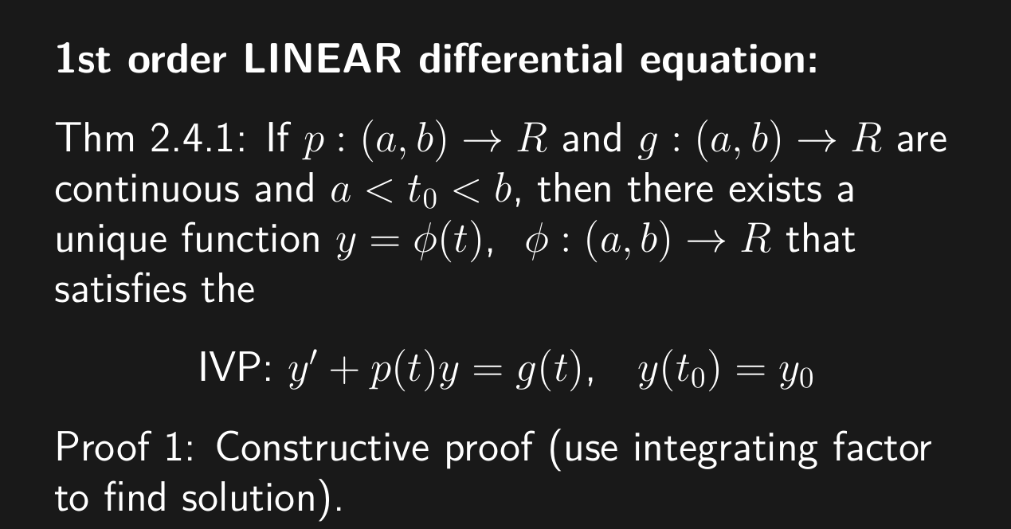

Slide 19
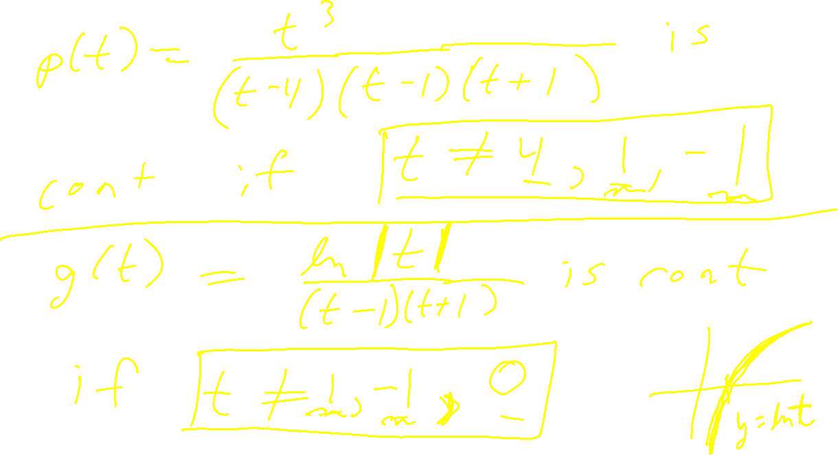

Slide 20
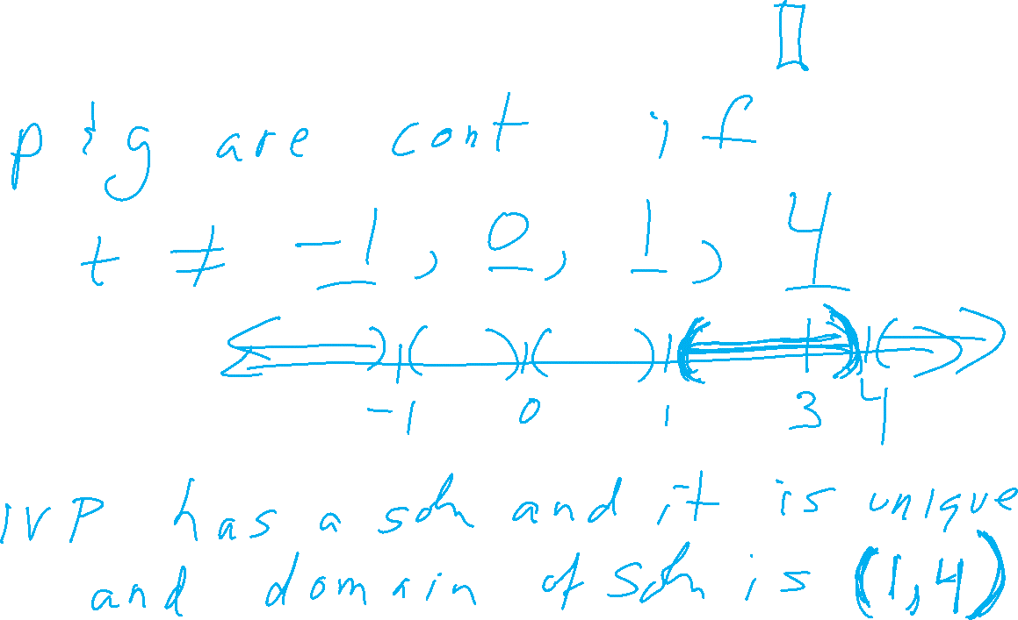

Slide 23
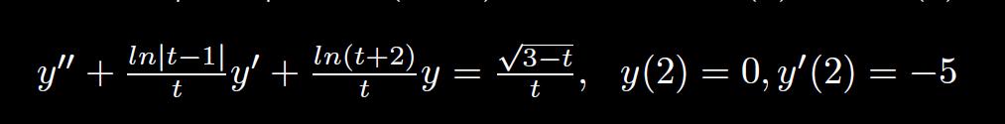

Slide 24
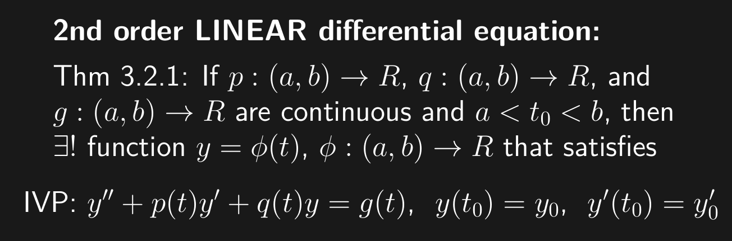
Slope at (t₀, y₀) is y₀
(t₀, y₀)

Slide 25
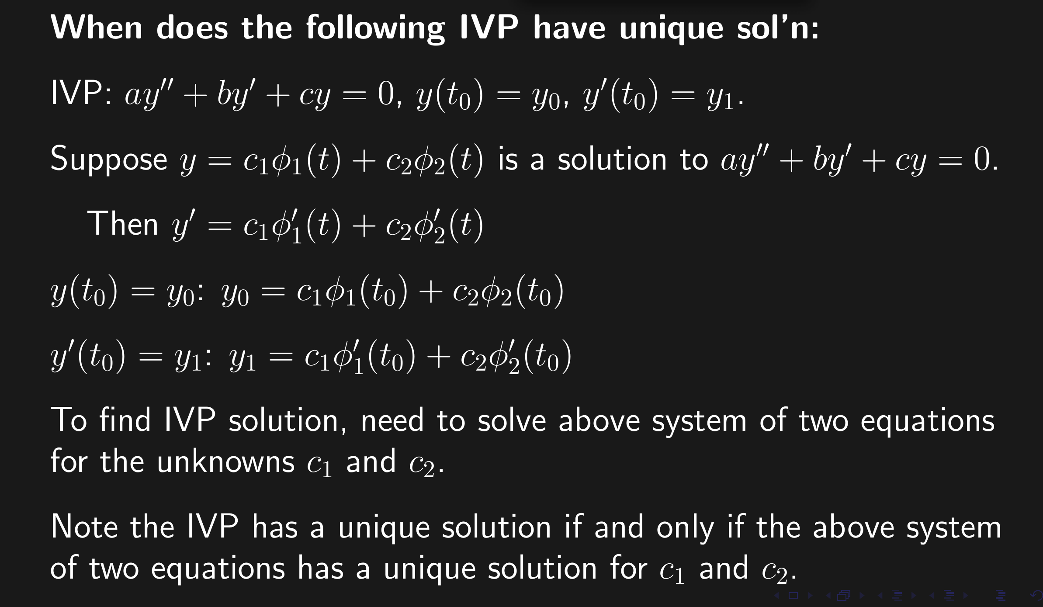

Slide 26
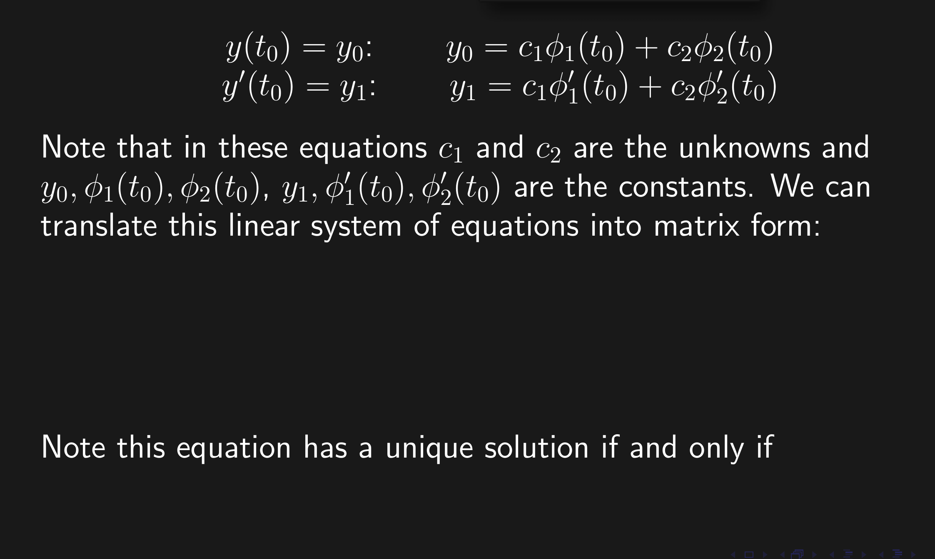

Slide 27
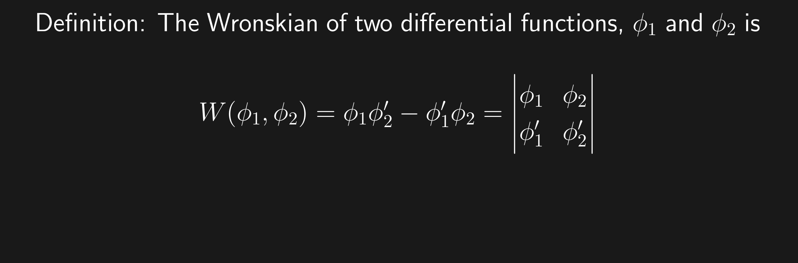
The Wronskian evaluated at t₀ is the coefficient matrix used to solve for the constants c_{i} for the IVP y(t₀) = y₀.

Slide 28
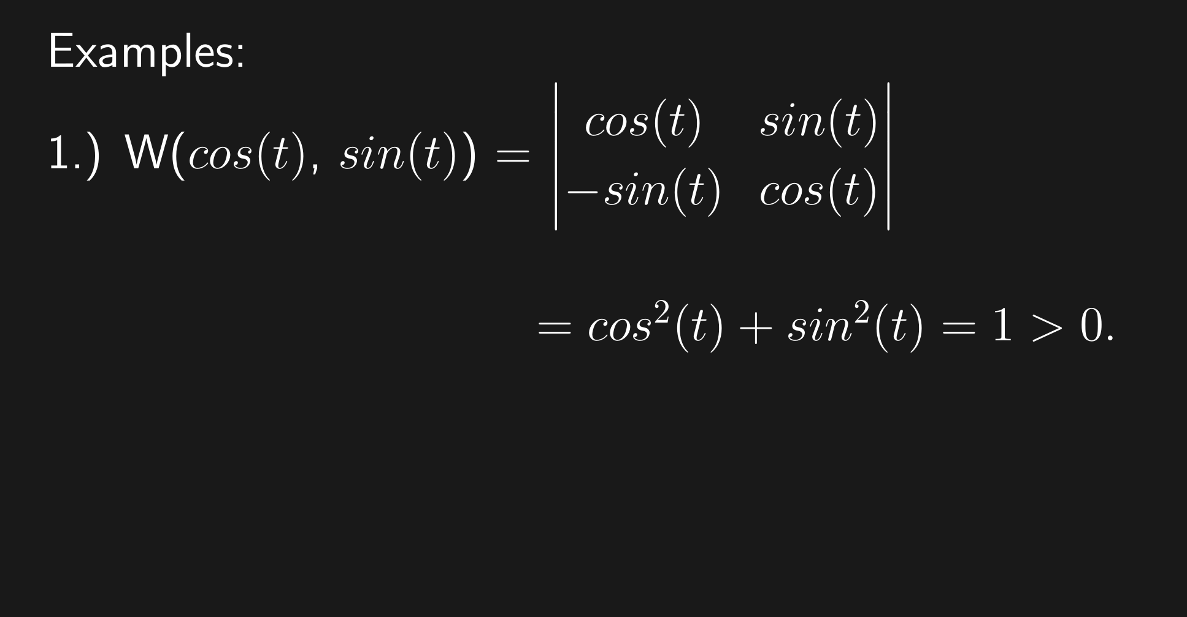

Slide 30
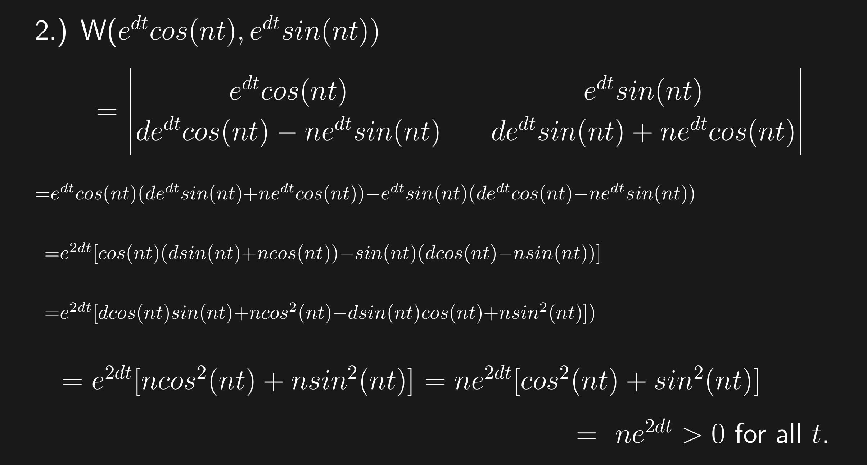

Slide 31
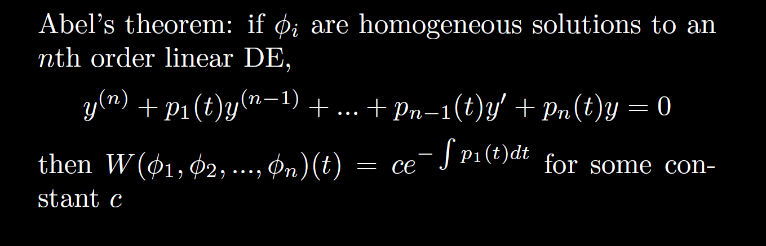

Slide 32
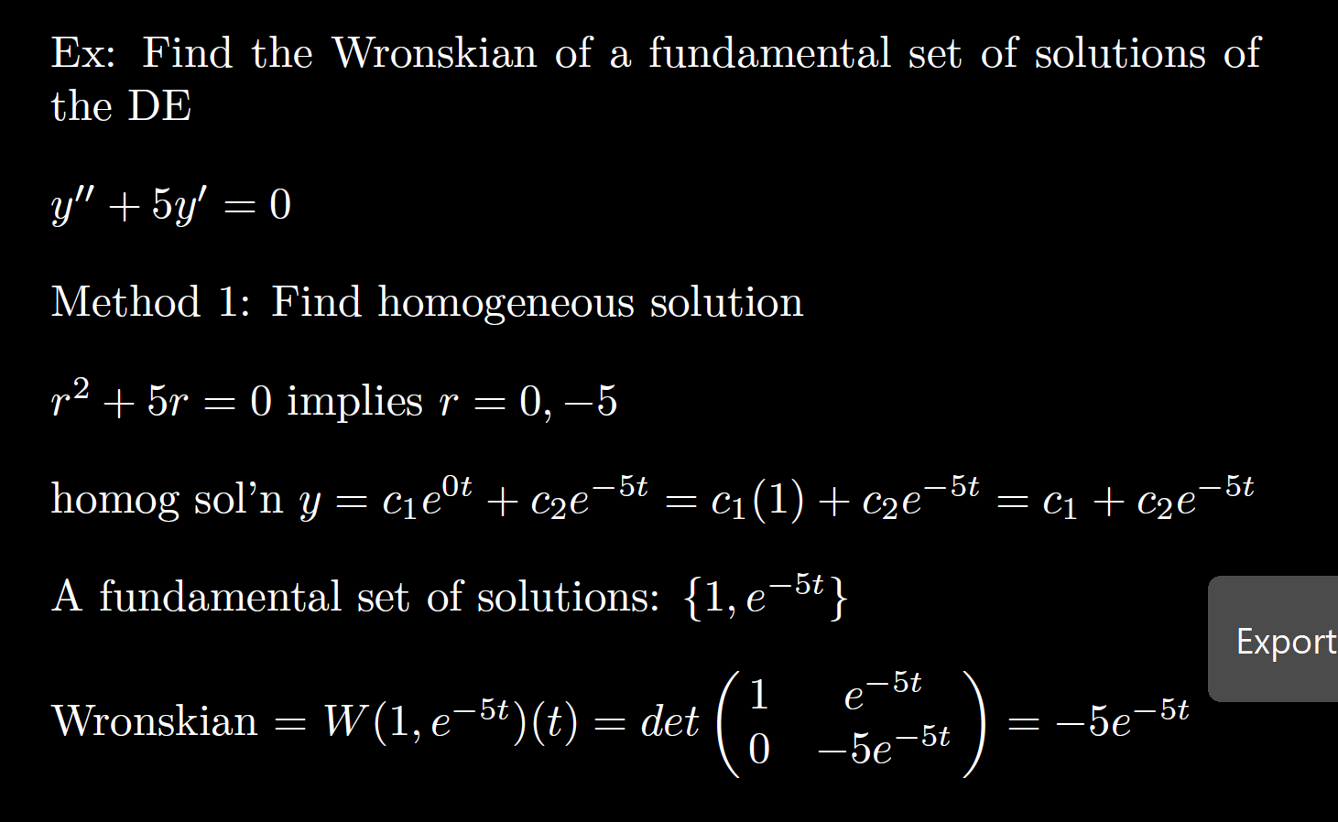

Slide 33
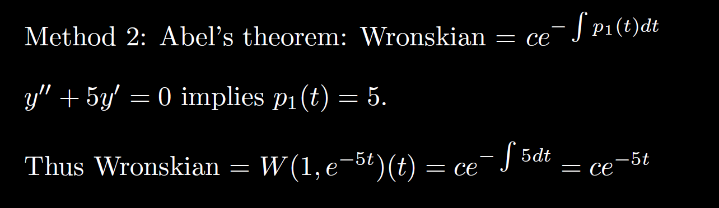

Slide 36
