Slide 4
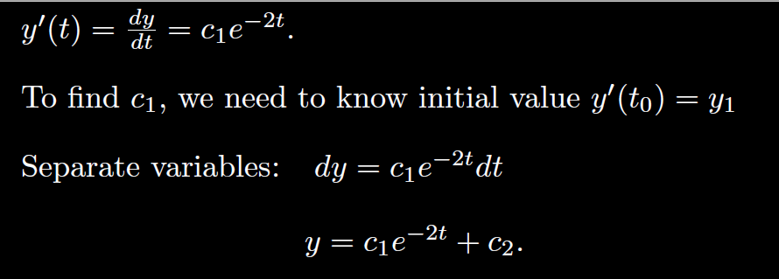

Slide 6
General solution of 2nd order Linear Homogenous DE is a linear combination of 2 linearly independent functions (which are solutions).
3.1
3.3
3.4

Slide 7
Recall from matrix algebra that Ax = b is a homogeneous equation iff b = 0.
Suppose A has 2 free variables. Then the general solution to the homogenous matrix equation Ax = 0 will be of the form
x =c₁v₁ + c₂v₂.

Slide 8
Recall from matrix algebra that Ax = b is a homogeneous equation iff b = 0.
Suppose A has 2 free variables. Then the general solution to the homogenous matrix equation Ax = 0 will be of the form
x =c₁v₁ + c₂v₂.

Slide 12
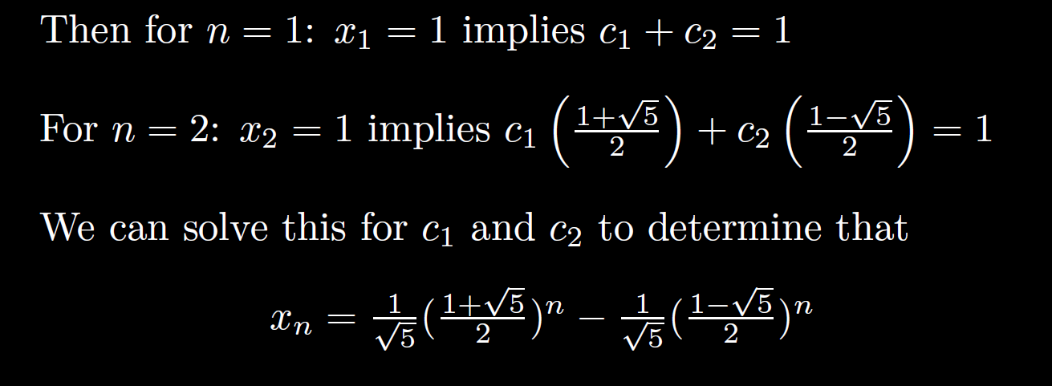

Slide 13
The previous slides were motivational.
The following slides contain material that can appear on exams

Slide 14
General solution of 2nd order Linear Homogenous DE is a linear combination of 2 linearly independent functions (which are solutions).
3.1
3.3
3.4

Slide 15
Recall from matrix algebra that Ax = b is a homogeneous equation iff b = 0.
Suppose A has 2 free variables. Then the general solution to the homogenous matrix equation Ax = 0 will be of the form
x =c₁v₁ + c₂v₂.

Slide 24
Slope at (t₀, y₀) is y₀
(t₀, y₀)

Slide 27
The Wronskian evaluated at t₀ is the coefficient matrix used to solve for the constants c_{i} for the IVP y(t₀) = y₀.

