Slide 1
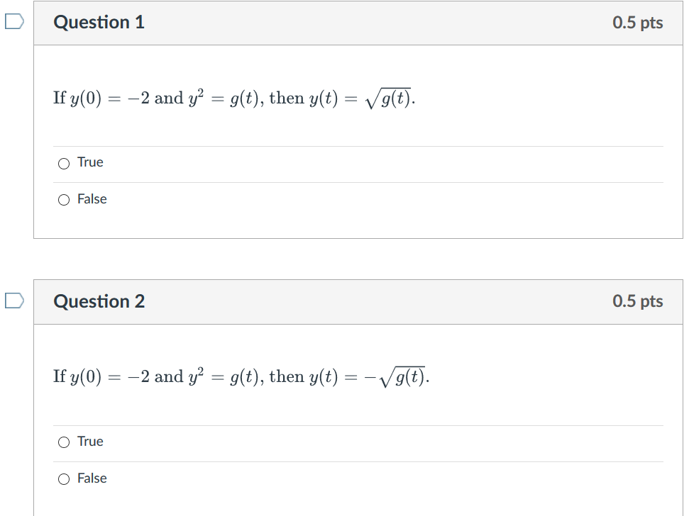

Slide 2
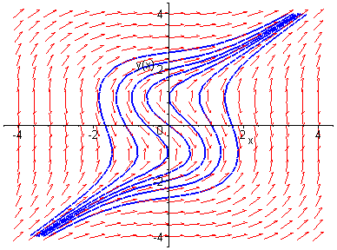
Example 1: Solving a Separable Equation
http://bcs.wiley.com/he-bcs/Books?action=resource &bcsId=2026&itemId=047143339X&resourceId=4140
Solve the following first order nonlinear equation:
Separating variables, and using calculus, we obtain
The equation above defines the solution y implicitly. A graph showing the direction field and implicit plots of several integral curves for the differential equation is given above.

Slide 3
Example 2:
Implicit and Explicit Solutions (1 of 4)
http://bcs.wiley.com/he-bcs/Books?action=resource&bcsId=2026&itemId=047143339X&resourceId=4140
Solve the following first order nonlinear equation:
Separating variables and using calculus, we obtain
The equation above defines the solution y implicitly. An explicit expression for the solution can be found in this case:
If you can solve for y, you must do so and give explicit answer.

Slide 4
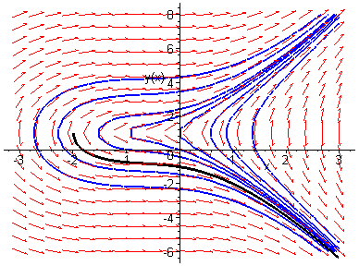
Example 2: Initial Value Problem (2 of 4)
http://bcs.wiley.com/he-bcs/Books?action=resource &bcsId=2026&itemId=047143339X&resourceId=4140
Suppose we seek a solution satisfying y(0) = -1. Using the implicit expression of y, we obtain
Thus the implicit equation defining y is
Using explicit expression of y,
It follows that
In this class (and in many applications), solutions will always be functions (and thus satisfy vertical line test).

Slide 5
Week 3 Video
Theorem 2.4.2/domain (28:41 min video) slides, annotated slides:
View after 2.4 in class lecture and before doing 2.4 HW
Thm 2.4.2 can sometimes be used to determine if an IVP has a unique solution, but it cannot be used to determine the domain of that solution. In this video, we first use Thm 2.4.2 to determine when y′=1/[(1−t)(2−y), y(t0)=y0 is guaranteed to have a unique solution. We then use a lot of algebra and a little bit of calculus to solve this DE and determine the domain of this solution when the initial value is the point (0, 1).

Slide 6
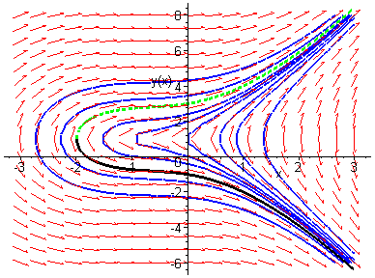
Example 2: Initial Condition y(0) = 3 (3 of 4)
http://bcs.wiley.com/he-bcs/Books?action=resource &bcsId=2026&itemId=047143339X&resourceId=4140
Note that if initial condition is y(0) = 3, then we choose the positive sign, instead of negative sign, on square root term:
In this class (and in many applications), solutions will always be functions (and thus satisfy vertical line test).
Domain will always be a single open interval.

Slide 7
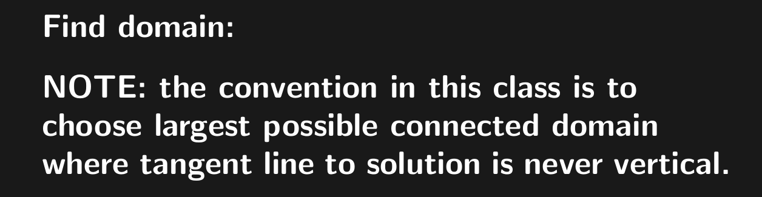
HW hint: For one of your HW problems, to find domain:
Determine where tangent line is vertical. For this
particular problem, this will occur at certain y-values.
Plug these y-values into solution and solve for x to find potential boundary of domain.
Note: Domain will always be a single open interval.

Slide 8
Example 2: Domain (4 of 4)
http://bcs.wiley.com/he-bcs/Books?action=resource &bcsId=2026&itemId=047143339X&resourceId=4140
Domain will always be a single open interval.
Thus the solutions to the initial value problem
are given by
From explicit representation of y, it follows that
and hence domain of y is (-2, ∞). Note x = -2 yields y = 1, which makes denominator of dy/dx zero (vertical tangent).
Conversely, domain of y can be estimated by locating vertical tangents on graph (useful for implicitly defined solutions).

Slide 9
Example 3: Implicit Solution of Initial Value Problem (1 of 2)
http://bcs.wiley.com/he-bcs/Books?action=resource&bcsId=2026&itemId=047143339X&resourceId=4140
Consider the following initial value problem:
Separating variables and using calculus, we obtain
Using the initial condition, it follows that
← Implicit solution

Slide 10
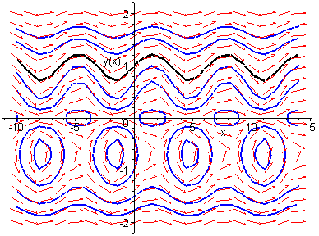
Example 3: Graph of Solutions (2 of 2)
http://bcs.wiley.com/he-bcs/Books?action=resource &bcsId=2026&itemId=047143339X&resourceId=4140
Thus
The graph of this solution (black), along with the graphs of the direction field and several integral curves (blue) for this differential equation, is given below.
Solutions vary dramatically based on initial value.

Slide 11
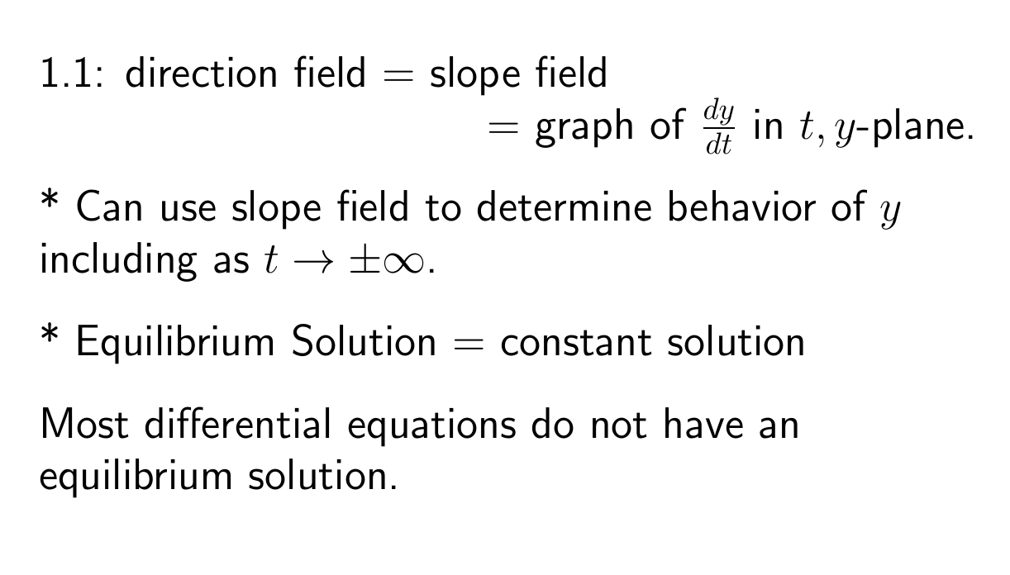

Slide 12
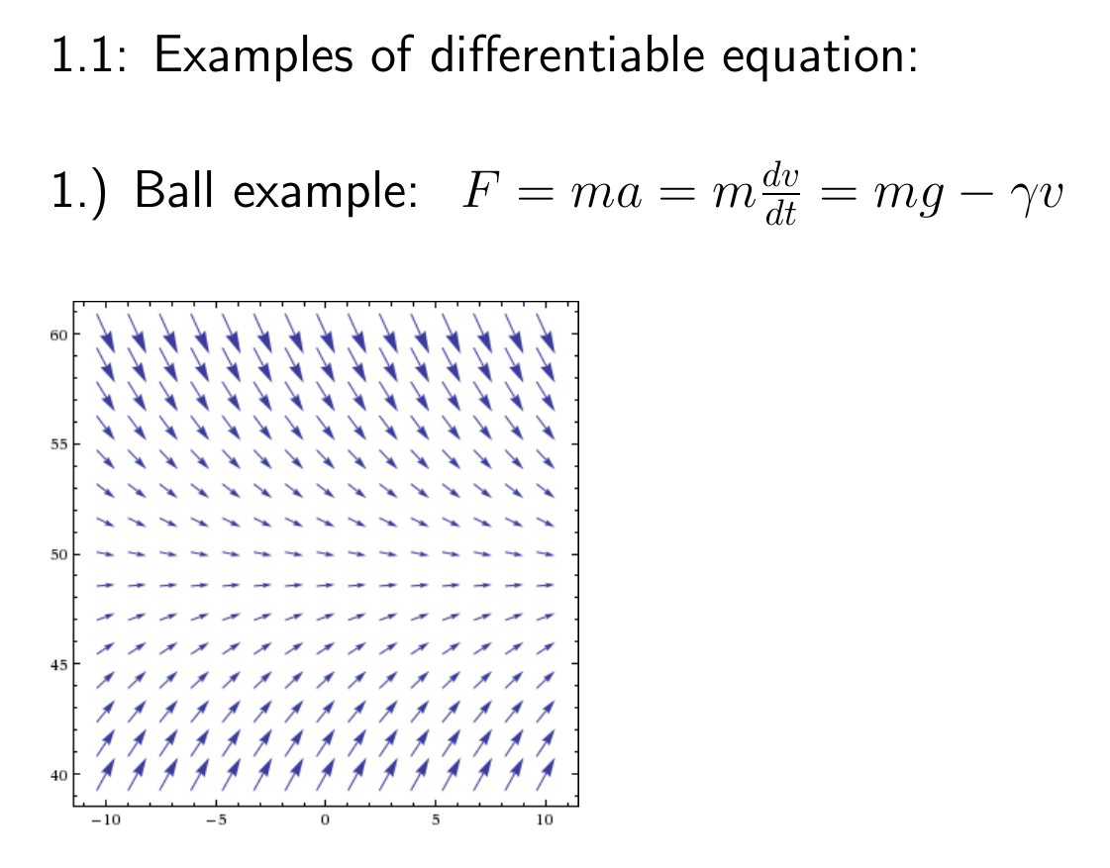
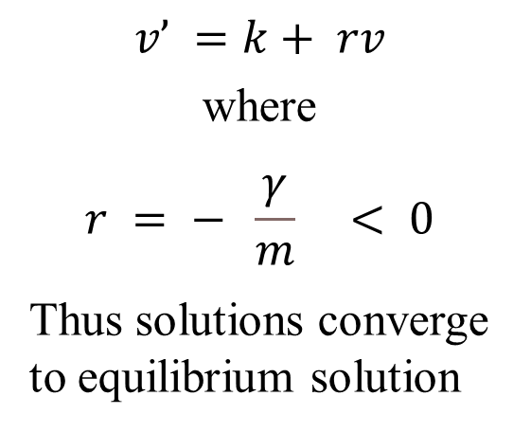
Force due to air resistance
Gravitational force
$$v’ =k+ rv$$
where
$$r = − \frac{γ}{m} < 0$$
Thus solutions converge to equilibrium solution
Equilibrium solution:
v = C
Note C is the limiting velocity.

Slide 13
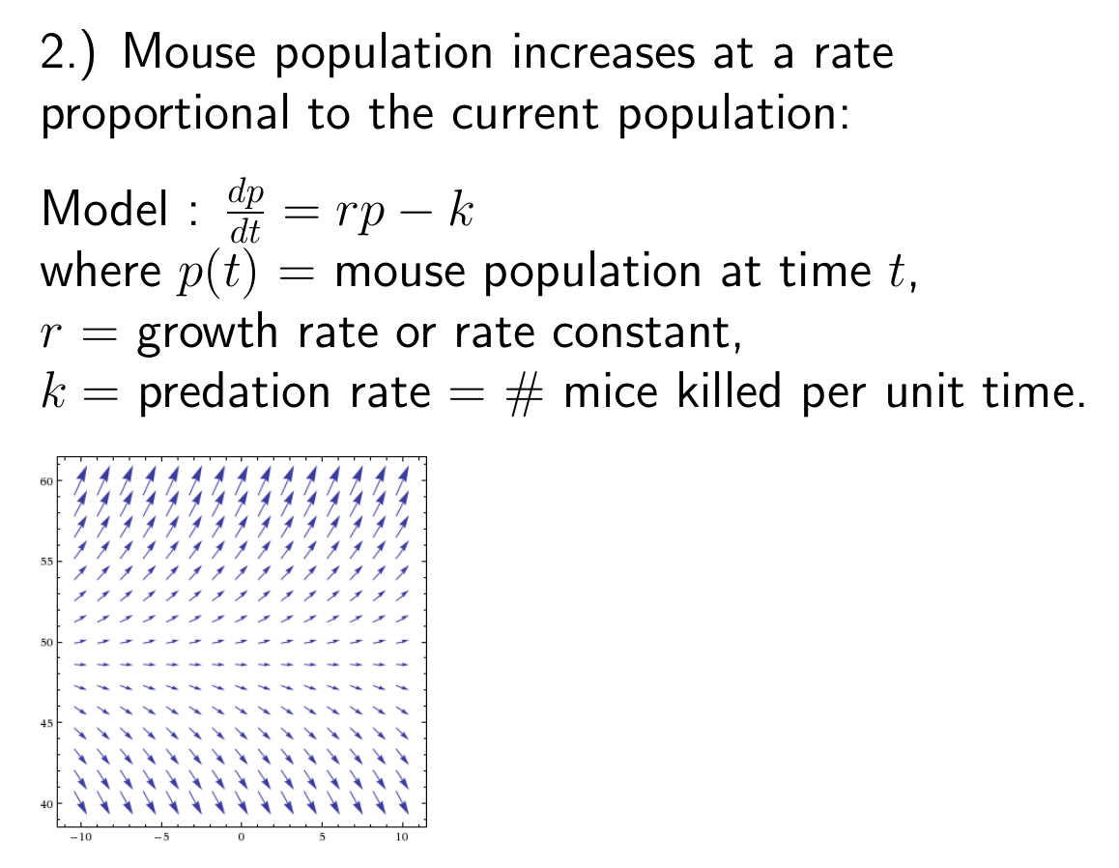
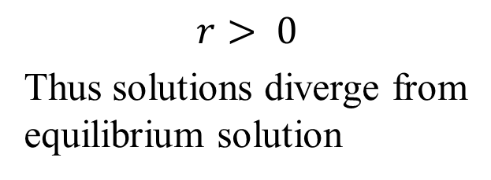
(
) - predation
or proportionality constant
$$r> 0$$
Thus solutions diverge from equilibrium solution

Slide 14
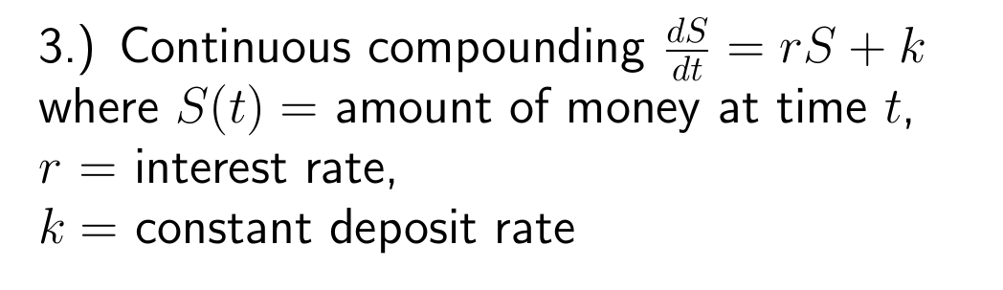

Slide 15
If rate of change is constant:

Slide 16
If rate of change proportional to S:

Slide 18
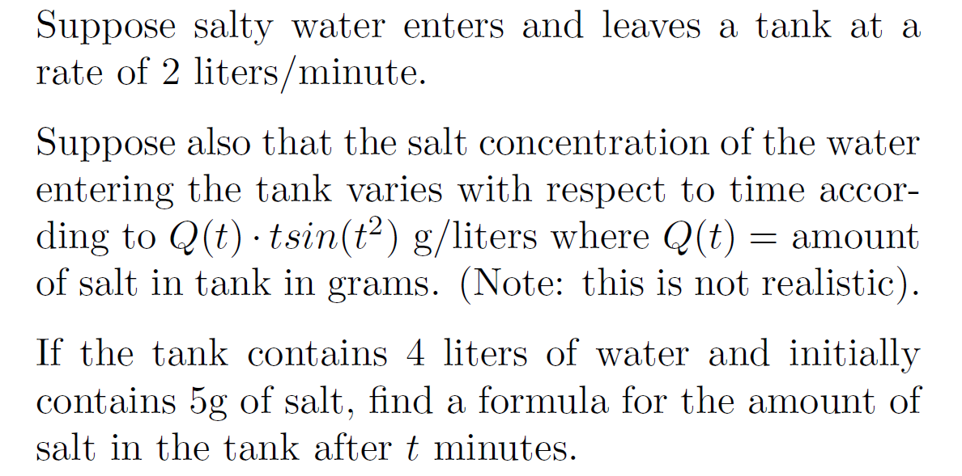

Slide 19
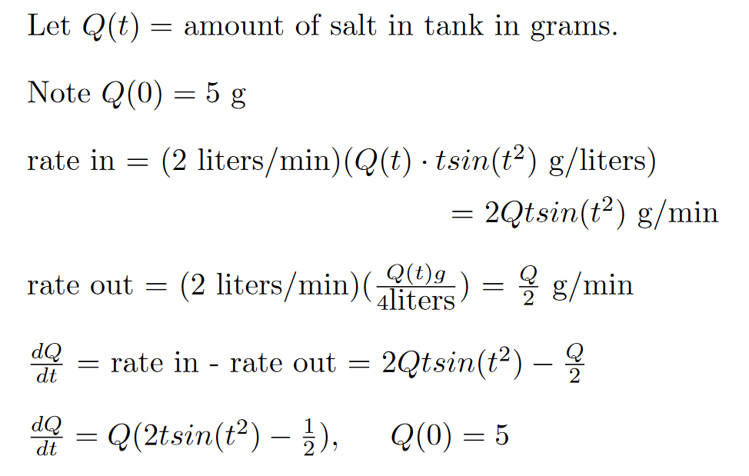

Slide 20
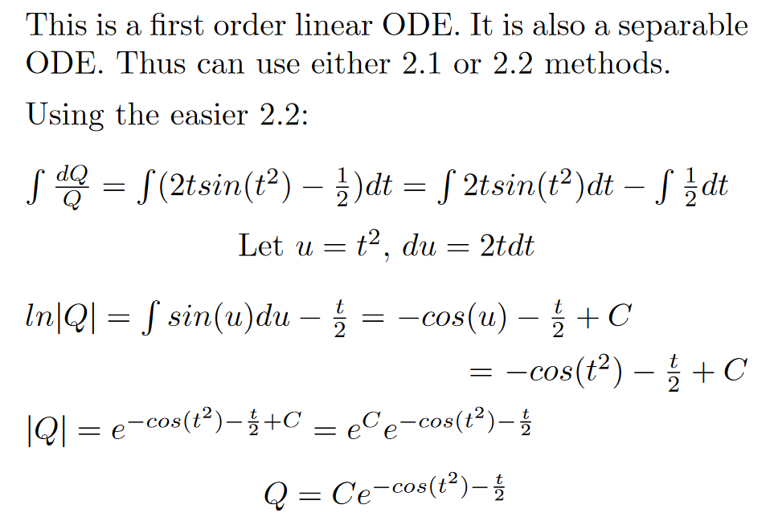

Slide 21
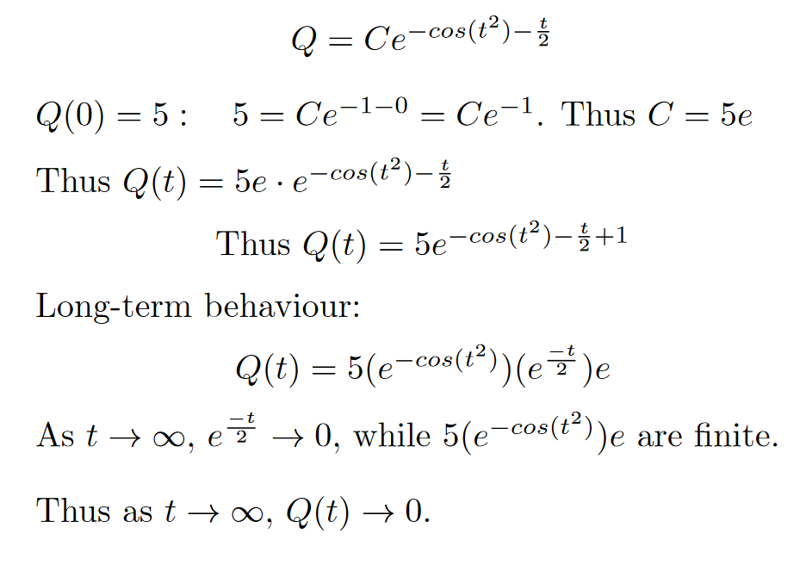

Slide 22
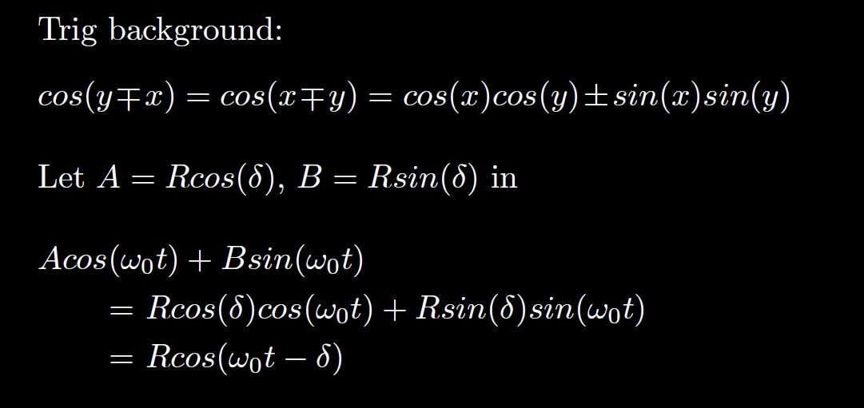
HW hint (next slide)

Slide 23
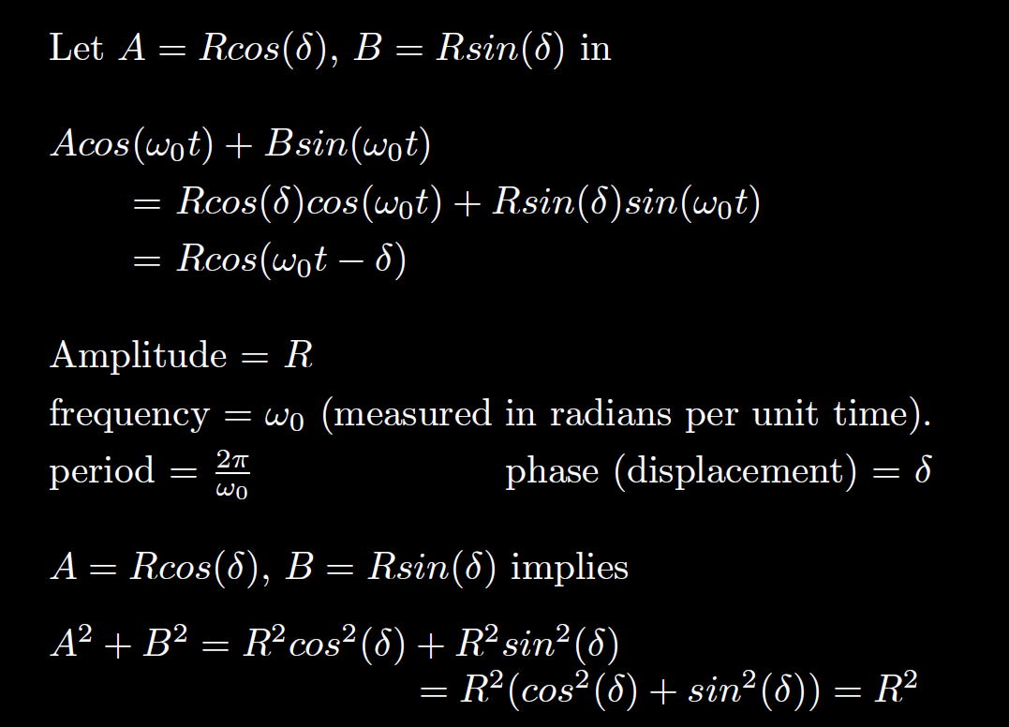

We will use this in section 3.7
$$= \sqrt{A^{2 }+B2}$$

Slide 24
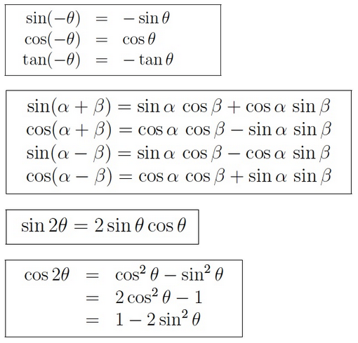
HW hint (#4): Simplify your answer.
https://www2.clarku.edu/faculty/djoyce/trig/identities.html

Slide 25
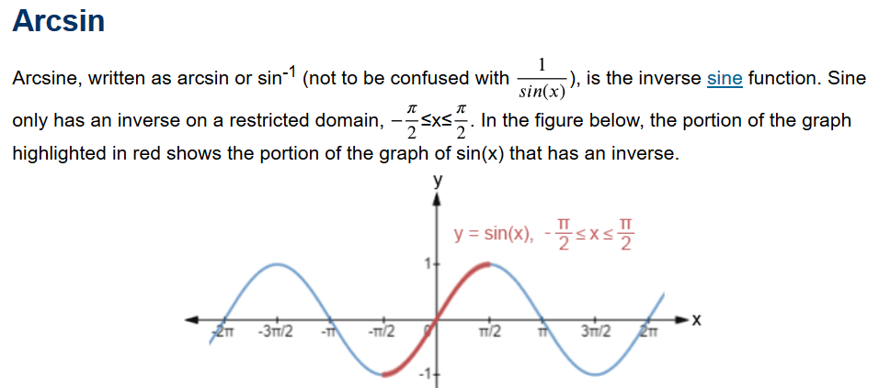
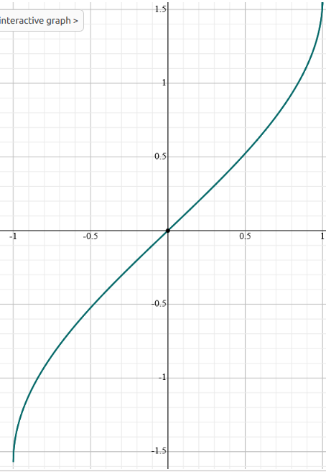
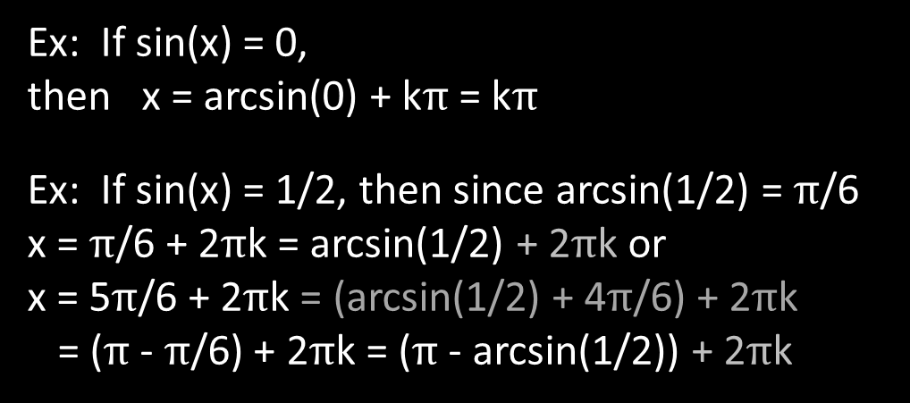
https://www.math.net/arcsin
y = arcsin(x)
Ex: If sin(x) = 0,
then x = arcsin(0) + k$π$ = k$π$
Ex: If sin(x) = 1/2, then since arcsin(1/2) = $π$/6
x = $π$/6 + 2$π$k = arcsin(1/2) + 2$π$k or
x = 5$π$/6 + 2$π$k = (arcsin(1/2) + 4$π$/6) + 2$π$k
= ($π$ - $π$/6) + 2$π$k = ($π$- arcsin(1/2)) + 2$π$k
https://www.symbolab.com/

Slide 26

If sin(x) = c, then
x = arcsin(c) + 2$π$k or x = ($π$- arcsin(c)) + 2$π$k

Slide 27
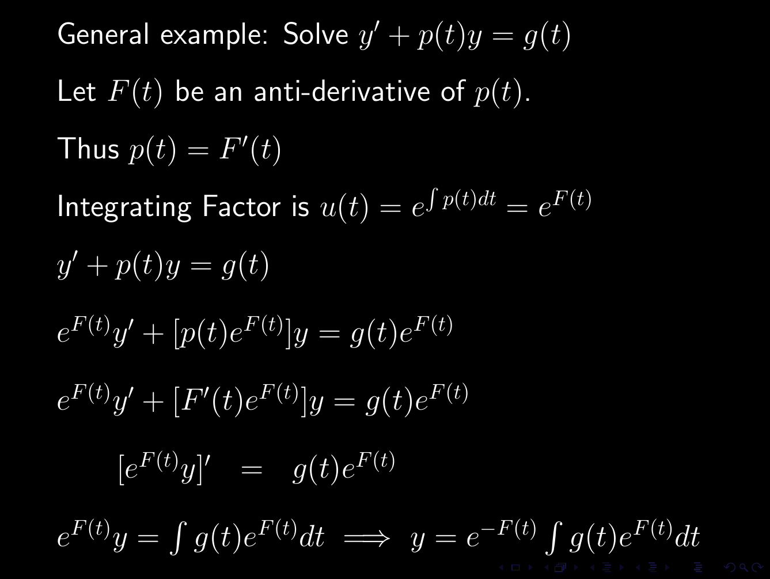
Section 2.1
You canNOT use formula. You must show product rule step.

Slide 28
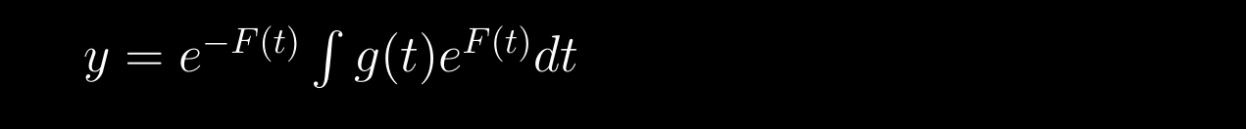



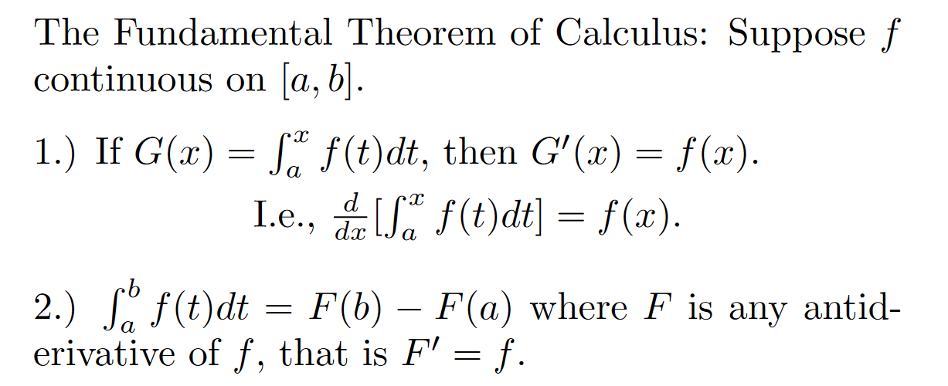
HW hint
If taking limit, might be able to use l’hopital’s rule and

Slide 29


