Slide 1
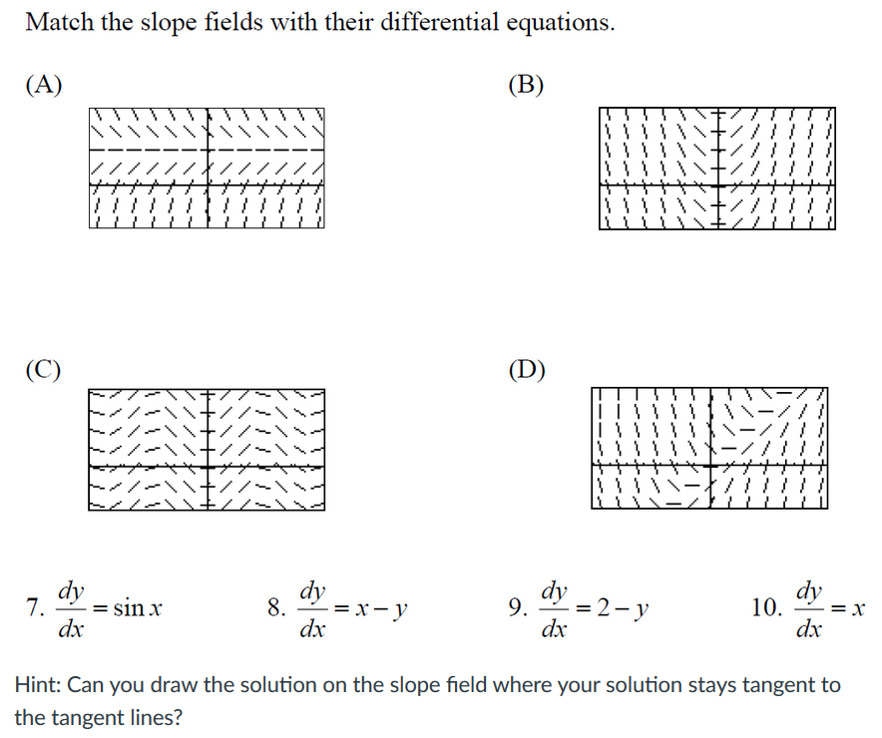
$$y’ = f(y)$$
$$y’ = f(x)$$
$$y’ = f(x)$$
$$y’ = f(x,y)$$

Slide 2
$$y’ = f(y)$$
$$y’ = f(x)$$
$$y’ = f(x)$$
$$y’ = f(x,y)$$

Slide 3
$$y’ = f(y)$$
$$y’ = f(x)$$
$$y’ = f(x)$$
$$y’ = f(x,y)$$
Separate Variables:
dy = sin(x) dx.
Thus y = -cos(x) + C
Separate Variables:
dy = x dx.
Thus y = $\frac{1}{2}$ x² + C
7 and 10 are calc 1 problems

Slide 4
$$y’ = f(y)$$
$$y’ = f(x)$$
$$y’ = f(x)$$
$$y’ = f(x,y)$$
#9 is both linear and separable.
Can use either 2.1 or 2.2 method to solve (or ch 3 method since constant coefficients).
#8 is linear, not separable. Must use 2.1 integrating factor to solve.

Slide 5
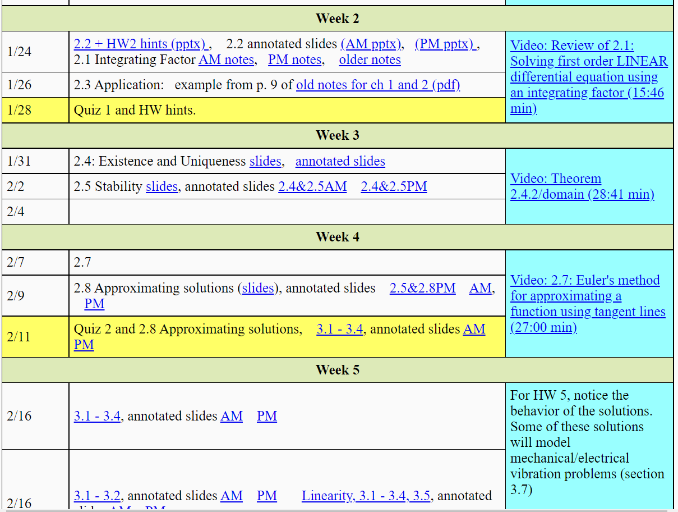

Slide 7
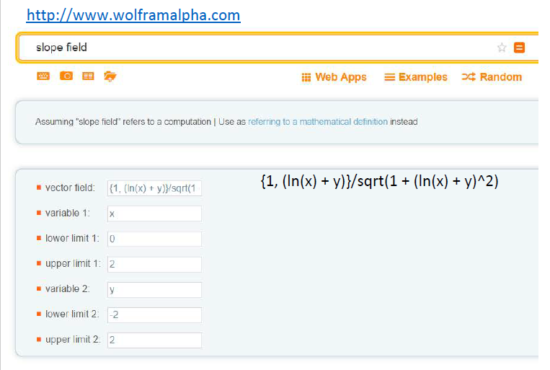

Slide 10
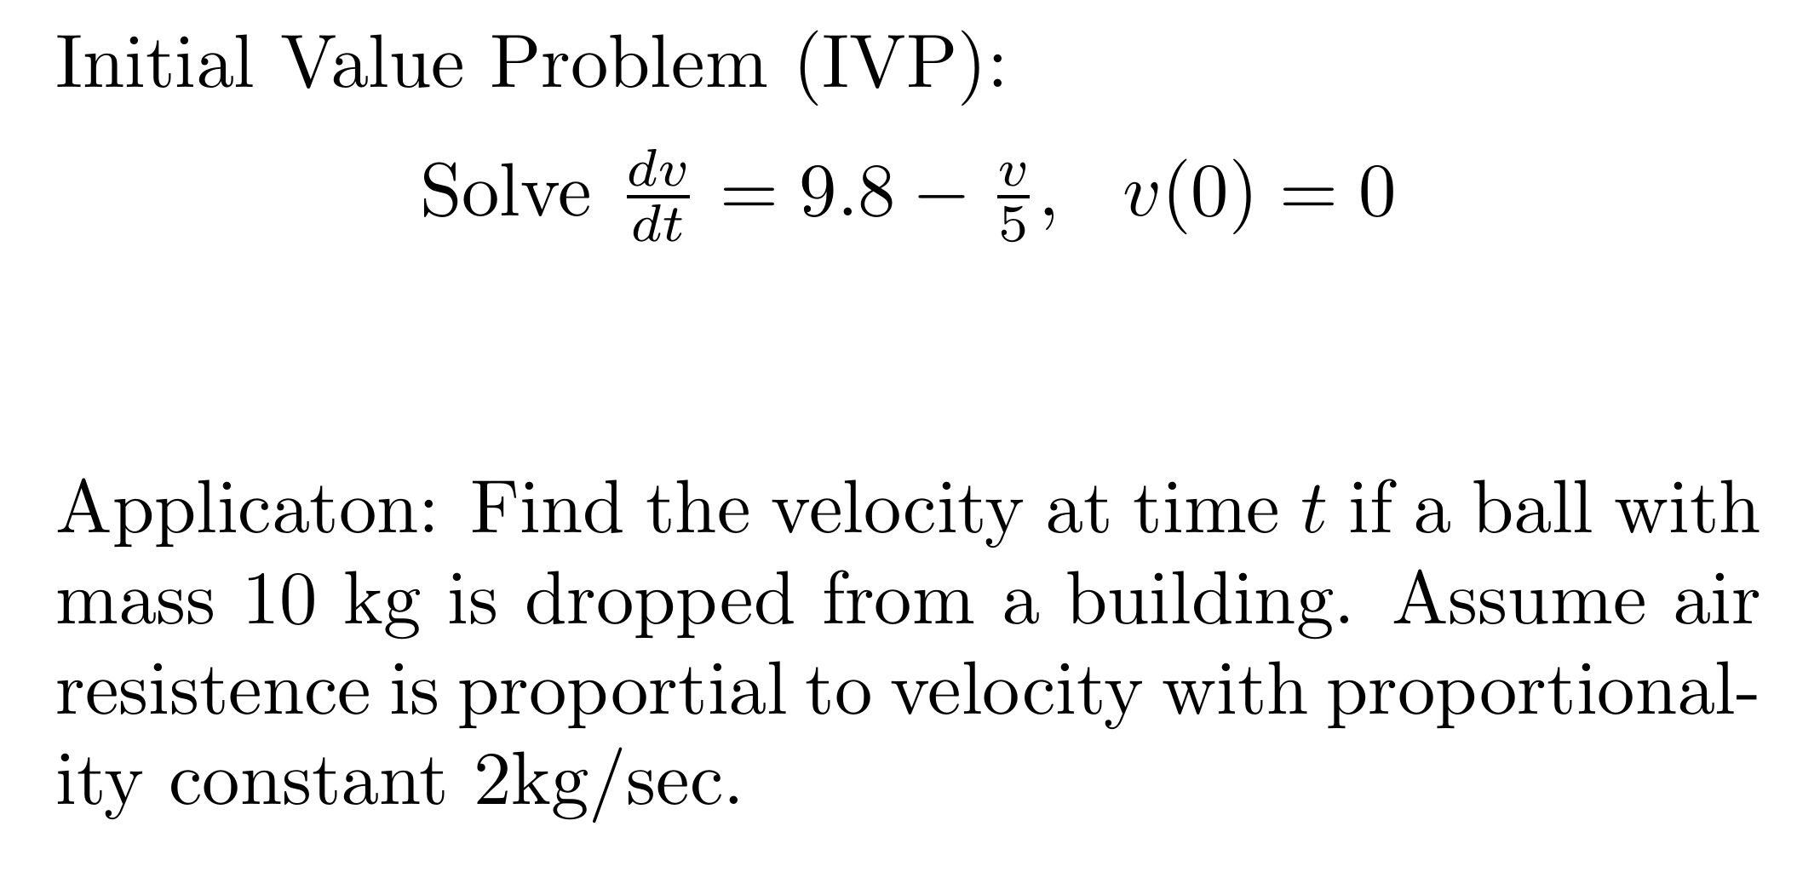

Slide 11
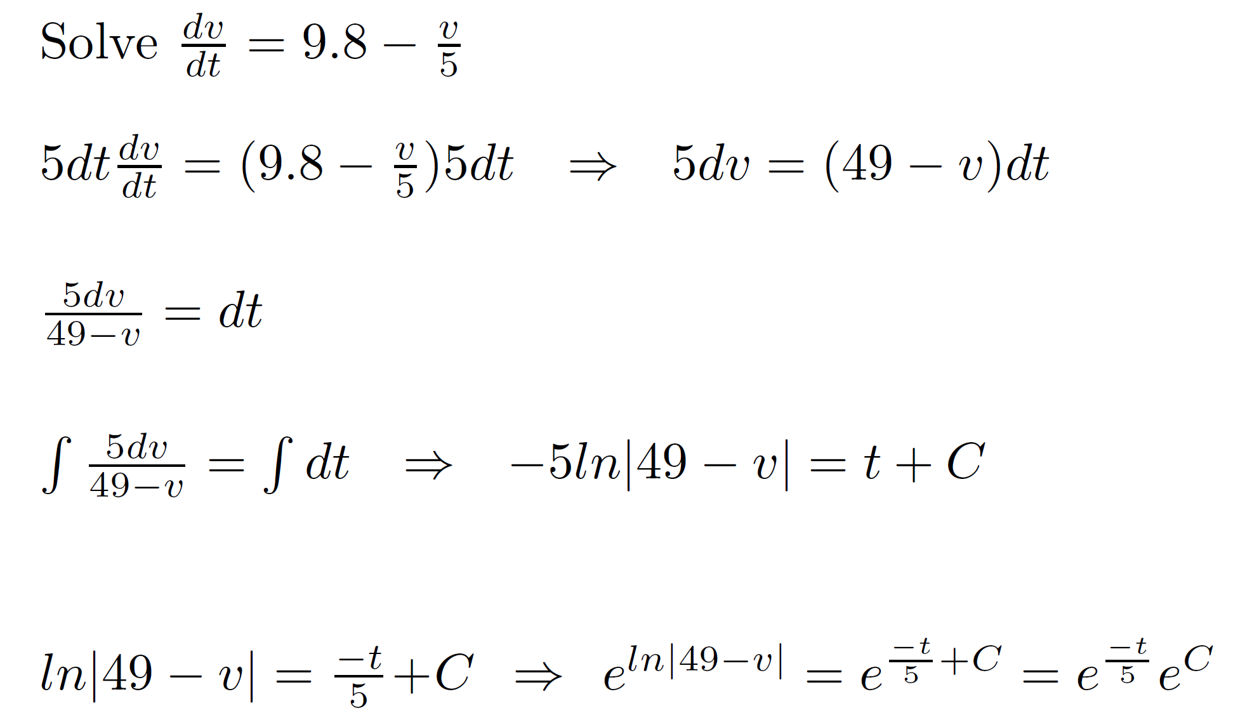
Section 2.2: We were very sloppy last time (similar example to last week with different numbers).
Divide by 0: Lost solution v = 49.
We also let C swallow constants (but NOT variables).

Slide 12
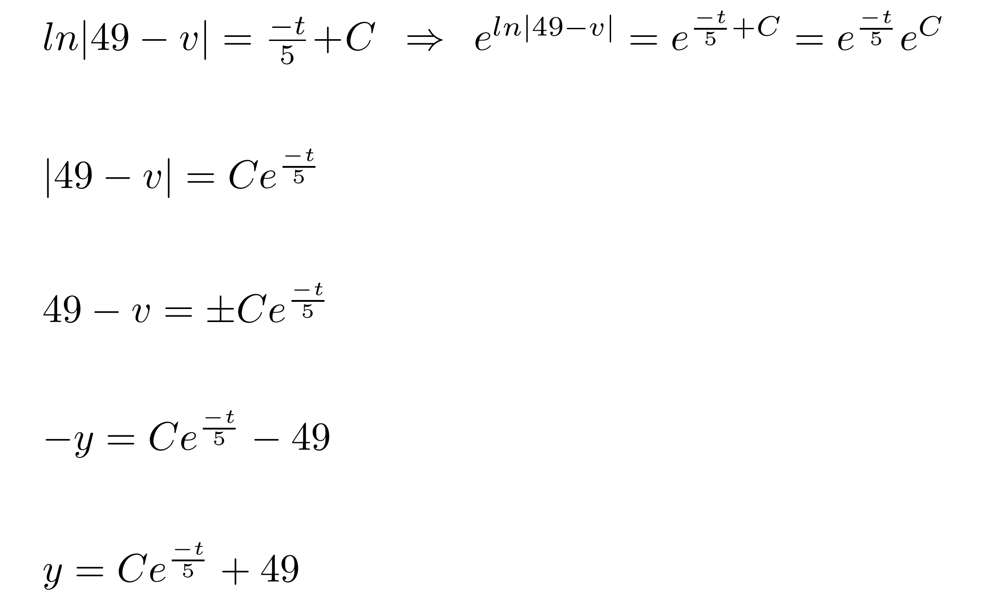
$e^{C }>0$, but C can be any real number. Thus now including additional (non?) solutions.
${±e}^{C }$ can be either positive or negative (but not 0). So it is fine to have C both positive and negative in the above step
Note we also need C = 0 for the equilibrium solution (which we temporarily lost when we divided by v – 49).
In the real world, worry about losing solutions and gaining non-solutions, but you don’t need to worry about this on exams and quizzes in this class.

Slide 14
Ch 2.2: Separable Equations
http://bcs.wiley.com/he-bcs/Books?action=resource &bcsId=2026&itemId=047143339X&resourceId=4140
In this section we examine a subclass of linear and nonlinear first order equations. Consider the first order equation
We can rewrite this in the form
For example, let M(x,y) = - f (x,y) and N (x,y) = 1. There may be other ways as well. In differential form,
If M is a function of x only and N is a function of y only, then
In this case, the equation is called separable.

Slide 15
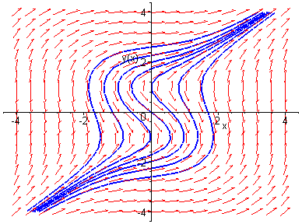
Example 1: Solving a Separable Equation
http://bcs.wiley.com/he-bcs/Books?action=resource &bcsId=2026&itemId=047143339X&resourceId=4140
Solve the following first order nonlinear equation:
Separating variables, and using calculus, we obtain
The equation above defines the solution y implicitly. A graph showing the direction field and implicit plots of several integral curves for the differential equation is given above.

Slide 16
Example 2: Implicit and Explicit Solutions (1 of 4)
http://bcs.wiley.com/he-bcs/Books?action=resource&bcsId=2026&itemId=047143339X&resourceId=4140
Solve the following first order nonlinear equation:
Separating variables and using calculus, we obtain
The equation above defines the solution y implicitly. An explicit expression for the solution can be found in this case:
If you can solve for y, you must do so and give explicit answer.

Slide 17
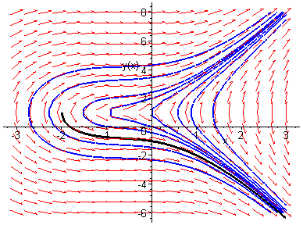
Example 2: Initial Value Problem (2 of 4)
http://bcs.wiley.com/he-bcs/Books?action=resource &bcsId=2026&itemId=047143339X&resourceId=4140
Suppose we seek a solution satisfying y(0) = -1. Using the implicit expression of y, we obtain
Thus the implicit equation defining y is
Using explicit expression of y,
It follows that
In this class (and in many applications), solutions will always be functions (and thus satisfy vertical line test).

Slide 18
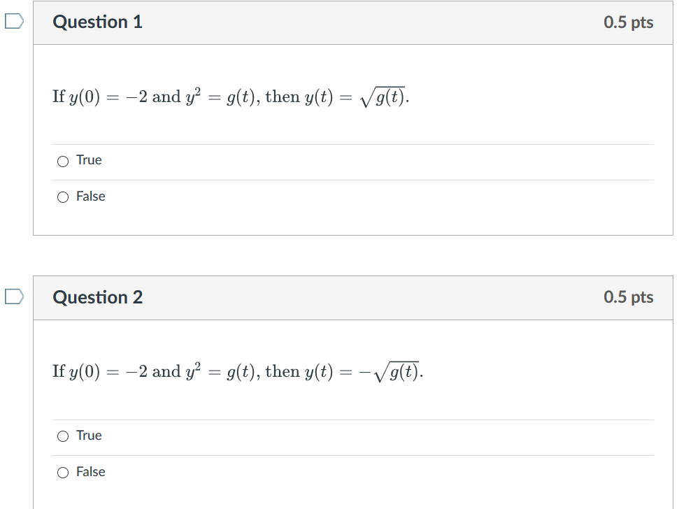

Slide 19
Week 3 Video
Theorem 2.4.2/domain (28:41 min video) slides, annotated slides: View after 2.4 in class lecture and before doing 2.4 HW Thm 2.4.2 can sometimes be used to determine if an IVP has a unique solution, but it cannot be used to determine the domain of that solution. In this video, we first use Thm 2.4.2 to determine when y′=1/[(1−t)(2−y), y(t0)=y0 is guaranteed to have a unique solution. We then use a lot of algebra and a little bit of calculus to solve this DE and determine the domain of this solution when the initial value is the point (0, 1).

Slide 20
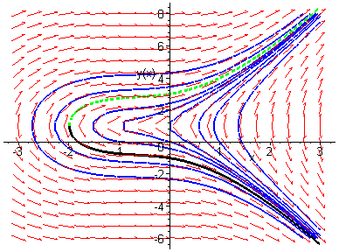
Example 2: Initial Condition y(0) = 3 (3 of 4)
http://bcs.wiley.com/he-bcs/Books?action=resource &bcsId=2026&itemId=047143339X&resourceId=4140
Note that if initial condition is y(0) = 3, then we choose the positive sign, instead of negative sign, on square root term:
In this class (and in many applications), solutions will always be functions (and thus satisfy vertical line test).
Domain will always be a single open interval.

Slide 21
HW hint: For one of your HW problems, to find domain:
Determine where tangent line is vertical. For this
particular problem, this will occur at certain y-values.
Plug these y-values into solution and solve for x to find potential boundary of domain.

Slide 22
Example 2: Domain (4 of 4)
http://bcs.wiley.com/he-bcs/Books?action=resource &bcsId=2026&itemId=047143339X&resourceId=4140
Domain will always be a single open interval.
Thus the solutions to the initial value problem
are given by
From explicit representation of y, it follows that
and hence domain of y is (-2, ∞). Note x = -2 yields y = 1, which makes denominator of dy/dx zero (vertical tangent).
Conversely, domain of y can be estimated by locating vertical tangents on graph (useful for implicitly defined solutions).

Slide 23
Example 3: Implicit Solution of Initial Value Problem (1 of 2)
http://bcs.wiley.com/he-bcs/Books?action=resource&bcsId=2026&itemId=047143339X&resourceId=4140
Consider the following initial value problem:
Separating variables and using calculus, we obtain
Using the initial condition, it follows that

Slide 24
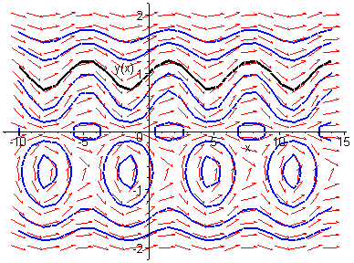
Example 3: Graph of Solutions (2 of 2)
http://bcs.wiley.com/he-bcs/Books?action=resource &bcsId=2026&itemId=047143339X&resourceId=4140
Thus
The graph of this solution (black), along with the graphs of the direction field and several integral curves (blue) for this differential equation, is given below.
Solutions vary dramatically based on initial value.

Slide 25
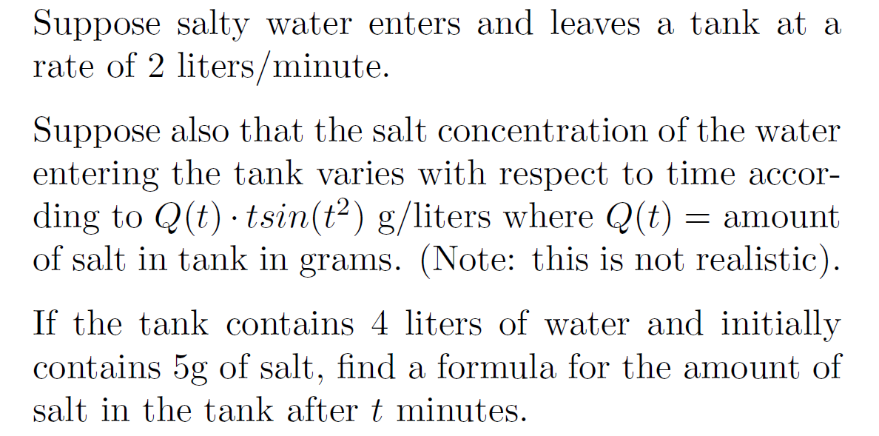

Slide 26
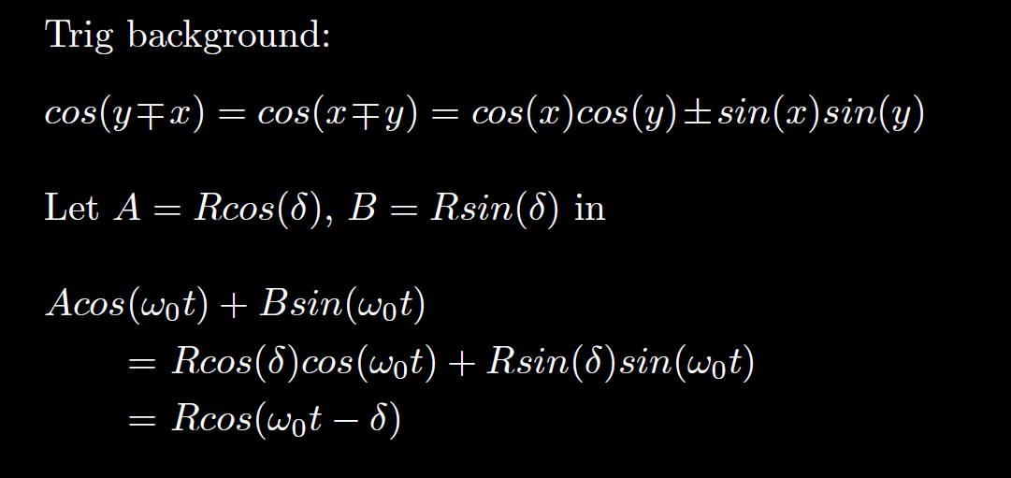
HW hint (next slide)

Slide 27
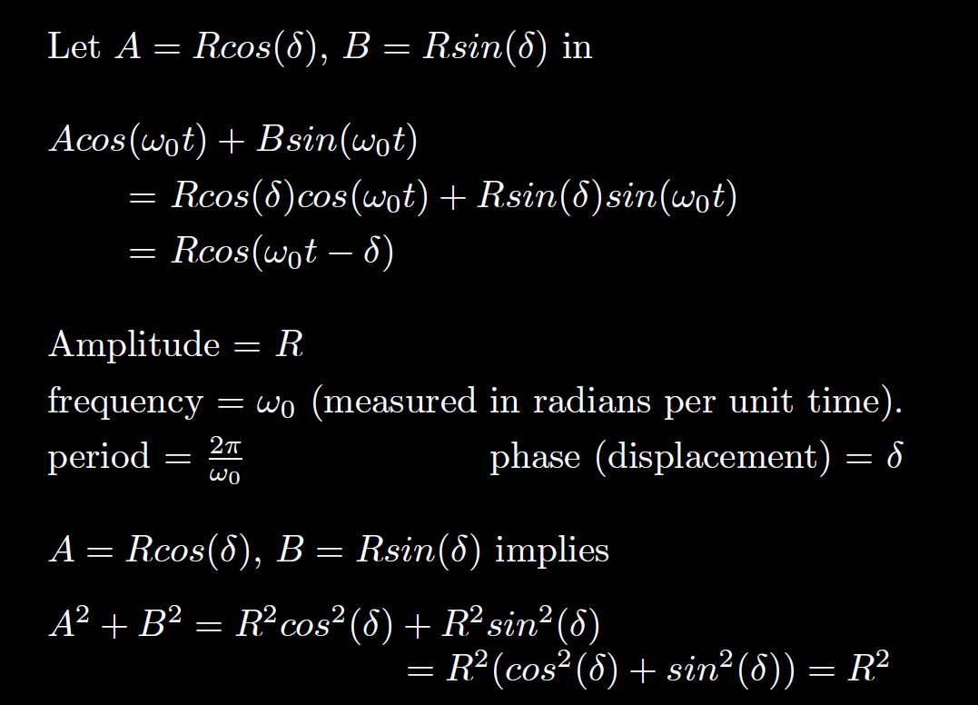
We will use this in section 3.7
$$= \sqrt{A^{2 }+B2}$$

Slide 28
Section 2.1
You canNOT use formula. You must show product rule step.

Slide 29
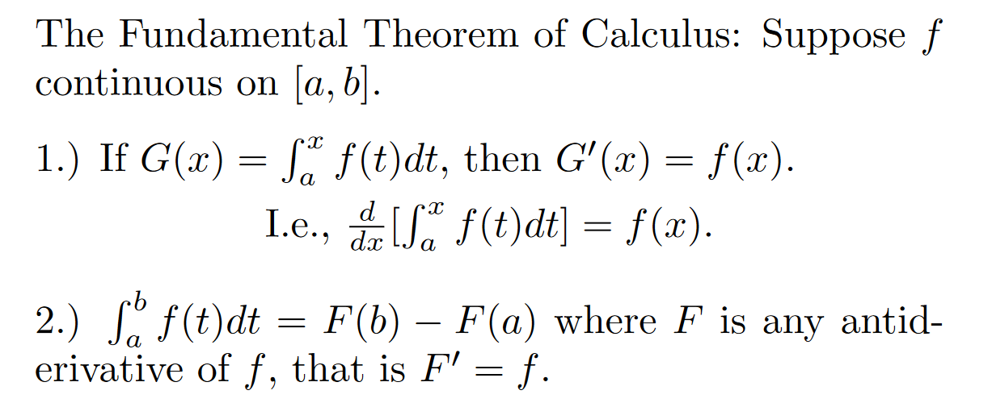
HW hint
If taking limit, might be able to use l’hopital’s rule and

