Slide 1
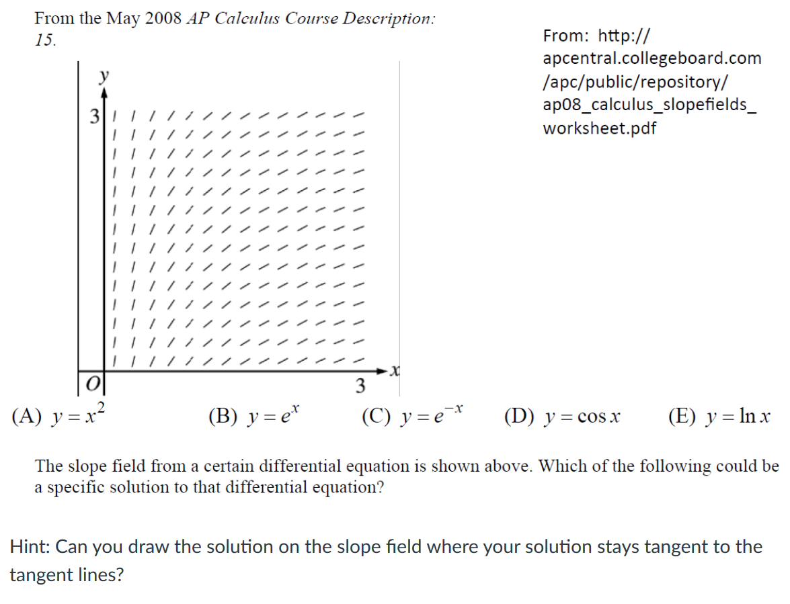

Slide 5
No equilibrium solution

Slide 6
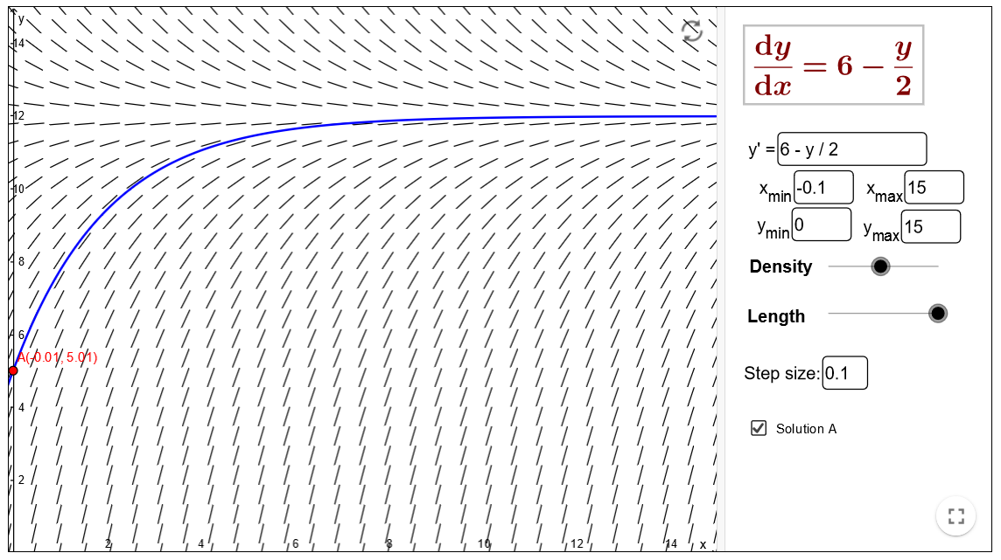
Math 4 DE: $y’ = f\left(t, y\right)$
Special case from calc 1 Special case from section 2.5
$y’ = f\left(t\right)$ $y’ = f\left(y\right)$
Example: $y’ = \frac{1}{t}$ Example: $y’ =6 − \frac{y}{2}$
$$y = ln⁡(t) + C$$

Slide 7
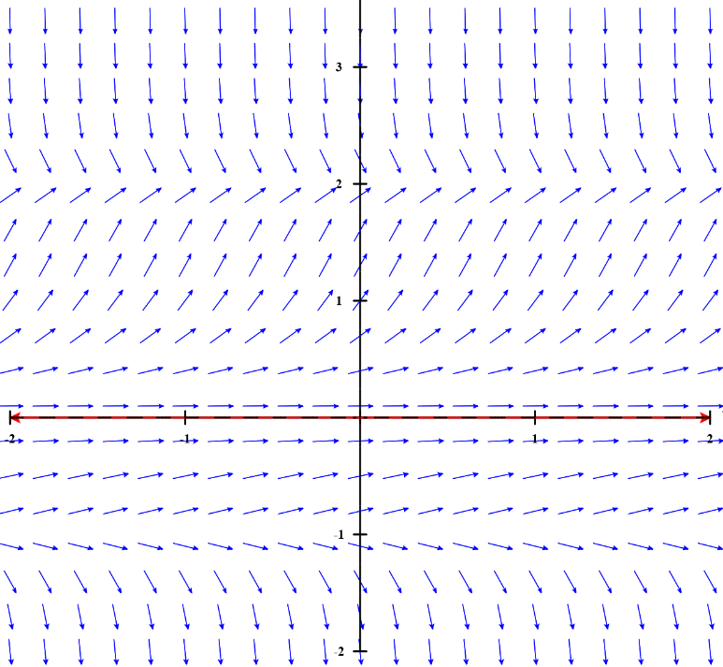
https://www.geogebra.org/m/Pd4Hn4BR
Find a differential equation that could correspond to the following direction field. (Note this example is harder than your HW).
$$y’ = f\left(y\right)$$
Recall: Equilibrium solutions are constant solutions.
I.e. Equilibrium solutions are horizontal lines: y = C

Slide 9
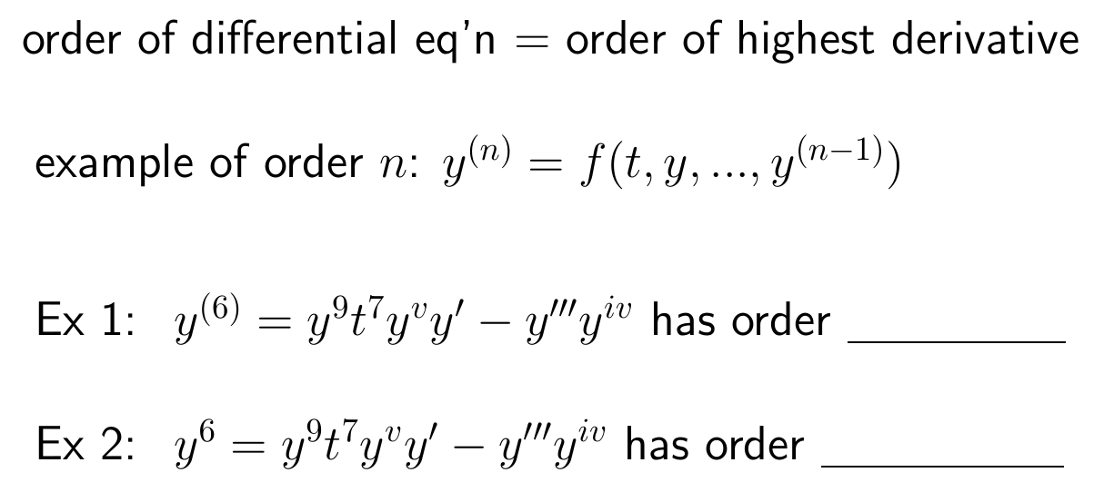

Slide 11
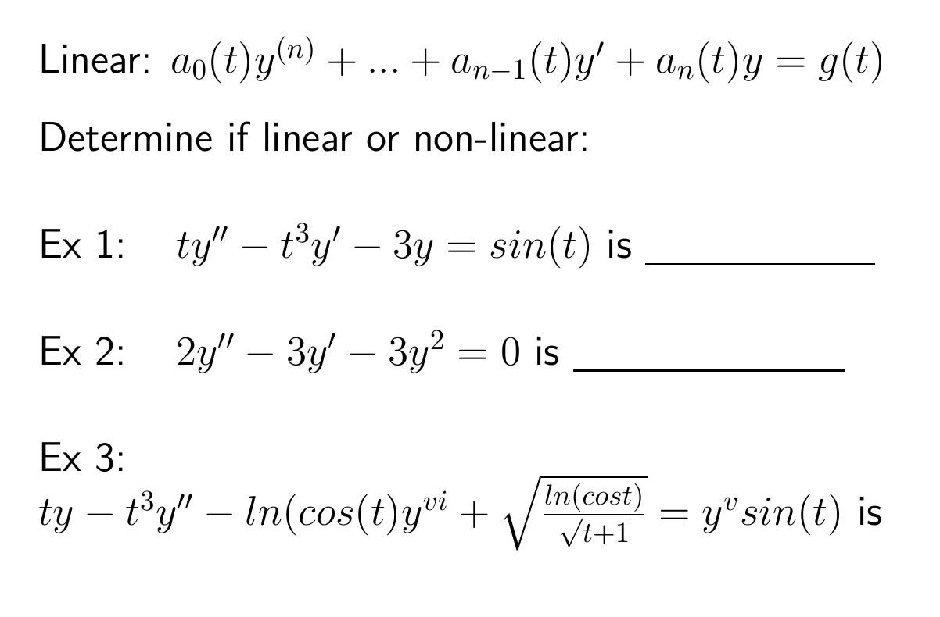

Slide 12
HW hint:

Slide 13
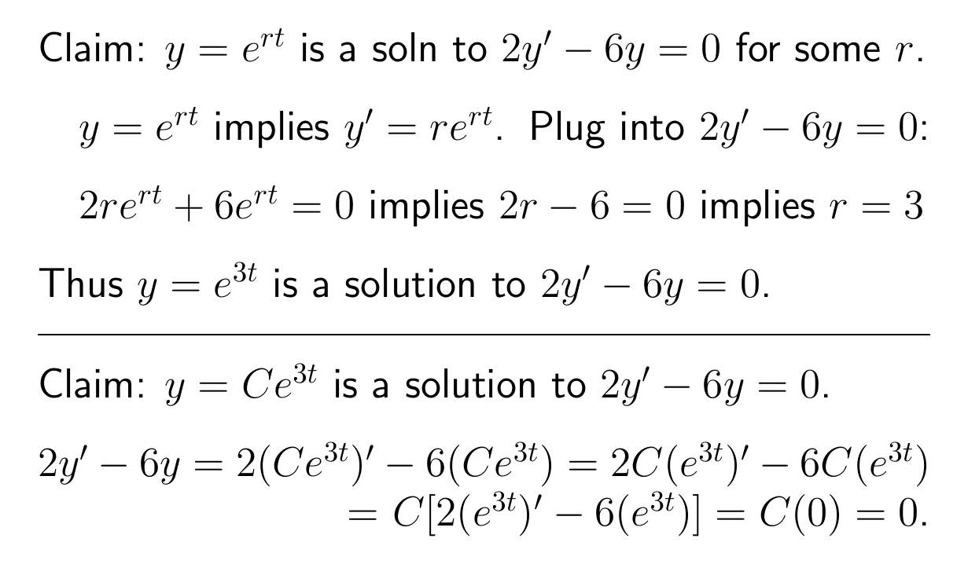
HW hint:

Slide 14
Ch 3 method for solving (higher order) homogeneous linear equations.

Slide 15
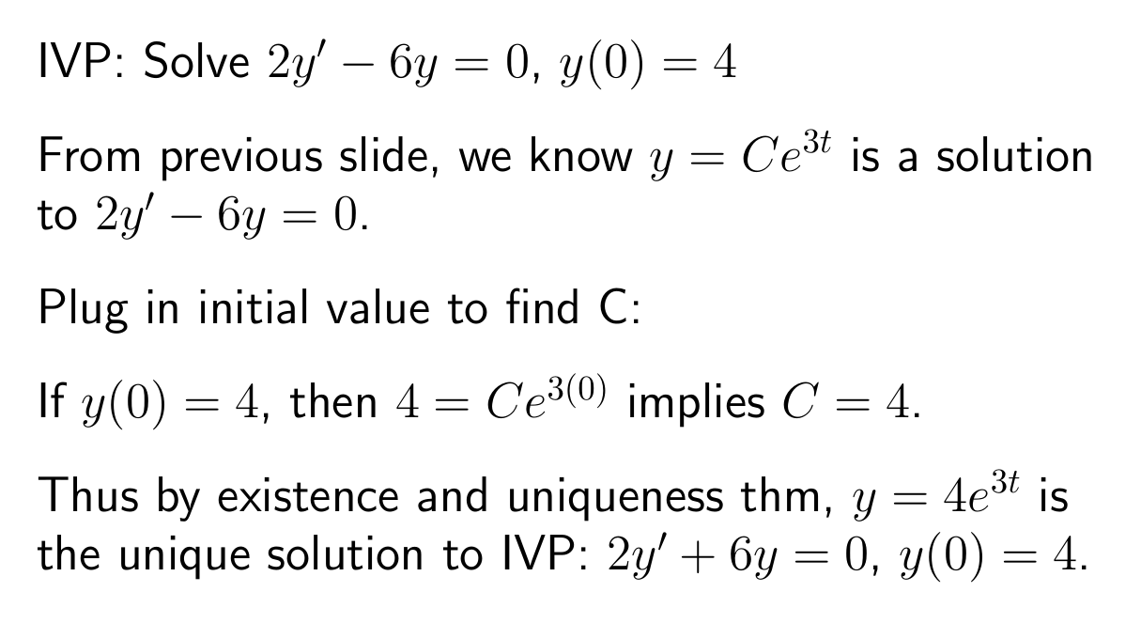

Slide 17
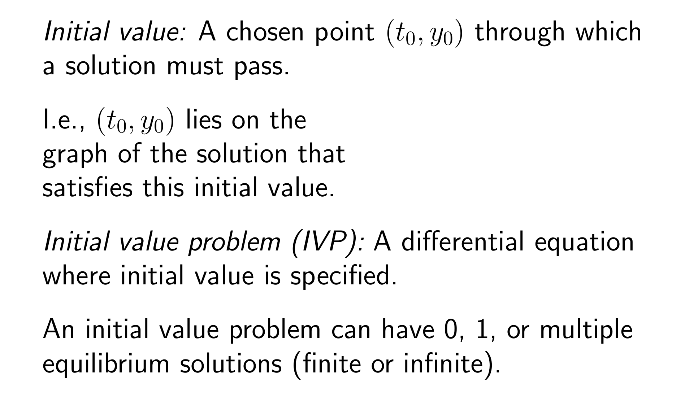
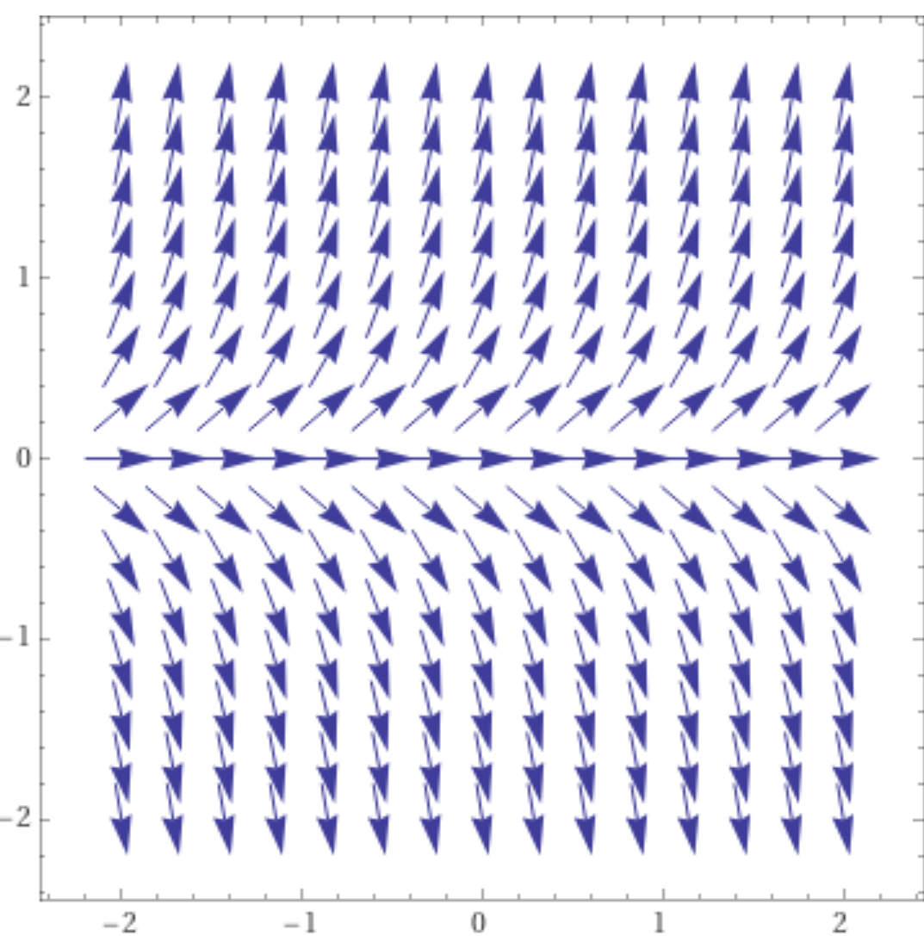
https://www.wolframalpha.com/input/?i=slope%20field

Slide 18
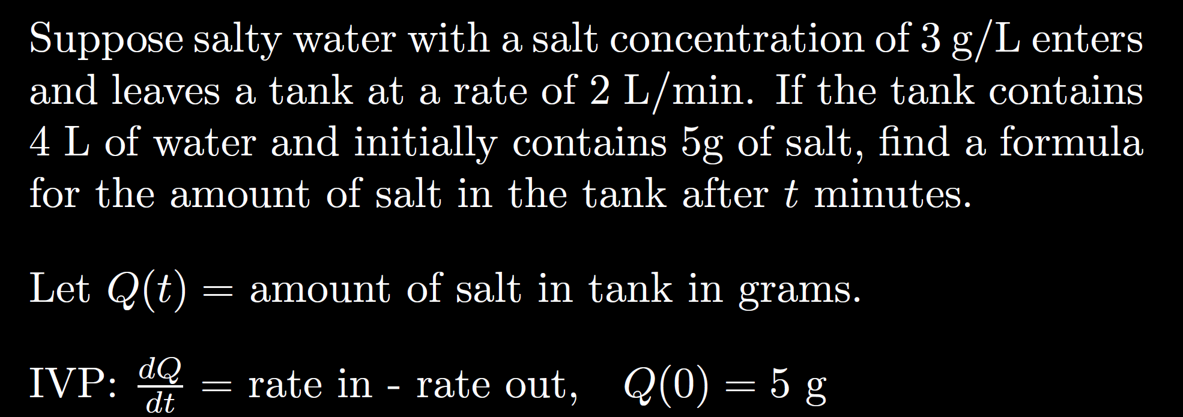
https://www.geogebra.org/m/Pd4Hn4BR

Slide 31
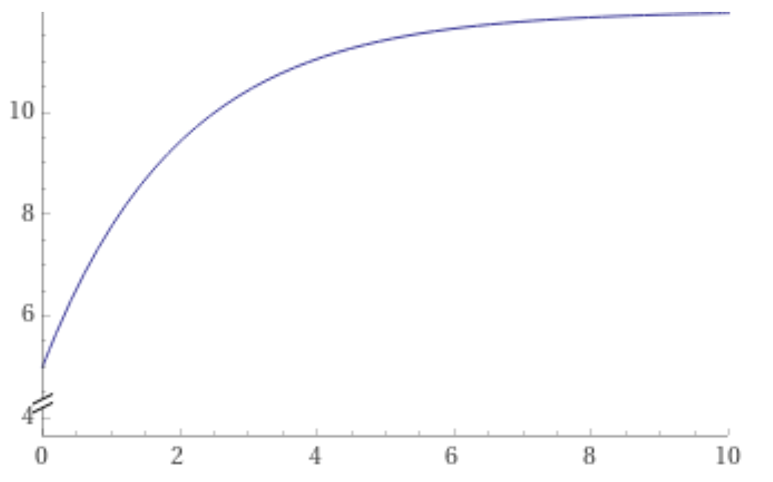
https://www.wolframalpha.com/input/?i=plot+-7+e%5E%7B-x%2F2%7D+%2B+12+from+x%3D0+to+10

Slide 34
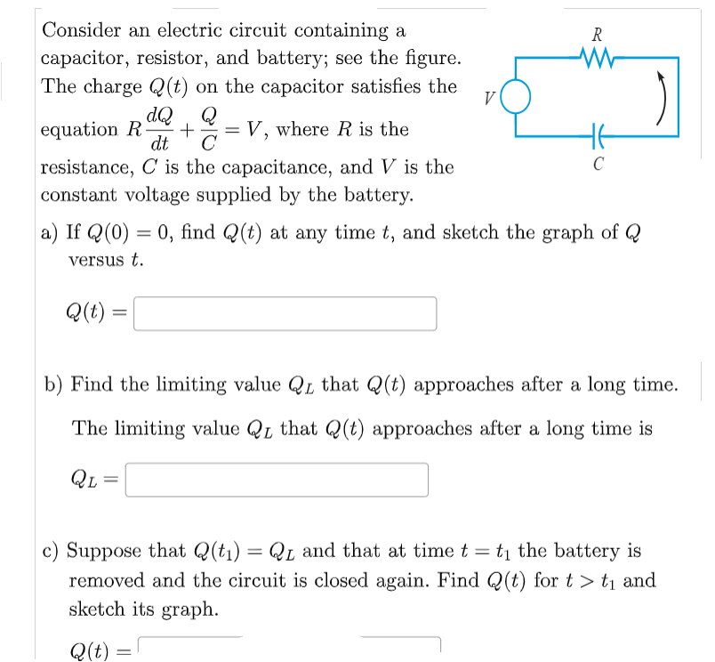
HW hint:
When the battery is removed, what is the new voltage?
V =
Thus you know the new DE.
You can also approximate the new initial value when t₁ is large
Batteries supply voltage
Assume t₁ is large

Slide 36
Force due to air resistance
Gravitational force
$$v’ =k+ rv$$
where
$$r = − \frac{γ}{m} < 0$$
Thus solutions converge to equilibrium solution
Equilibrium solution:
v = C
Note C is the limiting velocity.

Slide 37
(
) - predation
or proportionality constant
$$r> 0$$
Thus solutions diverge from equilibrium solution

Slide 39
If rate of change is constant:

Slide 40
If rate of change proportional to S:

Slide 42
https://www.wolframalpha.com/input/?i=slope%20field

Slide 43
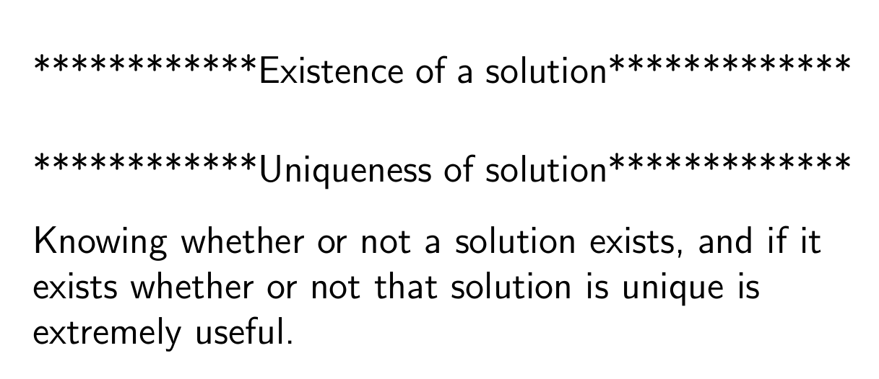

Slide 44
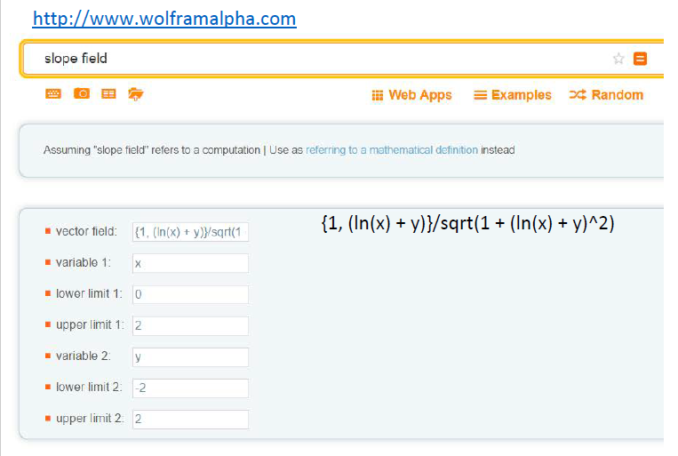

Slide 47
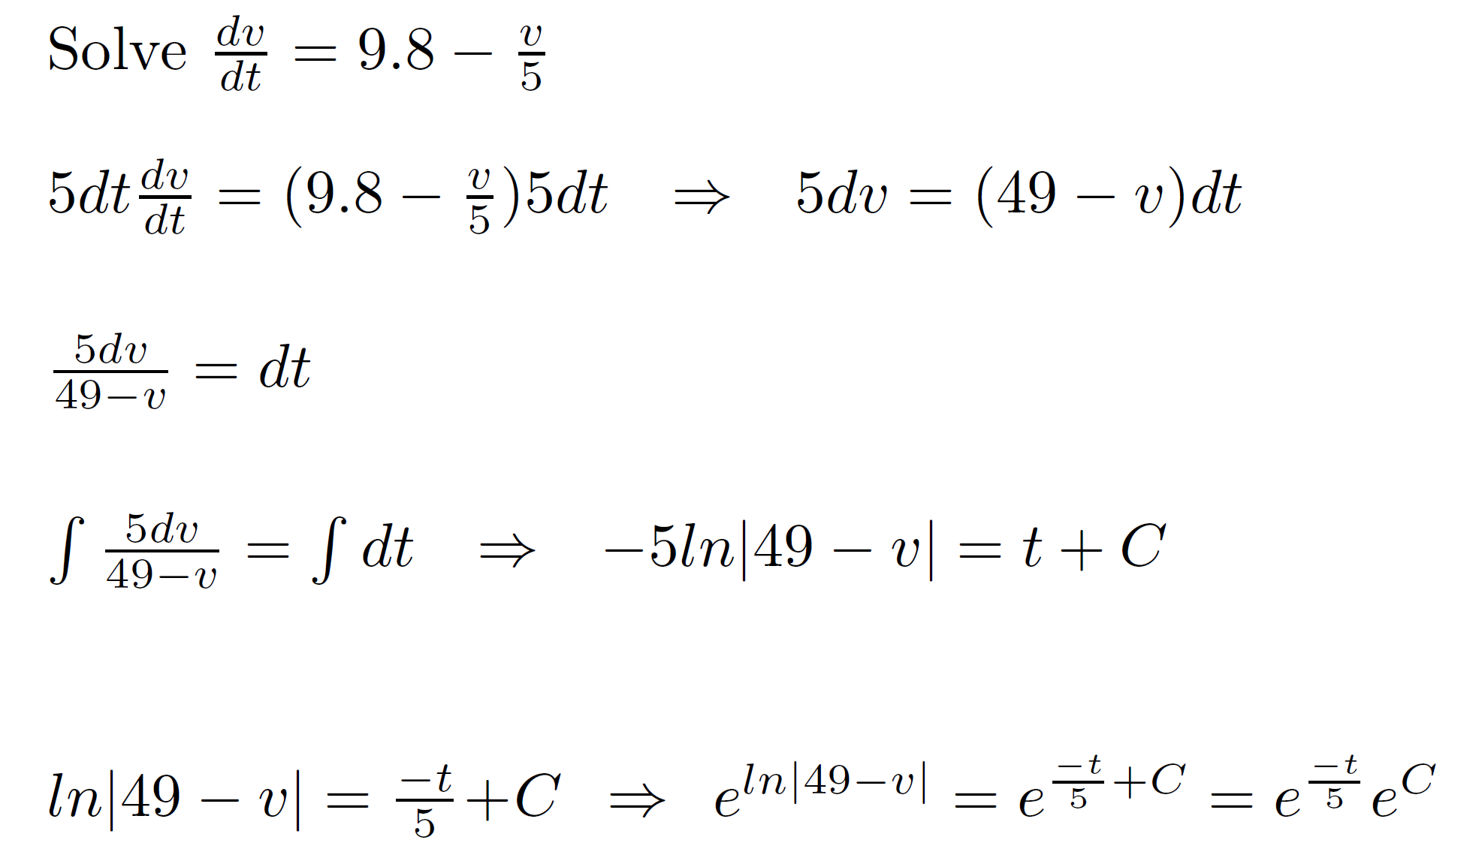

Slide 48
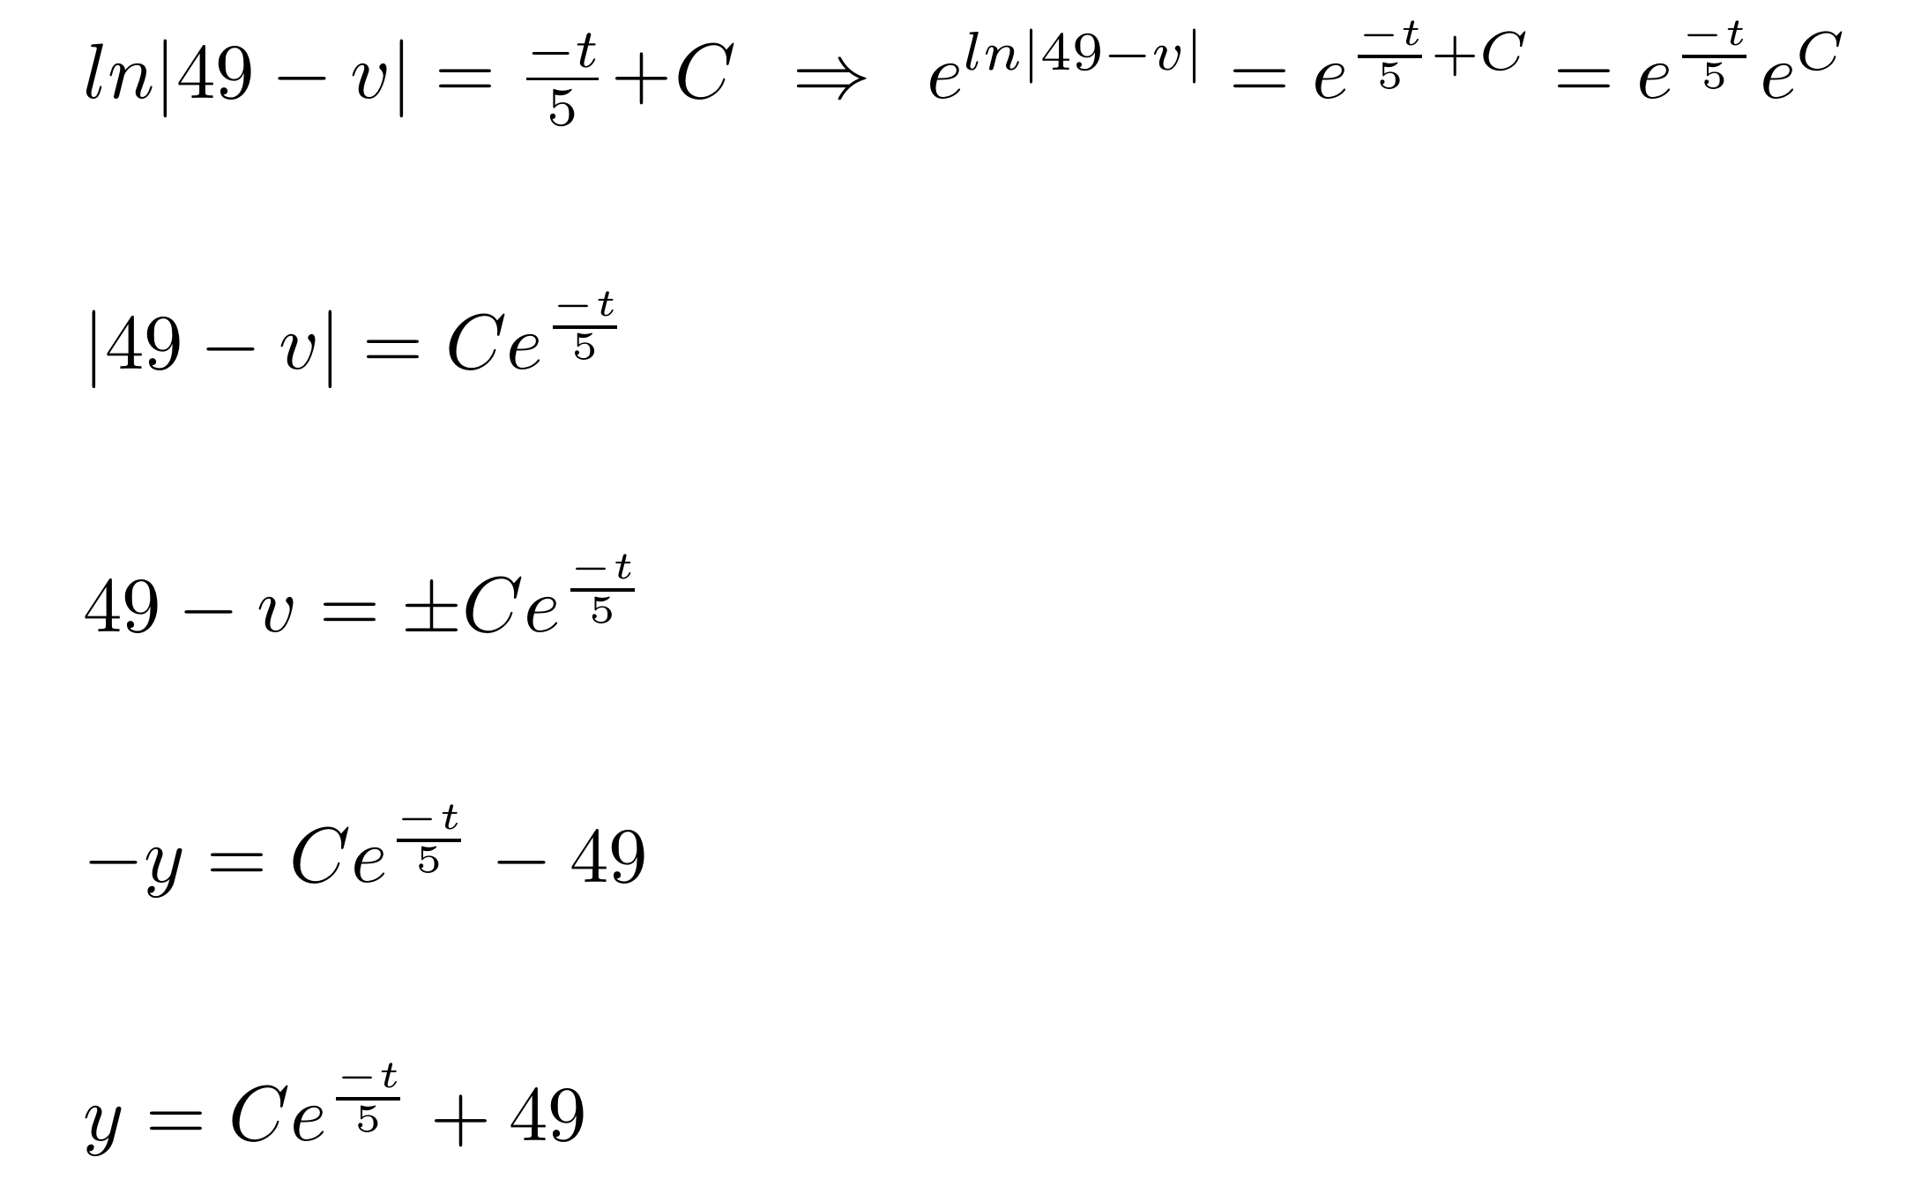

Slide 49
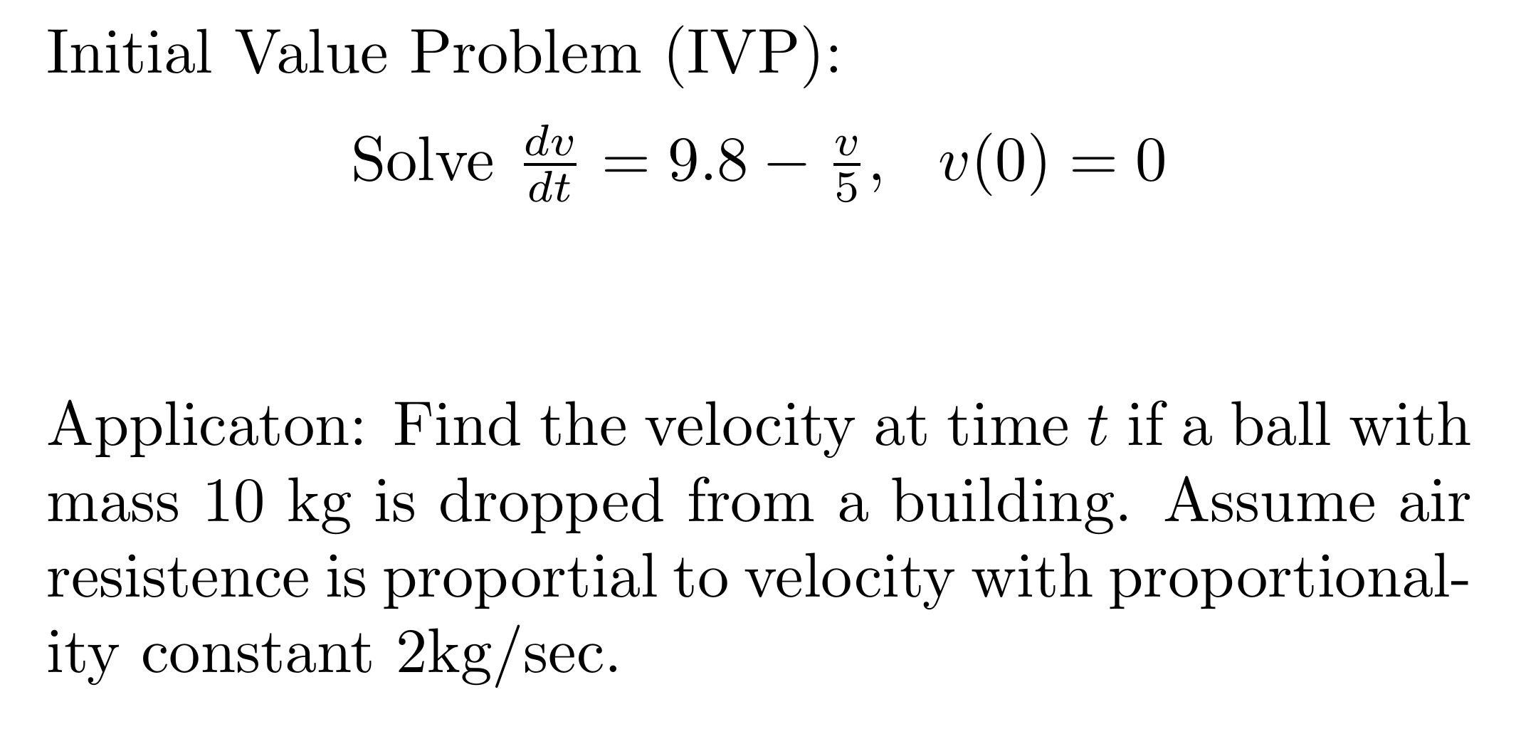

Slide 51
Ch 2.2: Separable Equations
http://bcs.wiley.com/he-bcs/Books?action=resource &bcsId=2026&itemId=047143339X&resourceId=4140
In this section we examine a subclass of linear and nonlinear first order equations. Consider the first order equation
We can rewrite this in the form
For example, let M(x,y) = - f (x,y) and N (x,y) = 1. There may be other ways as well. In differential form,
If M is a function of x only and N is a function of y only, then
In this case, the equation is called separable.

Slide 52
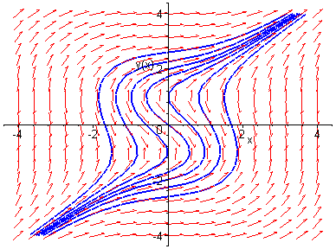
Example 1: Solving a Separable Equation
http://bcs.wiley.com/he-bcs/Books?action=resource &bcsId=2026&itemId=047143339X&resourceId=4140
Solve the following first order nonlinear equation:
Separating variables, and using calculus, we obtain
The equation above defines the solution y implicitly. A graph showing the direction field and implicit plots of several integral curves for the differential equation is given above.

Slide 53
Example 2: Implicit and Explicit Solutions (1 of 4)
http://bcs.wiley.com/he-bcs/Books?action=resource&bcsId=2026&itemId=047143339X&resourceId=4140
Solve the following first order nonlinear equation:
Separating variables and using calculus, we obtain
The equation above defines the solution y implicitly. An explicit expression for the solution can be found in this case:

Slide 54
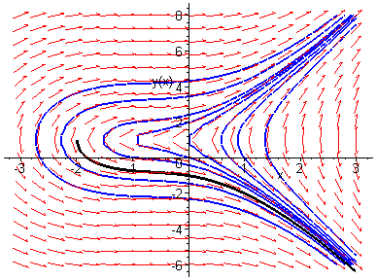
Example 2: Initial Value Problem (2 of 4)
http://bcs.wiley.com/he-bcs/Books?action=resource &bcsId=2026&itemId=047143339X&resourceId=4140
Suppose we seek a solution satisfying y(0) = -1. Using the implicit expression of y, we obtain
Thus the implicit equation defining y is
Using explicit expression of y,
It follows that

Slide 55
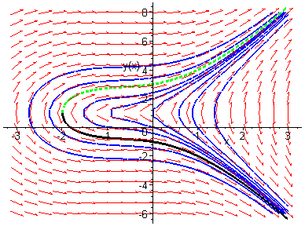
Example 2: Initial Condition y(0) = 3 (3 of 4)
http://bcs.wiley.com/he-bcs/Books?action=resource &bcsId=2026&itemId=047143339X&resourceId=4140
Note that if initial condition is y(0) = 3, then we choose the positive sign, instead of negative sign, on square root term:

Slide 56
Example 2: Domain (4 of 4)
http://bcs.wiley.com/he-bcs/Books?action=resource &bcsId=2026&itemId=047143339X&resourceId=4140
Thus the solutions to the initial value problem
are given by
From explicit representation of y, it follows that
and hence domain of y is (-2, ∞). Note x = -2 yields y = 1, which makes denominator of dy/dx zero (vertical tangent).
Conversely, domain of y can be estimated by locating vertical tangents on graph (useful for implicitly defined solutions).

Slide 57
Example 3: Implicit Solution of Initial Value Problem (1 of 2)
http://bcs.wiley.com/he-bcs/Books?action=resource&bcsId=2026&itemId=047143339X&resourceId=4140
Consider the following initial value problem:
Separating variables and using calculus, we obtain
Using the initial condition, it follows that

Slide 58
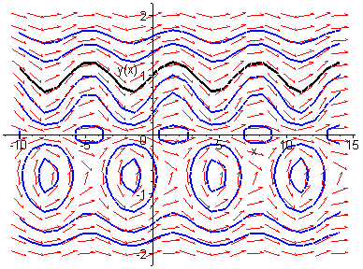
Example 3: Graph of Solutions (2 of 2)
http://bcs.wiley.com/he-bcs/Books?action=resource &bcsId=2026&itemId=047143339X&resourceId=4140
Thus
The graph of this solution (black), along with the graphs of the direction field and several integral curves (blue) for this differential equation, is given below.

