Slide 1
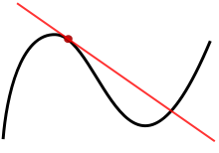

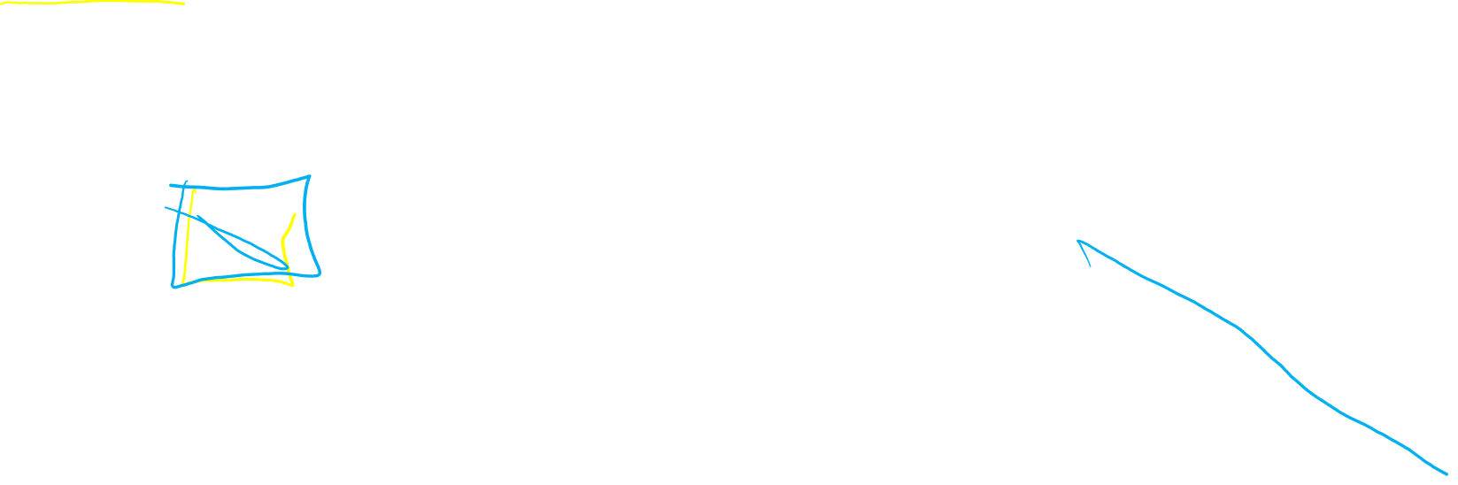
9.2
Calculus 1:
Linear approx. = tangent line

Slide 2
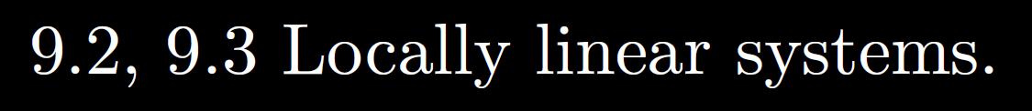
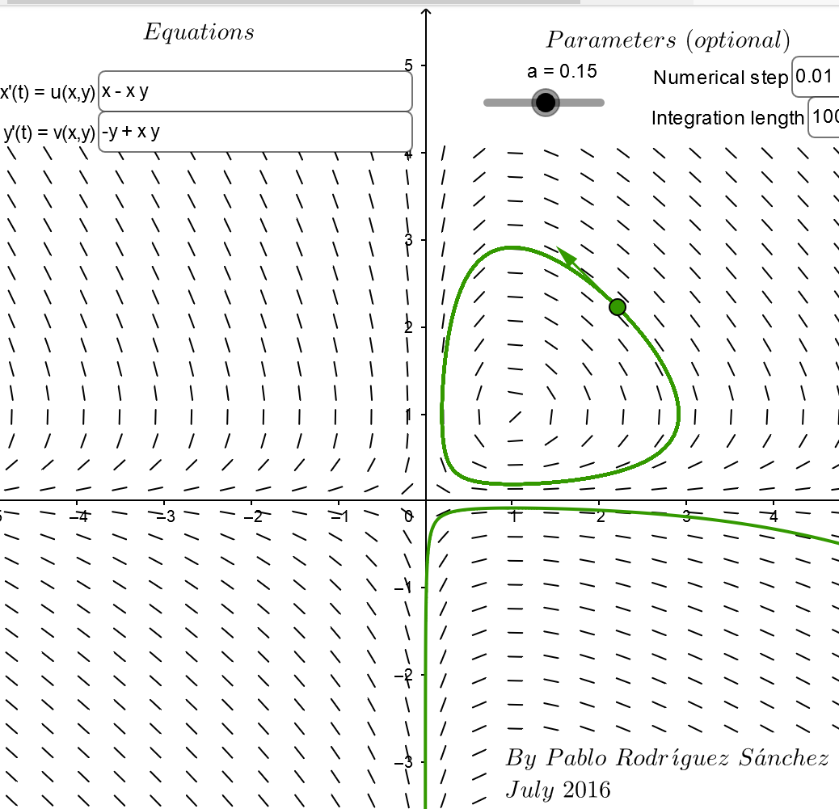
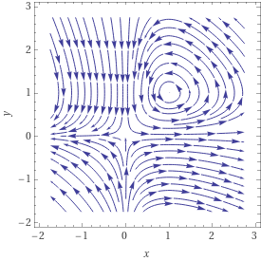
https://www.geogebra.org/m/abg8NJzF
https://www.wolframalpha.com/input/?i=streamplot+%7B+x+-+xy%2C++-y+%2B+xy%7D

Slide 3
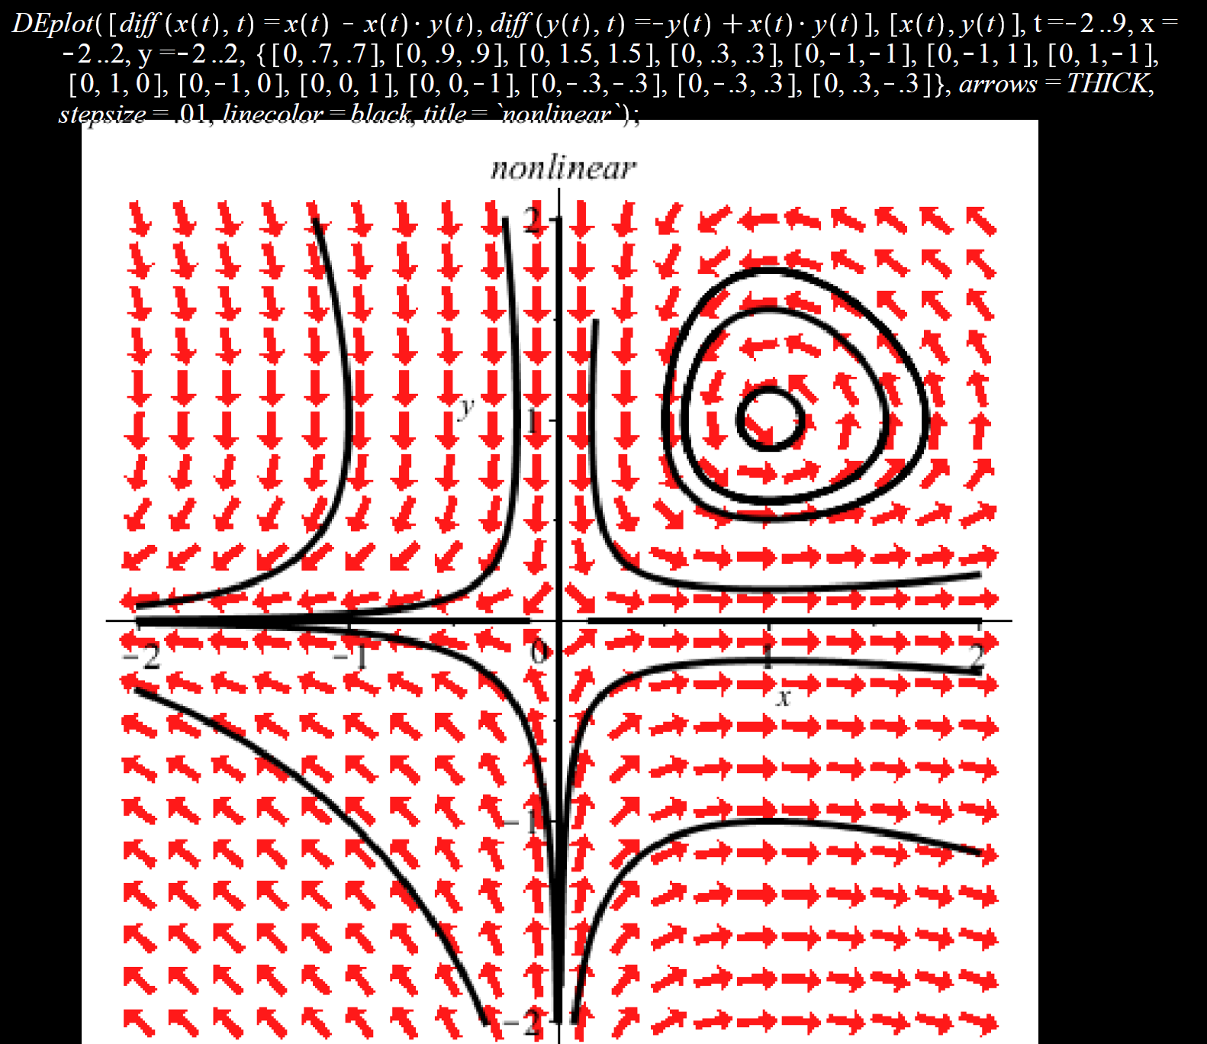
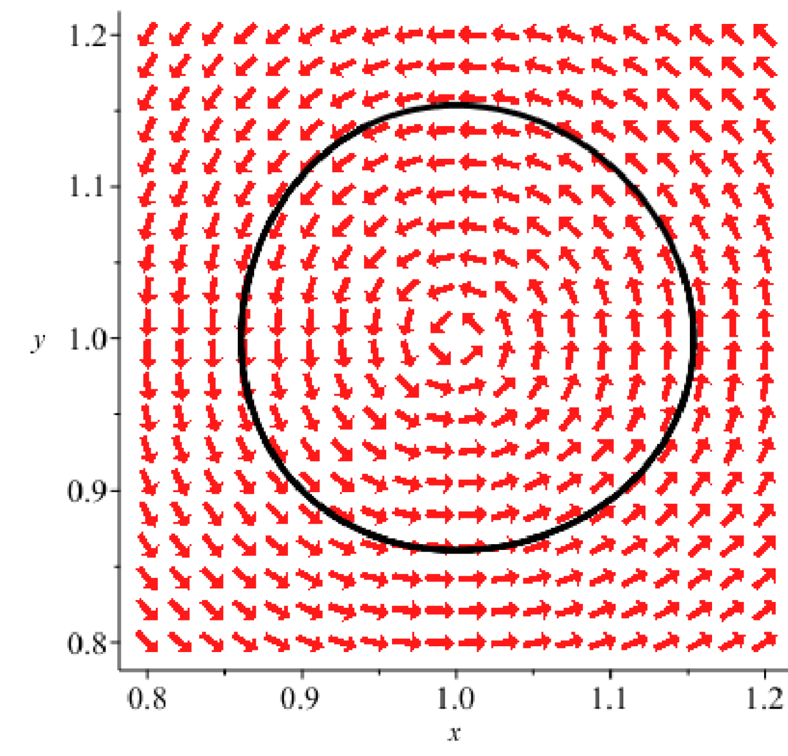
Locally can be approximated by a stable center
Locally can be approximated by an unstable saddle

Slide 4
Homogeneous linear system of equations: x’ = Ax
Non-homogeneous linear system of equations: x’ = Ax + b
To find equilibrium solutions, set x’ = 0:
Suppose Aw + b = 0 for some constant vector w.
Then x = w is a solution to x’ = Ax + b : [w]’ = 0 = Aw + b
Thus x = w is an equilibrium solution.
To determine its type, translate to the origin (or graph):
Let u = x – w. Then x = u + w
(u + w)’ = A(u + w) + b
u ‘+ w’ = Au + Aw + b
u’ = Au

Slide 5
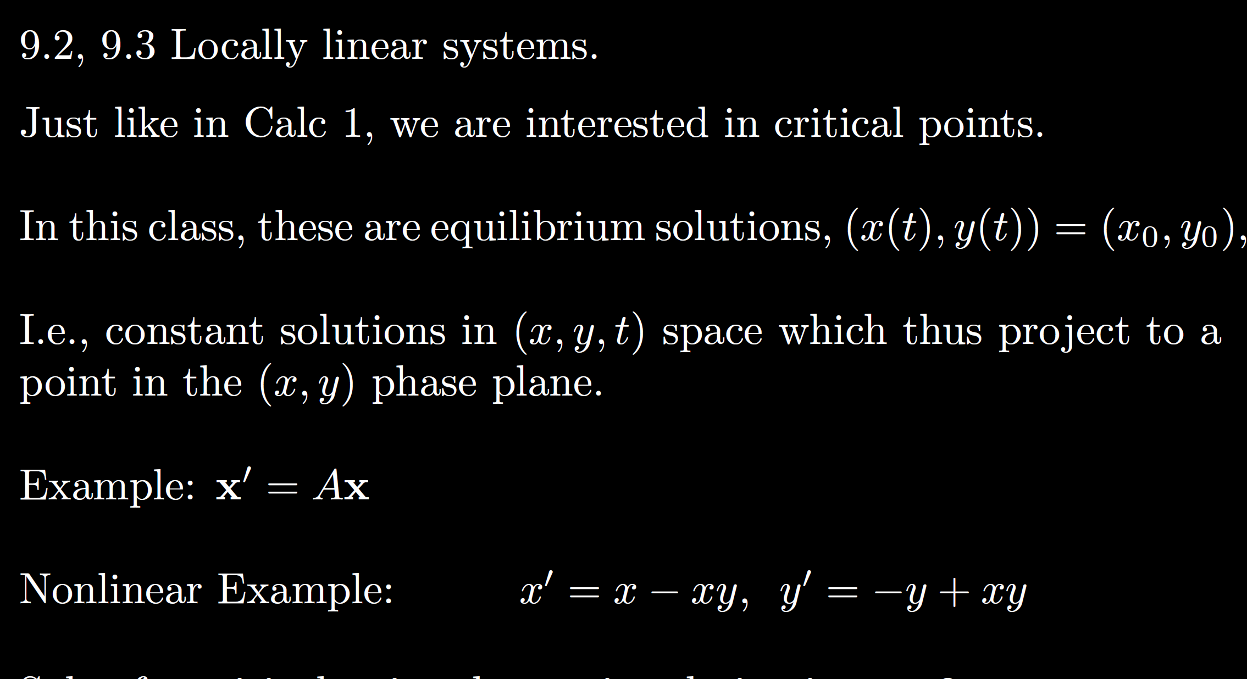

Slide 6
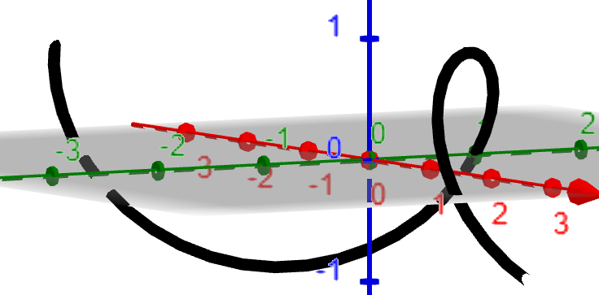
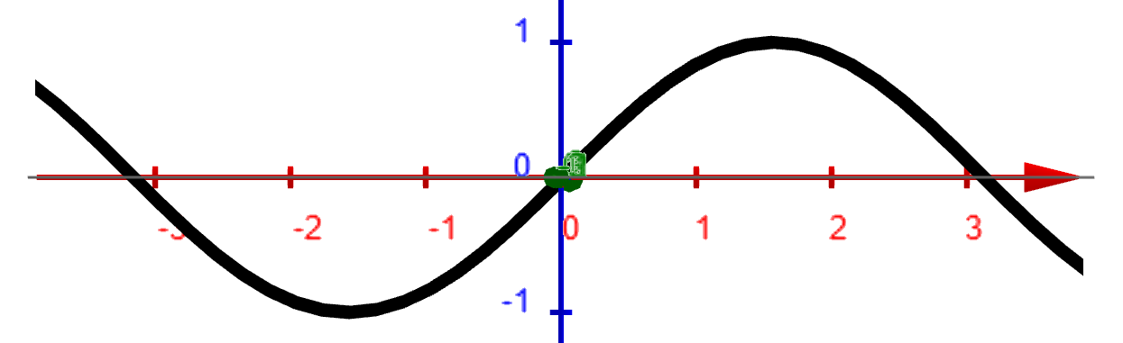
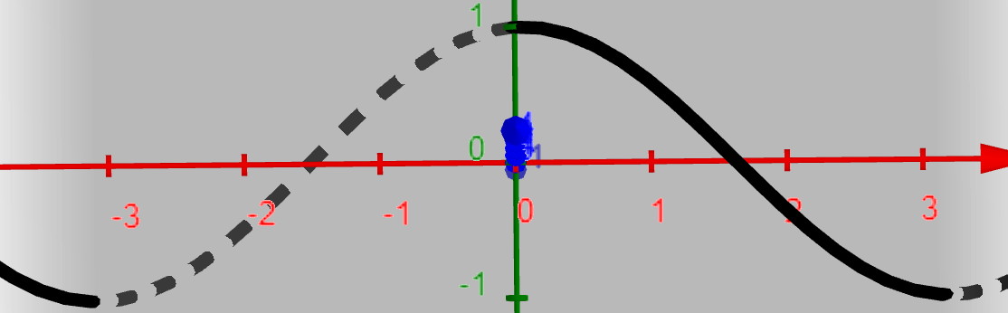
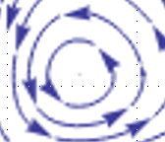
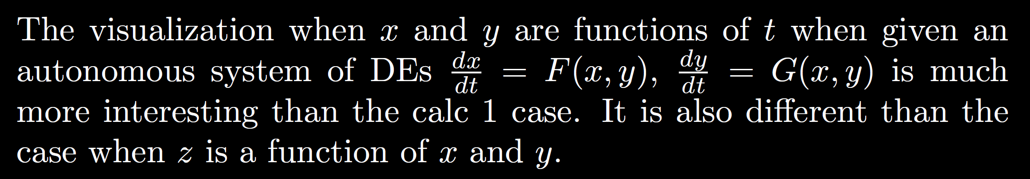
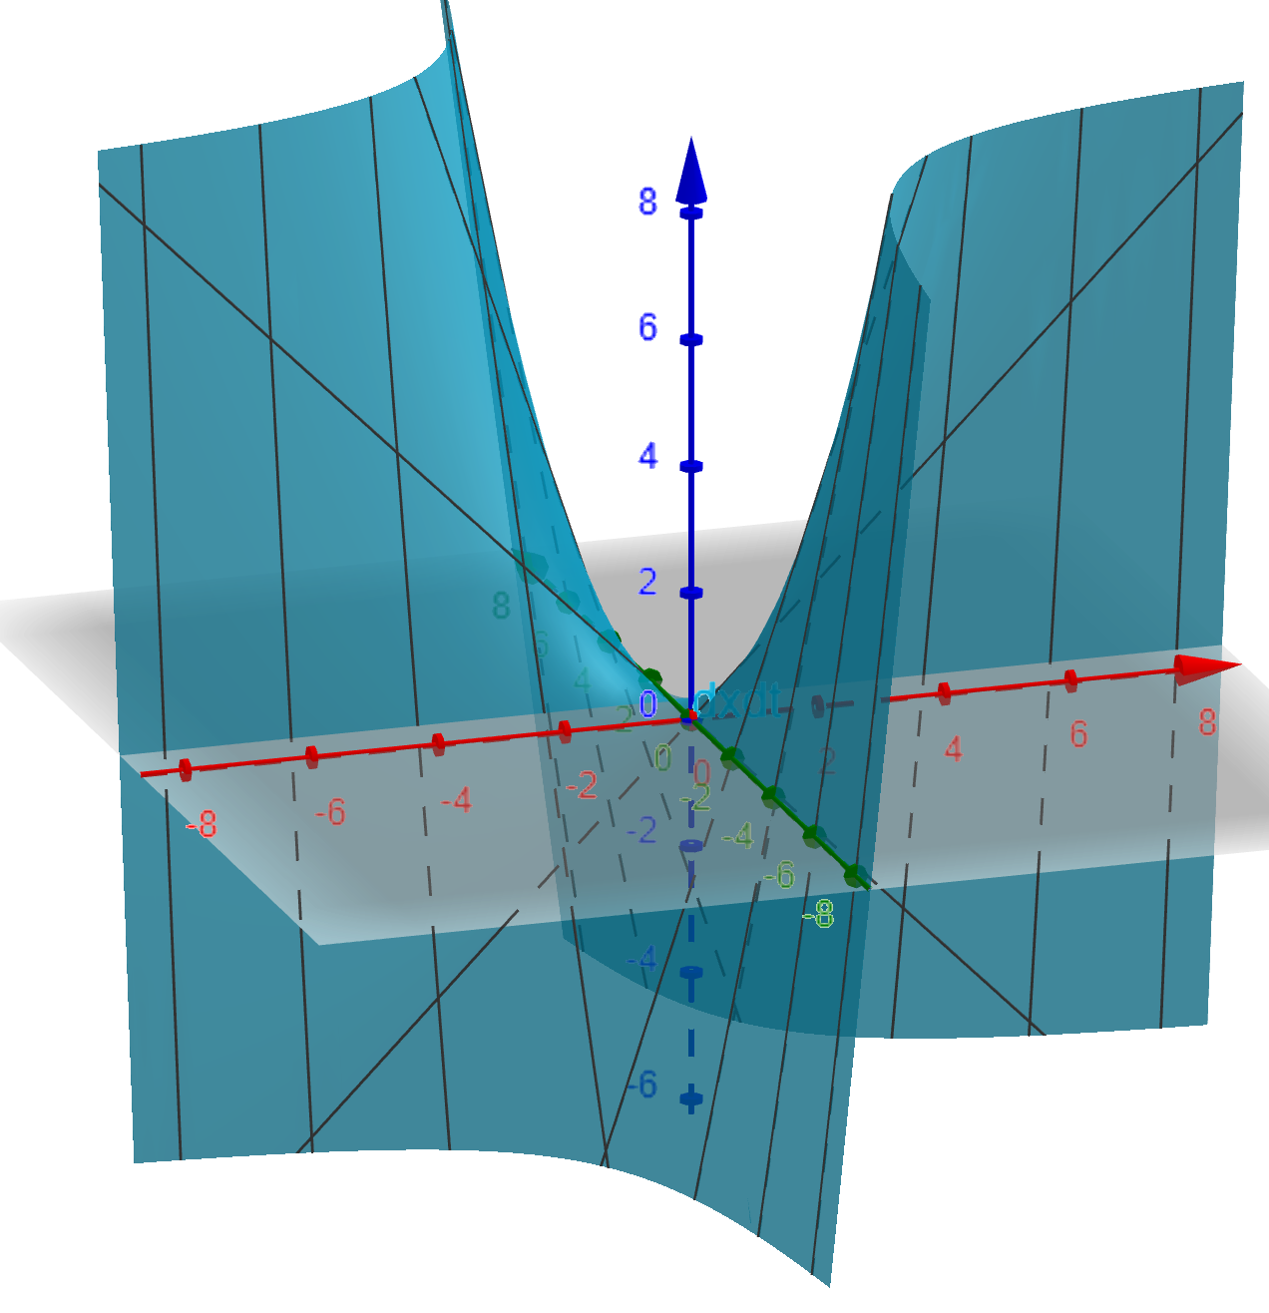
x
y
t
t

Slide 7
Locally can be approximated by a stable center
Locally can be approximated by an unstable saddle

Slide 8
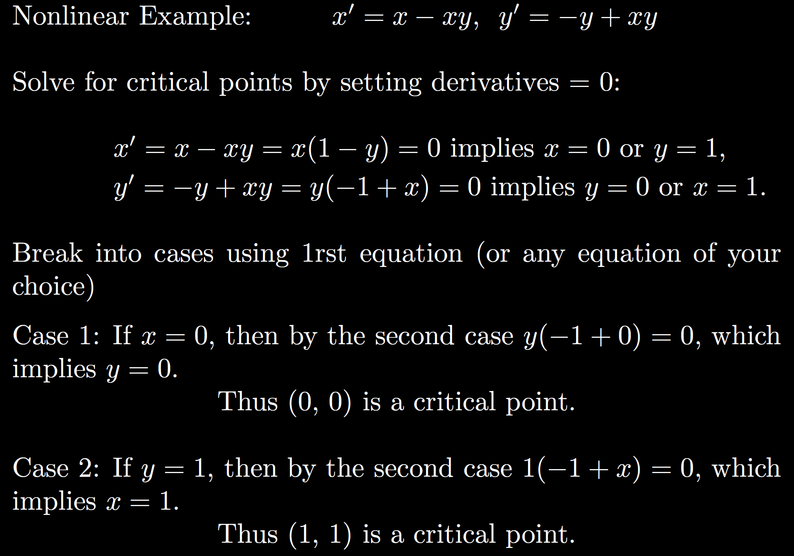

Slide 11
We will determine stability of these critical points in 9.3
via linear approximations.
Can also determine graphically
(but be careful):

Slide 12
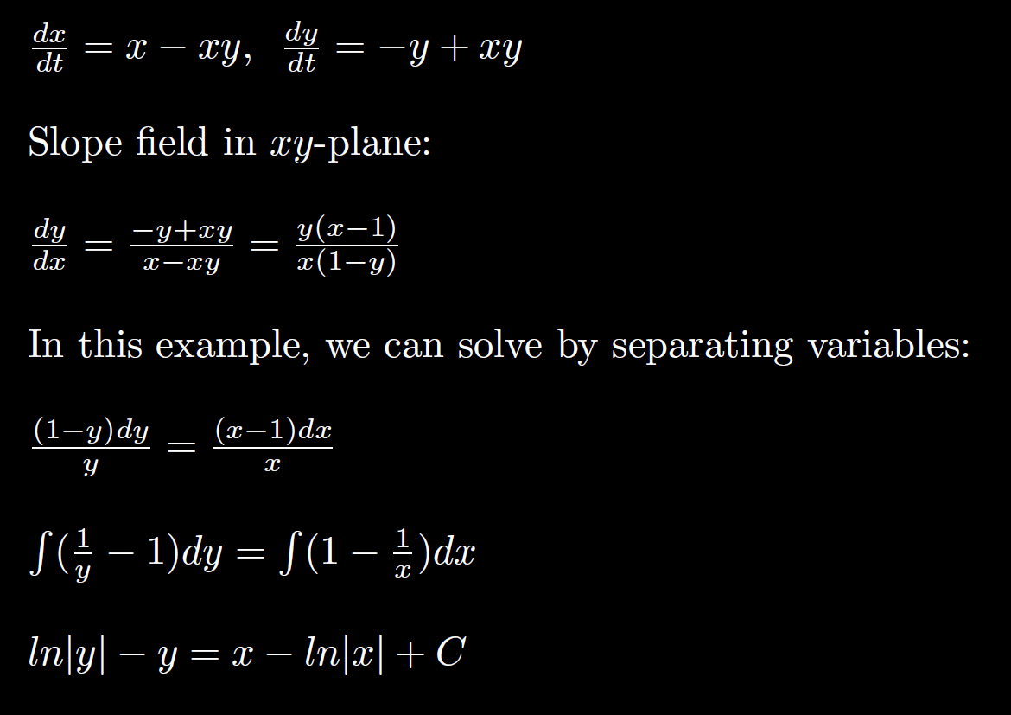

Slide 15
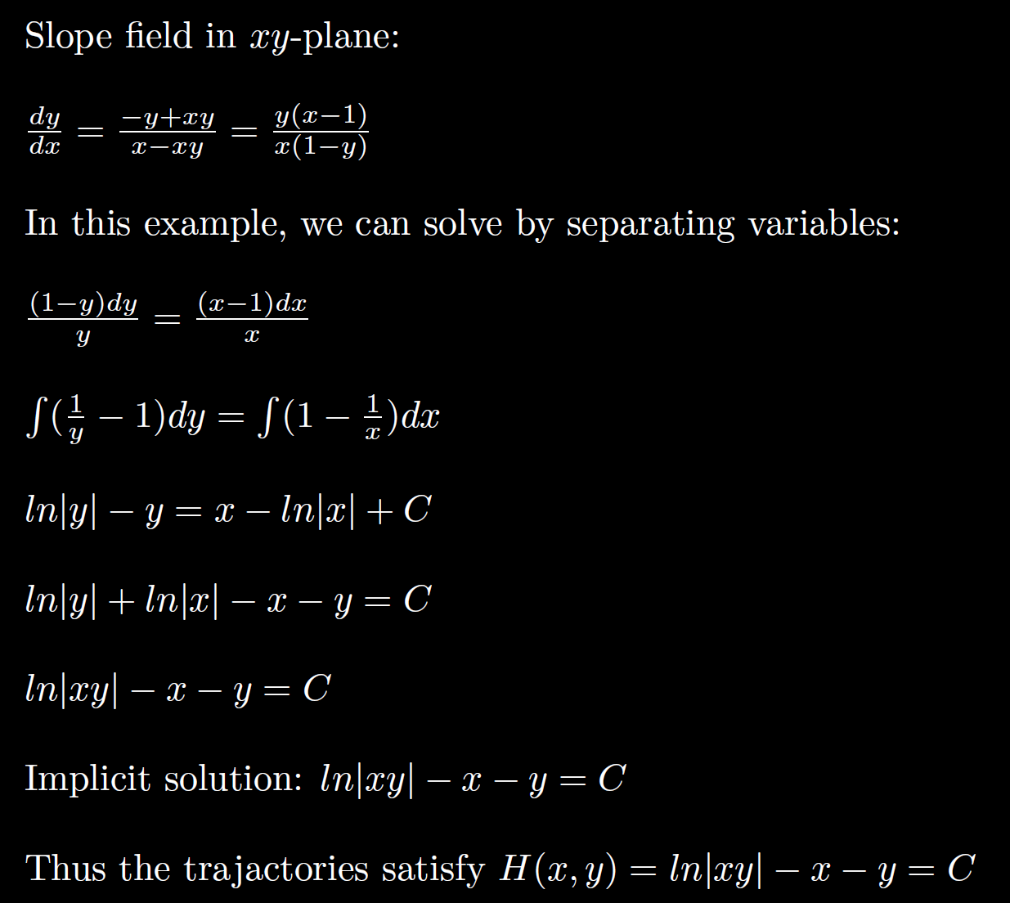
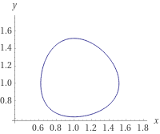
ln|xy| - x - y = -2.1

Slide 16
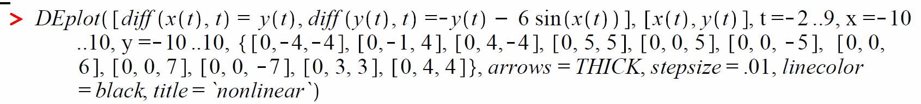
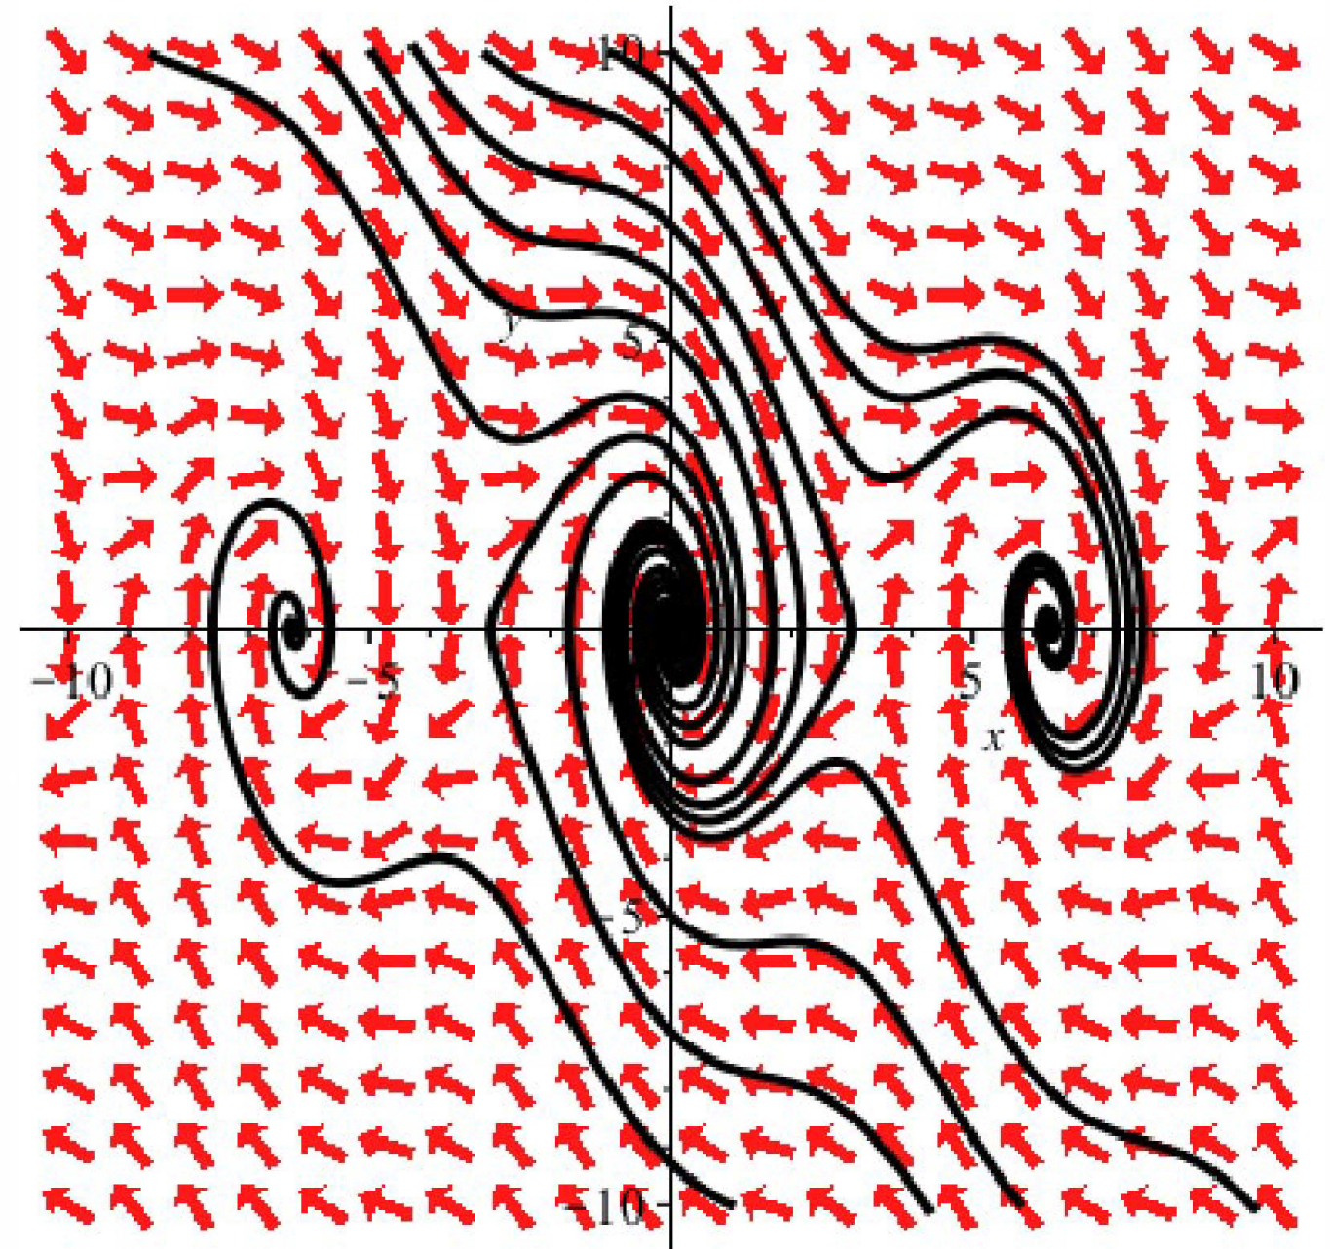

Slide 17
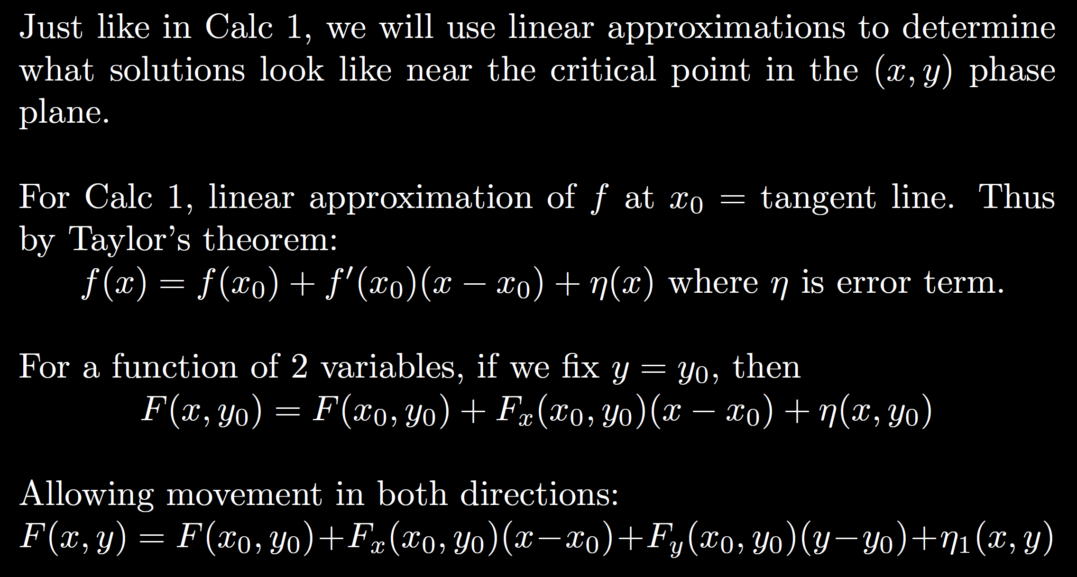

Slide 18
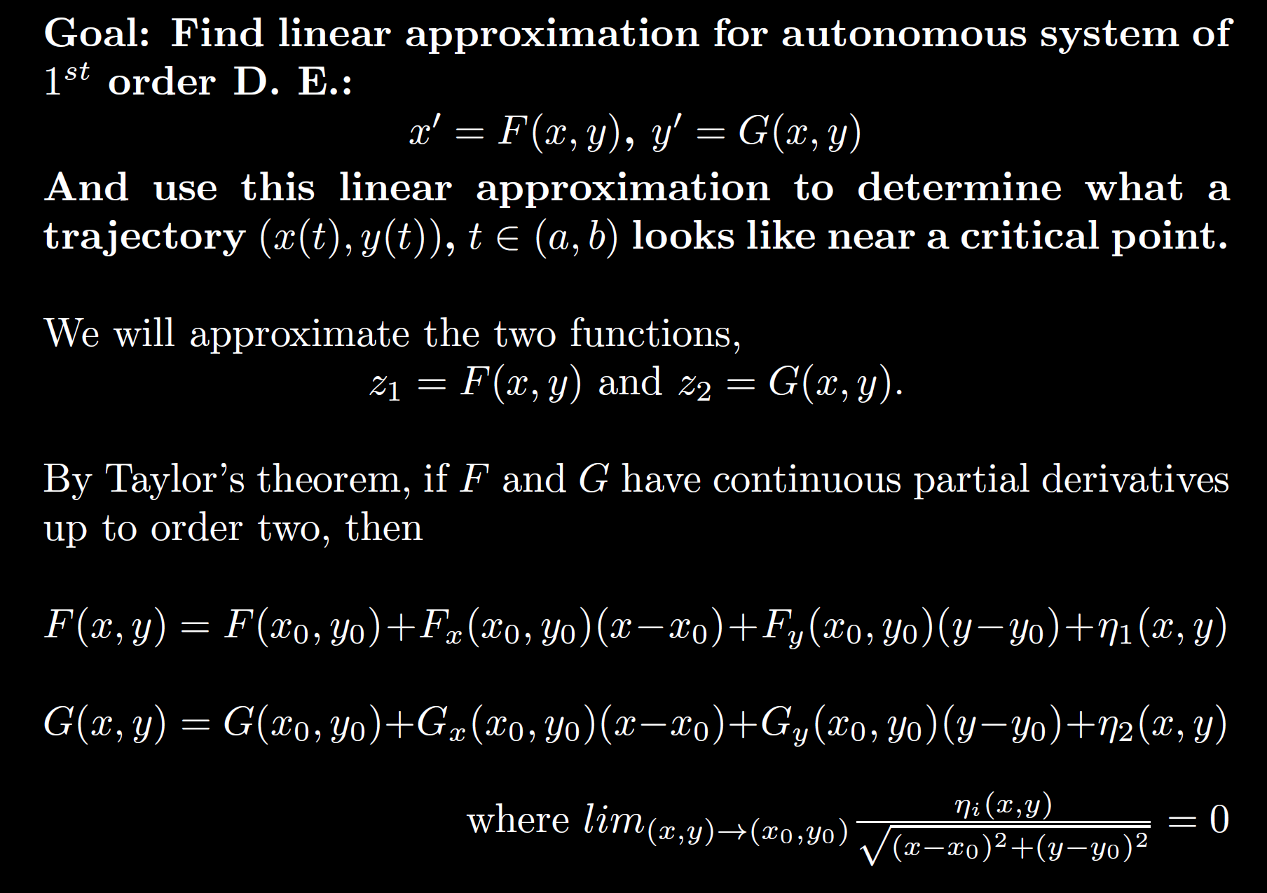

Slide 19
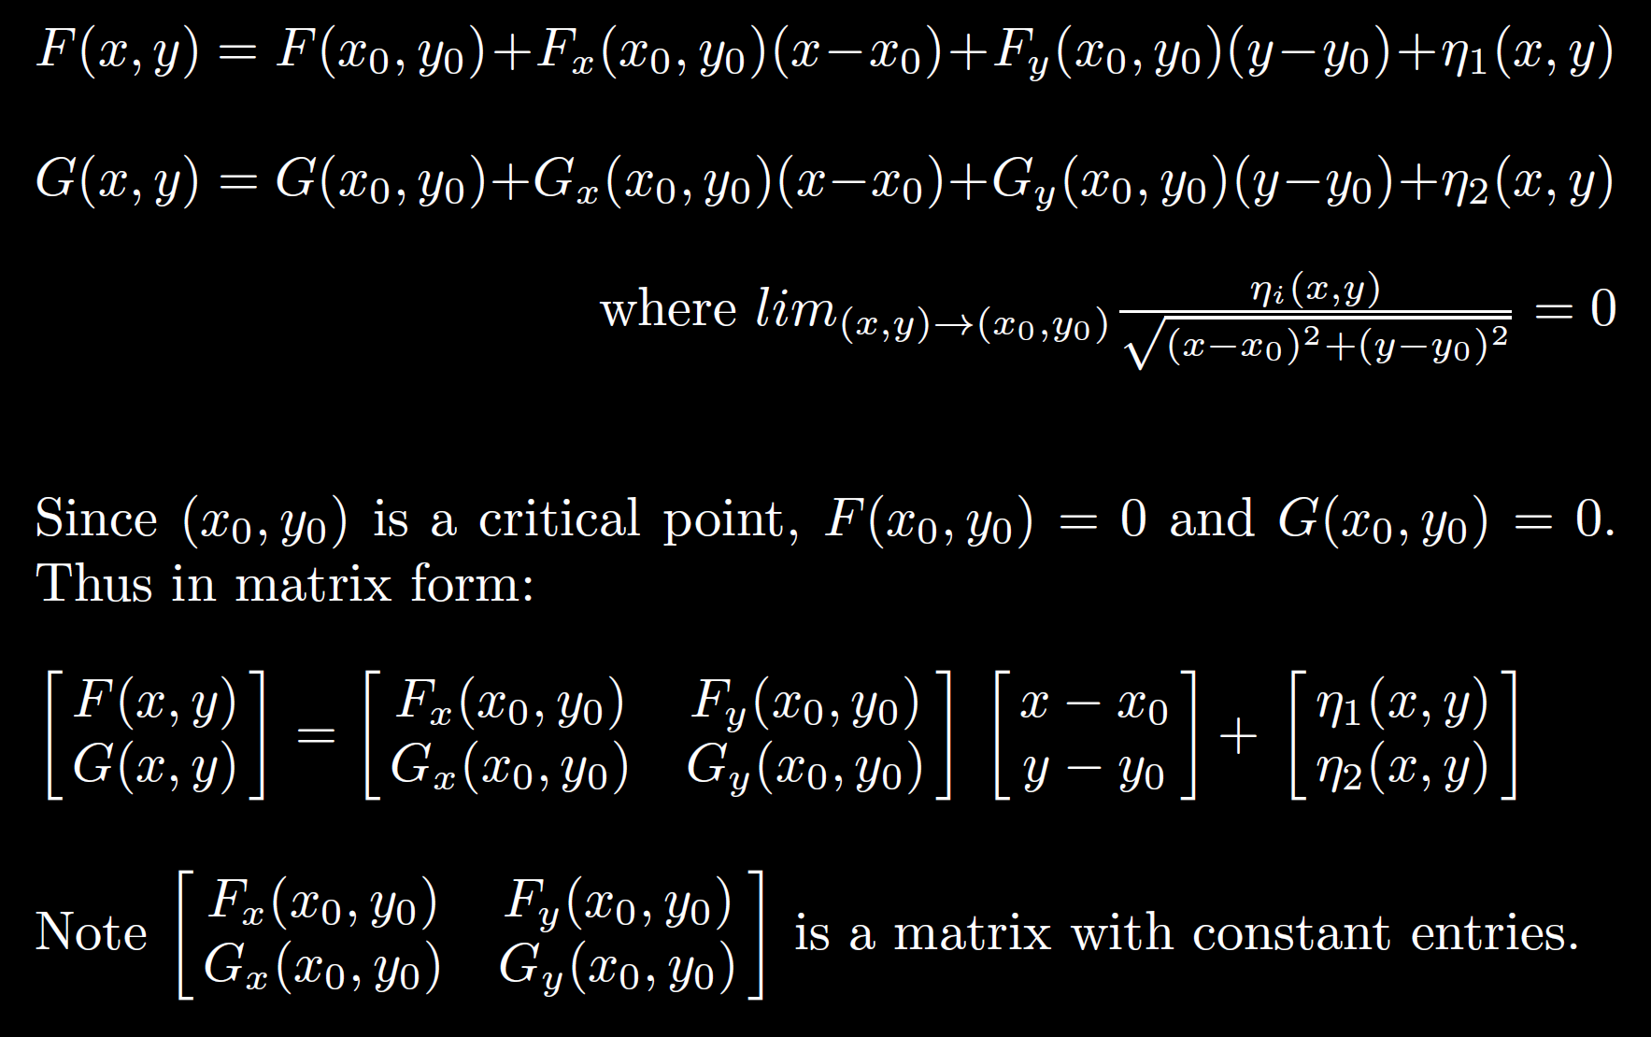

Slide 21
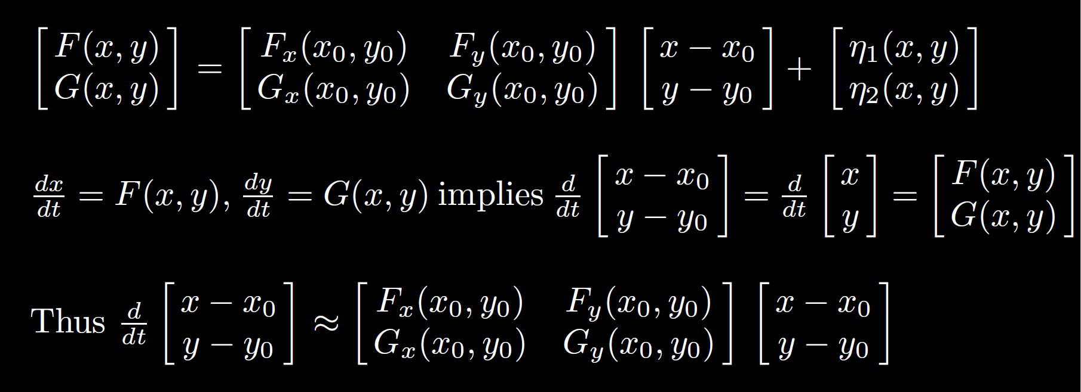

Slide 23
Error term

Slide 24
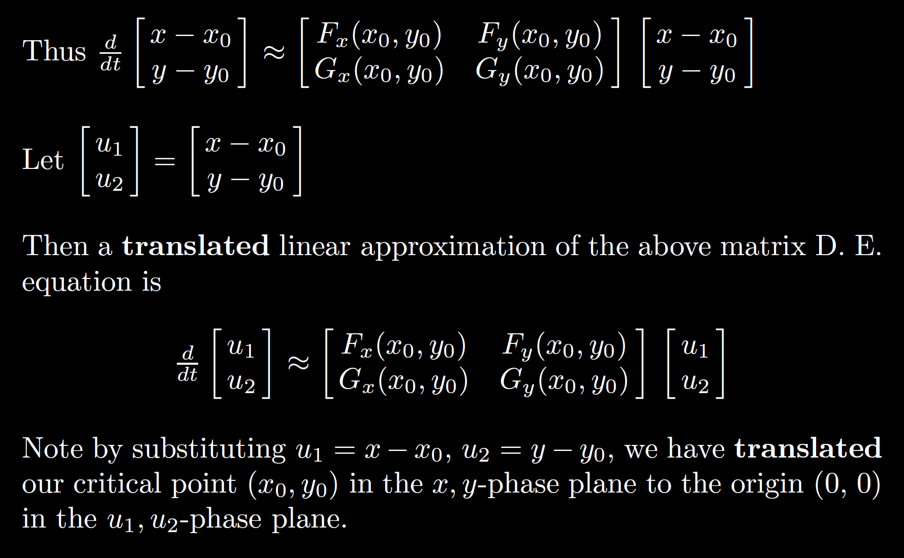

Slide 26
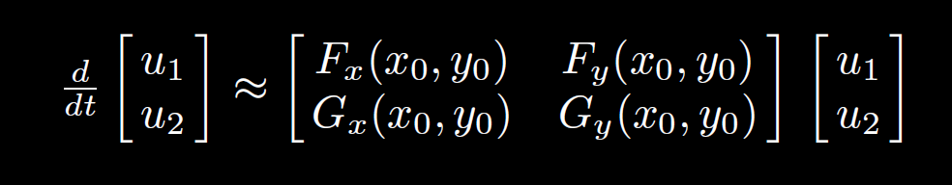
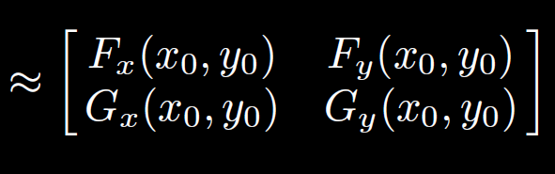






After translating critical point to origin:
$$u′$$
$$u$$
Thus at the critical point , the system of DEs
is approximated by the translated linear system:
$$x′$$
$$x$$

Slide 27
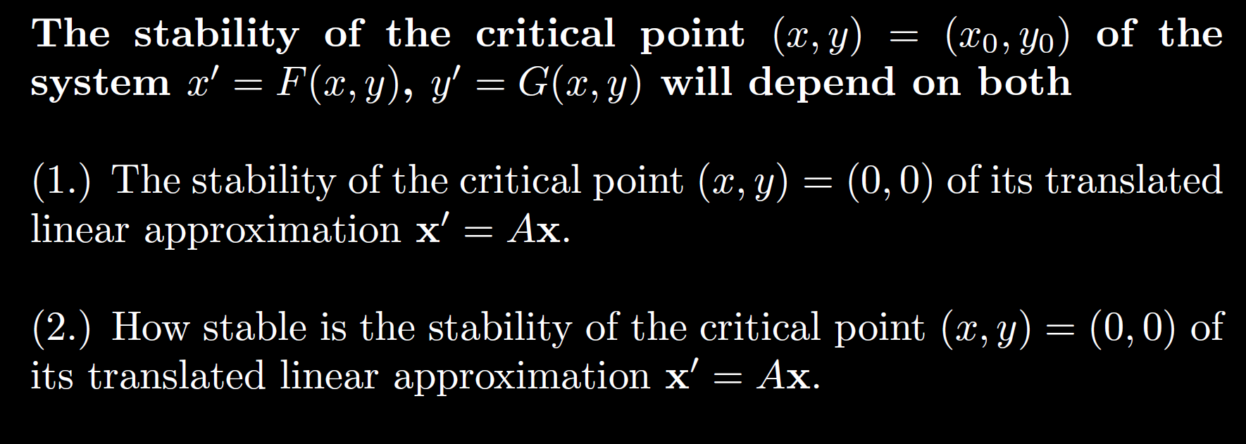


After translating critical point to origin:
$$x′$$
$$x$$

Slide 28
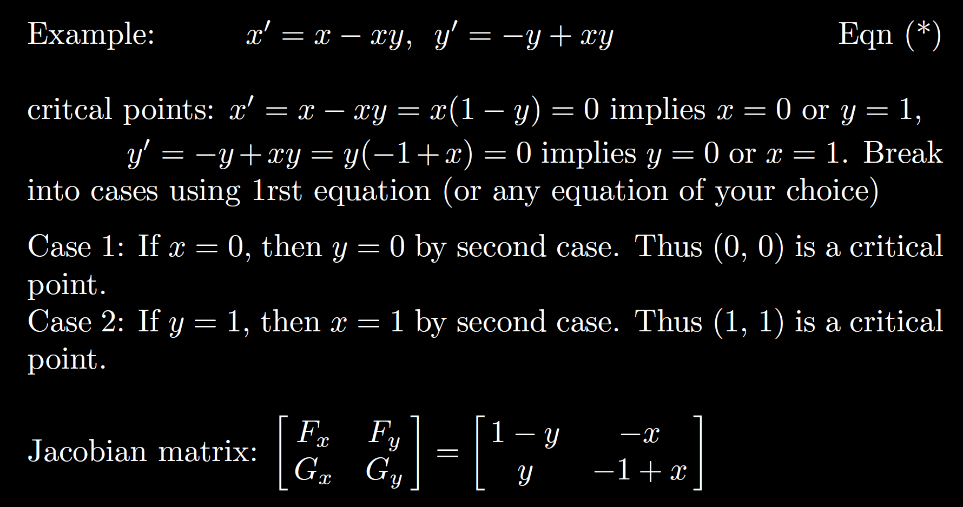

Slide 29
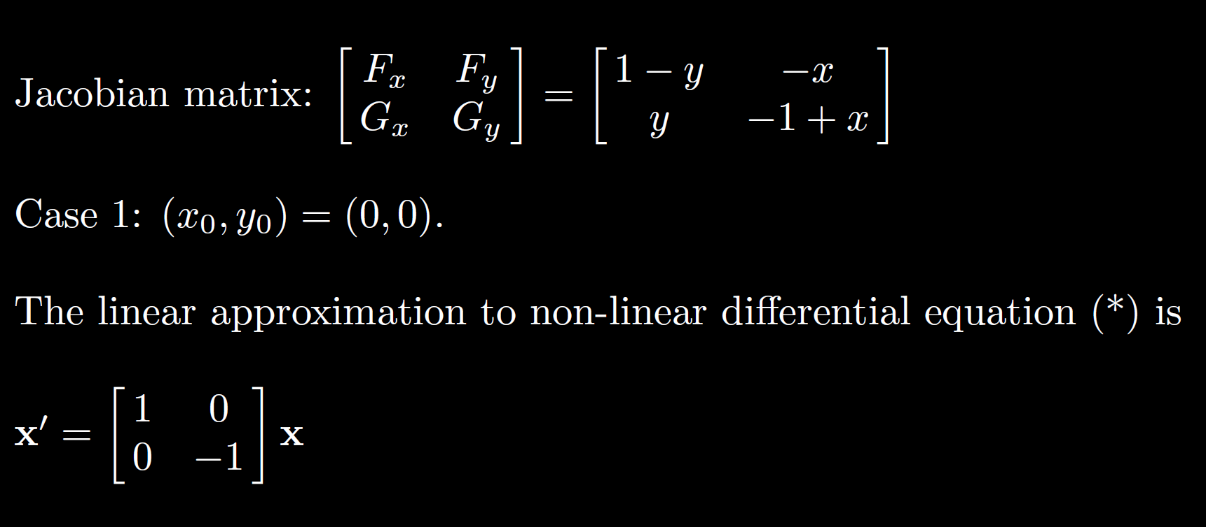

Slide 32
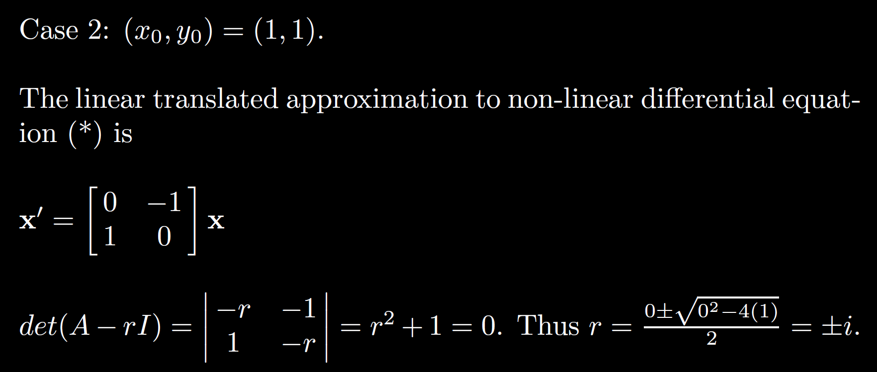

Slide 33
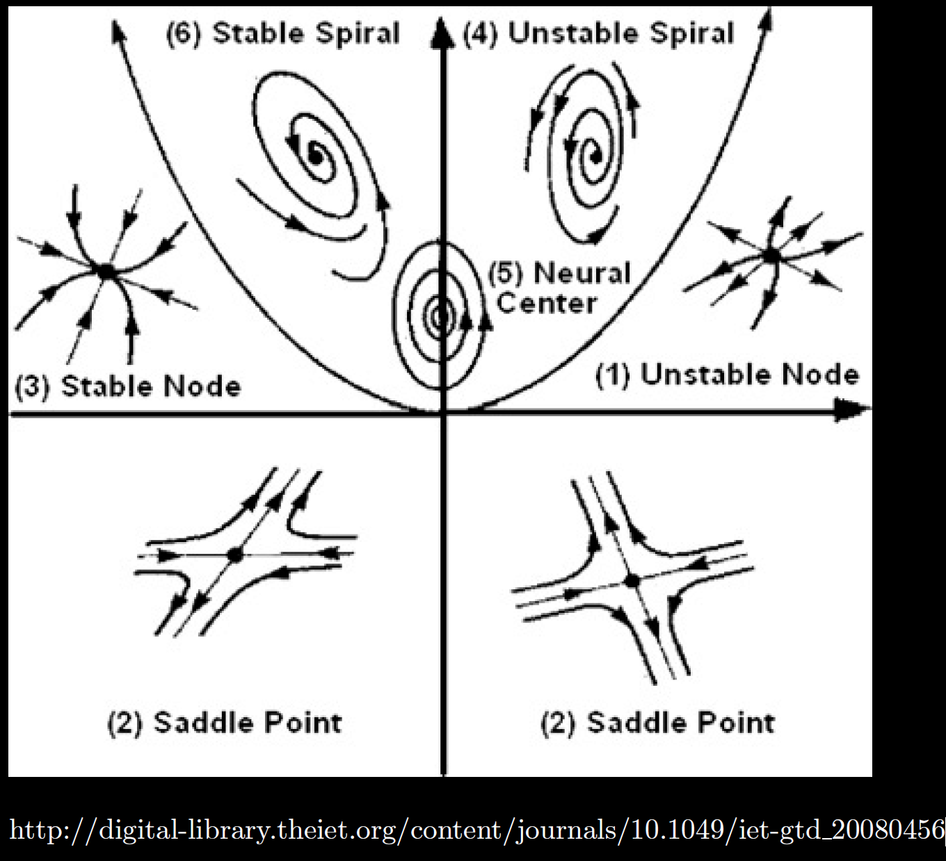

Slide 36
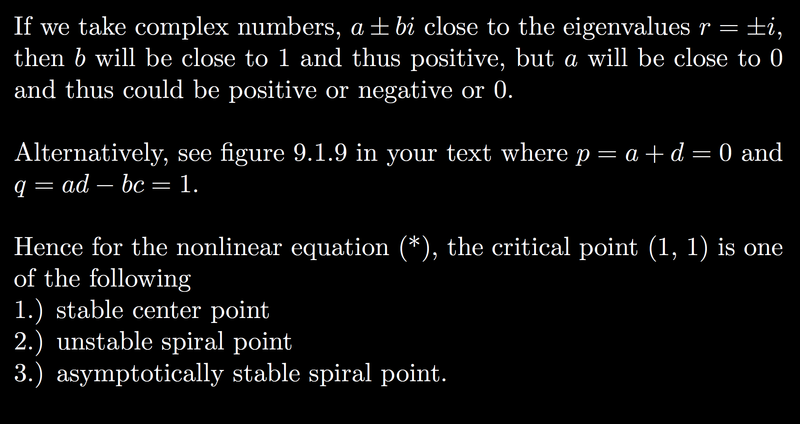

Slide 39
Basin of attraction – region of asymptotic stability of a critical point
Separatrix = trajectory that bounds basin of attaction

Slide 40
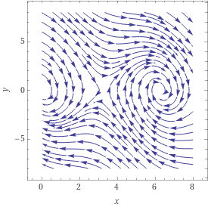






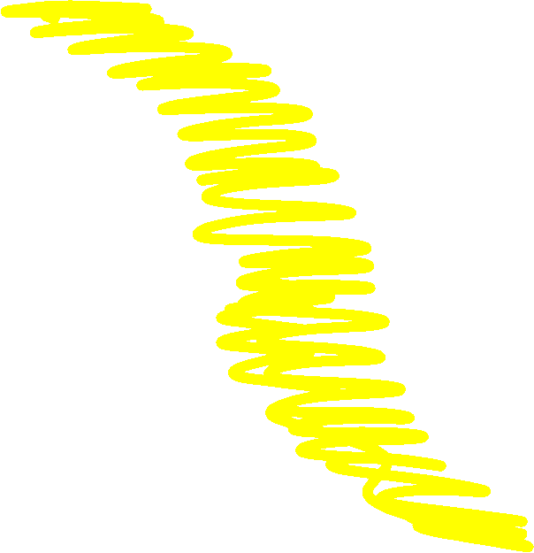

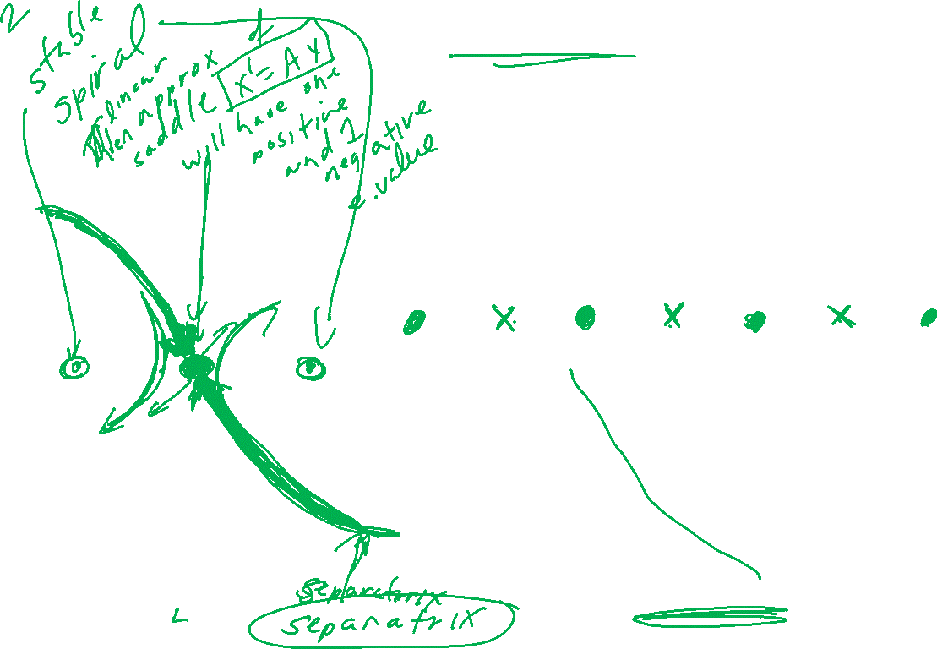



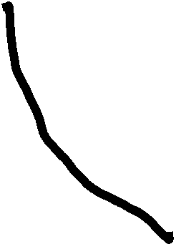





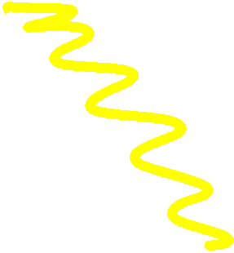



Slide 42
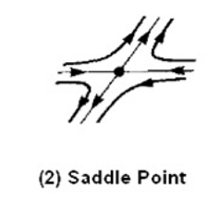
Center is stable, but not asymptotically stable
Asymptotically stable
Just need one positive expo-nential for
Unstable

