Slide 2
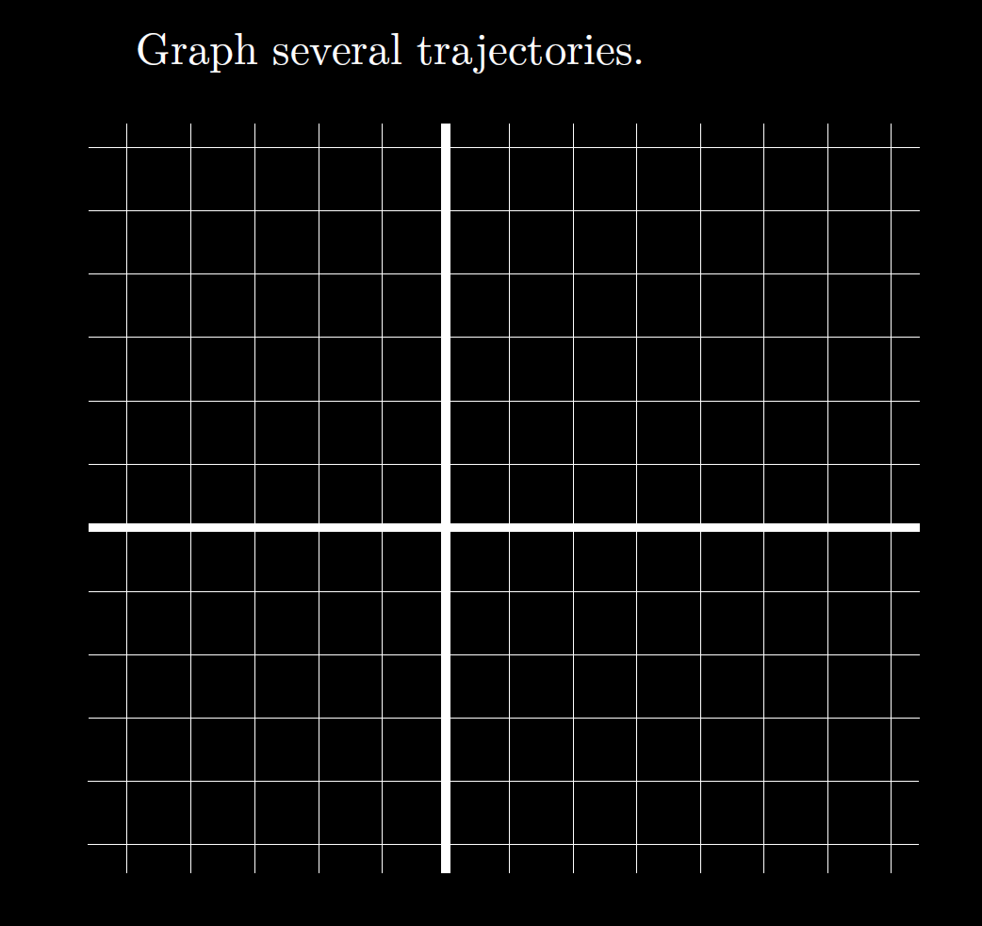

Slide 3
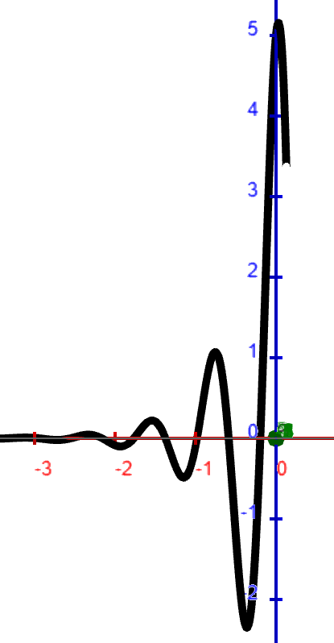
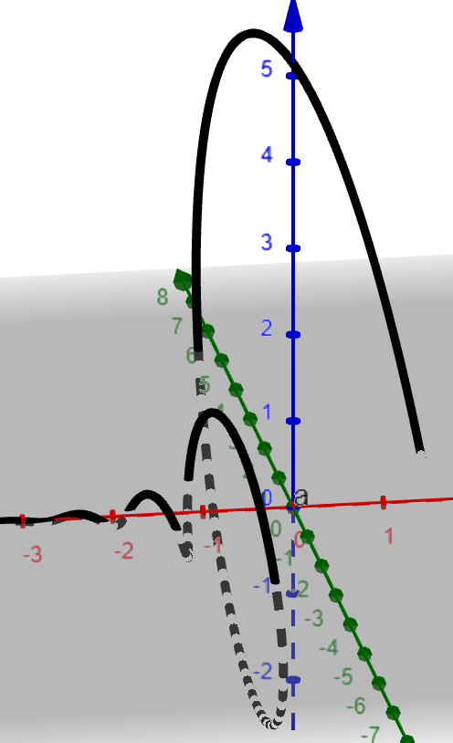

Slide 7
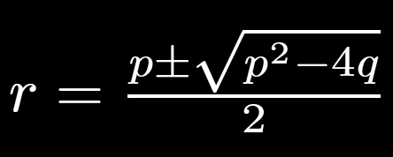
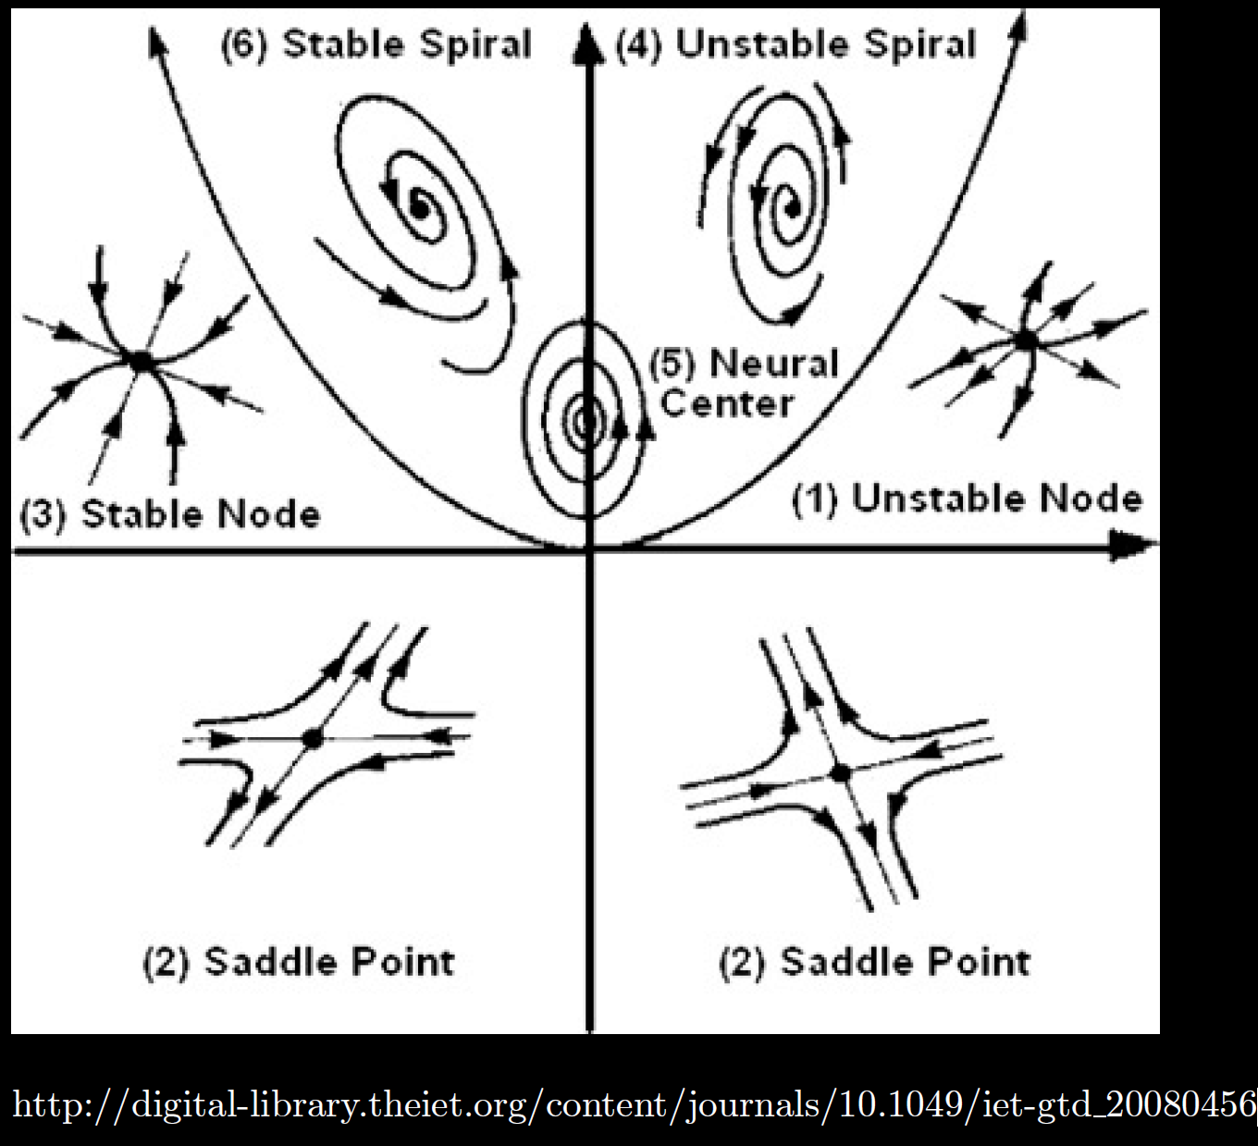
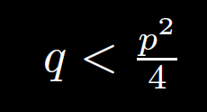
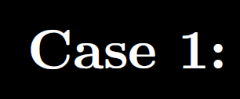
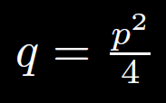
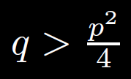

Slide 14
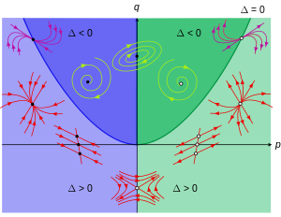
https://en.wikipedia.org/wiki/Phase_plane

Slide 20
Stability
Case A: ALL exponentials are negative.

Slide 21
Stability
Case B: NO exponential.

Slide 22
Stability
Case C: At least one positive exponential.

Slide 24
Stability
Case A: ALL exponentials are negative.

Slide 25
Stability
Case B: NO exponential.

Slide 26
Stability
Case C: At least one positive exponential.

Slide 27
Case not covered:
https://en.wikipedia.org/wiki/Phase_plane

Slide 28
https://en.wikipedia.org/wiki/Phase_plane

Slide 29
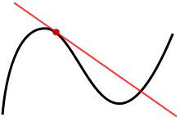
9.2
Calculus 1:
Linear approx. = tangent line

Slide 30
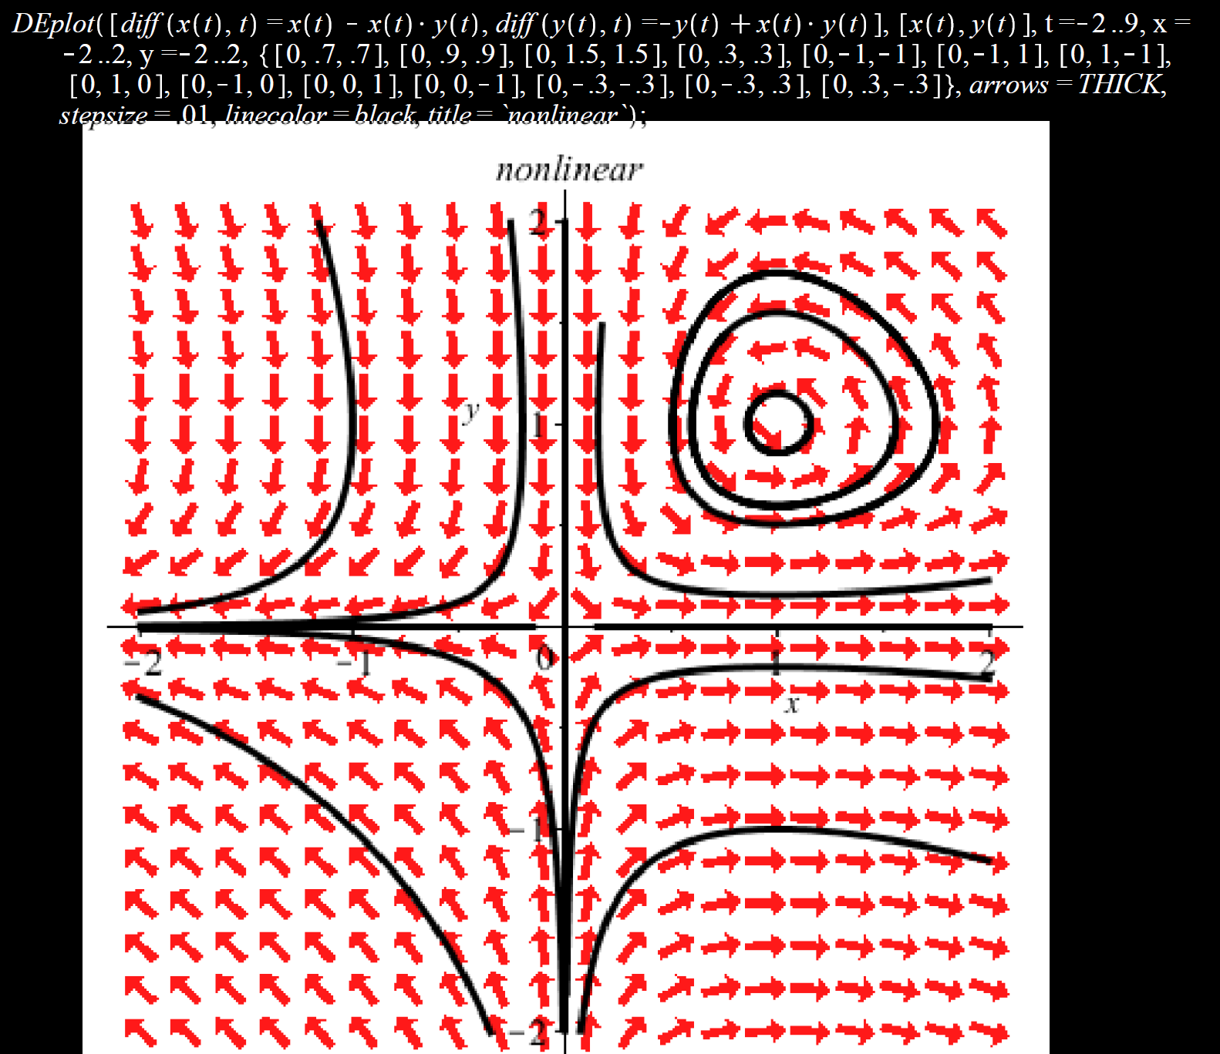
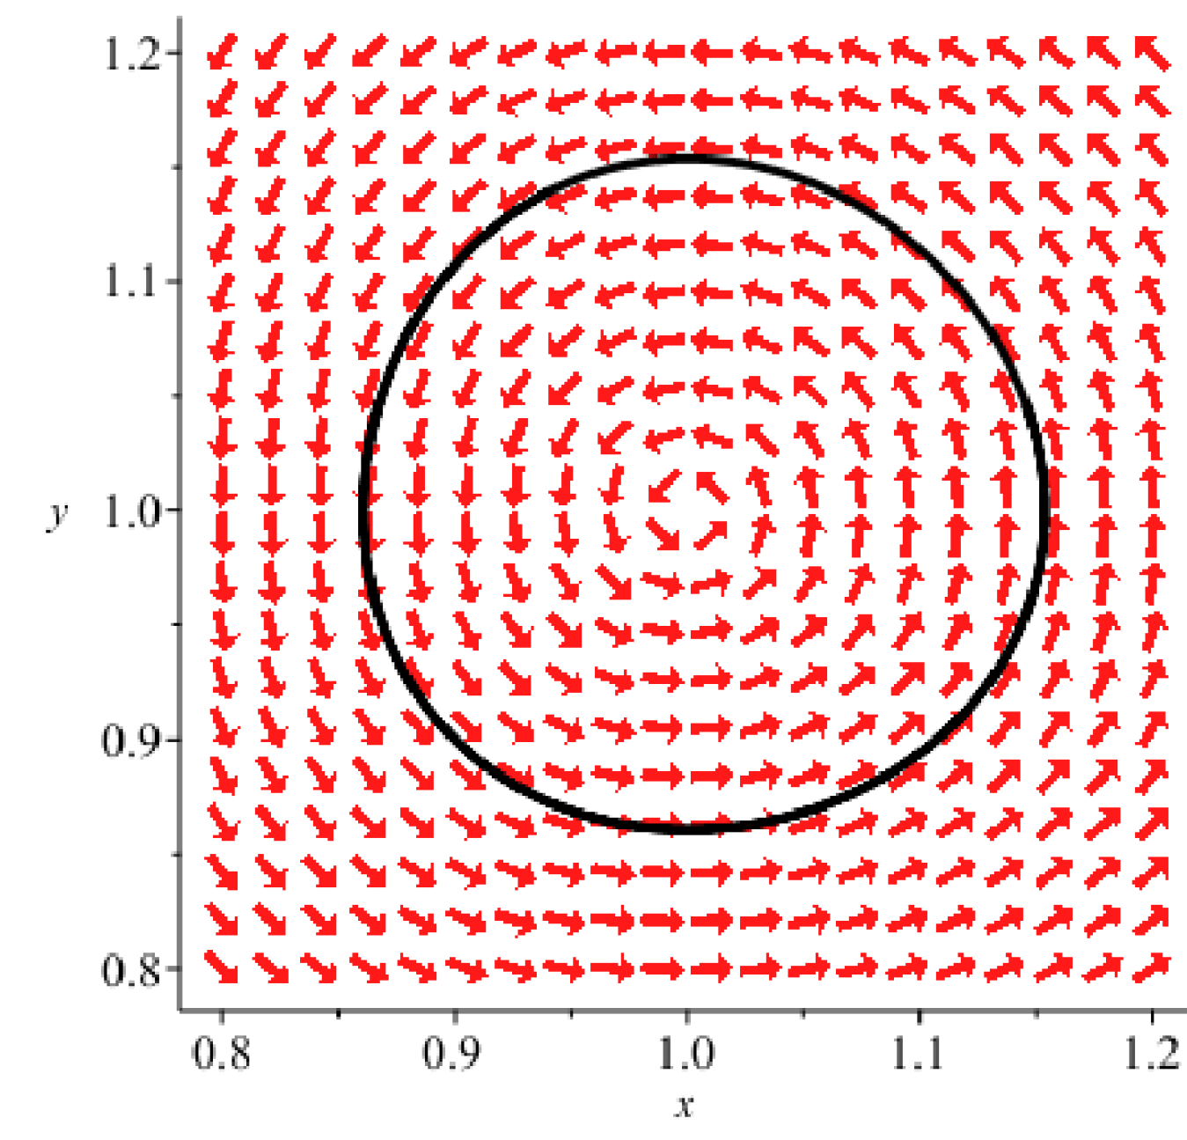
Locally can be approximated by a stable center
Locally can be approximated by an unstable saddle
Nonlinear system of differential equations can be locally approximated by linear homog DE x’ = Ax

Slide 31
Your 9.2 HW are linear homogenous system of DE x’ = Ax
So we won’t cover the nonlinear case.

Slide 32
6.1: Define LaPlace transform including review improper integrals,
Derive formulas 1 – 11, 18 in LaPlace transform table.
6.2: Use LaPlace transform to solve linear DE.
6.3: Derive formulas 12 – 14 including algebra review.
****** Formulas 13 and 13’ ******
6.4 Use formulas 13 and 13’ to solve linear DE.
6.5: Derive formula 17 including intro to impulse function which is a
“generalized function”.
6.6: Formula 16 including brief intro to convolution integral.

Slide 33
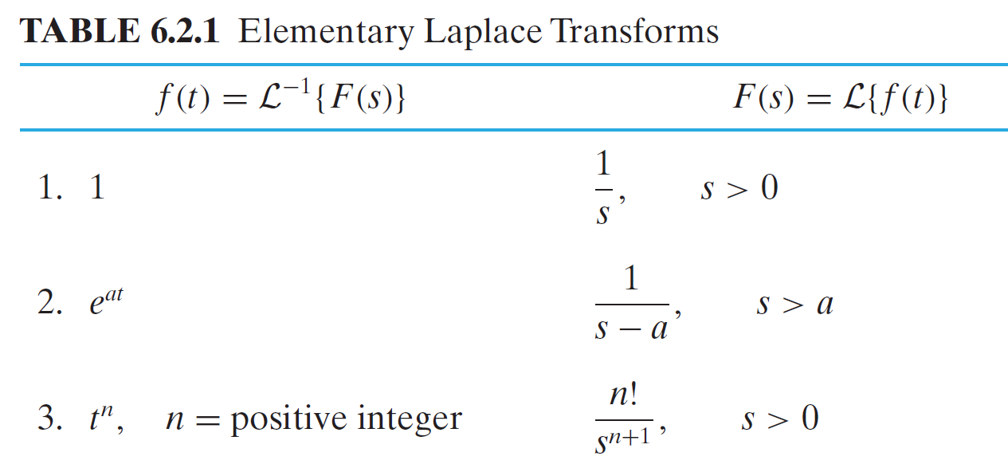
6.1: LaPlace transform

Slide 34
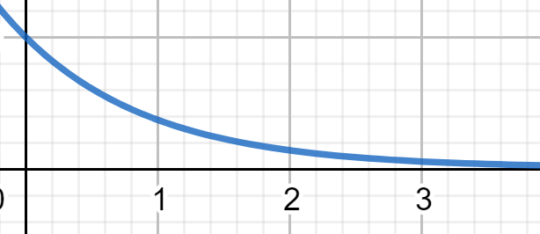
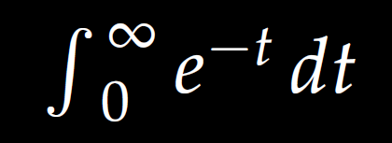
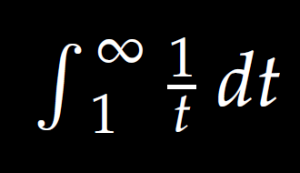
6.1: Improper integral

Slide 35
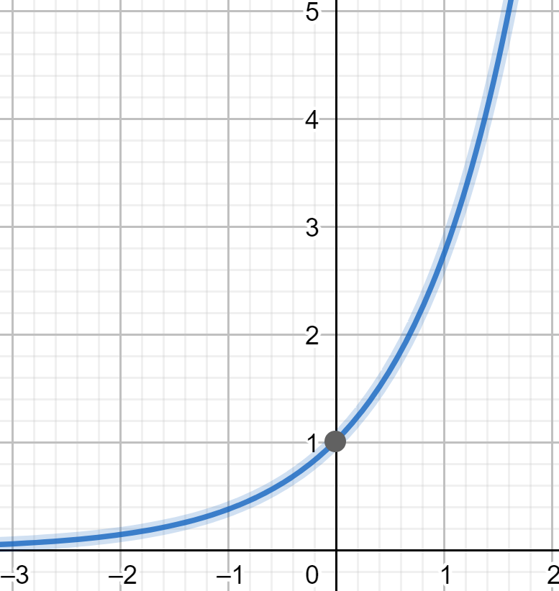
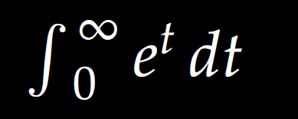
6.1: Improper integral

