Slide 1
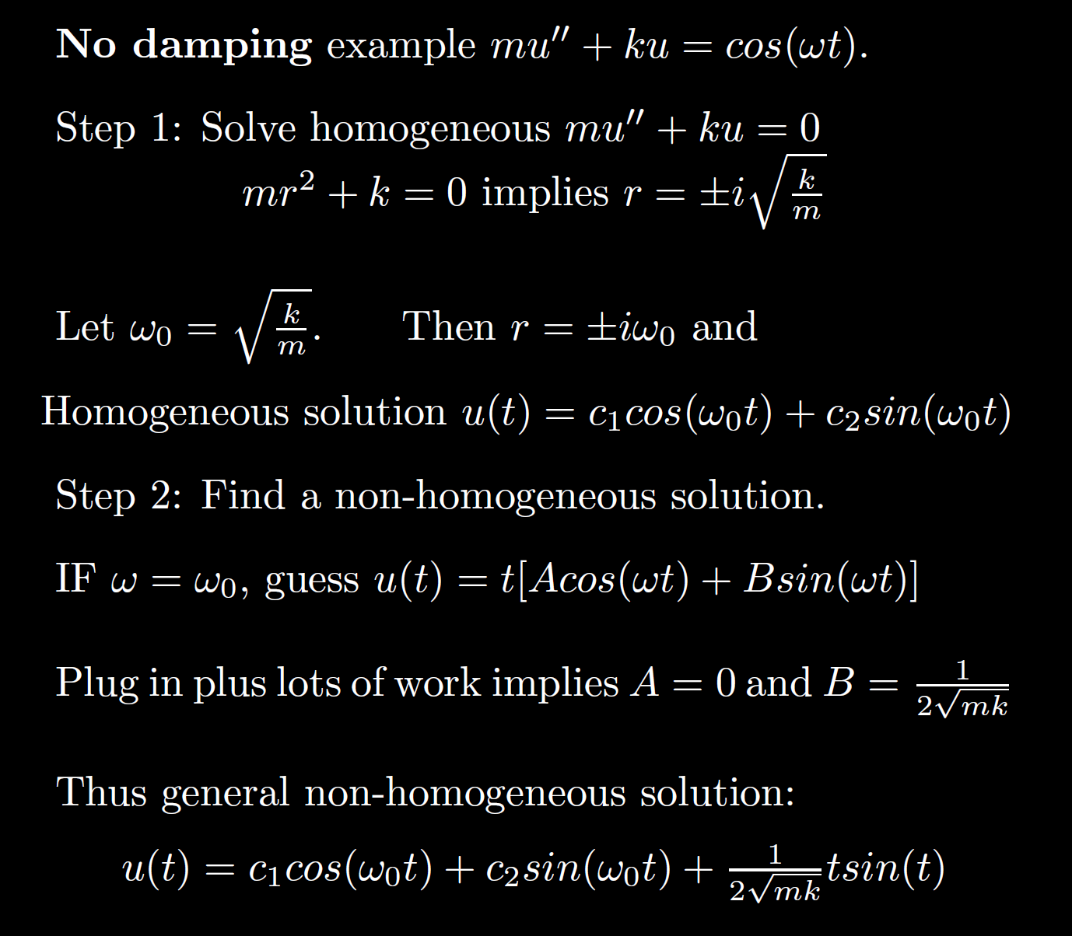
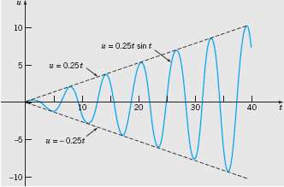
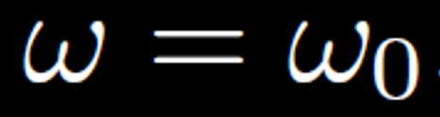
Boyce/DiPrima/Meade 11th ed, Ch 3.8: Forced Periodic Vibrations

Slide 2
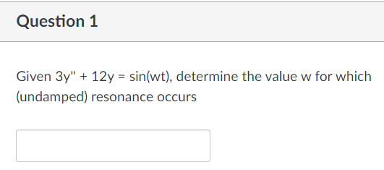

Slide 3
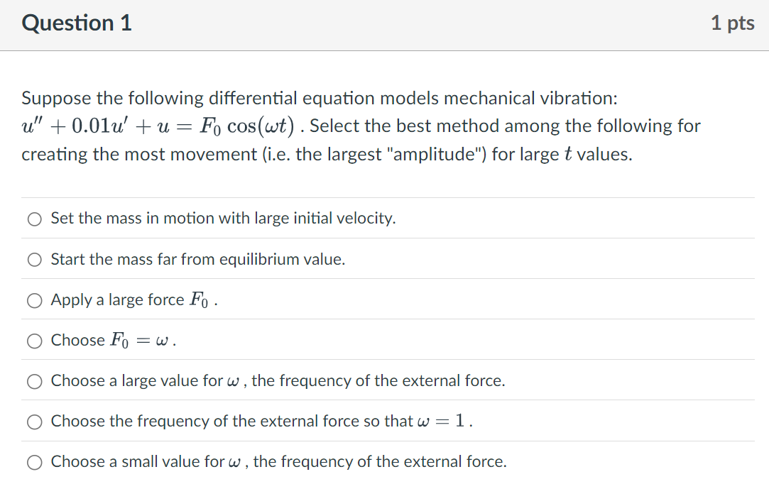

Slide 4
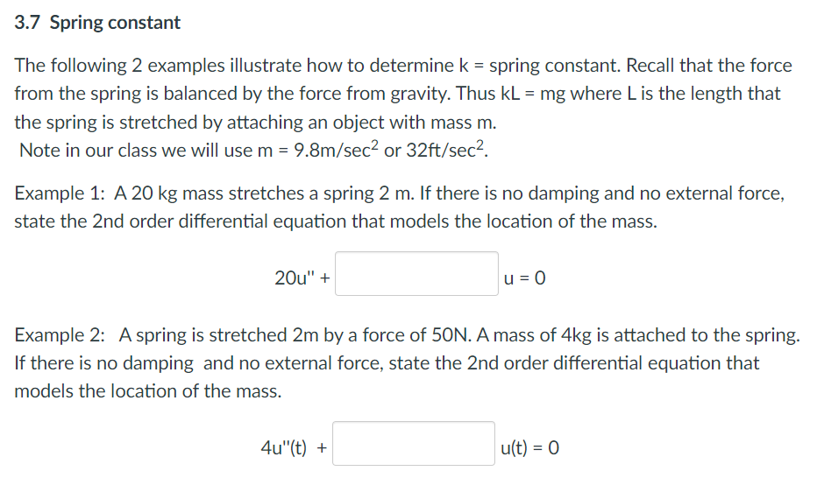

Slide 5
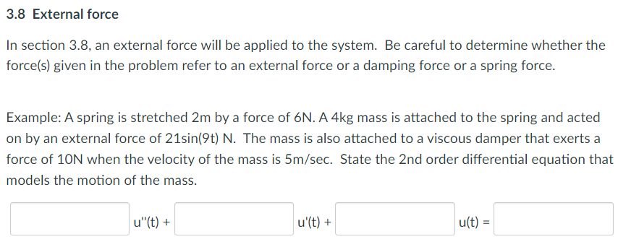

Slide 6
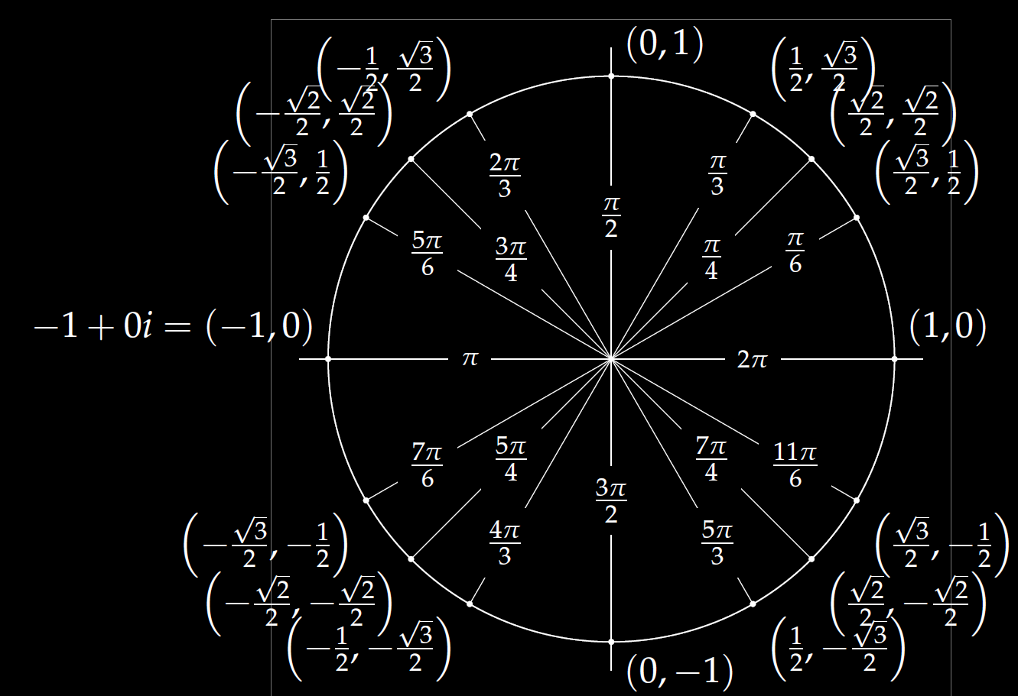
(a, b) = a + ib
= ( Rcos(x), R sin(x) )
= R [cos(x) + i sin(x)]
= R e^{ix}

Slide 7
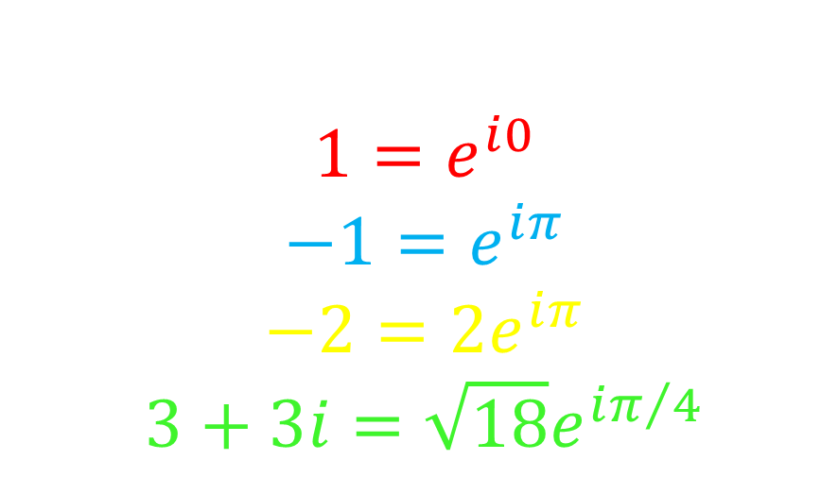
Examples:
$$1=ⅇ^{ⅈ0}$$
$$−1=ⅇ^{ⅈπ}$$
$$−2=2ⅇ^{ⅈπ}$$
$$3+3ⅈ=\sqrt{18}ⅇ^{iπ/4}$$

Slide 8
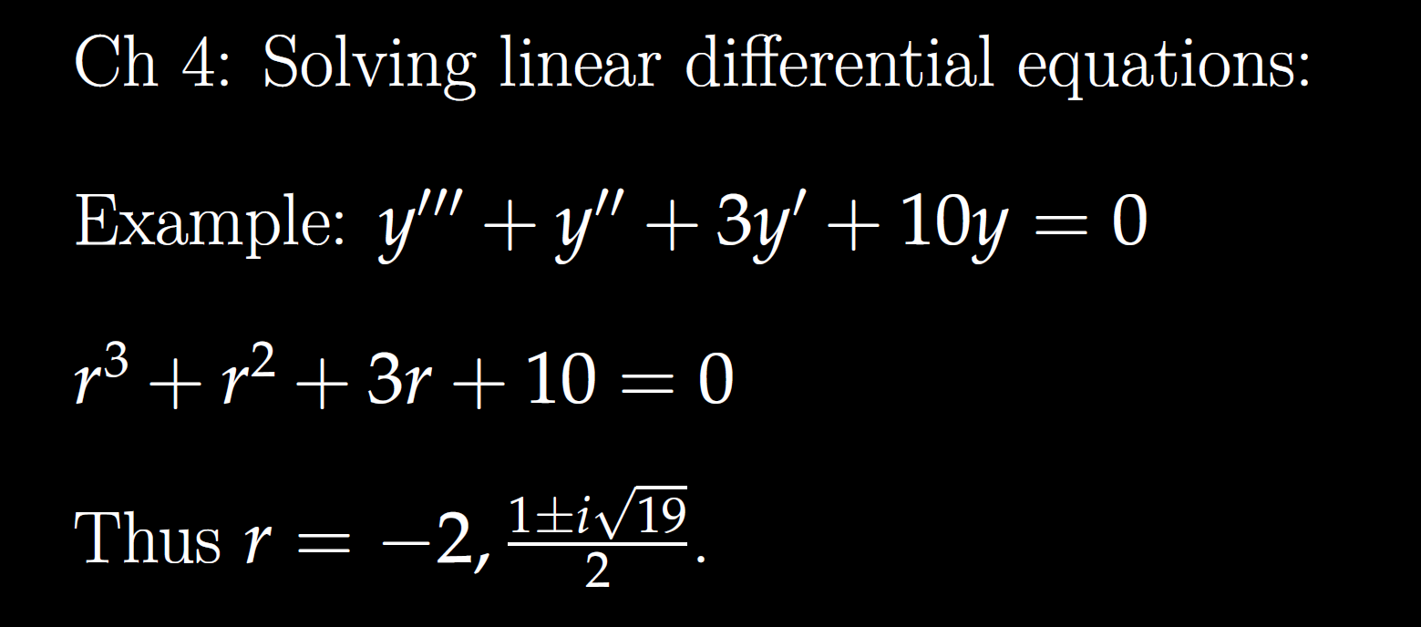
All your problems will involve special factoring cases, so you don’t need to know how to factor higher order polynomials in general.
Thus you don’t need to know how to factor the characteristic equation for the DE above, but you will need to know how to factor special cases.

Slide 9
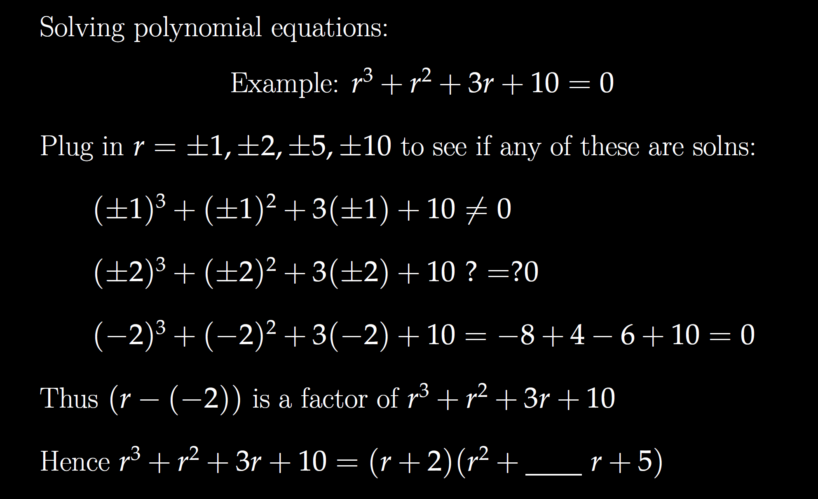
FYI

Slide 10
FYI

Slide 11
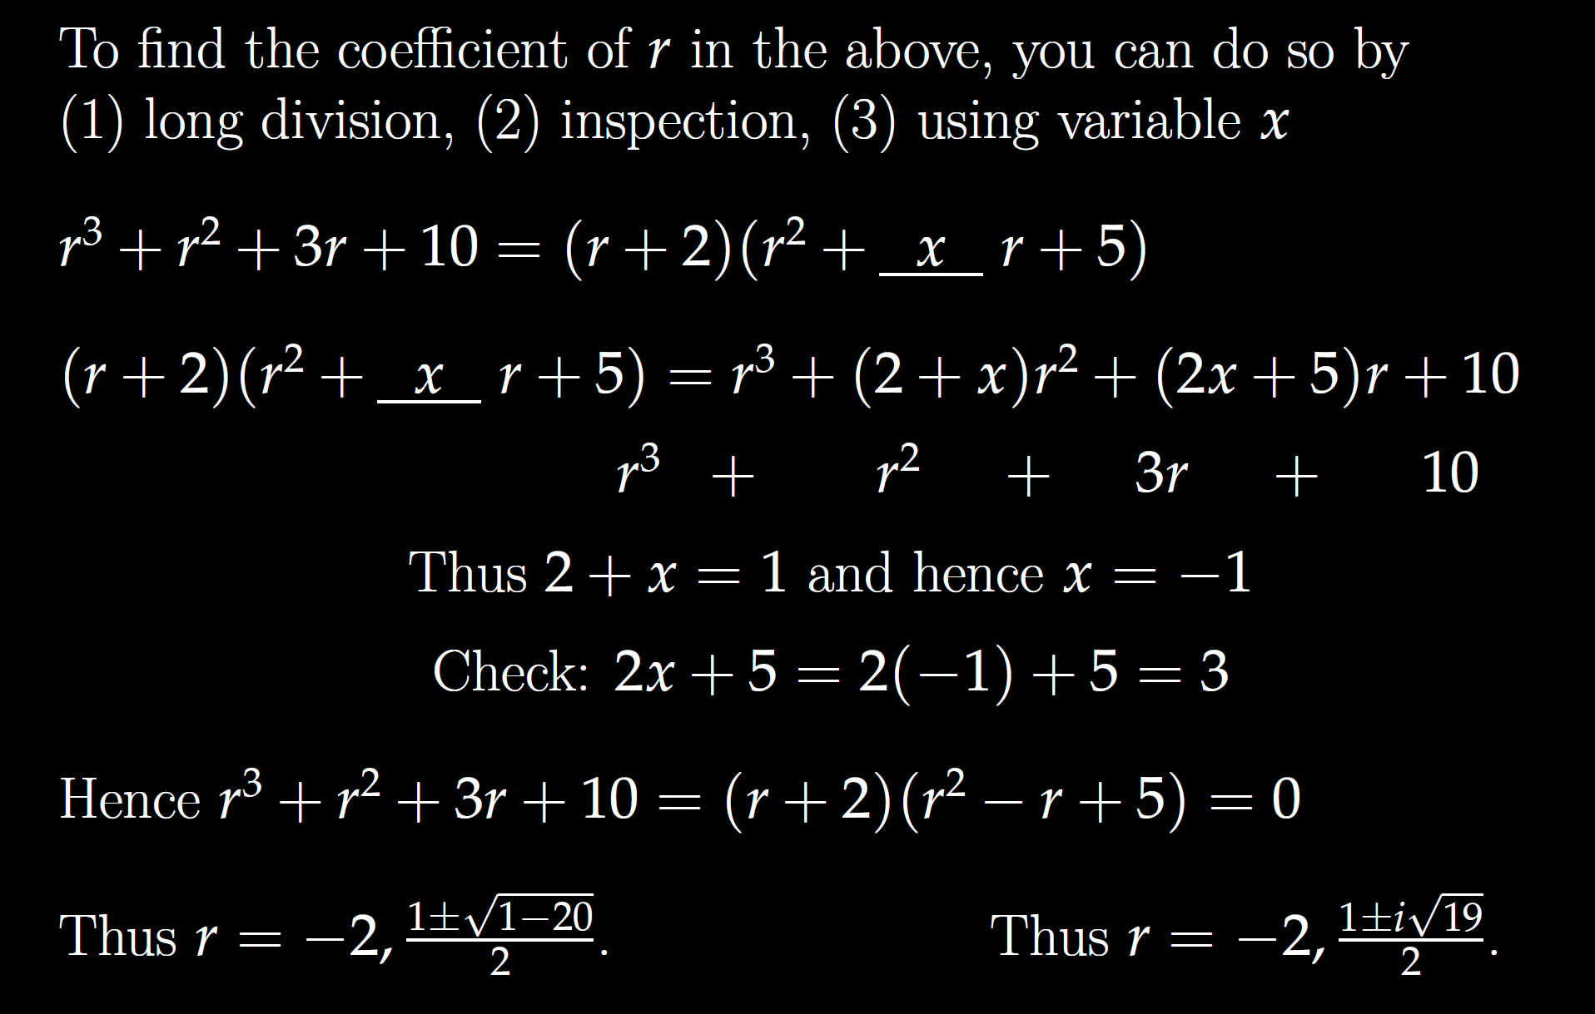
FYI

Slide 12
FYI

Slide 13
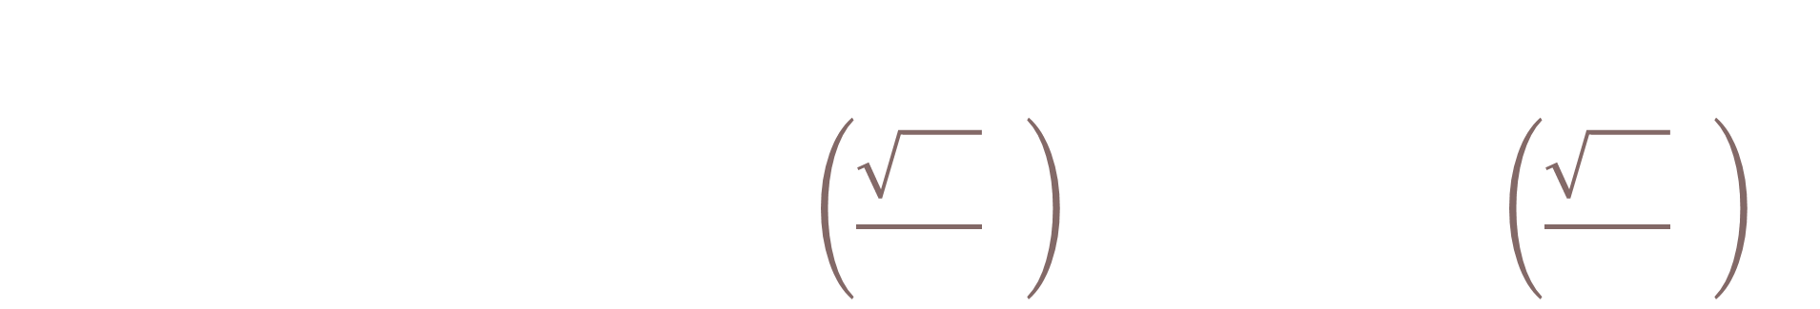
General solution:
$$y=c_{1}ⅇ^{−2t}+c_{2}ⅇ^{t/2}\sin\left(\frac{\sqrt{19}}{2}t\right)+c_{3}ⅇ^{{t/2}^{}}\cos\left(\frac{\sqrt{19}}{2}t\right)$$

Slide 14

Be able to factor the following:
$$ar4 − b = 0$$
$$ar4+ br2+ c = 0$$
$$kar3+ kbr2+ nar + nb =kr2(ar + b)+ n\left(ar + b\right)$$
$= (kr2+ n)(ar + b)$

Slide 15
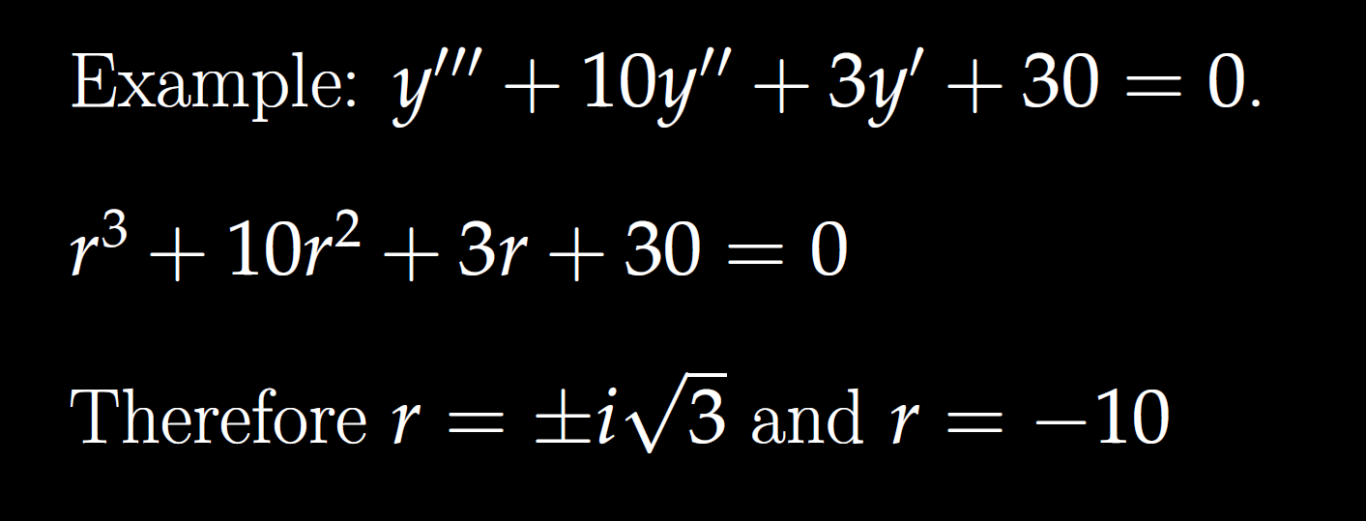



Solve $y^{′′}′′ – 16y = 0$
Solve $y^{′′}′′–3y^{′′}−4y = 0$

Slide 16

Solve $y^{′′}′′ – 16y = 0$
$$r^{4}−16=0=\left(r^{2}−4\right)\left(r^{2}+4\right)$$
$r^{2}=4⇒r=±2 r^{2}=−4⇒r=±$2i

Slide 17

Solve $y^{′′}′′–3y^{′′}−4y = 0$

Slide 18
Solve $y^{′′}′′–3y^{′′}−4y = 0$

Slide 19


Slide 20
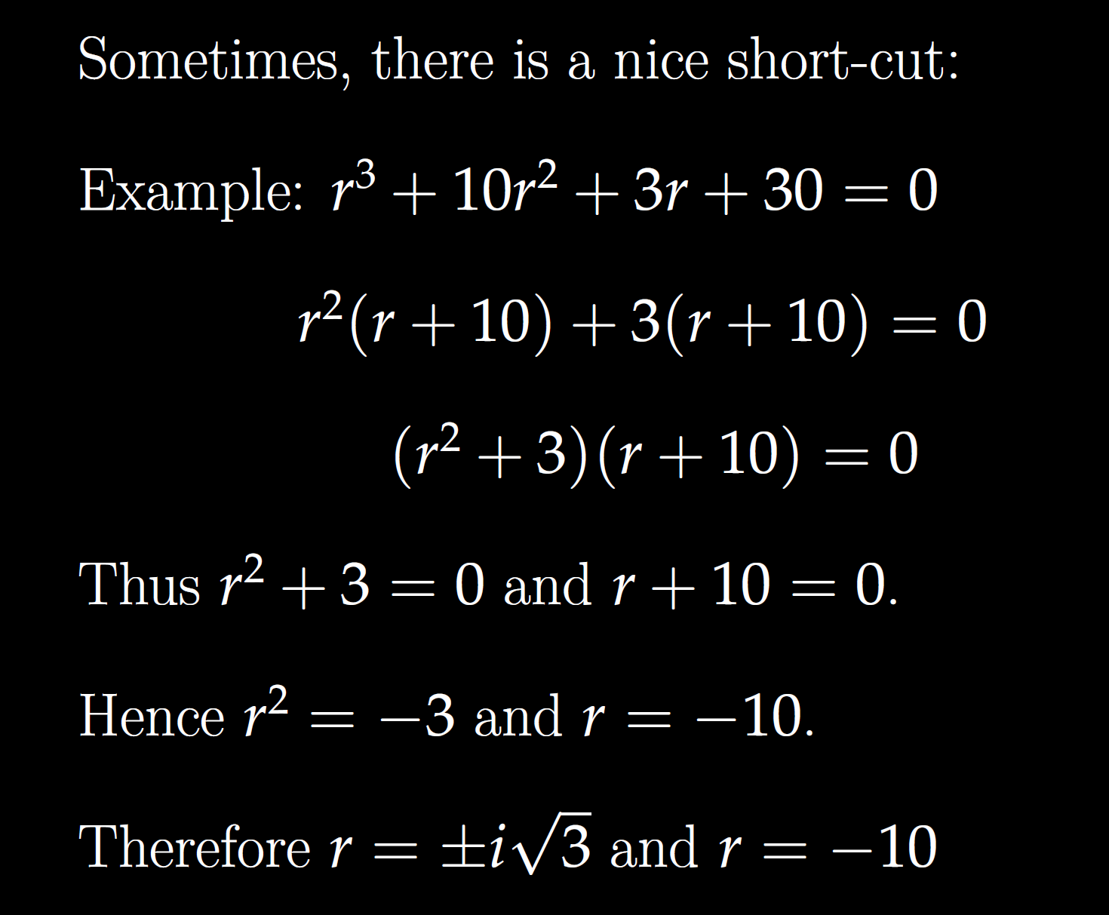

Slide 23


General solution:
$$y=c1cos\left(\sqrt{3}t\right)+c_{2}\sin\left(\sqrt{3}t\right)+c_{3}ⅇ^{−10t}$$

Slide 24
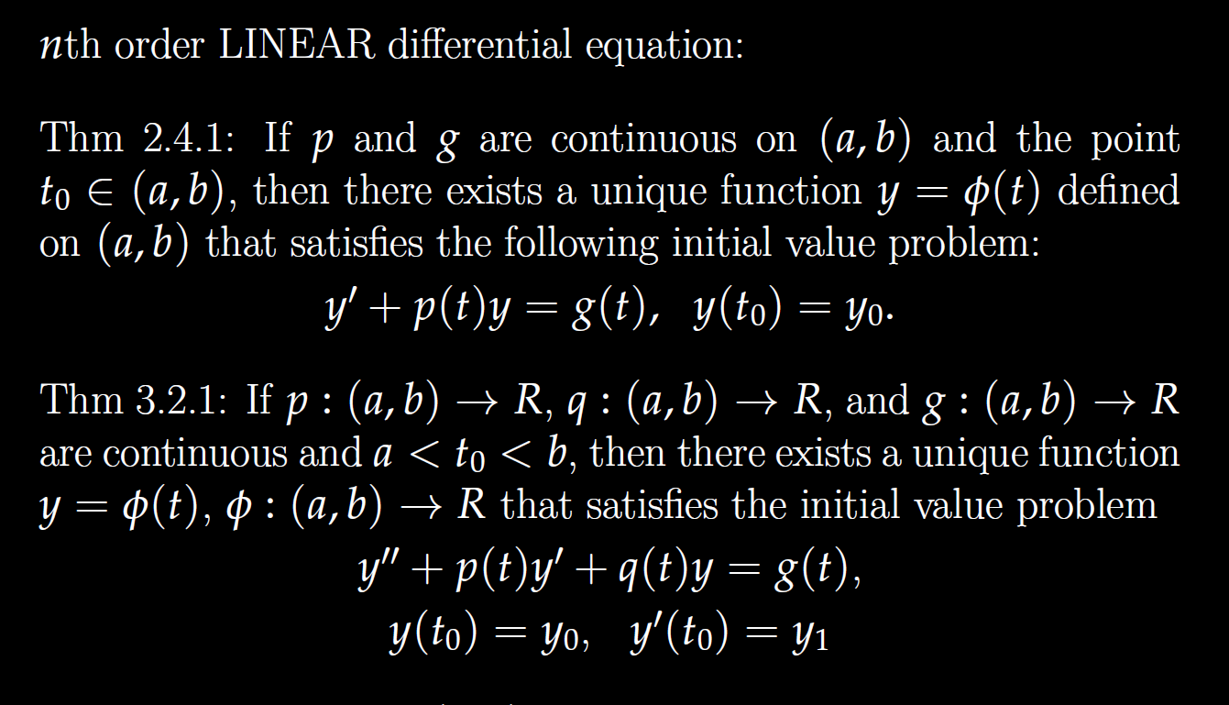

Slide 25
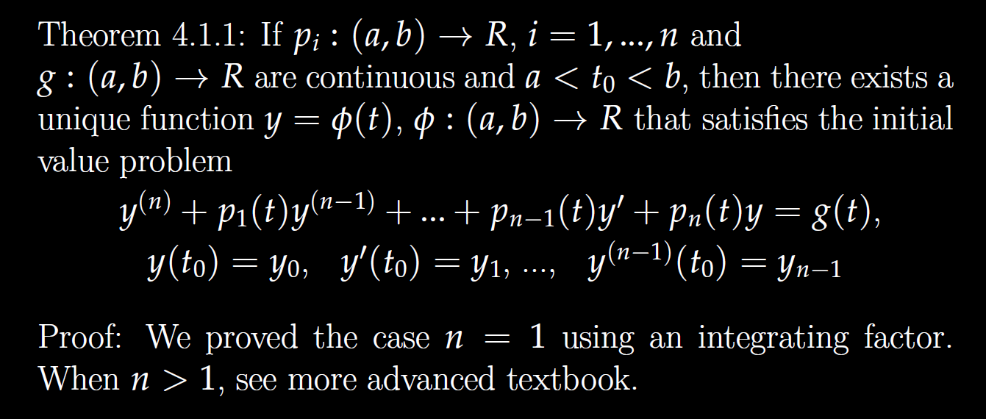

Slide 26
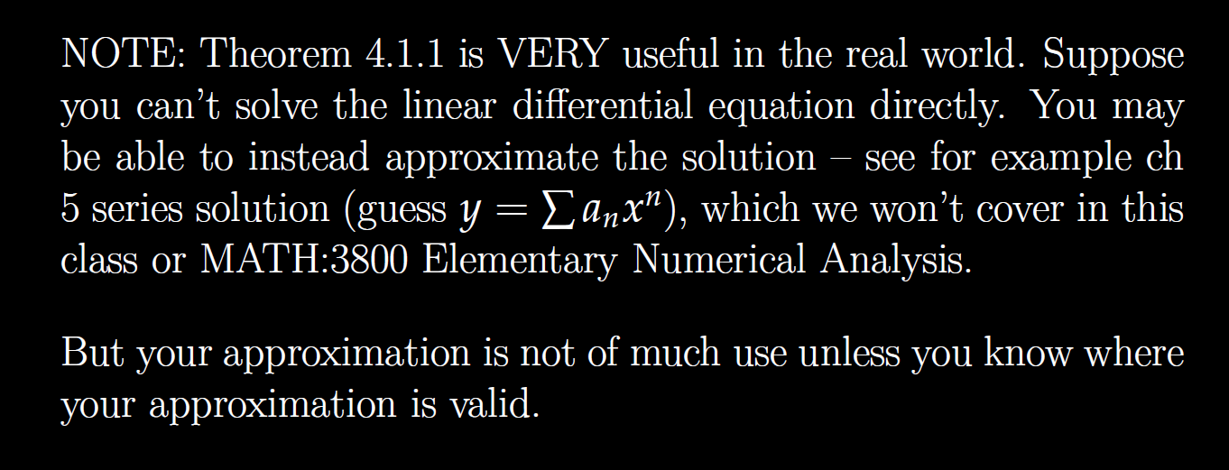

Slide 27
Determine (without solving the problem) an interval in which the solution of the given initial value problem is certain to exist and be unique.
$$\left(1 − t\right)\left(1 + t^{2}\right)y^{′′′}+\ln\left|t − 5\right|y^{′}+2y = \sqrt{t+4} y(0) = 3$$

Slide 28

Determine (without solving the problem) an interval in which the solution of the given initial value problem is certain to exist and be unique.
$$\left(1 − t\right)\left(1 + t^{2}\right)y^{′′′}+\ln\left|t − 5\right|y^{′}+2y = \sqrt{t+4} y(0) = 3$$

Slide 29
Determine (without solving the problem) an interval in which the solution of the given initial value problem is certain to exist and be unique.
$$\left(1 − t\right)\left(1 + t^{2}\right)y^{′′′}+\ln\left|t − 5\right|y^{′}+2y = \sqrt{t+4} y(0) = 3$$
( )( )(
-4 1 5

Slide 30
Determine (without solving the problem) an interval in which the solution of the given initial value problem is certain to exist and be unique.
$$\left(1 − t\right)\left(1 + t^{2}\right)y^{′′′}+\ln\left|t − 5\right|y^{′}+2y = \sqrt{t+4} y(0) = 3$$
( )( )(
-4 1 5
t = 0, thus domain is (-4, 1) for the solution to this initial value problem.

Slide 31

Determine (without solving the problem) an interval in which the solution of the given initial value problem is certain to exist and be unique.
$$\left(1 − t\right)\left(1 + t^{2}\right)y^{′′′}+\ln\left|t − 5\right|y^{′}+2y = \sqrt{t+4} y\left(t0\right)= ?$$
( )( )(
-4 1 5
Unique solution exists if $t_{0}∈\left(−4,1\right)∪\left(1,5\right)∪\left(5,∞\right)$
  If $t_{0}∈\left(−4,1\right)$, domain of solution is $\left(−4,1\right)$.
  If $t_{0}∈\left(1,5\right)$, domain of solution is $\left(1,5\right)$.
  If $t_{0}∈\left(5,∞\right)$, domain of solution is $\left(5,∞\right)$.
We have no information regarding existence/uniqueness if initial value is not in one of these 3 intervals.

Slide 32
Linear Independence and the Wronskian

Slide 33
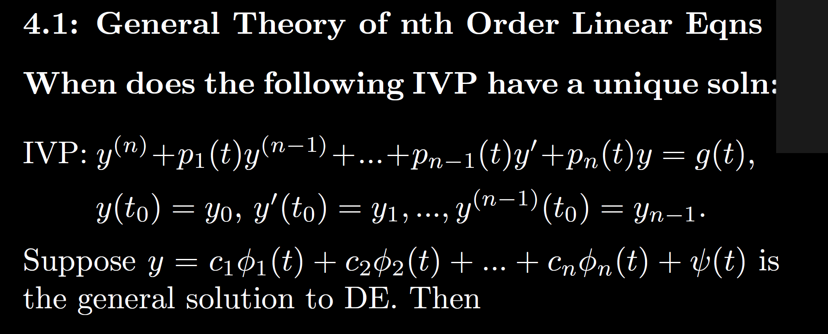

Slide 34
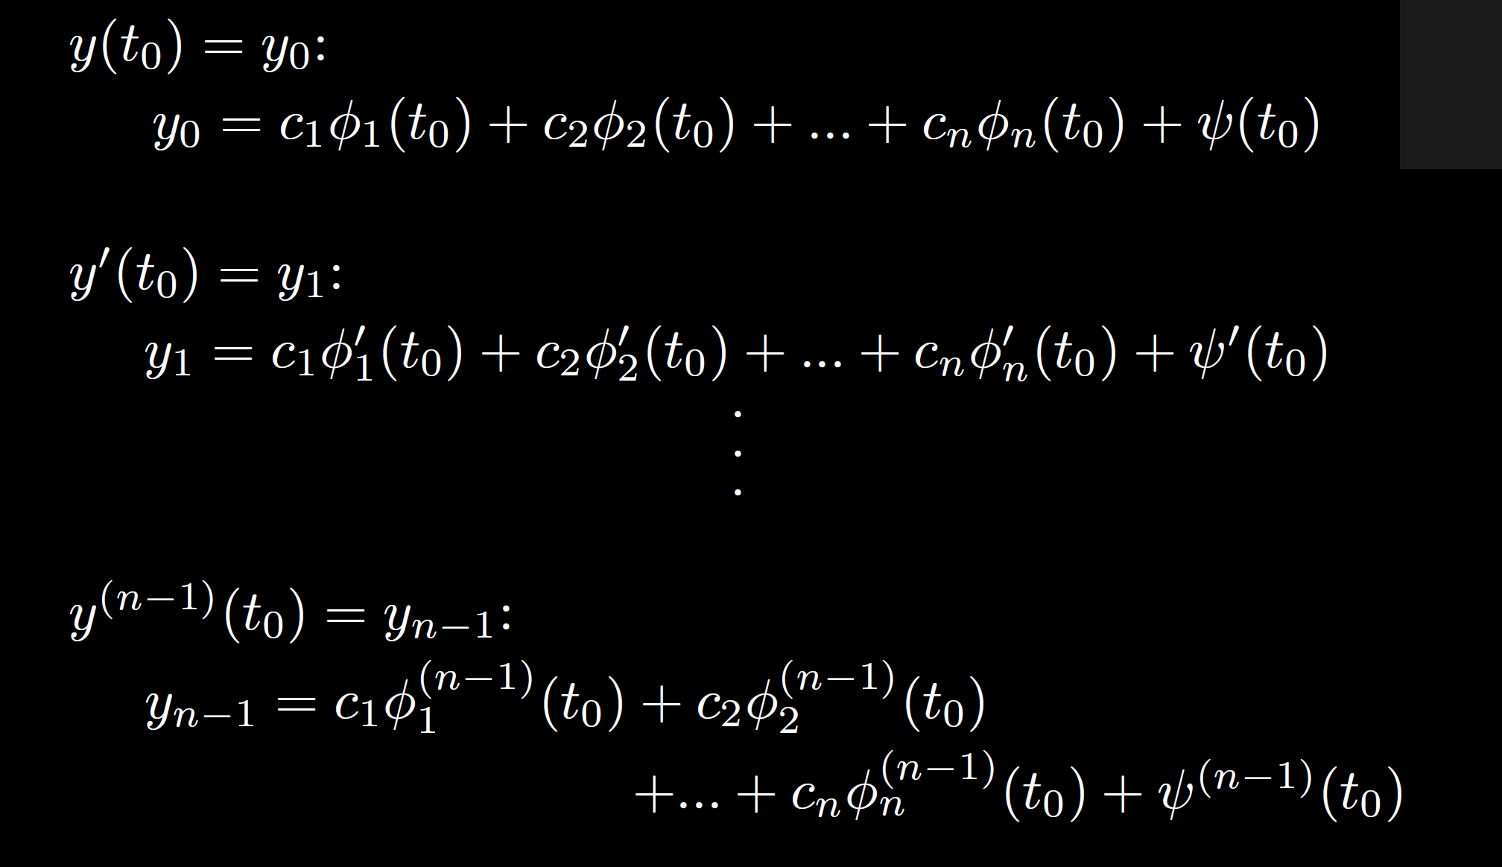

Slide 35
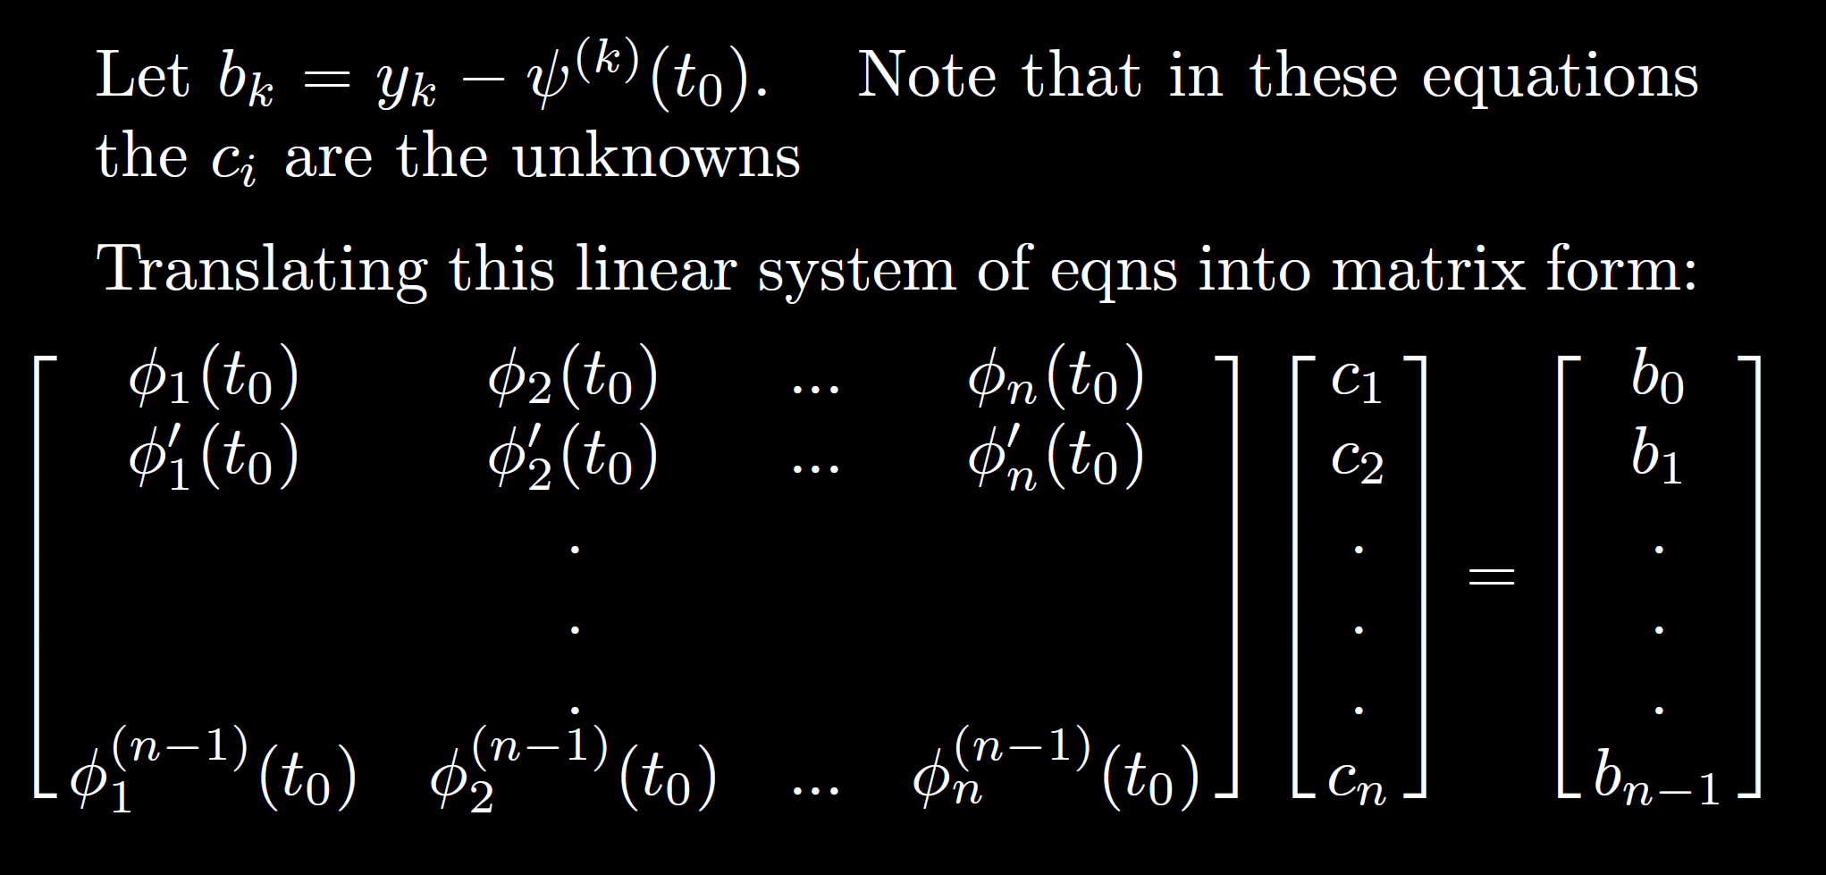

Slide 36
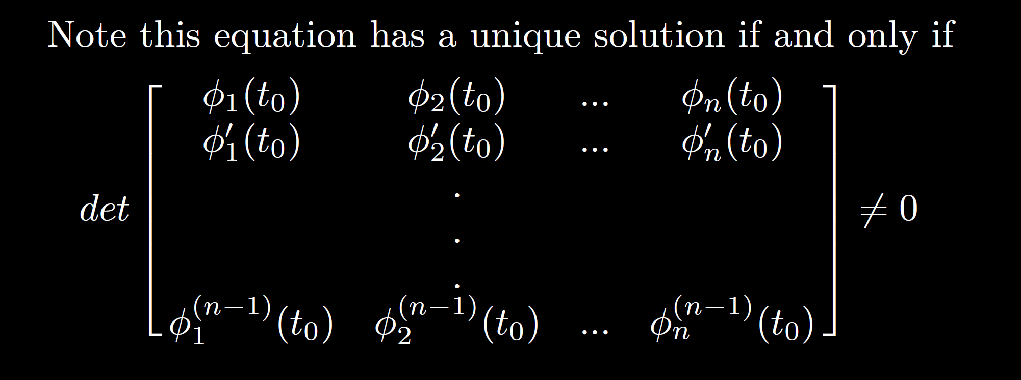

Slide 37
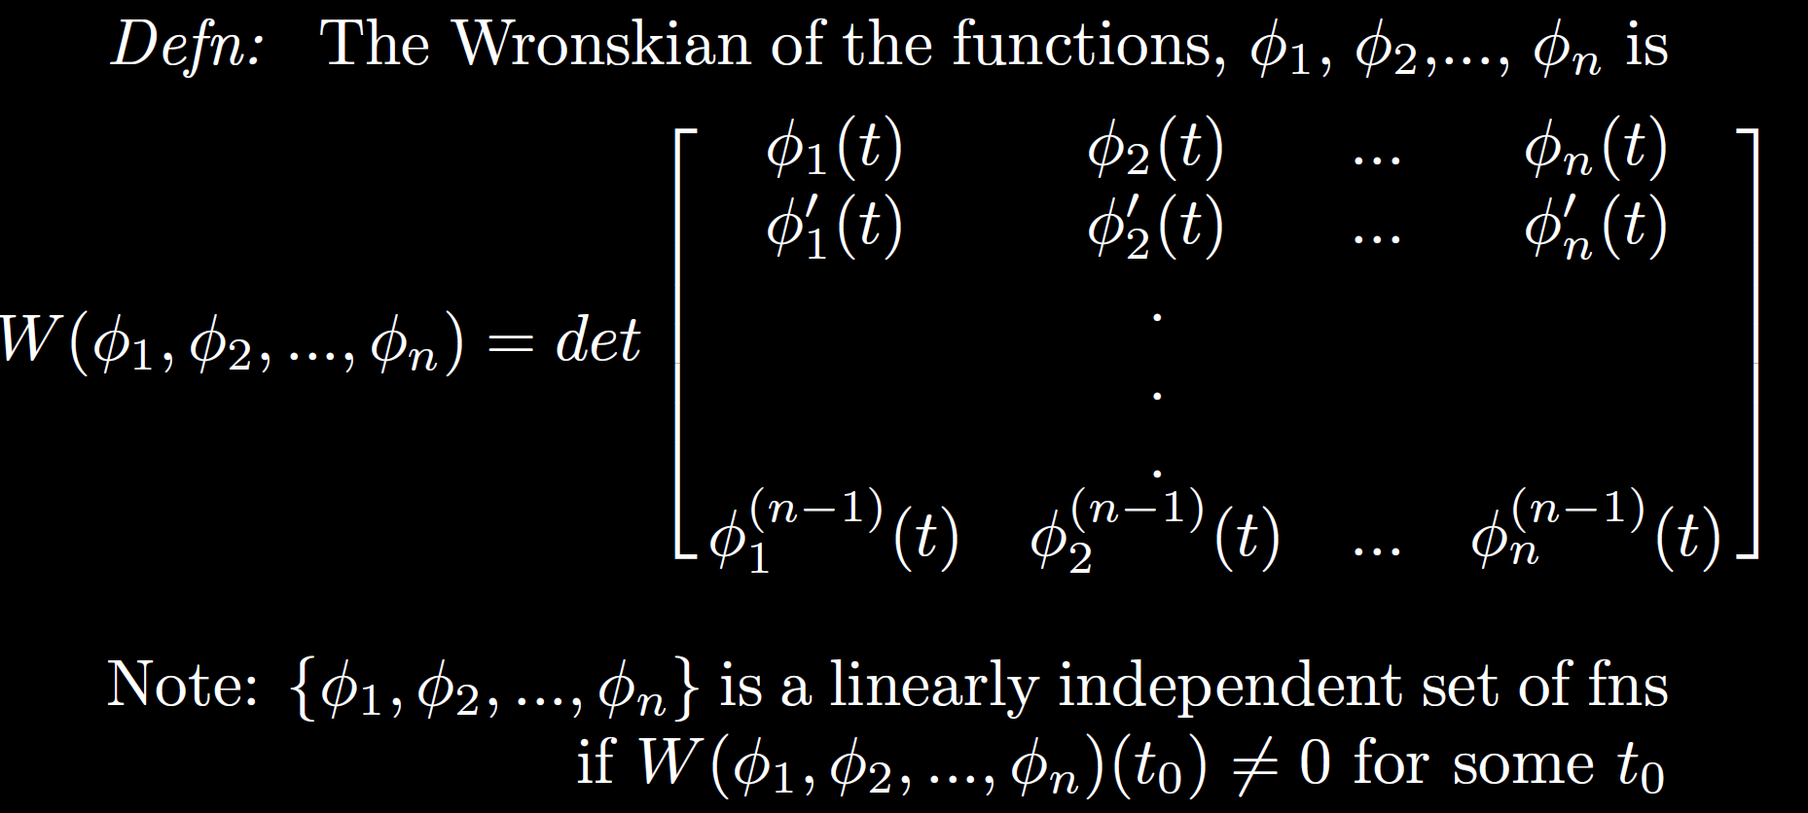

Slide 38
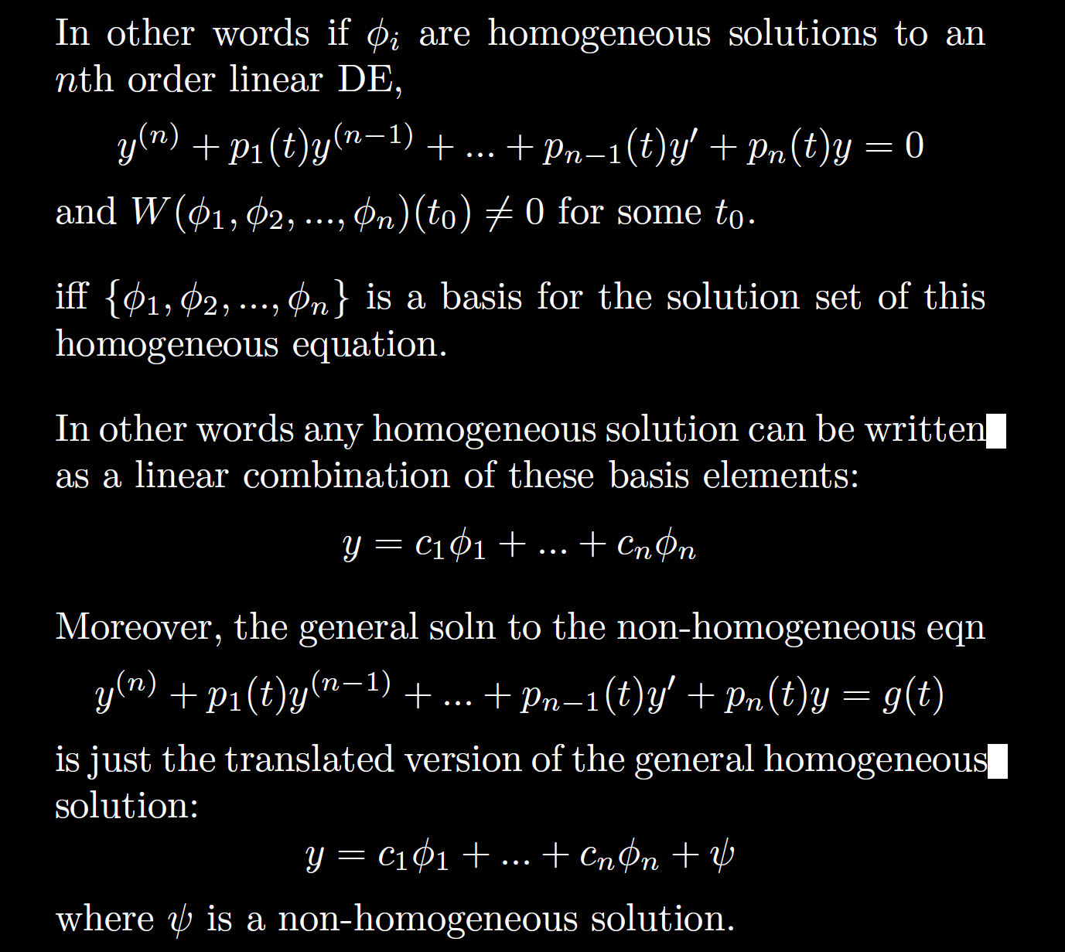

Slide 41
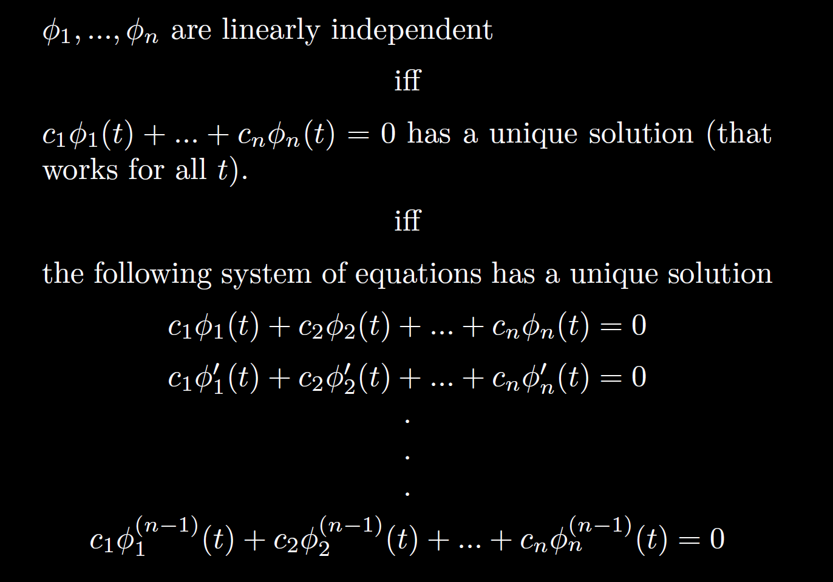

Slide 42

Show that the following functions are not linearly independent:
$t^{2}+3t−1$, $t^{2}+3$, $4t^{2}+ 24t − 20$
Note that these polynomials are not linearly independent if the constant 0 polynomial cannot be uniquely represented via a linear combination of these polynomials. I.e,
$c1$($t^{2}+3t−1) +$ $c2$($t^{2}+3$) + $c3$($4t^{2}+ 24t − 20$) = ${0t}^{2}+0t+0$
has a nontrivial solution (in addition to the solution where all $ci$’s are zero).
Or equivalently, the following has a nontrivial solution:
$c1 \left[\begin{matrix} 1 \\ 3 \\ −1\end{matrix}\right] + c_{2}\left[\begin{matrix}1 \\ 0 \\ 3\end{matrix}\right] + c3$ $\left[\begin{matrix} 4 \\ 24 \\ −20\end{matrix}\right]$ = $\left[\begin{matrix}0 \\ 0 \\ 0\end{matrix}\right]$

Slide 44
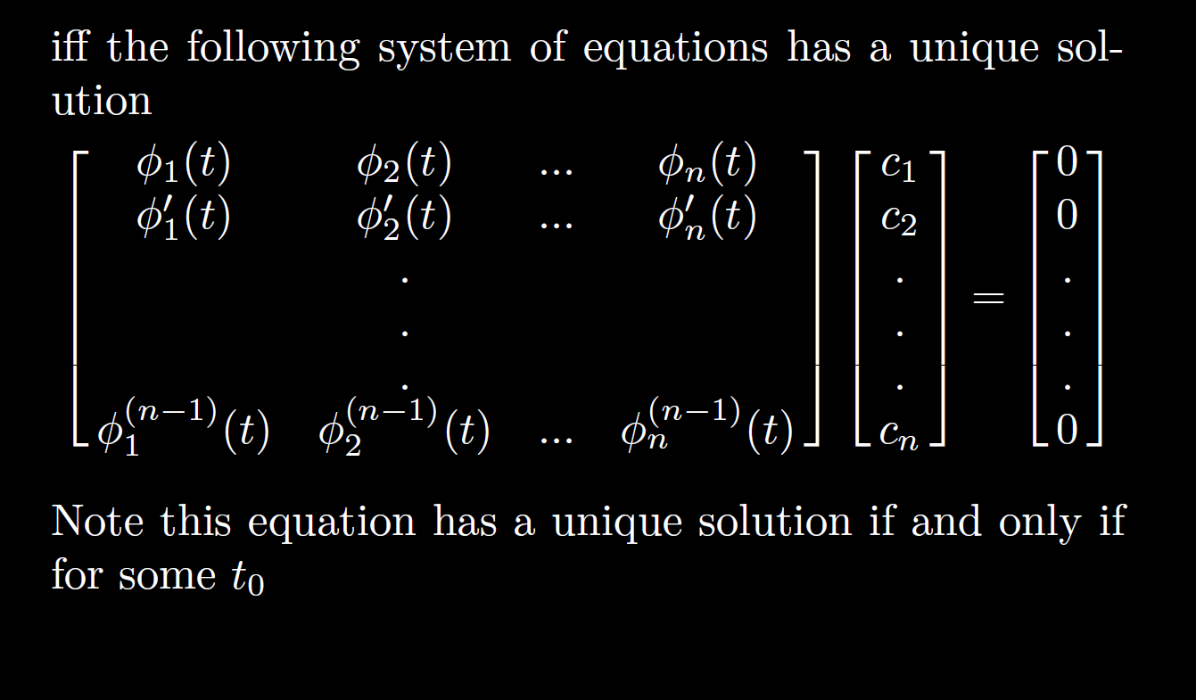

Slide 45
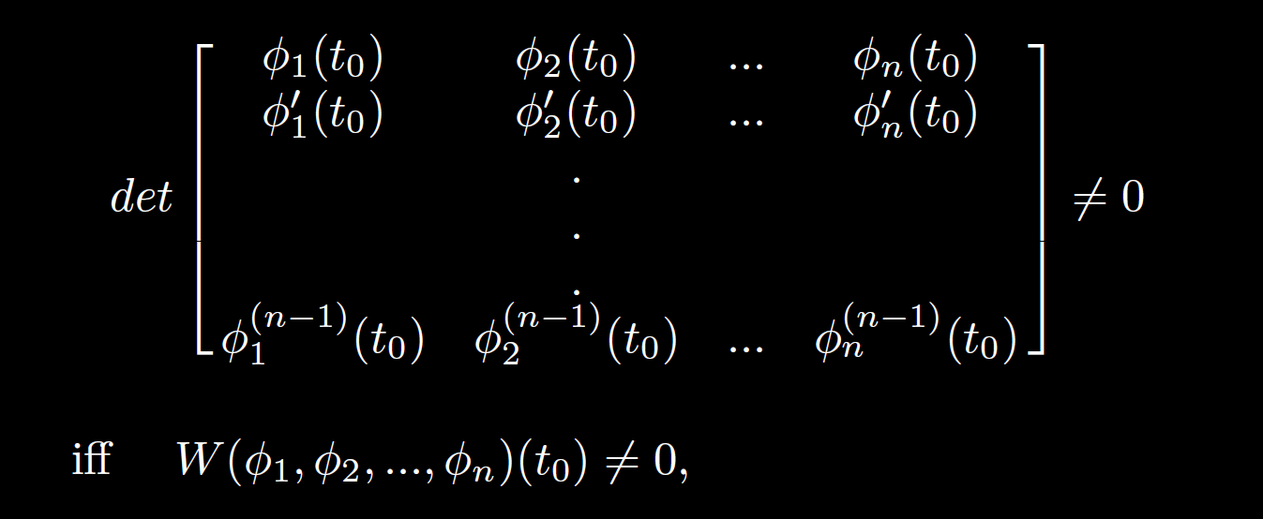

Slide 46
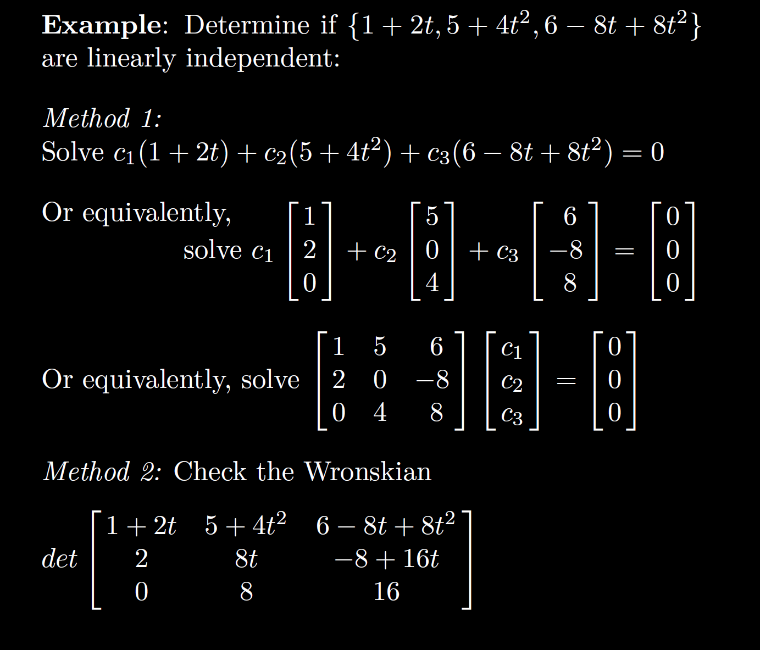

Slide 48
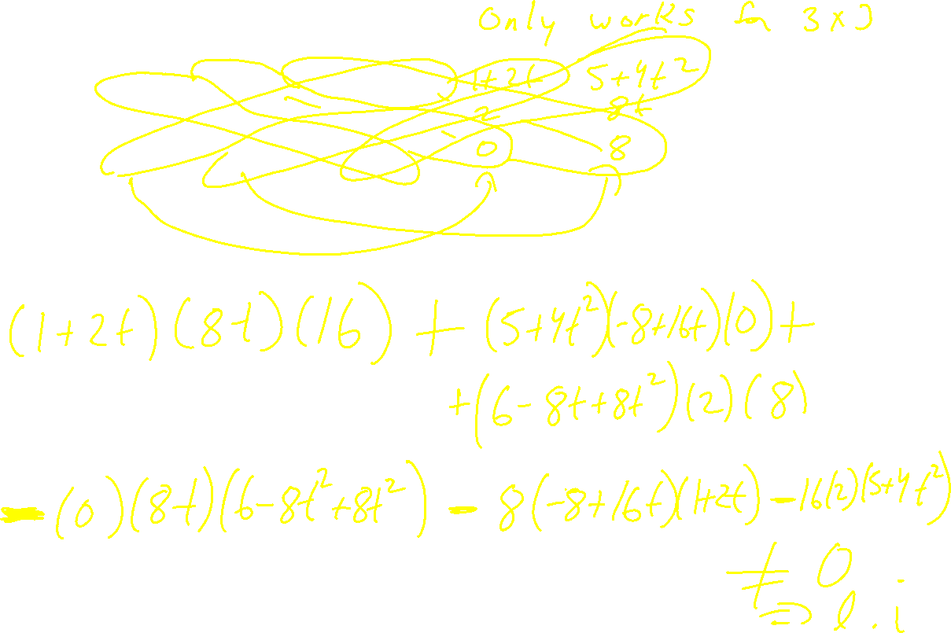

Slide 49
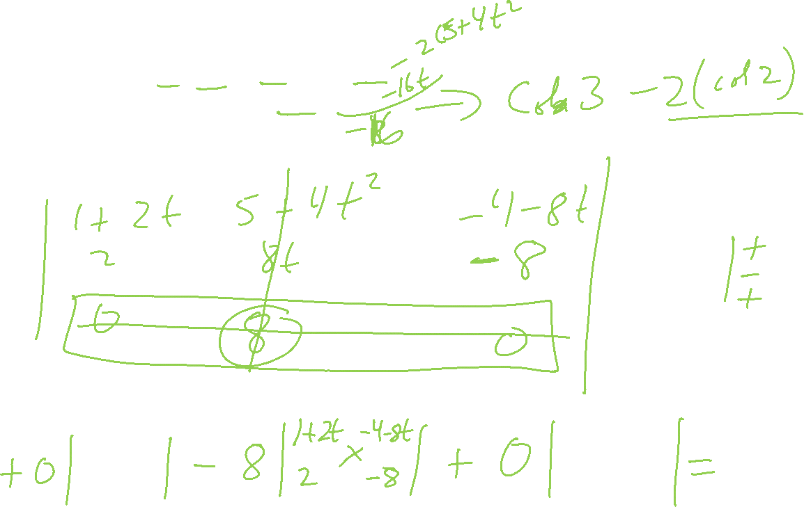

Slide 50
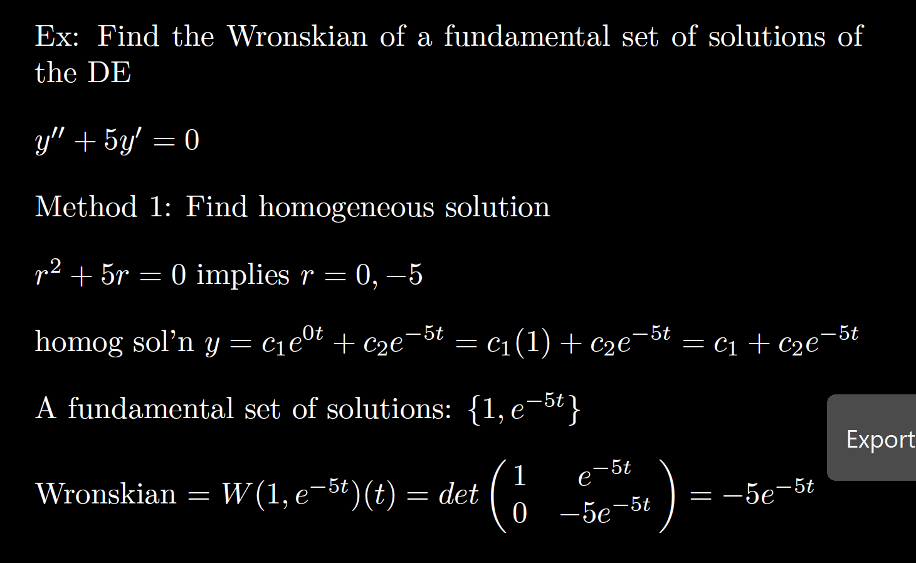

Slide 51
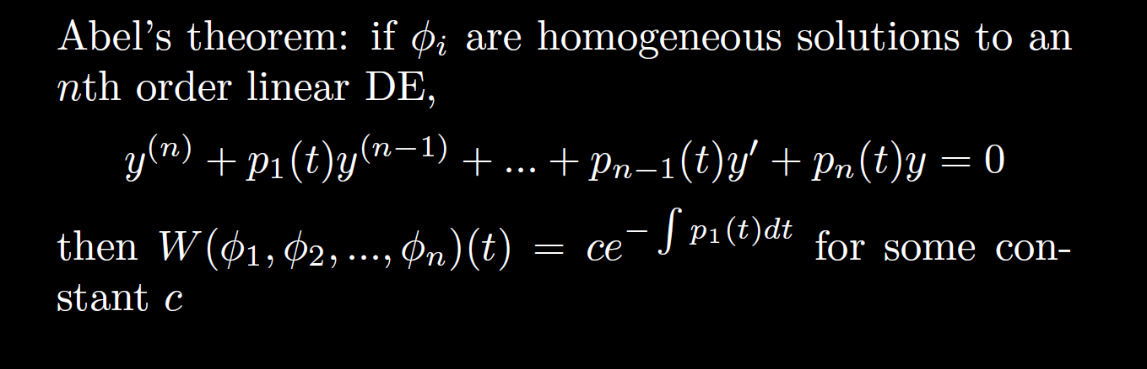

Slide 52
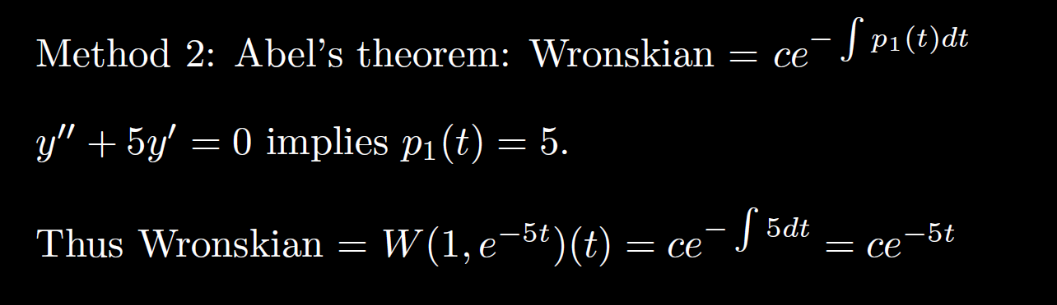

Slide 56
0
0
k
= C

Slide 57
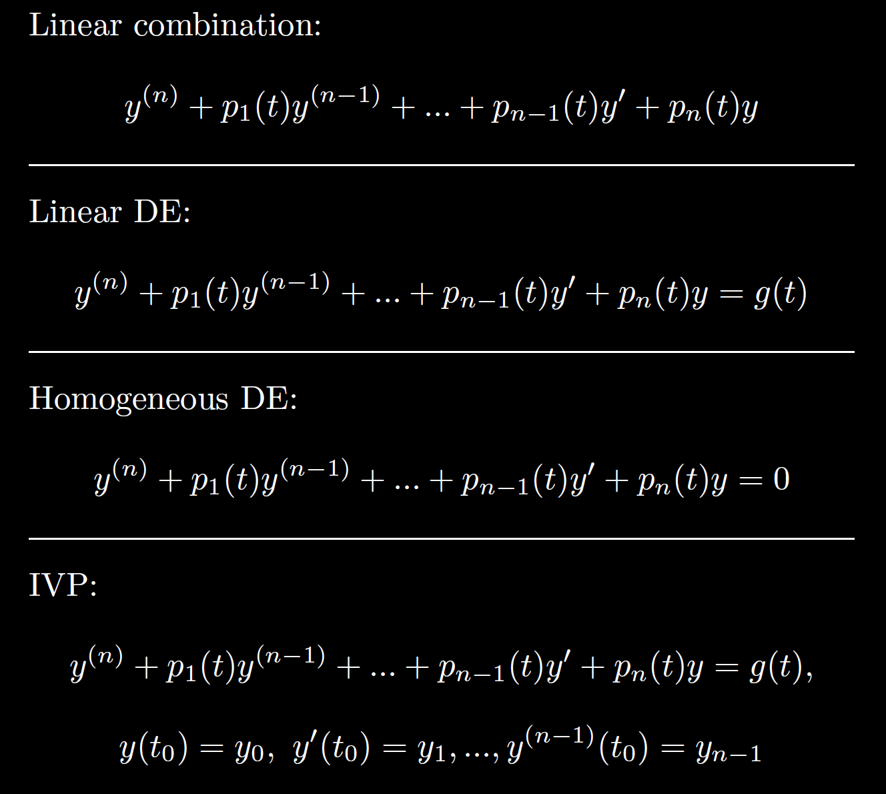

Slide 58
