Slide 1
https://www.youtube.com/watch?v=XyMDwLLa7pA

Slide 2
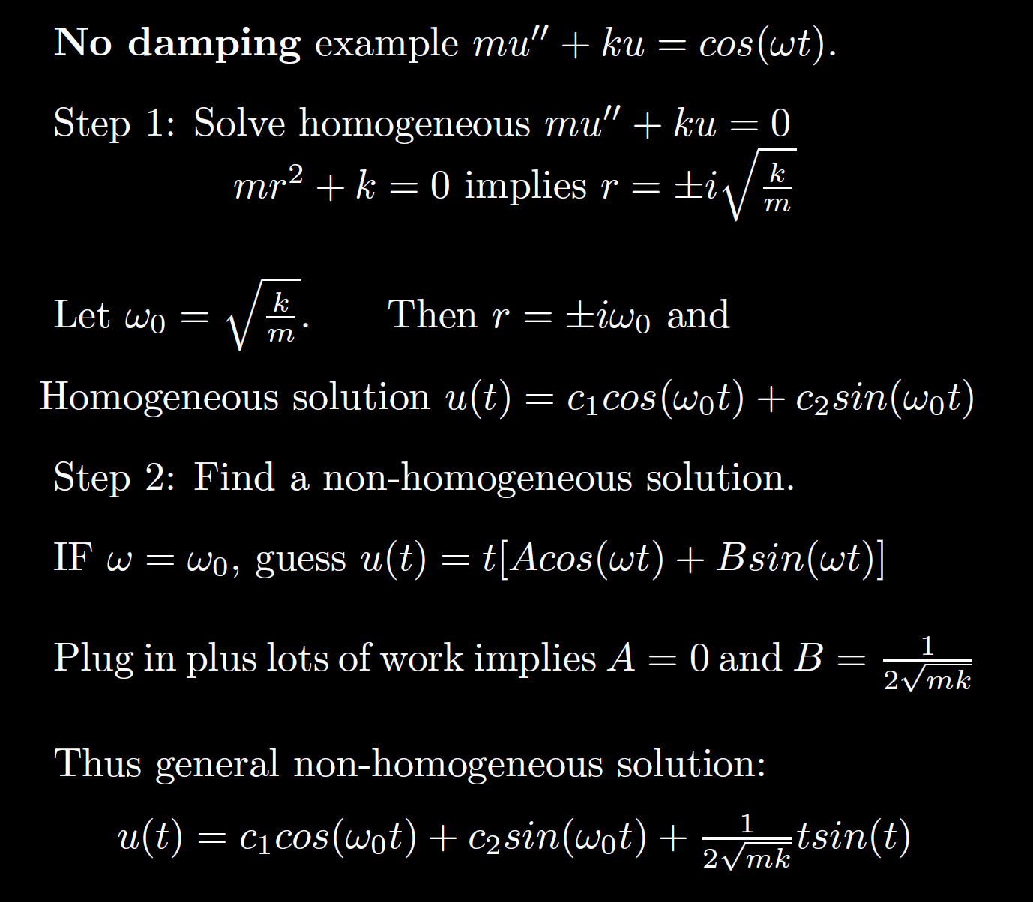
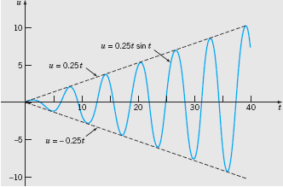
Boyce/DiPrima/Meade 11th ed, Ch 3.8: Forced Periodic Vibrations

Slide 7
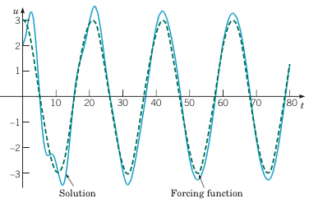
Example 2: Forced Vibrations with Damping (2 of 4)
Graphs of the solution and external force for .
Boyce/DiPrima/Meade 11th ed, Ch 3.8: Forced Periodic Vibrations

Slide 8
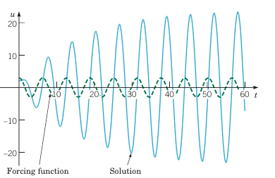
Example 2: Forced Vibrations with Damping (3 of 4)
Graphs of the solution and external force for
Boyce/DiPrima/Meade 11th ed, Ch 3.8: Forced Periodic Vibrations

Slide 9
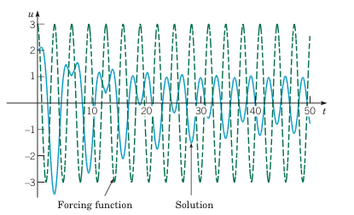
Example 2: Forced Vibrations with Damping (4 of 4)
Graphs of the solution and external force for
Boyce/DiPrima/Meade 11th ed, Ch 3.8: Forced Periodic Vibrations

