Slide 1
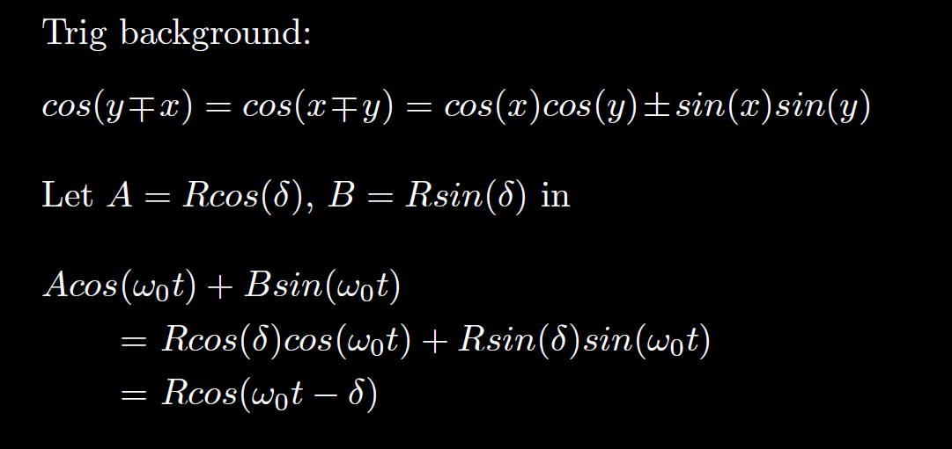

Slide 2
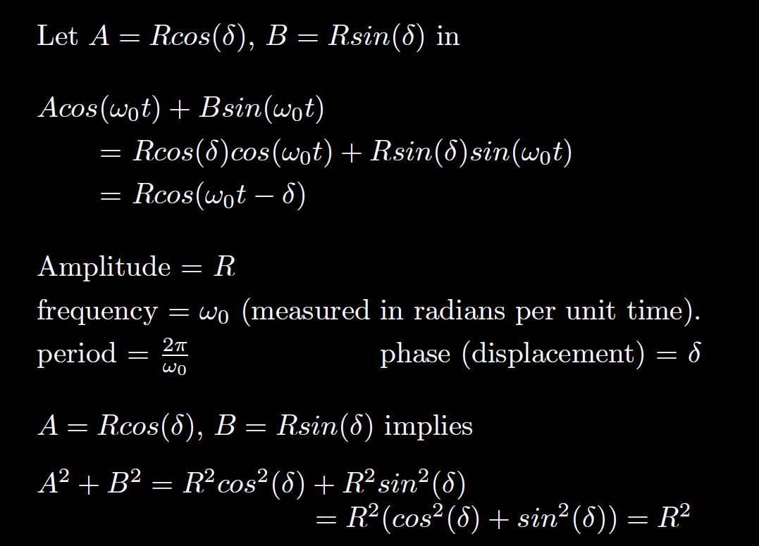

Slide 8
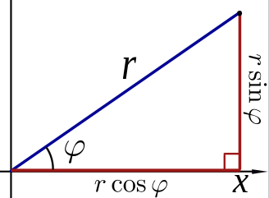
Find R = amplitude:
R
R
δ
δ
R
δ
https://en.wikipedia.org/wiki/File:Polar_to_cartesian.svg

Slide 10
$$R=\sqrt{{\left(1\right)}^{2}+{\left(−1\right)}^{2}}=\sqrt{2}$$
2 π /

Slide 11
Find

Slide 12
R
R
δ
δ
R
δ
https://en.wikipedia.org/wiki/File:Polar_to_cartesian.svg

Slide 13
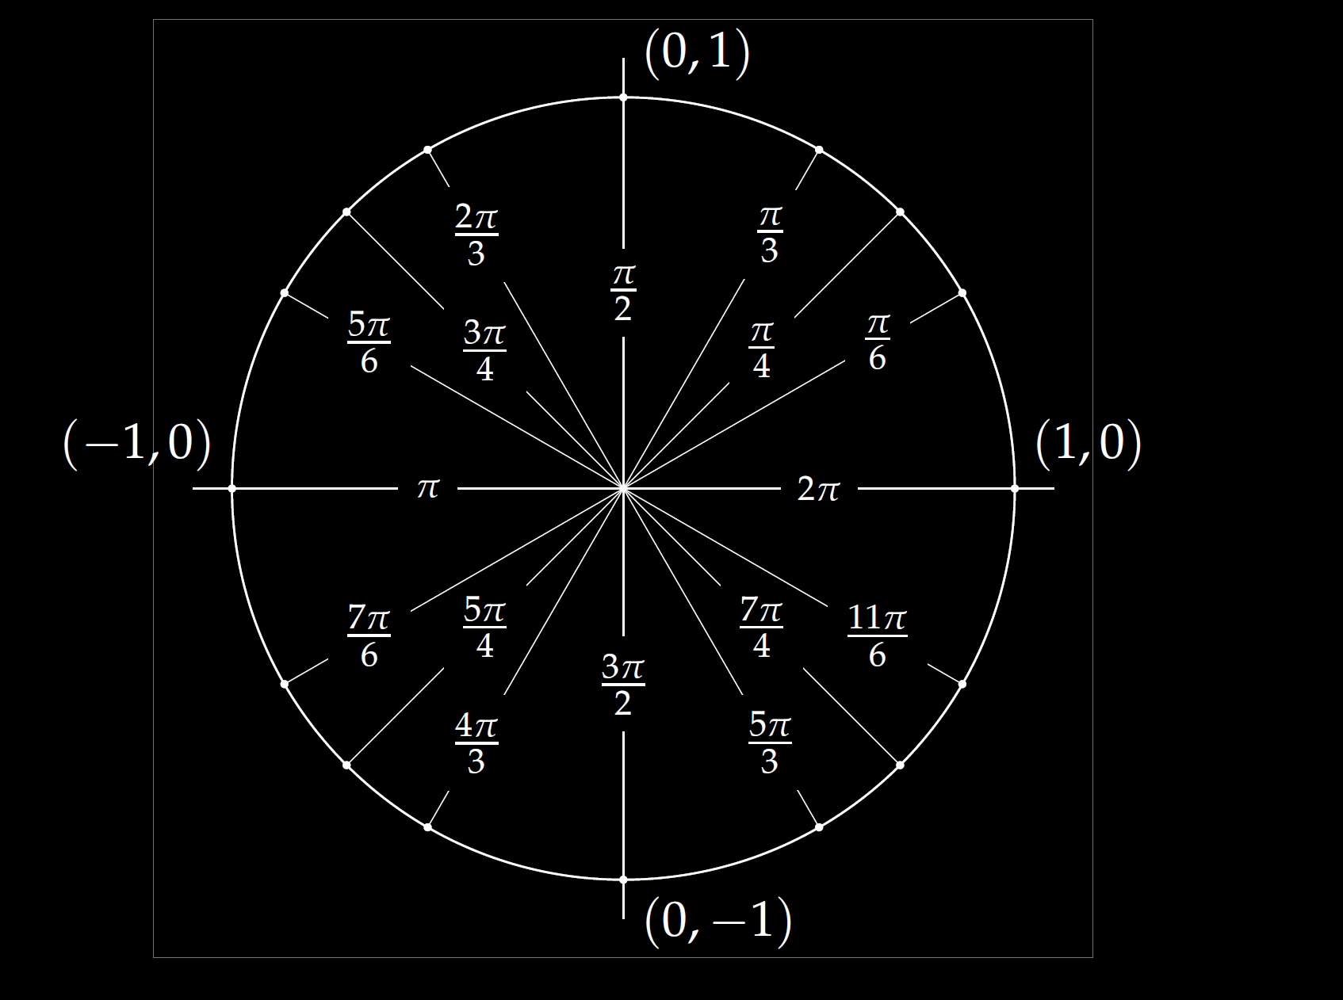
first coordinate
second coordinate
R
R
δ
δ
R
δ
https://en.wikipedia.org/wiki/File:Polar_to_cartesian.svg

Slide 14
2 π /

Slide 15
2 π /

Slide 16
$$R=\sqrt{A^{2}+B^{2}}$$

Slide 19
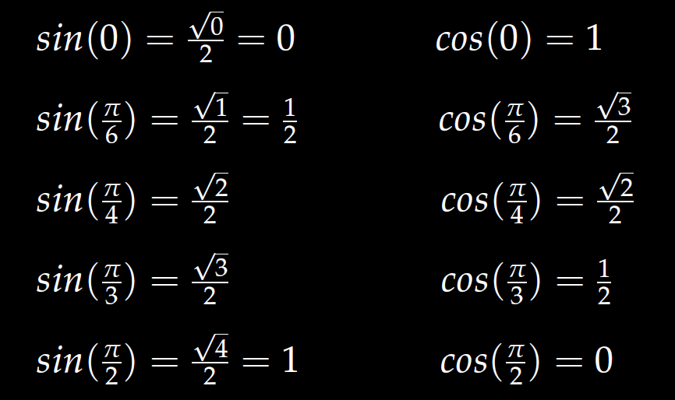

Slide 20
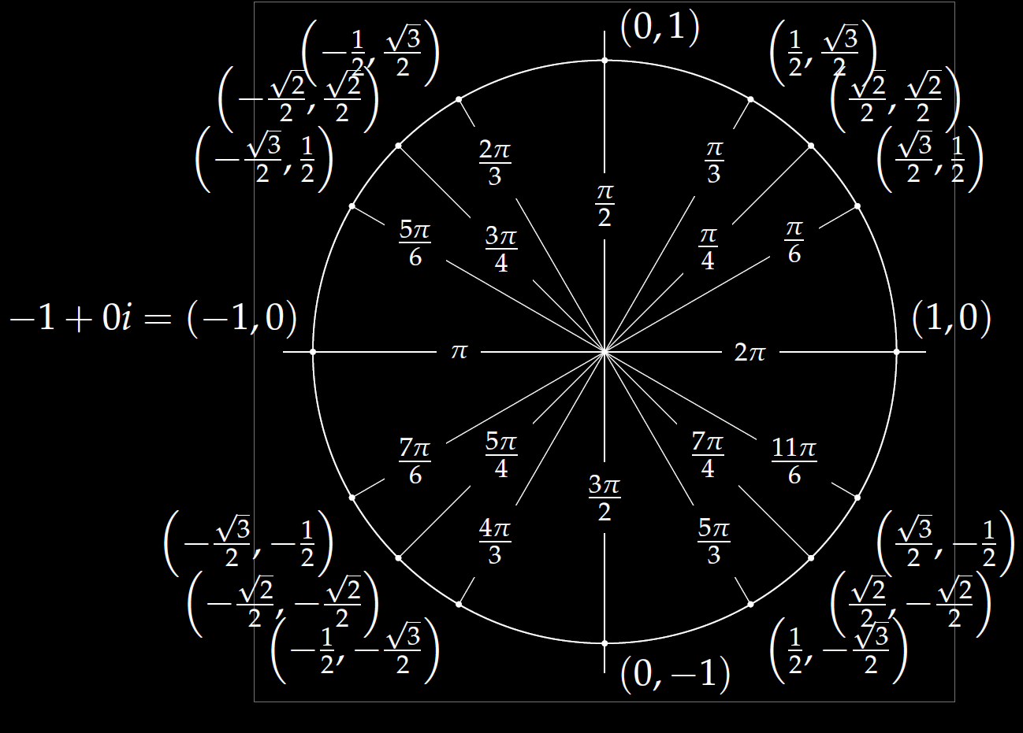
(cos δ, sin δ)

