Slide 1
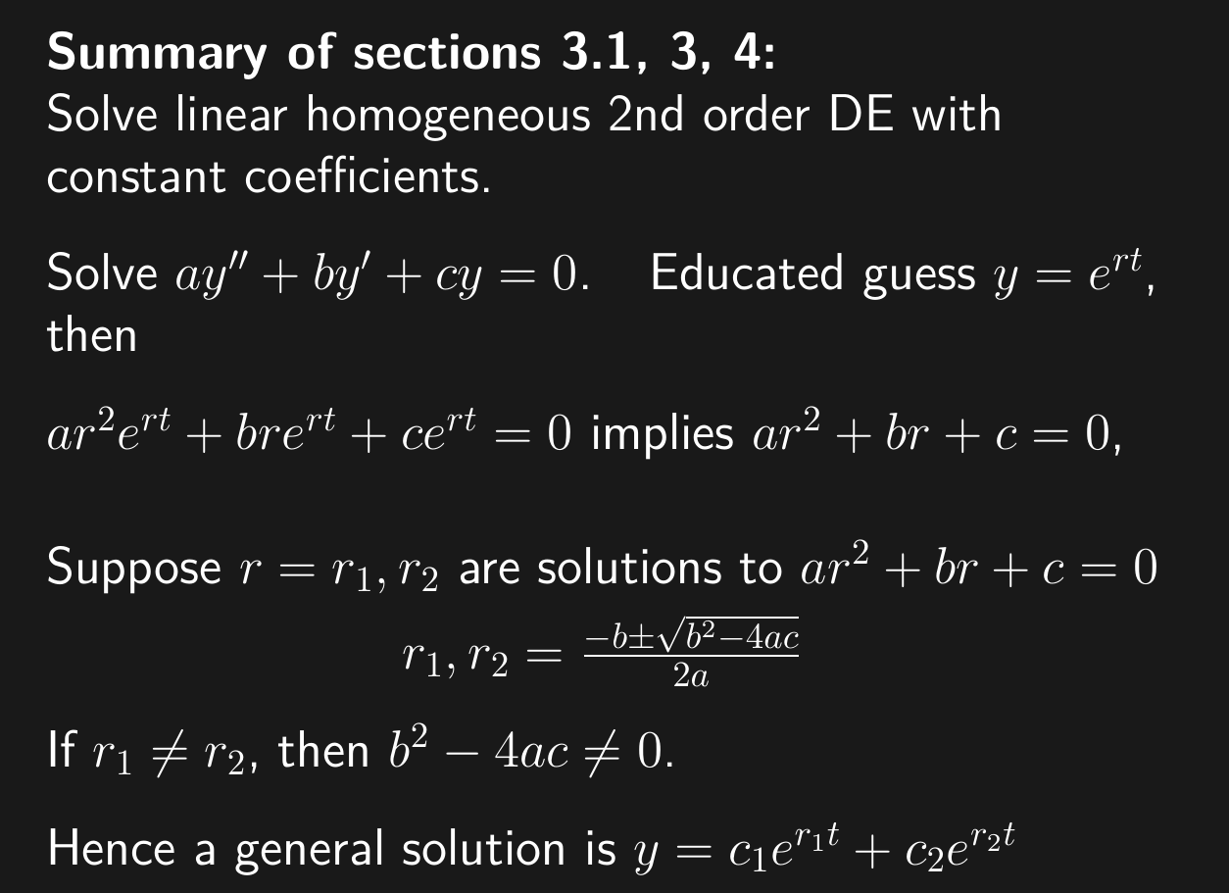

Slide 2
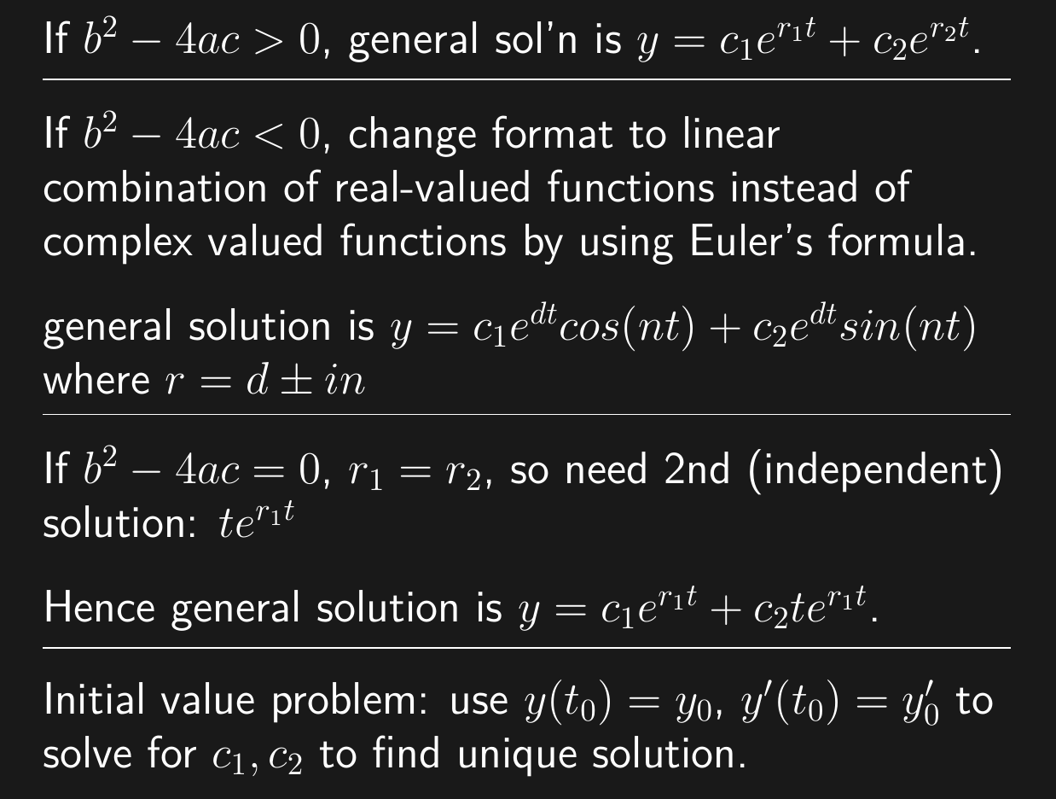
3.1
3.3
3.4

Slide 3
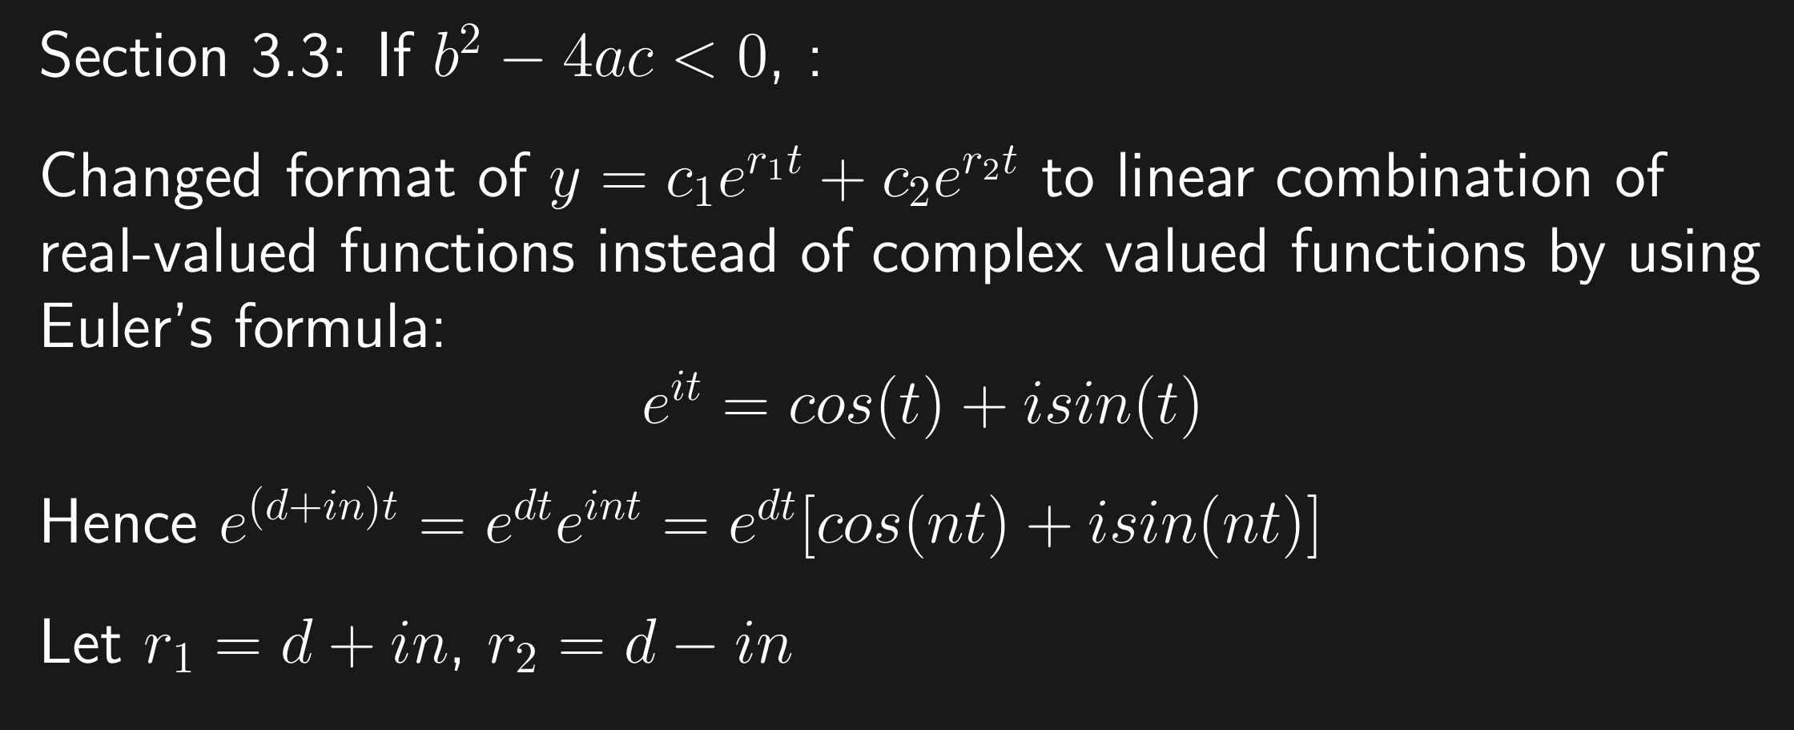

Slide 5
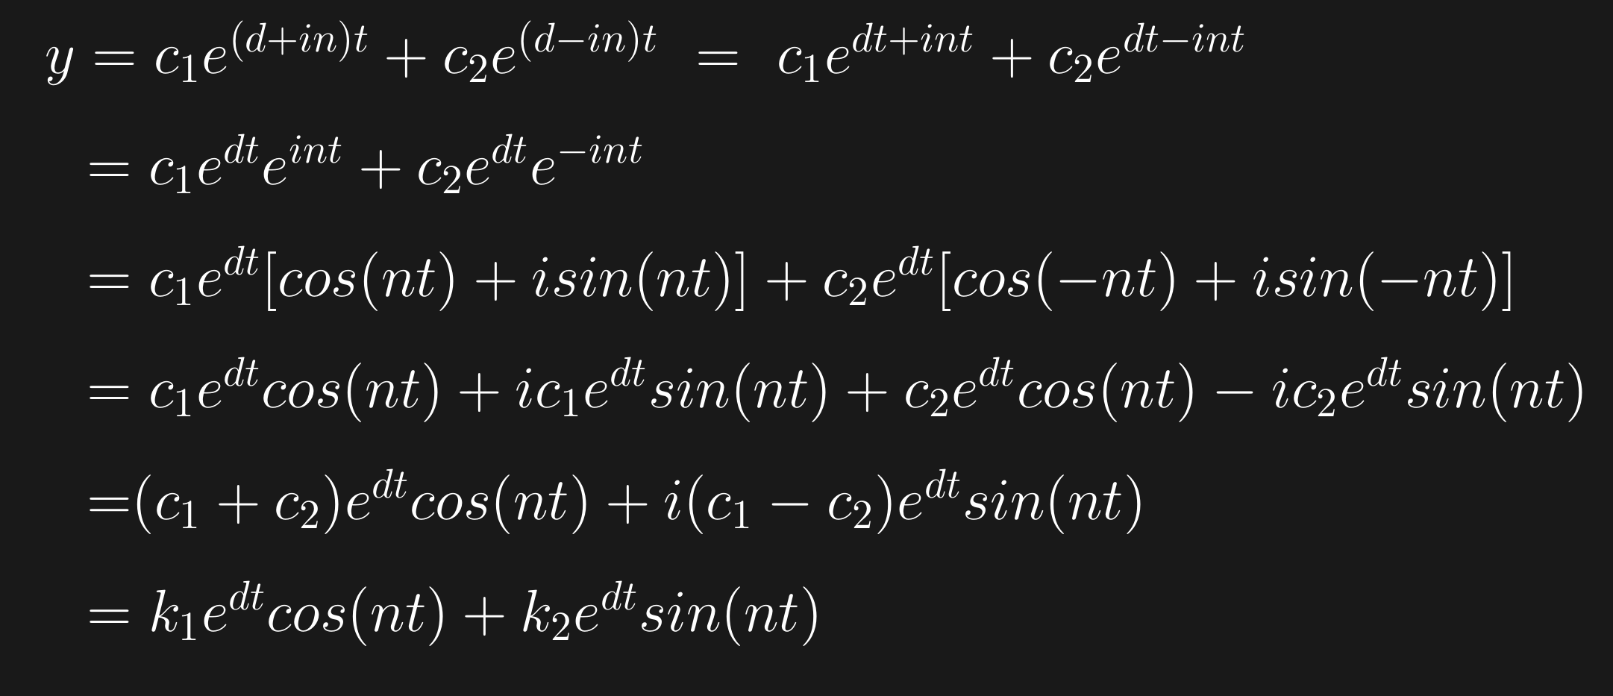

Slide 6
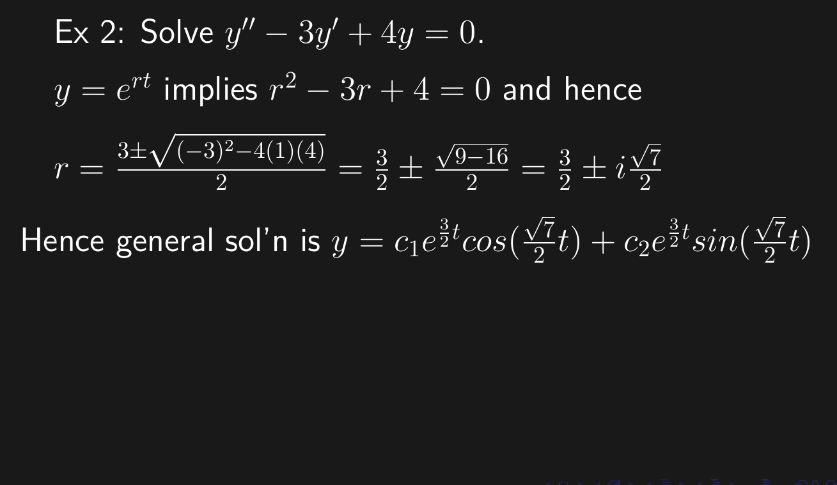

Slide 10
3.1
3.3
3.4

Slide 11
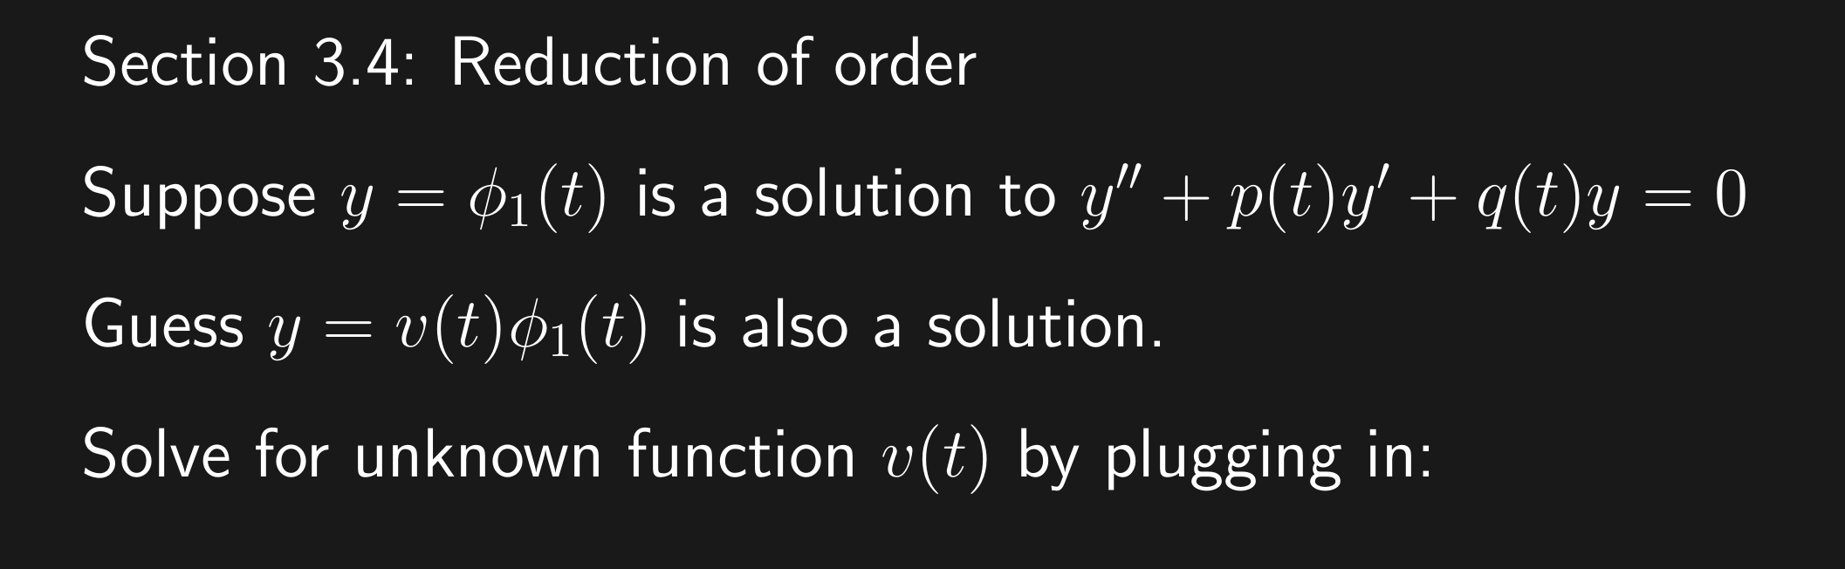

Slide 12
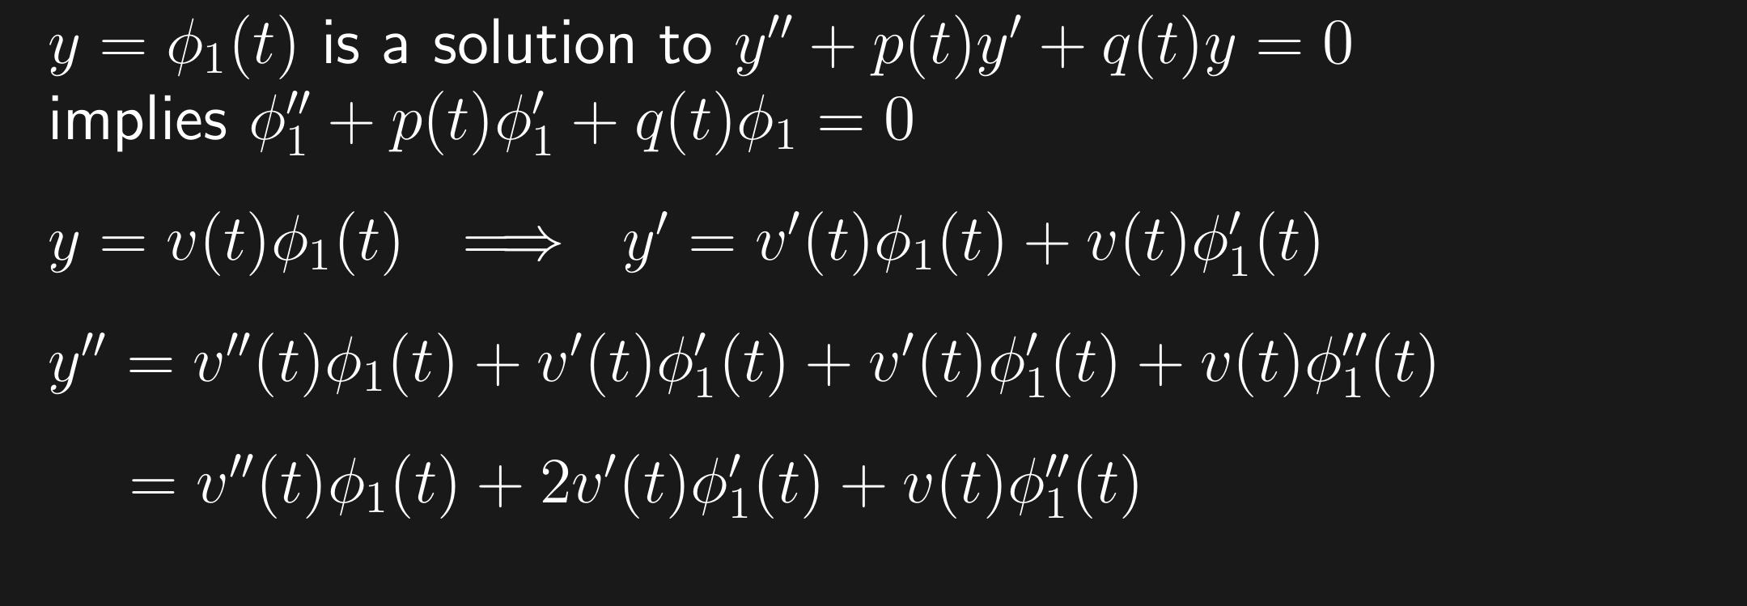

Slide 13
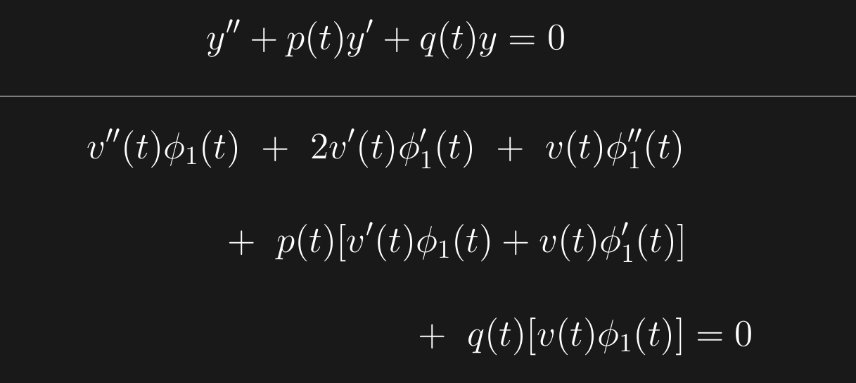

Slide 14



( )

Slide 15



Recall we know the solution
And now want to solve for
We can turn this into a first order DE involving
using the following substitution:

Slide 16
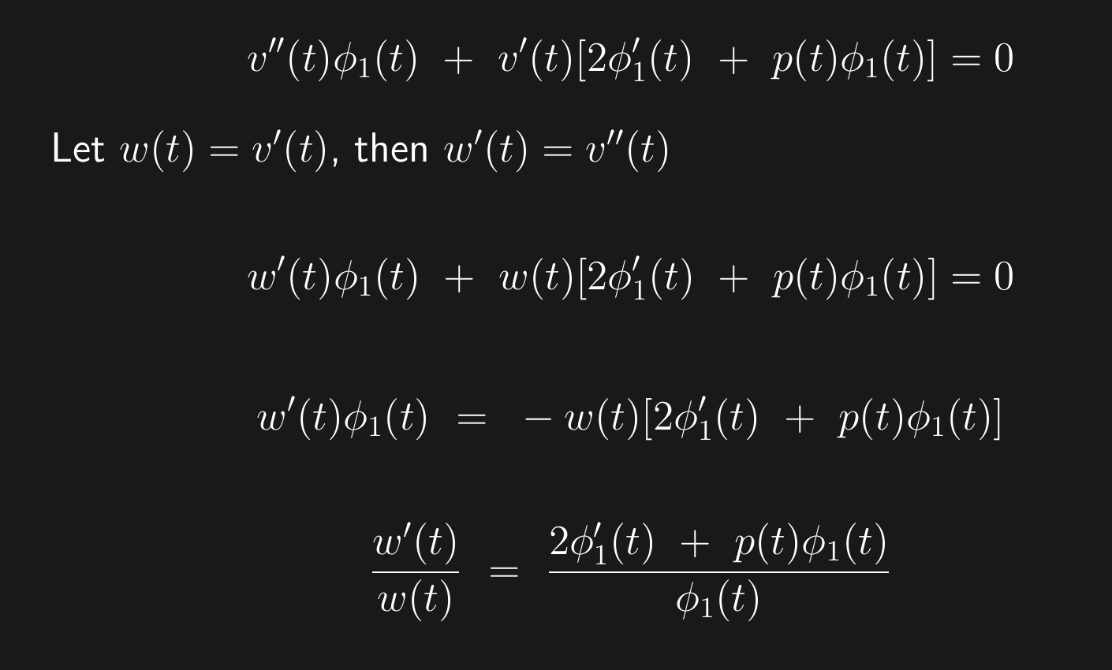

Slide 18
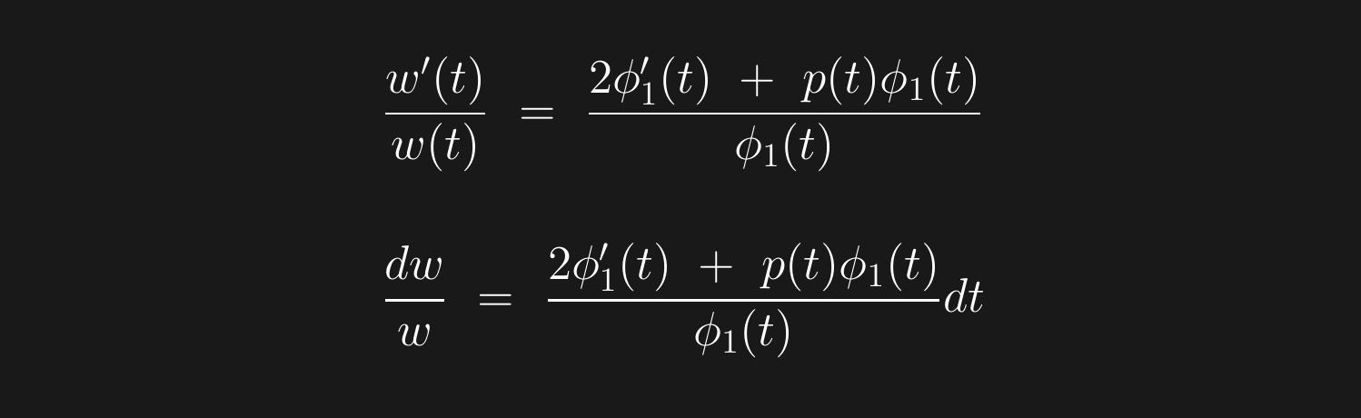

Slide 19
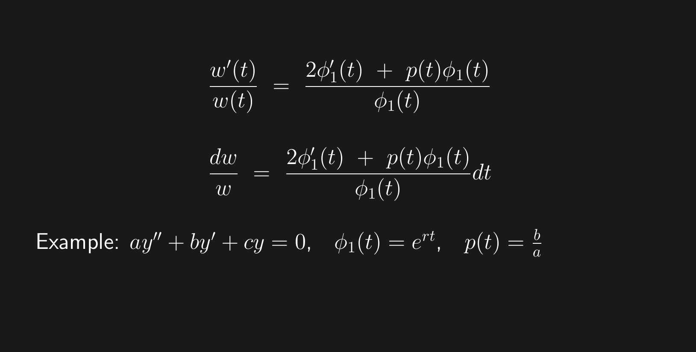
Lots of algebra implies =

Slide 21
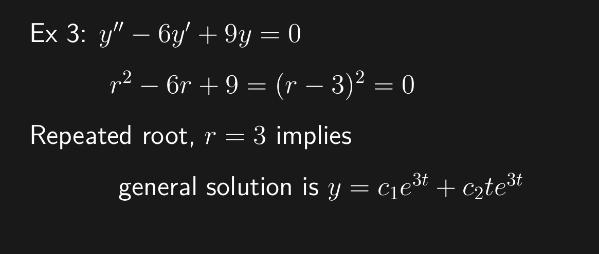

Slide 23
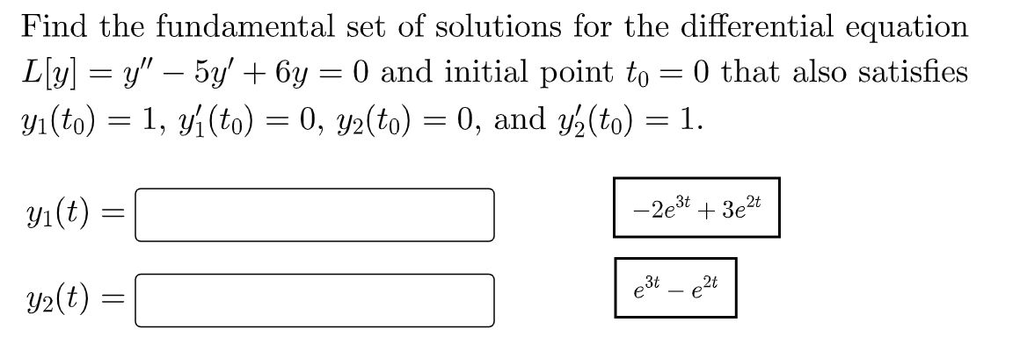
HW Hints
HW 5 #4
Solve one initial value problem to find y₁
And a 2nd initial value problem to find y₂
A general solution: y = c₁y₁+ c₂ y₂
Note: {y₁, y₂} is a superior basis (fundamental set of solutions)

Slide 24


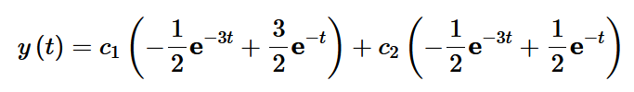
Example from https://tutorial.math.lamar.edu/classes/de/FundamentalSetsofSolutions.aspx
A general solution:
An equally correct general solution:
For this 2nd general solution, note that y(0) = c₁ and y’(0) = c₂

Slide 25
HW 5 #5
To be a fundamental set of solutions, they need to be
1.) SOLUTIONS
2.) Form a basis for the solution set.
For 2nd order this means that
there are 2 linearly independent functions
which is equivalent to
their Wronskian is not 0
To calculate Wronskian (if needed), use definition and/or Abel’s theorem.
Abel’s theorem only determine Wronskian up to a constant, but if you know Wronskian at one point, can determine the constant.

Slide 26
Recall: Linear combinations of solutions are solutions
The graphs of the solutions will be important when we get to sections 3.7 and 3.8

Slide 27
