Slide 4
2.8
Look for patterns. For example:
Powers: 2^{k} or 2^{2k+1} if you want only odd powers of 2, (-1)^{k} if alternating, etc
Factorials: k! or
9*7*5*3*1 implies (2k-1)(2k-3)…(1) or
a shifted version such as (2k+5)(2k+3)(2k+1)(2k-1)(2k-3)…(1) or
33*28*23*18*13*8*3 implies
or a shifted version

Slide 5
Look for patterns. For example:
Powers: 2^{k} or 2^{2k+1} if you want only odd powers of 2, (-1)^{k} if alternating, etc
Factorials: k! or
Products:
For product of odd numbers: $\prod_{j=1}^{k}{\left(2j−1\right) = \left(1\right)\left(3\right)…(2k−1)}$
For example if $k = 5$,
$\prod_{j=1}^{5}{\left(2j−1\right) = \left(1\right)\left(3\right)…\left(2\left(5\right)−1\right)}$ = (1)(3)(5)(7)(9)
For product where difference between terms is 5 with 7 terms and sequence starts at 3:
33*28*23*18*13*8*3 = $\prod_{j=1}^{7}{\left(5j−2\right) = }$ $\prod_{j=0}^{6}{\left(5j+3\right) }$

Slide 6
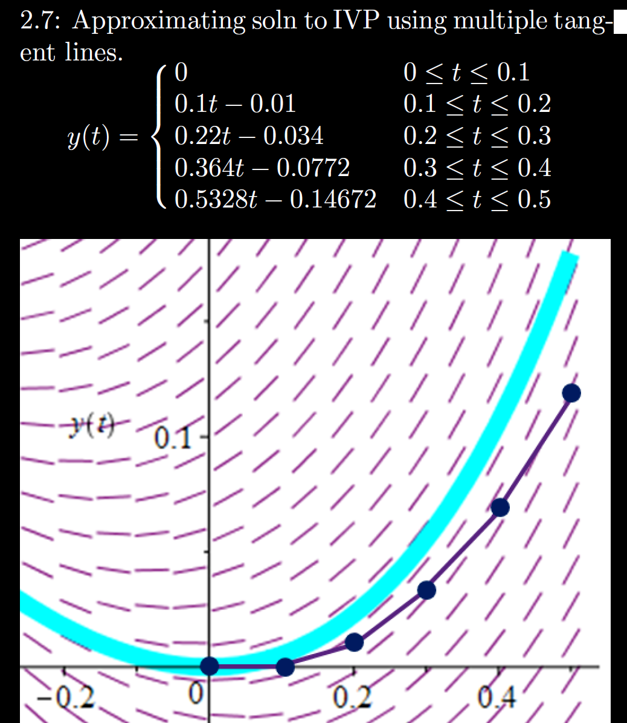
h = Step size
= Δt = 0.1
Sequence of functions
One function consisting of pasting together tangent lines

Slide 7
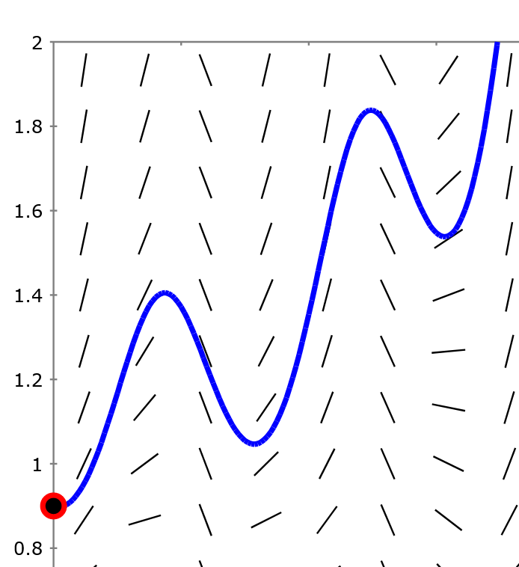
Section 2.7 Euler’s method: Using tangent lines to
approximate a
function.
http://slopefield.nathangrigg.net

Slide 8
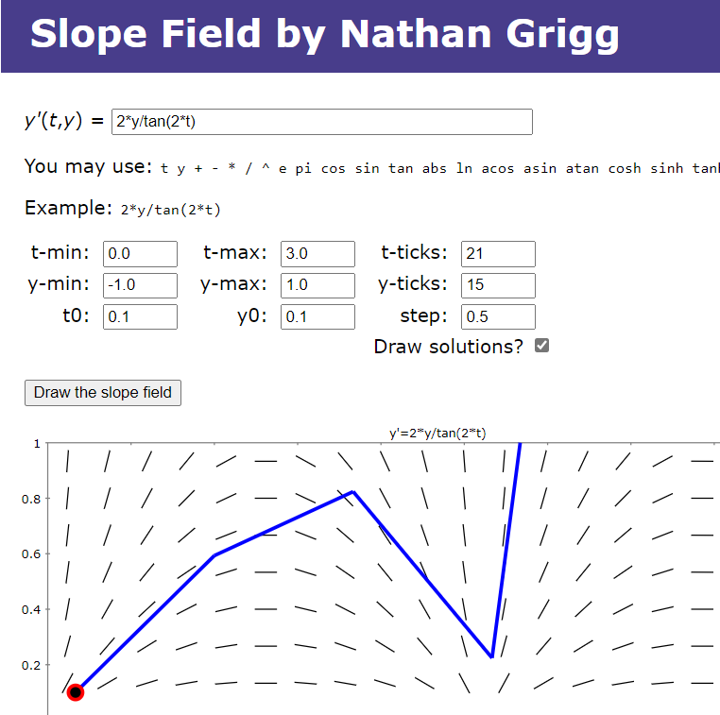

Slide 9
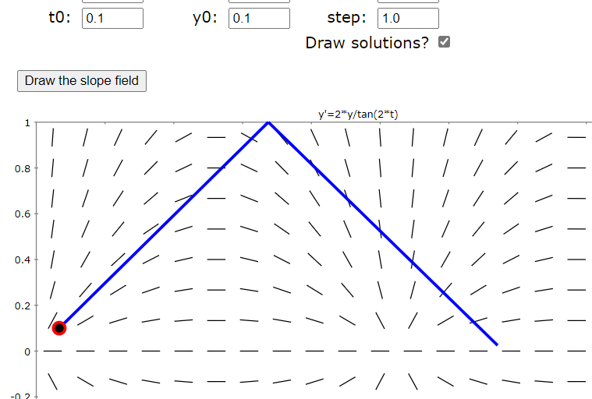
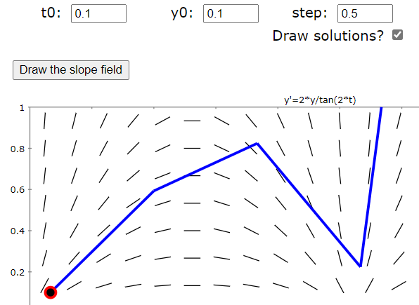
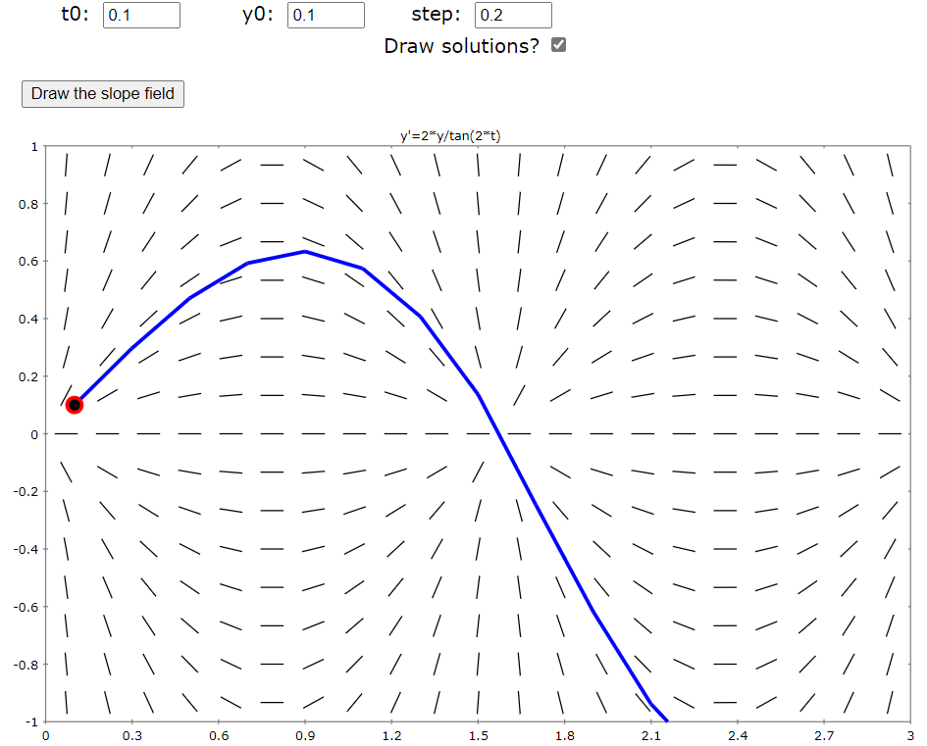
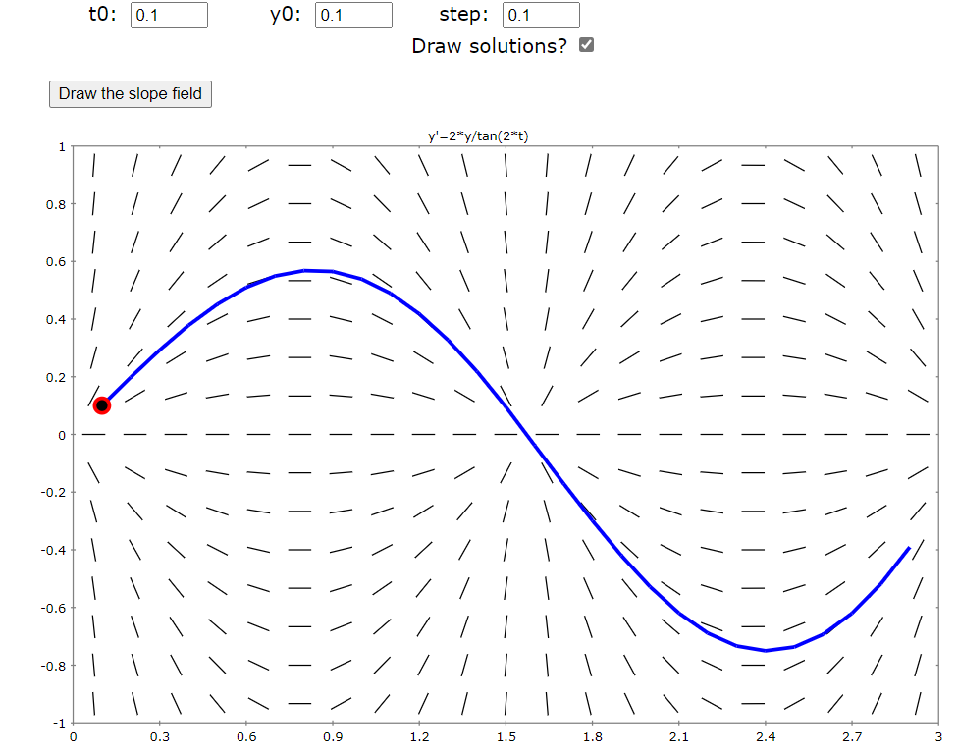

Slide 10
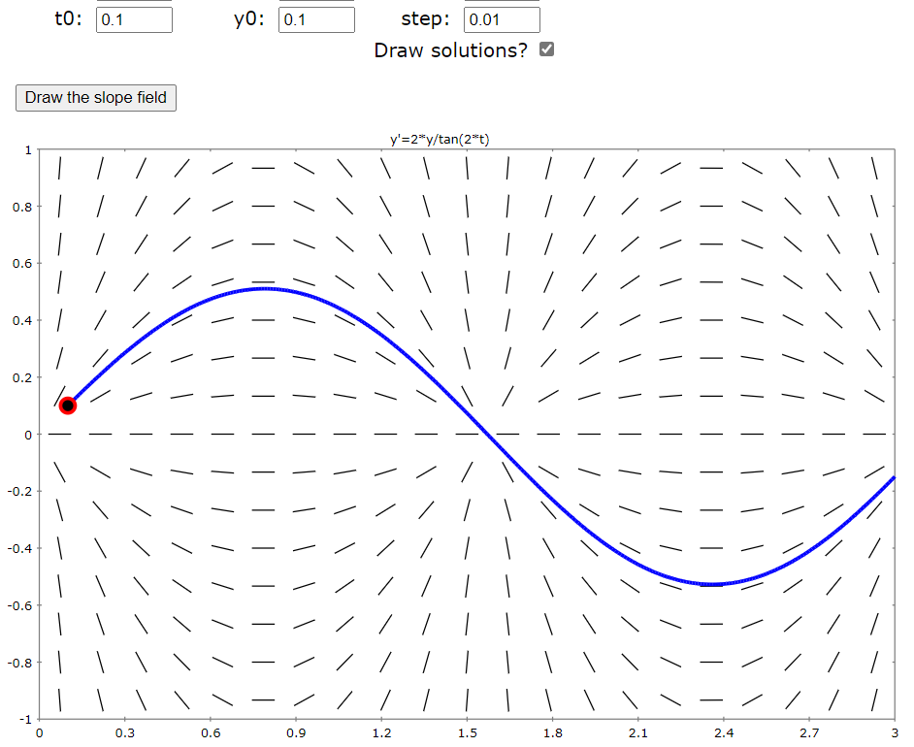
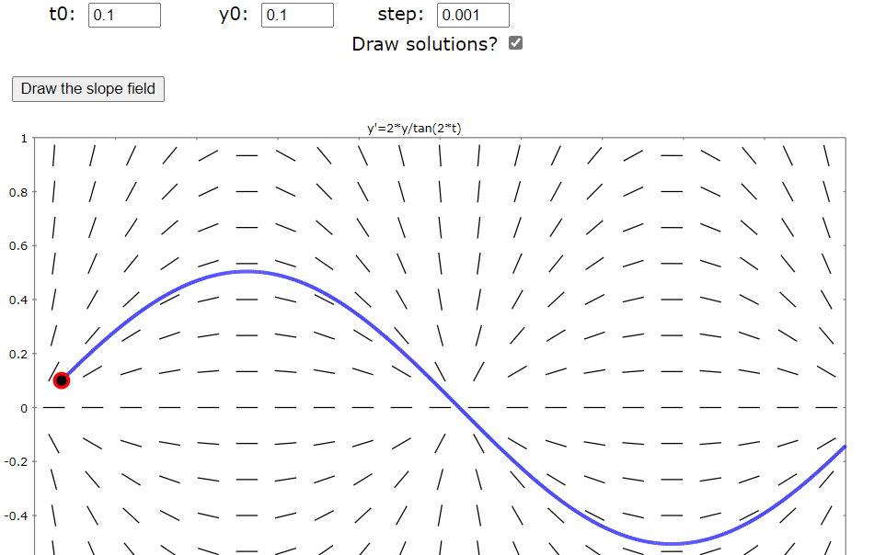

Slide 11
Estimate y(0.3) using h = Step size = Δt = 0.1
Thus if $(t0, y0) = (0, 0)$← the initial value, then
$t1 = 0.1$ and $y1 = y0 + ∆y=y0+\left[f\left(t0, y0\right)\right] \left(0. 1\right)$
$t2 = 0.2$ and $y2 = y1 + ∆y=y1+\left[f\left(t1, y1\right)\right] (0. 1)$
$t3 = 0.3$ and $y3 = y2 + ∆y=y2+\left[f\left(t2, y2\right)\right] (0. 1)$
$$(ti+1, yi+1)$$
$$∆y$$
Slope at $(t0, y0)$ $∆t$
$$(ti, yi)$$
$$∆t=0.1$$

Slide 12
$$yi+1 = yi + ∆y=yi+\left[f\left(ti, yi\right)\right]∆t$$
Part of tangent line at $(ti, yi)$
Thus slope is $f(ti, yi)$
Its length is determined by $∆t$
$$(ti+1, yi+1)$$
$$∆y$$
$$(ti, yi)$$
$$∆t=0.1$$

Slide 13
h = Step size
= Δt = 0.1

Slide 14
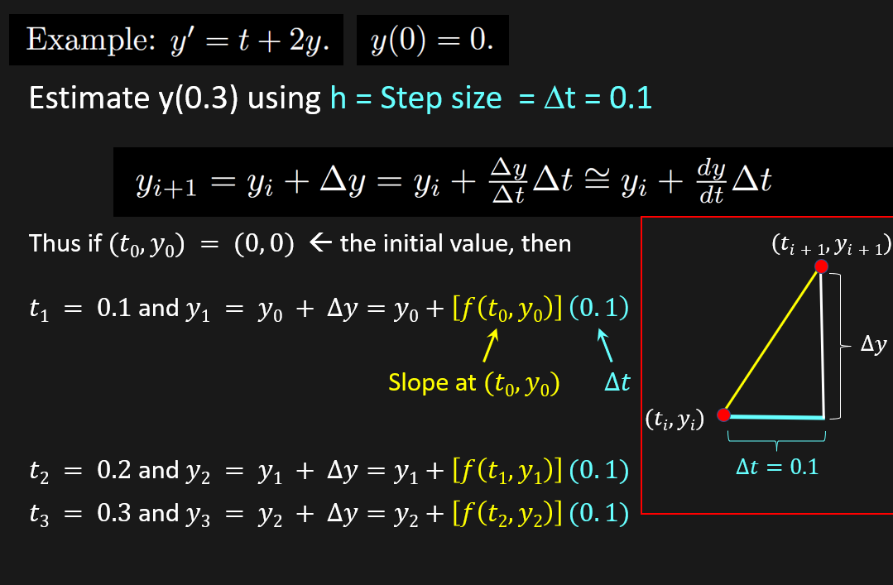

Slide 16
For the initial value problem, y’ = t²y, y(5) = 3,
use Euler’s method to estimate y(5.2) using t = $∆$0.1

Slide 18
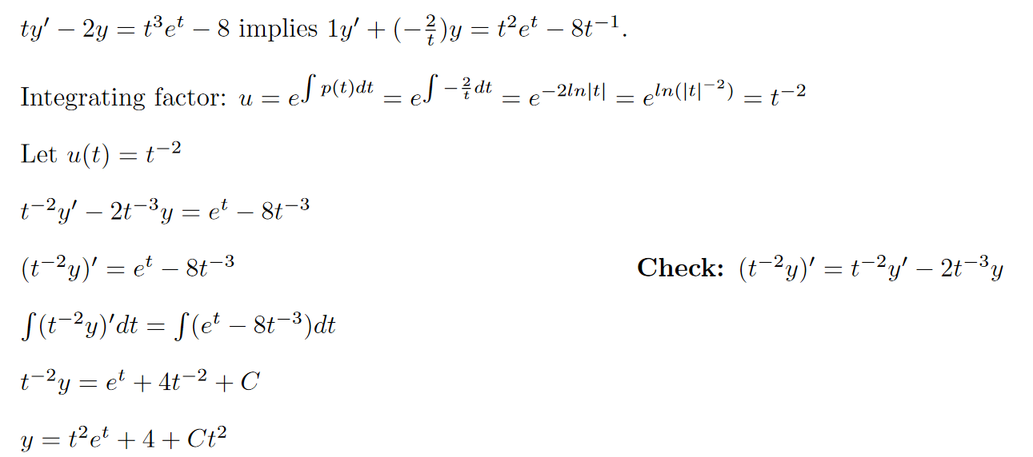

Slide 20
