Slide 1
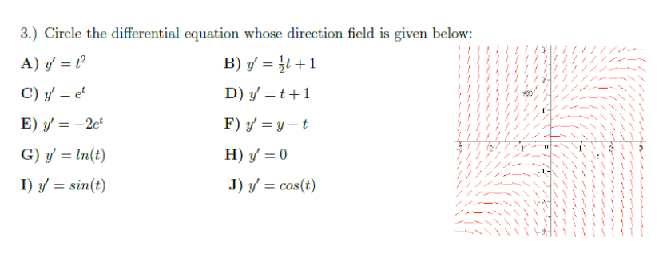

Slide 2

For the initial value problem, y’ = t²y, y(5) = 3,
use Euler’s method to estimate y(5.2) using t = $∆$0.1

Slide 3
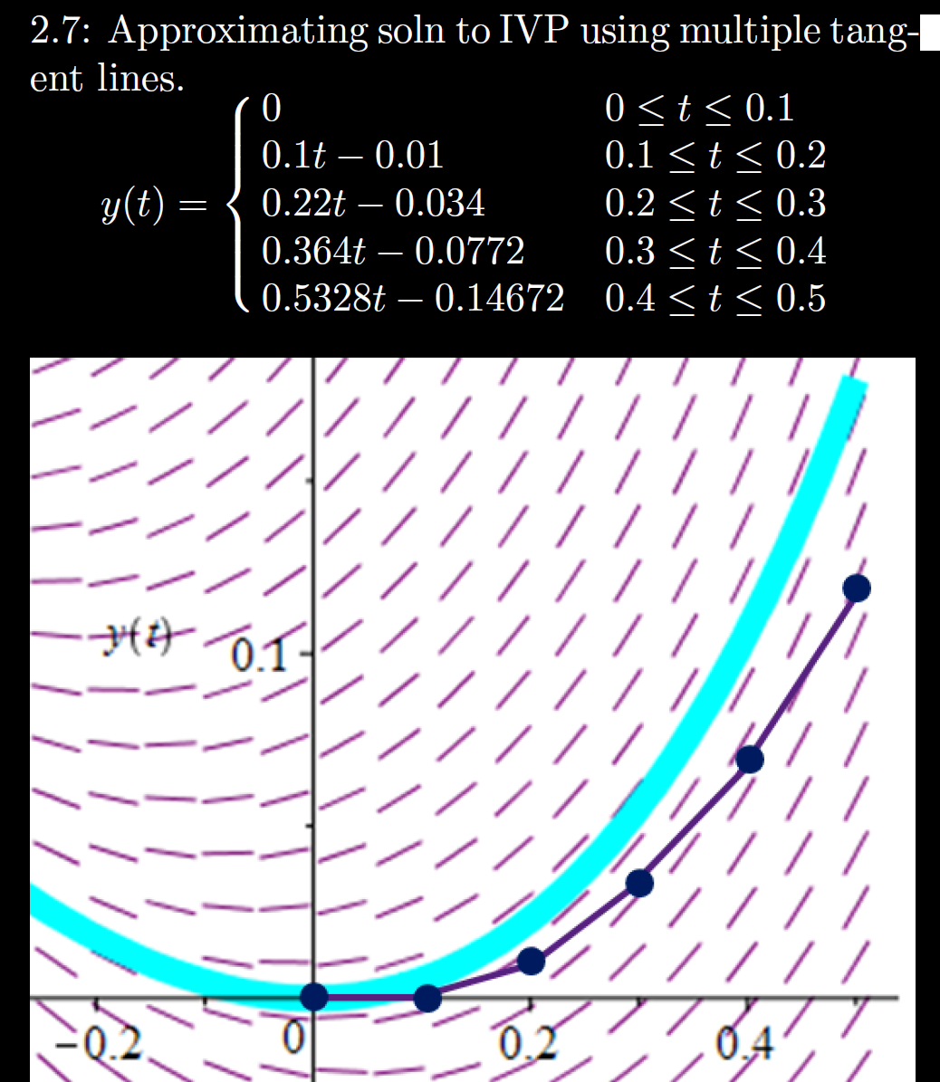

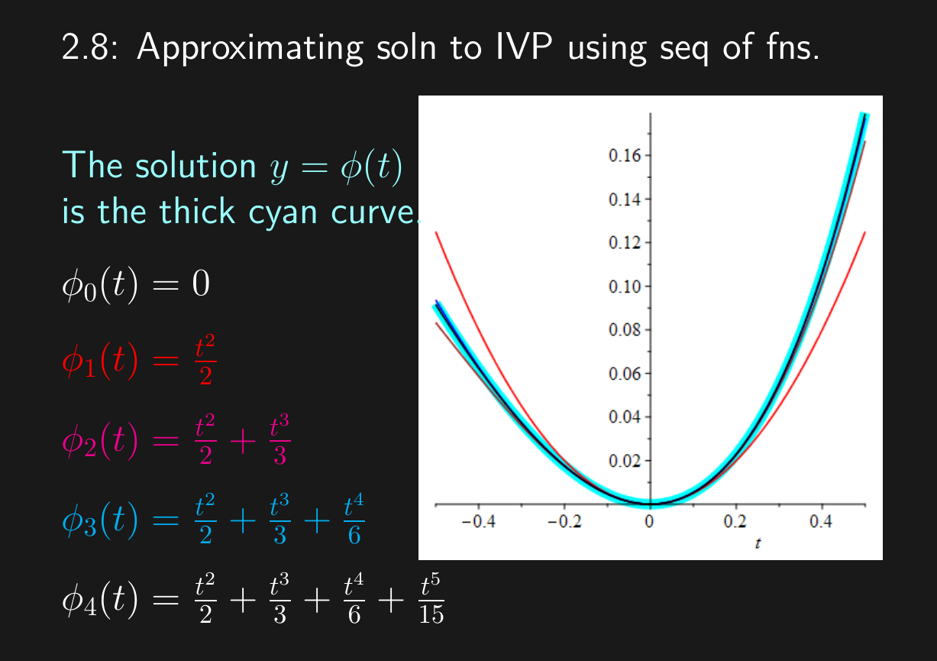


h = Step size
= Δt = 0.1
Sequence of functions
One function consisting of pasting together tangent lines

Slide 4
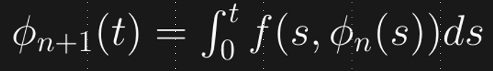
2.7: Glue together tangent lines to find a single function approximating y(t)
h = Step size
= Δt = 0.1
2.8: Find a sequence of functions that converge to y(t)

Slide 5
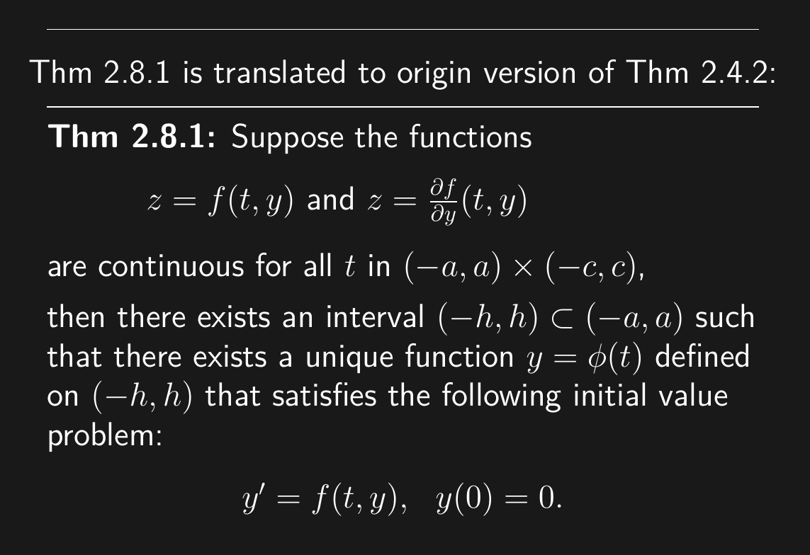

Slide 6
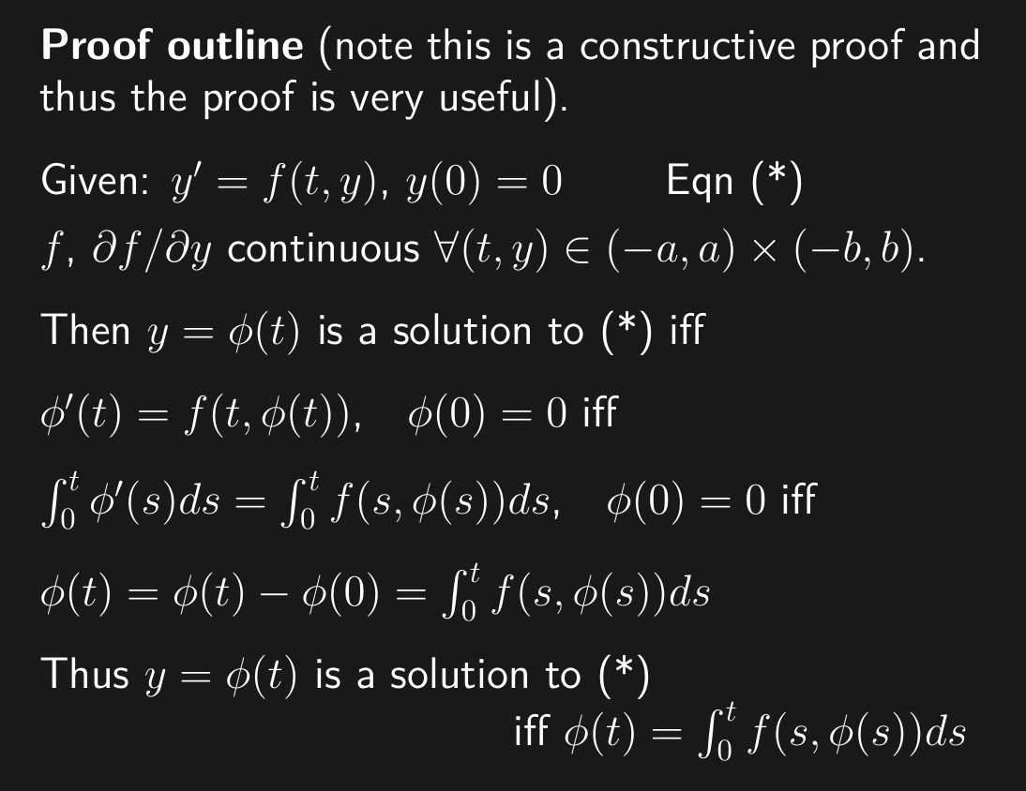

Slide 7
s is a dummy variable. The variable s disappears after integrating and plugging in the endpoints 0 and t.

Slide 11
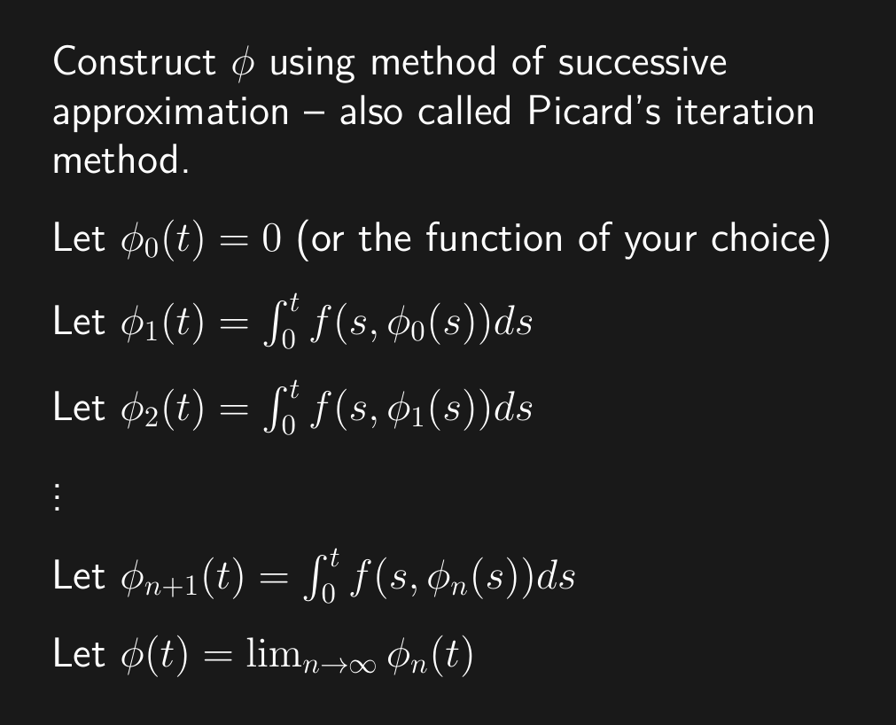

Slide 13
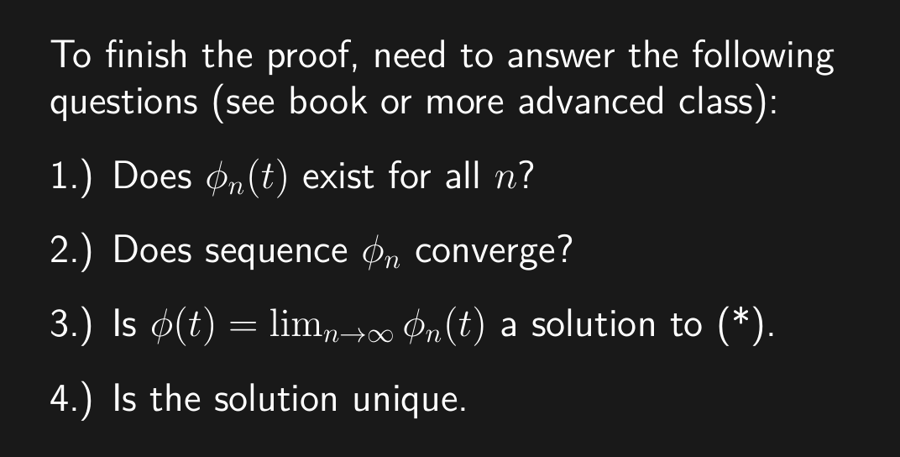

Slide 14
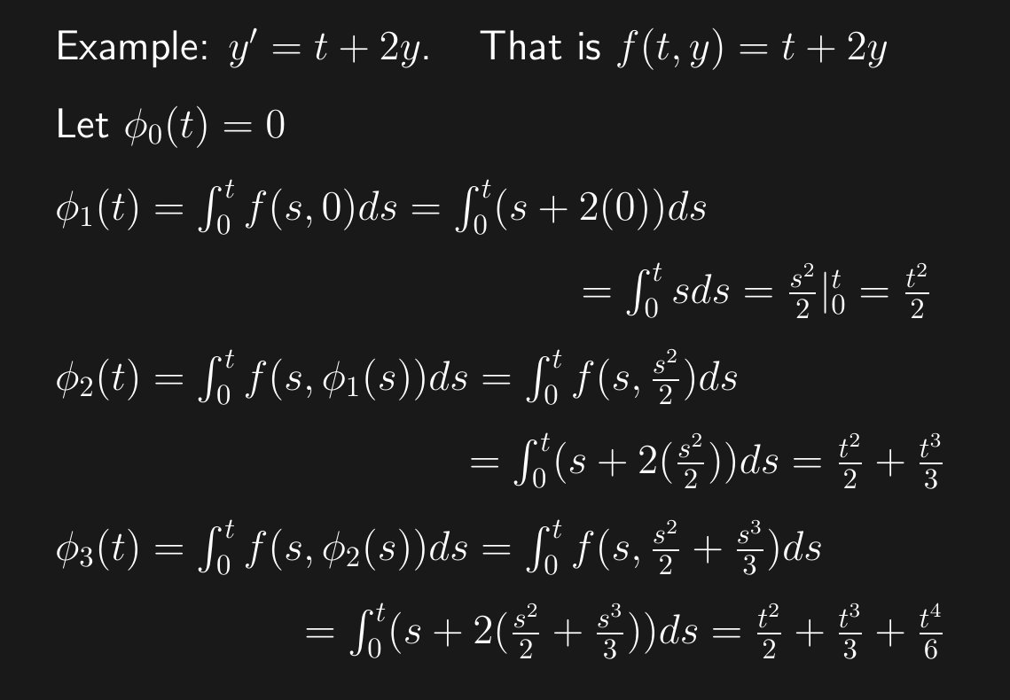

Picard’s iteration method requires that the initial value is y(0) = 0

Slide 18
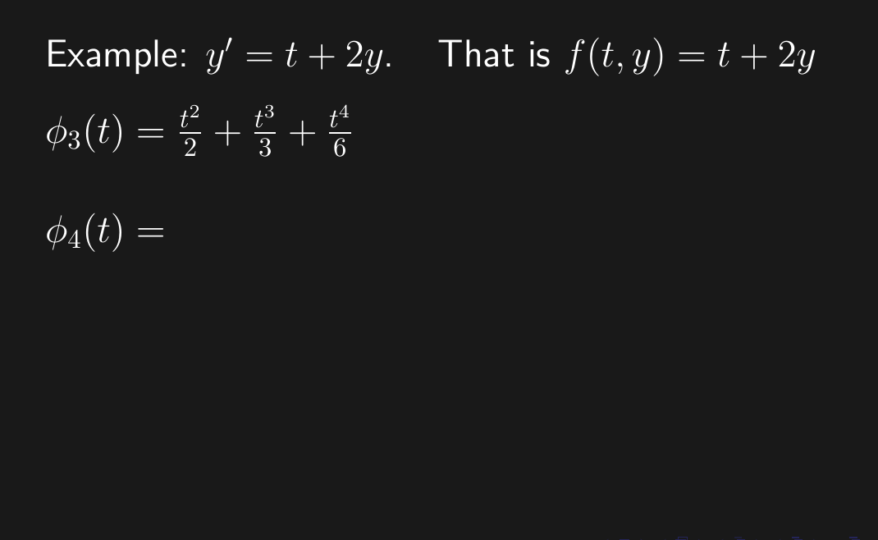

Slide 19
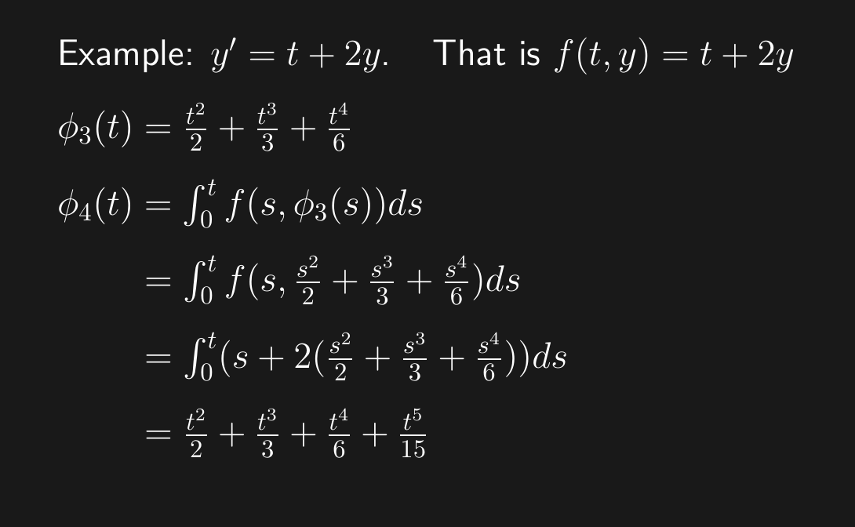

Slide 20
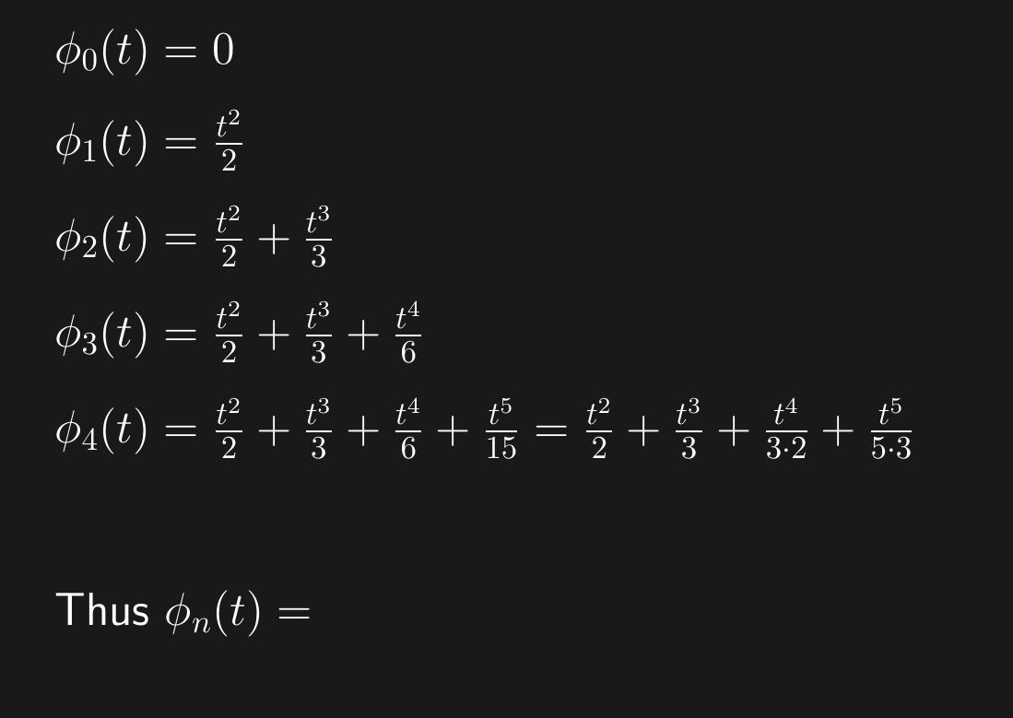

Slide 21
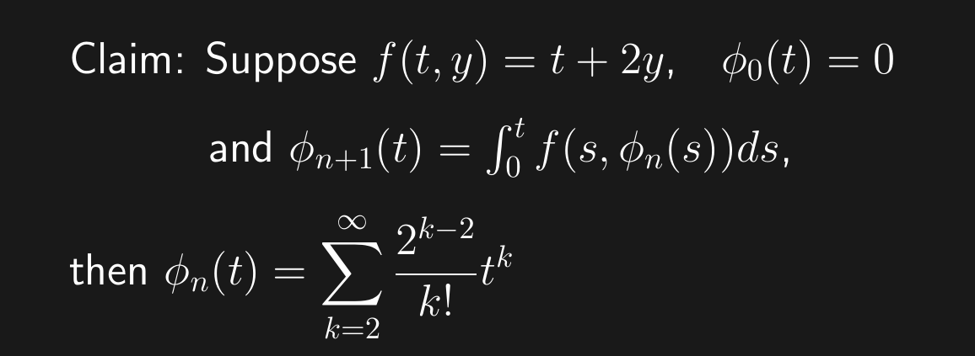
2.8
Look for patterns. For example:
Factorials: k! or
Powers: 2^{k} or
2^{2k+1} if you want only odd powers of 2 or
2^{2k} if you want only even powers of 2 or
(-1)^{k} if alternating, etc.

Slide 22
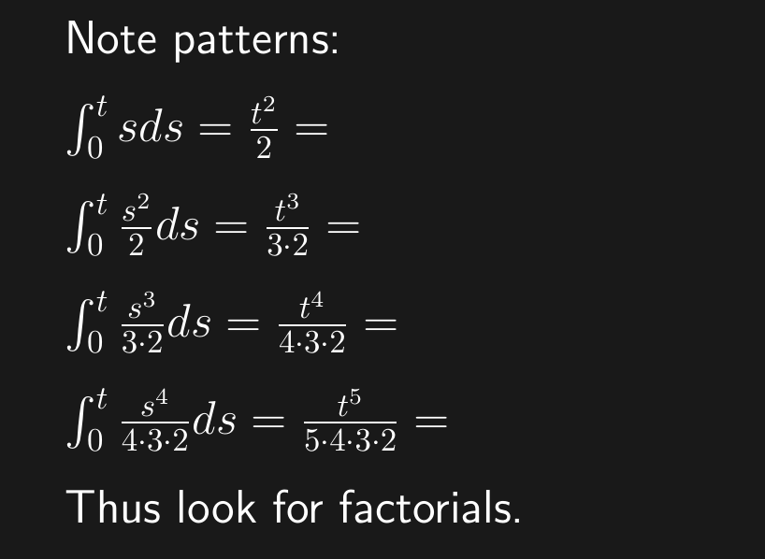

Slide 23
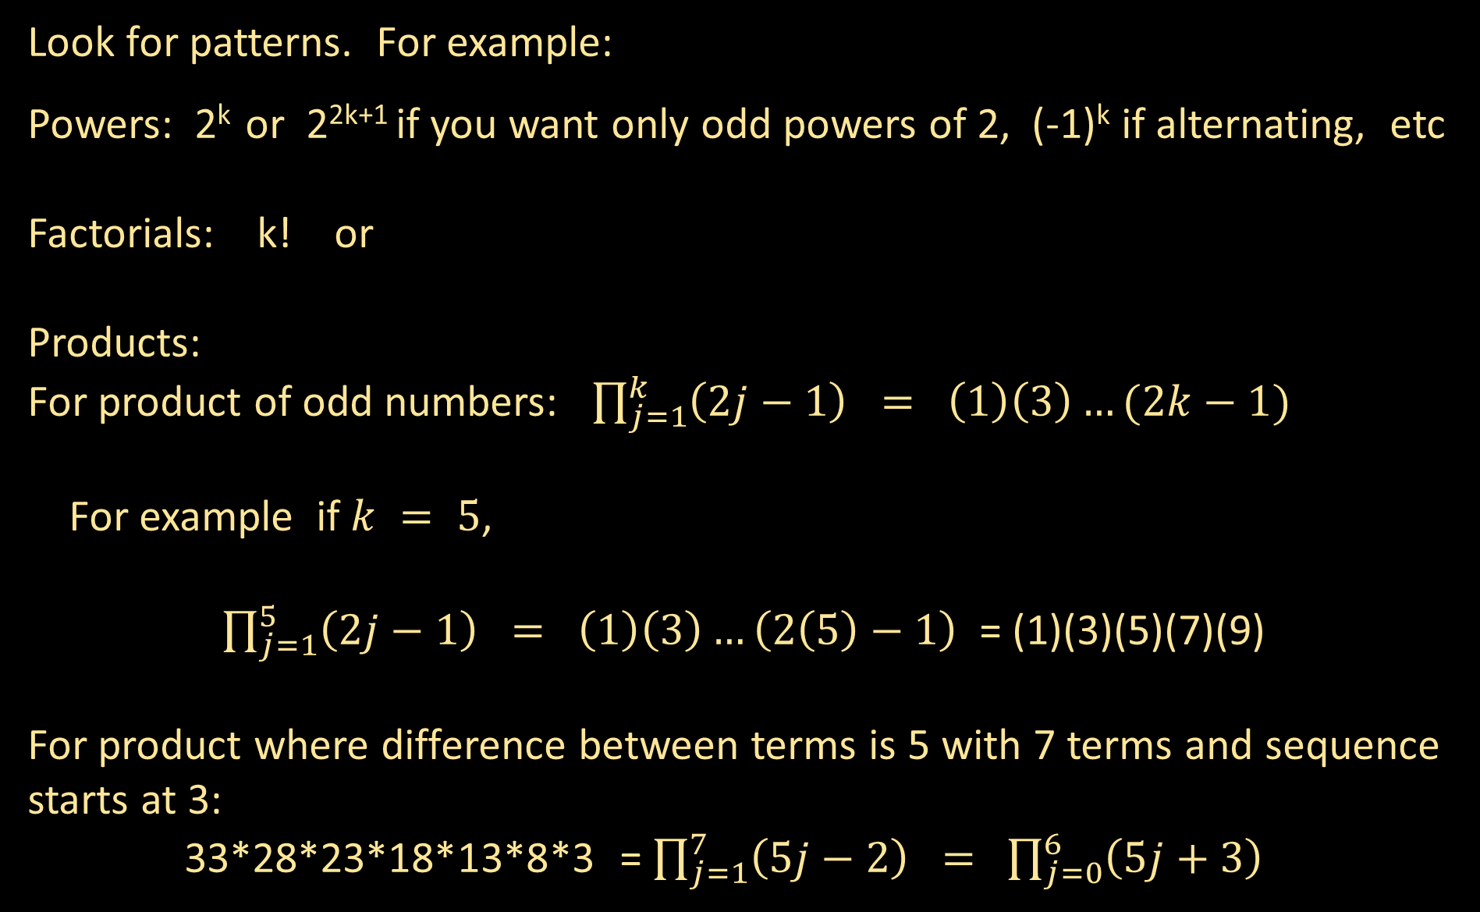
Look for patterns. For example:
Powers: 2^{k} or 2^{2k+1} if you want only odd powers of 2, (-1)^{k} if alternating, etc
Factorials: k! or
Products:
For product of odd numbers: $\prod_{j=1}^{k}{\left(2j−1\right) = \left(1\right)\left(3\right)…(2k−1)}$
For example if $k = 5$,
$\prod_{j=1}^{5}{\left(2j−1\right) = \left(1\right)\left(3\right)…\left(2\left(5\right)−1\right)}$ = (1)(3)(5)(7)(9)
For product where difference between terms is 5 with 7 terms and sequence starts at 3:
33*28*23*18*13*8*3 = $\prod_{j=1}^{7}{\left(5j−2\right) = }$ $\prod_{j=0}^{6}{\left(5j+3\right) }$

Slide 24
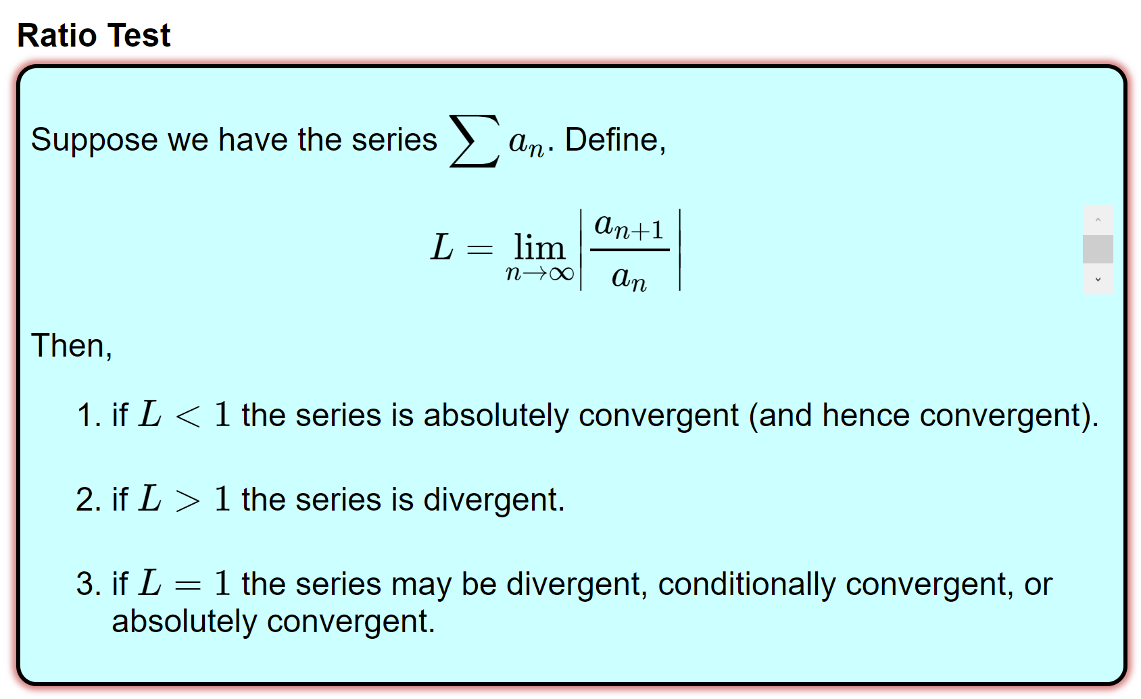
Proving Convergence
https://tutorial.math.lamar.edu/Classes/CalcII/RatioTest.aspx

Slide 25
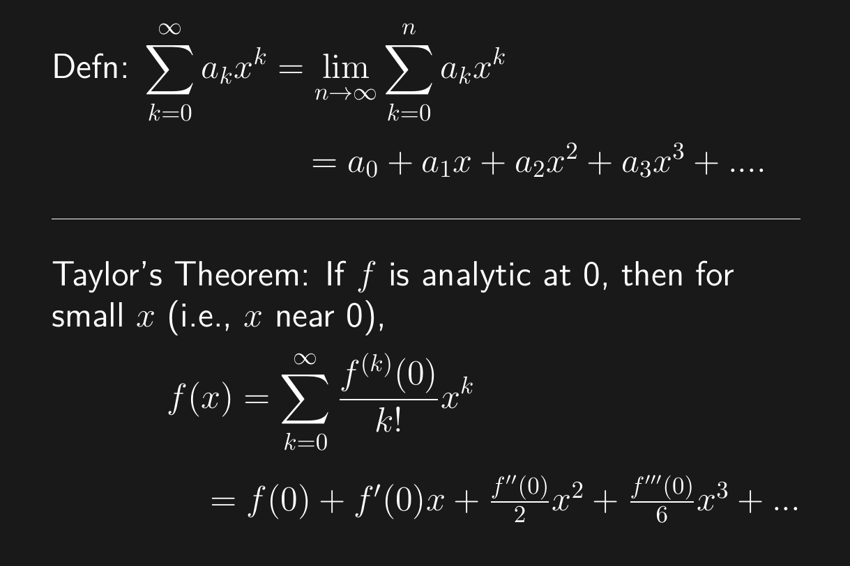

Slide 26
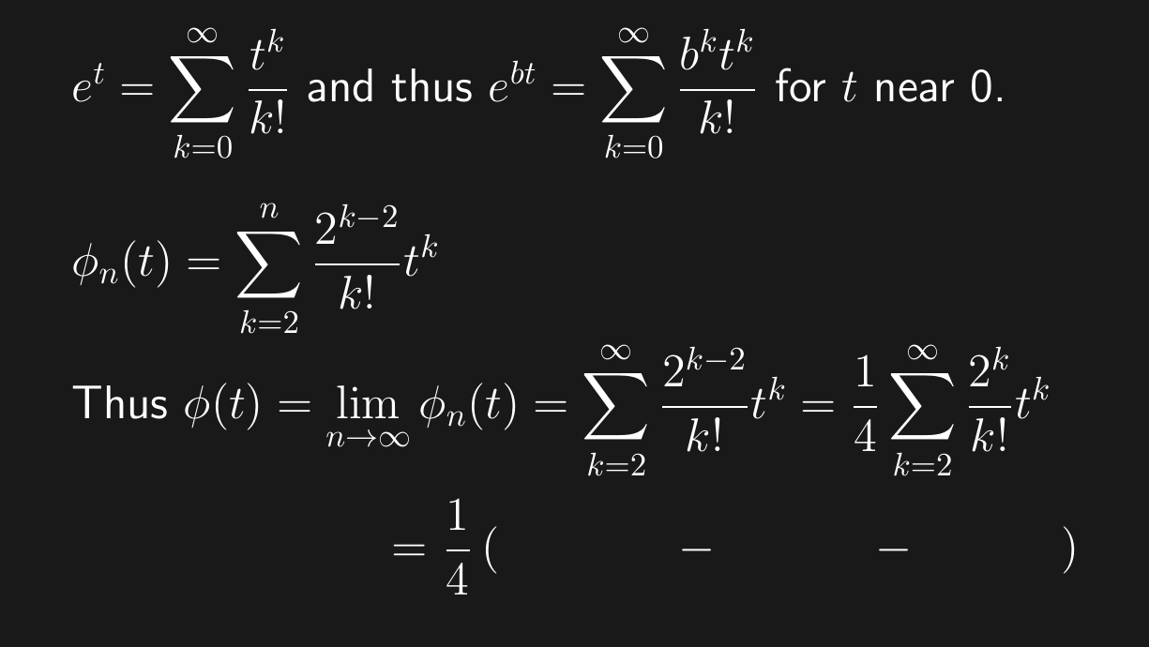




$$\sum_{k=0}^{∞}{\frac{2^{k}t^{k}}{k!}}$$
$$\frac{2^{0}t^{0}}{0!}$$
$$\frac{2^{1}t^{1}}{1!}$$
= $\frac{1}{4}\left(ⅇ^{2t}−1−2t\right)$

Slide 27

Solution: y = $\frac{1}{4}\left(ⅇ^{2t}−1−2t\right)$

Slide 28
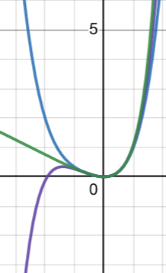
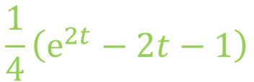
$$\frac{1}{4}\left(ⅇ^{2t}−2t−1\right)$$

