Slide 1
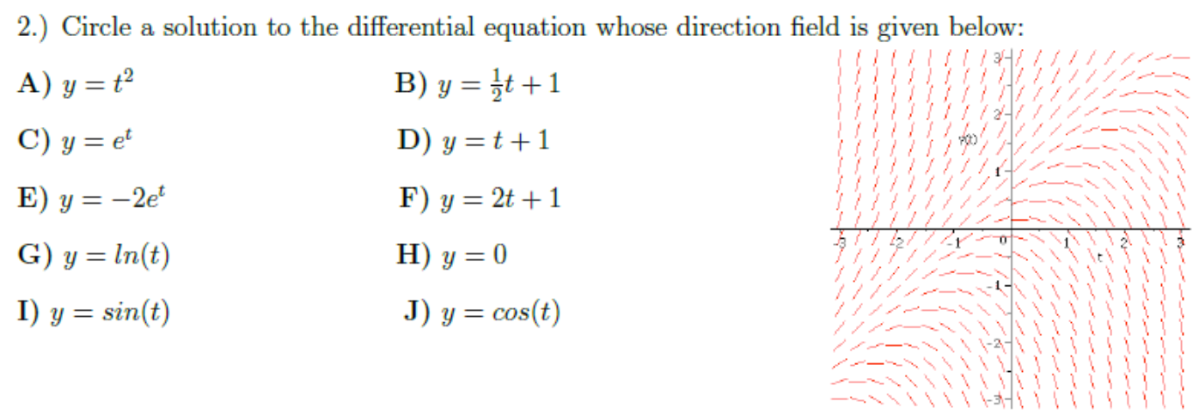

Slide 5
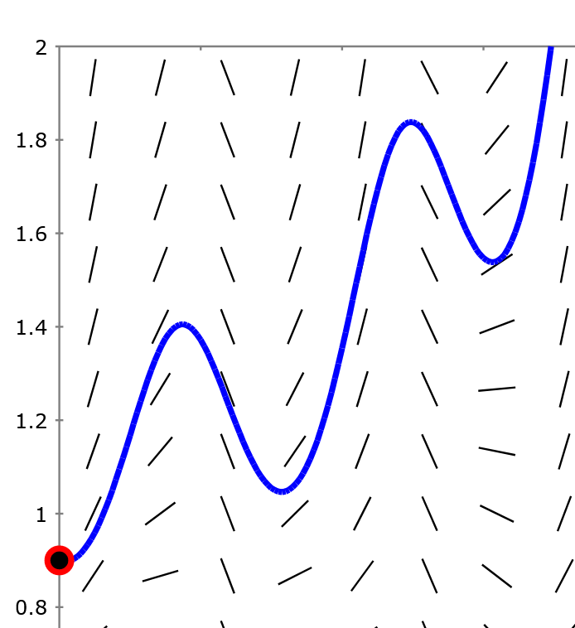
Section 2.7 Euler’s method: Using tangent lines to approximate a function.
We often cannot solve differential equations directly and thus need to use numerical methods to approximate solutions.
For more info (and to earn a math minor), take MATH:3800 Introduction to Numerical Methods.
Math minor info (15 math units): https://math.uiowa.edu/undergraduate-program/majors-minor/minor-requirements
Or double major: eg Math Program C: Engineering
https://math.uiowa.edu/sites/math.uiowa.edu/files/print_pdf/Engineering%20Program%20C%20Template%202016%20.pdf
http://slopefield.nathangrigg.net

Slide 6
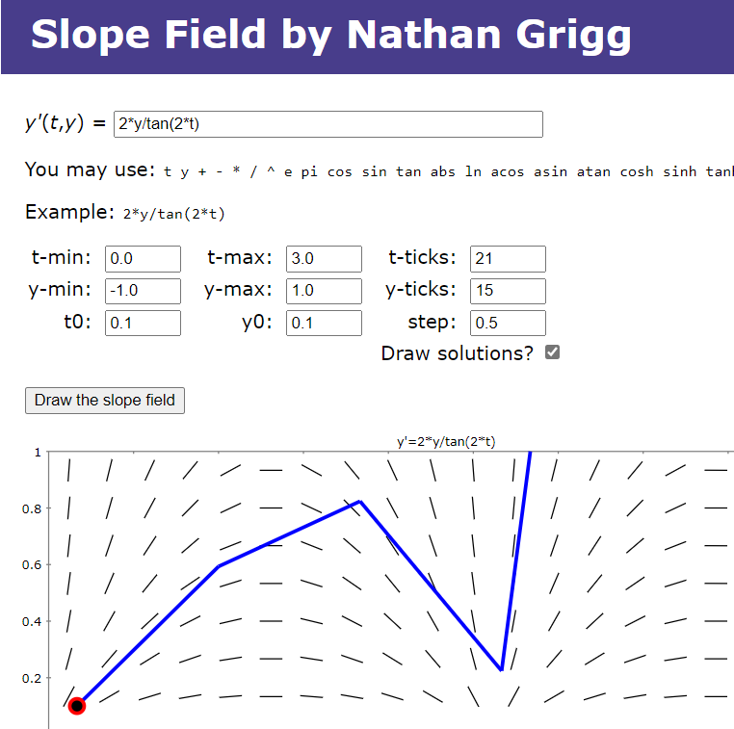

Slide 7
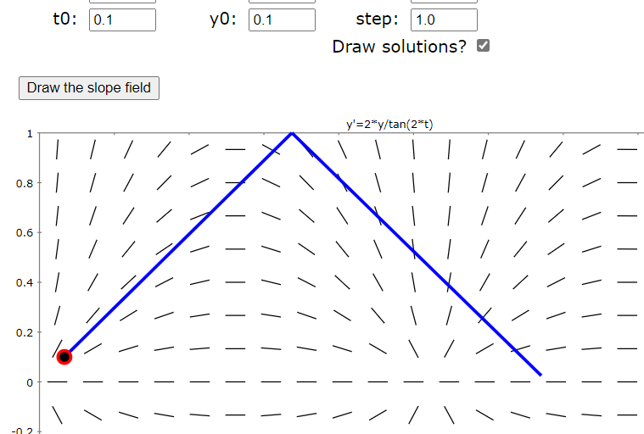
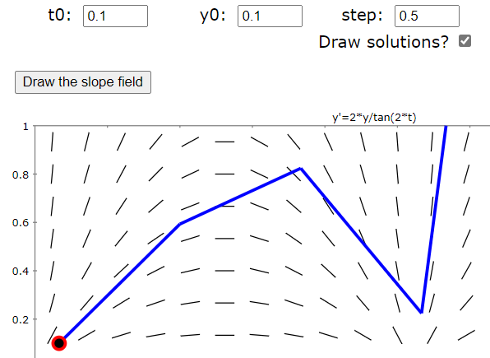
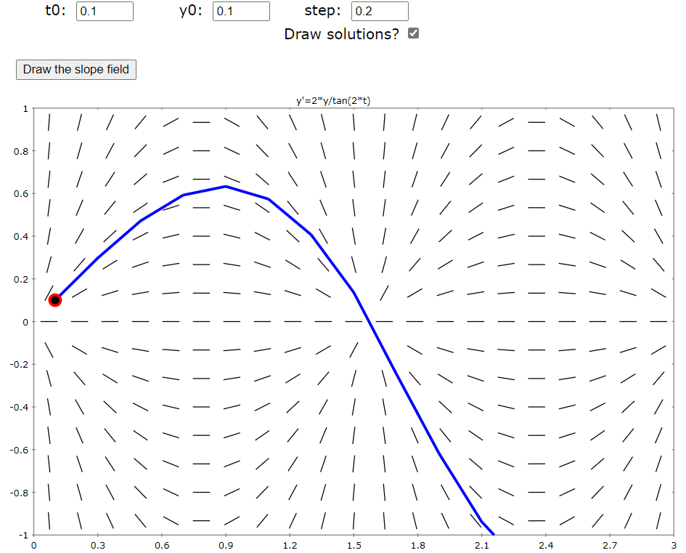
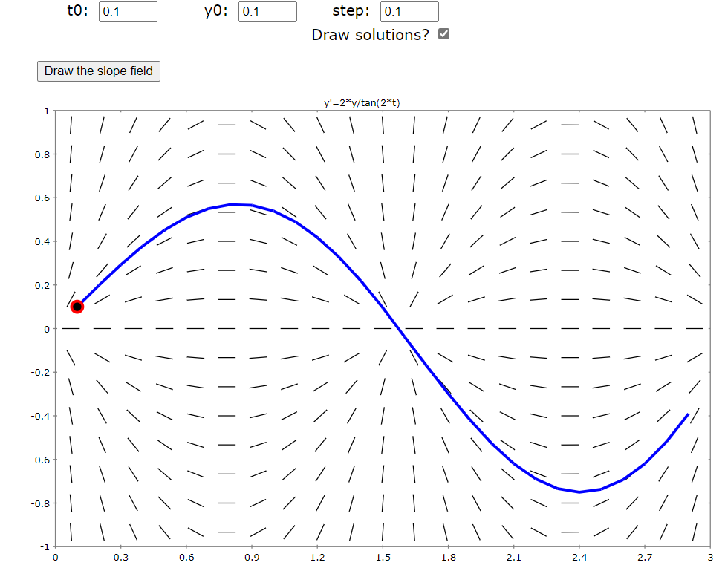

Slide 8
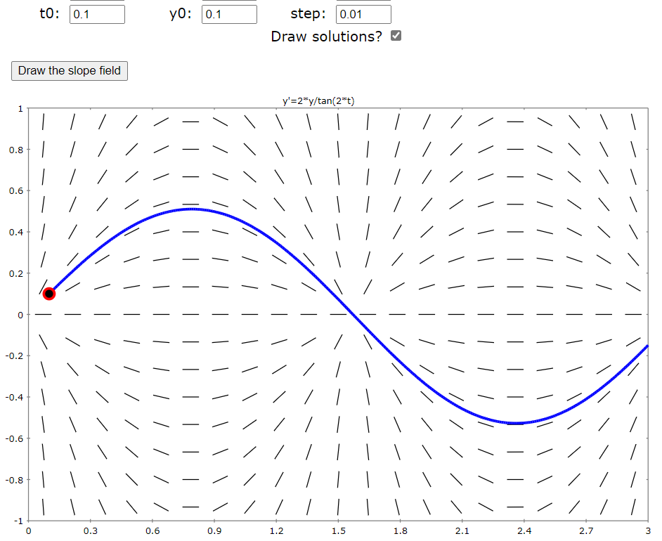
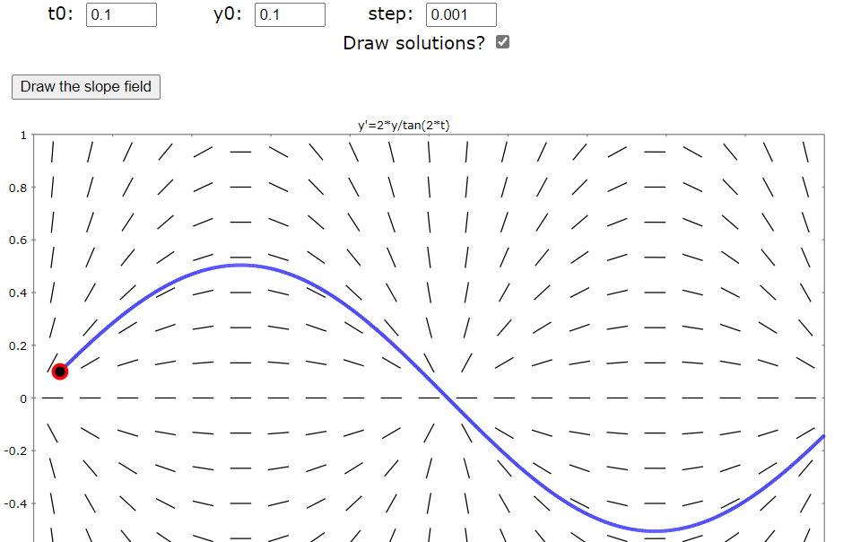

Slide 9
$$yi+1 = yi+ ∆y=yi+\left[f\left(ti, yi\right)\right]∆t$$
Part of tangent line at $(ti, yi)$
Thus slope is $f(ti, yi)$
Its length is determined by $∆t$
$$(ti+1, yi+1)$$
$$∆y$$
$$(ti, yi)$$
$$∆t=0.1$$
(t₂, y₂)
(t₁, y₁)
(t₃, y₃)
(t₀, y₀)

Slide 10
Estimate y(0.3) using h = Step size = Δt = 0.1
Thus if $(t0, y0) = (0, 0)$← the initial value, then
$t1 = 0.1$ and $y1 = y0 + ∆y=y0+\left[f\left(t0, y0\right)\right] \left(0. 1\right)$
$t2 = 0.2$ and $y2 = y1 + ∆y=y1+\left[f\left(t1, y1\right)\right] (0. 1)$
$t3 = 0.3$ and $y3 = y2 + ∆y=y2+\left[f\left(t2, y2\right)\right] (0. 1)$
$$(ti+1, yi+1)$$
$$∆y$$
Slope at $(t0, y0)$ $∆t$
$$(ti, yi)$$
$$∆t=0.1$$

Slide 11
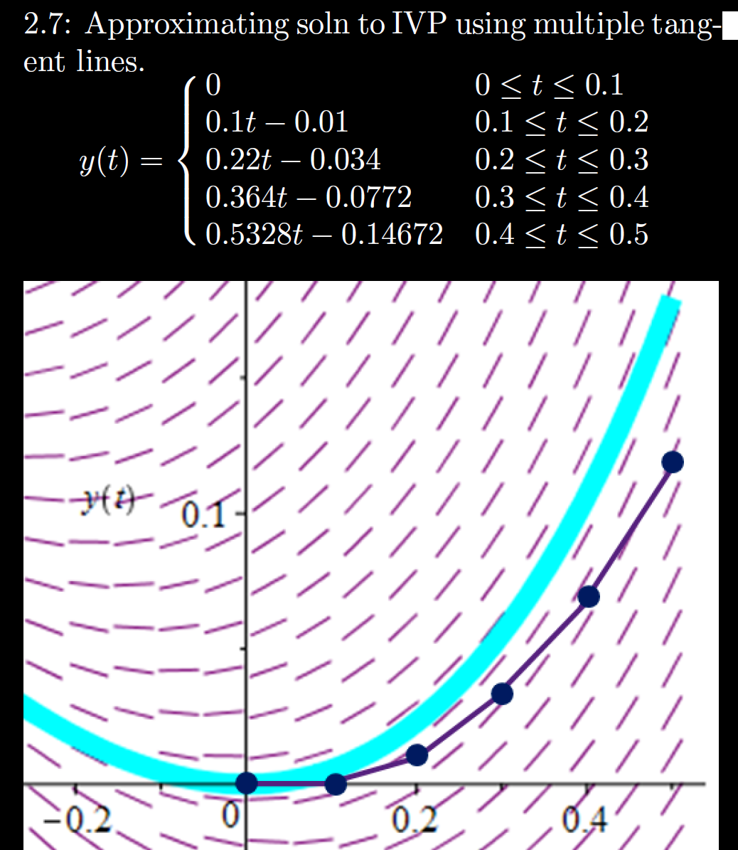
h = Step size
= Δt = 0.1

Slide 12
For the initial value problem, y’ = t²y, y(5) = 3,
use Euler’s method to estimate y(5.2) using t = $∆$0.1

Slide 13
h = Step size
= Δt = 0.1
Sequence of functions
One function consisting of pasting together tangent lines

Slide 14
2.7: Glue together tangent lines to find a single function approximating y(t)
h = Step size
= Δt = 0.1
2.8: Find a sequence of functions that converge to y(t)

