Slide 4
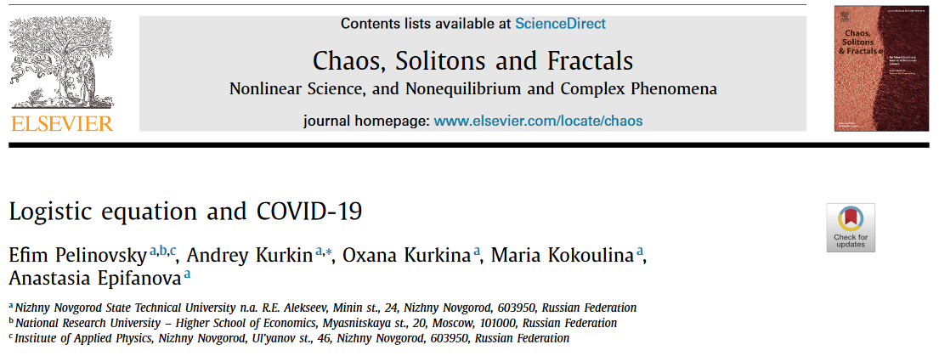
Differential equations and Covid:
Section 2.5: https://www.ncbi.nlm.nih.gov/pmc/articles/PMC7444956/

Slide 6
Phase line

Slide 7
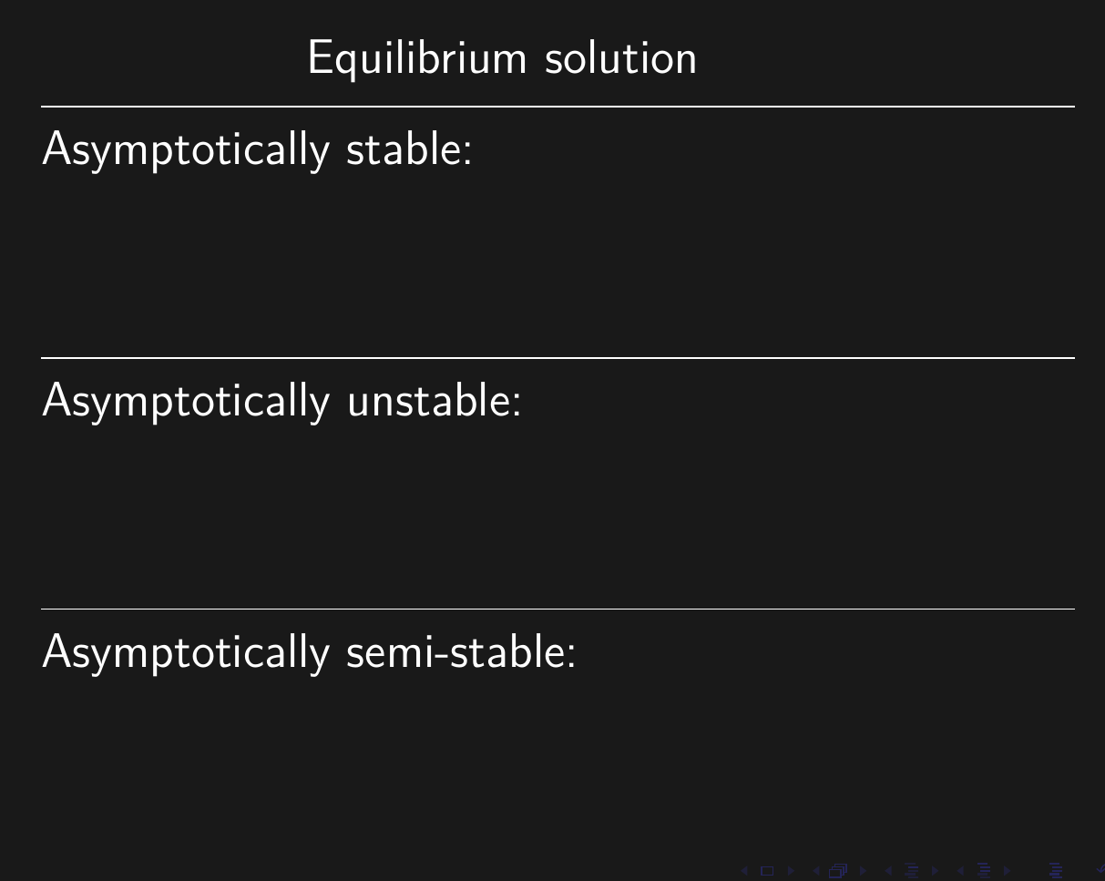

Slide 10
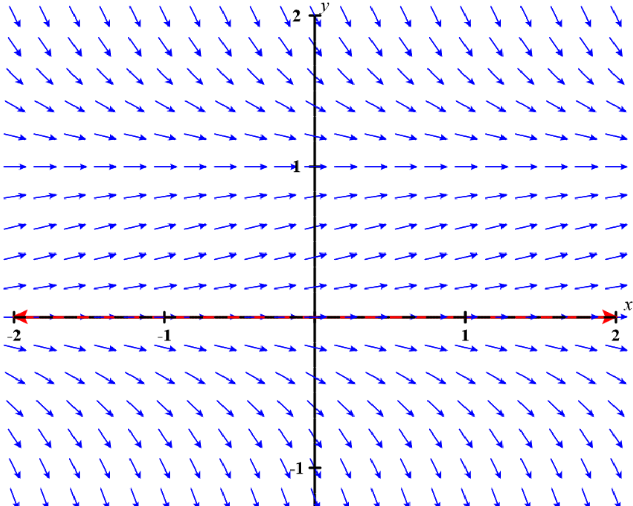
https://c3d.libretexts.org/DirectionField/index.html

Slide 11
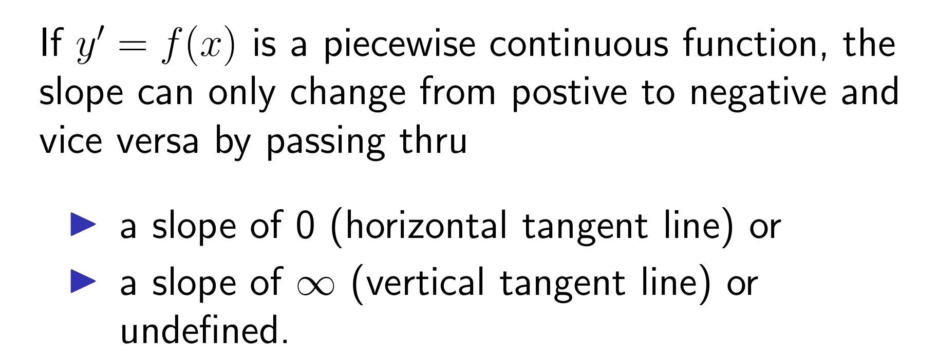
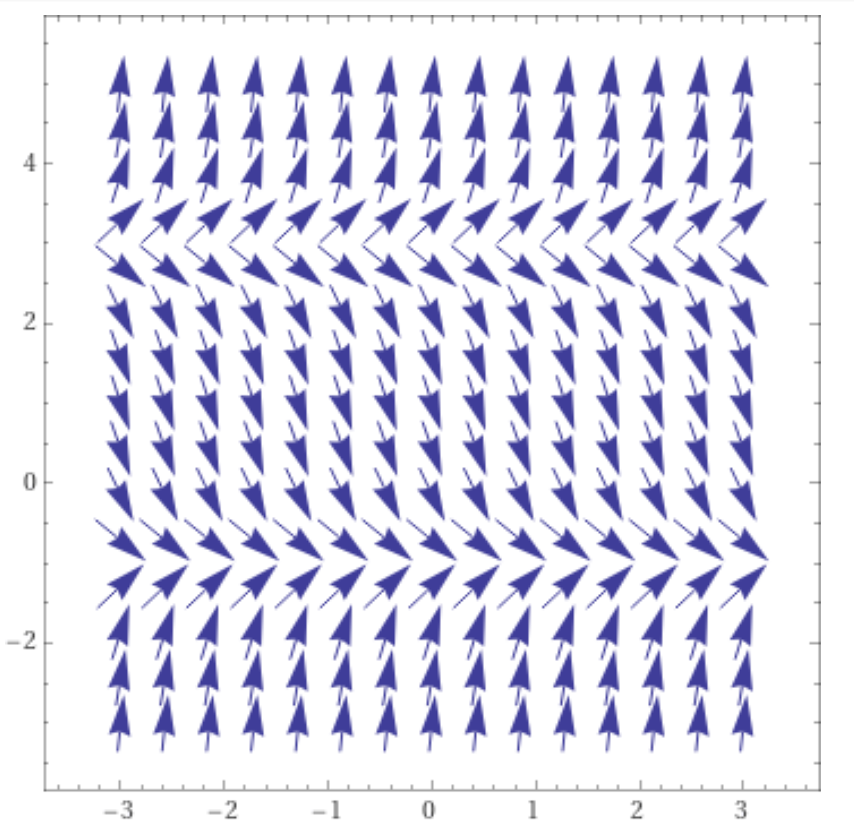
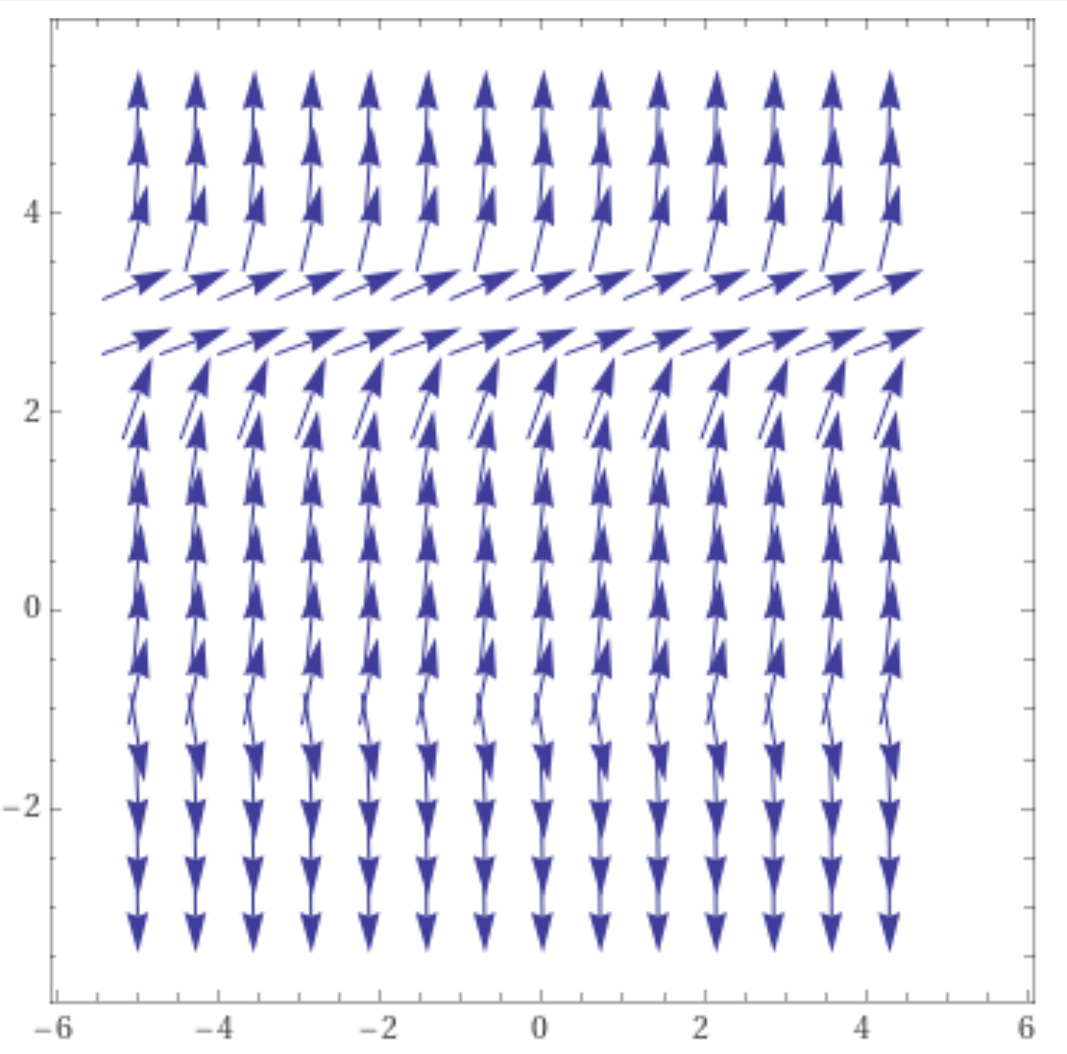
https://www.wolframalpha.com/input/?i=slope%20field

Slide 12
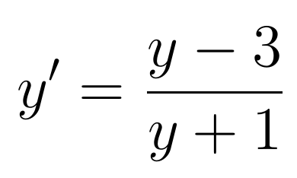
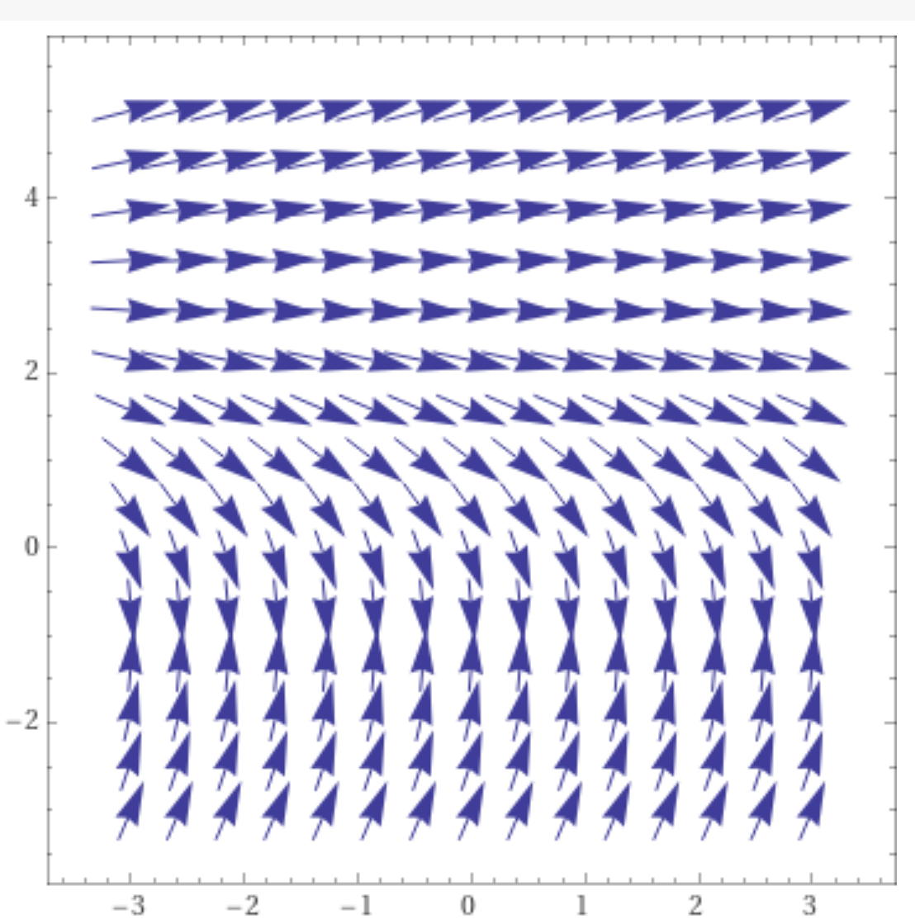
y = 3 is a
equilibrium solution,
But y = -1 is not an
equilibrium solution
for the graph on the
right.
https://www.wolframalpha.com/input/?i=slope%20field

Slide 14
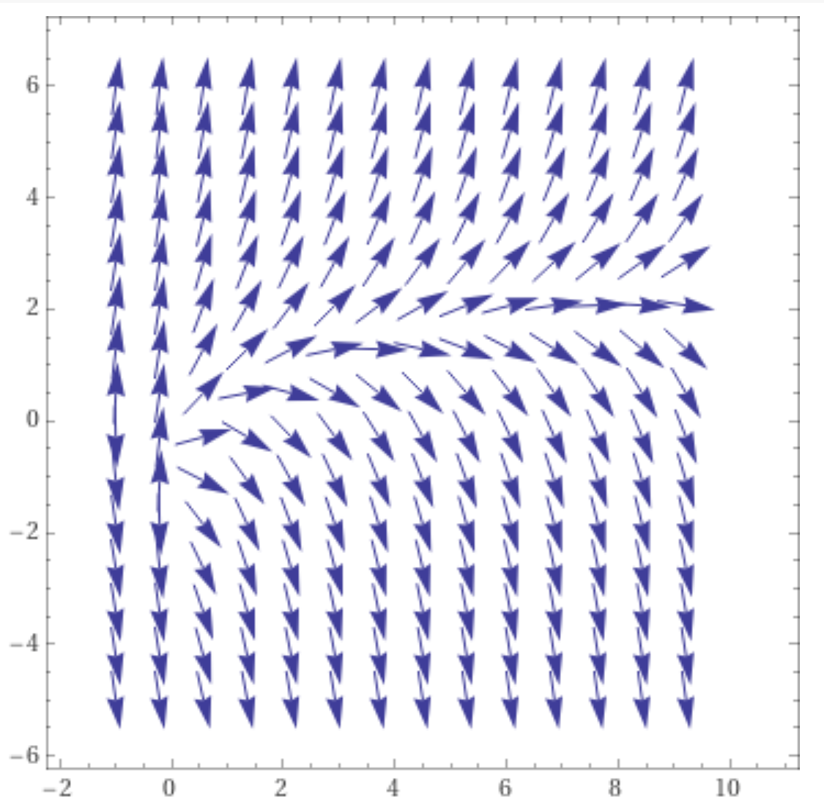
NOT an autonomous DE
y' = f(t, y)
No equilibrium solution, but slope 0 still divides positive slopes from negative slopes.
0 = -ln(t) + y implies
y = ln(t)
https://www.wolframalpha.com/input/?i=slope%20field

Slide 15
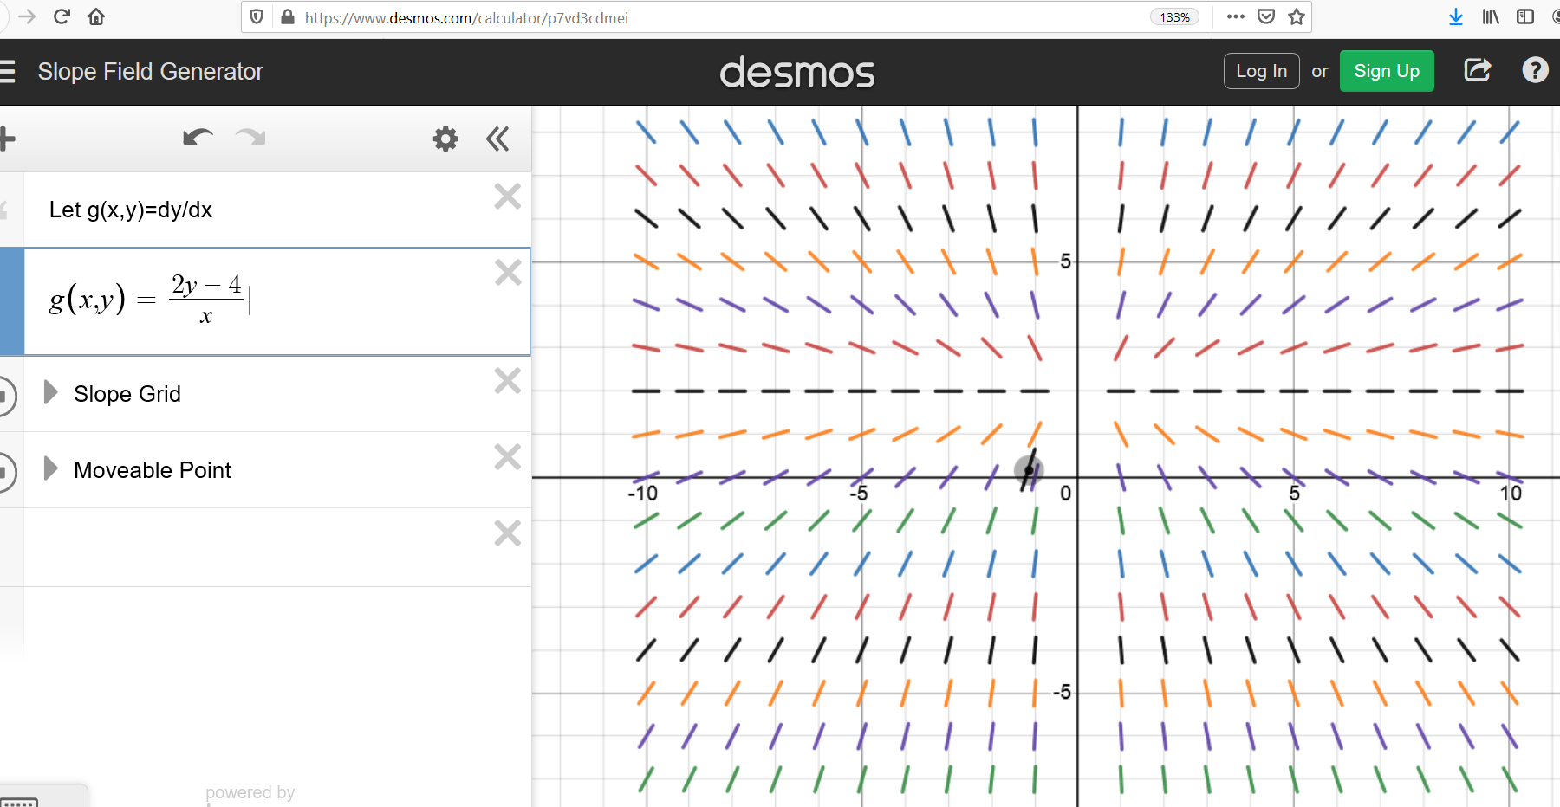
NOT an autonomous DE: y’ = g(x, y)
Has a stable equilibrium solution: y = 2 with domain (-$∞, 0)$
and an unstable equilibrium solution: y = 2 with domain$(0,∞$)

