Slide 1
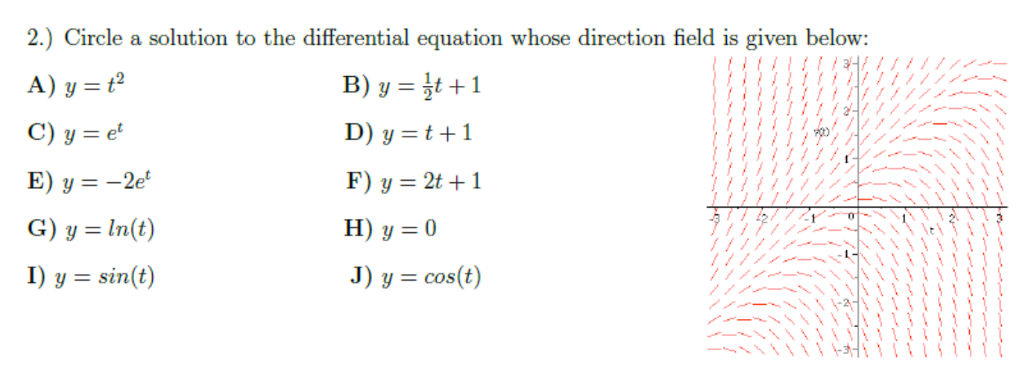

Slide 2
HW 3:
Problems 4 and 5: Consider drawing slope field first by hand, but then use a slope field generator for a more accurate analysis.
For example: https://www.geogebra.org/m/Pd4Hn4BR
Problem 10: Use calculator at the end when plugging in numbers.

Slide 21
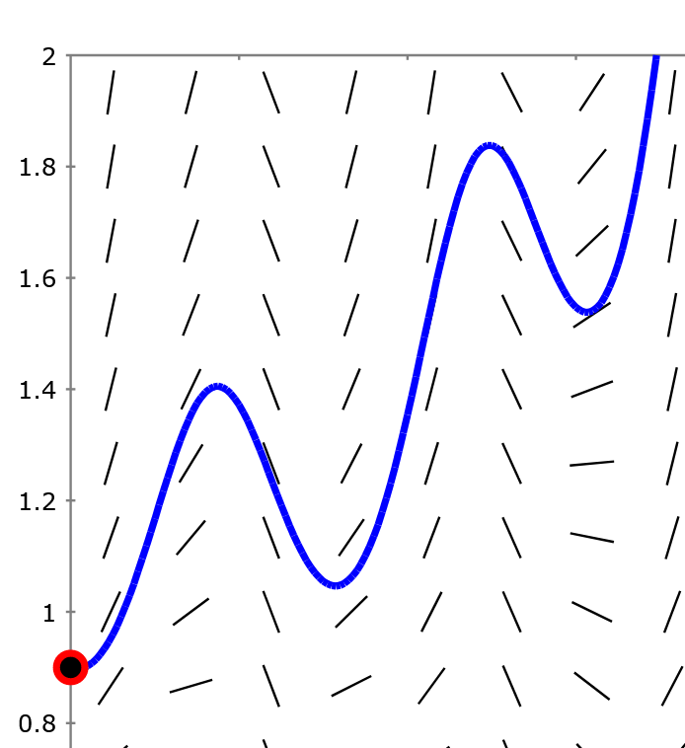
Section 2.7 Euler’s method: Using tangent lines to
approximate a
function.
http://slopefield.nathangrigg.net

Slide 22
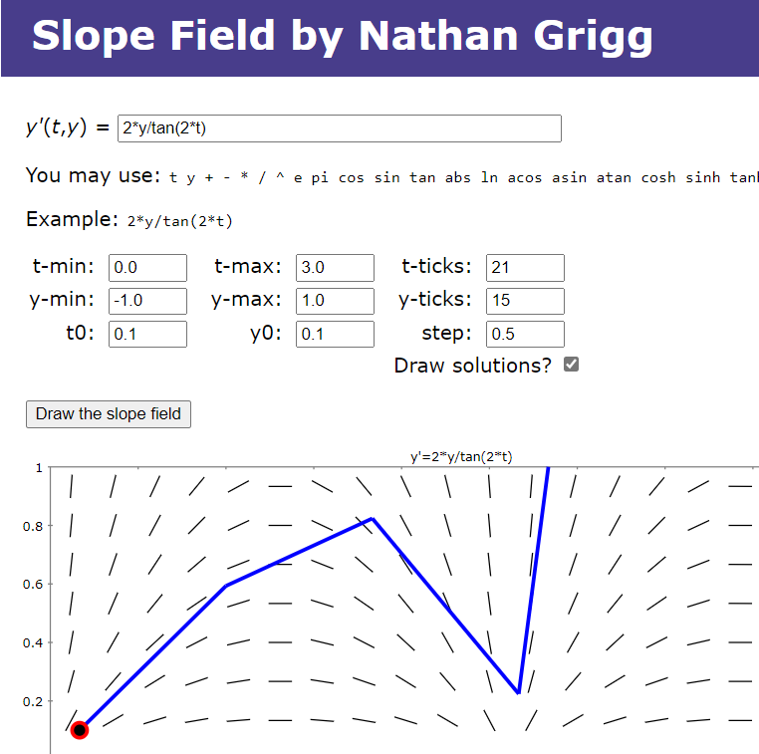

Slide 23
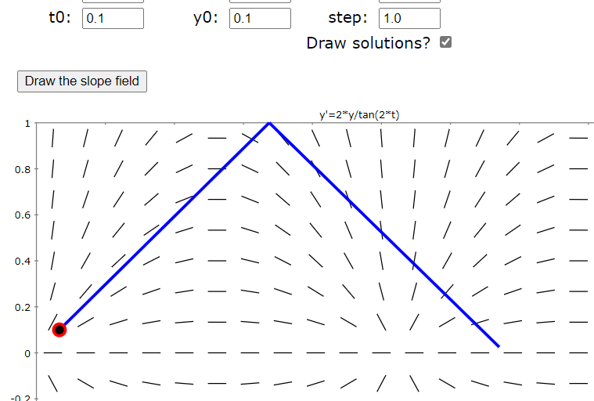
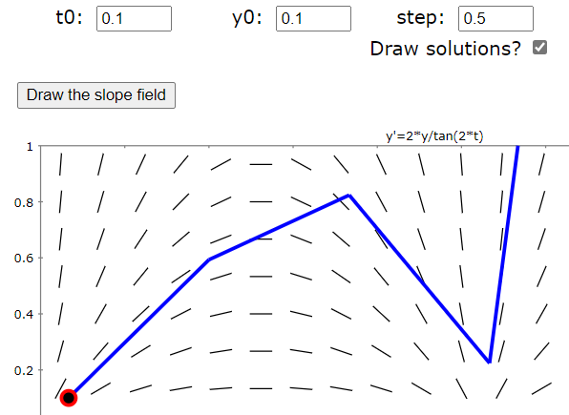
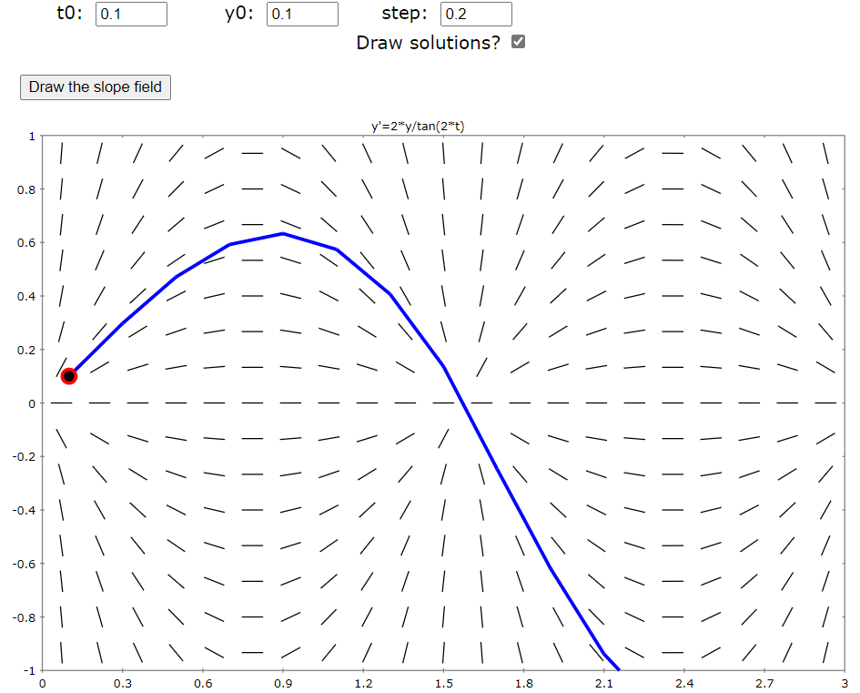
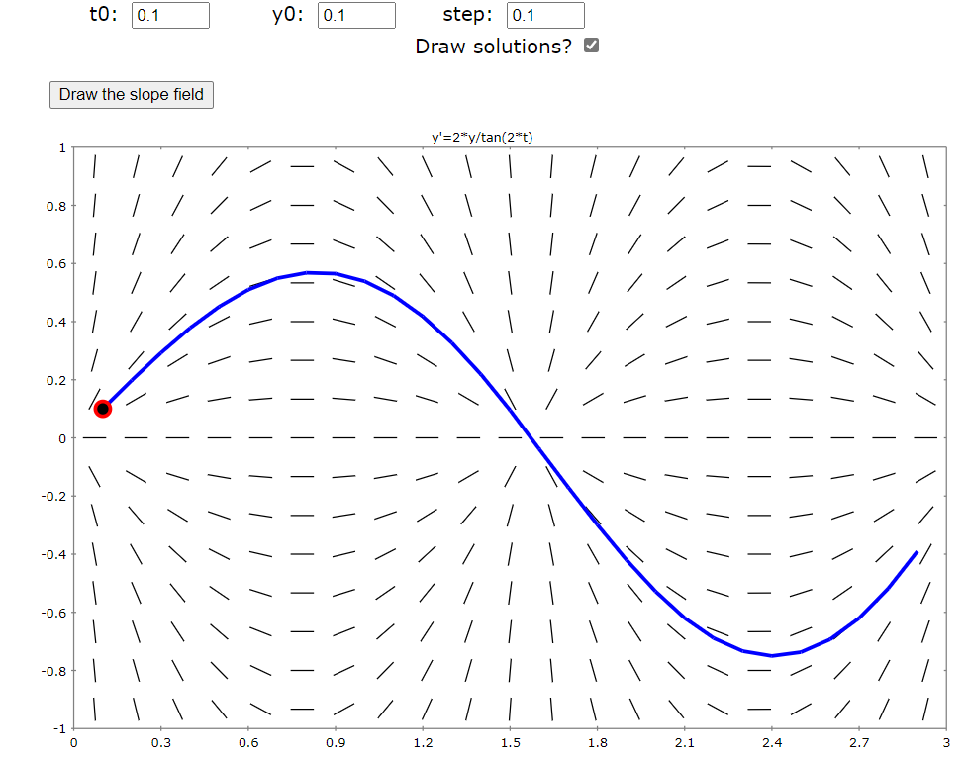

Slide 24
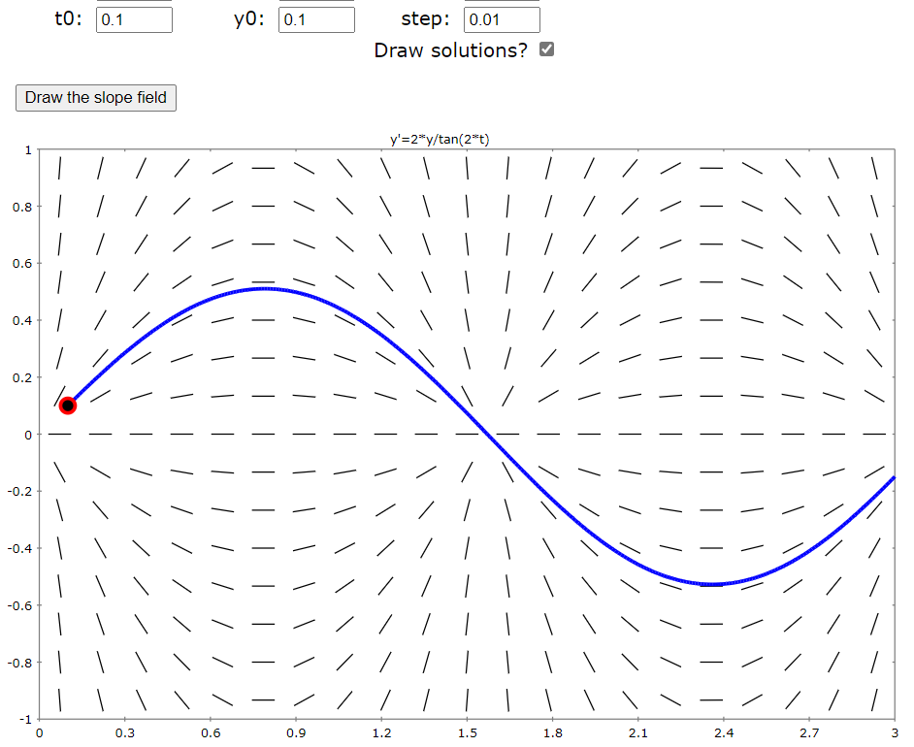
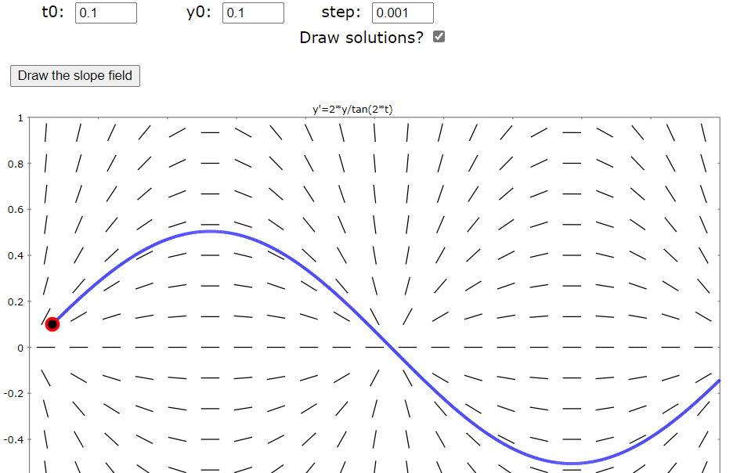

Slide 25
Estimate y(0.3) using h = Step size = Δt = 0.1

