Slide 1
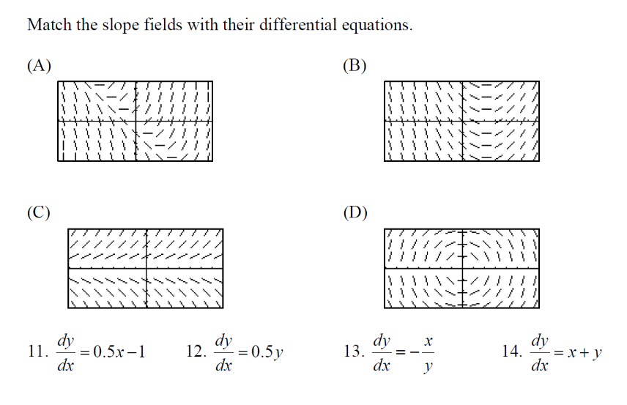

Slide 3
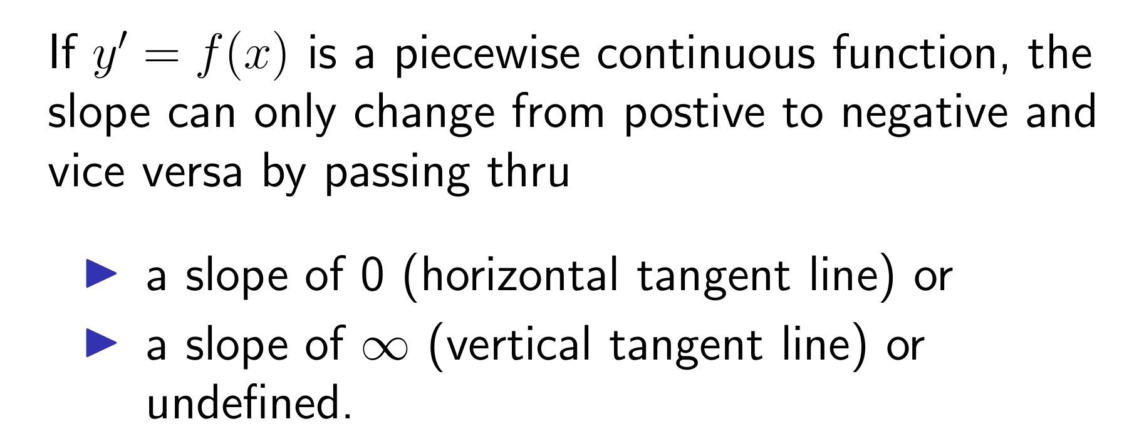
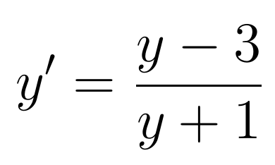
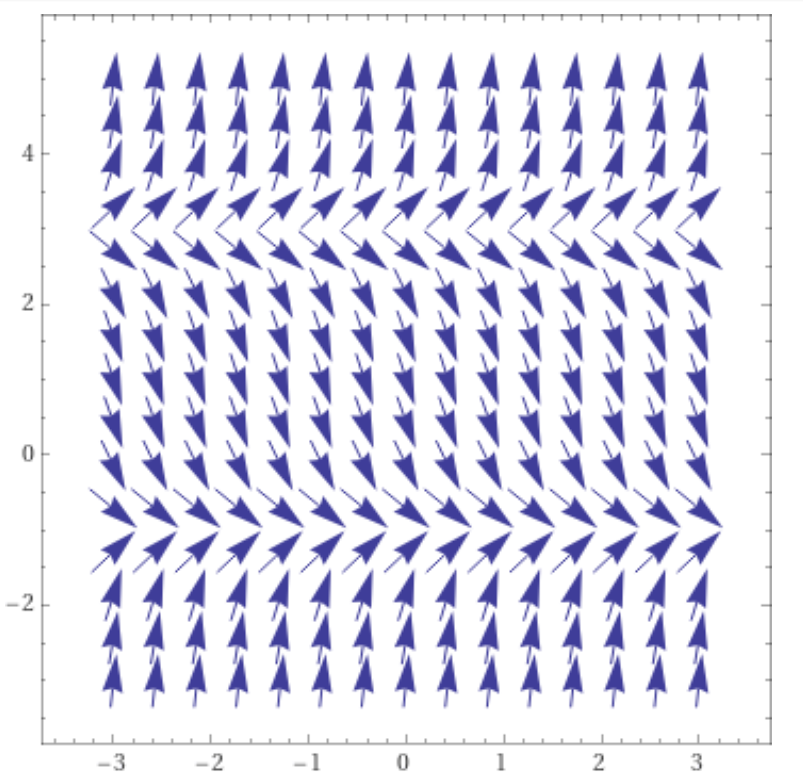
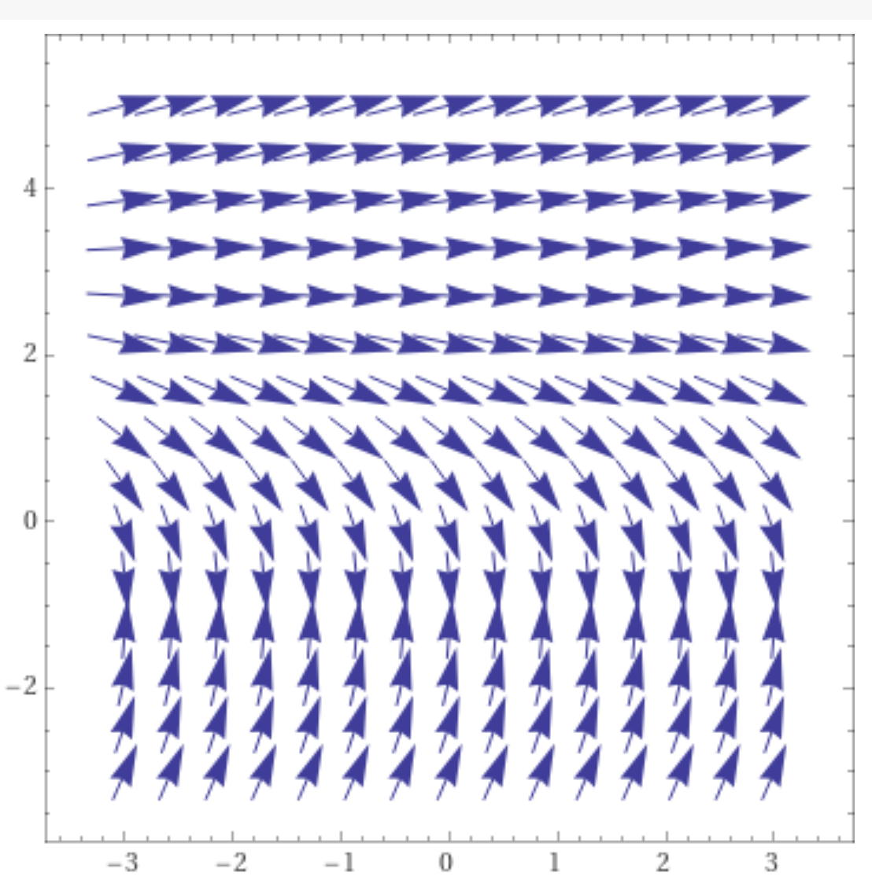
y = 3 is a
equilibrium solution,
But y = -1 is not an
equilibrium solution
for the graph on the
right.
https://www.wolframalpha.com/input/?i=slope%20field

Slide 4
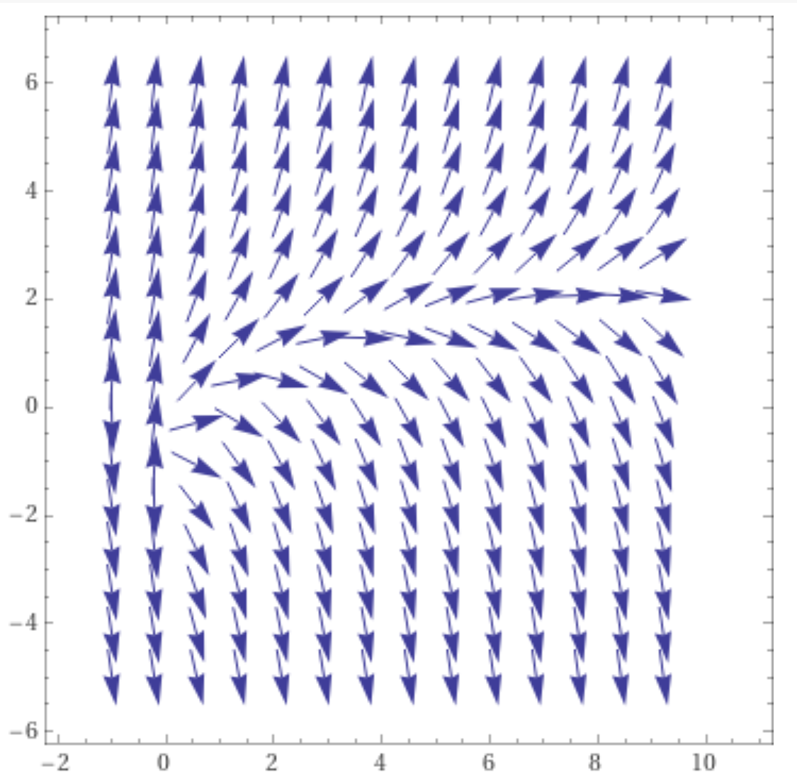
NOT an autonomous DE
y' = f(t, y)
No equilibrium solution, but slope 0 still divides positive slopes from negative slopes.
0 = -ln(t) + y implies
y = ln(t)
https://www.wolframalpha.com/input/?i=slope%20field

Slide 10
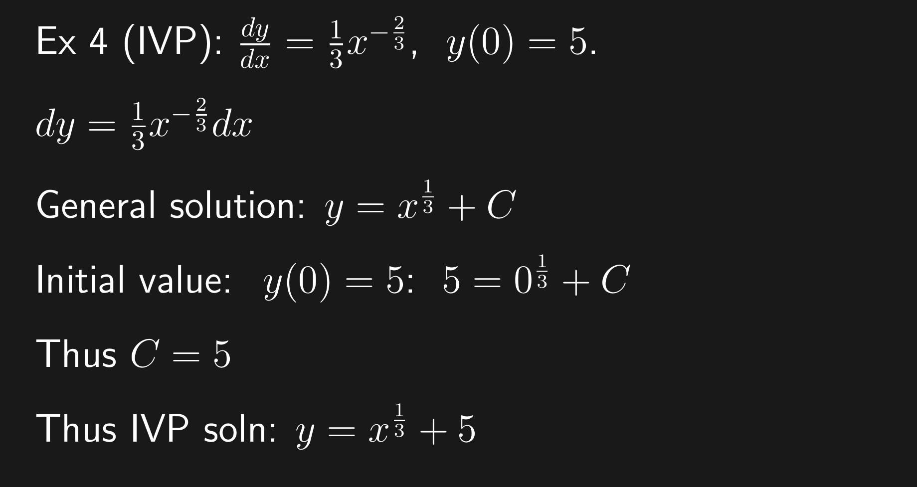

Slide 21
If

Slide 24
Special cases:
When do we know a unique solution exists?

Slide 25
Calculus 1 problem:

