Slide 1
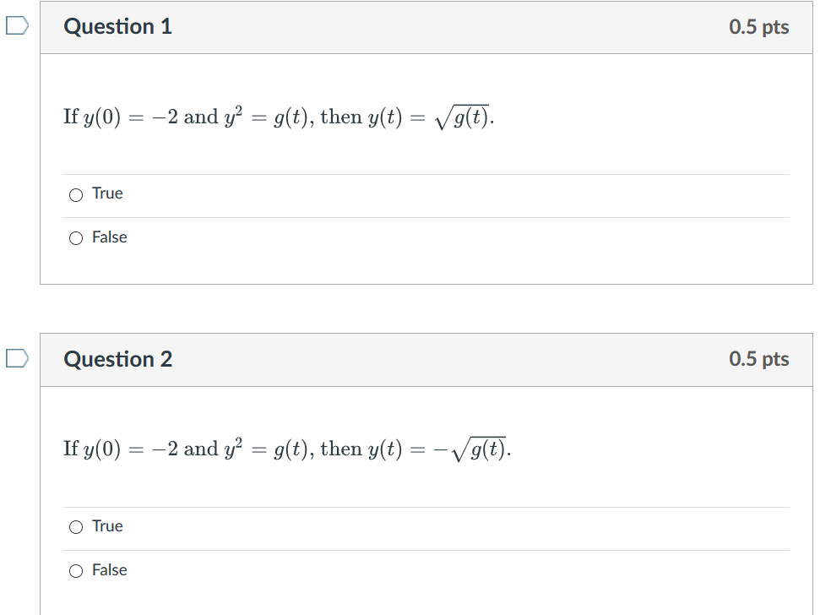

Slide 2
Week 3 Video
Theorem 2.4.2/domain (28:41 min video) slides, annotated slides: View after 2.4 in class lecture and before doing 2.4 HW Thm 2.4.2 can sometimes be used to determine if an IVP has a unique solution, but it cannot be used to determine the domain of that solution. In this video, we first use Thm 2.4.2 to determine when y′=1/[(1−t)(2−y), y(t0)=y0 is guaranteed to have a unique solution. We then use a lot of algebra and a little bit of calculus to solve this DE and determine the domain of this solution when the initial value is the point (0, 1).

Slide 3
Example from Theorem 2.4.2/domain video

Slide 7
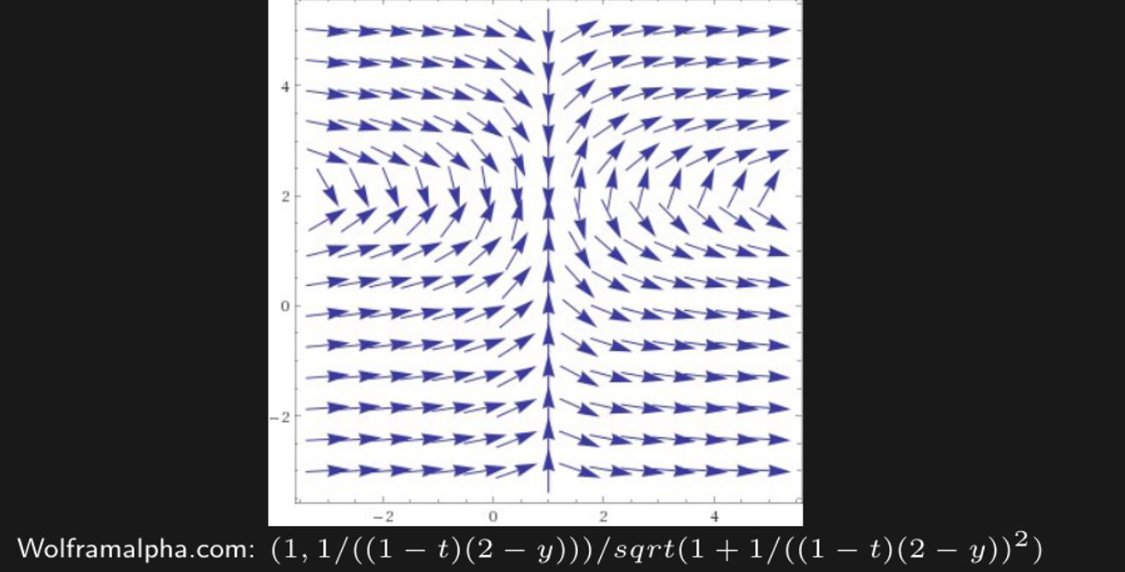
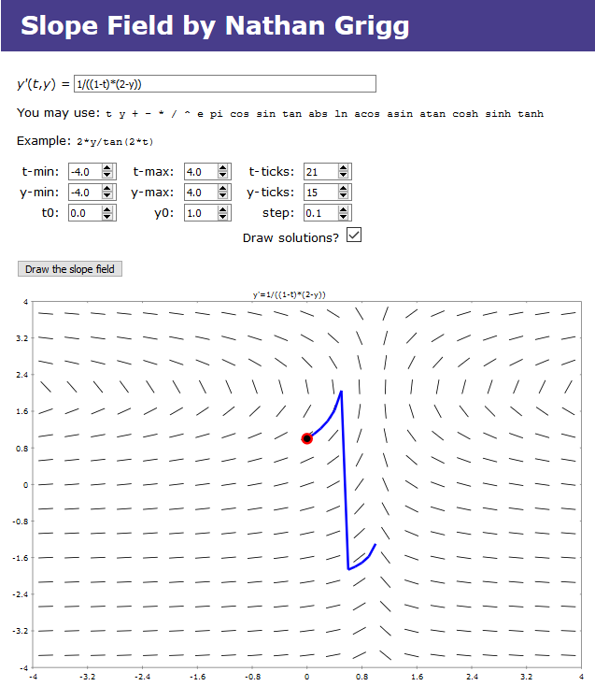
Note: Domain will always be a single open interval.
http://slopefield.nathangrigg.net

Slide 9
Note: Domain will always be a single open interval.

Slide 13
Note: Domain will always be a single open interval.

Slide 14
HW hint: For one of your HW problems, to find domain:
Determine where tangent line is vertical. For this
particular problem, this will occur at certain y-values.
Plug these y-values into solution and solve for x to find potential boundary of domain.
Note: Domain will always be a single open interval.

Slide 15
Example 3: Implicit Solution of Initial Value Problem (1 of 2)
http://bcs.wiley.com/he-bcs/Books?action=resource&bcsId=2026&itemId=047143339X&resourceId=4140
Consider the following initial value problem:
Separating variables and using calculus, we obtain
Using the initial condition, it follows that

Slide 16
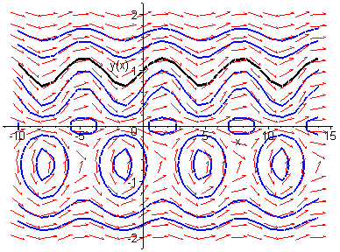
Example 3: Graph of Solutions (2 of 2)
http://bcs.wiley.com/he-bcs/Books?action=resource &bcsId=2026&itemId=047143339X&resourceId=4140
Thus
The graph of this solution (black), along with the graphs of the direction field and several integral curves (blue) for this differential equation, is given below.
Solutions vary dramatically based on initial value.

Slide 17
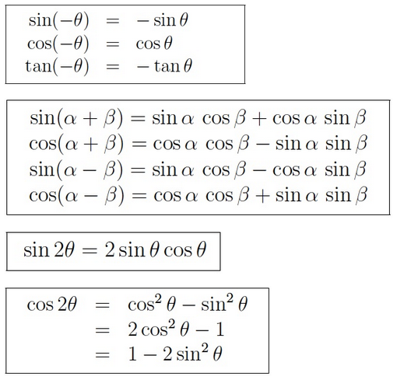
HW hint (#4): Simplify your answer.
https://www2.clarku.edu/faculty/djoyce/trig/identities.html

Slide 18
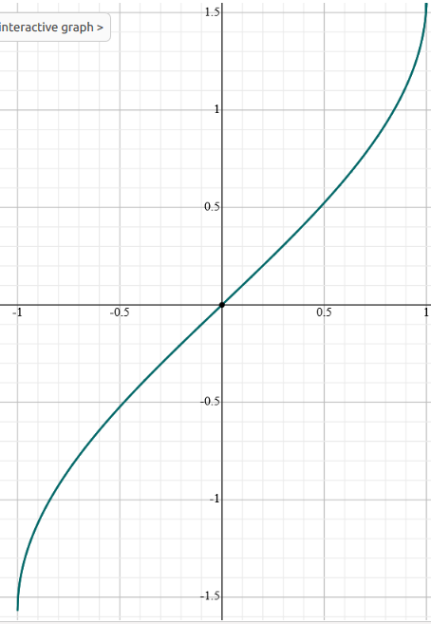
https://www.math.net/arcsin
y = arcsin(x)
Ex: If sin(x) = 0,
then x = arcsin(0) + k$π$ = k$π$
Ex: If sin(x) = 1/2, then since arcsin(1/2) = $π$/6
x = $π$/6 + 2$π$k = arcsin(1/2) + 2$π$k or
x = 5$π$/6 + 2$π$k = (arcsin(1/2) + 4$π$/6) + 2$π$k
= ($π$ - $π$/6) + 2$π$k = ($π$- arcsin(1/2)) + 2$π$k
https://www.symbolab.com/

Slide 19
If sin(x) = c, then
x = arcsin(c) + 2$π$k or x = ($π$- arcsin(c)) + 2$π$k

Slide 20
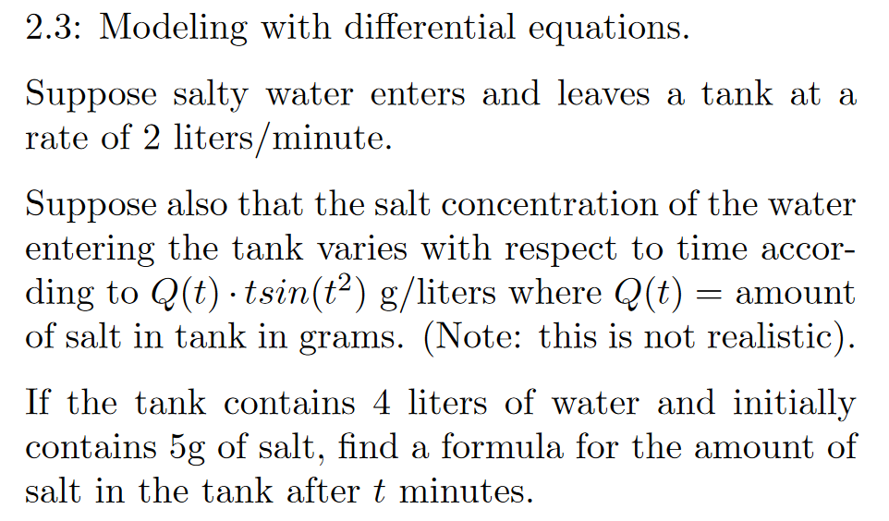

Slide 21
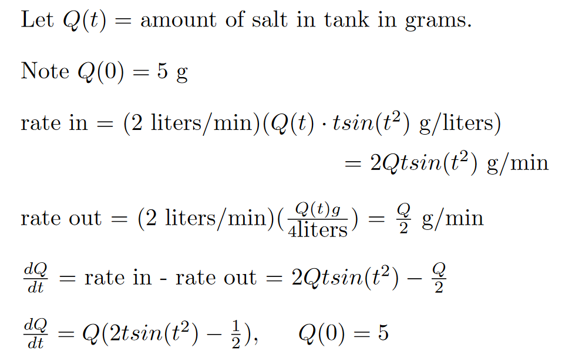

Slide 23
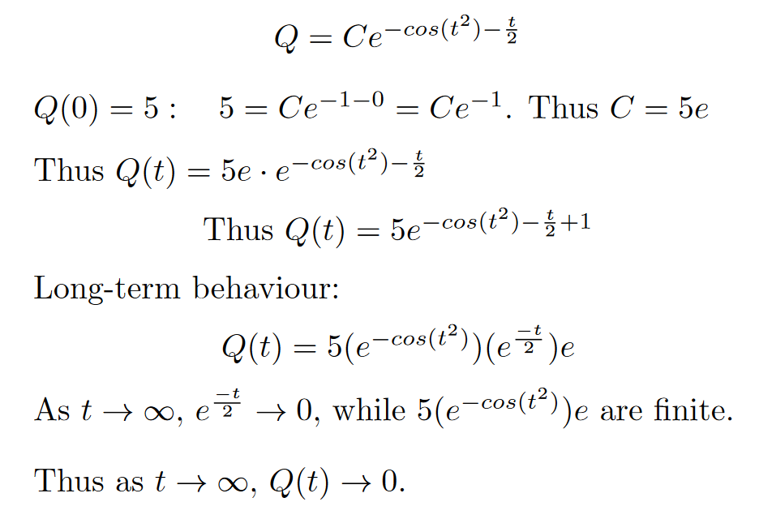

Slide 24
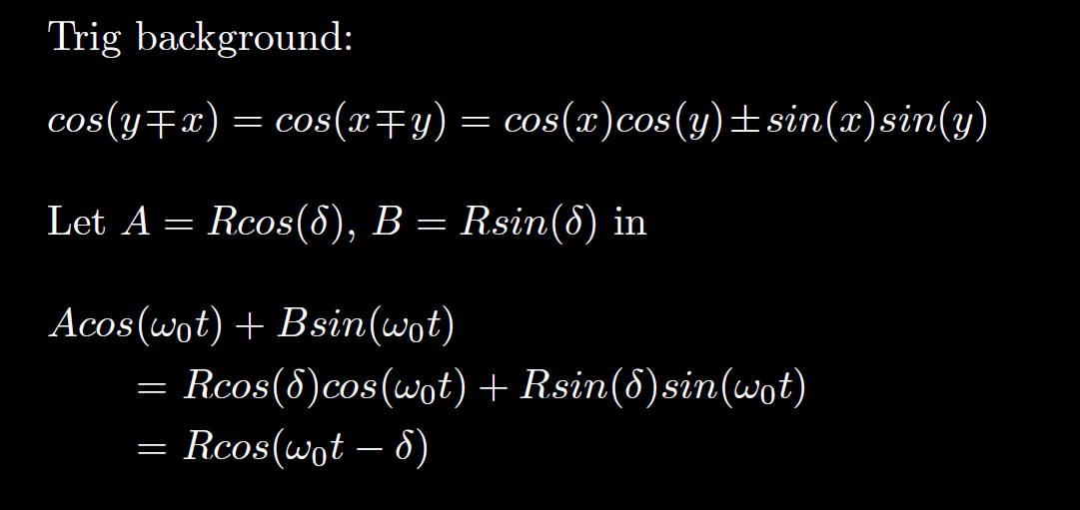
HW hint (next slide)

Slide 25
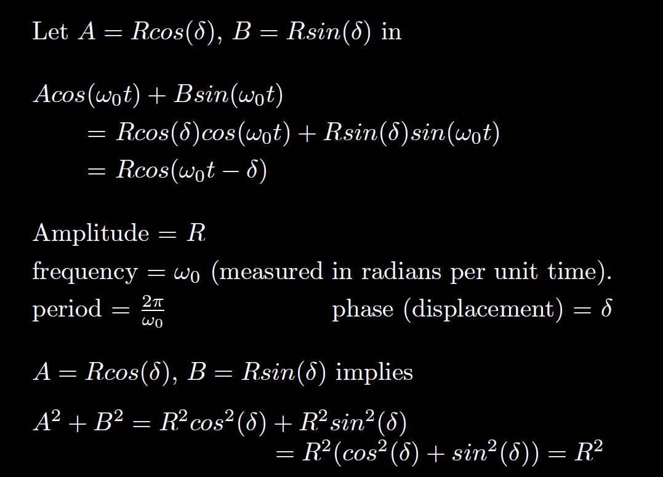
We will use this in section 3.7
$$= \sqrt{A^{2 }+B2}$$

Slide 26
Section 2.1
You canNOT use formula. You must show product rule step.

Slide 27
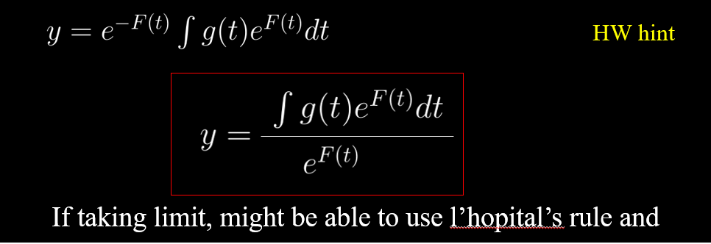
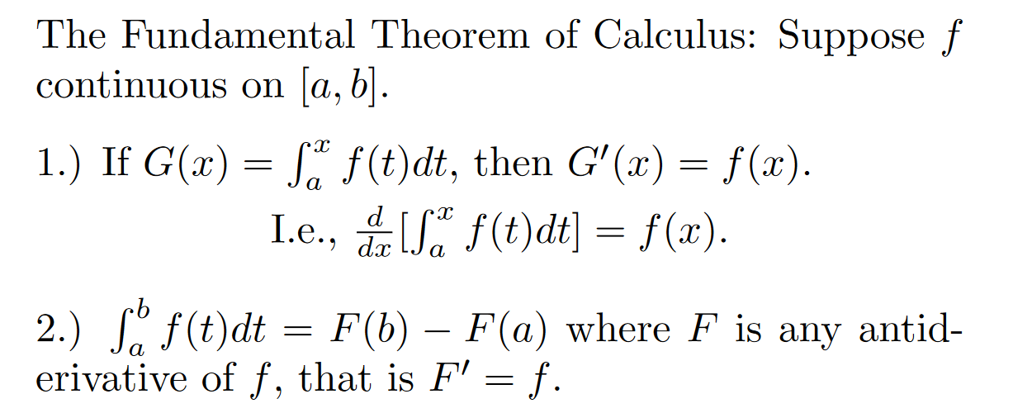
HW hint
If taking limit, might be able to use l’hopital’s rule and

