Slide 1

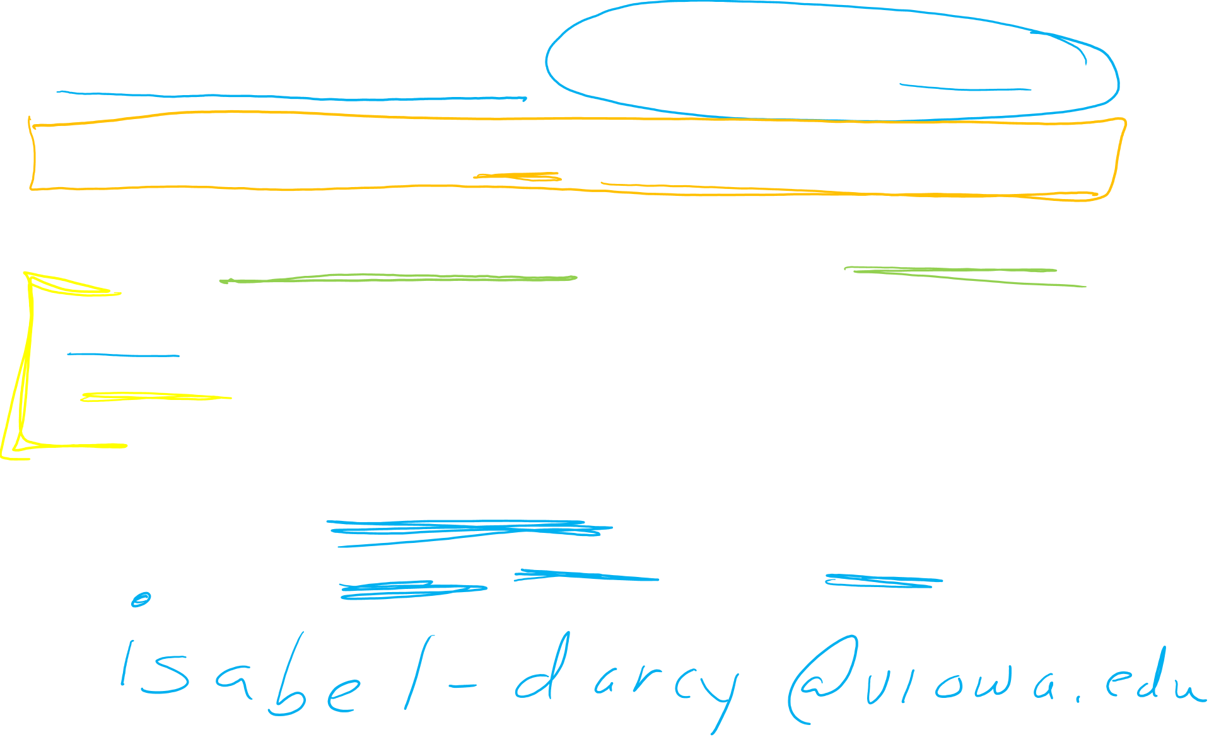
Exam 3 is this Friday during class. Exams will be graded by Sunday.
Problem session Thursday at 5pm. Zoom link will be posted on ICON.
Similar format to last exam except as discussed in the next few slides.
E-mail me your exam if you would like me to check it (sometimes uploads are corrupted). I can quickly check and respond to e-mails. Checking uploads on ICON takes much longer.
If you don’t get an e-mailed response from me, there are no guarantees that your upload is readable. Unreadable upload = 0 points on written part

Slide 2
Exam 3 is this Friday during class. Exams will be graded by Sunday.
Problem session Thursday at 5pm. Zoom link will be posted on ICON.
Similar format to last exam except as discussed in the next few slides.
E-mail me your exam if you would like me to check it (sometimes uploads are corrupted). I can quickly check and respond to e-mails. Checking uploads on ICON takes much longer.
If you don’t get an e-mailed response from me, there are no guarantees that your upload is readable. Unreadable upload = 0 points on written part
E-mail: isabel-darcy@uiowa.edu

Slide 3
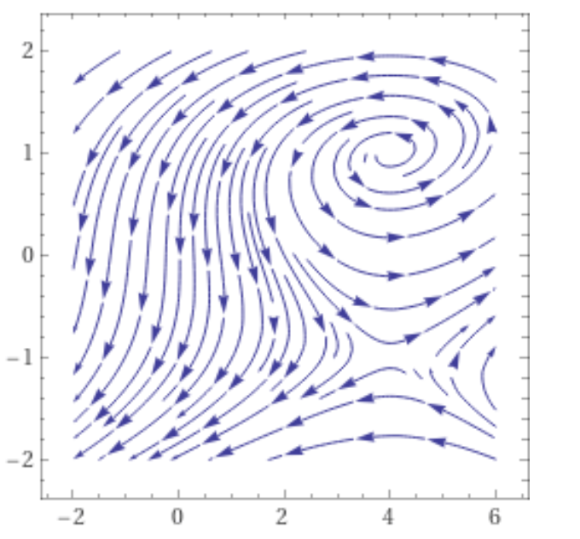
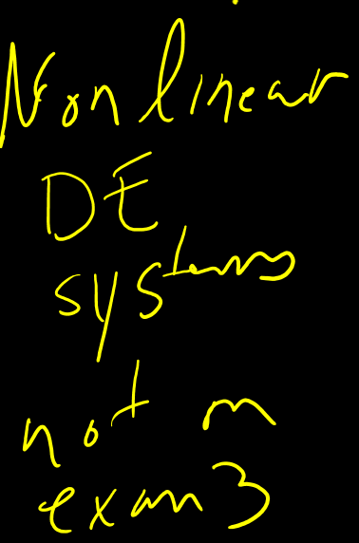

Slide 4
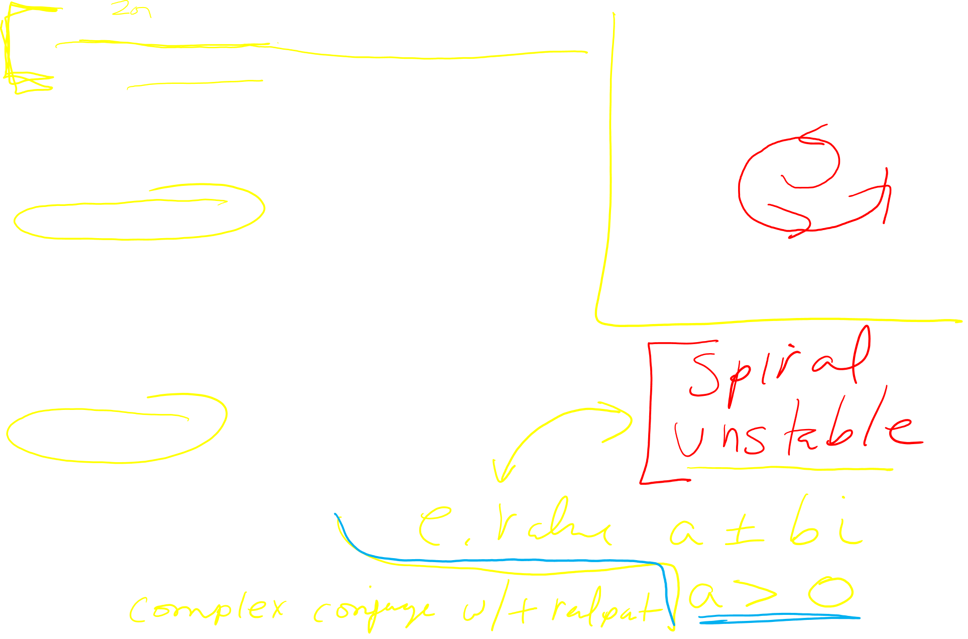
The next 3 problems all involve the following graph.:
Choose the best answer
1. The point (0, 0) is
a.) asymptotically stable.
b.) stable.
c.) unstable.
d.) Not a critical point.
2. The point (0, 0) is a
a.) node.
b.) saddle.
c.) spiral.
d.) center.
e.) Not a critical point.
3. The eigenvalues are ….

Slide 5
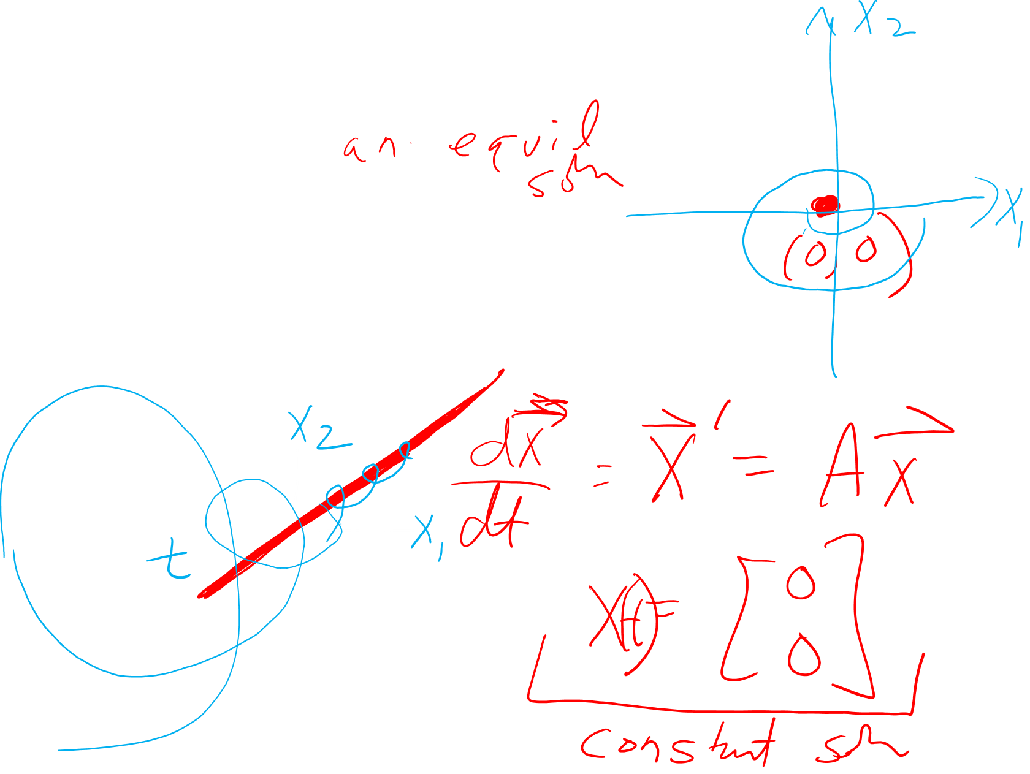
The next 3 problems all involve the following graph.:
Choose the best answer
1. The solution x(t) = (0, 0) is
a.) asymptotically stable.
b.) stable.
c.) unstable.
d.) Not an equilibrium solution.
2. The solution x(t) = (0, 0) is a
a.) node.
b.) saddle.
c.) spiral.
d.) center.
e.) Not an equilibrium solution.
3. The eigenvalues are ….

Slide 6
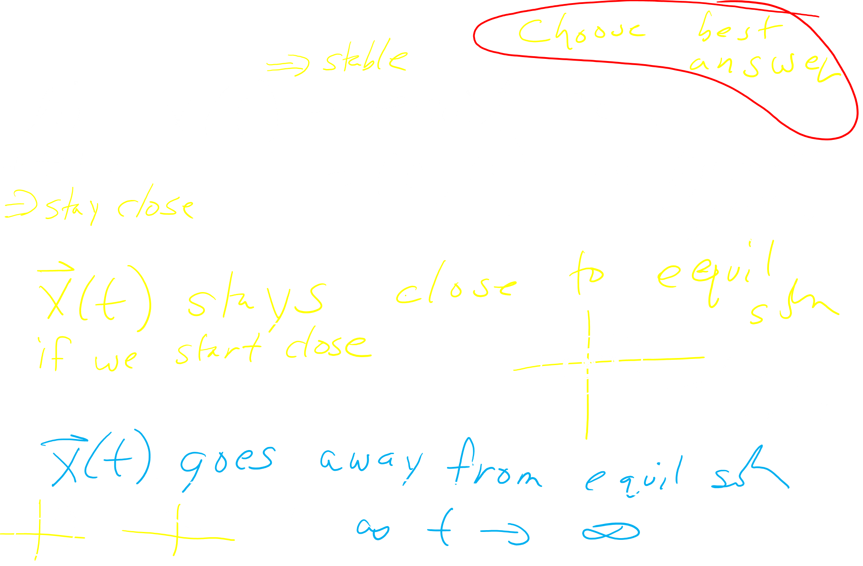
1. The solution x(t) = (0, 0) is
a.) asymptotically stable.
b.) stable.
c.) unstable.

Slide 7
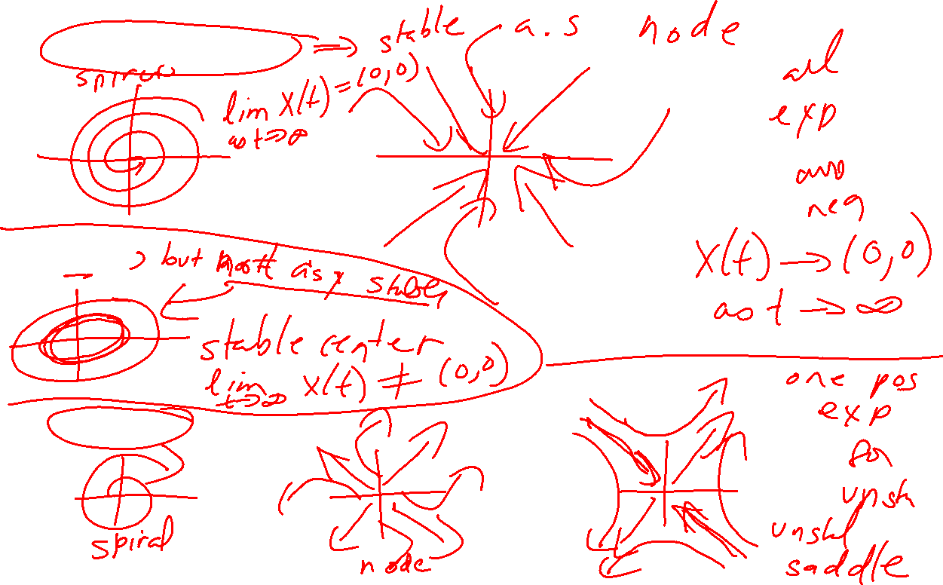
1. The solution x(t) = (0, 0) is
a.) asymptotically stable.
b.) stable.
c.) unstable.

Slide 8
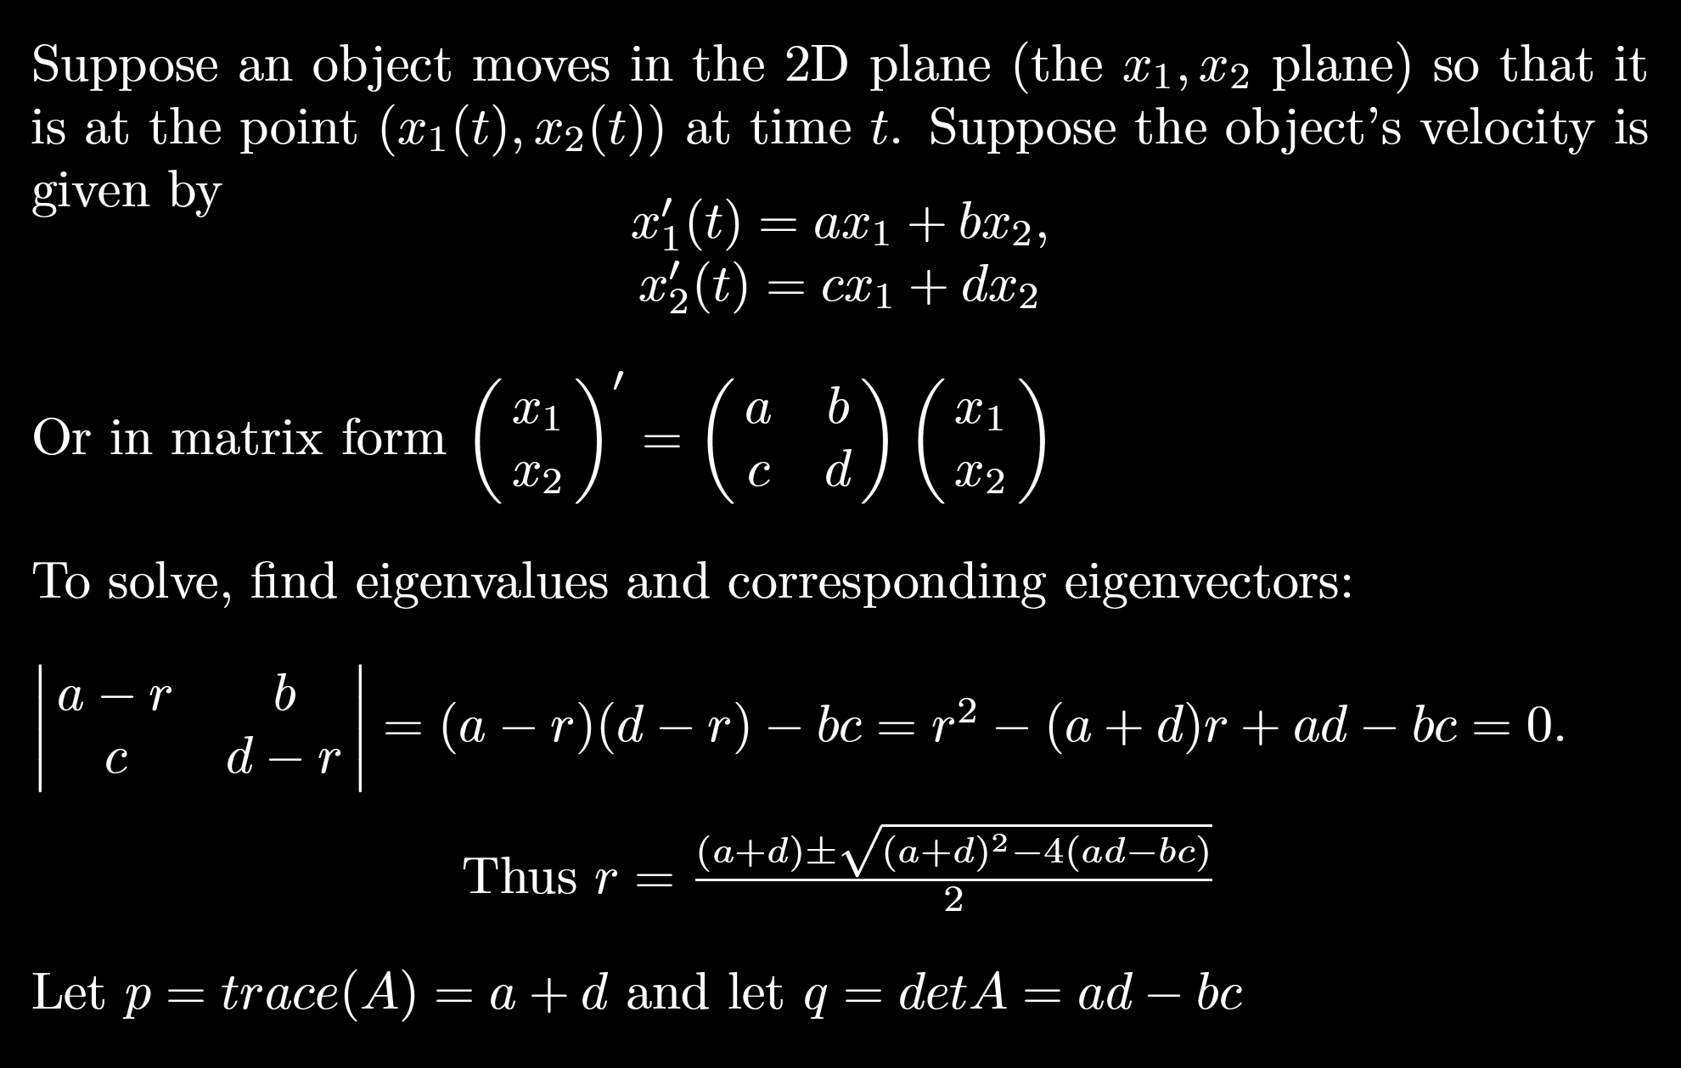
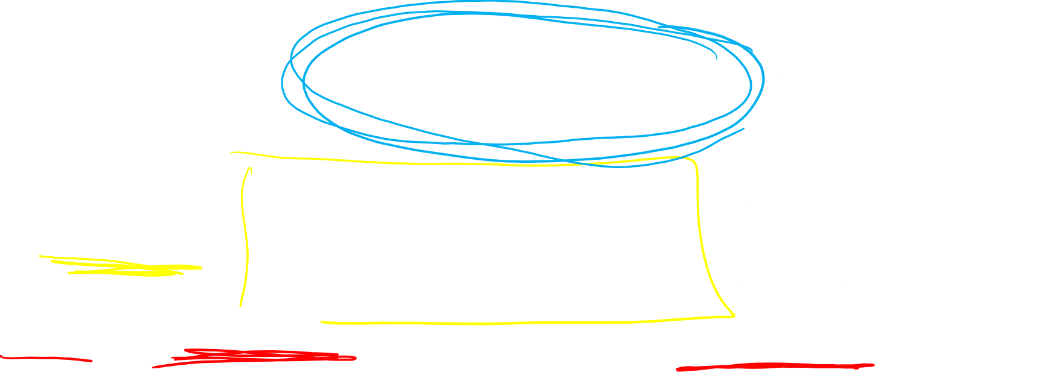

Slide 9
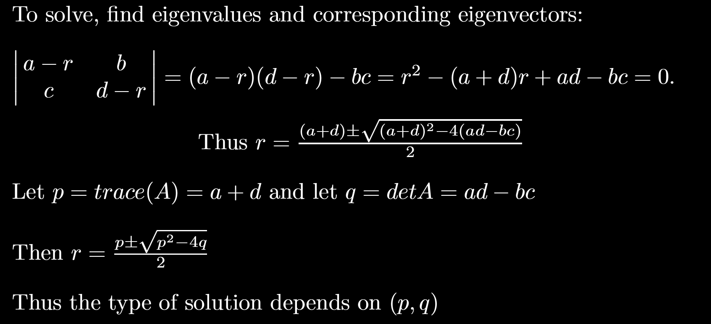
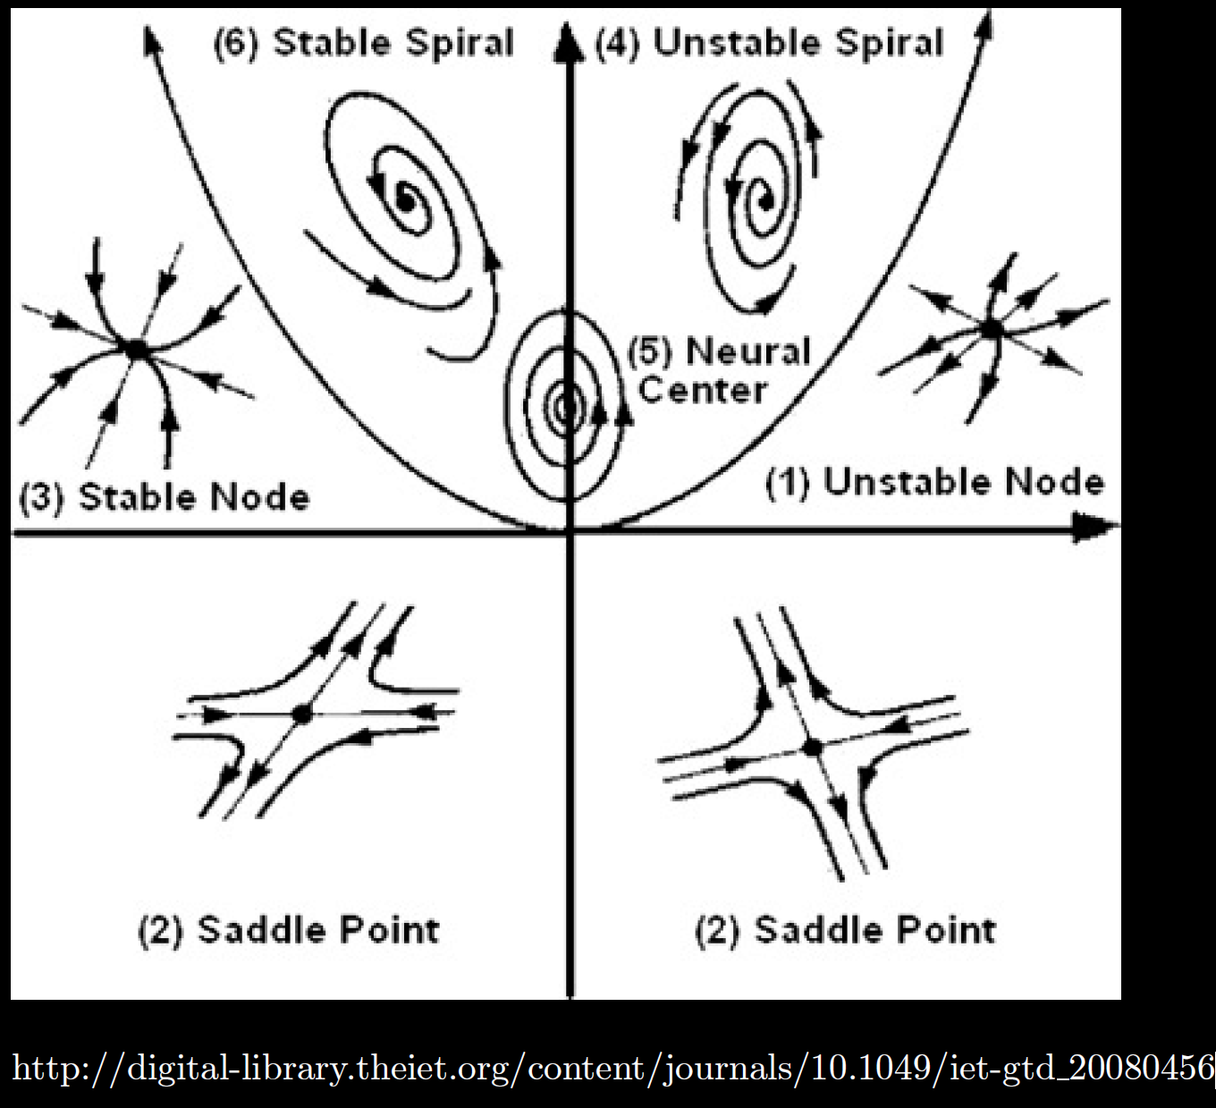
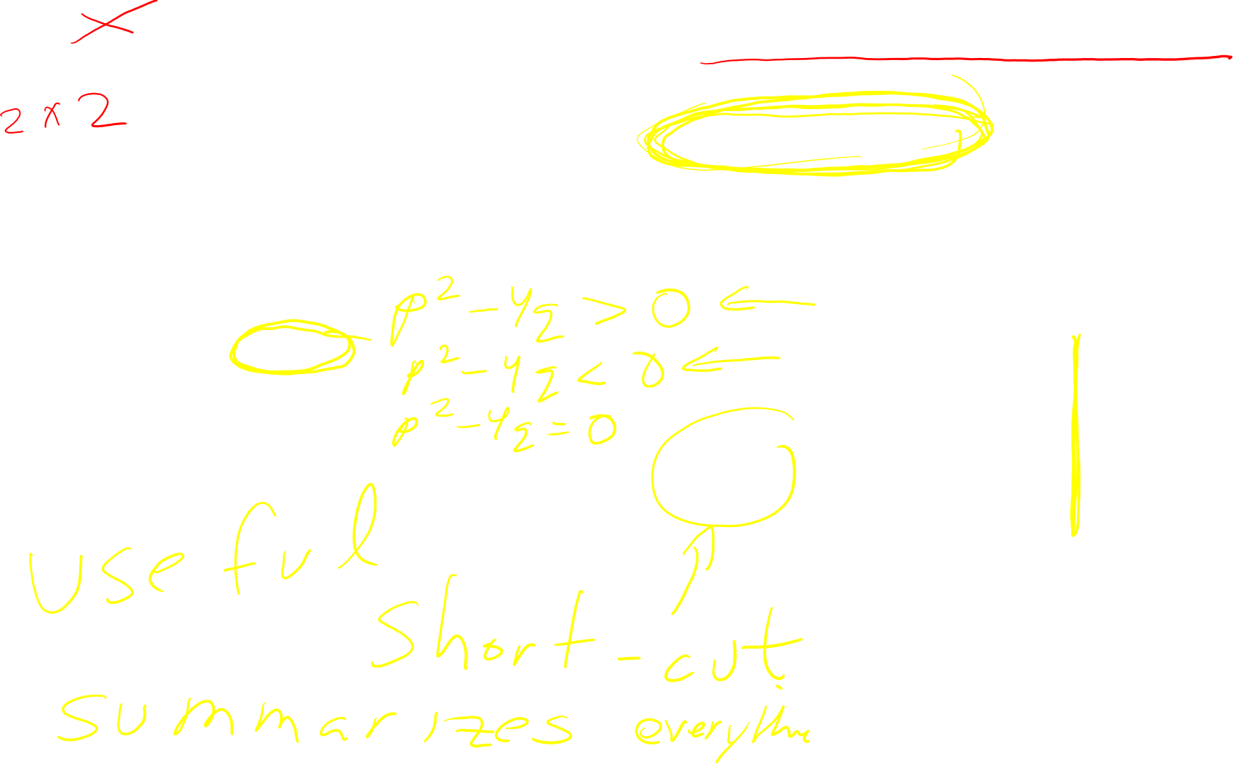

Slide 10
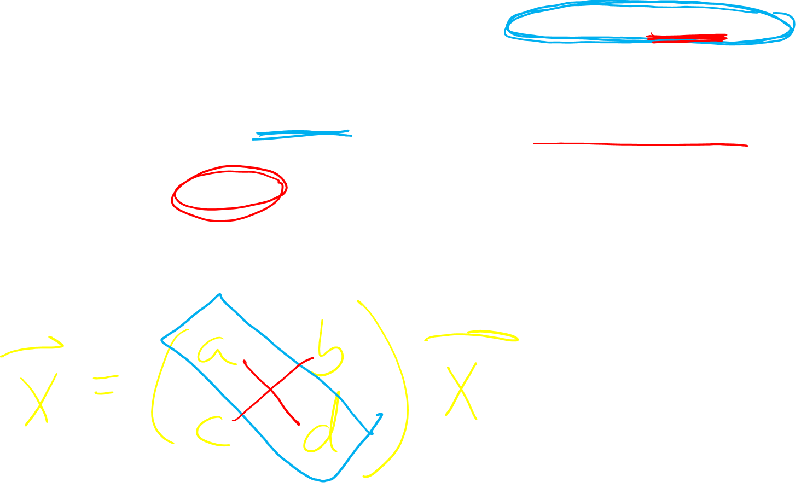

Slide 11
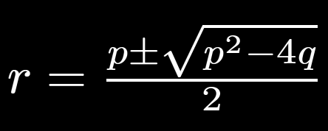
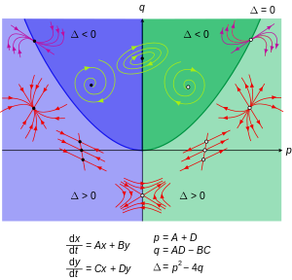

https://en.wikipedia.org/wiki/Phase_plane

Slide 12
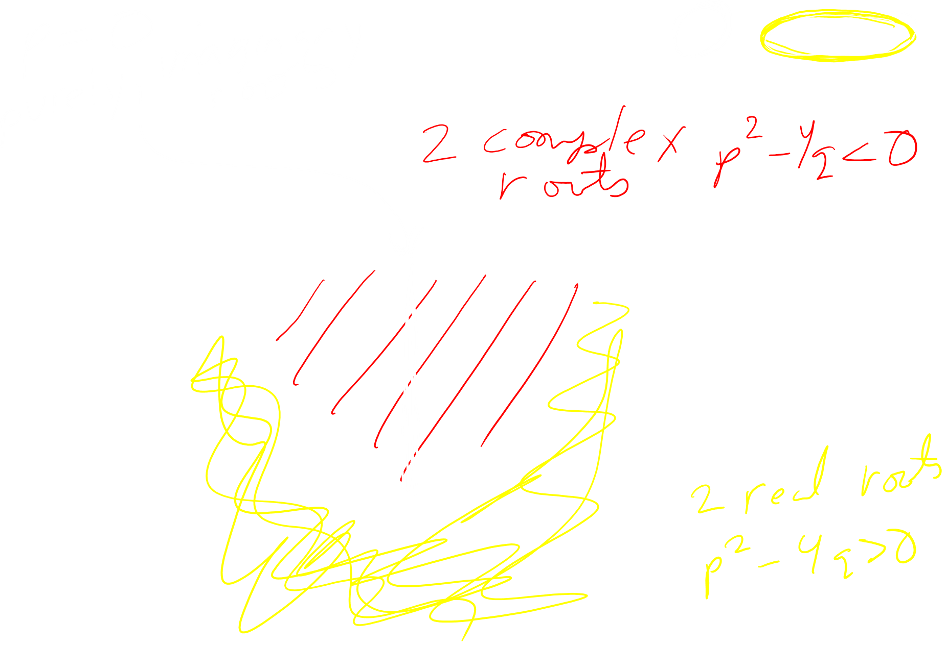
https://en.wikipedia.org/wiki/Phase_plane

Slide 13
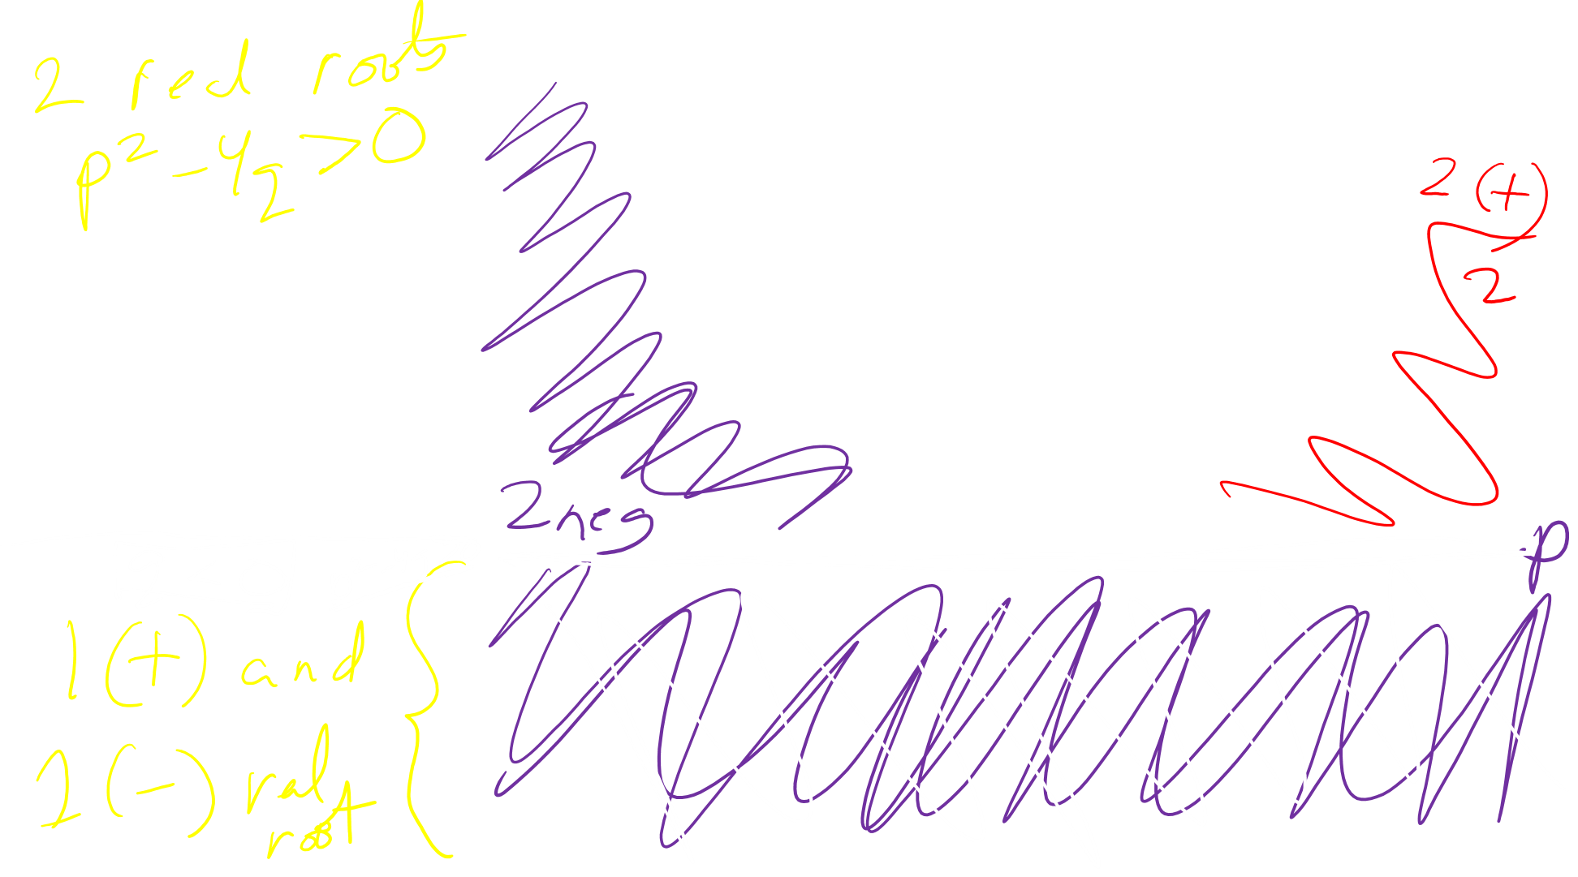
https://en.wikipedia.org/wiki/Phase_plane

Slide 14
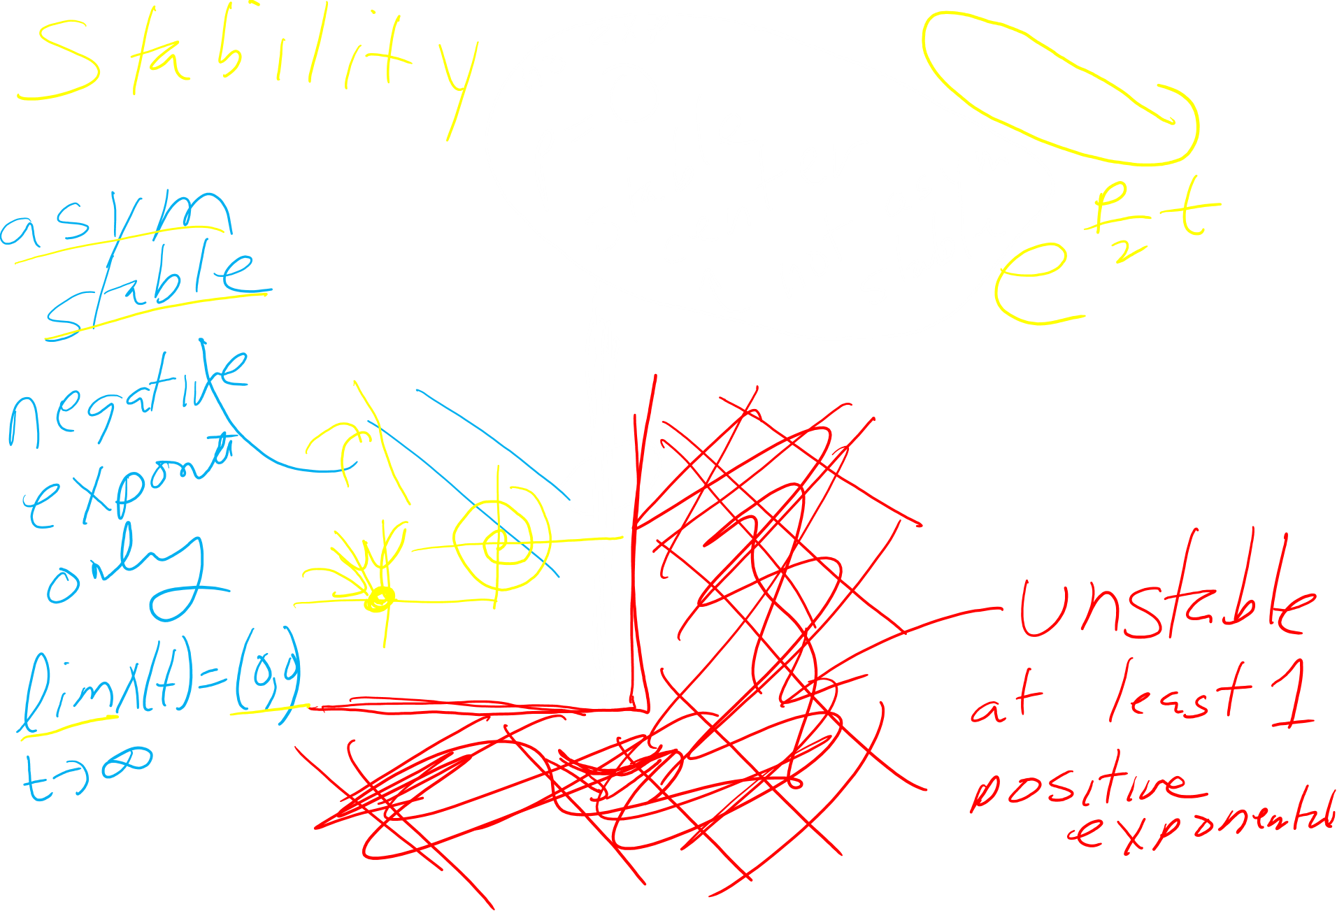
https://en.wikipedia.org/wiki/Phase_plane

Slide 15
https://en.wikipedia.org/wiki/Phase_plane

Slide 16
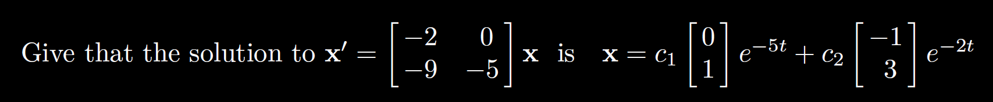
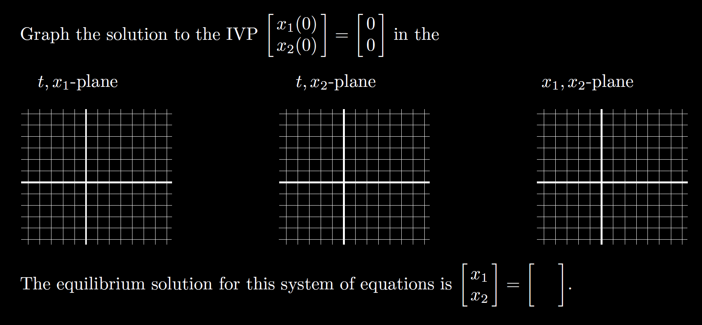
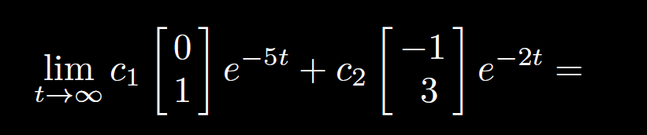


Slide 17


Slide 18
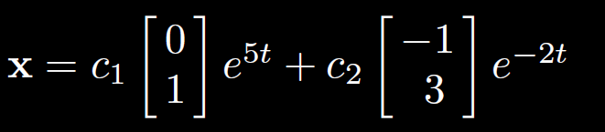
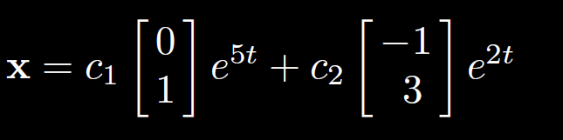
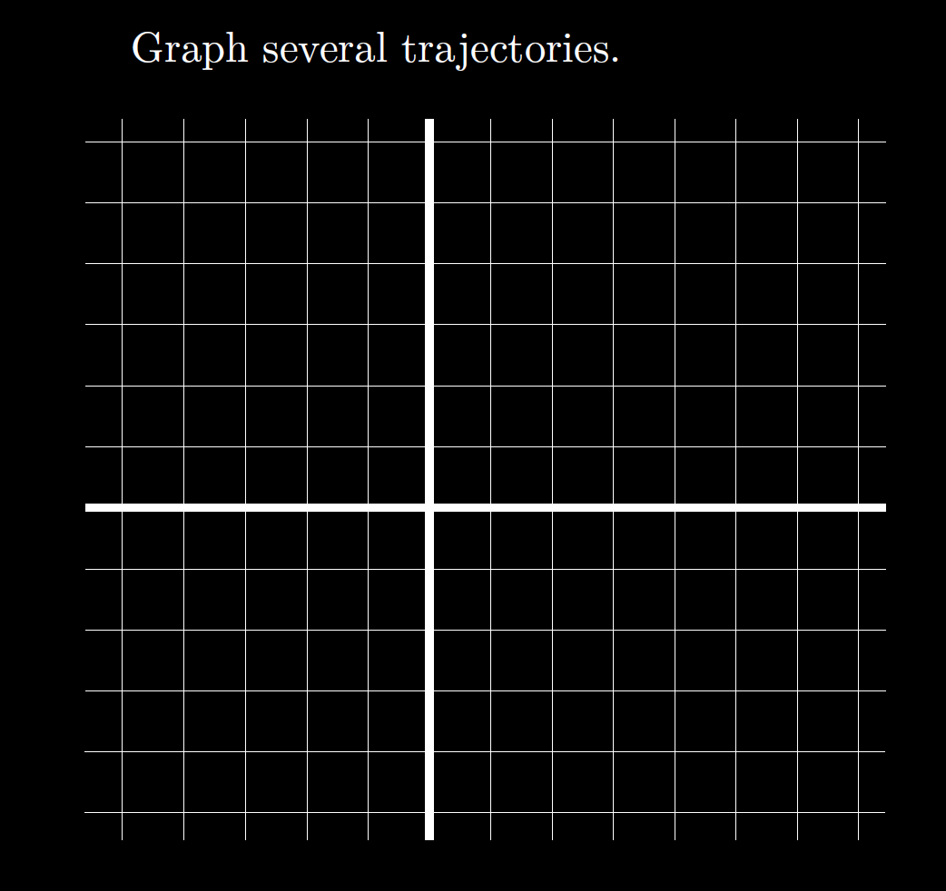




























Slide 19
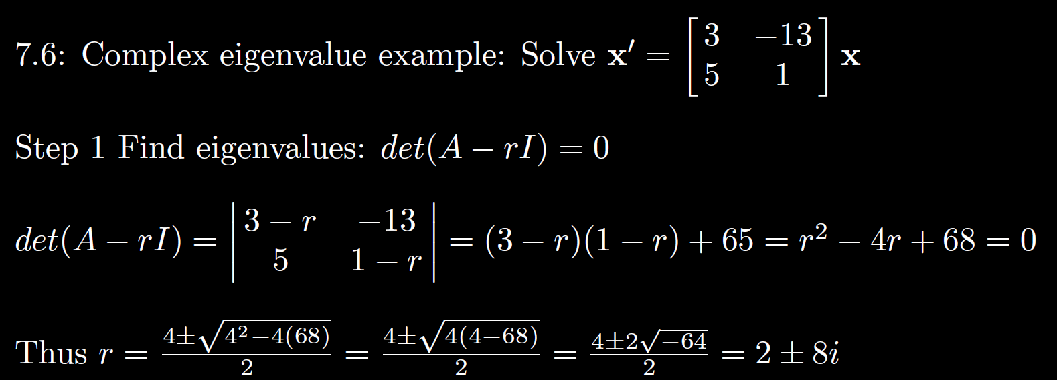
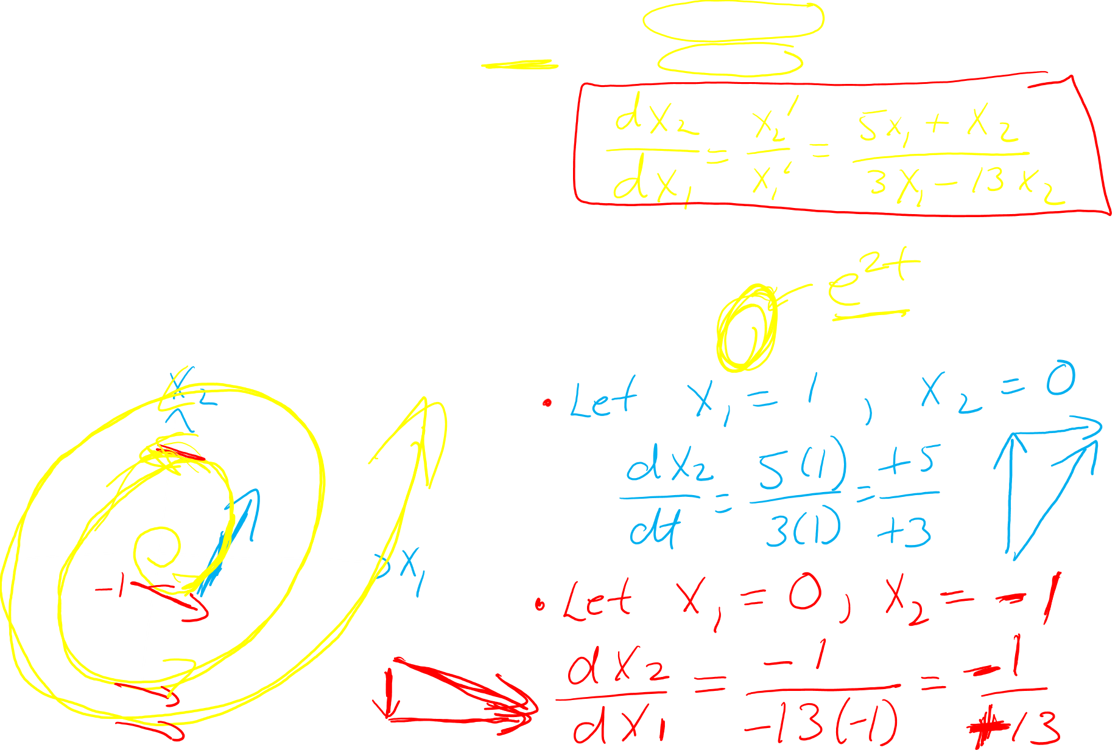


Graph

Slide 20
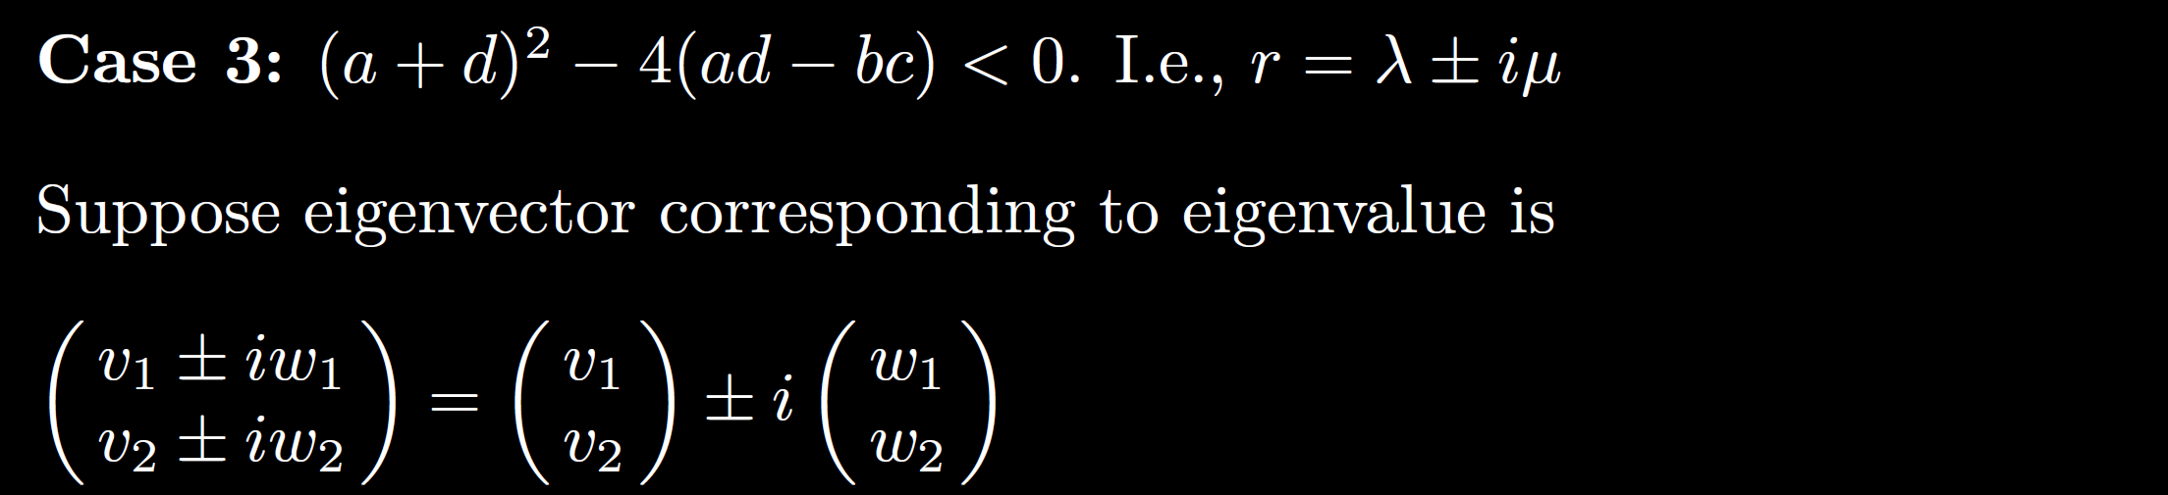
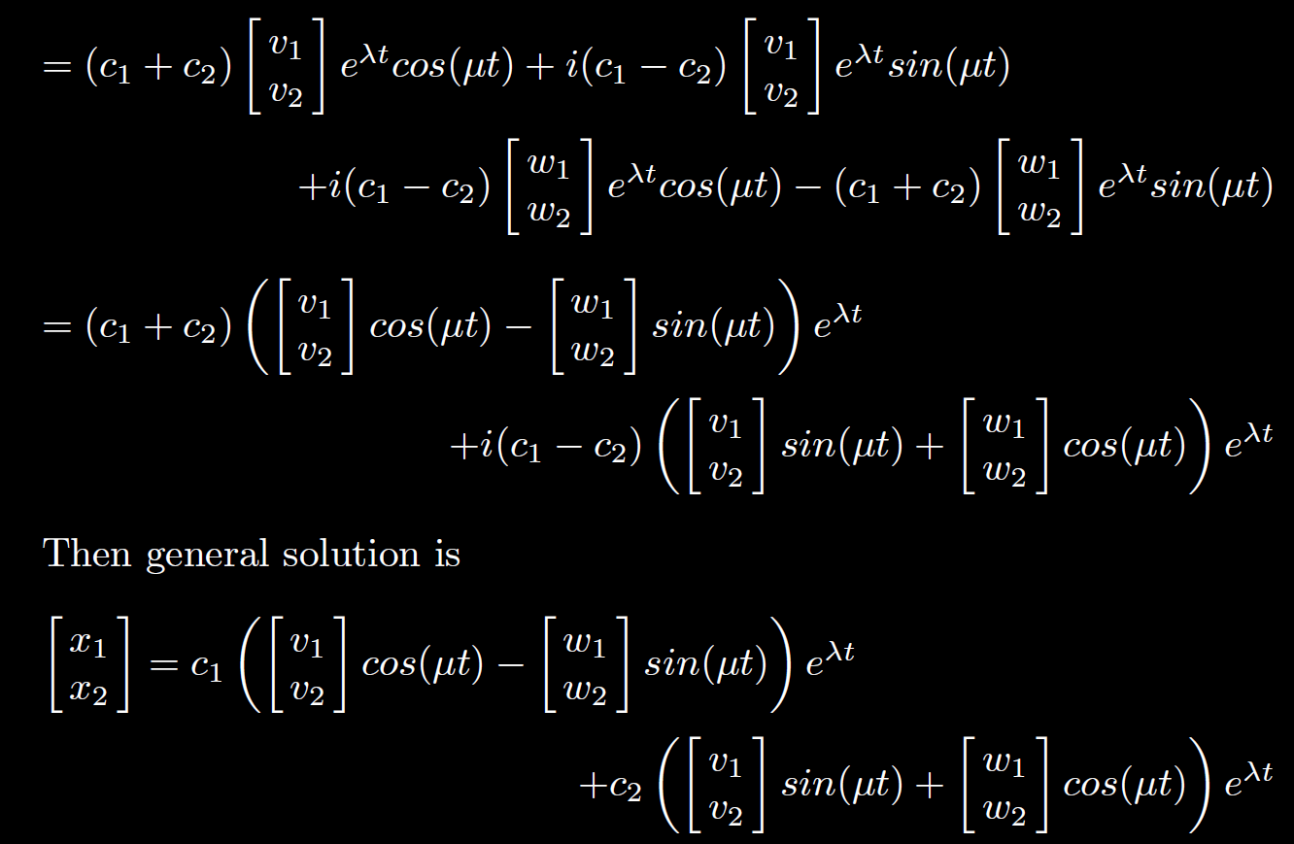
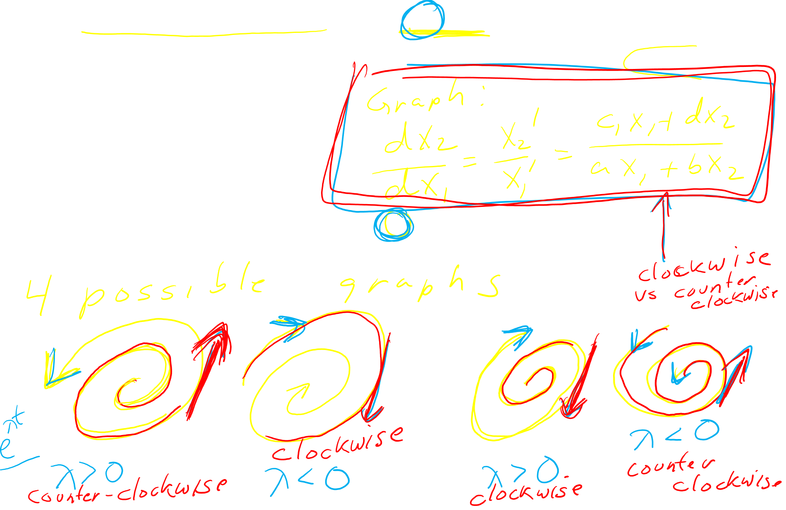

Slide 21
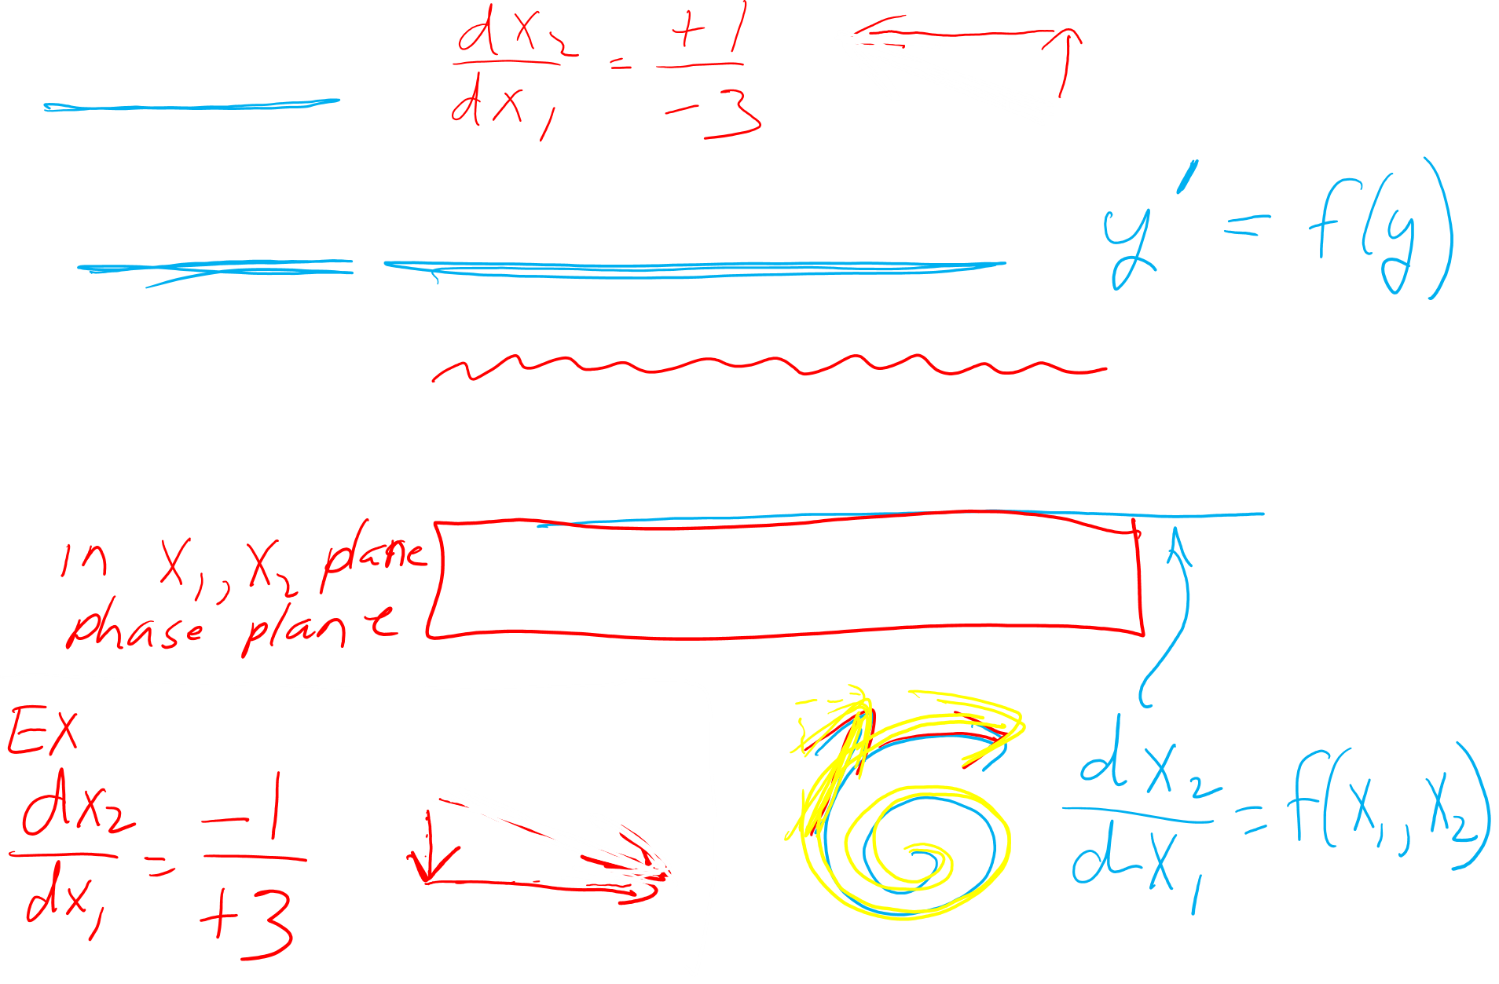
Slope field:
In chapter 2: usually autonomous
arrows are not required.
In chapter 7, 9: usually not autonomous
arrows are required.

Slide 22


Slide 23
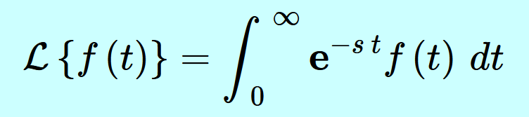
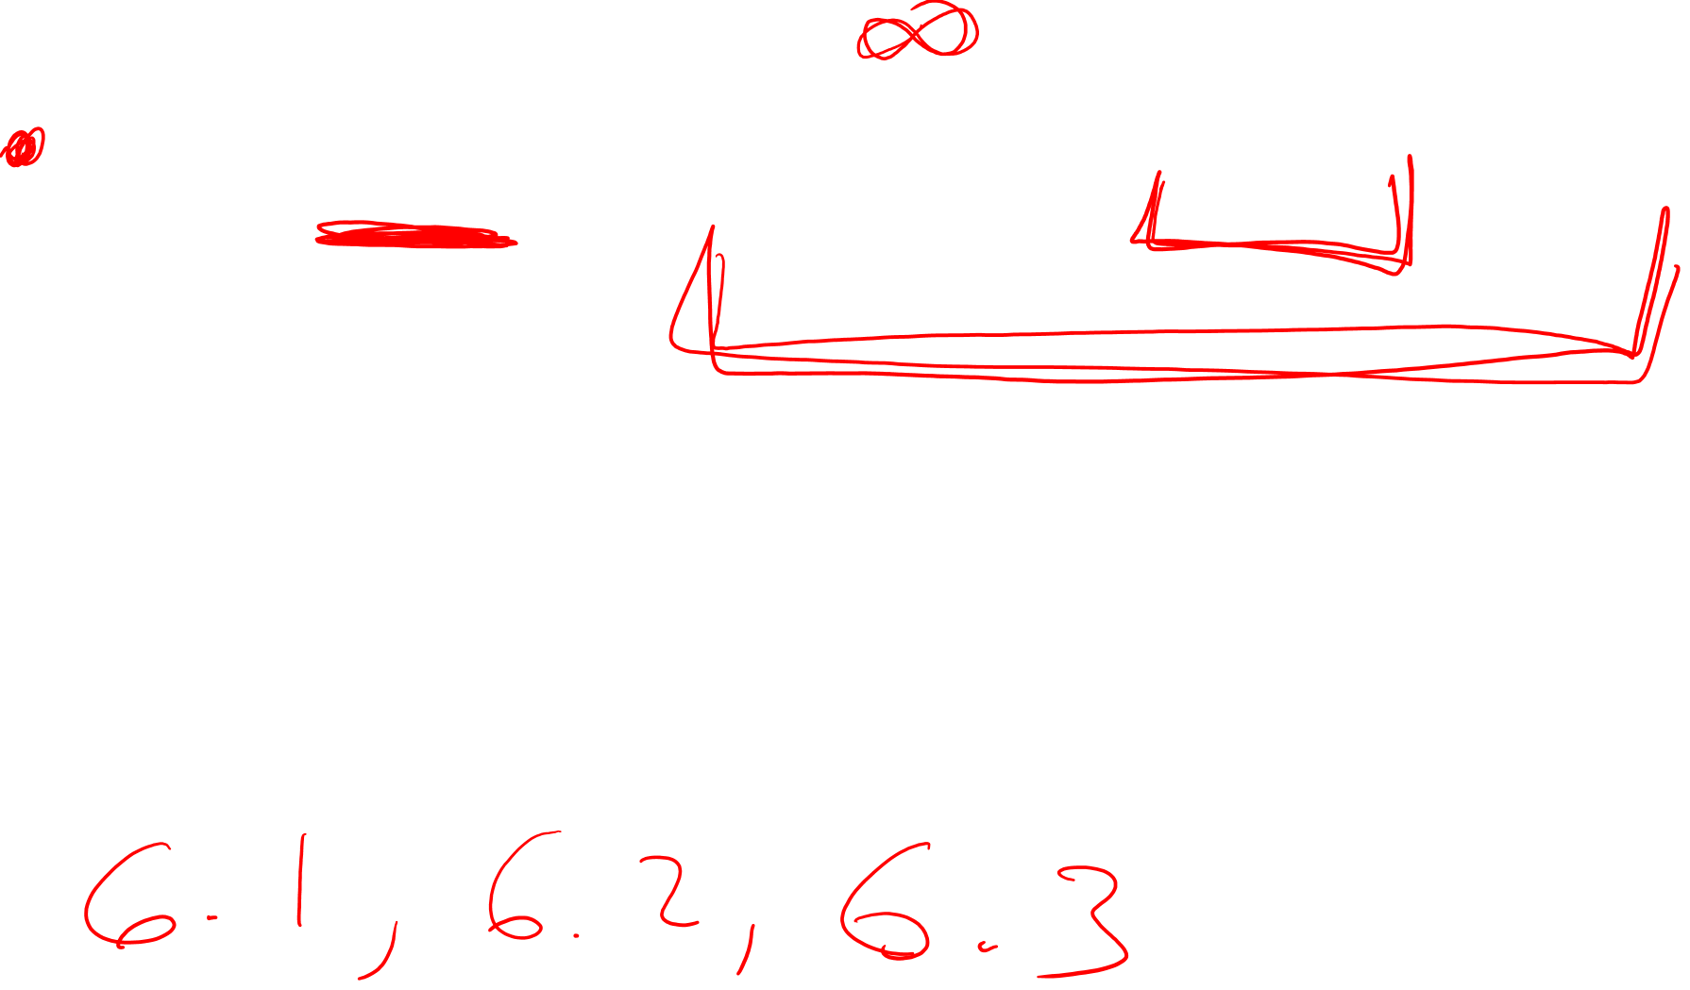
6.1: LaPlace transform

Slide 24
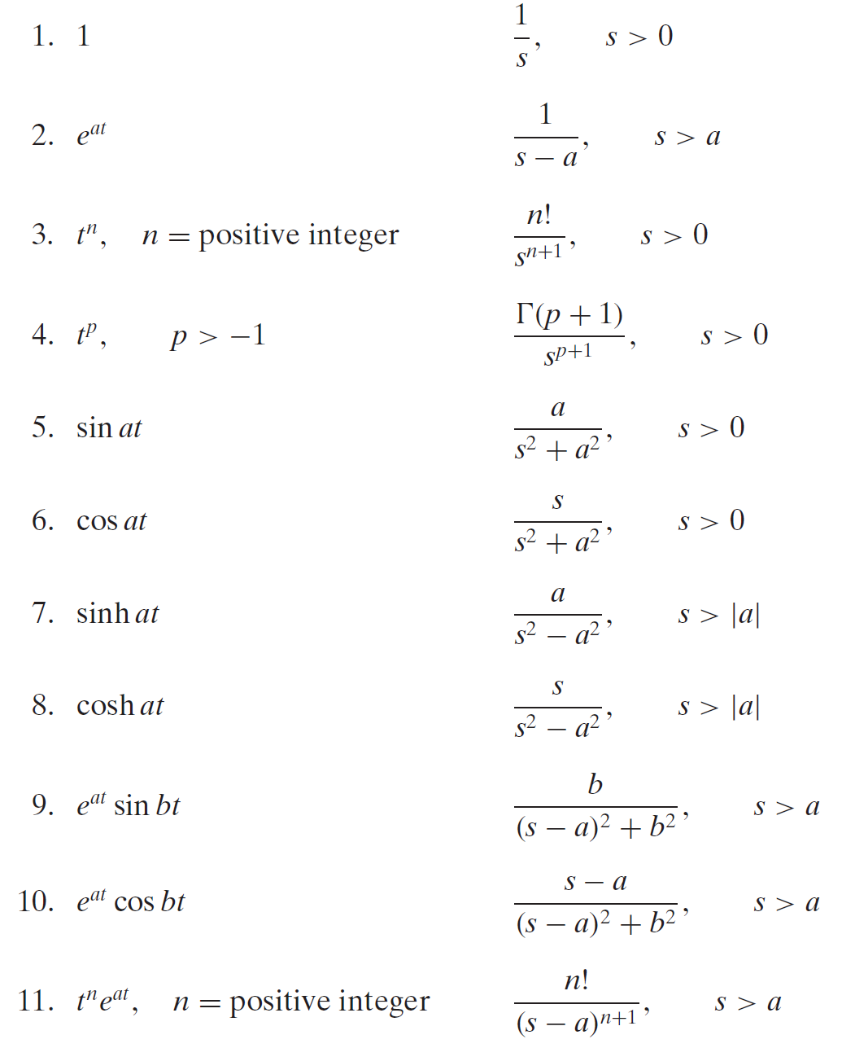
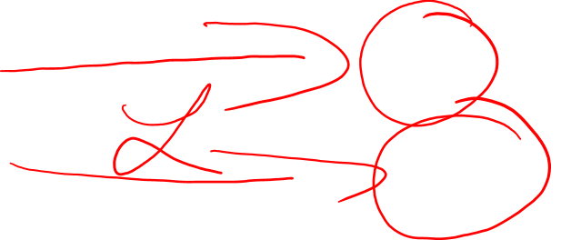

Slide 25
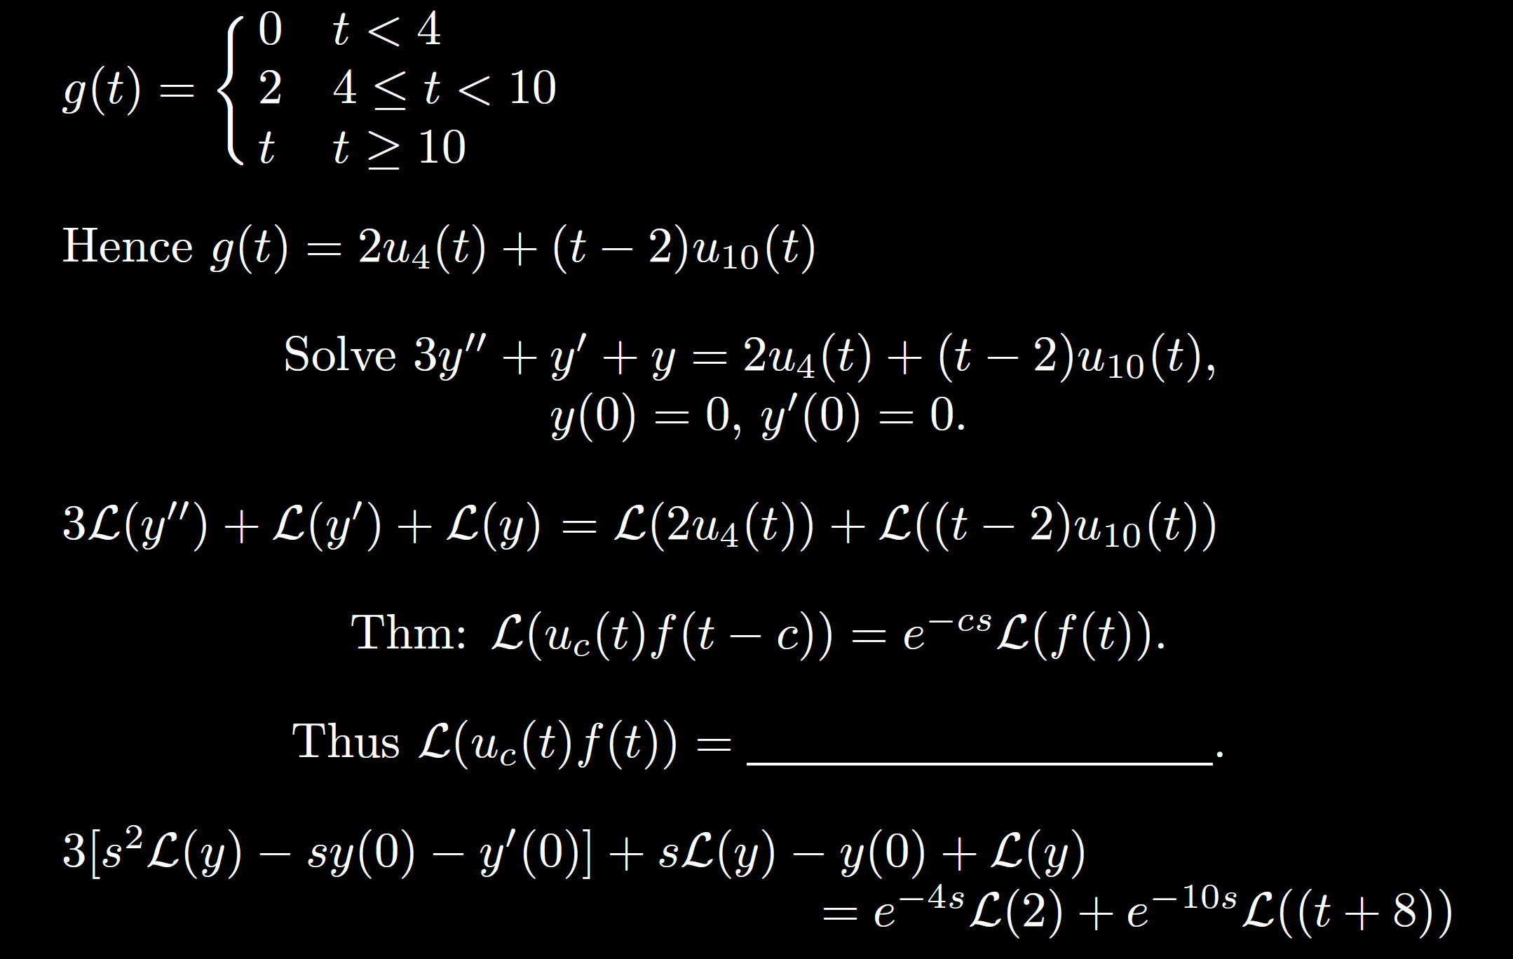
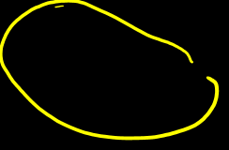
6.4

Slide 26
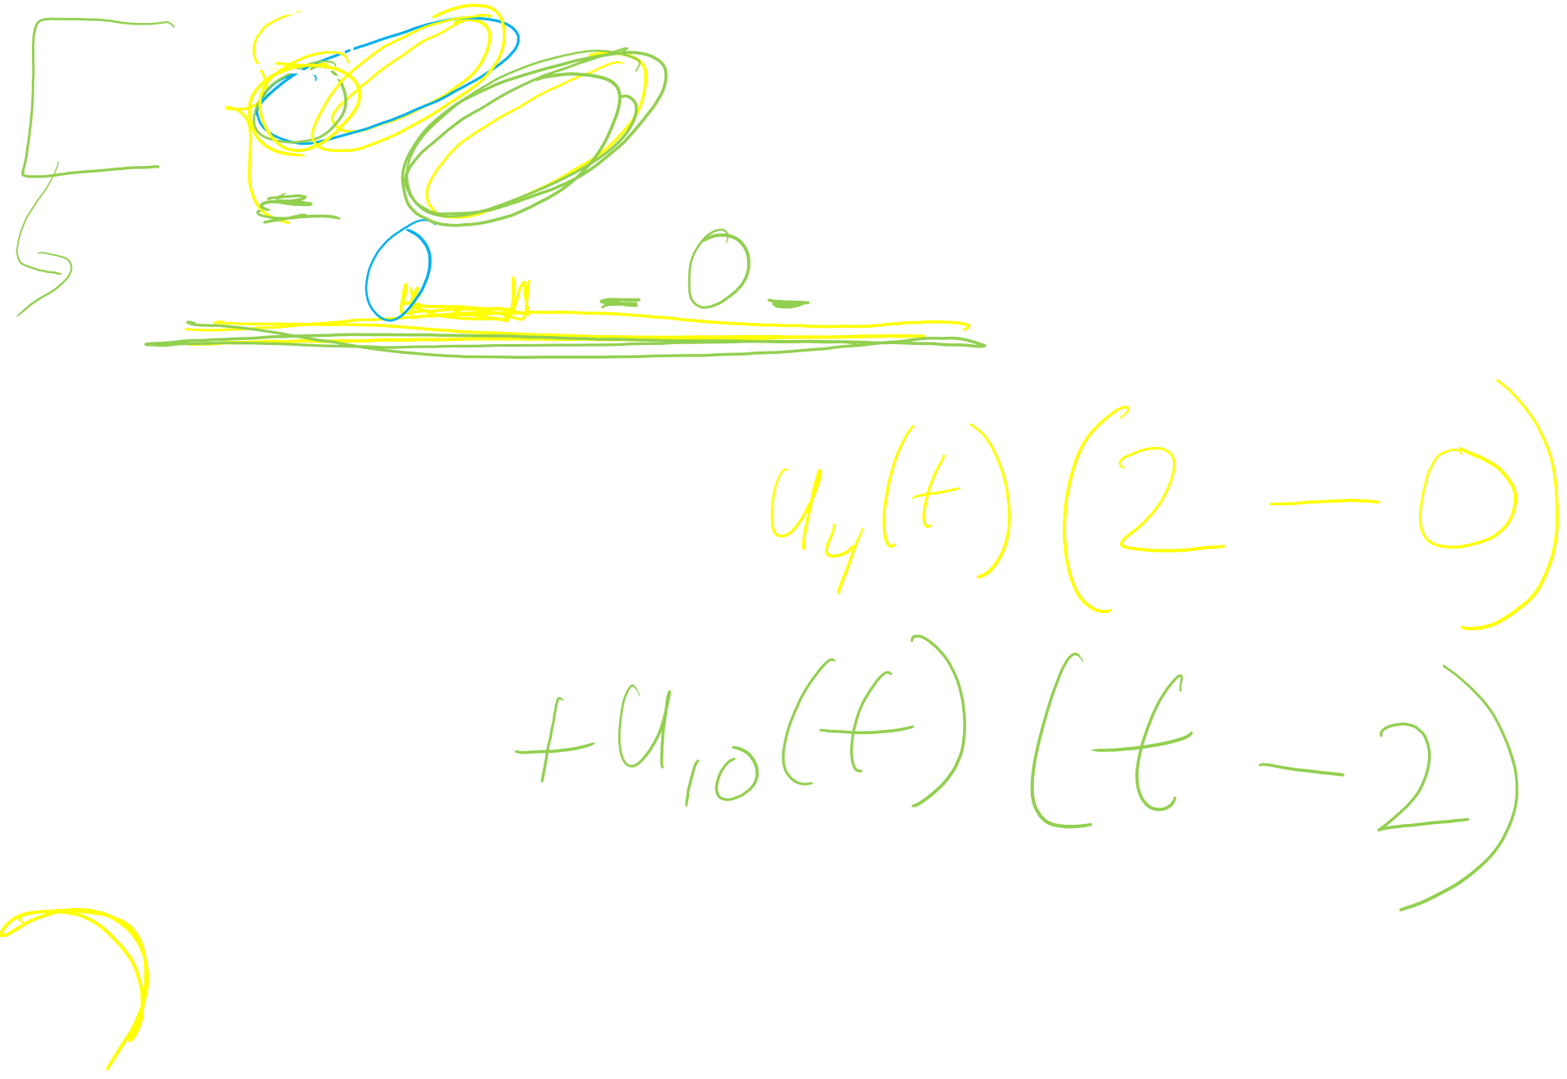
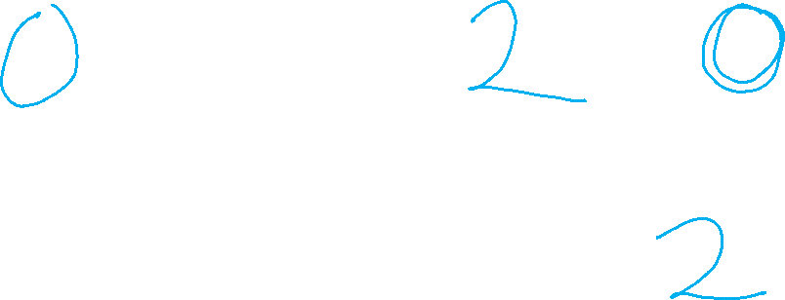
6.3

Slide 27
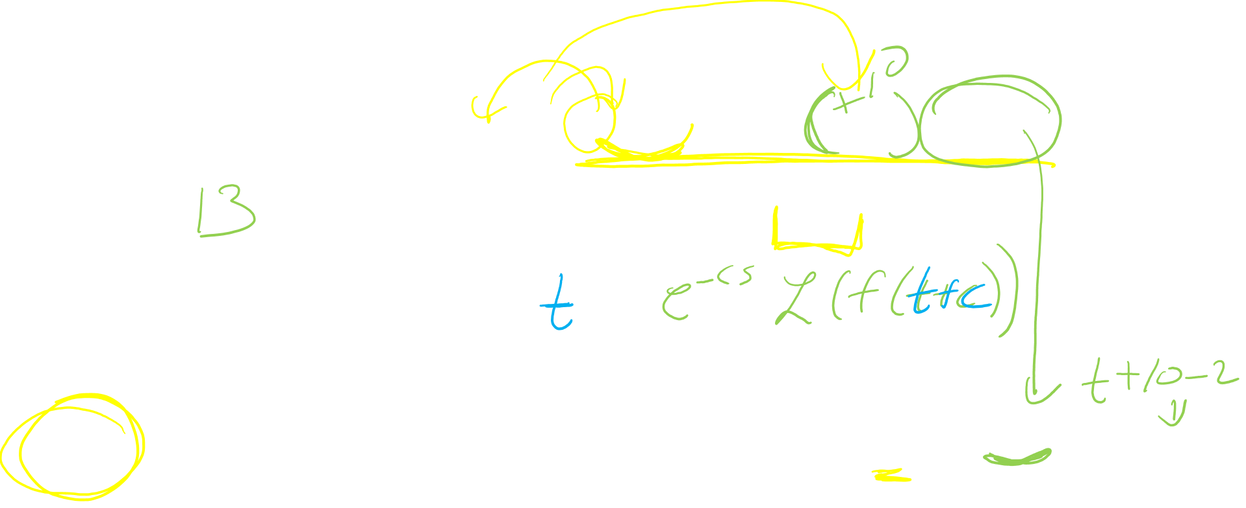
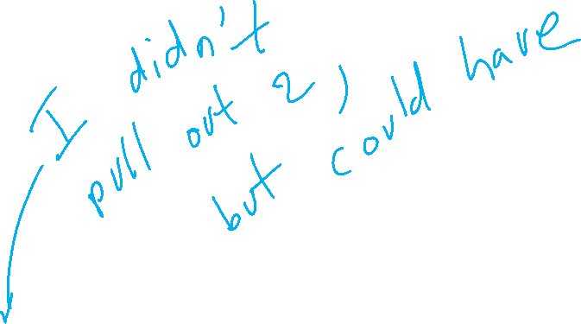
6.3

Slide 28

6.4

Slide 29
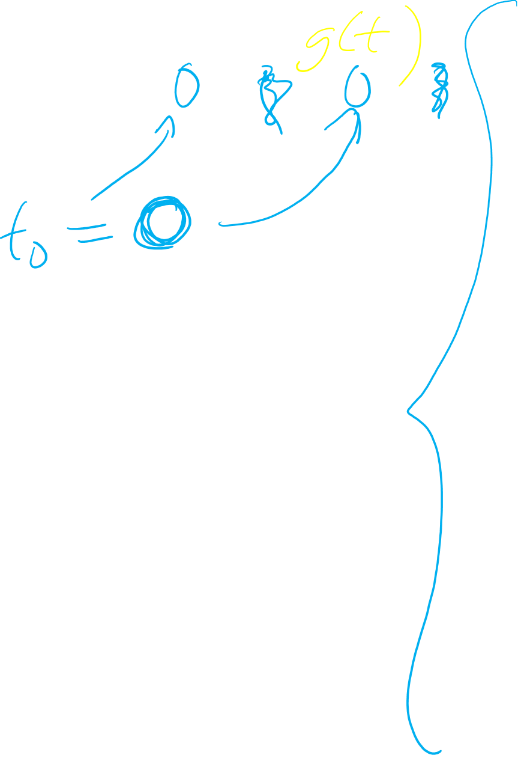
6.2

Slide 30
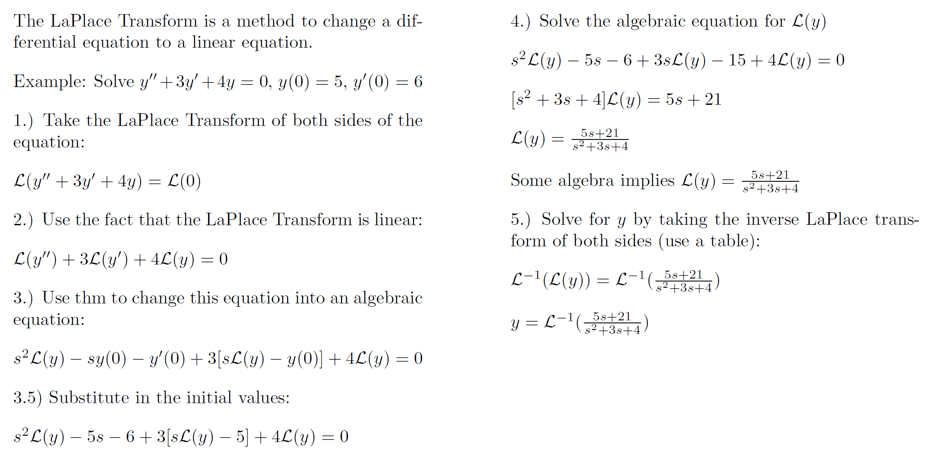
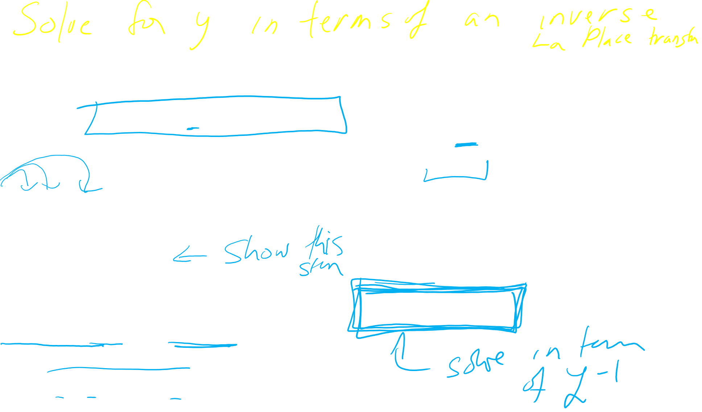

Slide 32
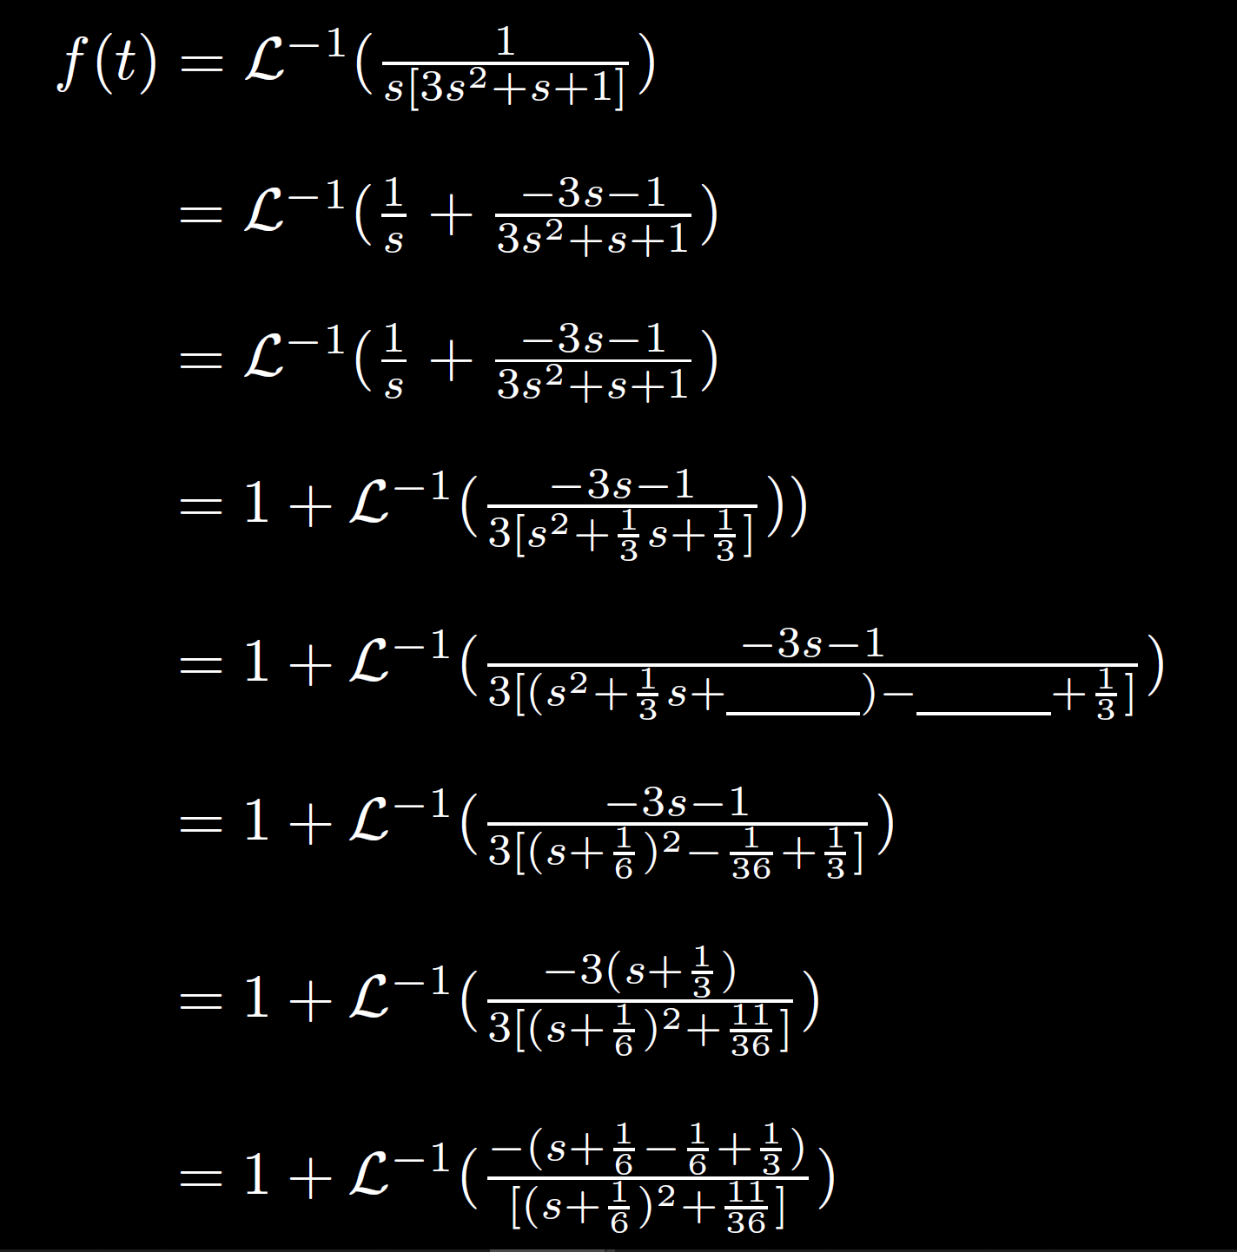
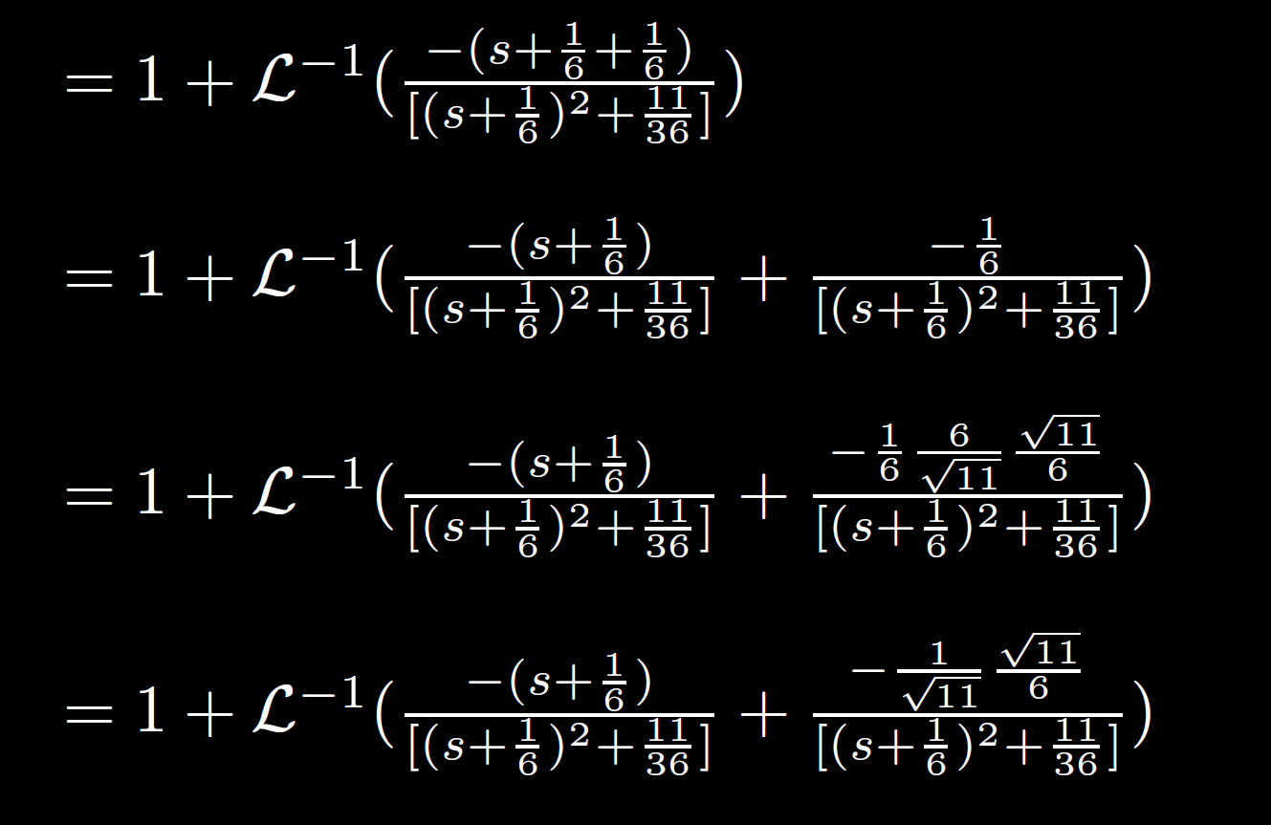
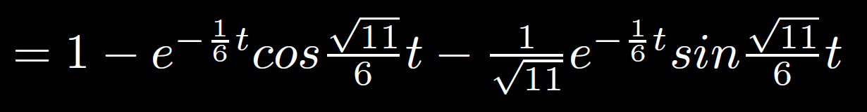


Slide 33
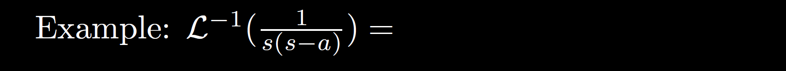
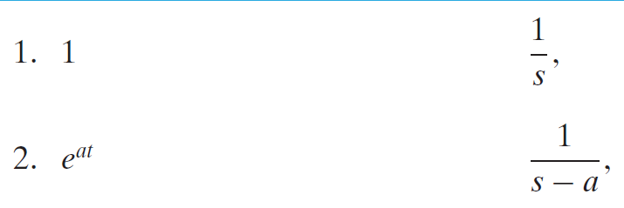





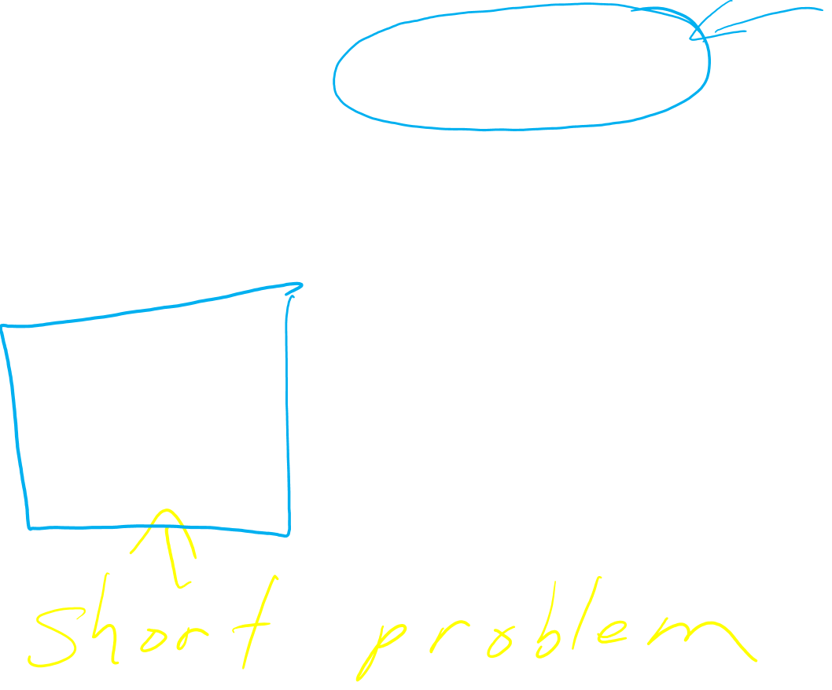














Slide 34
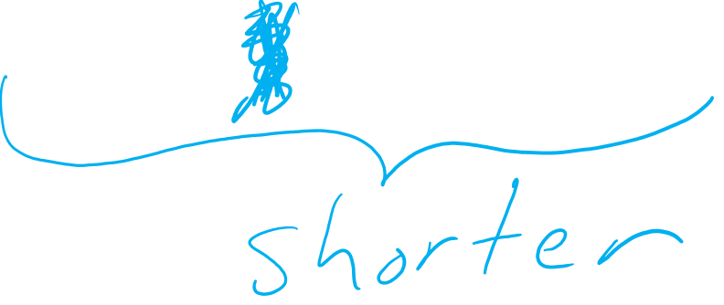

Slide 35


Slide 36


Slide 37


Slide 38








































Slide 39


Slide 40


Slide 41


Slide 42


Slide 43


