Slide 1
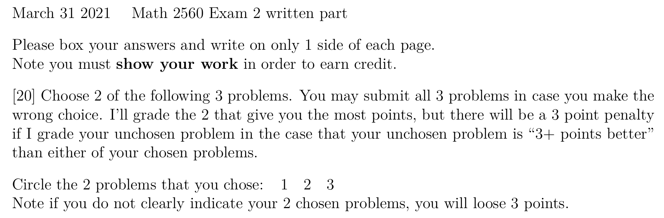
Exam 2 is next Wednesday March 31, covering Ch 3, Ch 4, and finding eigenvalues for 2 x 2 matrices. Format will be similar to last exam.
NOTE: We will use concepts from Ch 3 and 4 thru the rest of the semester, so please overstudy for this exam. It will make the rest of this course much easier
.
See e-mail/ICON announcement (will be sent today).

Slide 2
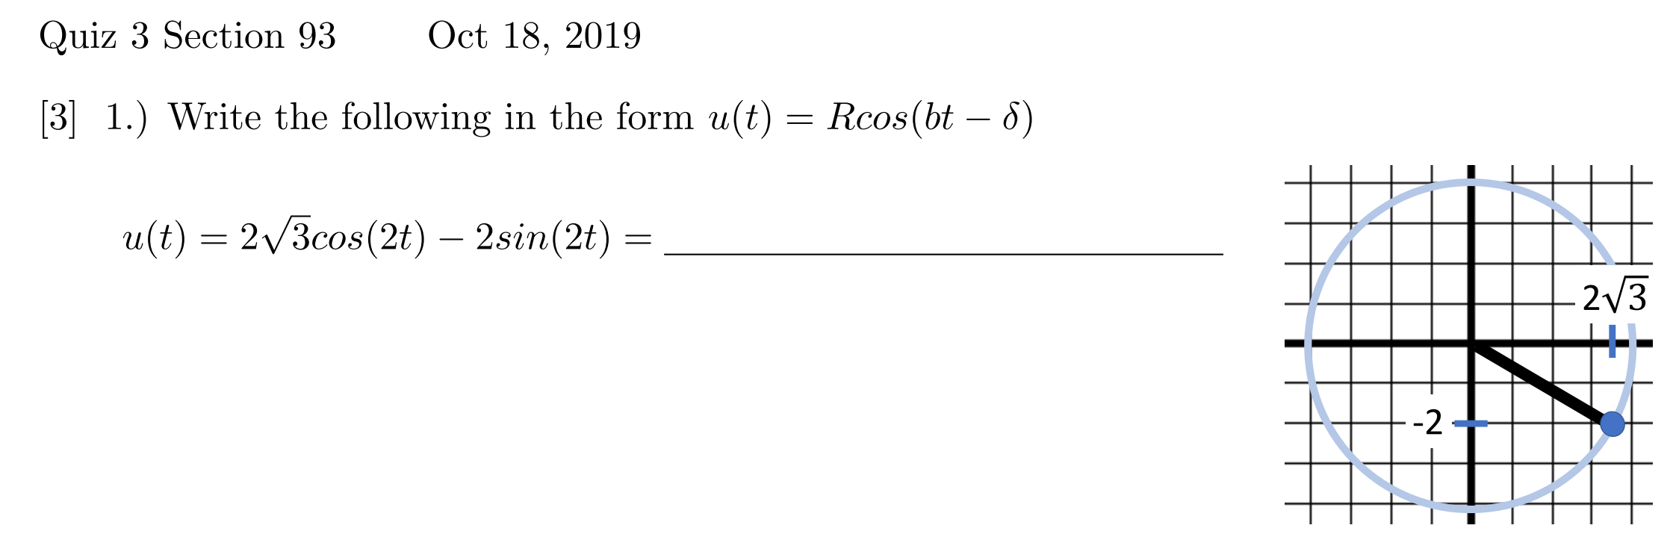
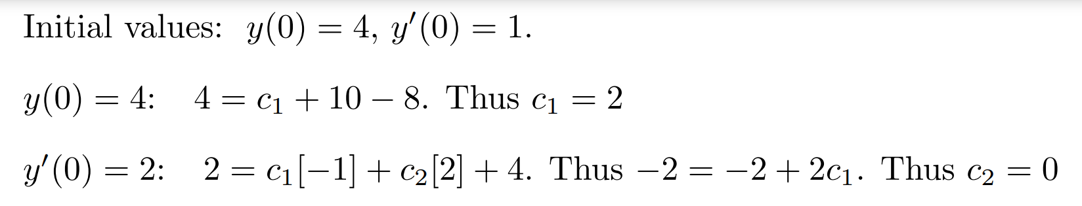
Compare the different versions of problems 1, 3, 4

Slide 3
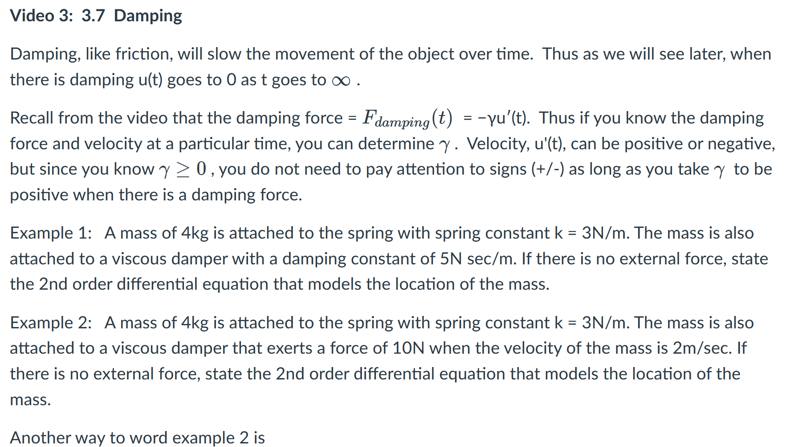

Slide 4
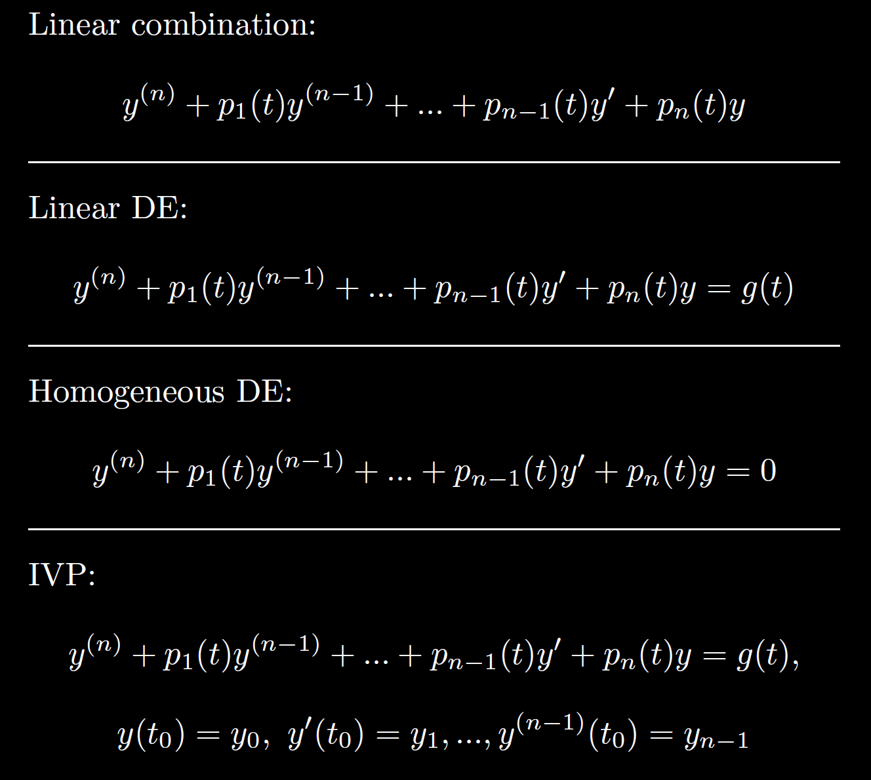

Slide 5
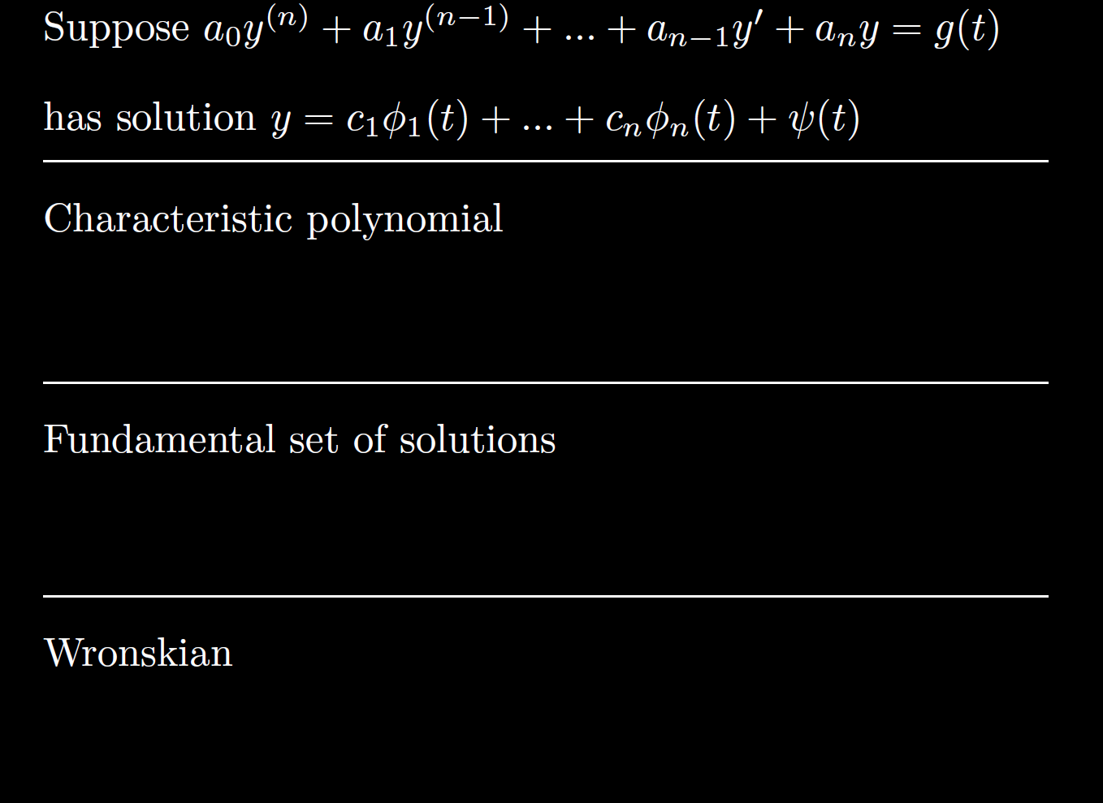

Slide 6
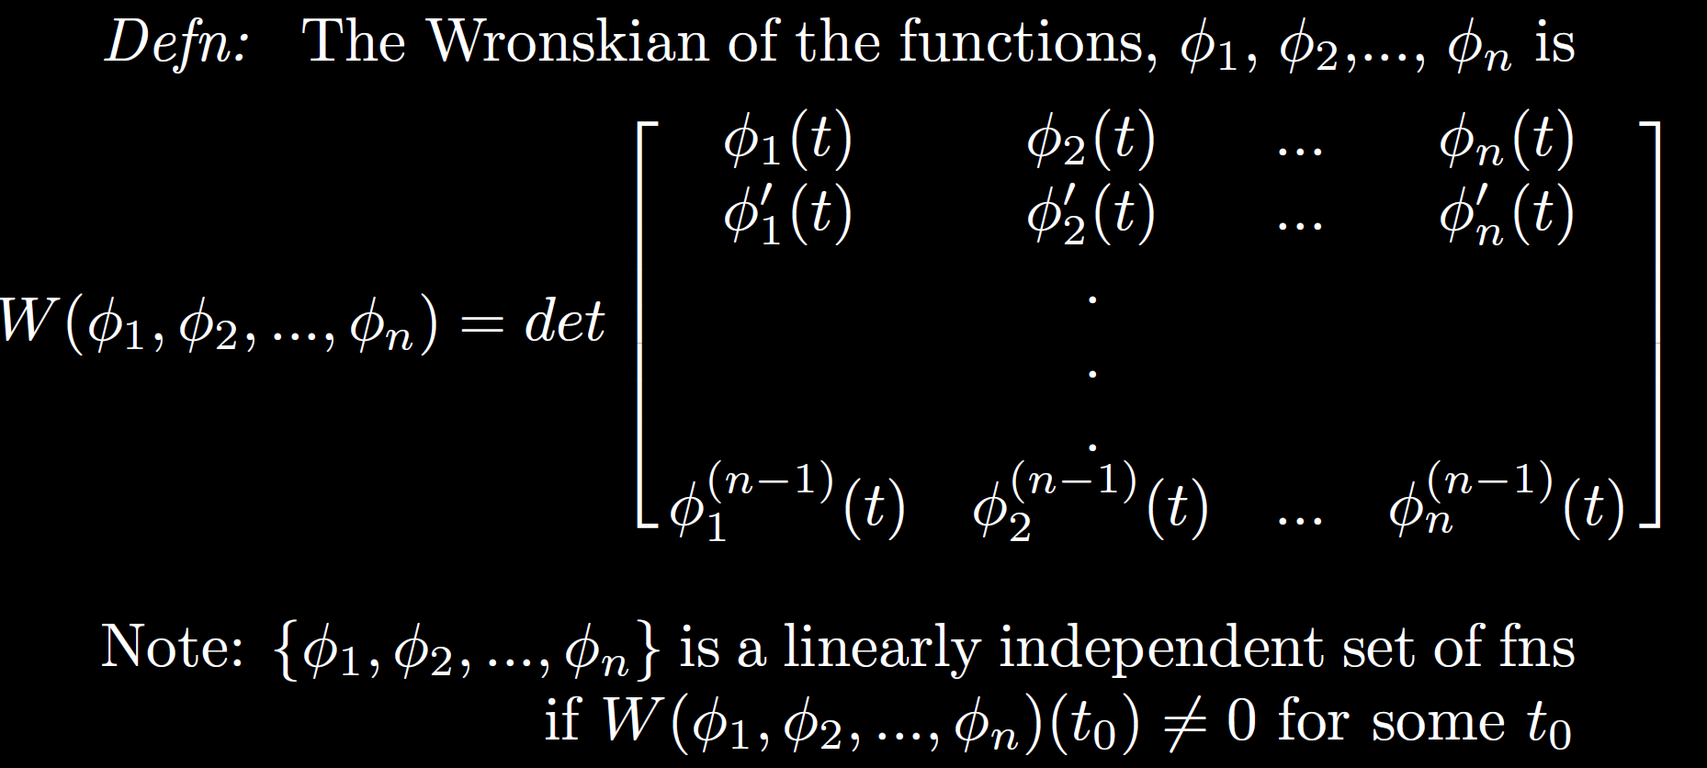

Slide 7
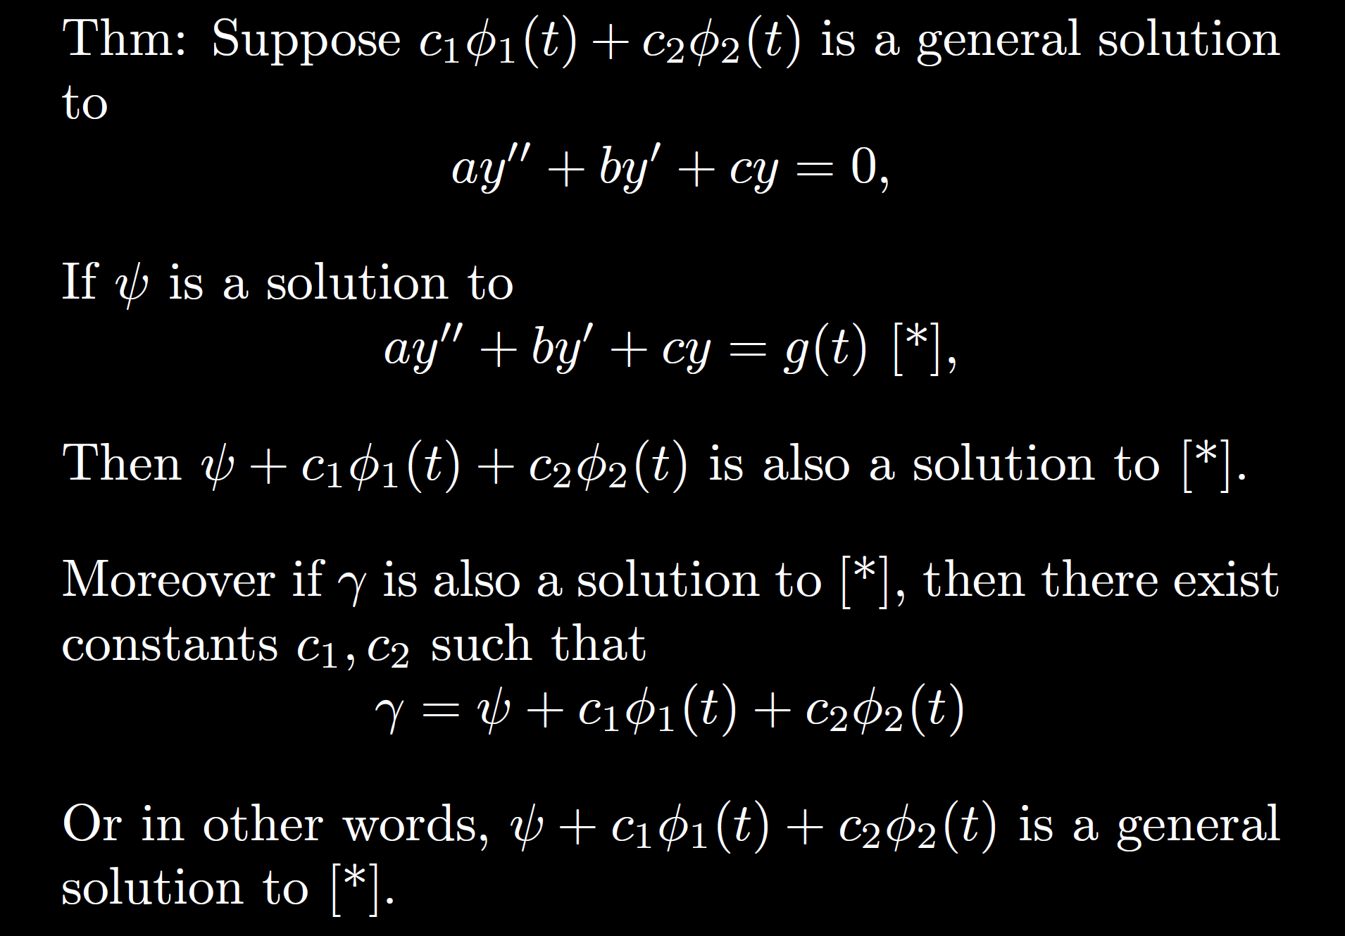

Slide 8
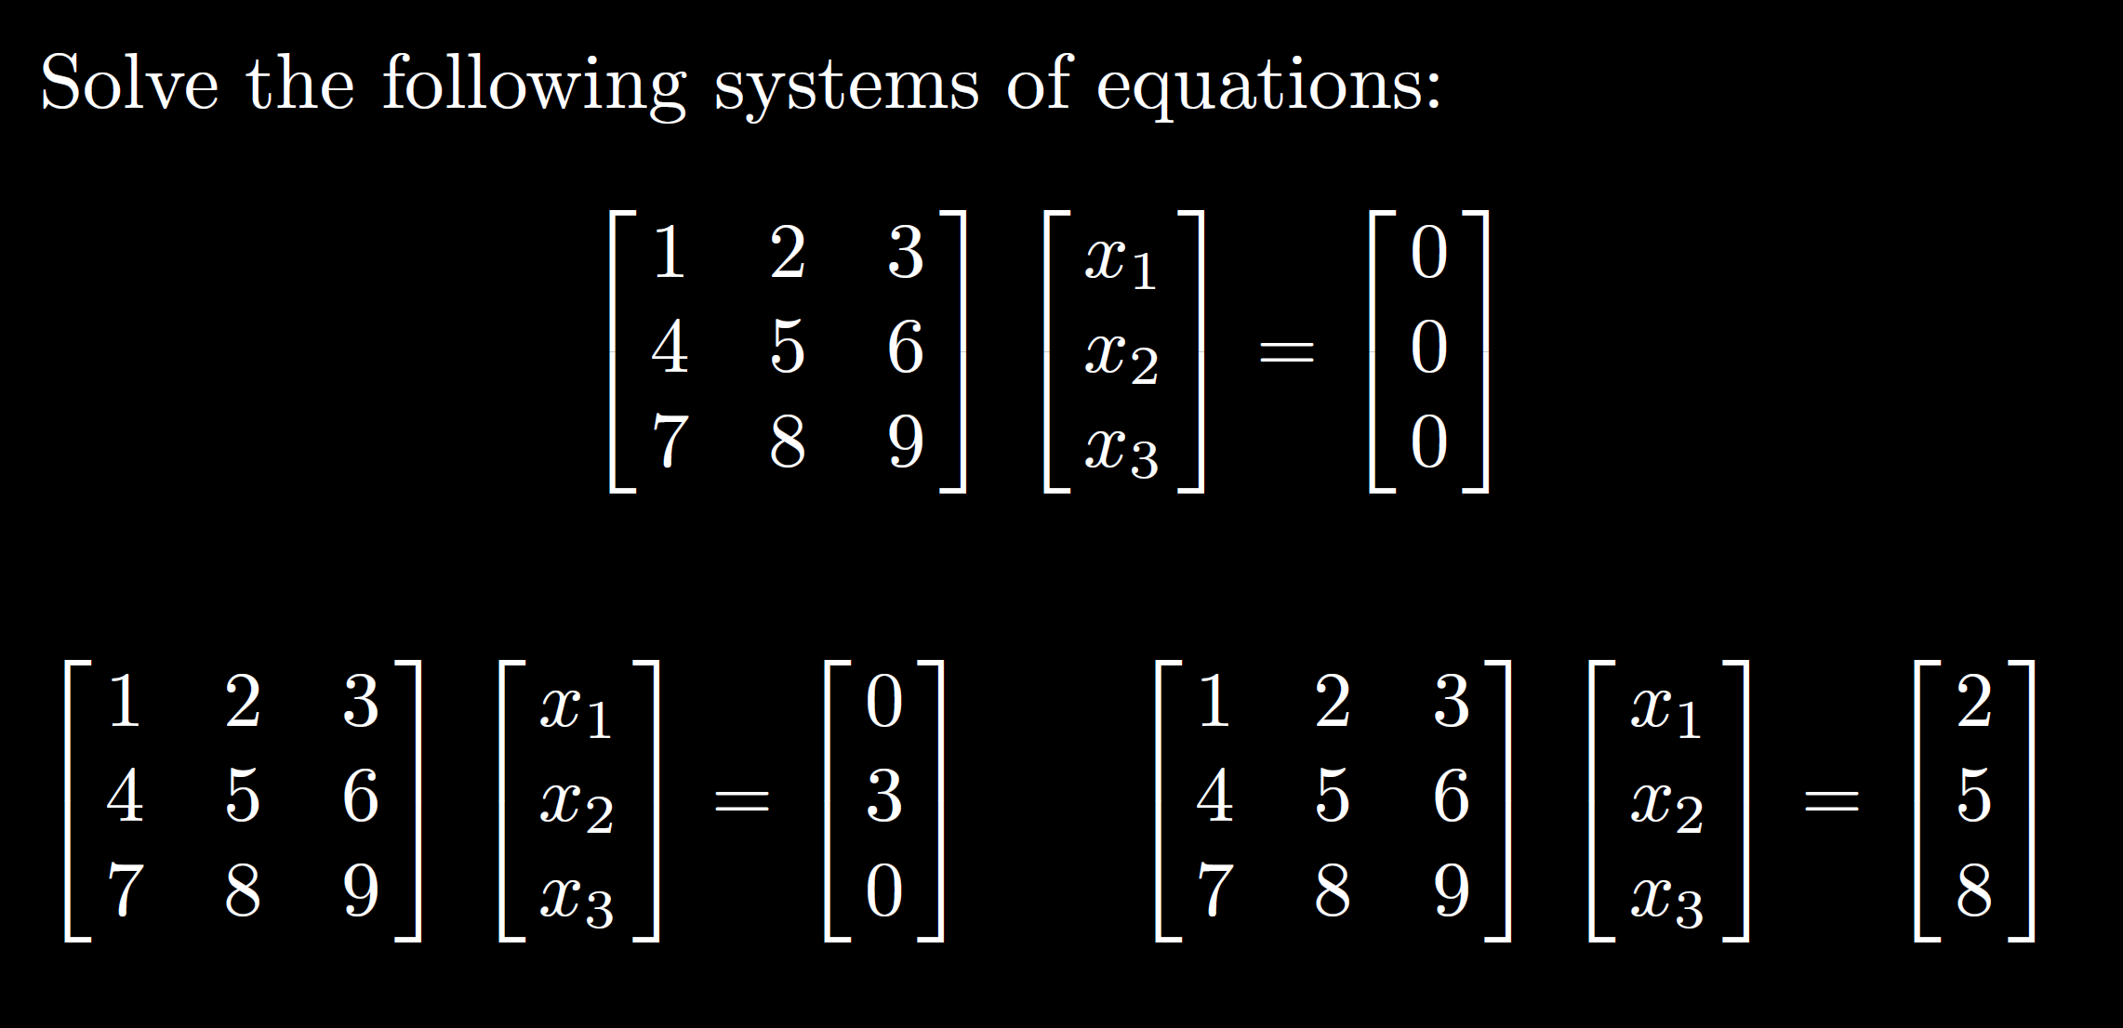

Slide 9
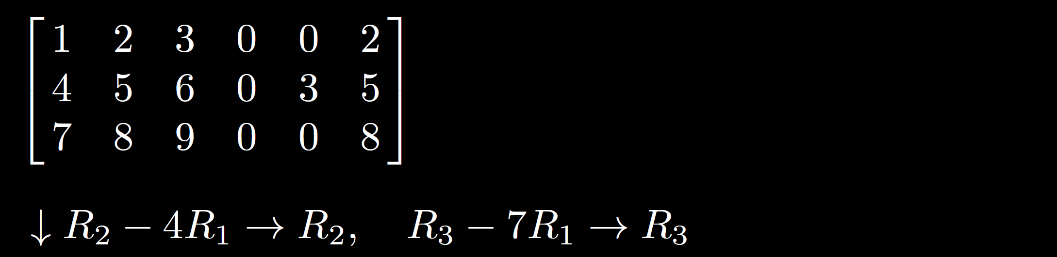
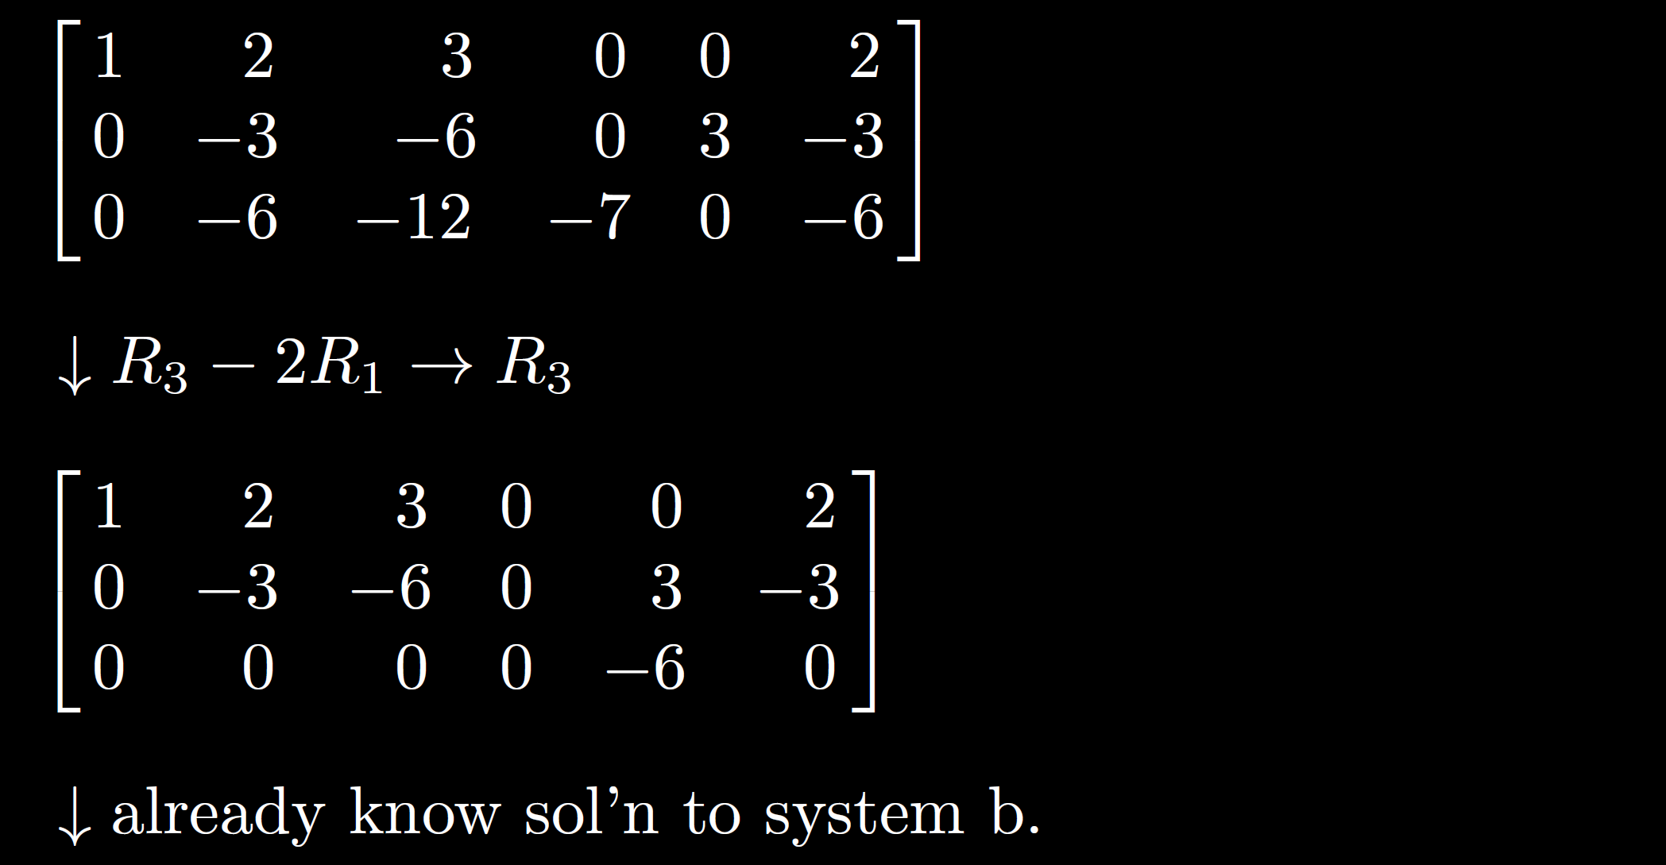

Slide 10
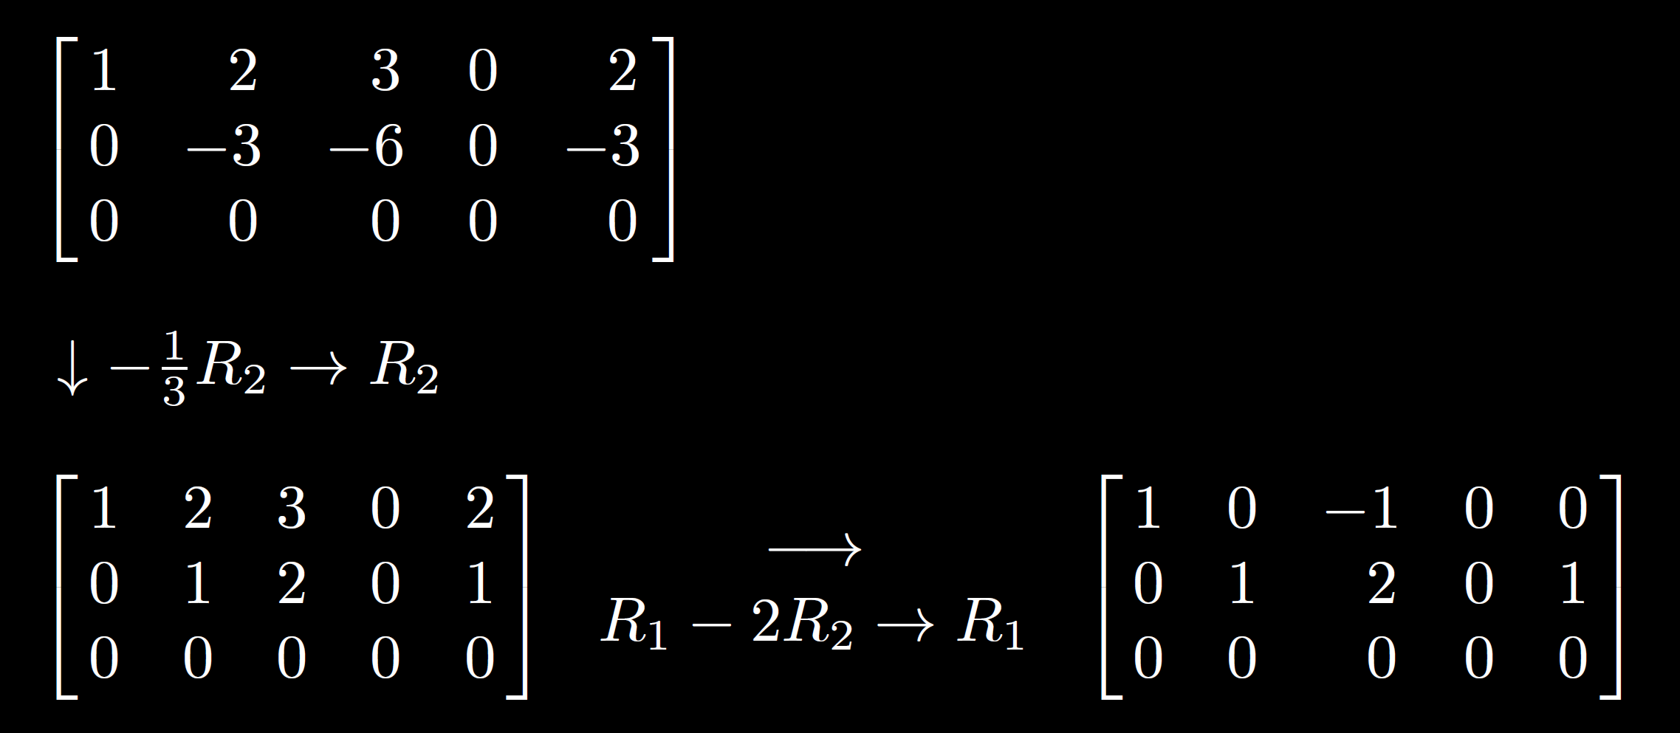

Slide 11
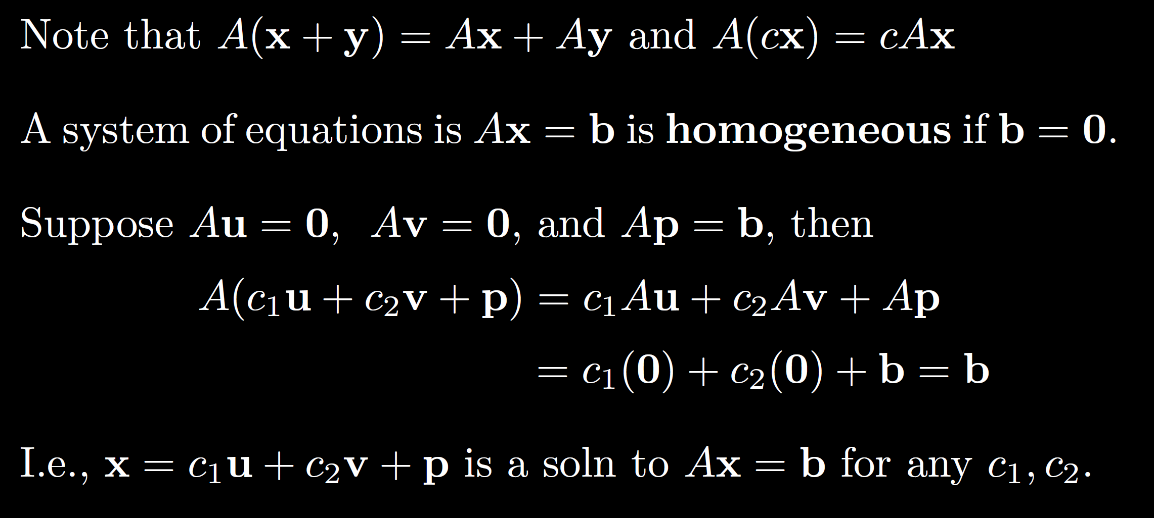

Slide 13
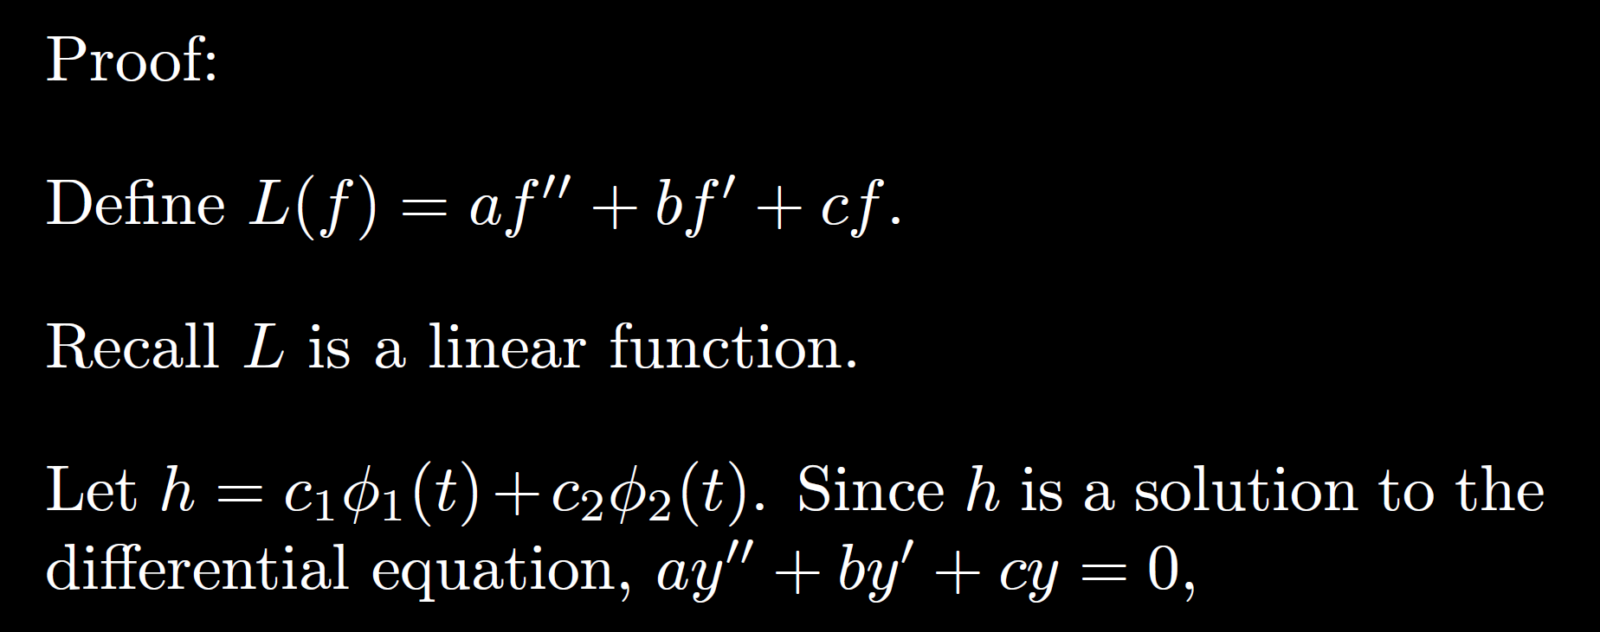

Slide 14
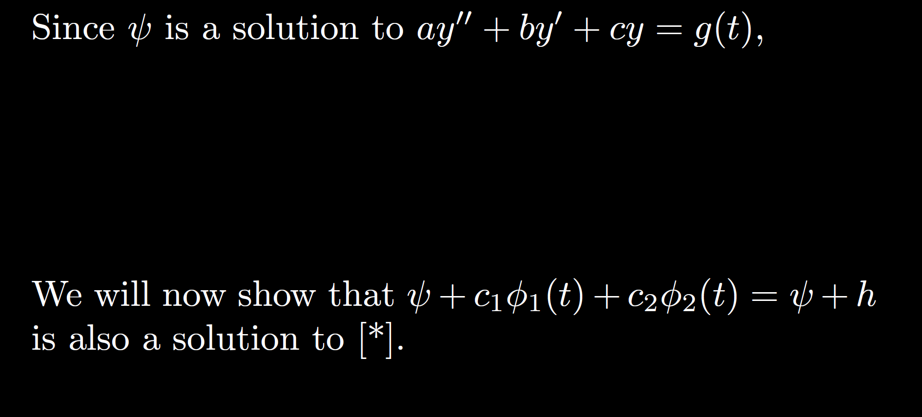

Slide 15
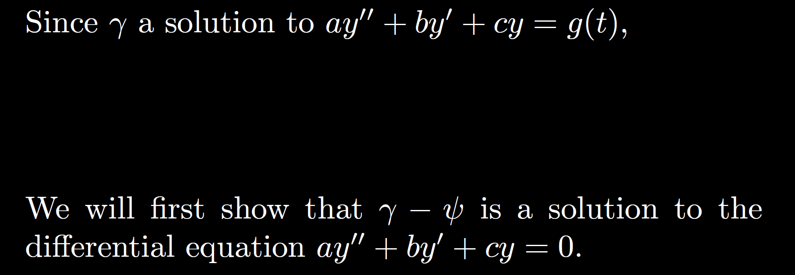

Slide 16
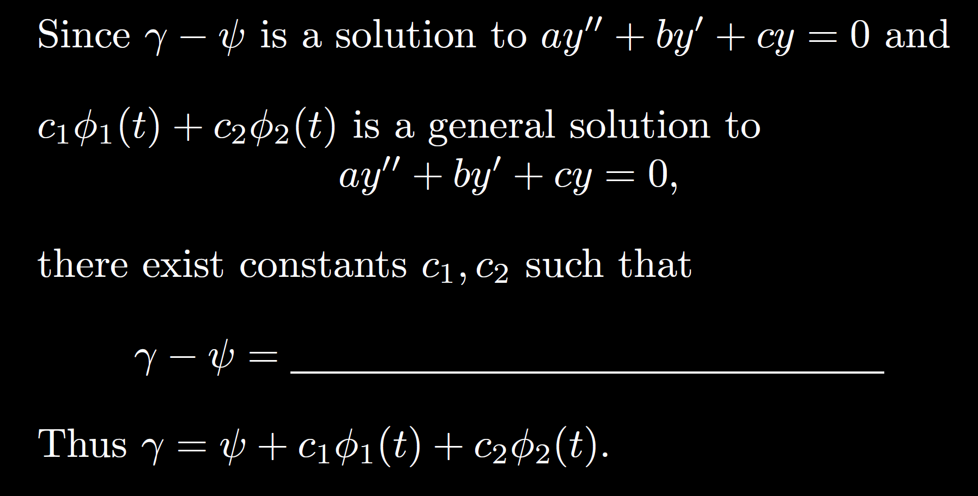

Slide 18
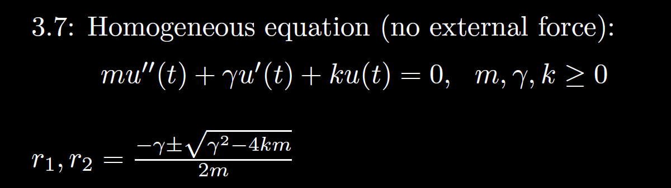
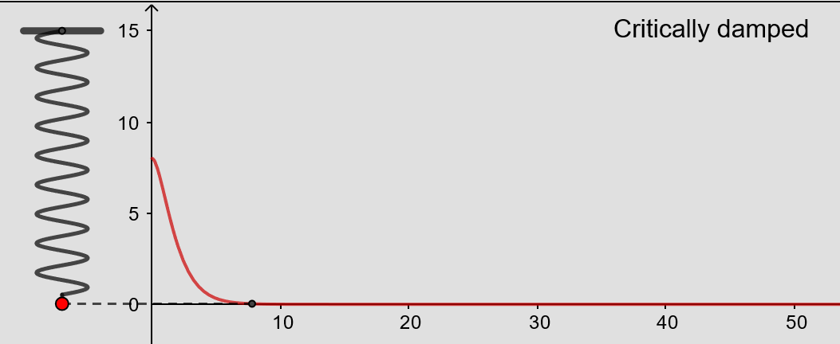
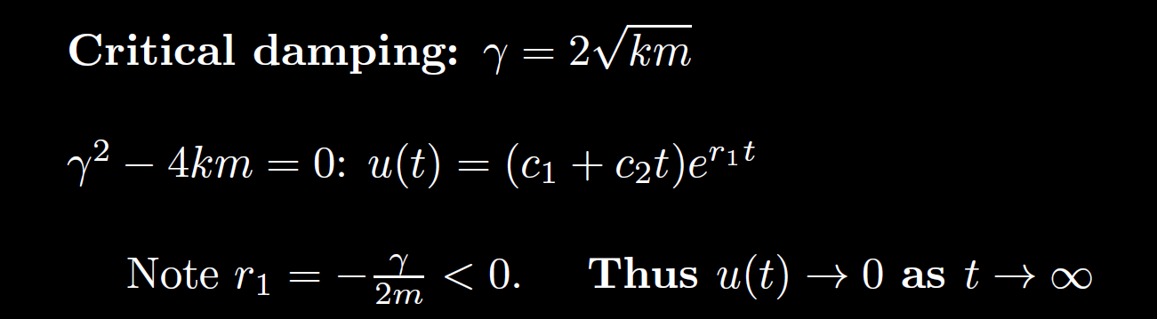
From https://www.geogebra.org/m/ZzKbkvnz
Note: Sign convention is opposite our convention

Slide 19
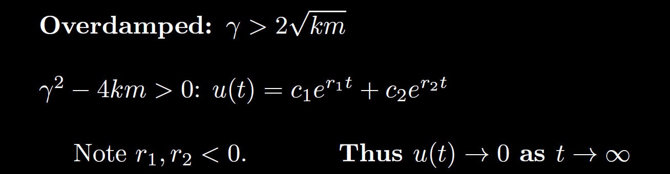
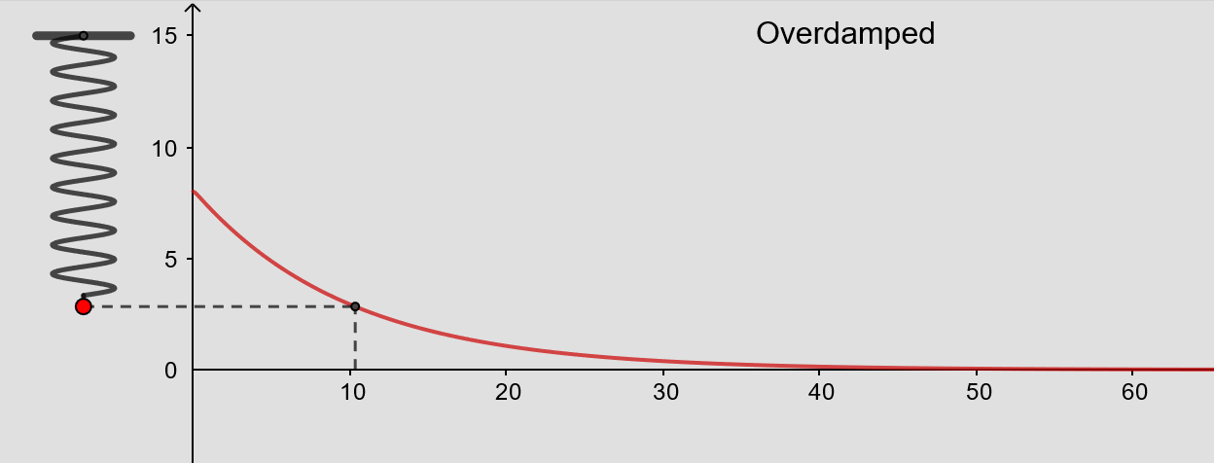
From https://www.geogebra.org/m/ZzKbkvnz
Note: Sign convention is opposite our convention

Slide 20
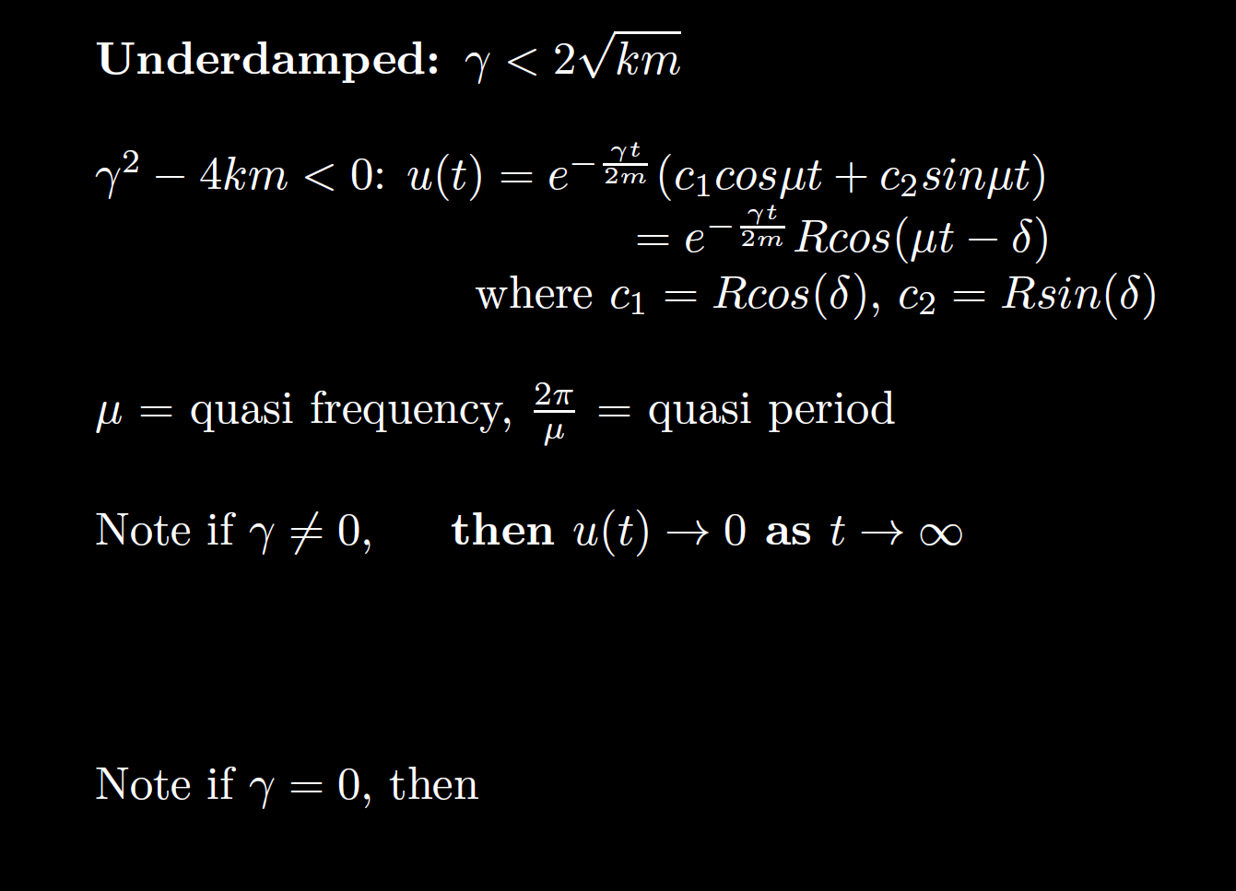
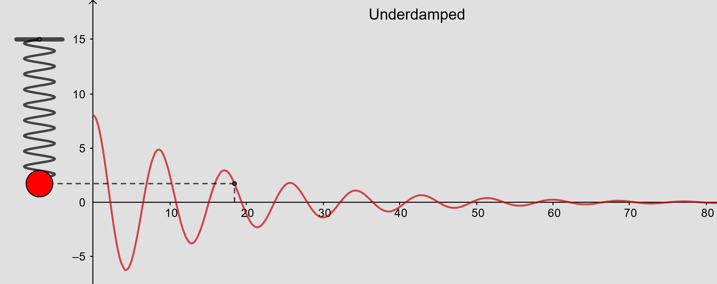
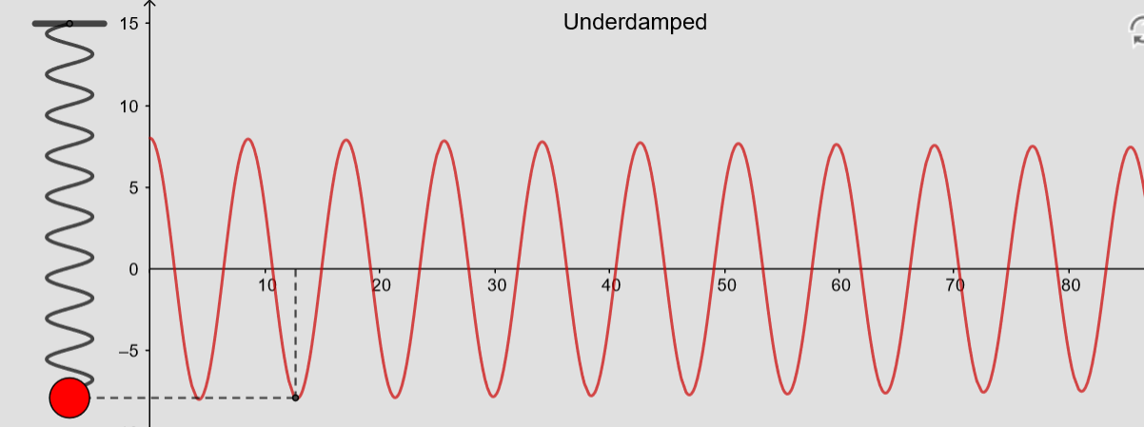
From https://www.geogebra.org/m/ZzKbkvnz
Note: Sign convention is opposite our convention

Slide 21
From https://www.geogebra.org/m/ZzKbkvnz
Note: Sign convention is opposite our convention

Slide 22
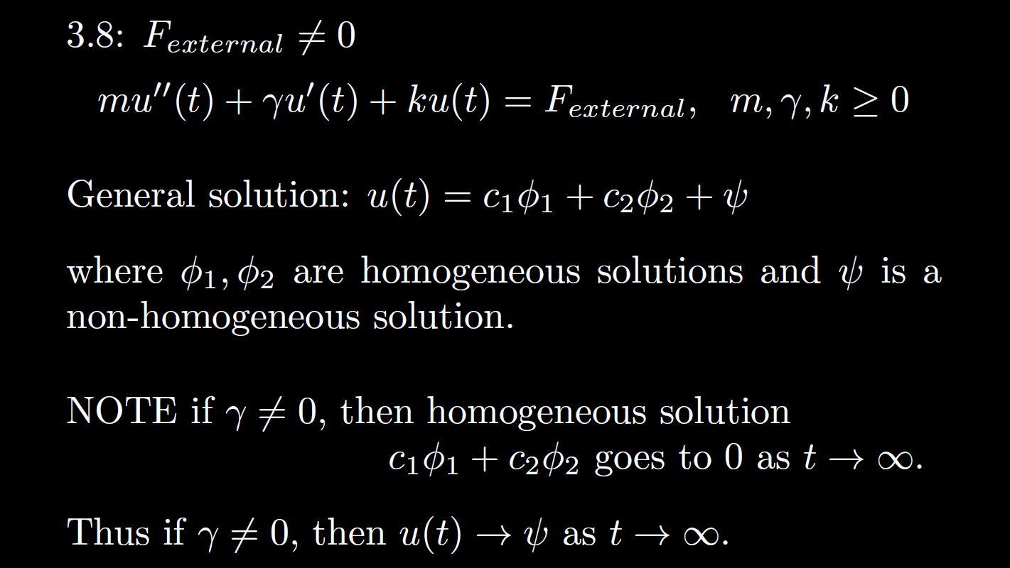

Slide 23
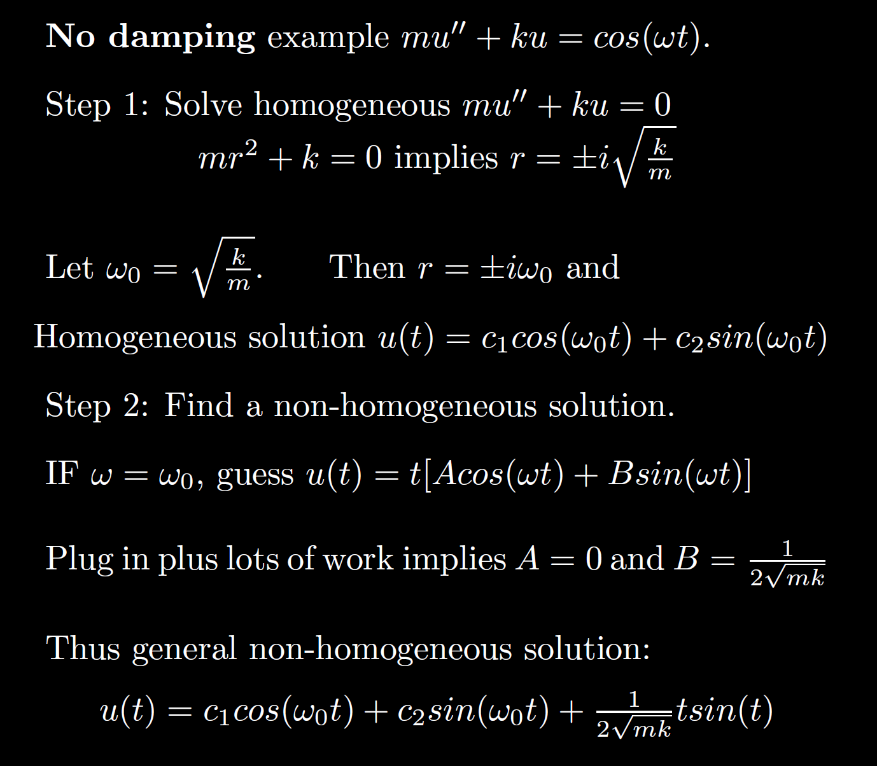
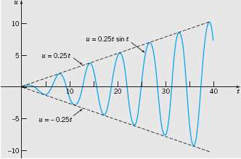
Boyce/DiPrima/Meade 11th ed, Ch 3.8: Forced Periodic Vibrations

Slide 24

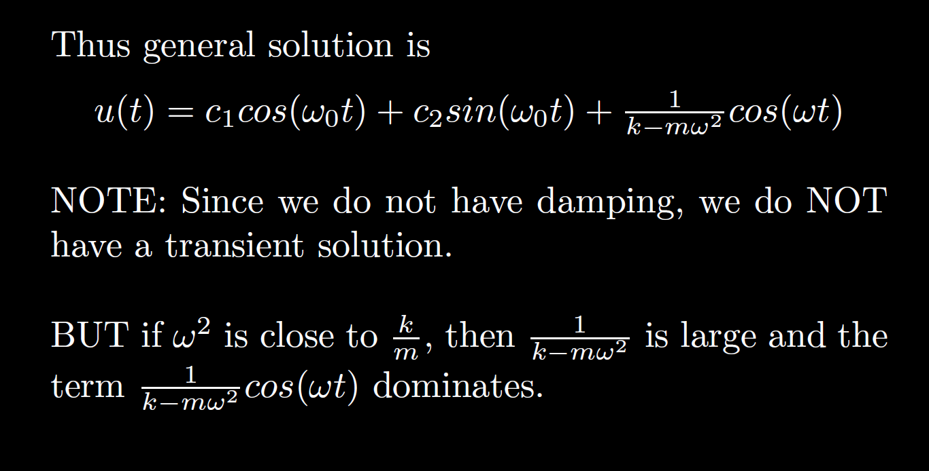

Slide 25
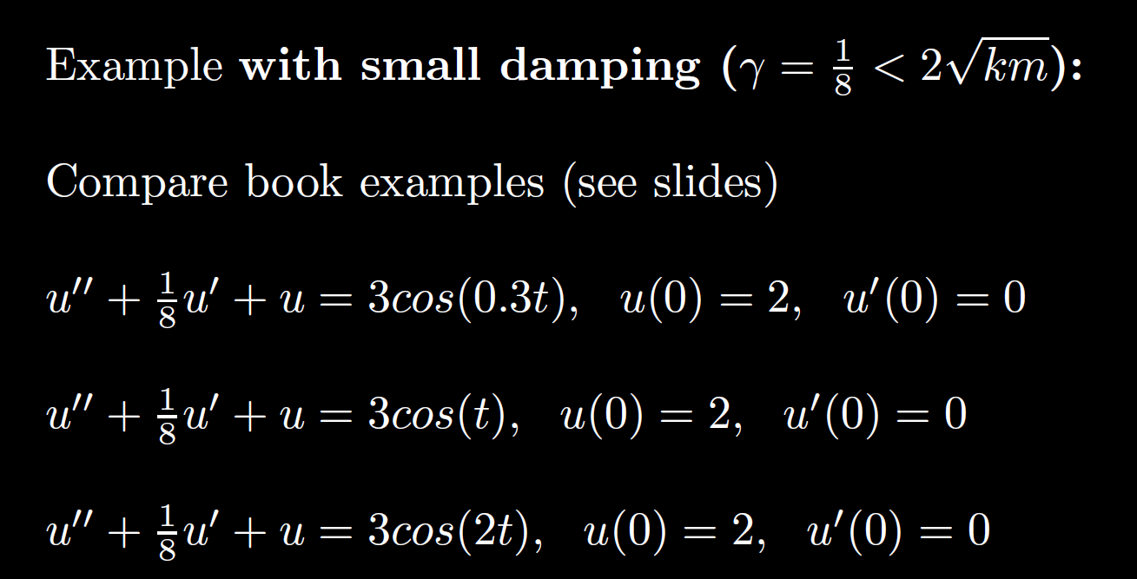

Slide 26
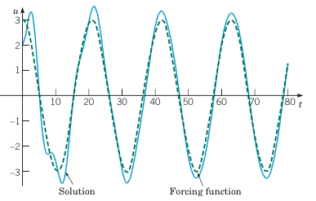
Example 2:
Forced Vibrations with Damping (2 of 4)
Graphs of the solution and external force for .
Boyce/DiPrima/Meade 11th ed, Ch 3.8: Forced Periodic Vibrations

Slide 27
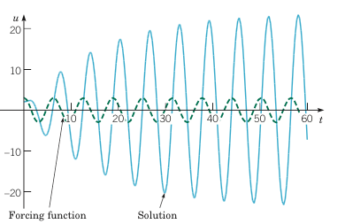
Example 2:
Forced Vibrations with Damping (3 of 4)
Graphs of the solution and external force for
Boyce/DiPrima/Meade 11th ed, Ch 3.8: Forced Periodic Vibrations

Slide 28
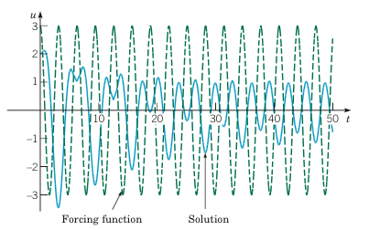
Example 2:
Forced Vibrations with Damping (4 of 4)
Graphs of the solution and external force for
Boyce/DiPrima/Meade 11th ed, Ch 3.8: Forced Periodic Vibrations

Slide 29
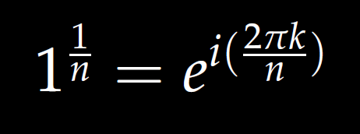


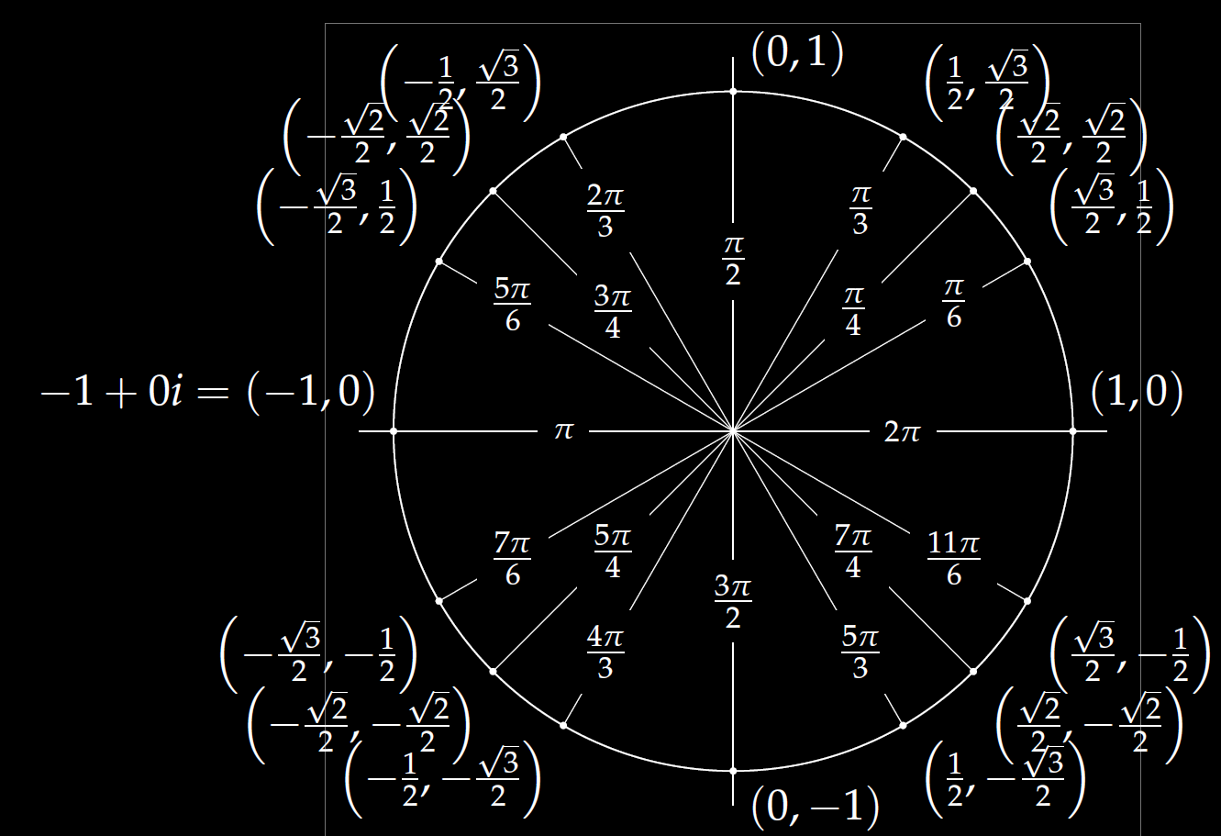
Roots of unity
r^{n} = 1

Slide 30
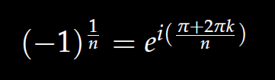

We will also solve
r^{n} = -1

Slide 31


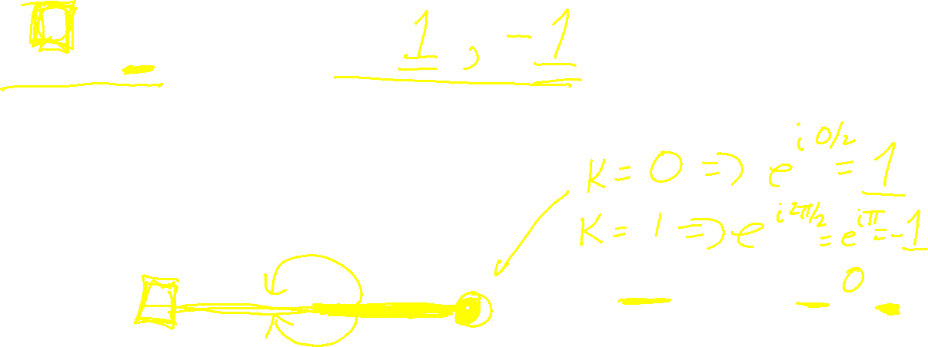


$r^{2}=$ 1 implies r =
$$1^{1/2}=ⅇ^{ⅈ\left(2πk/2\right)}$$
Roots of unity
r^{n} = 1

Slide 32


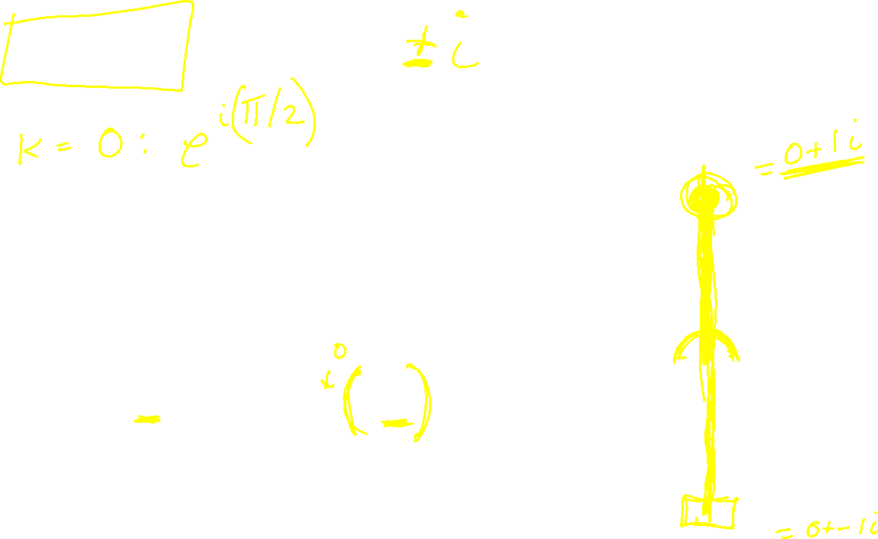
$r^{2}=$ -1 implies r =
$${(−1)}^{1/2}=ⅇ^{ⅈ\left(1+2k\right)π/2}$$

Slide 33

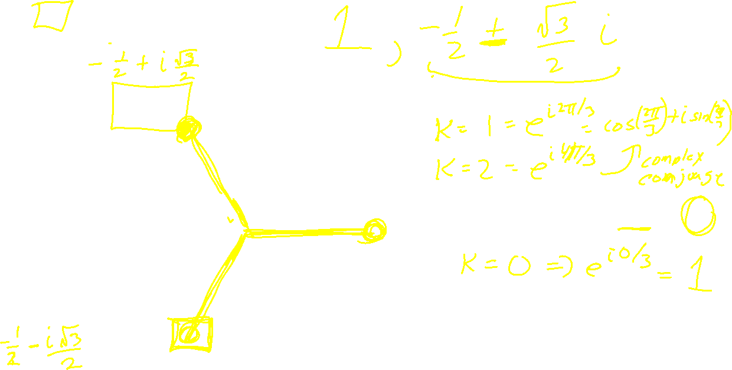

$r^{3}=$ 1 implies r =
$$1^{1/3}=ⅇ^{ⅈ\left(2πk/3\right)}$$
Roots of unity
r^{n} = 1

Slide 34


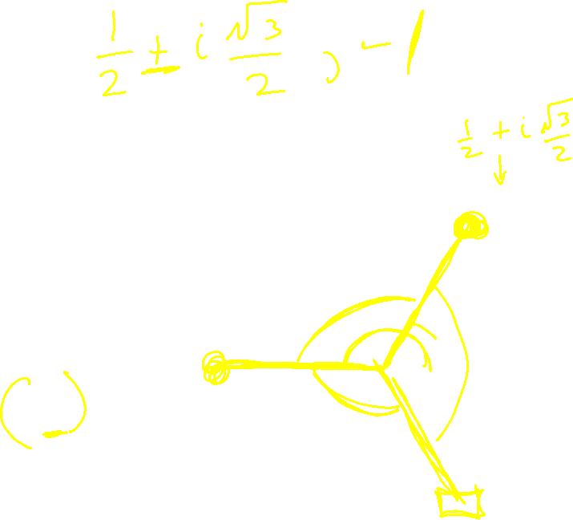
$r^{3}=$ -1 implies r =
$${(−1)}^{1/3}=ⅇ^{ⅈ\left(1+2k\right)π/3}$$

Slide 35


$r^{4}=$ 1 implies r =
$$1^{1/4}=ⅇ^{ⅈ\left(2πk/4\right)}$$
Roots of unity
r^{n} = 1

Slide 36


$r^{4}=$ -1 implies r =
$${(−1)}^{1/4}=ⅇ^{ⅈ\left(1+2k\right)π/4}$$

Slide 37
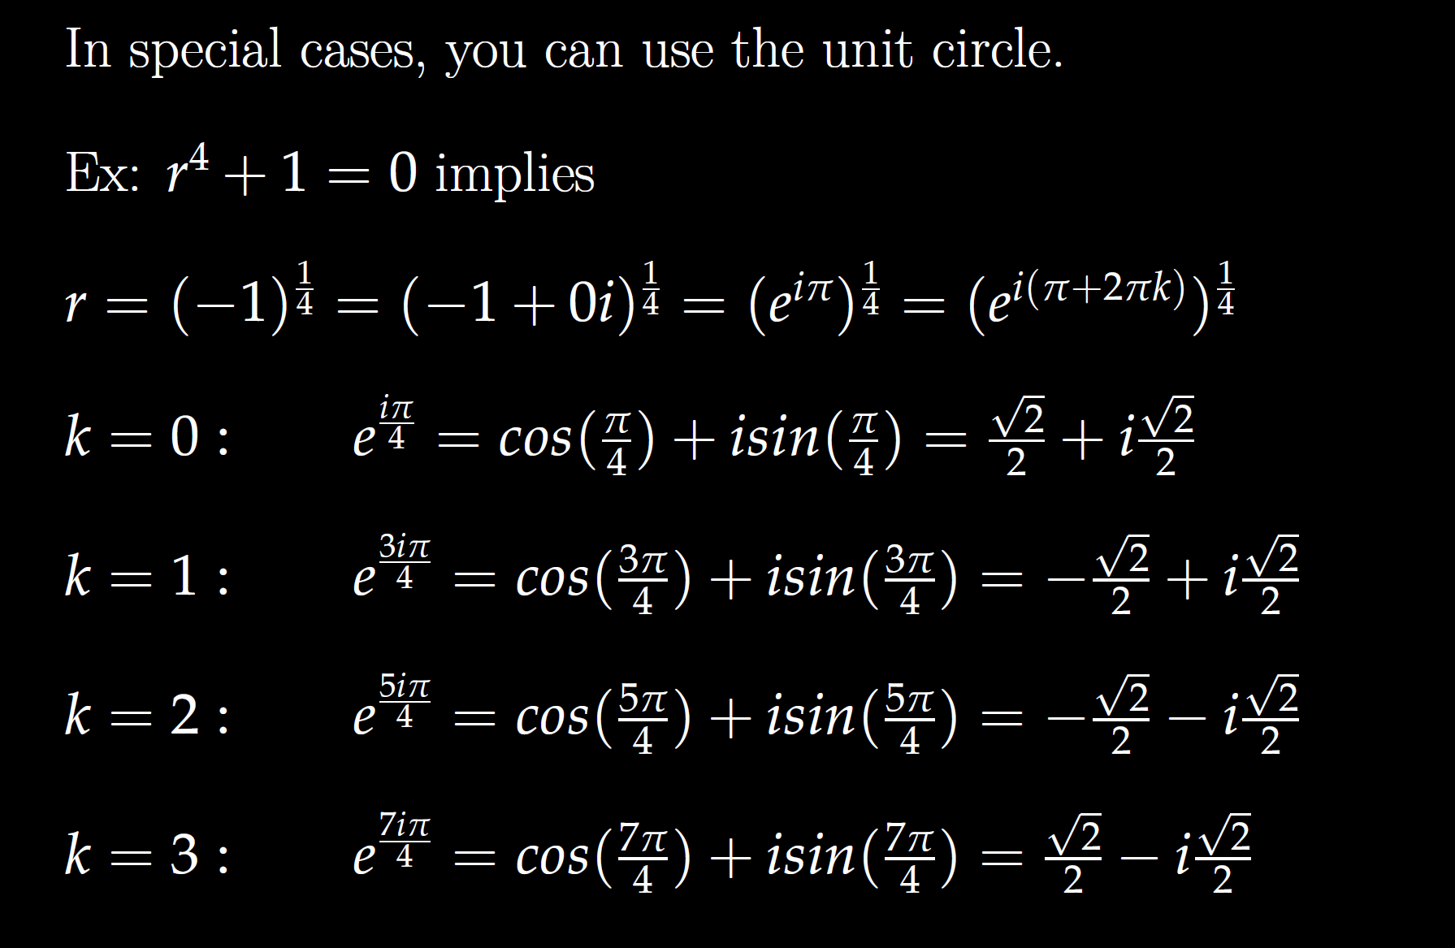

Slide 38
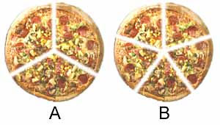


$r^{5}=$ 1 implies r =
$$1^{1/5}=ⅇ^{ⅈ\left(2πk/5\right)}$$
Roots of unity
r^{n} = 1

Slide 39


$r^{5}=$ -1 implies r =
$${(−1)}^{1/5}=ⅇ^{ⅈ\left(1+2k\right)π/5}$$

Slide 40
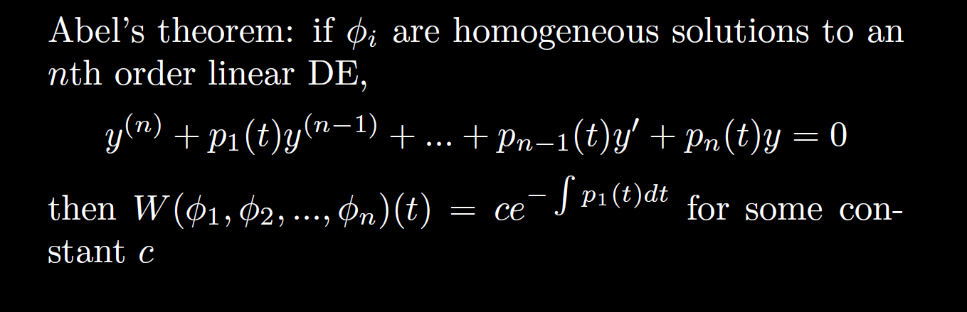

Slide 41
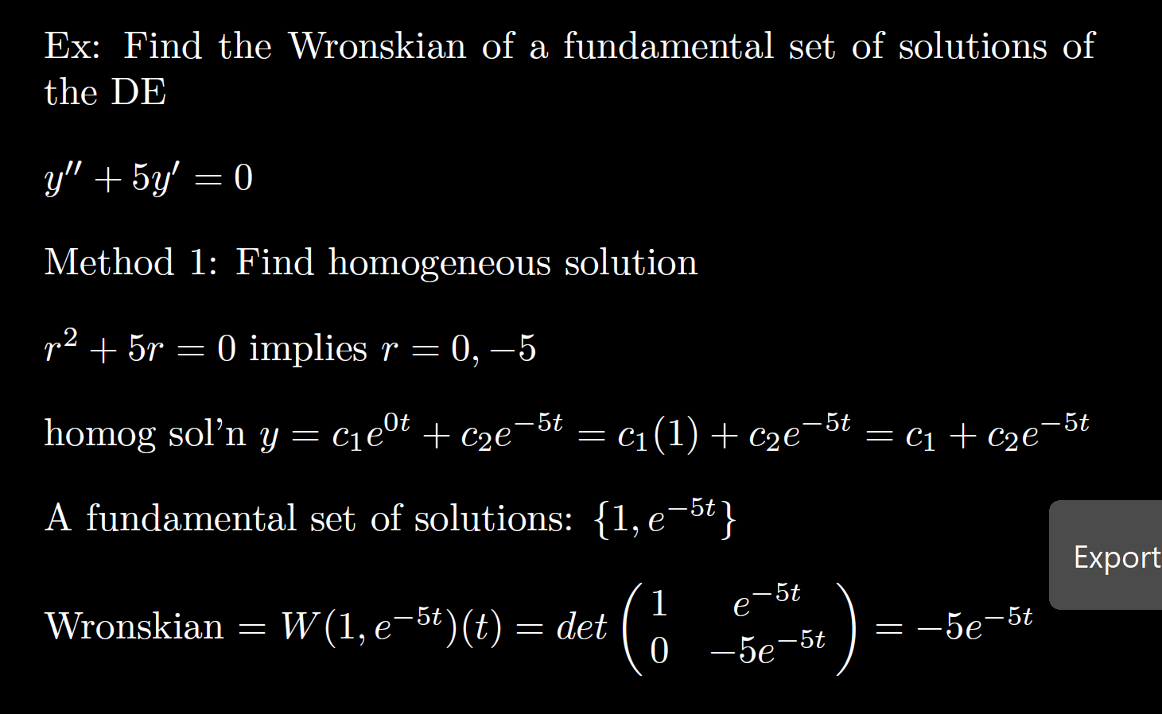

Slide 42
