Slide 1
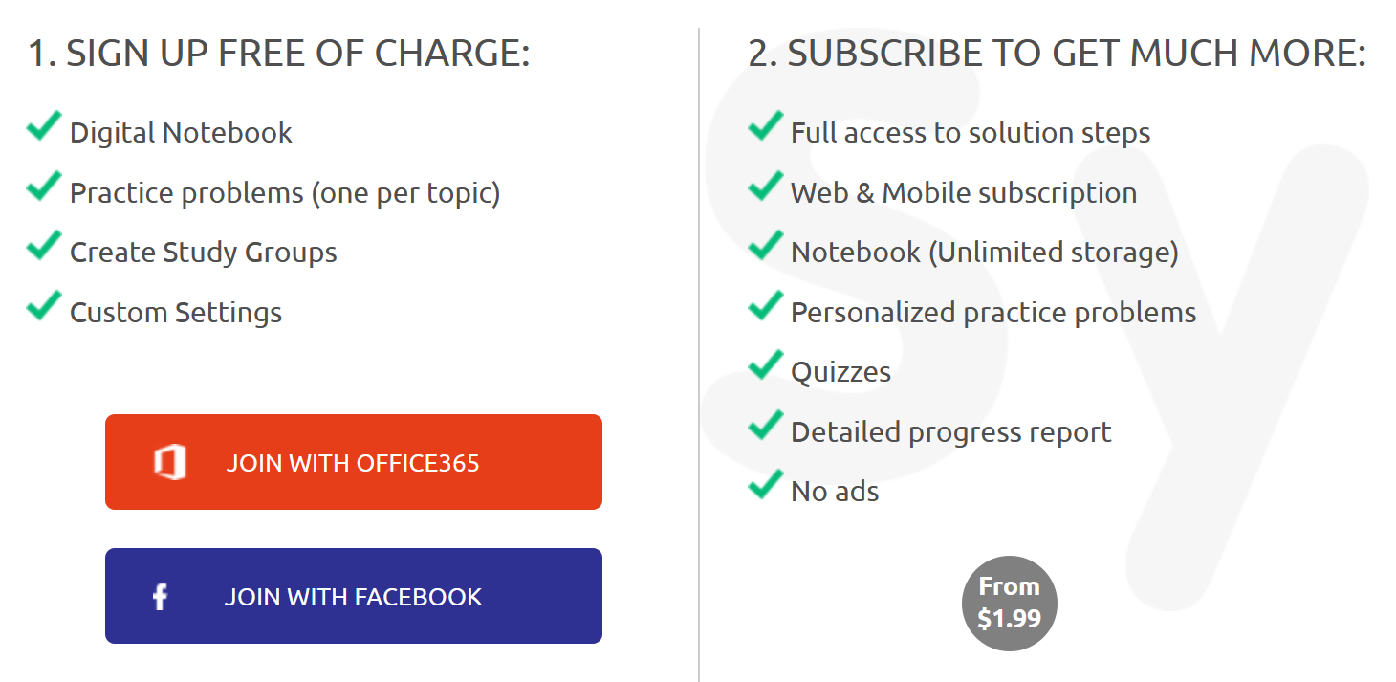
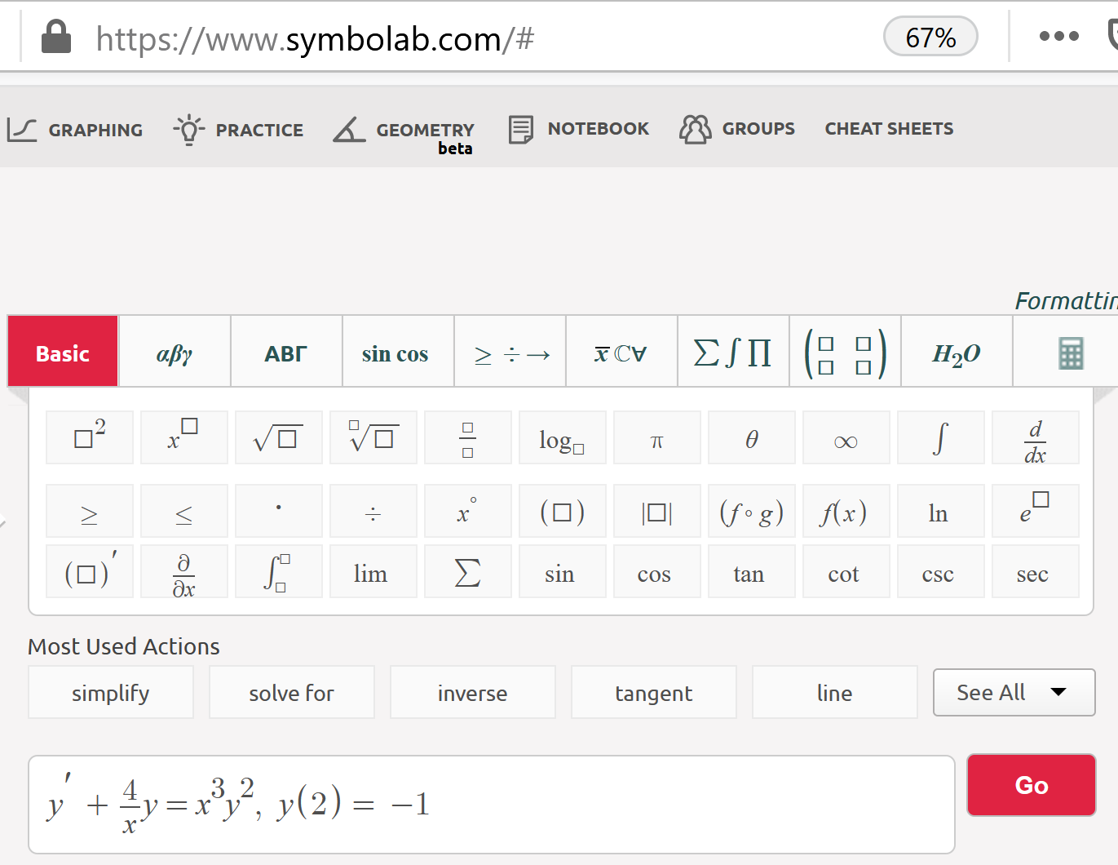
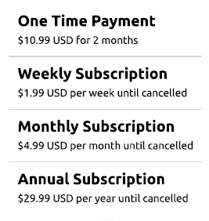
www.symbolab.com
Some steps shown in free version
Note: I am not recommending symbolab, but wanted to let you know it exists.

Slide 2
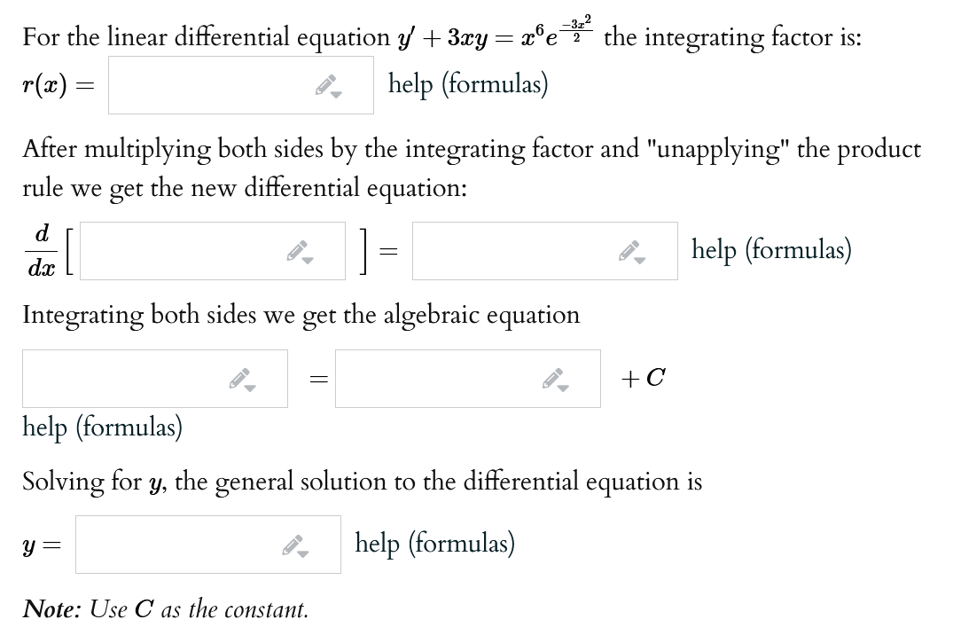
https://edfinity.com (cost = $32, see Icon announcement)
Note: I am not recommending edfinity, but wanted to let you know it exists.

Slide 3
Wednesday’s exam 1
1.) Log into zoom.
You can use the chat to text me questions anytime during the exam.
I will post messages to slide if there are multiple similar questions.
Do NOT log off until I have checked your upload.
2.) Log into ICON and take the exam. ICON will log you out of the exam after 50 minutes. If you have issues with uploading the written part of your exam, you can e-mail me.
3.) Written part: Two 10 point questions = 20 points.
Multiple choice: Six multiple choice questions = 30 points.

Slide 4
Numerical answer question:

Slide 5
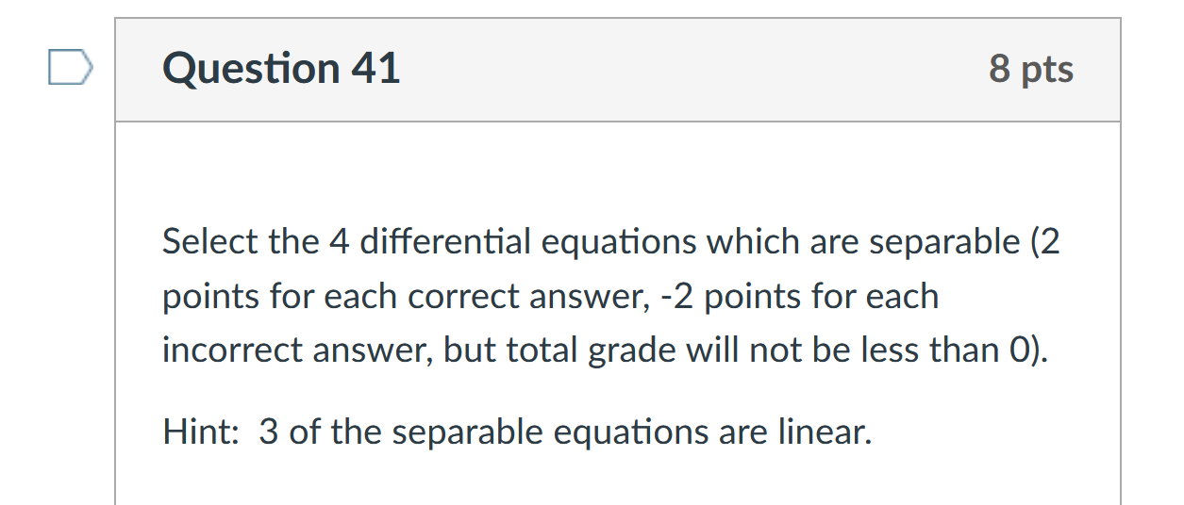
Multiple answer question:

Slide 6
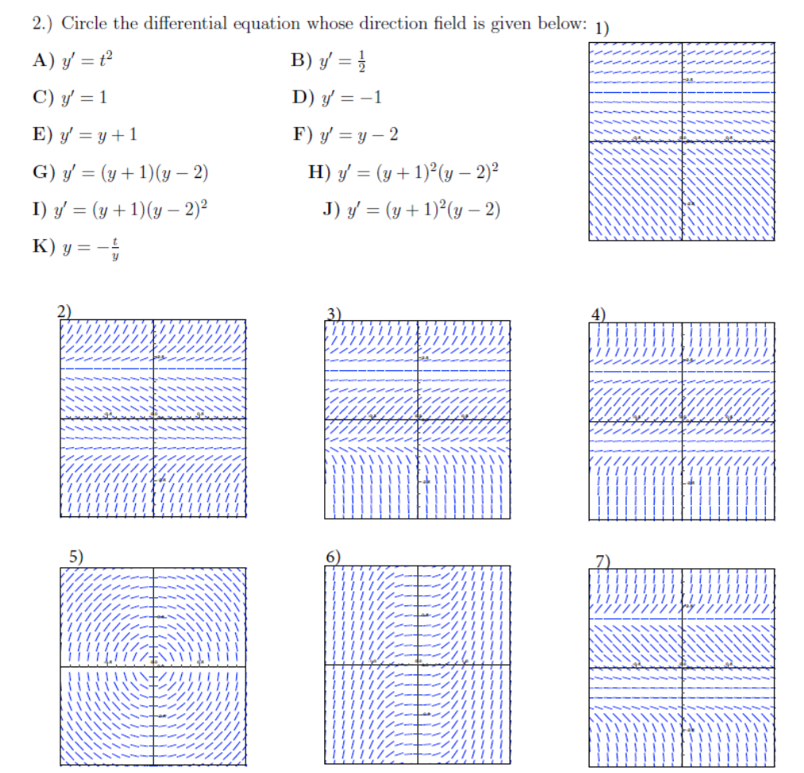
Matching:

Slide 15
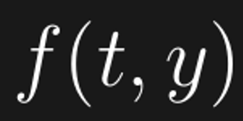

Slide 19
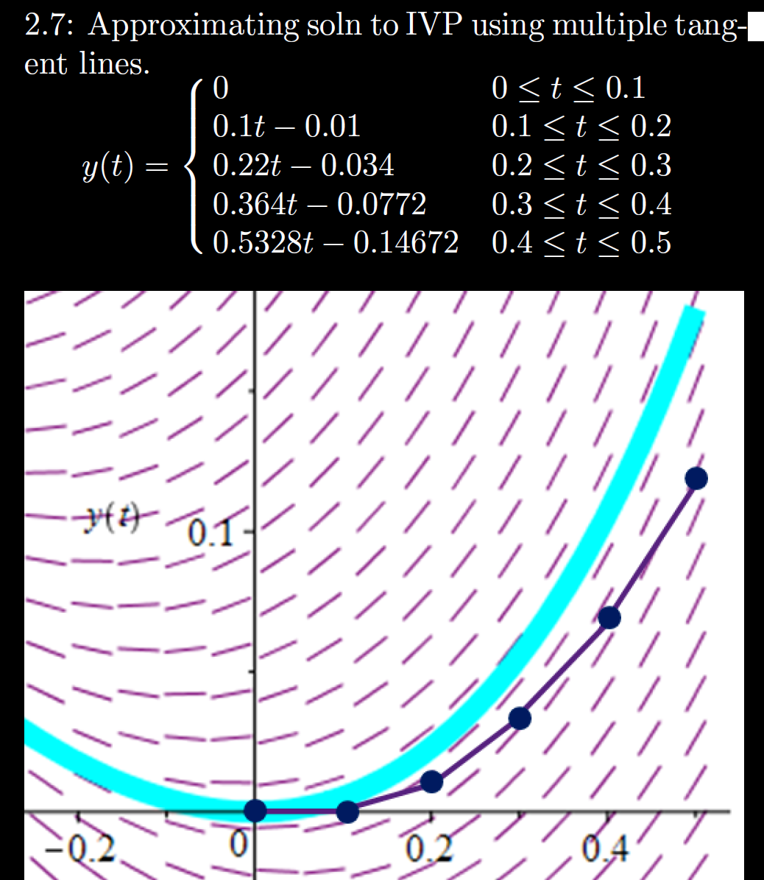
h = Step size
= Δt = 0.1

