Slide 1
Chapter 7: Systems of
Linear DE

Slide 2
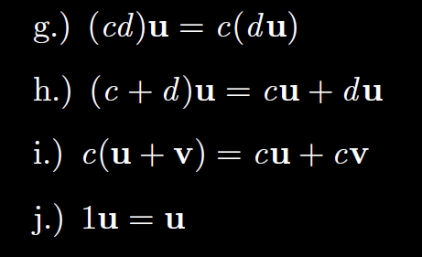

Slide 5
