Slide 2
Example: y‘’ + 2y’ + 10y = 0

Slide 4
General solution of 2nd order Linear Homogenous DE is a linear combination of 2 linearly independent functions (which are solutions).

Slide 5
Recall from matrix algebra that Ax = b is a homogeneous equation iff b = 0.
Suppose A has 2 free variables. Then the general solution to the homogenous matrix equation Ax = 0 will be of the form
x =c₁v₁ + c₂v₂.

Slide 6
Recall from matrix algebra that Ax = b is a homogeneous equation iff b = 0.
Suppose A has 2 free variables. Then the general solution to the homogenous matrix equation Ax = 0 will be of the form
x =c₁v₁ + c₂v₂.

Slide 13
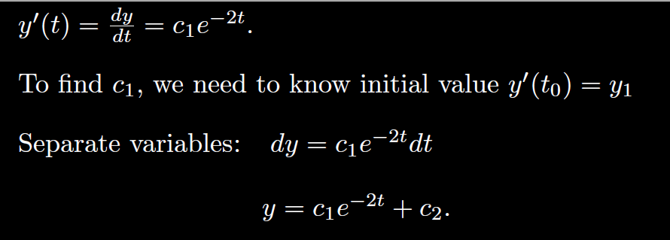

Slide 18
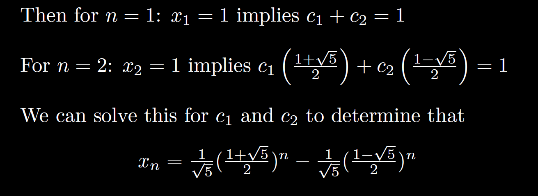

Slide 26
From office hours:

Slide 30
Don’t forget to multiply the entire sides when multiplying both
sides by a quantity:
Example: y’ + y = t is linear but not separable
Cannot separate variables

