Slide 1







Slide 2
Example: y‘’ + 2y’ + 10y = 0

Slide 3
Example: y‘’ + 2y’ + 10y = 0

Slide 4
General solution of 2nd order Linear Homogenous DE is a linear combination of 2 linearly independent functions (which are solutions).

Slide 5
Recall from matrix algebra that Ax = b is a homogeneous equation iff b = 0.
Suppose A has 2 free variables. Then the general solution to the homogenous matrix equation Ax = 0 will be of the form
x =c₁v₁ + c₂v₂.

Slide 6
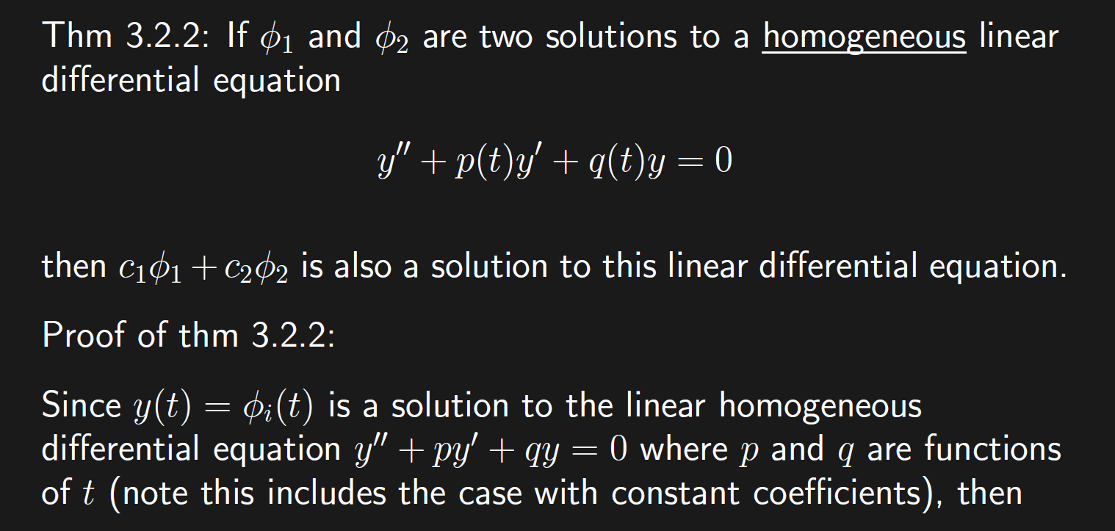
Recall from matrix algebra that Ax = b is a homogeneous equation iff b = 0.
Suppose A has 2 free variables. Then the general solution to the homogenous matrix equation Ax = 0 will be of the form
x =c₁v₁ + c₂v₂.

Slide 8
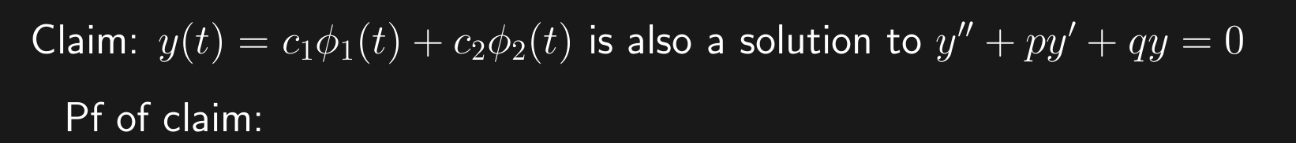

Slide 9
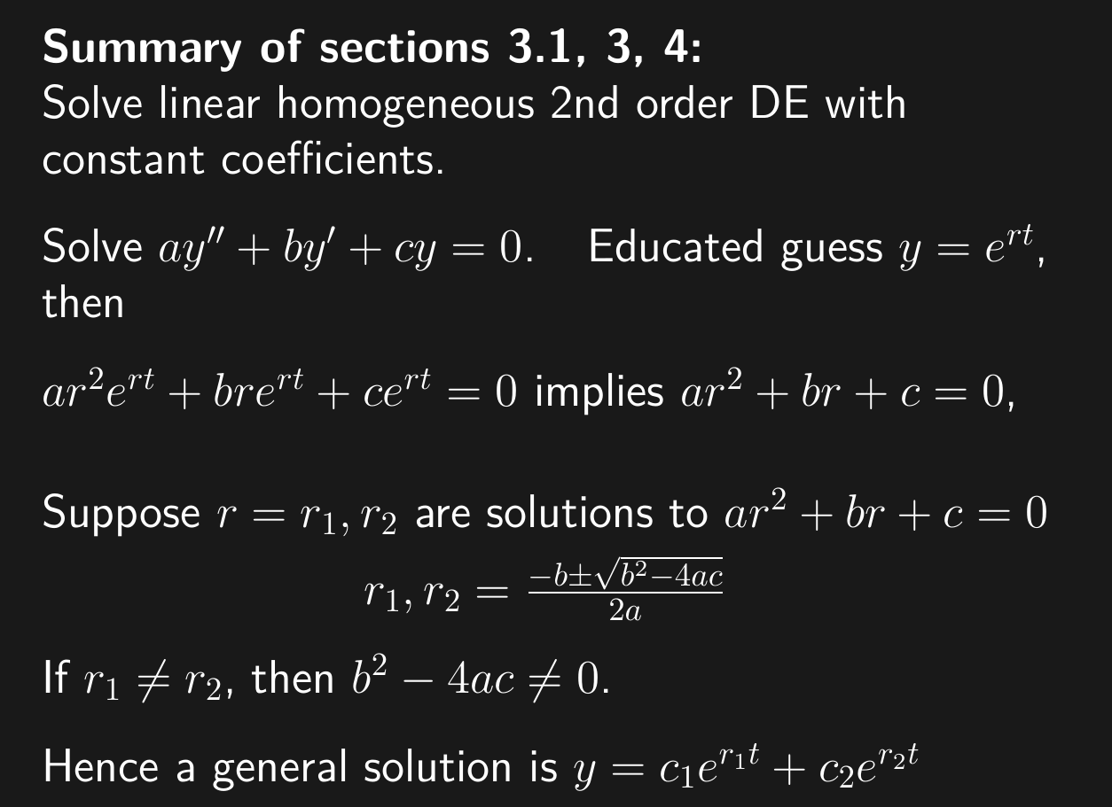

Slide 10
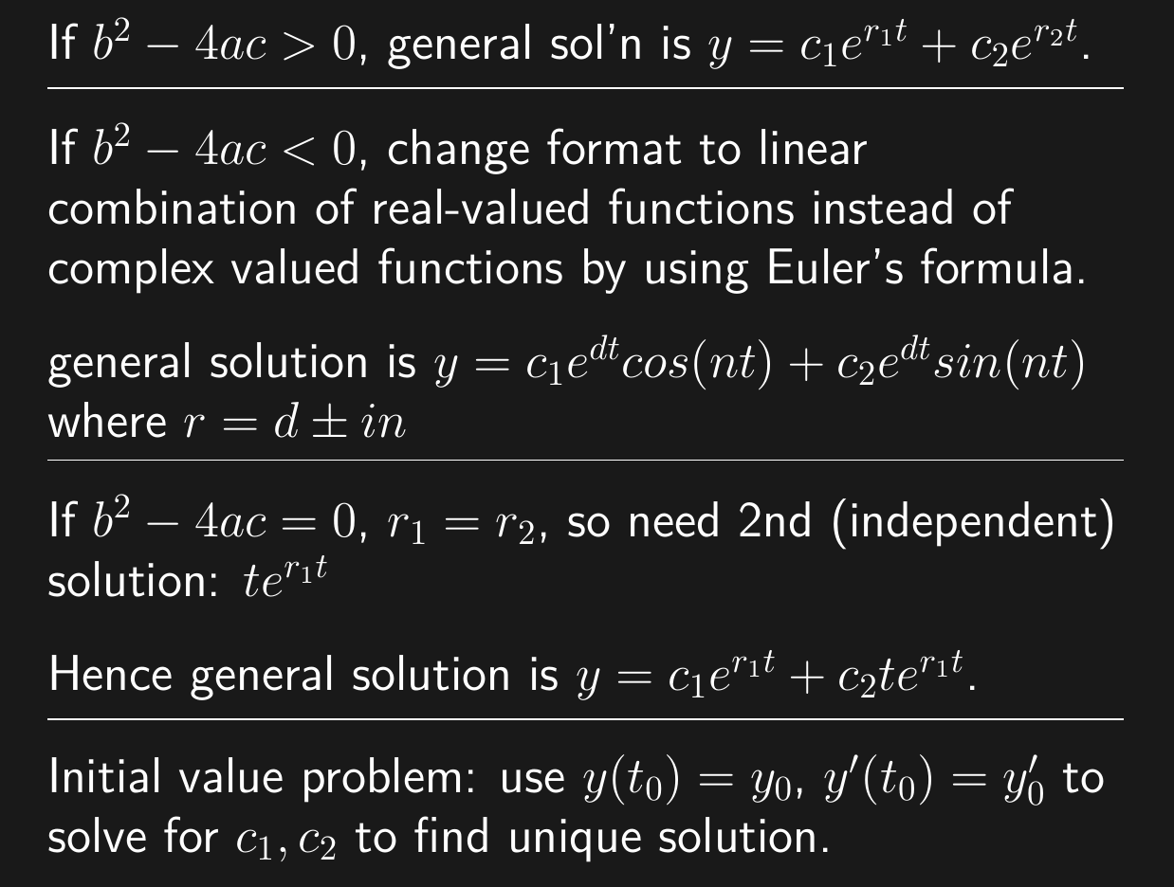

Slide 11
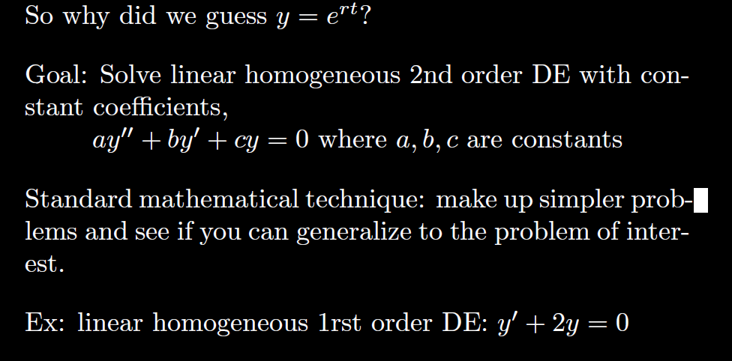

Slide 12
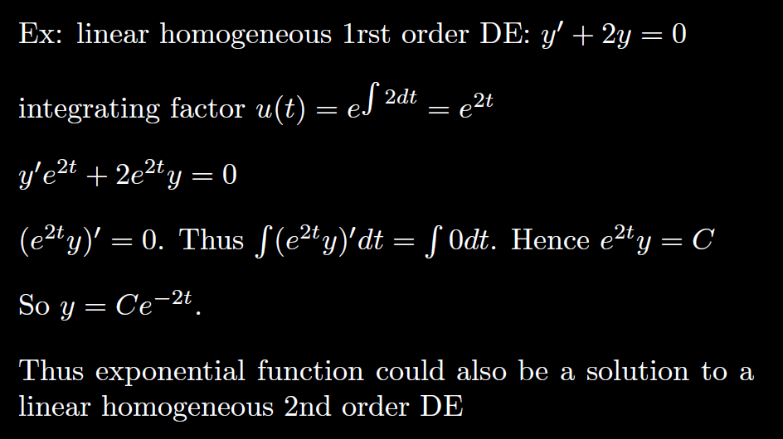

Slide 13
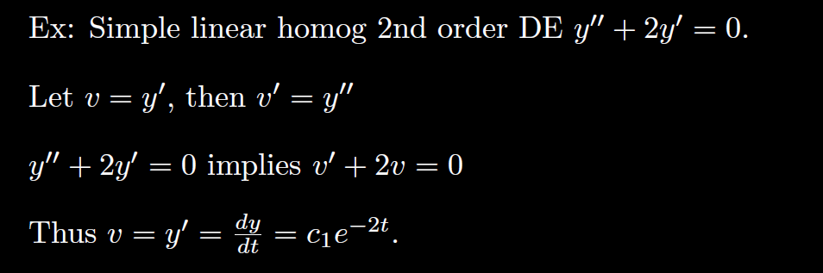
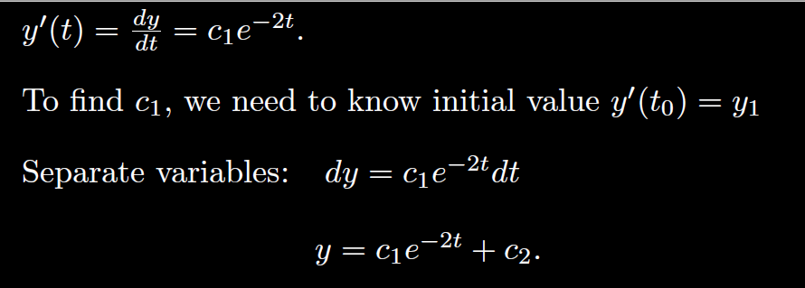

Slide 14
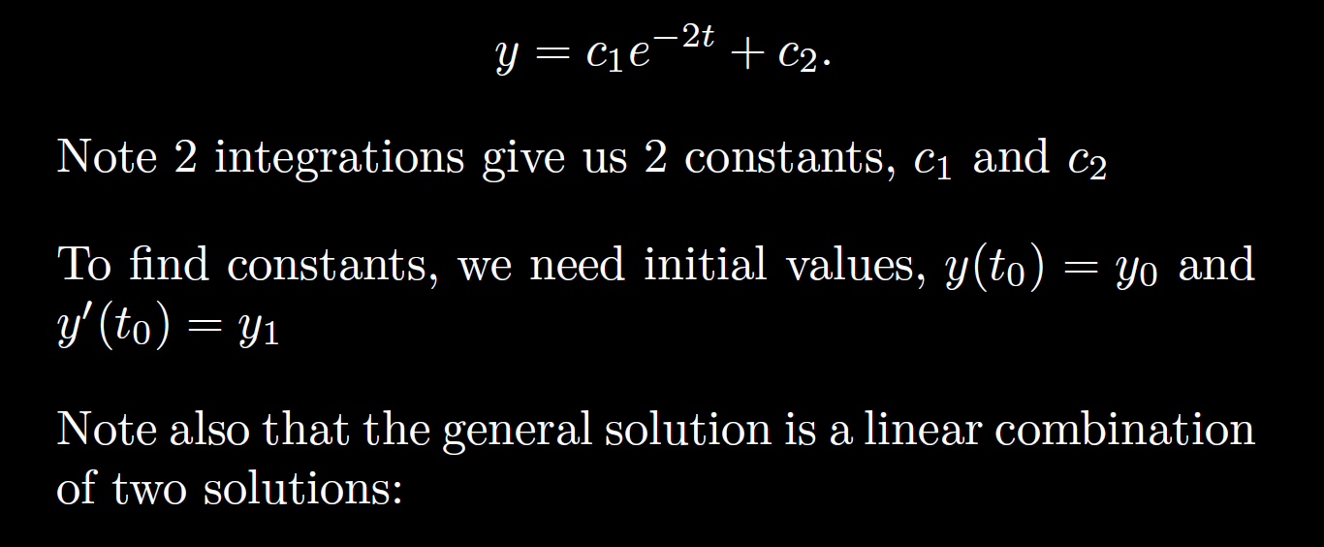
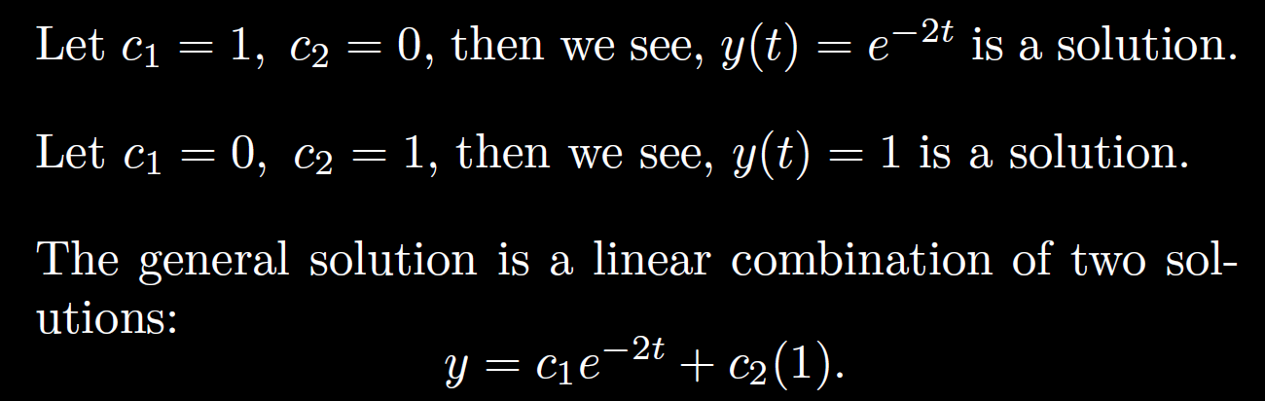

Slide 15
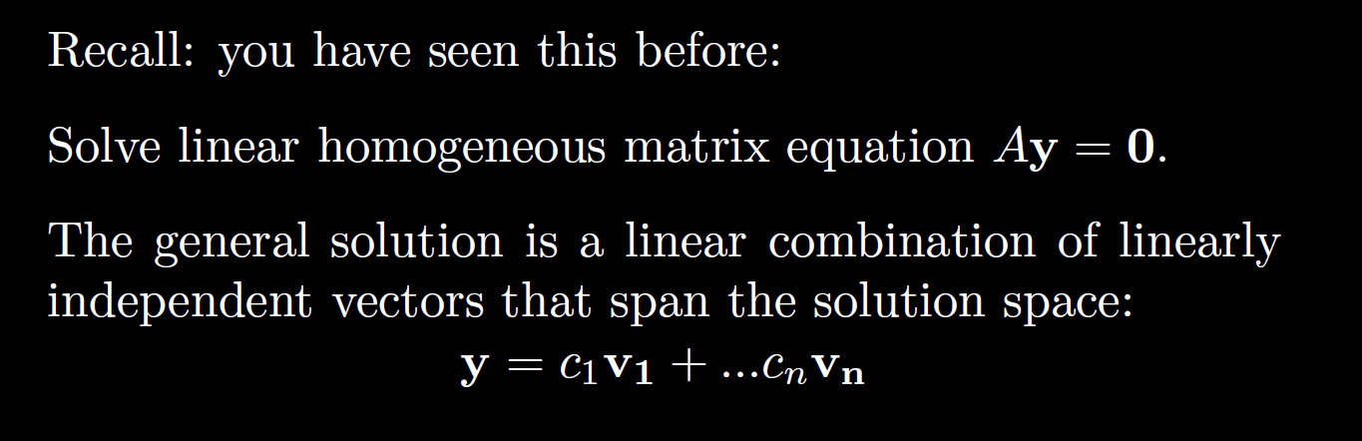

Slide 16
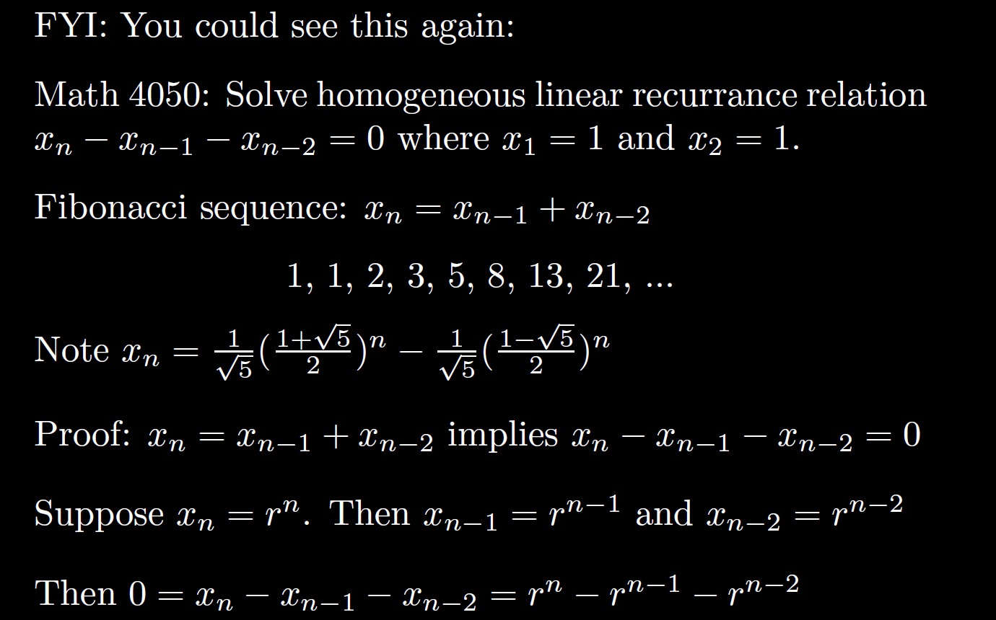

Slide 17
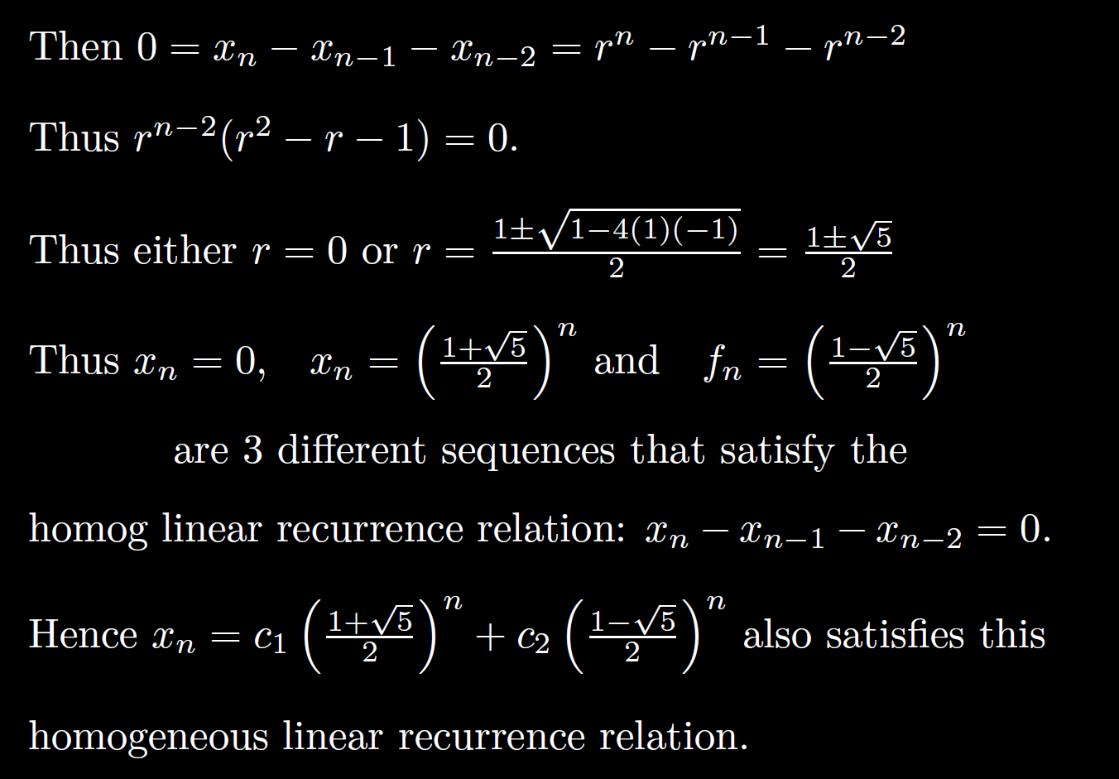

Slide 18
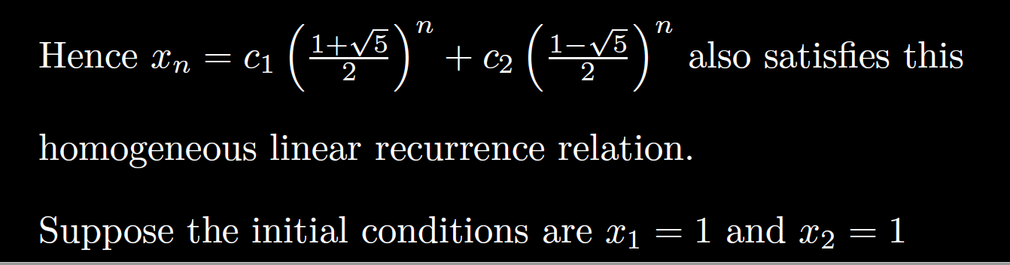
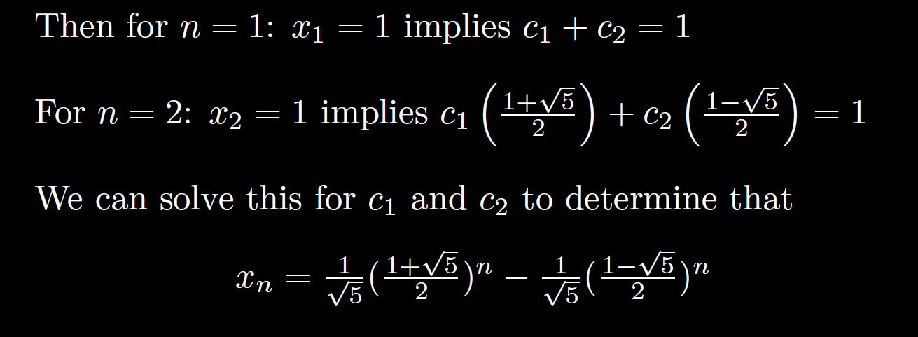

Slide 19
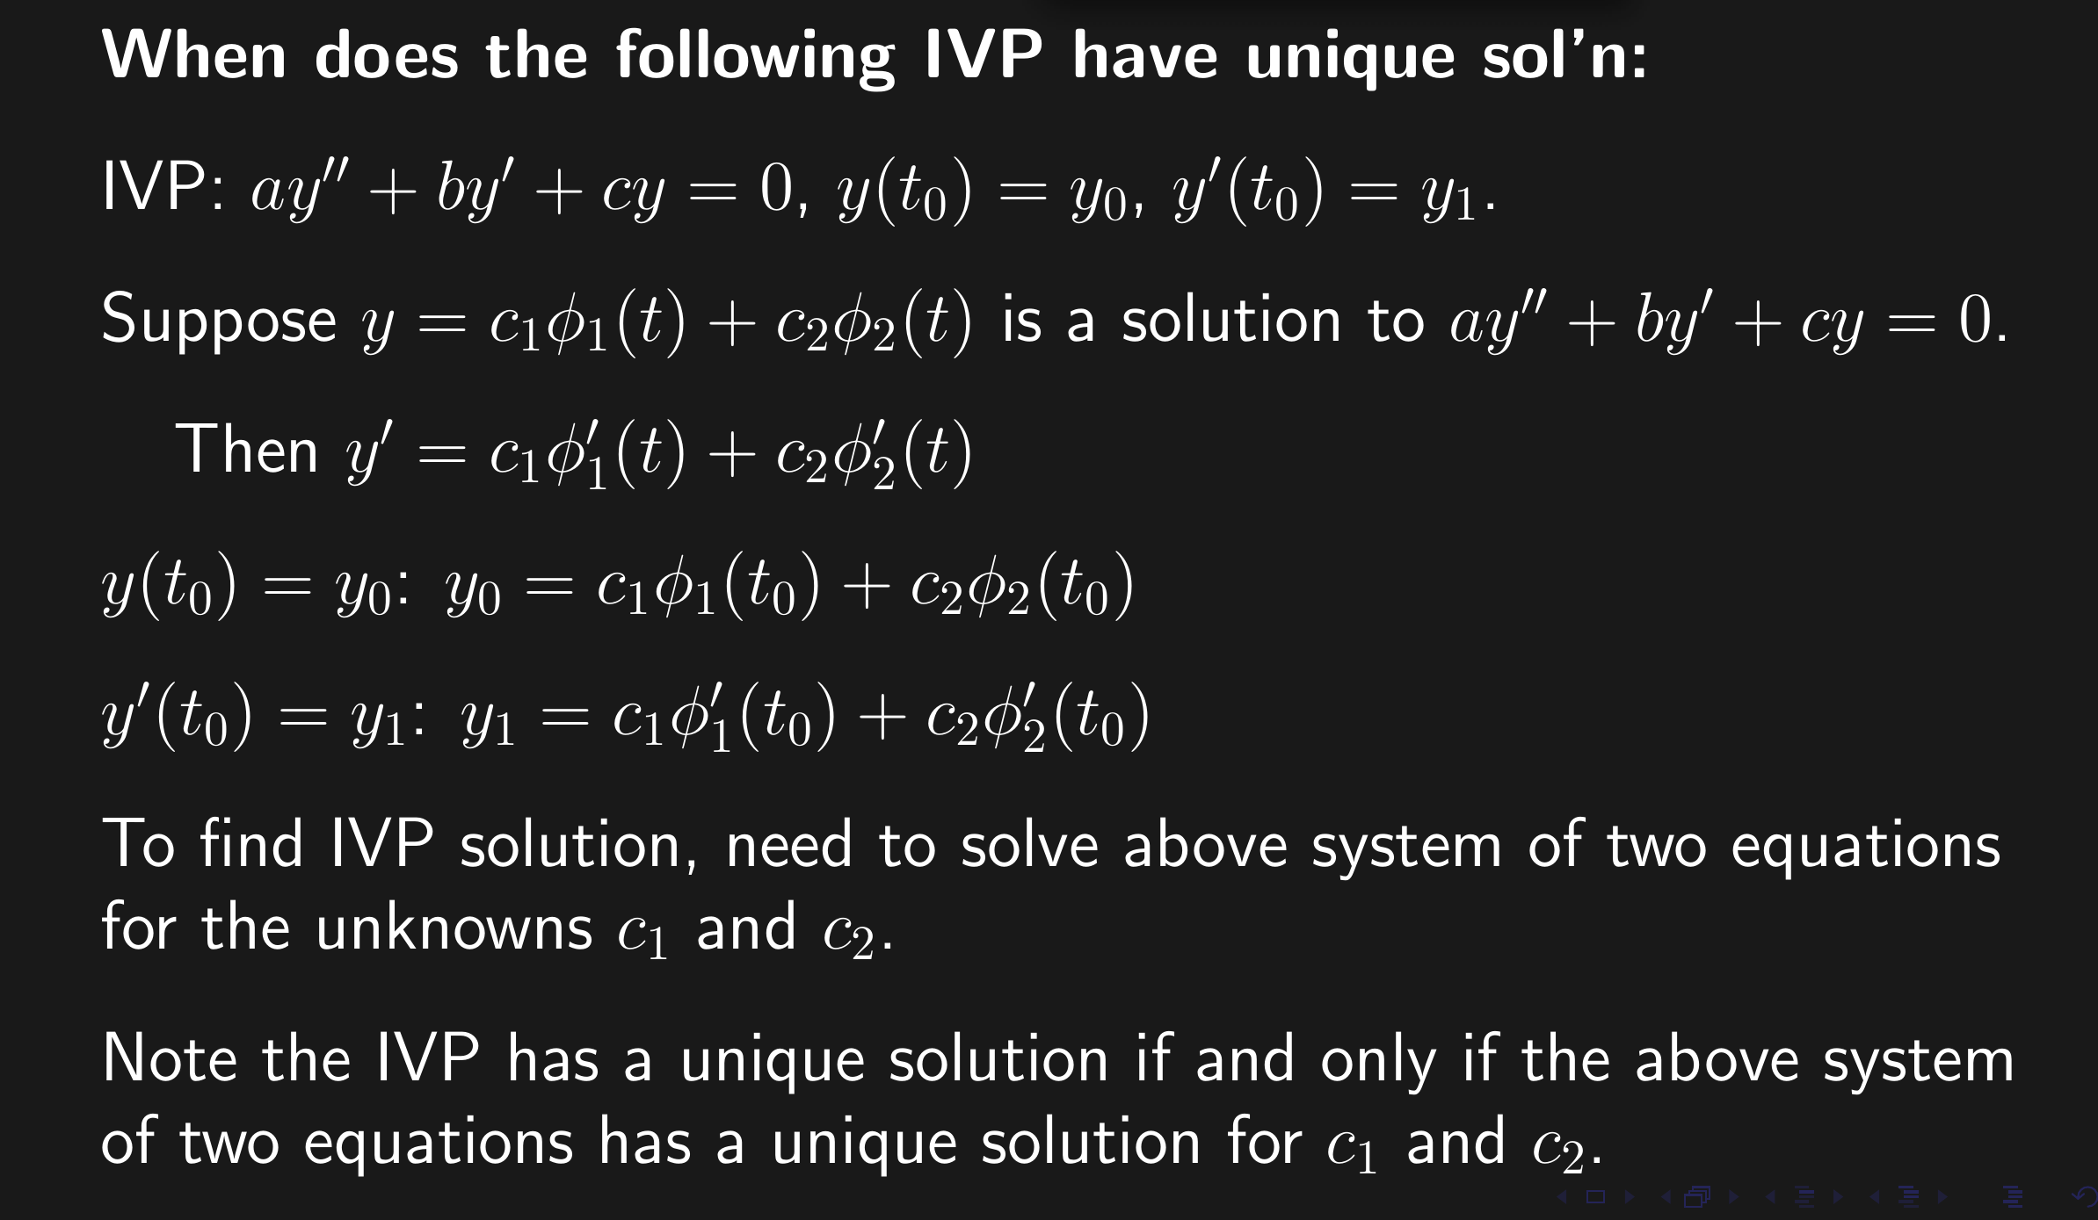

Slide 20
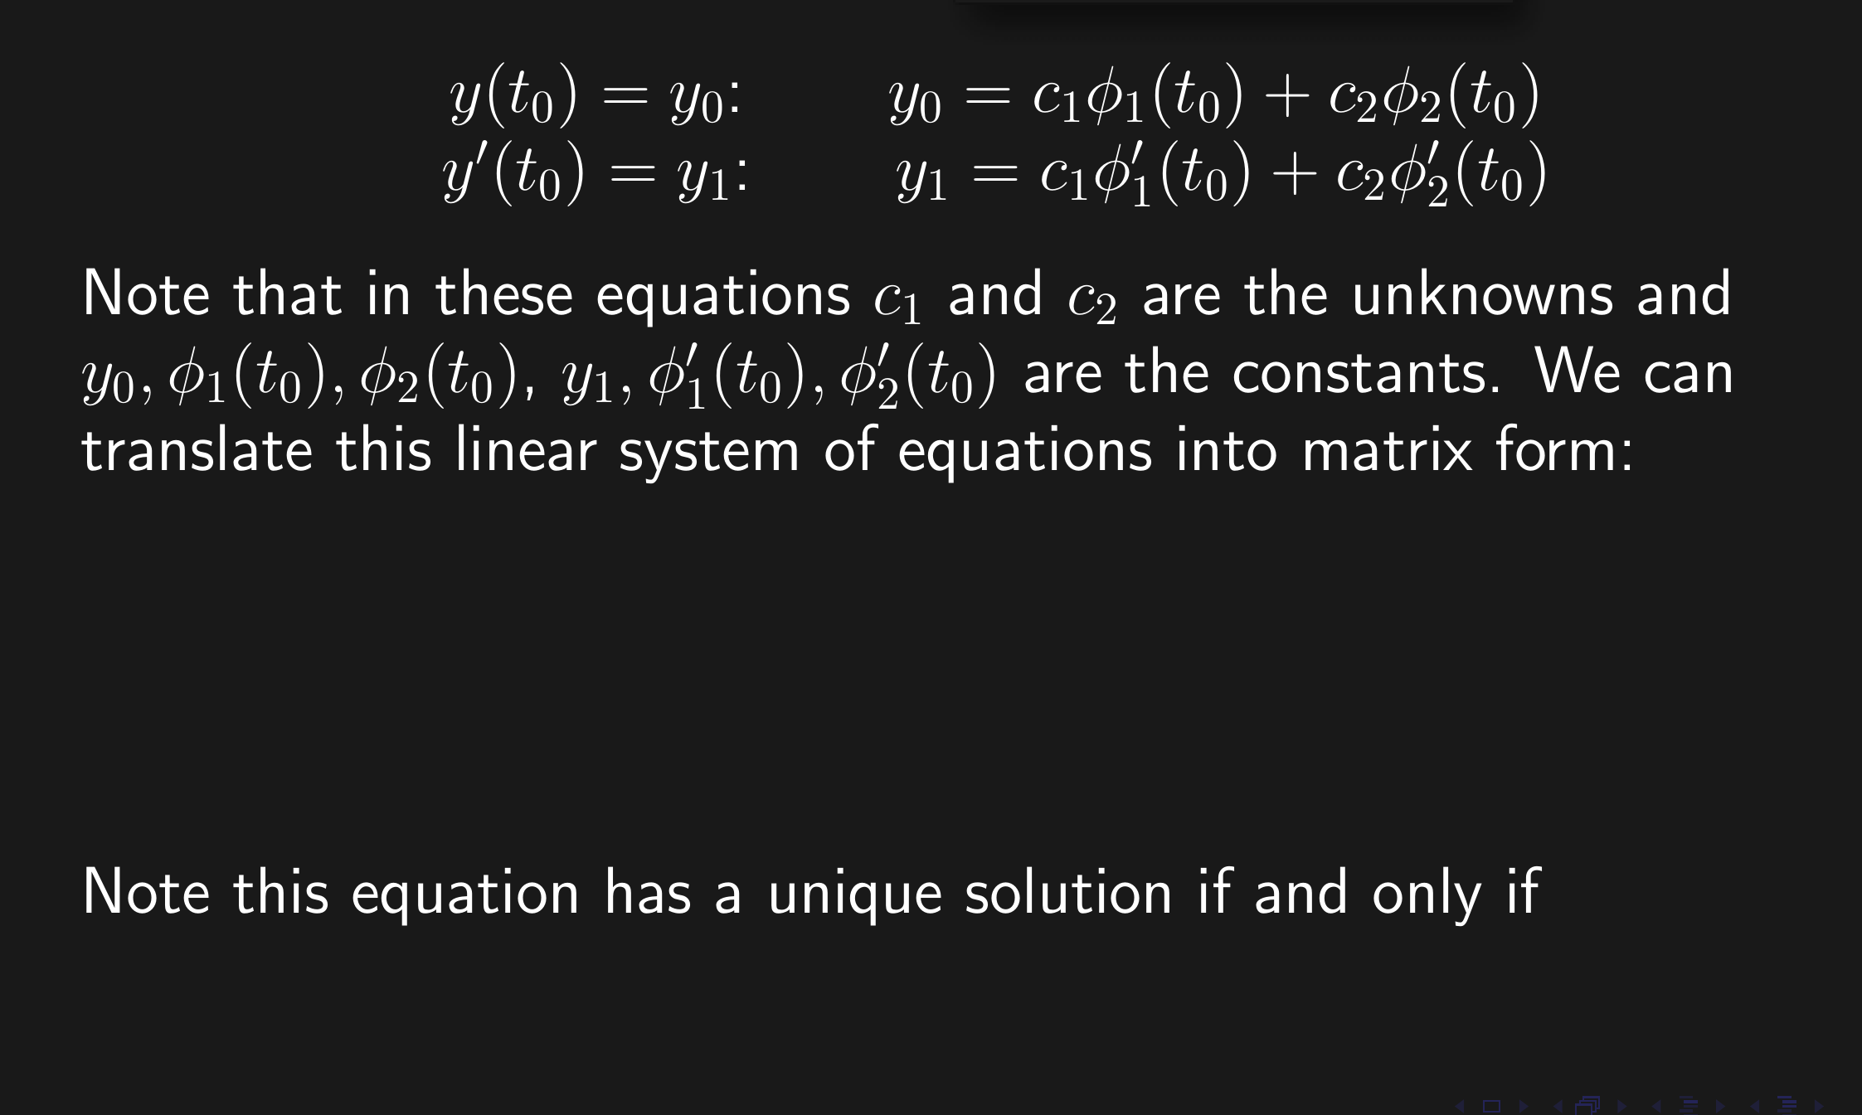

Slide 21
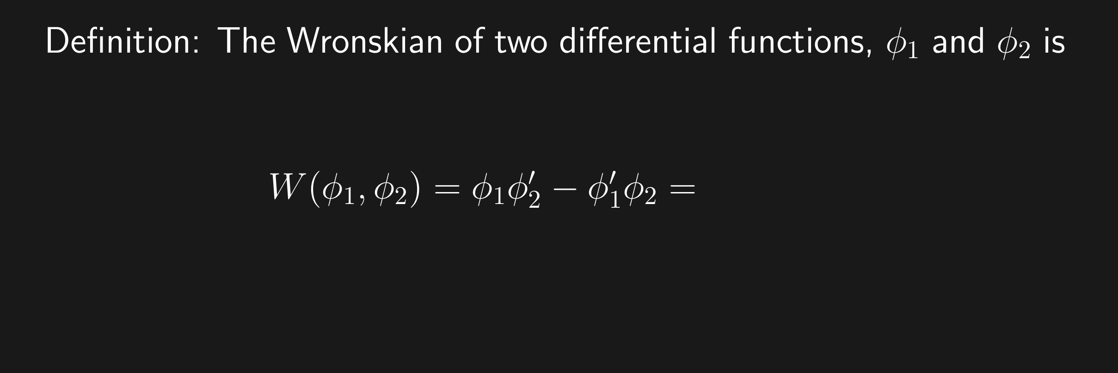

Slide 22
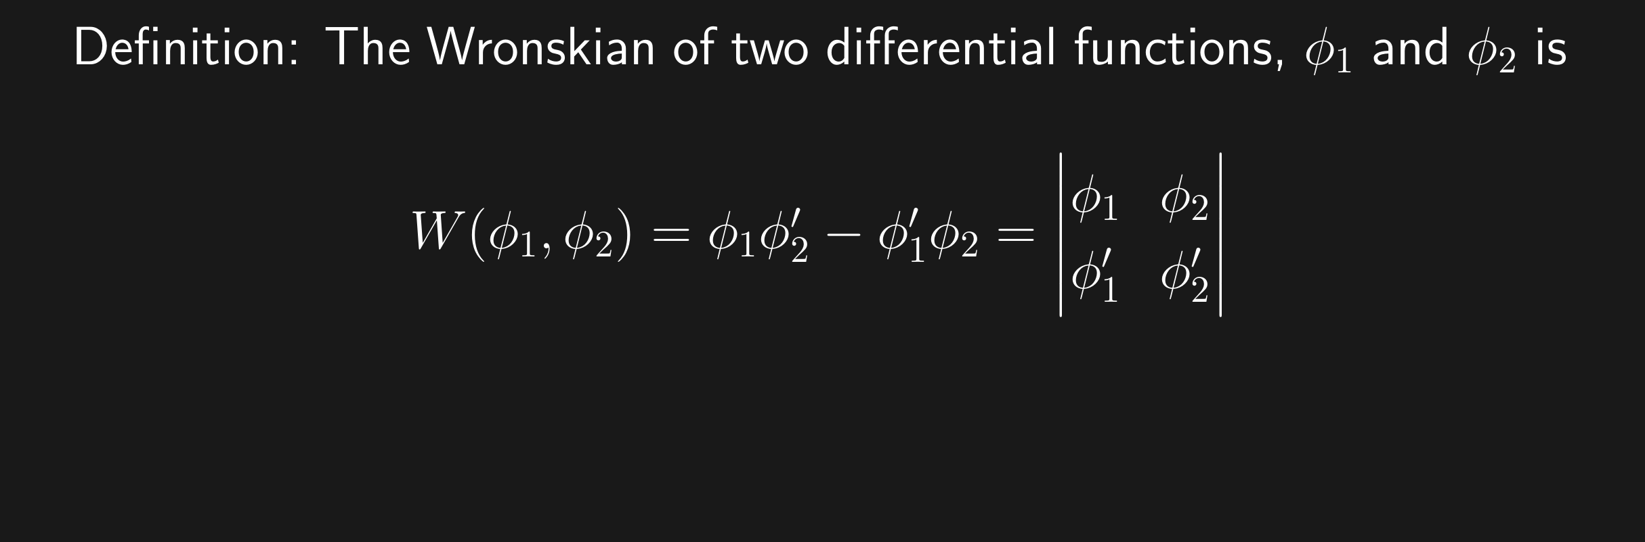

Slide 23
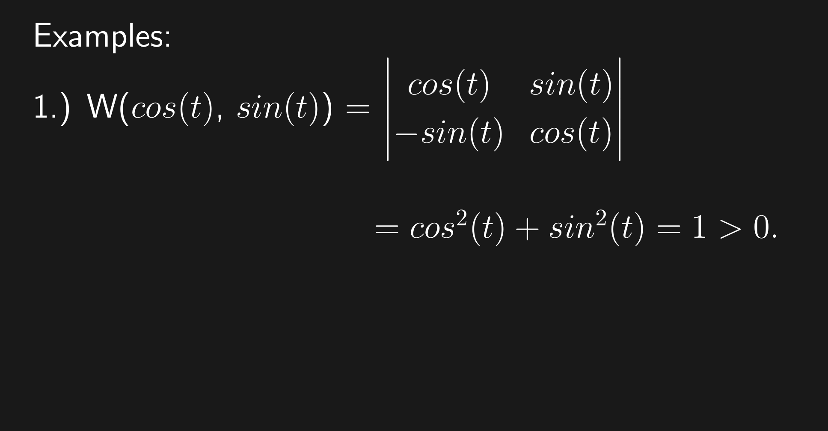

Slide 25
