Slide 1
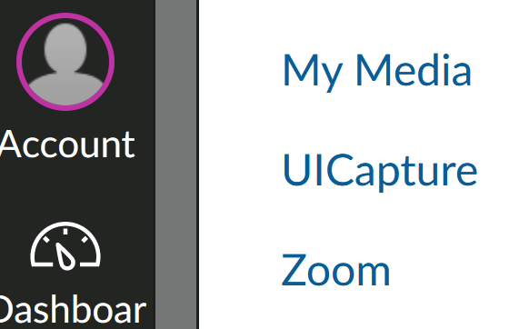
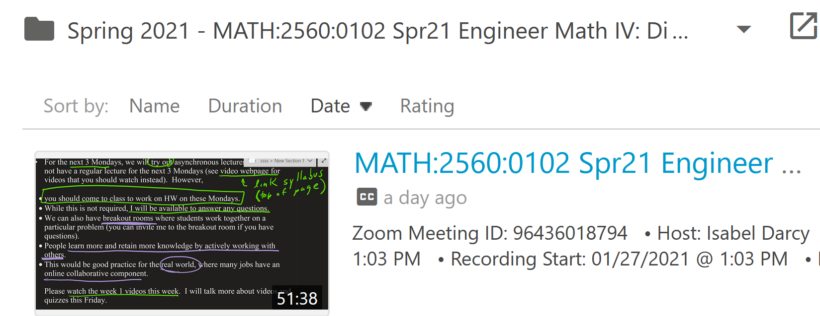
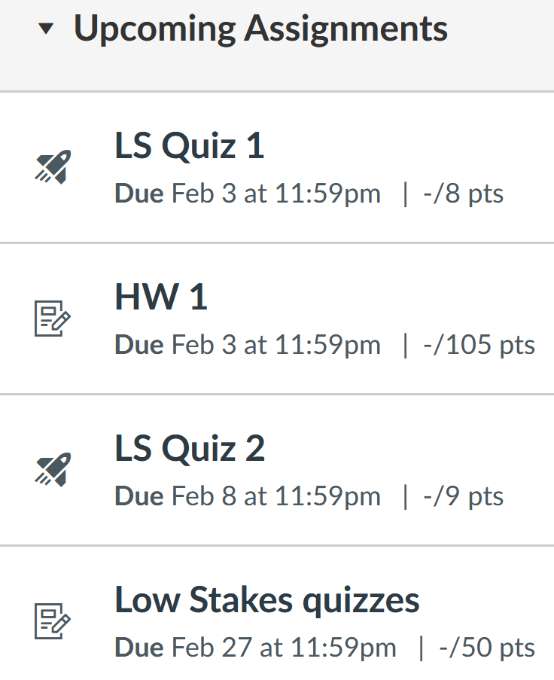

Slide 2
But you only need to earn 60% on the "Low stakes quizzes" assignment group in order to earn 100% on this assignment. Since you can redo the multiple choice quiz questions in the review quiz (where the later quiz allows unlimited attempts), everyone can earn 100% on this assignment even if you miss most of the questions on first try.

Slide 4
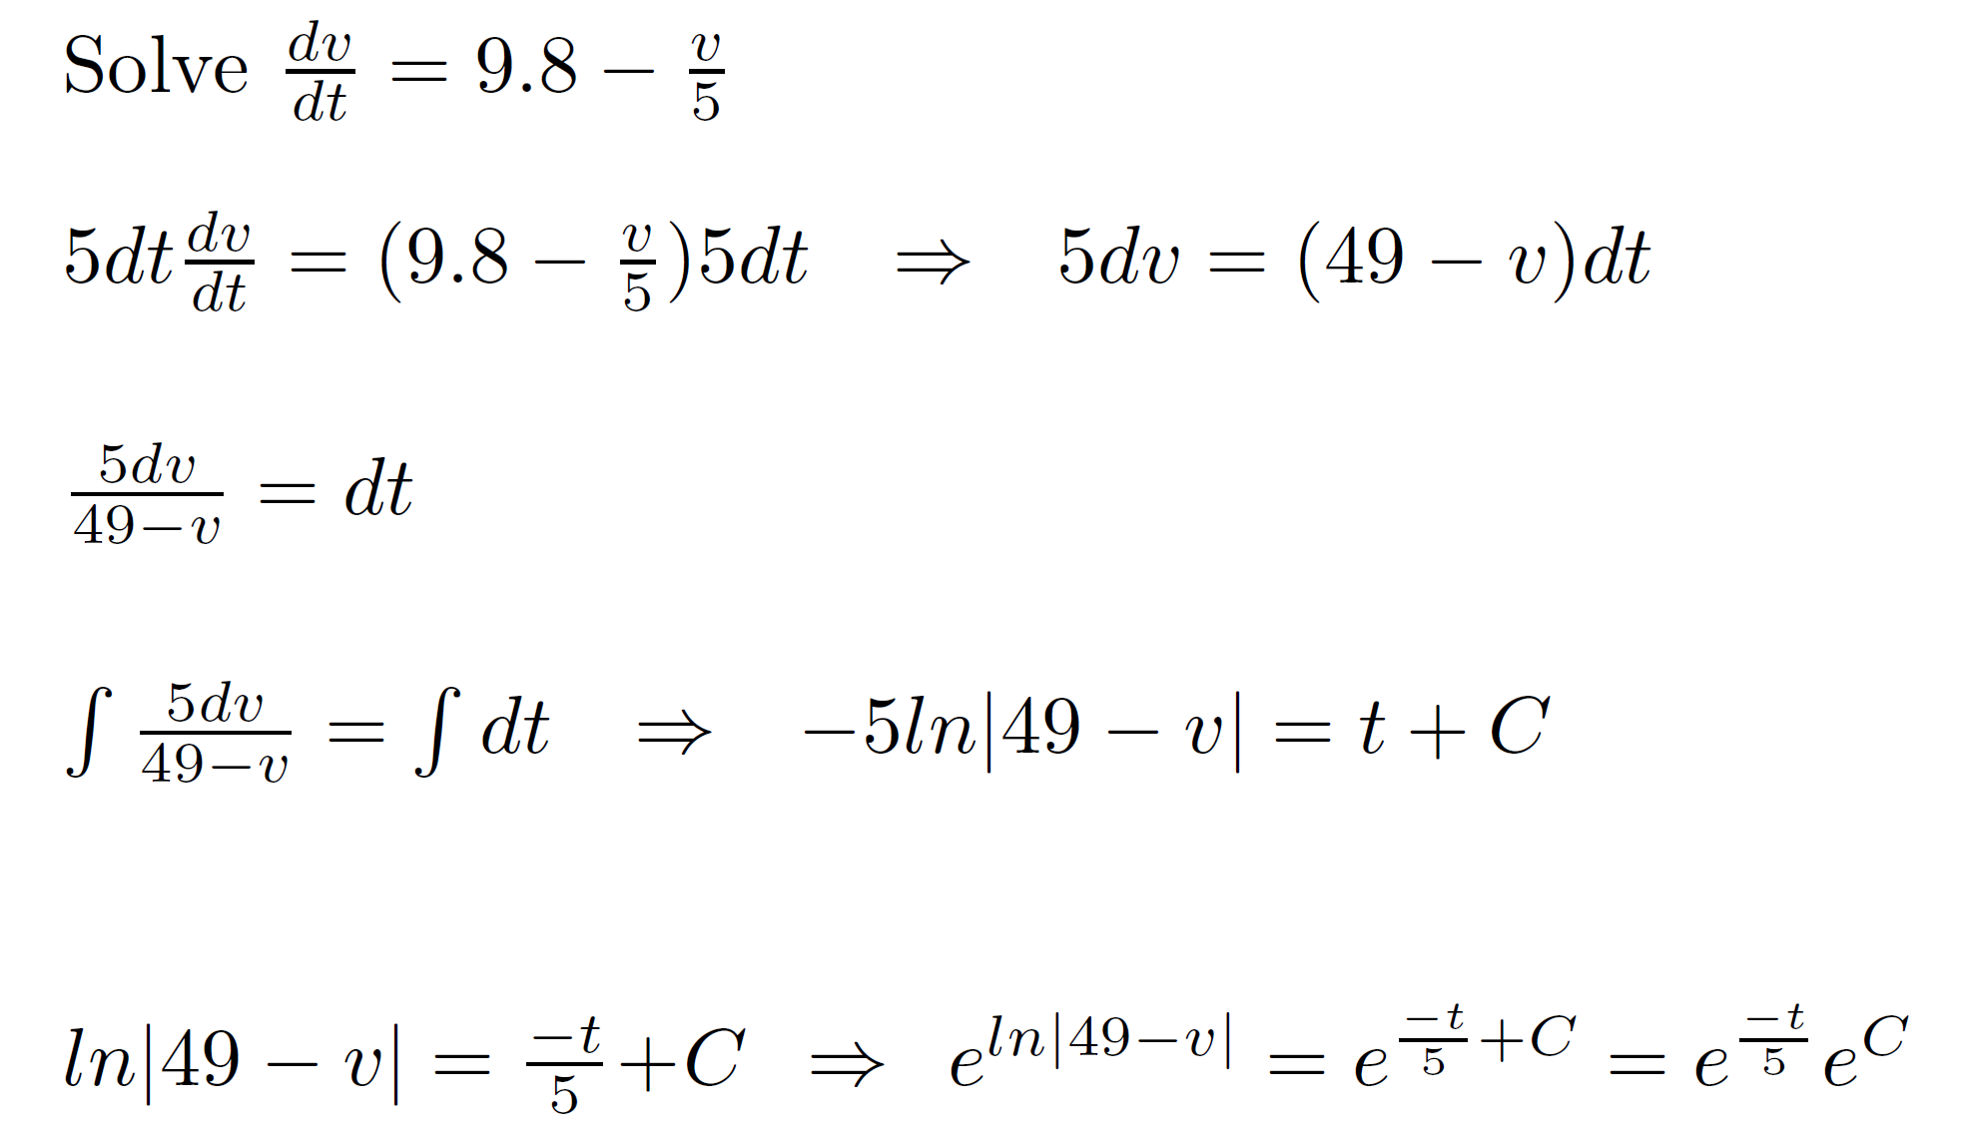

Slide 5
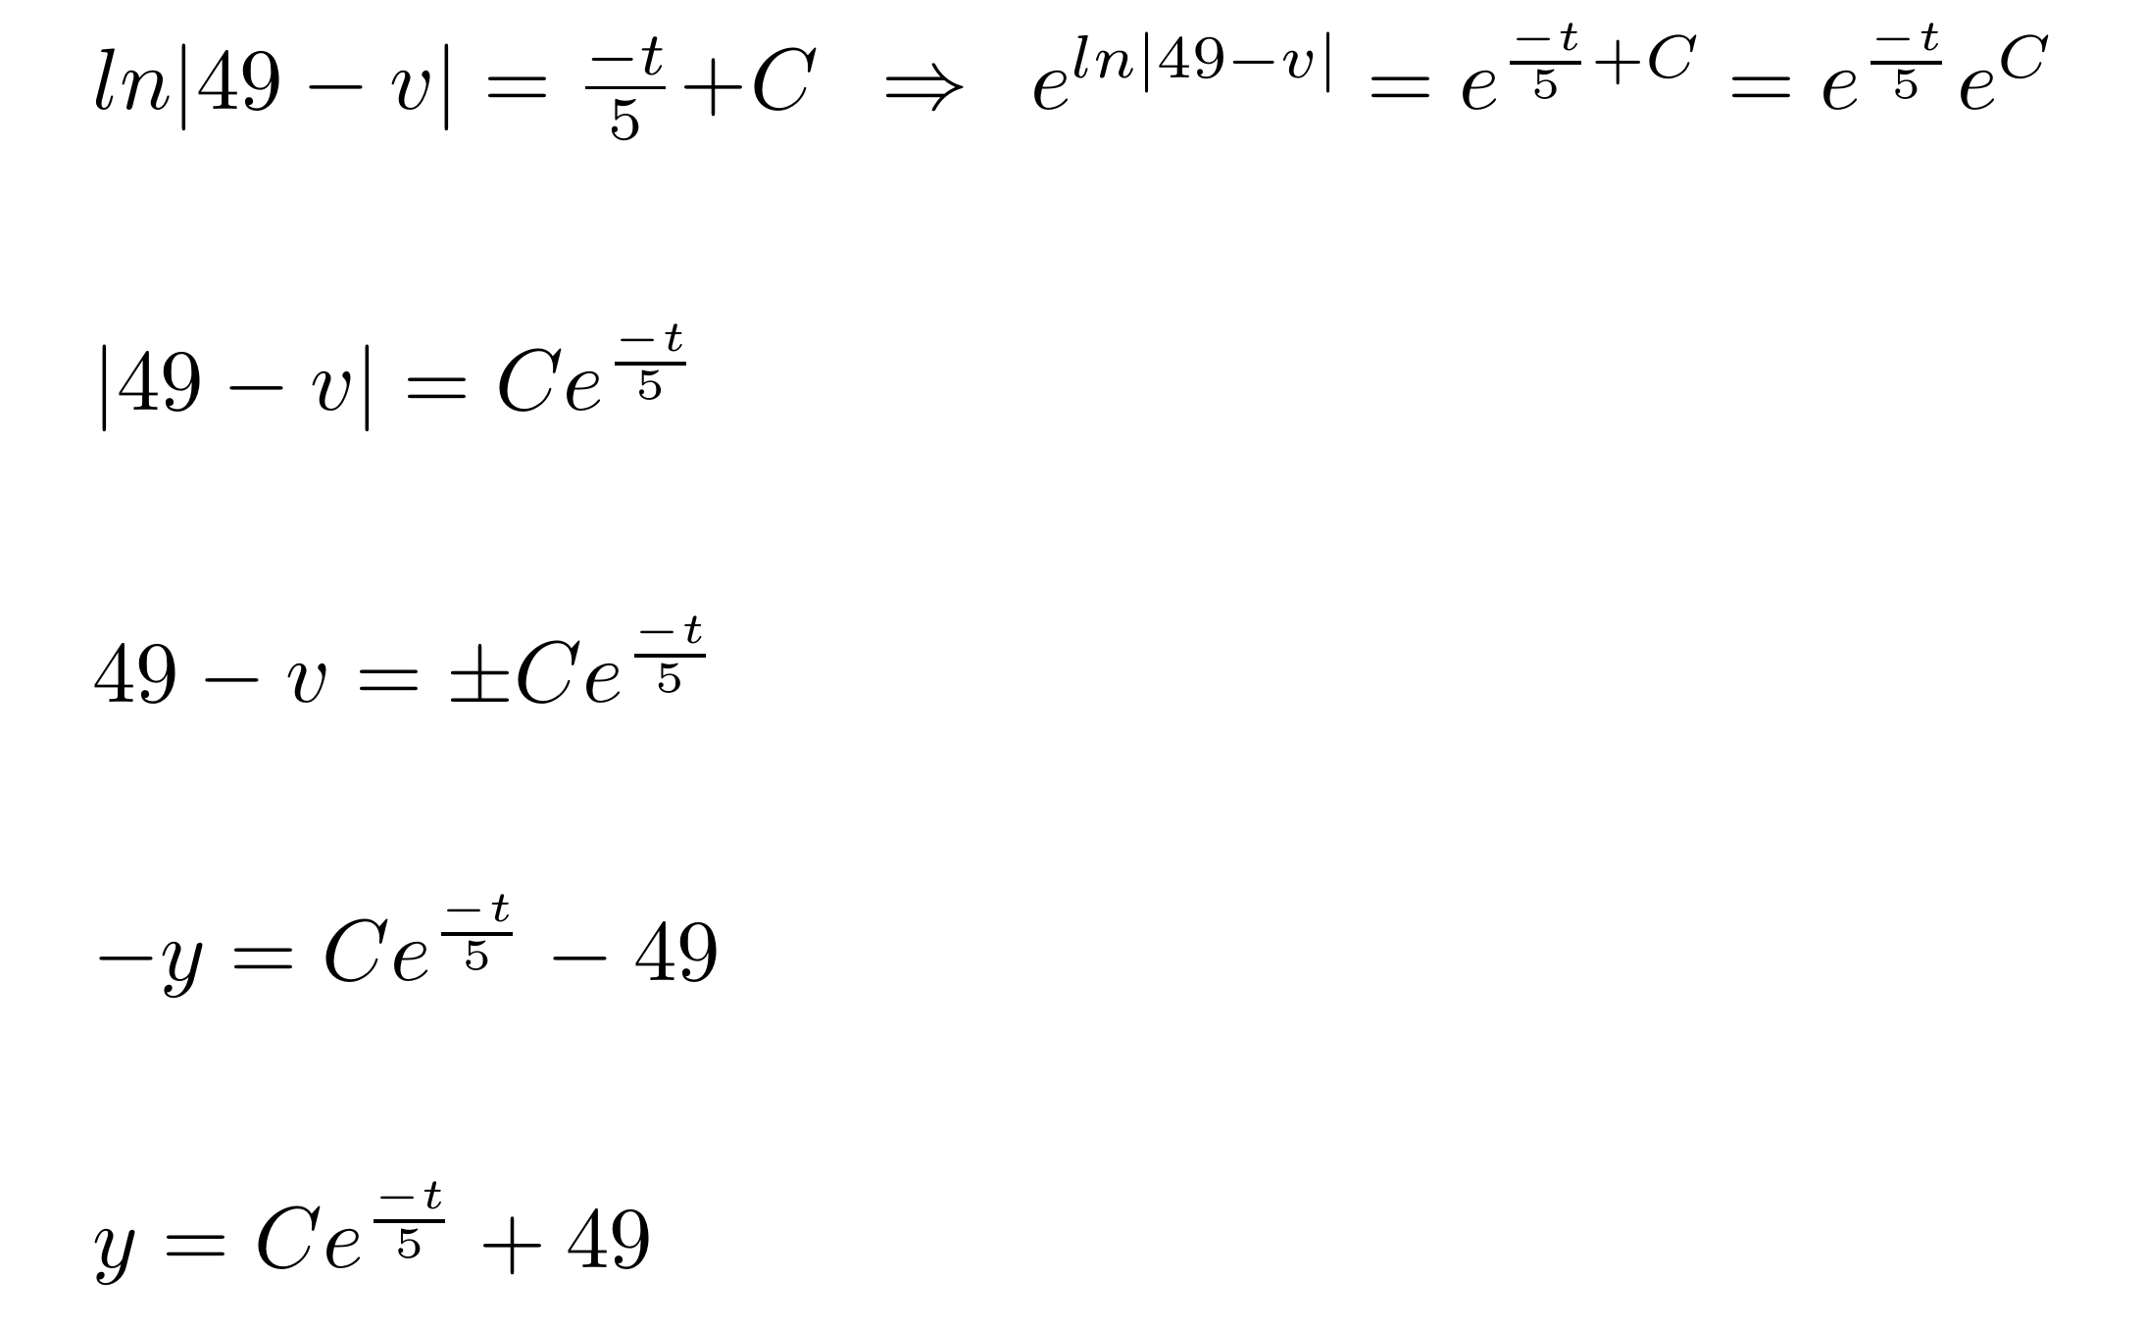

Slide 6
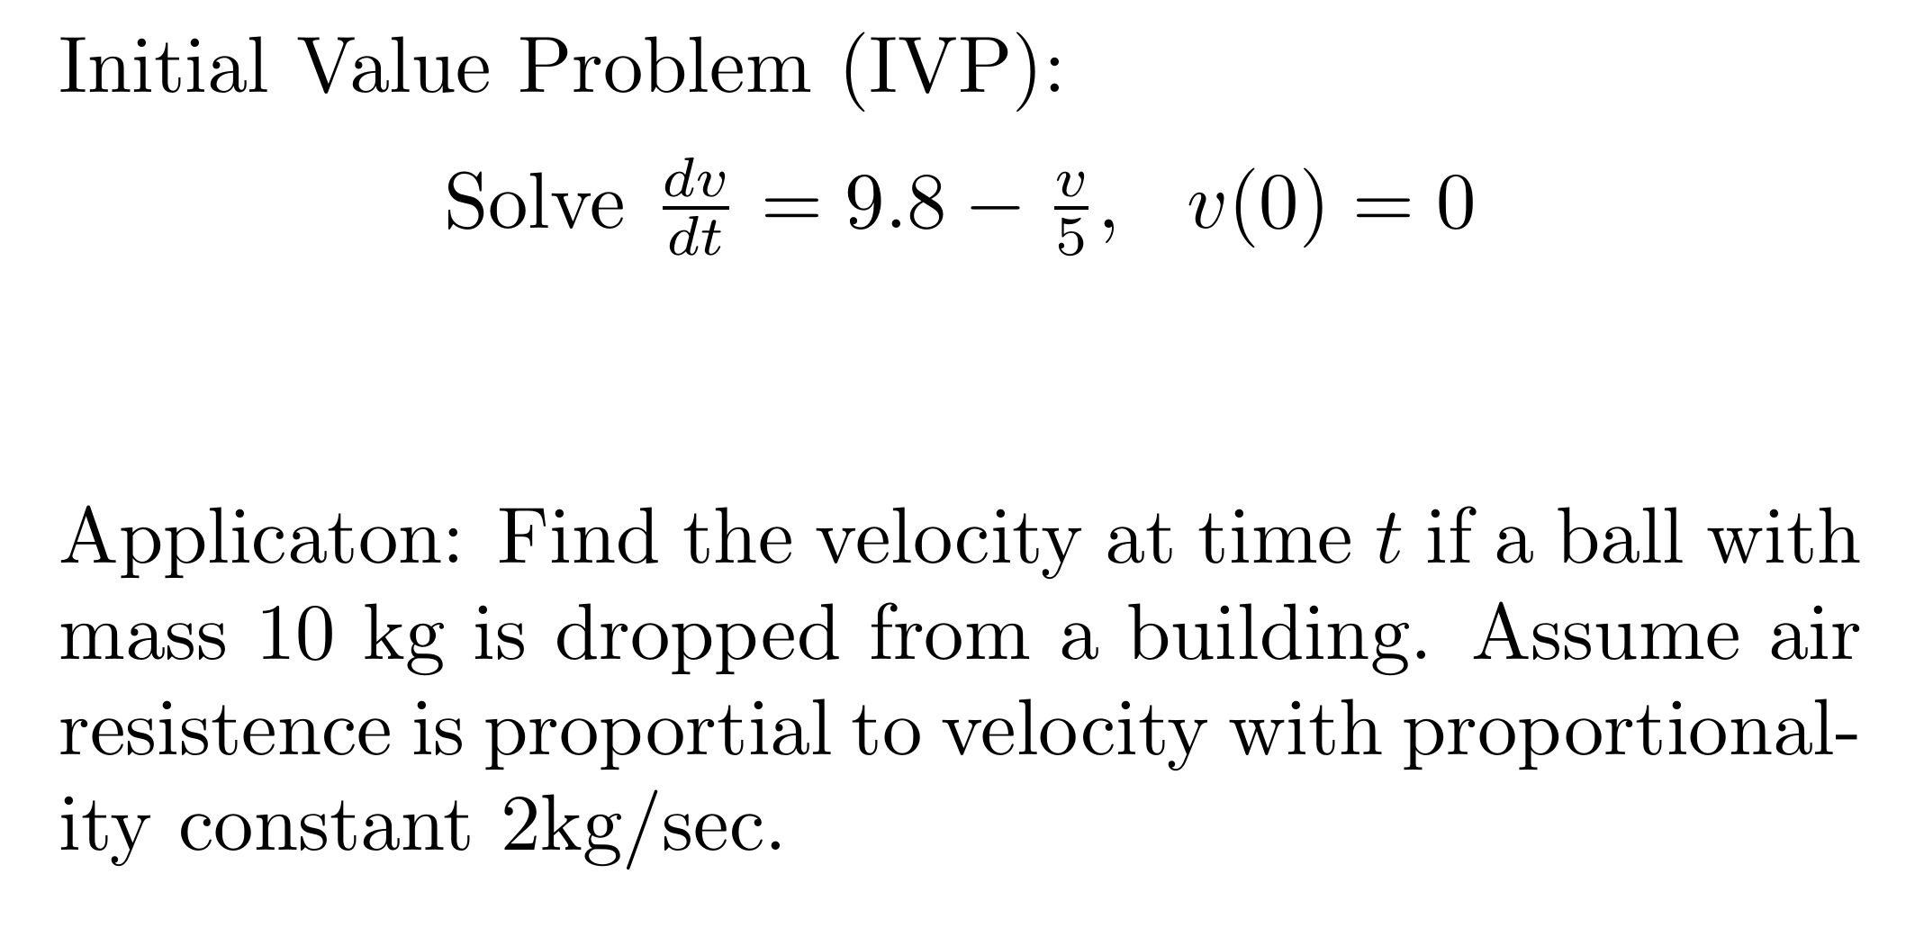

Slide 9
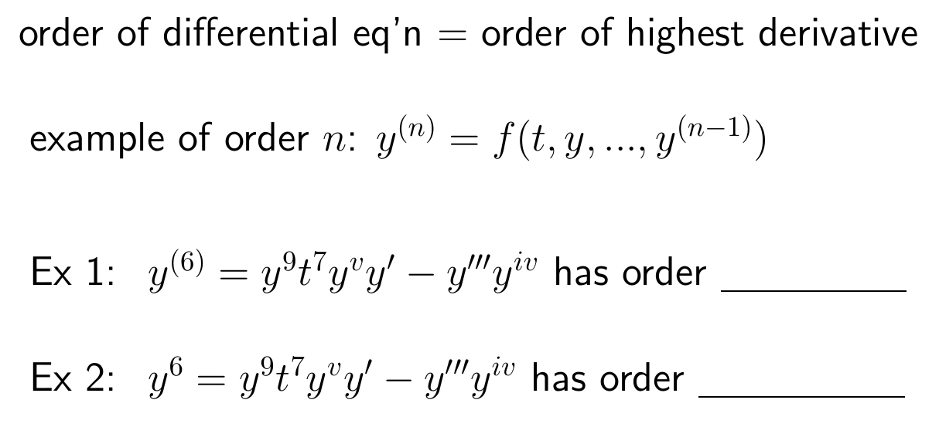

Slide 11
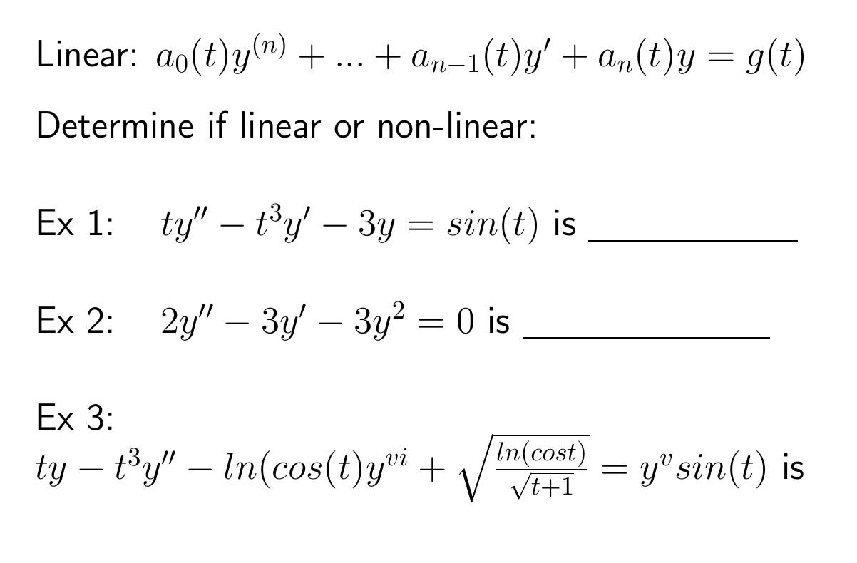

Slide 16
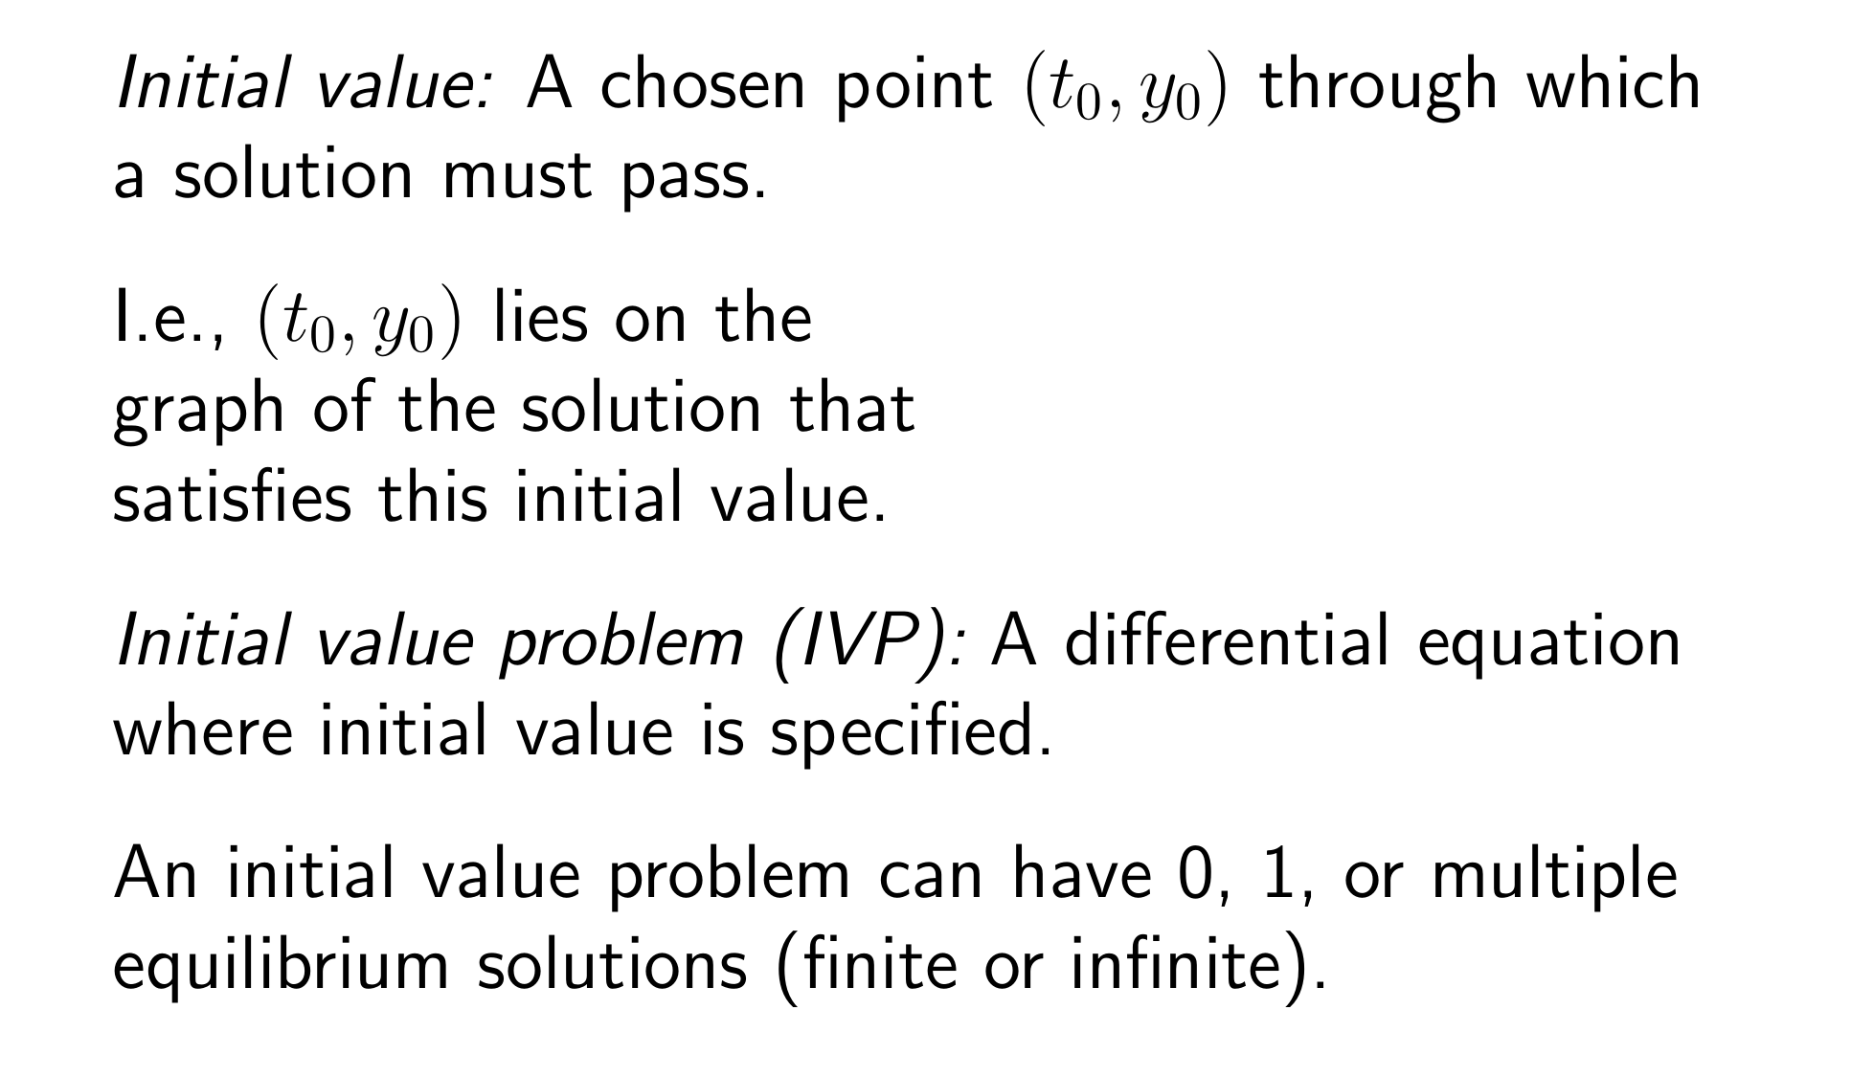
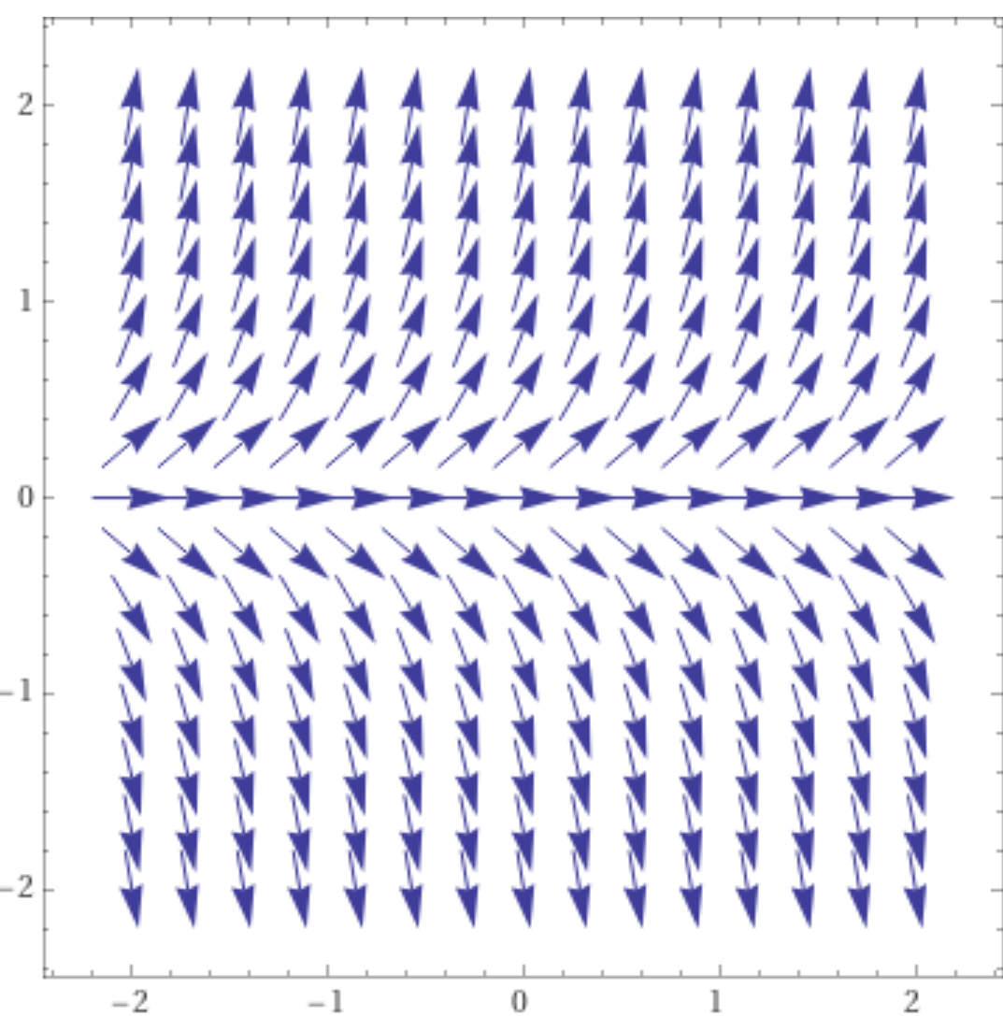
https://www.wolframalpha.com/input/?i=slope%20field

Slide 17
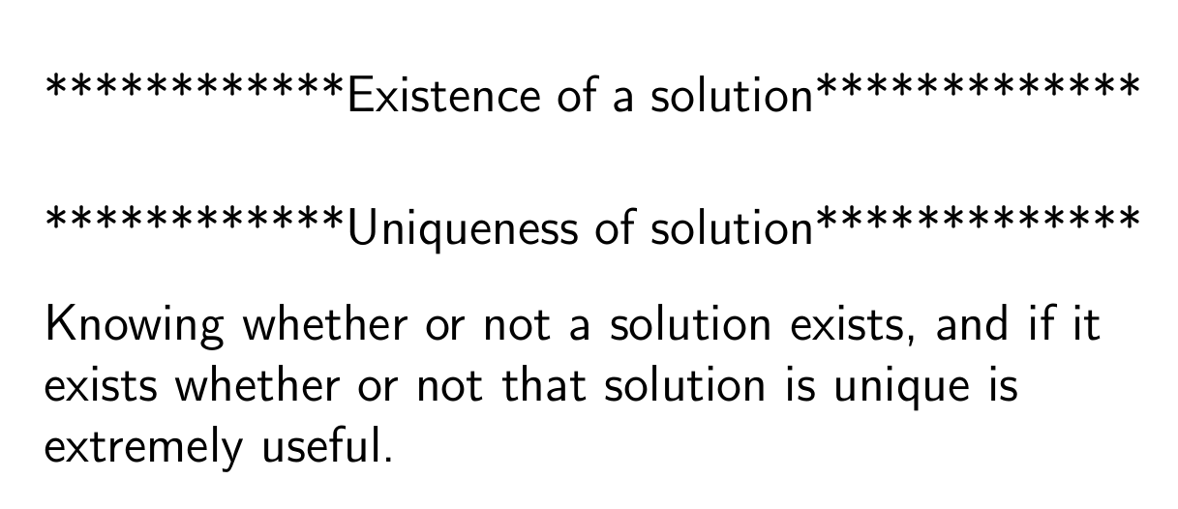

Slide 18
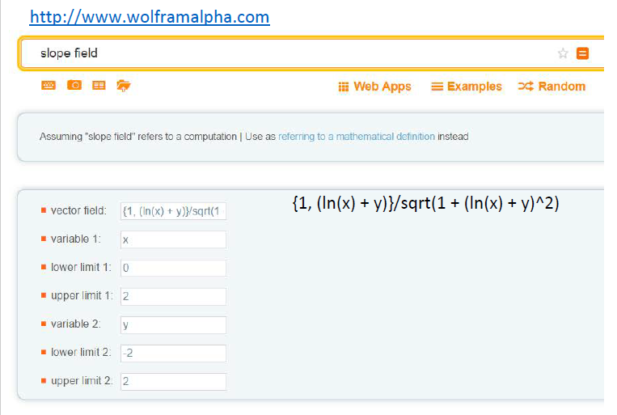

Slide 21
Ch 2.2: Separable Equations
http://bcs.wiley.com/he-bcs/Books?action=resource &bcsId=2026&itemId=047143339X&resourceId=4140
In this section we examine a subclass of linear and nonlinear first order equations. Consider the first order equation
We can rewrite this in the form
For example, let M(x,y) = - f (x,y) and N (x,y) = 1. There may be other ways as well. In differential form,
If M is a function of x only and N is a function of y only, then
In this case, the equation is called separable.

Slide 22
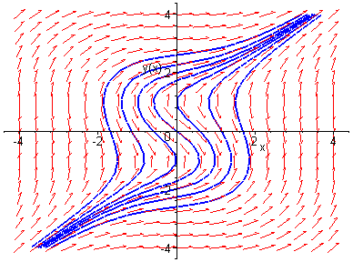
Example 1: Solving a Separable Equation
http://bcs.wiley.com/he-bcs/Books?action=resource &bcsId=2026&itemId=047143339X&resourceId=4140
Solve the following first order nonlinear equation:
Separating variables, and using calculus, we obtain
The equation above defines the solution y implicitly. A graph showing the direction field and implicit plots of several integral curves for the differential equation is given above.

