Slide 1
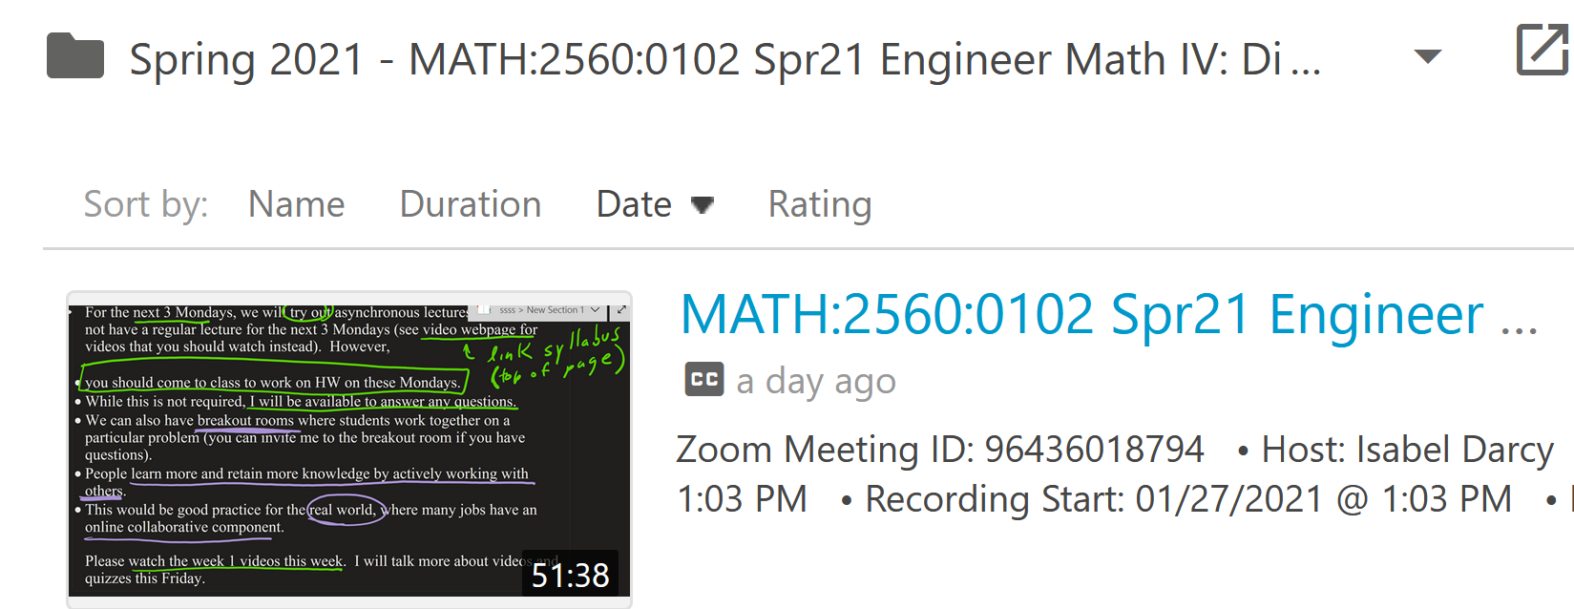
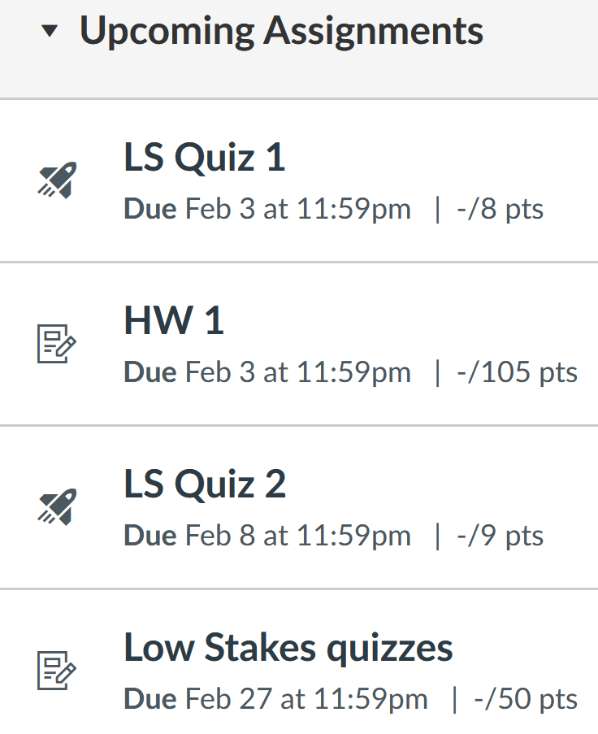

Slide 2
But you only need to earn 60% on the "Low stakes quizzes" assignment group in order to earn 100% on this assignment. Since you can redo the multiple choice quiz questions in the review quiz (where the later quiz allows unlimited attempts), everyone can earn 100% on this assignment even if you miss most of the questions on first try.

Slide 4
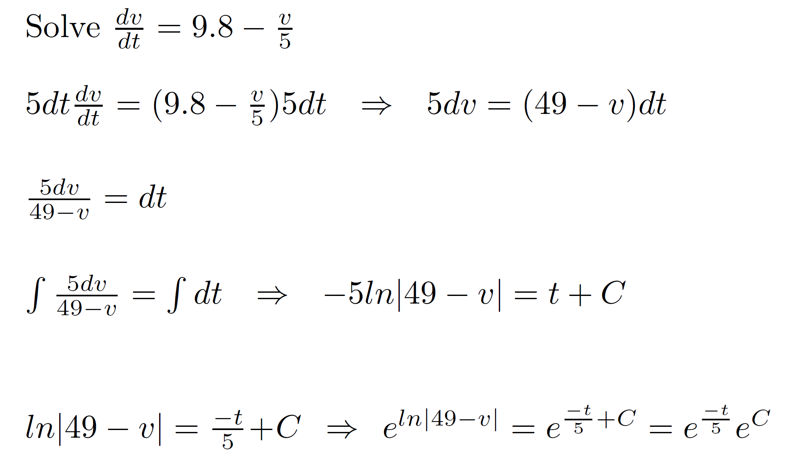

Slide 5
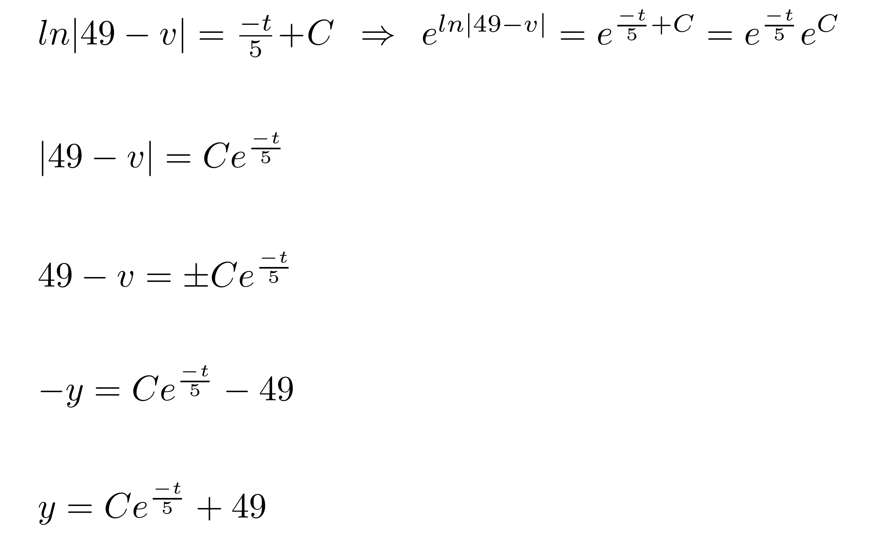

Slide 6
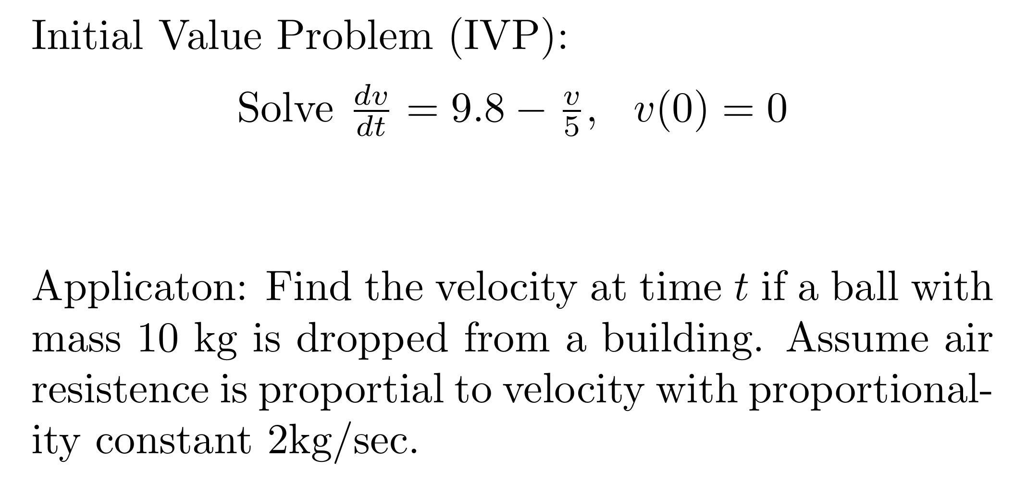

Slide 9
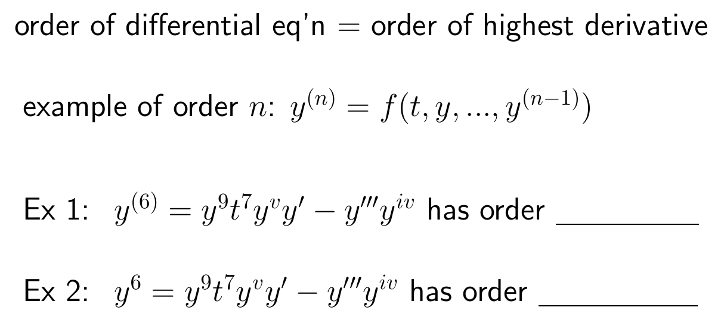

Slide 11
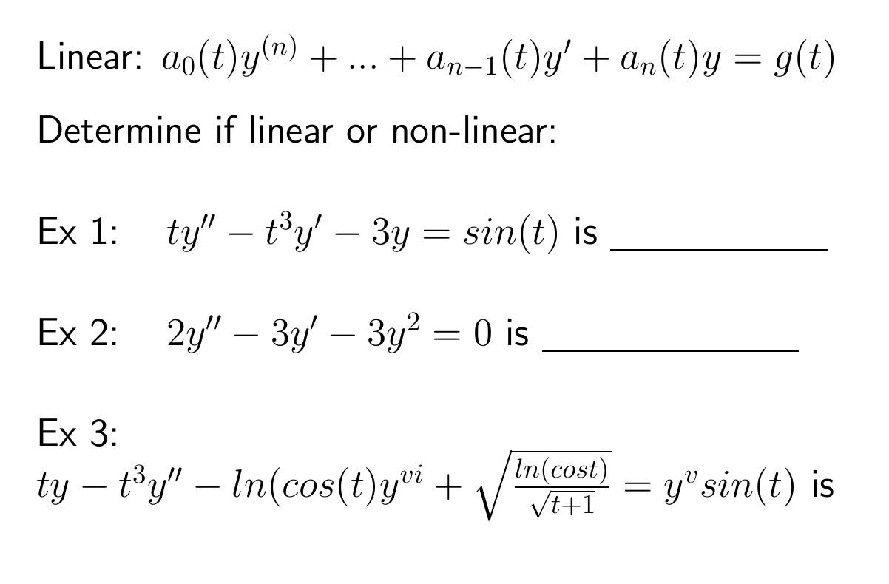

Slide 16
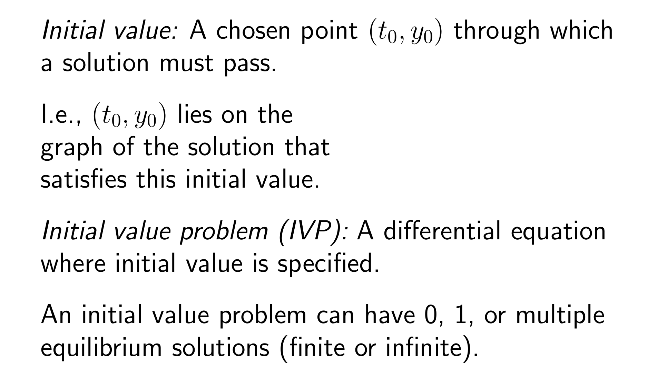
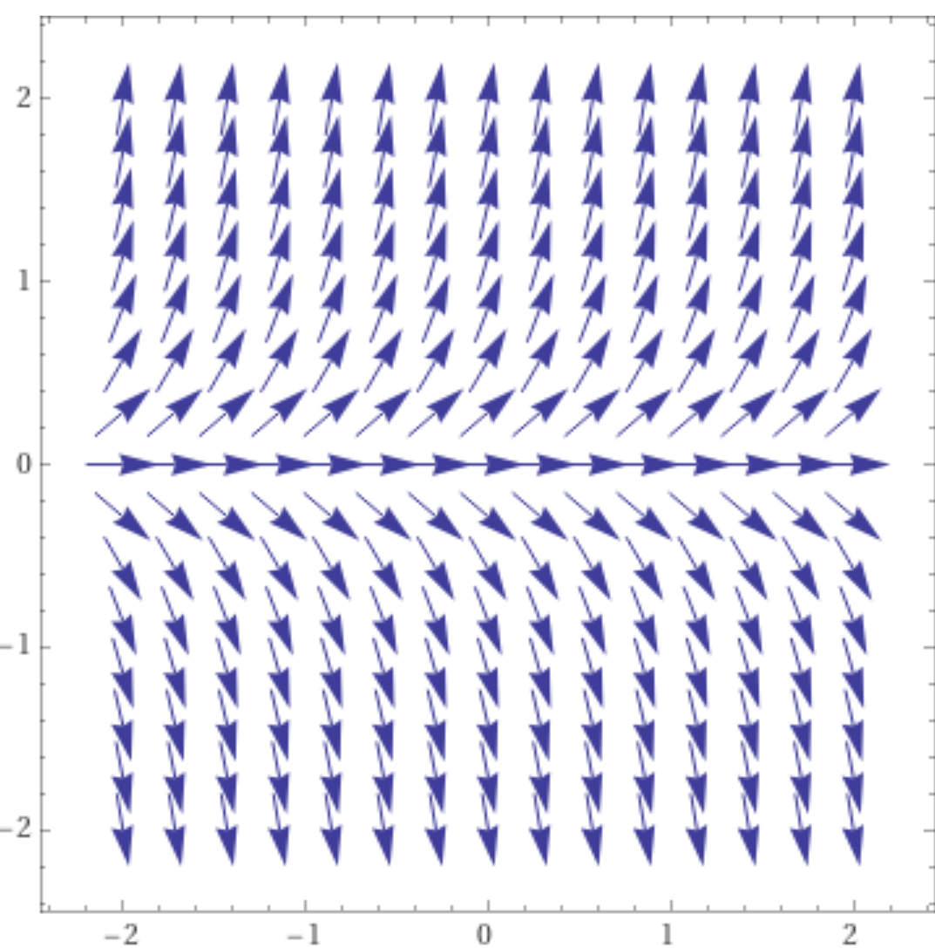
https://www.wolframalpha.com/input/?i=slope%20field

Slide 17
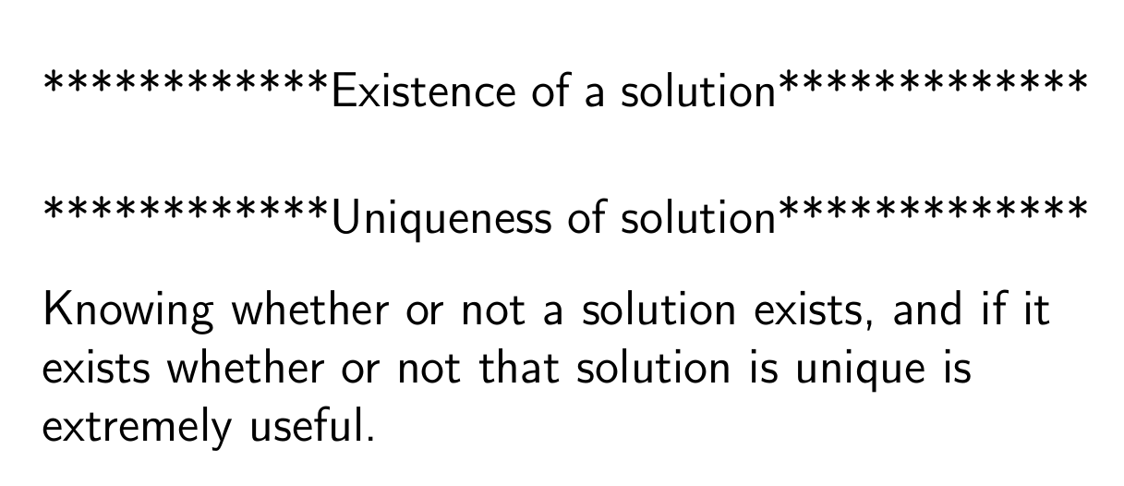

Slide 19
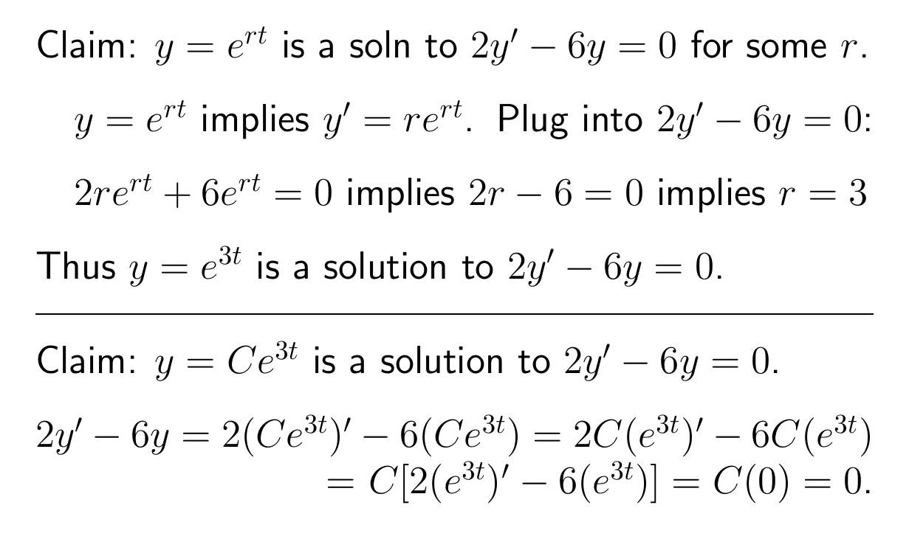

Slide 20
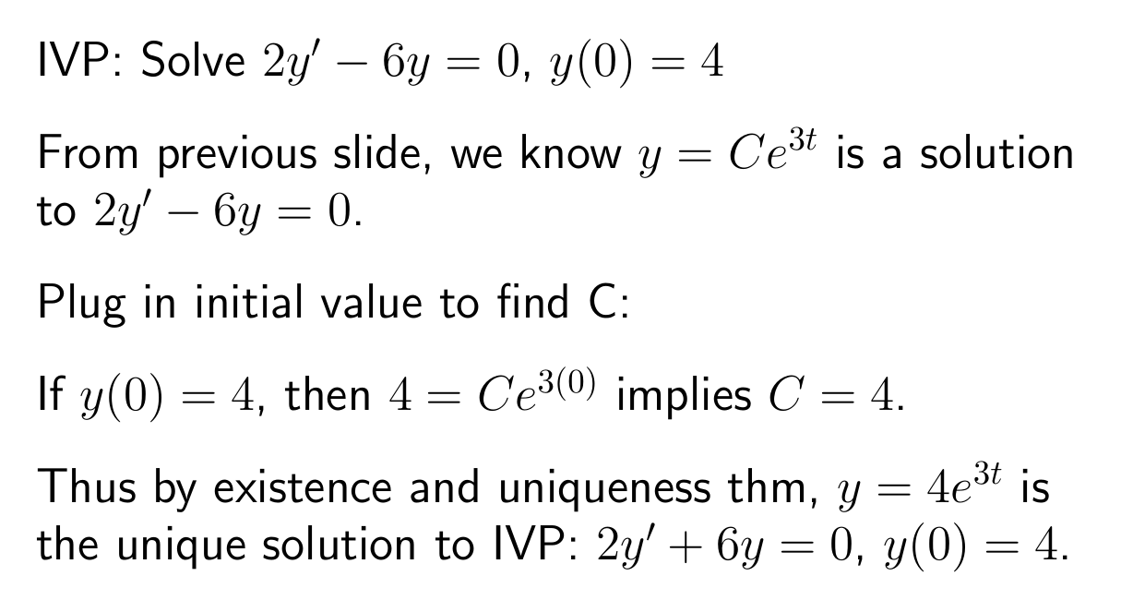

Slide 22
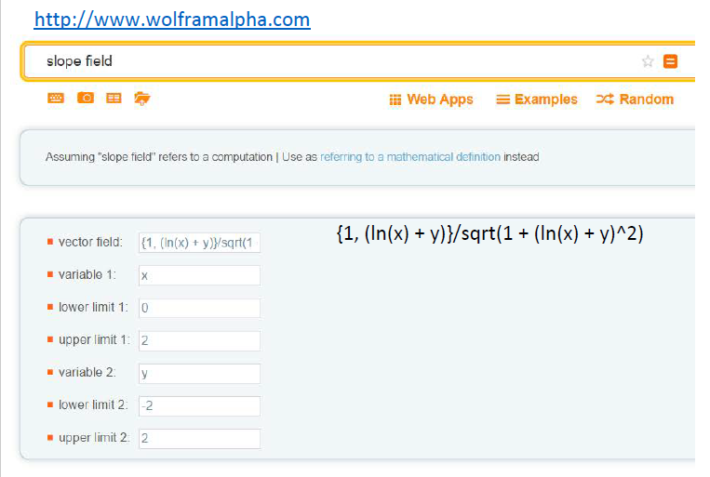

Slide 25
Ch 2.2: Separable Equations
http://bcs.wiley.com/he-bcs/Books?action=resource &bcsId=2026&itemId=047143339X&resourceId=4140
In this section we examine a subclass of linear and nonlinear first order equations. Consider the first order equation
We can rewrite this in the form
For example, let M(x,y) = - f (x,y) and N (x,y) = 1. There may be other ways as well. In differential form,
If M is a function of x only and N is a function of y only, then
In this case, the equation is called separable.

Slide 26
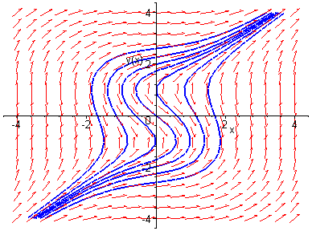
Example 1: Solving a Separable Equation
http://bcs.wiley.com/he-bcs/Books?action=resource &bcsId=2026&itemId=047143339X&resourceId=4140
Solve the following first order nonlinear equation:
Separating variables, and using calculus, we obtain
The equation above defines the solution y implicitly. A graph showing the direction field and implicit plots of several integral curves for the differential equation is given above.

Slide 27
Example 2: Implicit and Explicit Solutions (1 of 4)
http://bcs.wiley.com/he-bcs/Books?action=resource&bcsId=2026&itemId=047143339X&resourceId=4140
Solve the following first order nonlinear equation:
Separating variables and using calculus, we obtain
The equation above defines the solution y implicitly. An explicit expression for the solution can be found in this case:

Slide 28
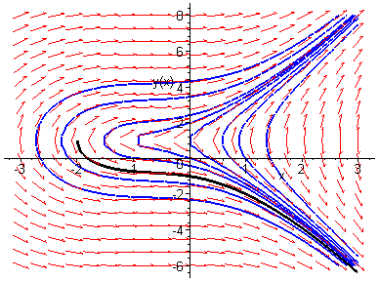
Example 2: Initial Value Problem (2 of 4)
http://bcs.wiley.com/he-bcs/Books?action=resource &bcsId=2026&itemId=047143339X&resourceId=4140
Suppose we seek a solution satisfying y(0) = -1. Using the implicit expression of y, we obtain
Thus the implicit equation defining y is
Using explicit expression of y,
It follows that

Slide 29
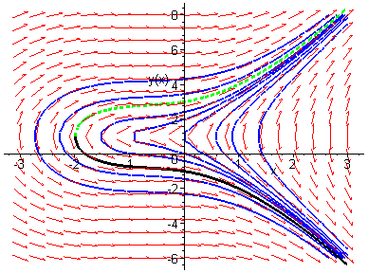
Example 2: Initial Condition y(0) = 3 (3 of 4)
http://bcs.wiley.com/he-bcs/Books?action=resource &bcsId=2026&itemId=047143339X&resourceId=4140
Note that if initial condition is y(0) = 3, then we choose the positive sign, instead of negative sign, on square root term:

Slide 30
Example 2: Domain (4 of 4)
http://bcs.wiley.com/he-bcs/Books?action=resource &bcsId=2026&itemId=047143339X&resourceId=4140
Thus the solutions to the initial value problem
are given by
From explicit representation of y, it follows that
and hence domain of y is (-2, ∞). Note x = -2 yields y = 1, which makes denominator of dy/dx zero (vertical tangent).
Conversely, domain of y can be estimated by locating vertical tangents on graph (useful for implicitly defined solutions).

Slide 31
Example 3: Implicit Solution of Initial Value Problem (1 of 2)
http://bcs.wiley.com/he-bcs/Books?action=resource&bcsId=2026&itemId=047143339X&resourceId=4140
Consider the following initial value problem:
Separating variables and using calculus, we obtain
Using the initial condition, it follows that

Slide 32
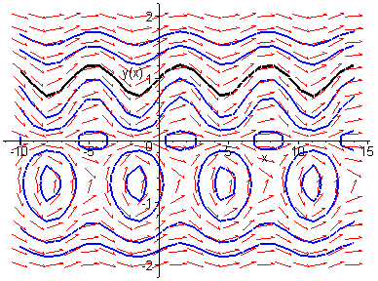
Example 3: Graph of Solutions (2 of 2)
http://bcs.wiley.com/he-bcs/Books?action=resource &bcsId=2026&itemId=047143339X&resourceId=4140
Thus
The graph of this solution (black), along with the graphs of the direction field and several integral curves (blue) for this differential equation, is given below.

