Slide 1
Note ICON does not automatically enforce deadlines, so you can improve your grade by retaking most ICON quizzes (while reviewing for final exam).
Most questions are automatically graded, but it is too late to earn points for giving comments on student videos.
Most of you have 100% on pre-exam 1 quizzes per 50 point “Low Stakes quizzes” assignment (so no need to retake any pre-exam 1 quizzes).
Extra credit is worth 32 points out of 1580 points. You are better off studying exam than doing extra credit (main reason for extra credit was to give points to students who worked ahead and thus thought this could be HW)
Any ungraded late HW will count as 0 points BUT if your course grade is borderline, I will take late ungraded HW into consideration. All graded HW counts even if submitted after soft deadline.
If you had an excused absence for HW per e-mail from me, and it was not graded, please let me know.
HW 0 videos and quizzes can still be uploaded for at least partial credit by midnight Friday.

Slide 2
Note ICON does not automatically enforce deadlines, so you can improve your grade by retaking most ICON quizzes (while reviewing for final exam).
Most questions are automatically graded, but it is too late to earn points for giving comments on student videos.
Most of you have 100% on pre-exam 1 quizzes per 50 point “Low Stakes quizzes” assignment (so no need to retake any pre-exam 1 quizzes).
Extra credit is worth 32 points out of 1580 points. You are better off studying exam than doing extra credit (main reason for extra credit was to give points to students who worked ahead and thus thought this could be HW)
Any ungraded late HW will count as 0 points BUT if your course grade is borderline, I will take late ungraded HW into consideration. All graded HW counts even if submitted after soft deadline.
If you had an excused absence for HW per e-mail from me, and it was not graded, please let me know.
HW 0 videos and quizzes can still be uploaded for at least partial credit by midnight Friday.

Slide 3
Exam will cover all the sections we have covered with the exception of
Not on exam: 6.5, 7.7, 7.8
Optional: 6.6
Final exam will be similar format as exams 1 – 3 ( breakdown between written part and ICON part TBD) but twice as long.
E-mail me the written part of your final exam so that I can check it before you sign out.
PLEASE write legibly on only 1 side.
Check answers BEFORE submitting multiple choice part. I cannot change your multiple choice grade because you accidentally selected wrong answer.

Slide 4
Exam will cover all the sections we have covered with the exception of
Not on exam: 6.5, 7.7, 7.8
Optional: 6.6
Final exam will be similar format as exams 1 – 3 ( breakdown between written part and ICON part TBD) but twice as long.
E-mail me the written part of your final exam so that I can check it before you sign out.
PLEASE write legibly on only 1 side.
Check answers BEFORE submitting multiple choice part. I cannot change your multiple choice grade because you accidentally selected wrong answer.

Slide 5
Problem sessions on Tuesday. Times TBA. If you have a preferred time (or if I should avoid a time), type it in the chat window or e-mail me.
Answers to ALL exams (written and multiple choice) will be available over the weekend. Study your old exams.
Two multiple choice reviews including answers will be posted this weekend:
one ICON quiz and
one pdf to be posted on ICON announcements
These do not include Ch 6, but Ch 6 is important and will be on the final exam.
Final exam will be similar format as exams 1 – 3 ( breakdown between written part and ICON part TBD) but at least twice as long.

Slide 6
Problem sessions on Tuesday. Times TBA. If you have a preferred time (or if I should avoid a time), type it in the chat window or e-mail me.
Answers to ALL exams (written and multiple choice) will be available over the weekend. Study your old exams.
Two multiple choice reviews including answers will be posted this weekend:
one ICON quiz and
one pdf to be posted on ICON announcements
These do not include Ch 6, but Ch 6 is important and will be on the final exam.
Final exam will be similar format as exams 1 – 3 ( breakdown between written part and ICON part TBD) but at least twice as long.

Slide 11
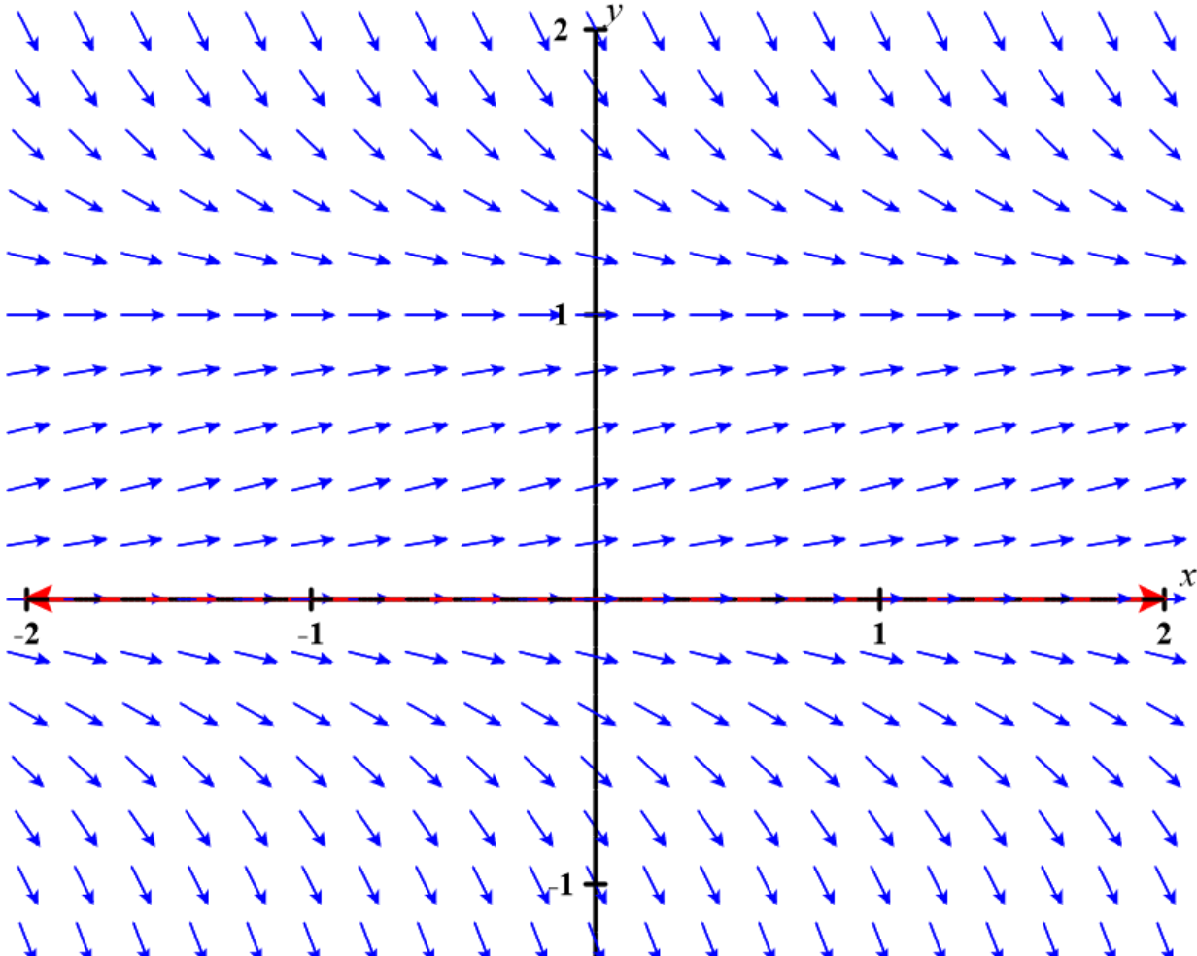
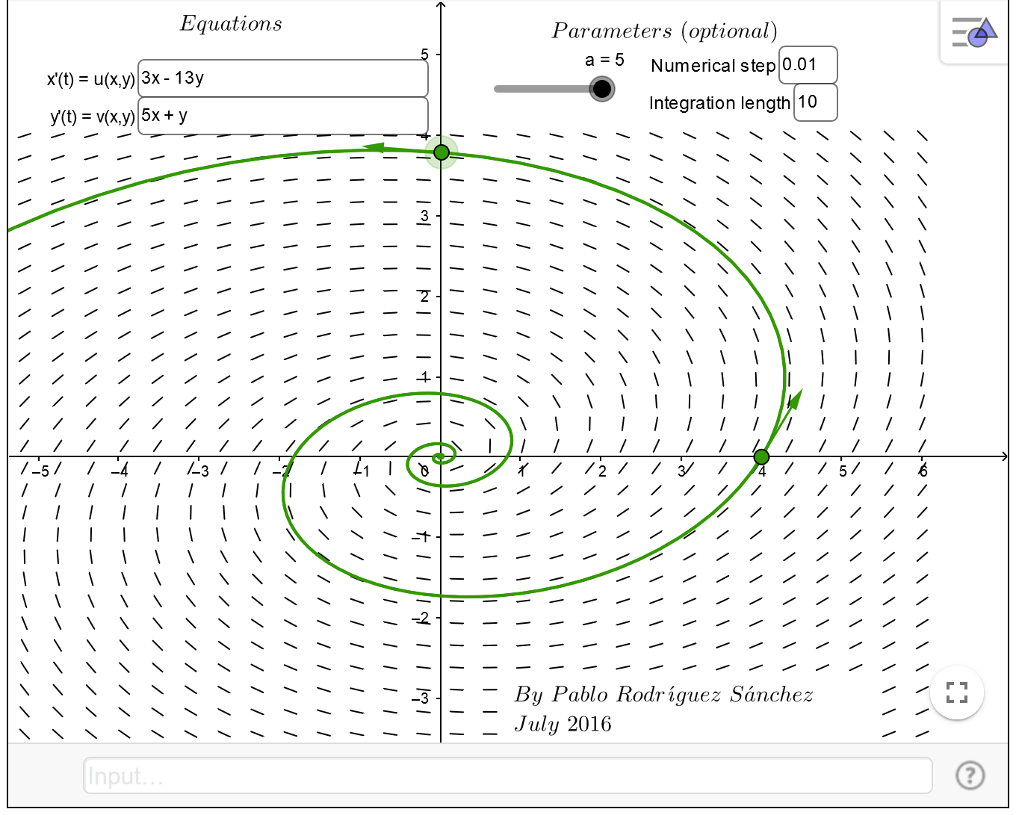
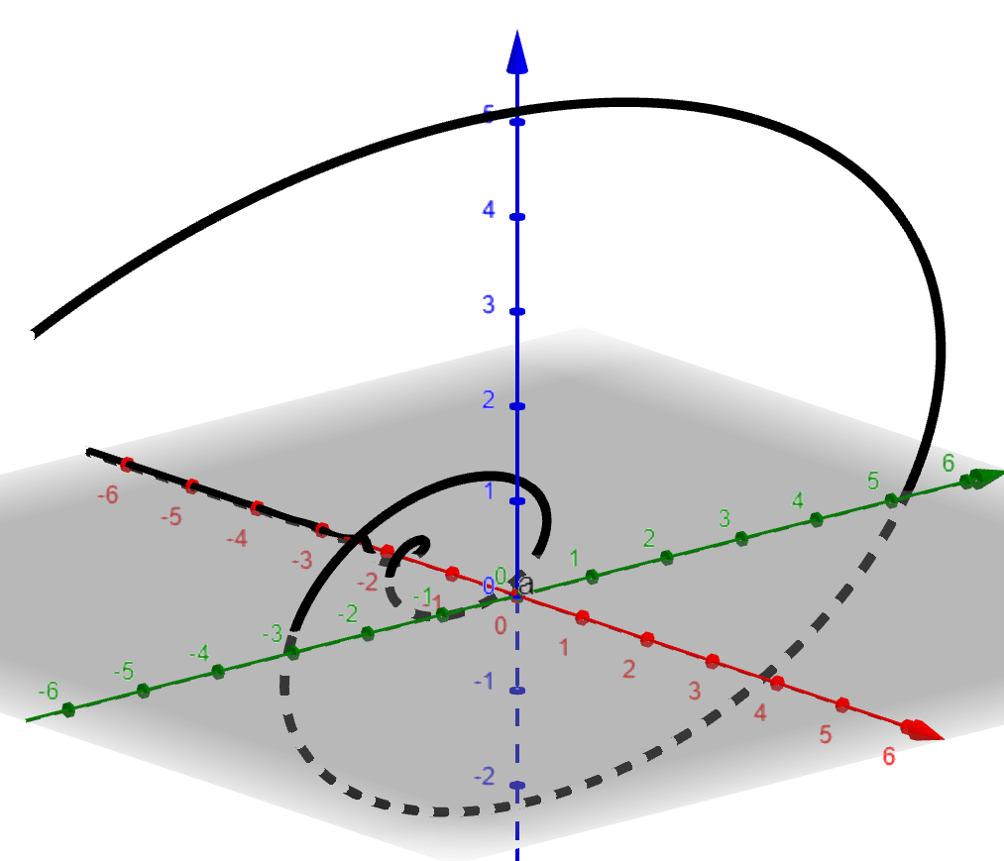
Compare similarities and differences between chapters.

Slide 12
Compare similarities and differences between chapters.

Slide 13
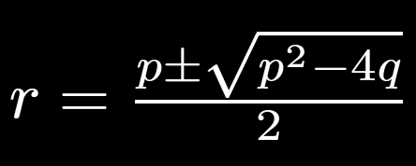
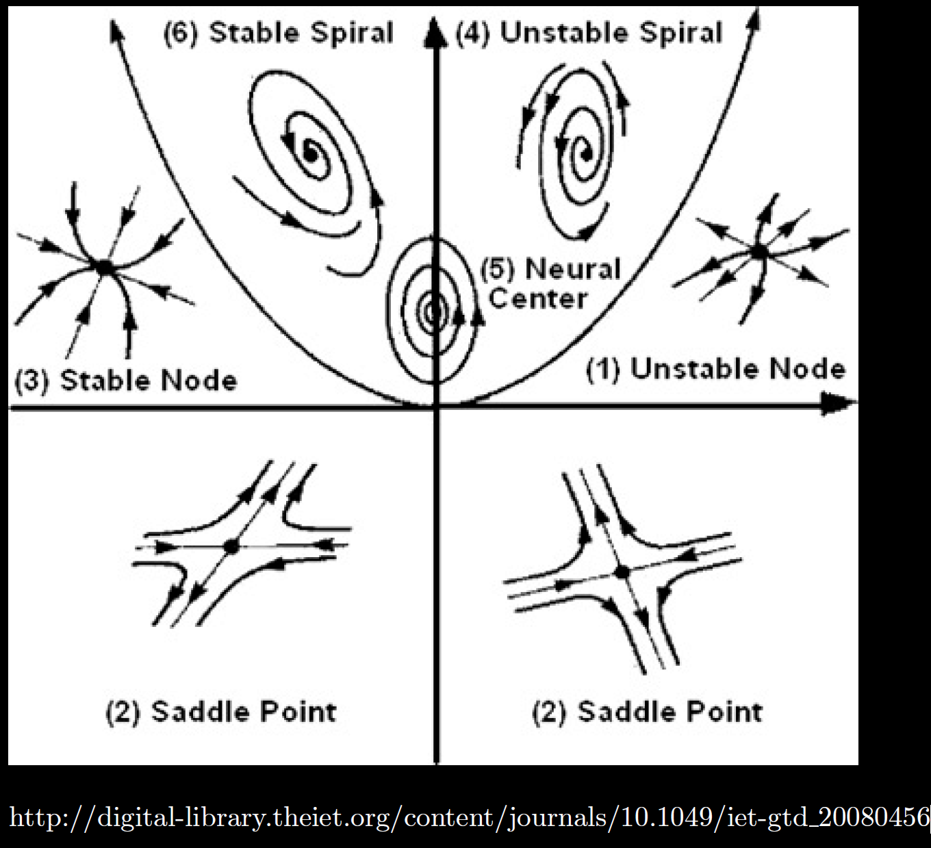

Slide 17
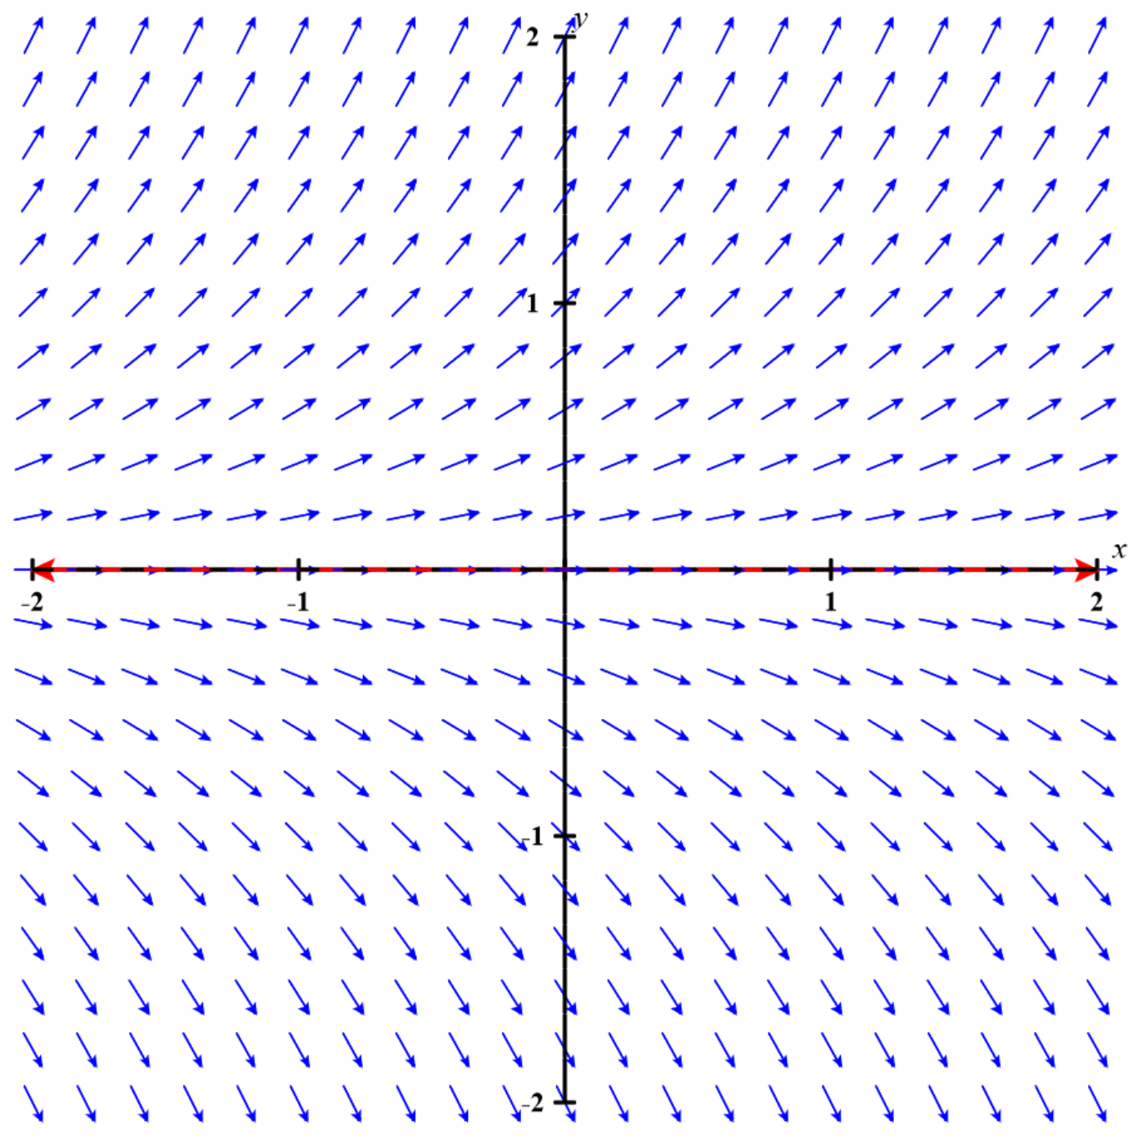
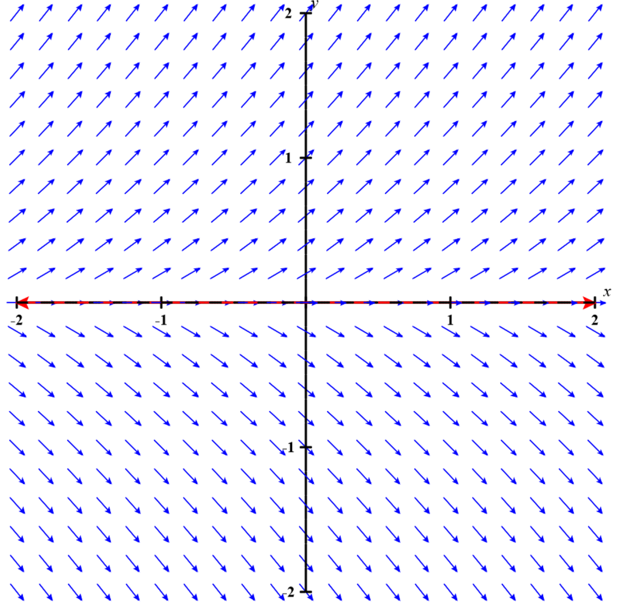
Given the direction fields below, which IVP: y’ = f(y), y(1) = 0 has a unique solution?
A
B

Slide 18
Given the direction fields below, which IVP: y’ = f(y), y(1) = 0 has a unique solution?
A
B

Slide 21
Determine (without solving the problem) an interval in which the solution of the given initial value problem is certain to exist and be unique.
$$\left(1 − t\right)\left(1 + t^{2}\right)y^{′′′}+\ln\left|t − 5\right|y^{′}+2y = \sqrt{t+4} y(0) = 3$$

Slide 22
Determine (without solving the problem) an interval in which the solution of the given initial value problem is certain to exist and be unique.
$$\left(1 − t\right)\left(1 + t^{2}\right)y^{′′′}+\ln\left|t − 5\right|y^{′}+2y = \sqrt{t+4} y(0) = 3$$
( )( )(
-4 1 5

Slide 31
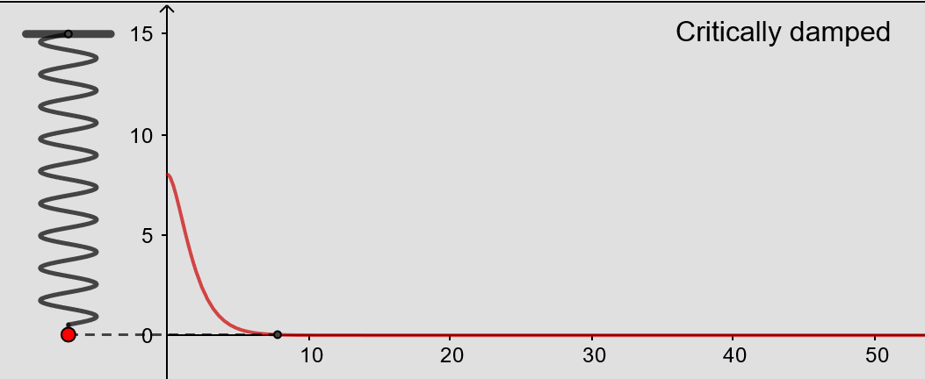
From https://www.geogebra.org/m/ZzKbkvnz
Note: Sign convention is opposite our convention

Slide 32
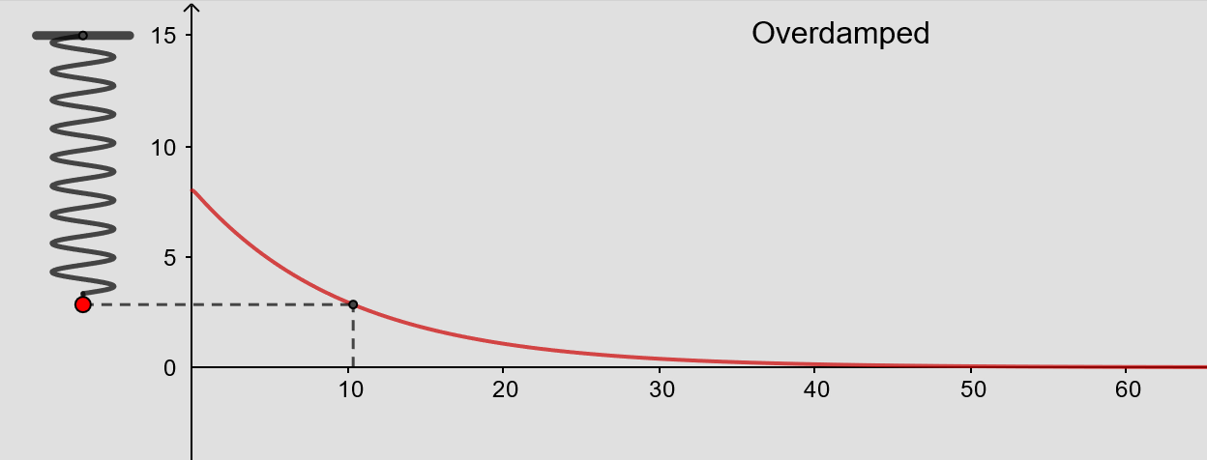
From https://www.geogebra.org/m/ZzKbkvnz
Note: Sign convention is opposite our convention

Slide 33
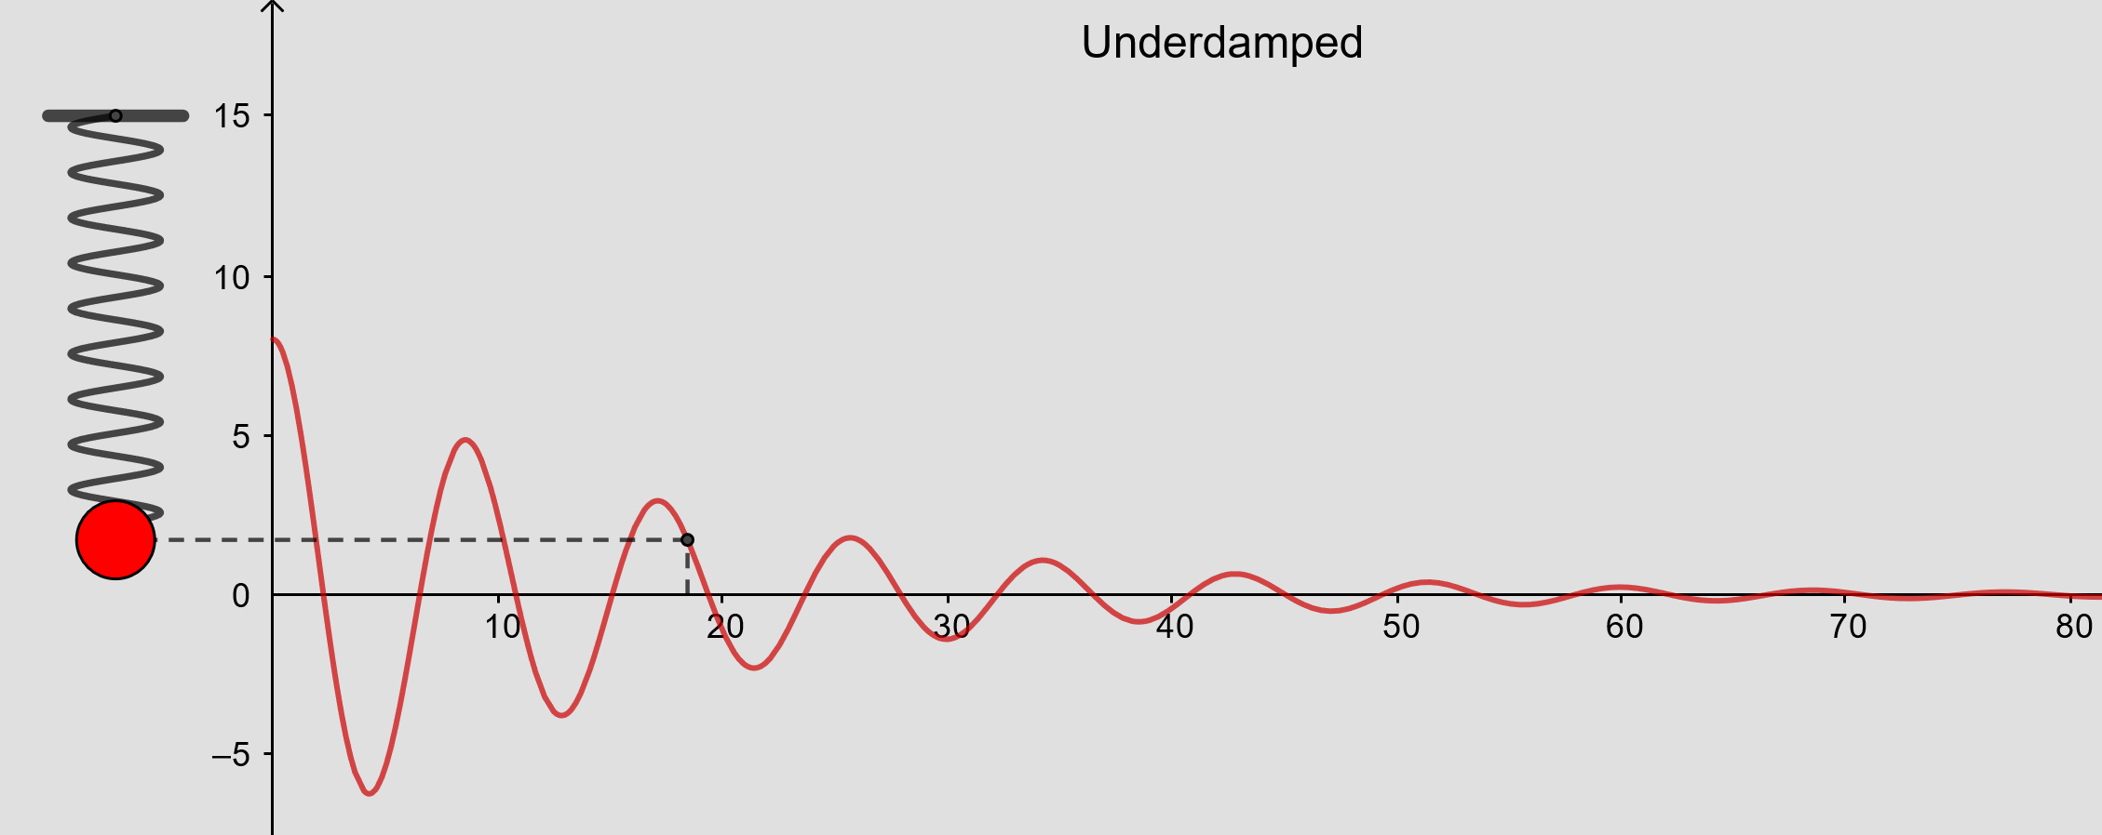
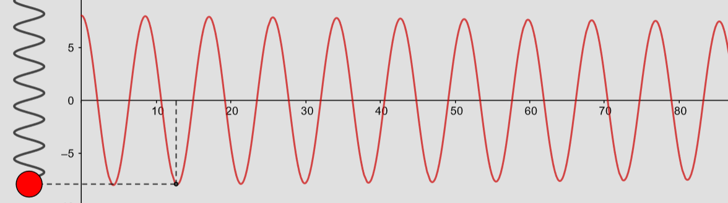
From https://www.geogebra.org/m/ZzKbkvnz
Note: Sign convention is opposite our convention

Slide 35
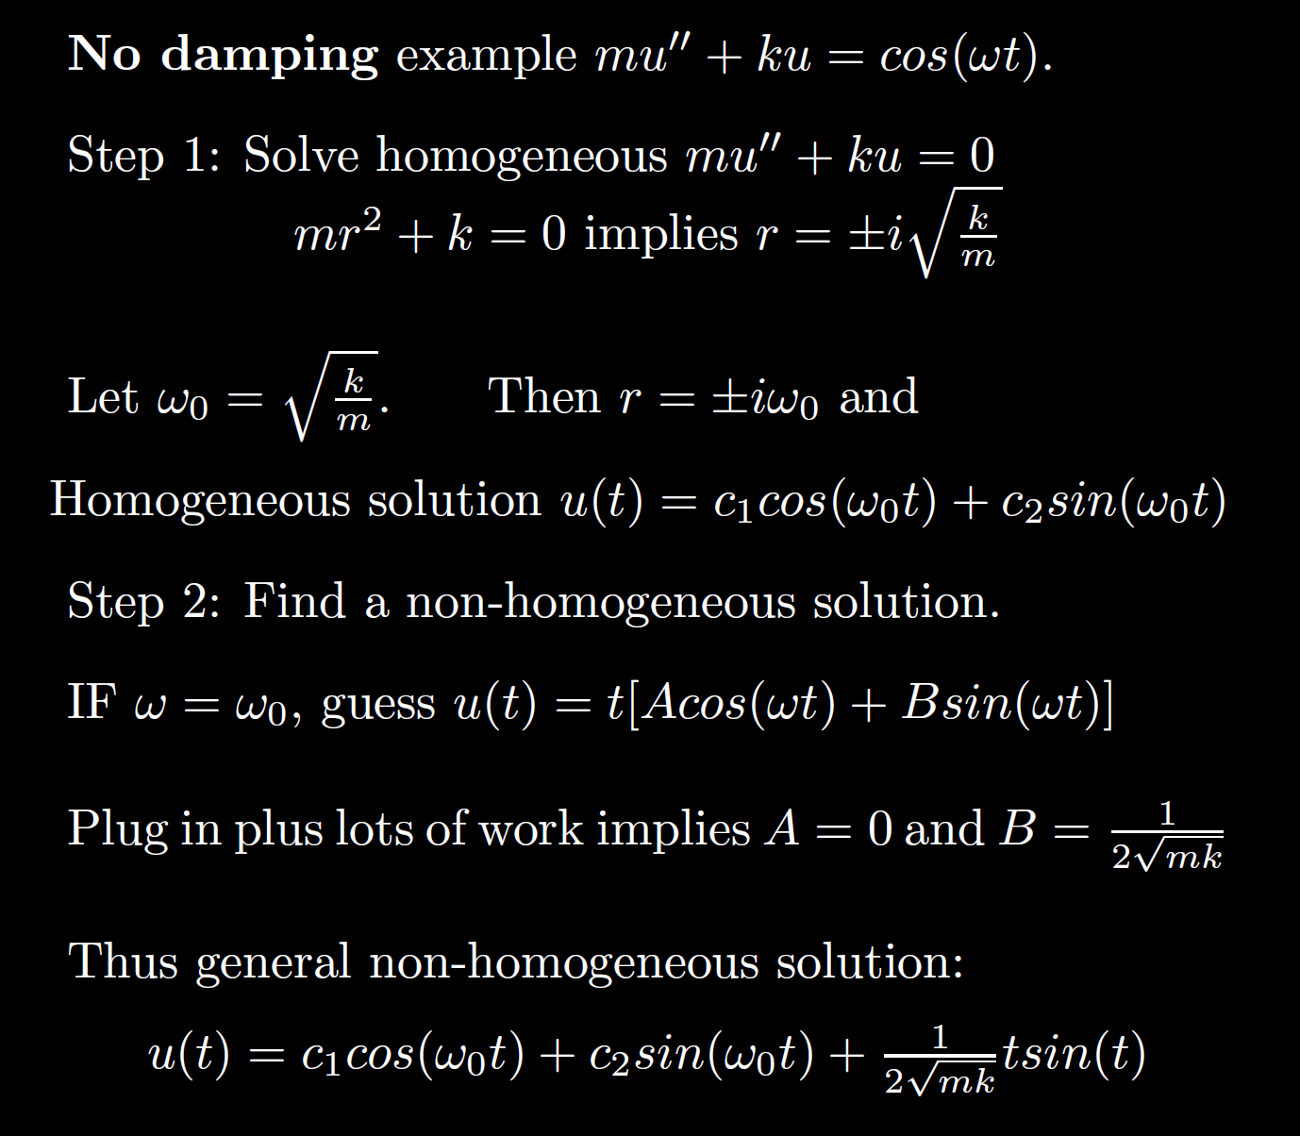
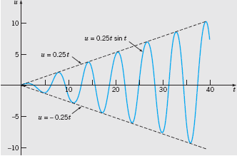
Boyce/DiPrima/Meade 11th ed, Ch 3.8: Forced Periodic Vibrations

Slide 38
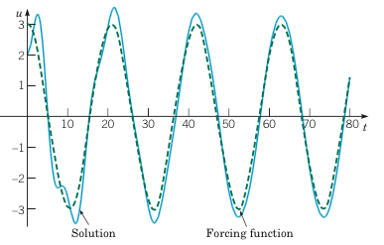
Example 2: Forced Vibrations with Damping (2 of 4)
Graphs of the solution and external force for .
Boyce/DiPrima/Meade 11th ed, Ch 3.8: Forced Periodic Vibrations

Slide 39
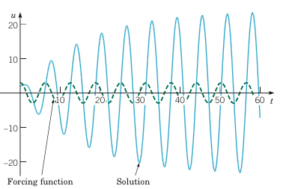
Example 2: Forced Vibrations with Damping (3 of 4)
Graphs of the solution and external force for
Boyce/DiPrima/Meade 11th ed, Ch 3.8: Forced Periodic Vibrations

Slide 40
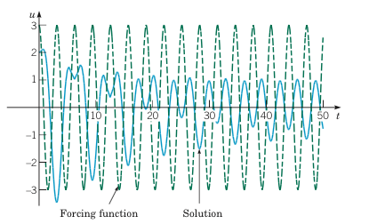
Example 2: Forced Vibrations with Damping (4 of 4)
Graphs of the solution and external force for
Boyce/DiPrima/Meade 11th ed, Ch 3.8: Forced Periodic Vibrations

