Slide 1
7.1: Transforming an n^{th} order linear DE into a system of n first order linear DEs.
Ex: $y′′ – 5y′ + 6y =sin⁡(t)$, $y\left(0\right)=1, { y}^{′}\left(0\right)=2$

Slide 2
7.1: Transforming an n^{th} order linear DE into a system of n first order linear DEs.
Ex: $y′′ – 5y′ + 6y =sin⁡(t)$, $y\left(0\right)=1, { y}^{′}\left(0\right)=2$

Slide 3
7.1: Transforming an n^{th} order linear DE into a system of n first order linear DEs.
Ex: $y′′ – 5y′ + 6y =sin⁡(t)$, $y\left(0\right)=1, { y}^{′}\left(0\right)=2$

Slide 4
7.1: Transforming an n^{th} order linear DE into a system of n first order linear DEs.
Ex: $y′′ – 5y′ + 6y =sin⁡(t)$, $y\left(0\right)=1, { y}^{′}\left(0\right)=2$

Slide 5
7.1: Transforming an n^{th} order linear DE into a system of n first order linear DEs.
Ex: $y′′′′ – 5y′′ + 6y =sin⁡(t)$

Slide 6
7.1: Transforming an n^{th} order linear DE into a system of n first order linear DEs.
Ex: $y′′′′ – 5y′′ + 6y =sin⁡(t)$

Slide 29
Can also use slope field:

Slide 30
Can also use slope field:

Slide 36
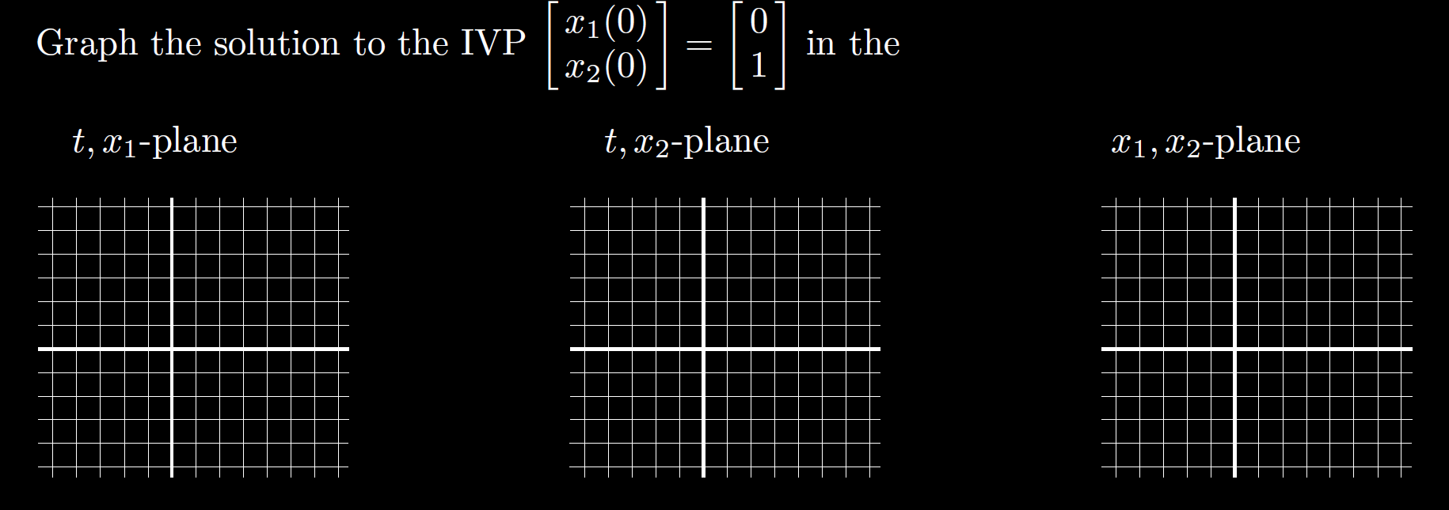

Slide 40
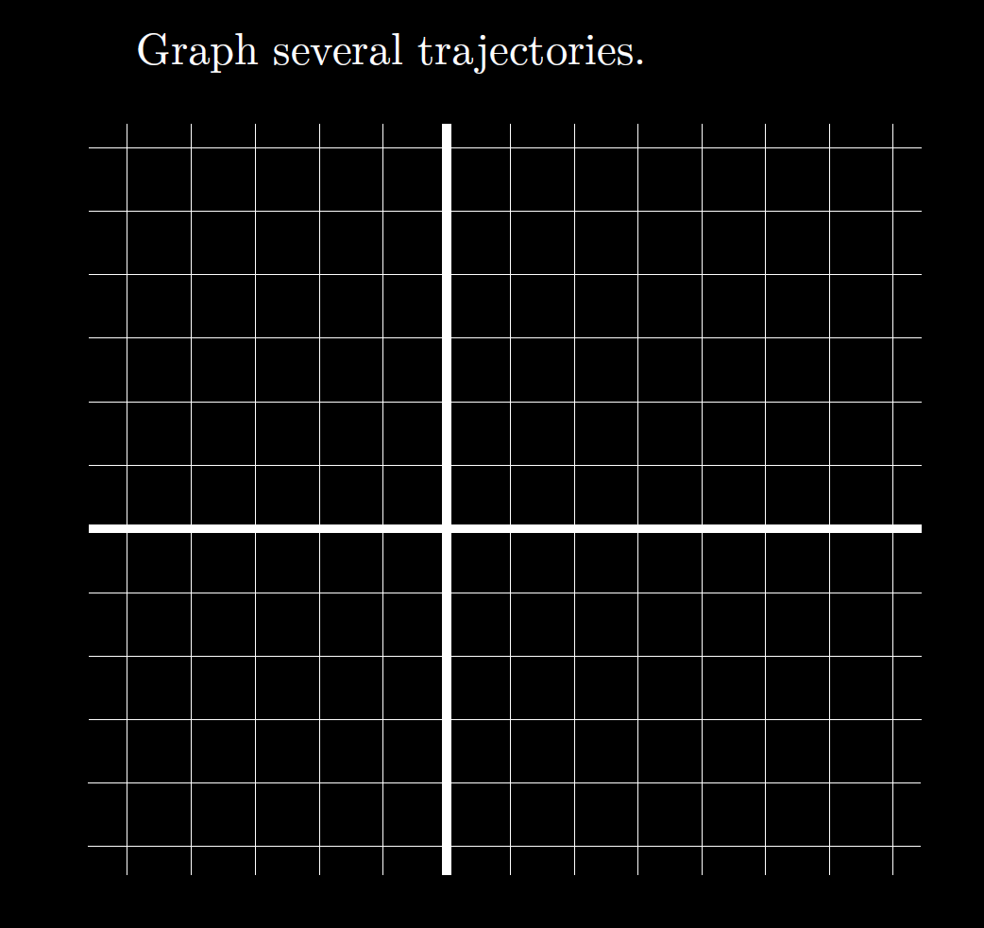

Slide 42
