Slide 1
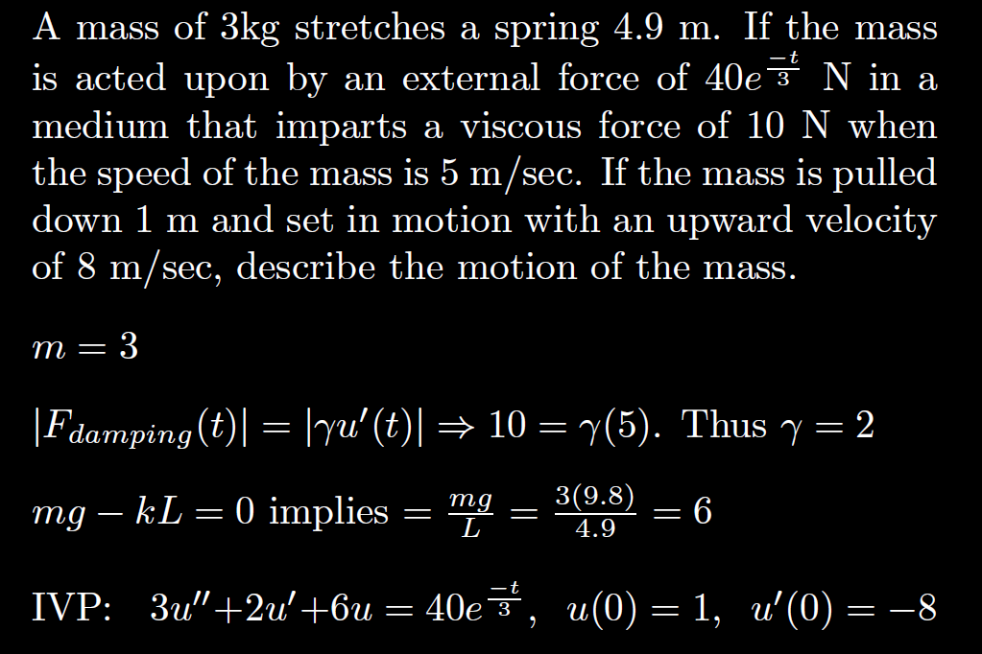

Slide 2
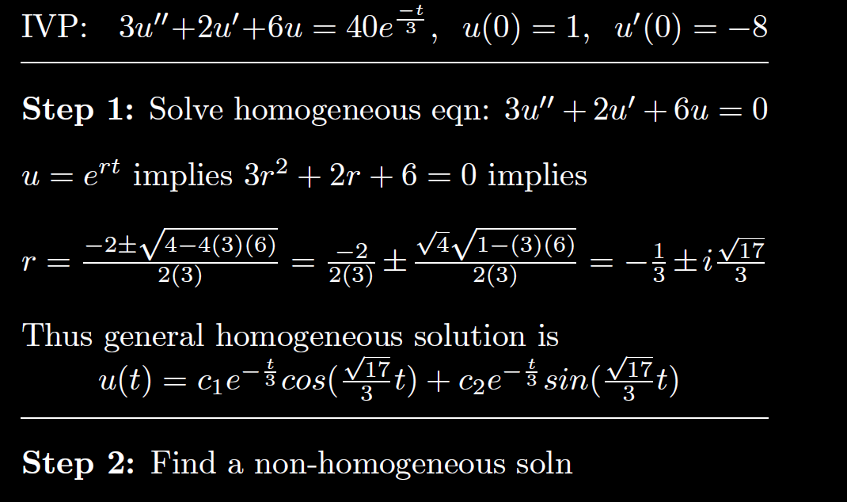

Slide 3
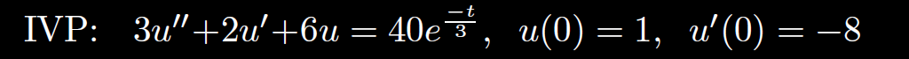
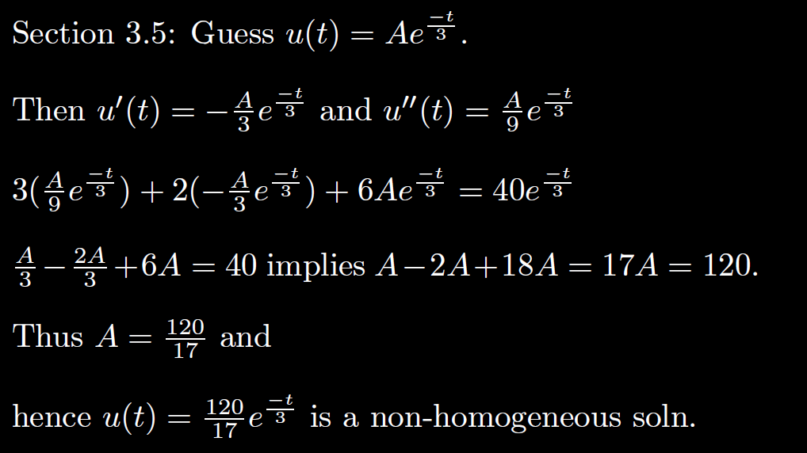

Slide 4
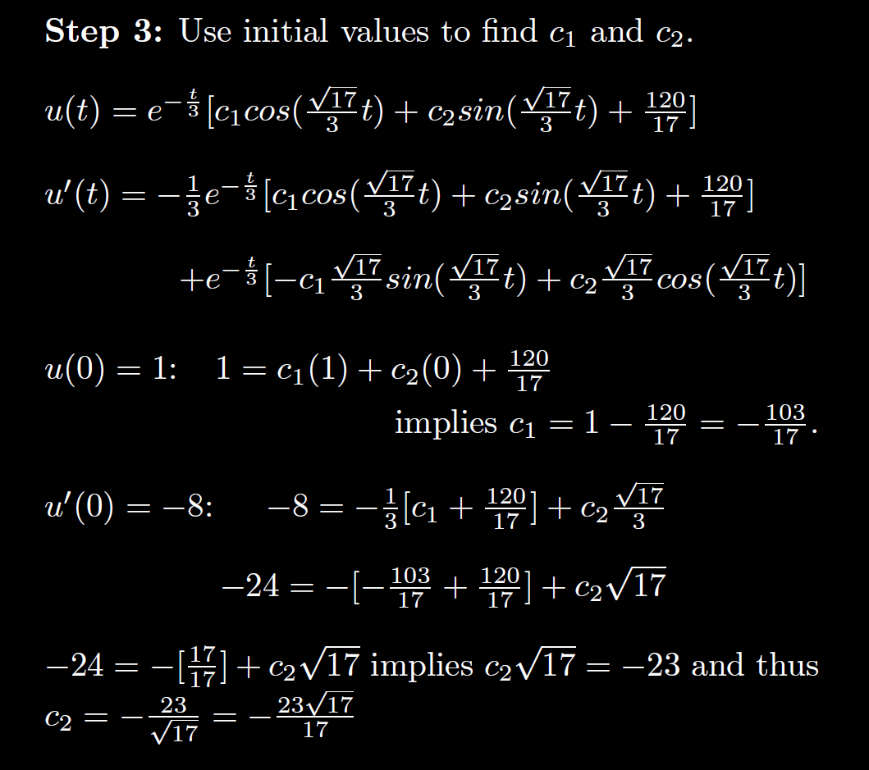

Slide 5
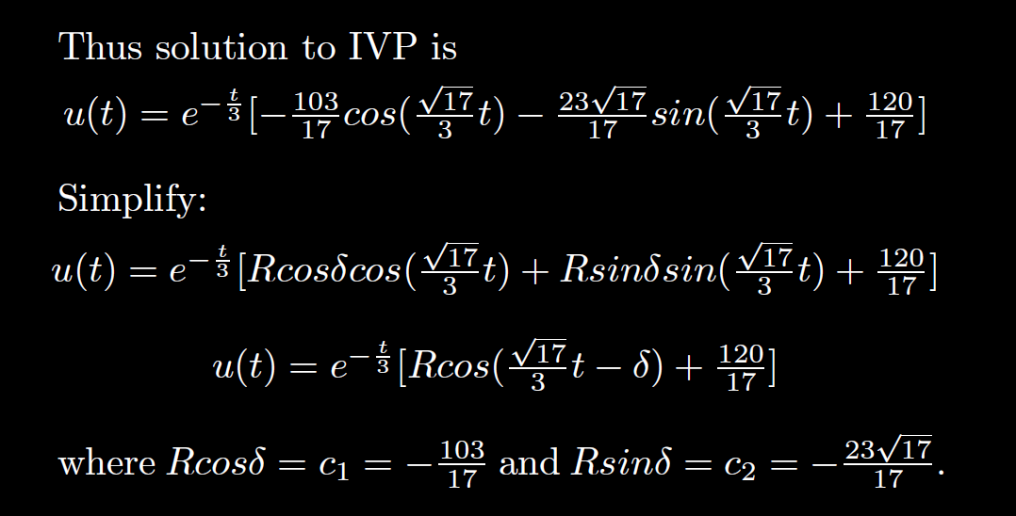

Slide 9
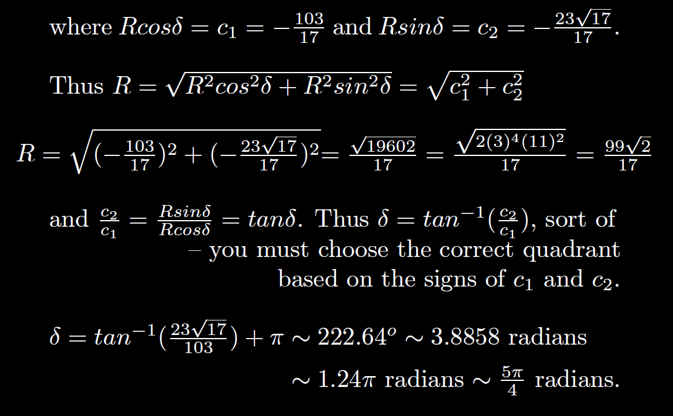
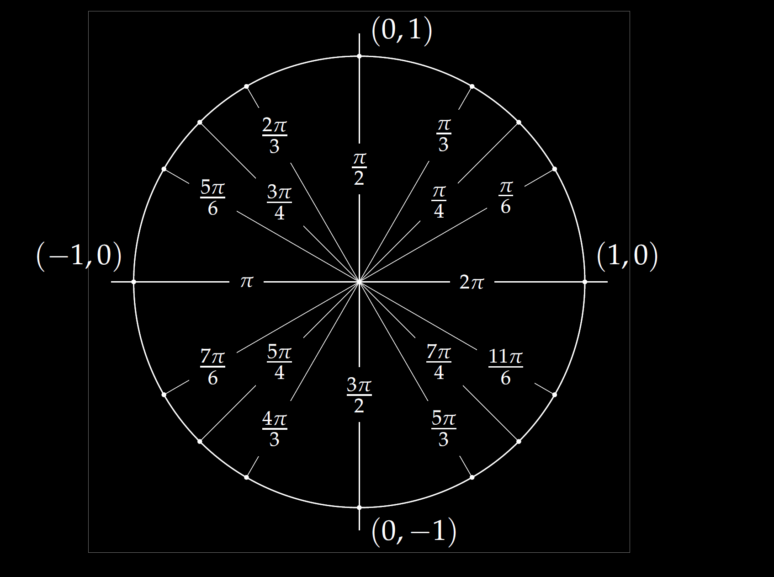

Slide 12
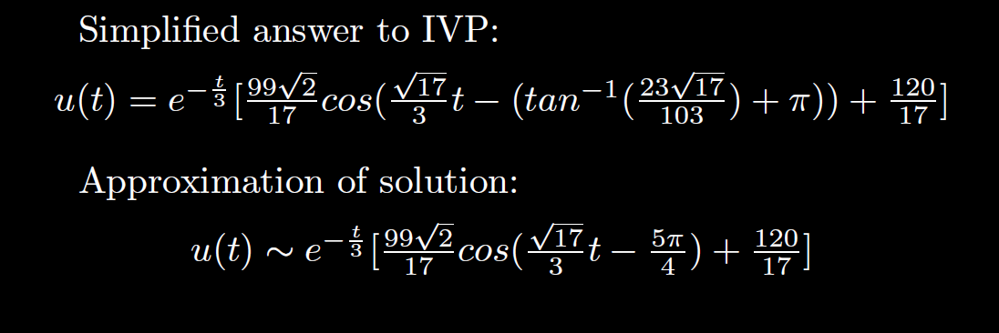

Slide 13
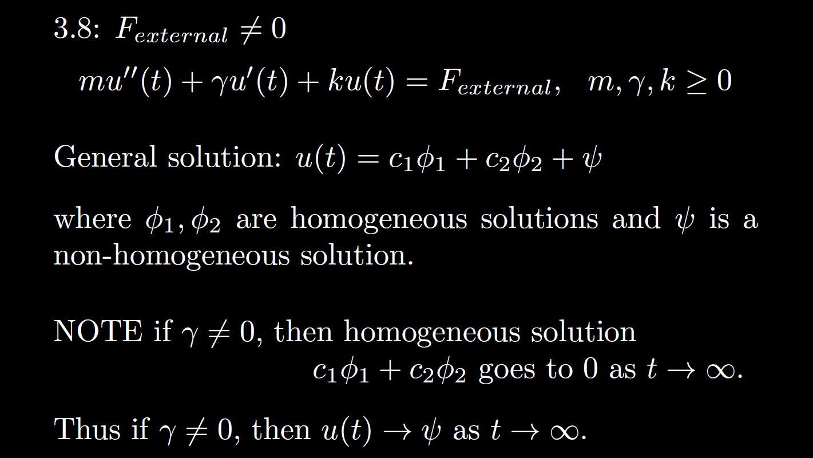

Slide 14
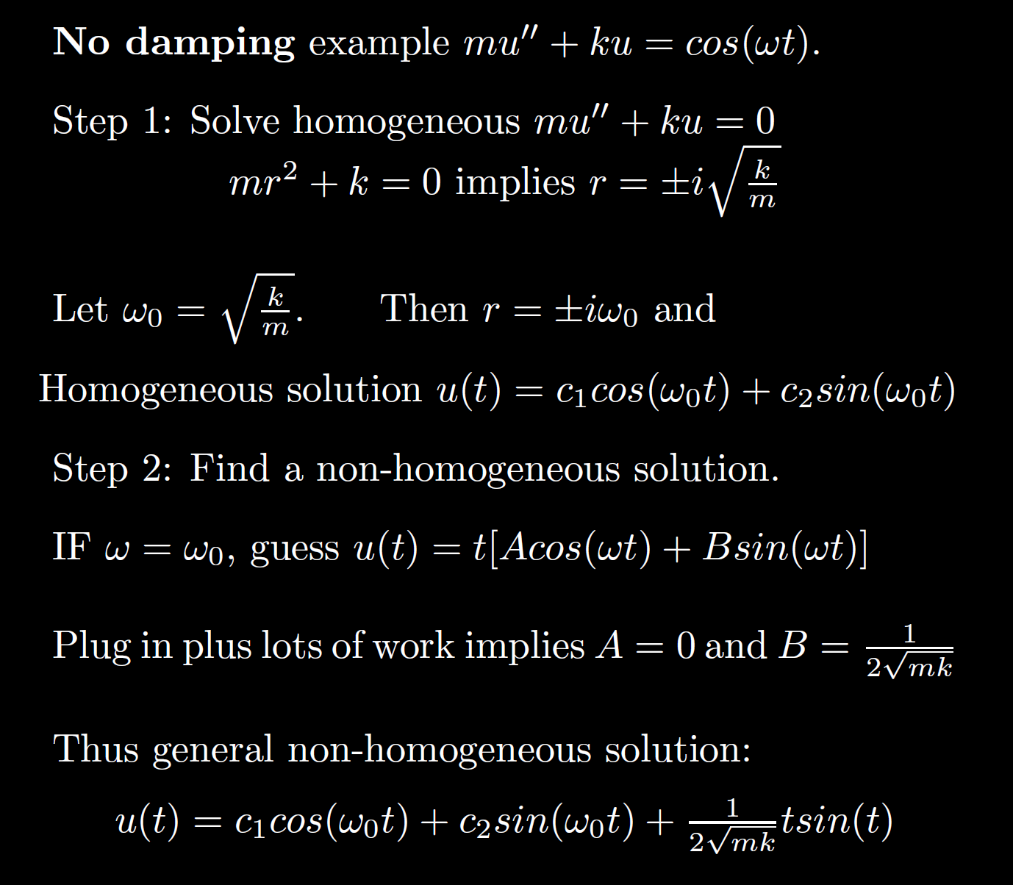

Slide 17
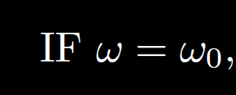
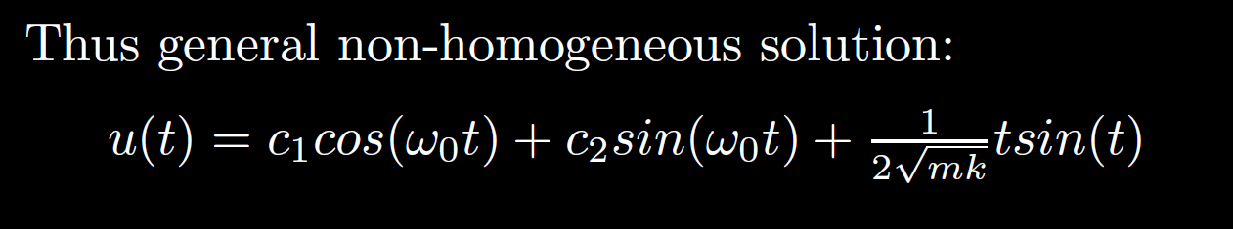

Slide 18
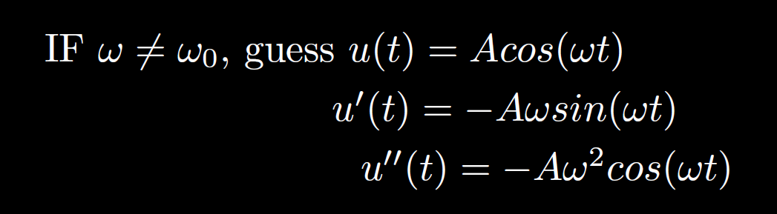

Slide 19
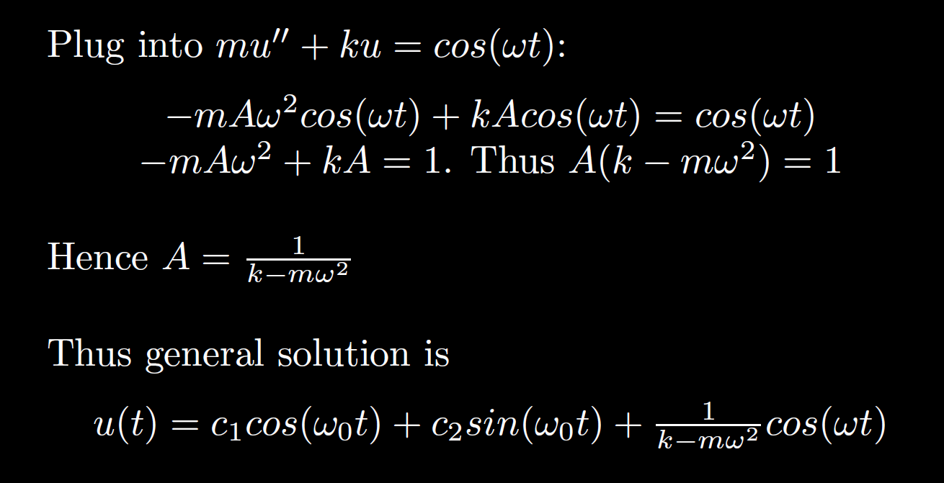

Slide 20

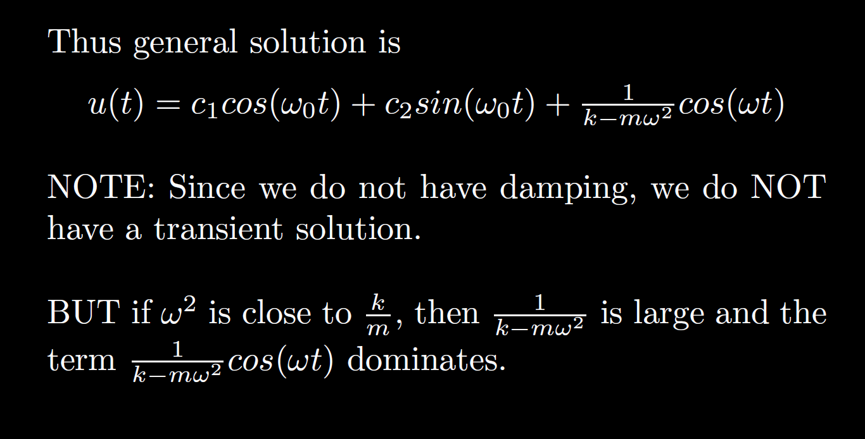

Slide 21
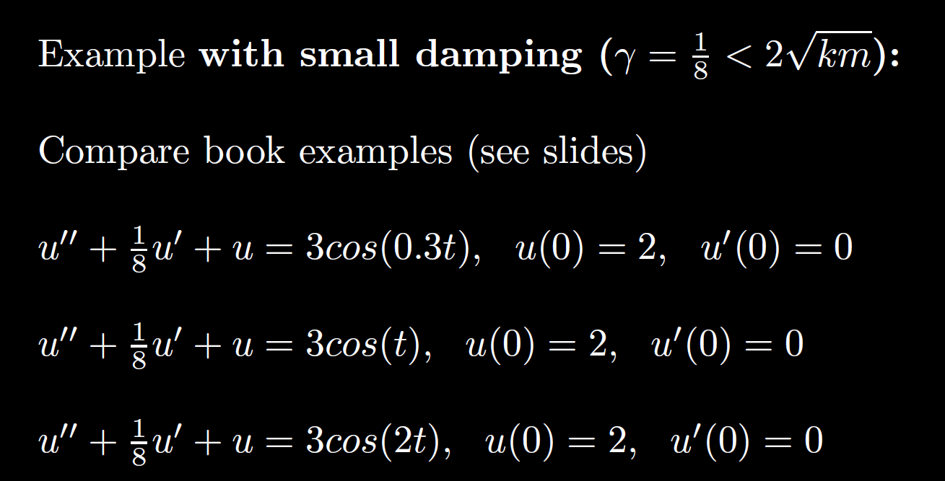

Slide 22
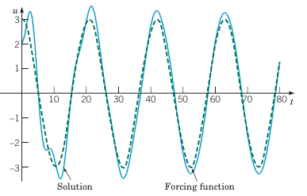
Example 2:
Forced Vibrations with Damping (2 of 4)
Graphs of the solution, along with the graph of the ratios Rk/F vs. for .
Boyce/DiPrima/Meade 11th ed, Ch 3.8: Forced Periodic Vibrations

Slide 23
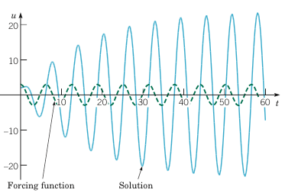
Example 2:
Forced Vibrations with Damping (3 of 4)
Graphs of the solution, along with the graph of the ratios Rk/F vs. for .
Boyce/DiPrima/Meade 11th ed, Ch 3.8: Forced Periodic Vibrations

Slide 24
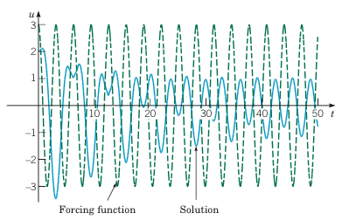
Example 2:
Forced Vibrations with Damping (4 of 4)
Graphs of the solution, along with the graph of the ratios Rk/F vs. for .
Boyce/DiPrima/Meade 11th ed, Ch 3.8: Forced Periodic Vibrations

Slide 30
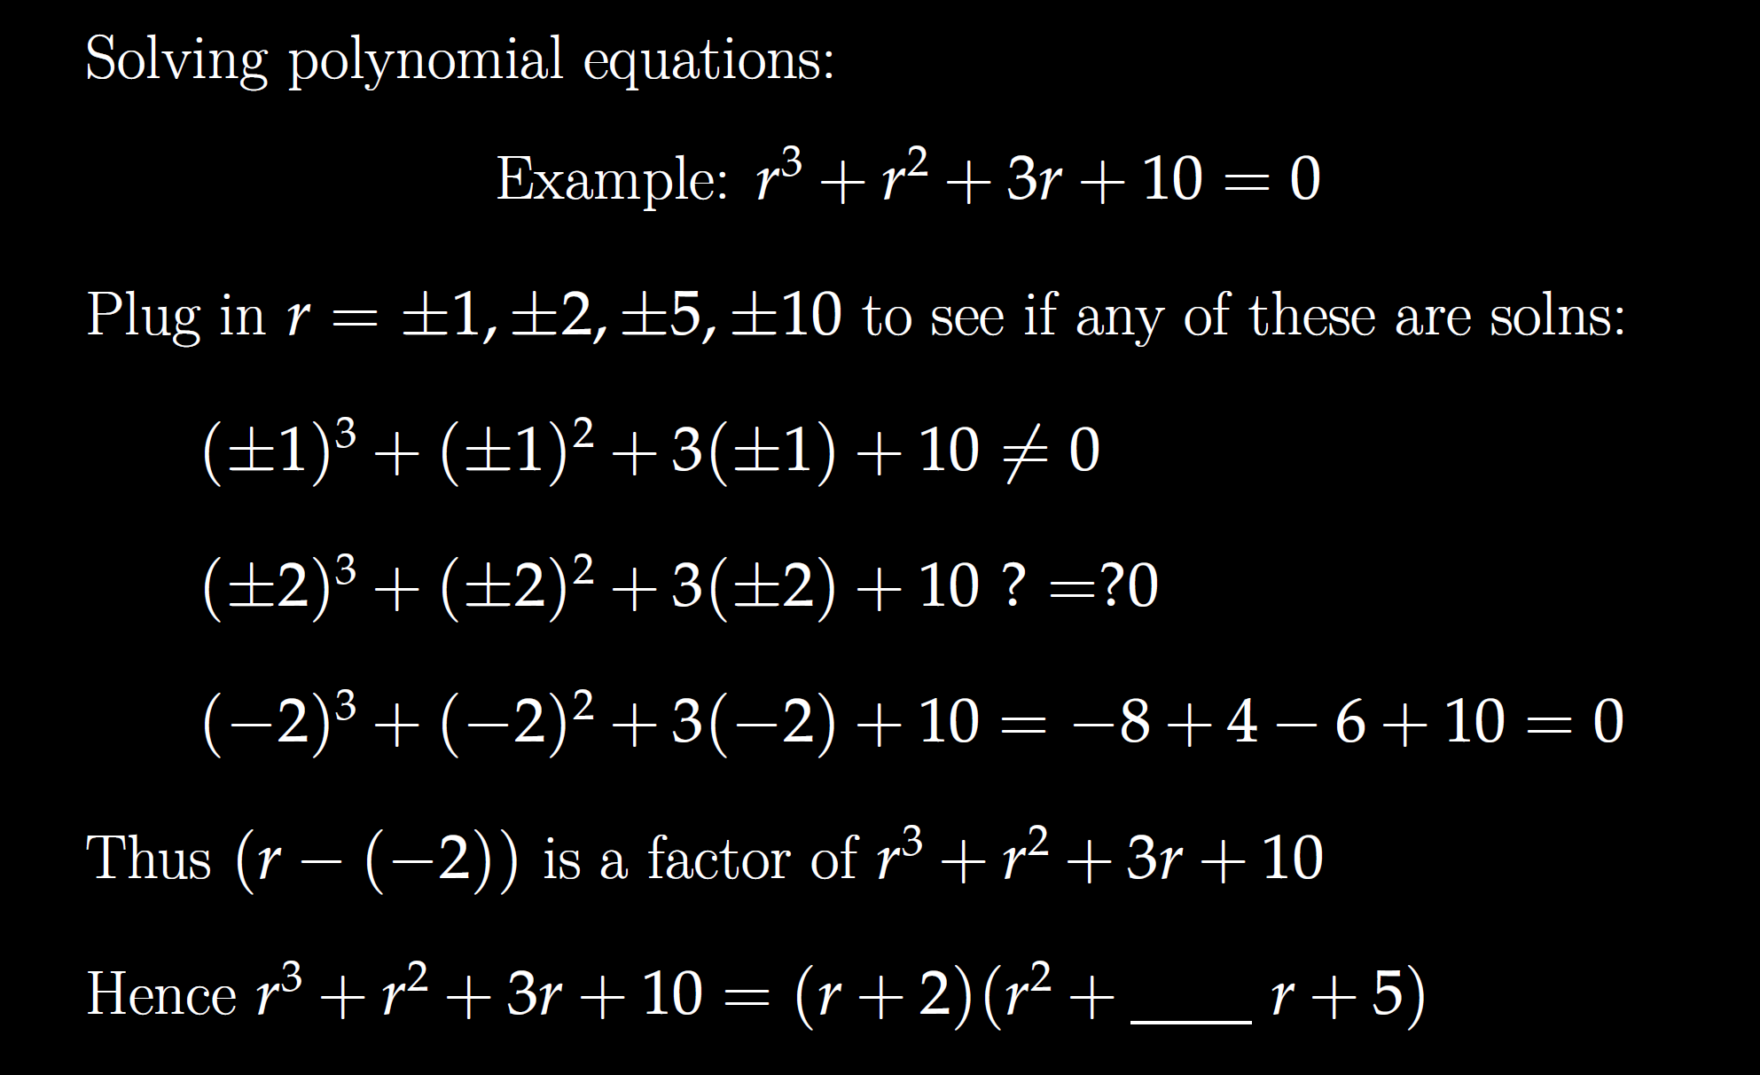

Slide 31
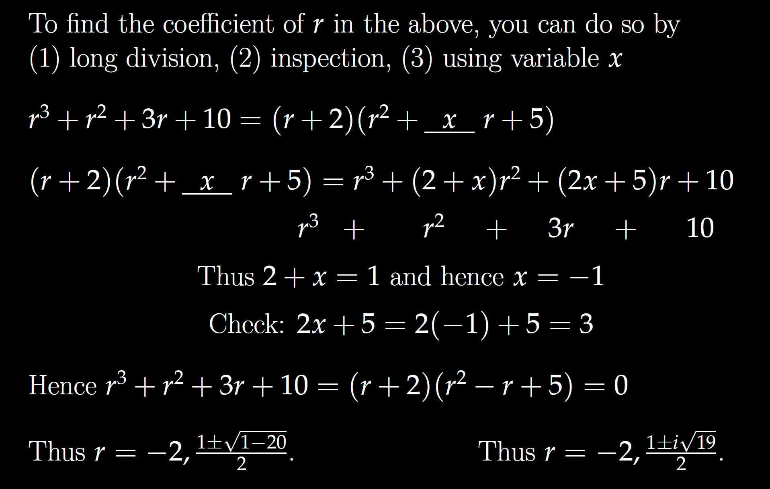

Slide 32
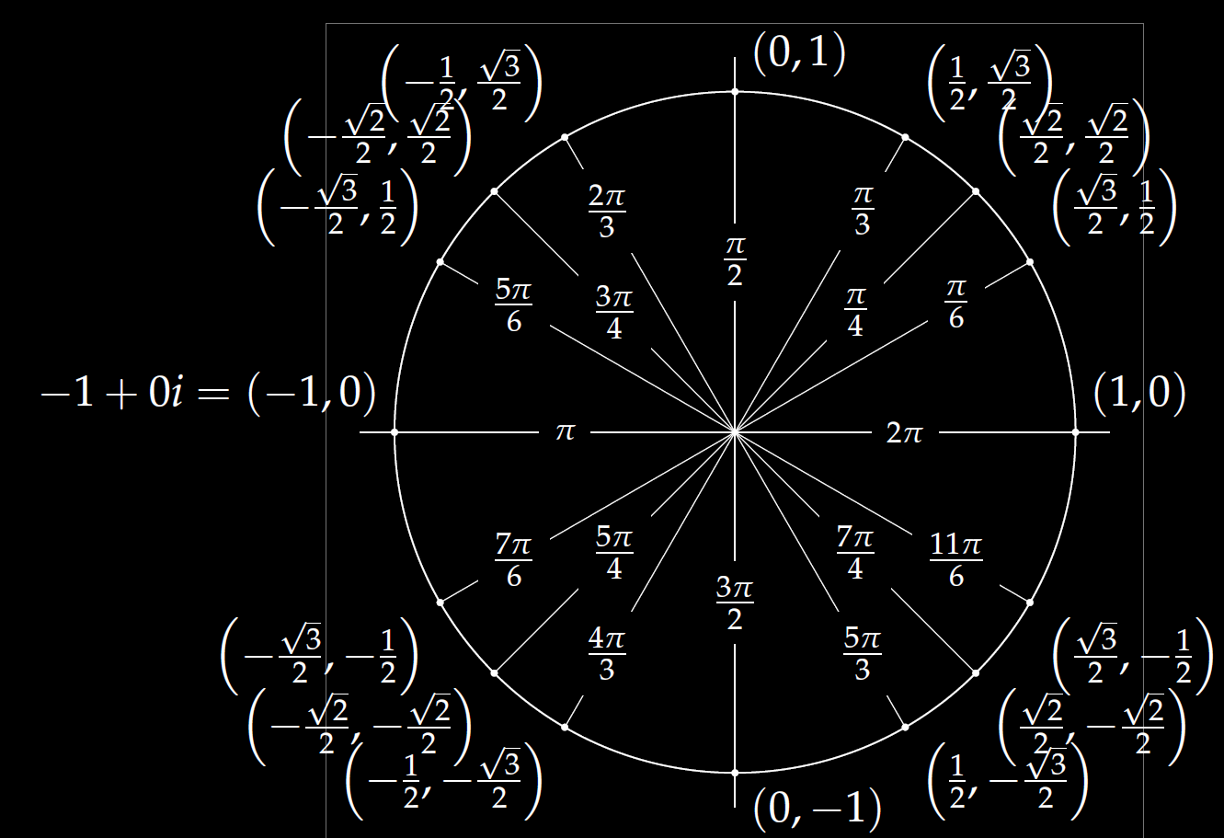
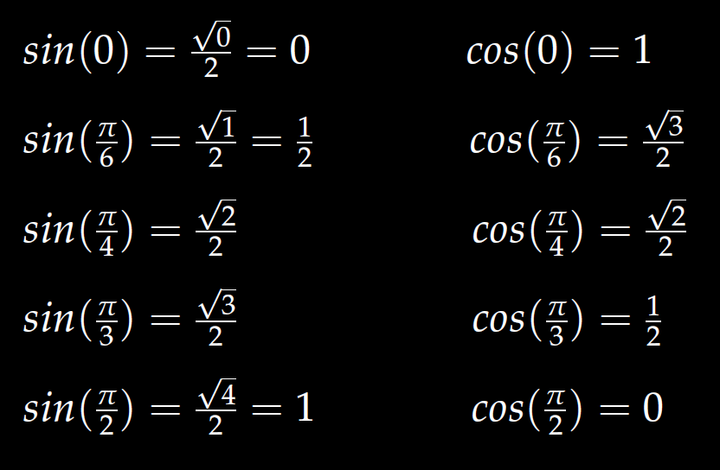
In special cases, you can use the unit circle.

Slide 33
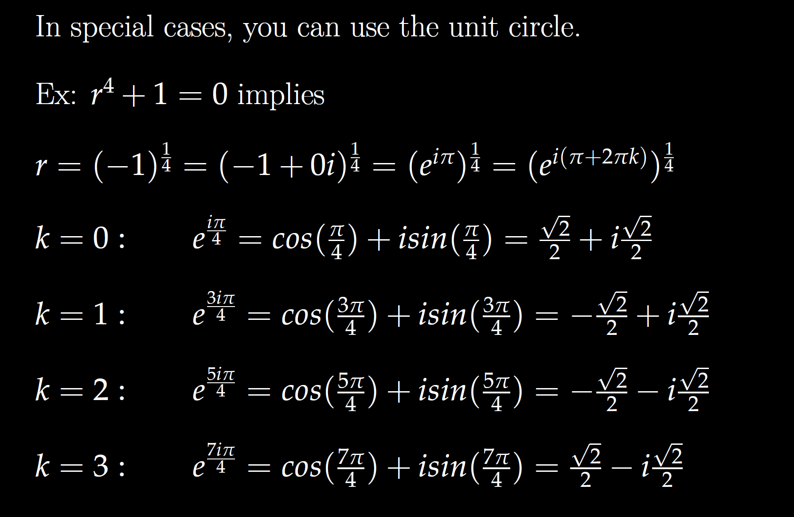

Slide 40
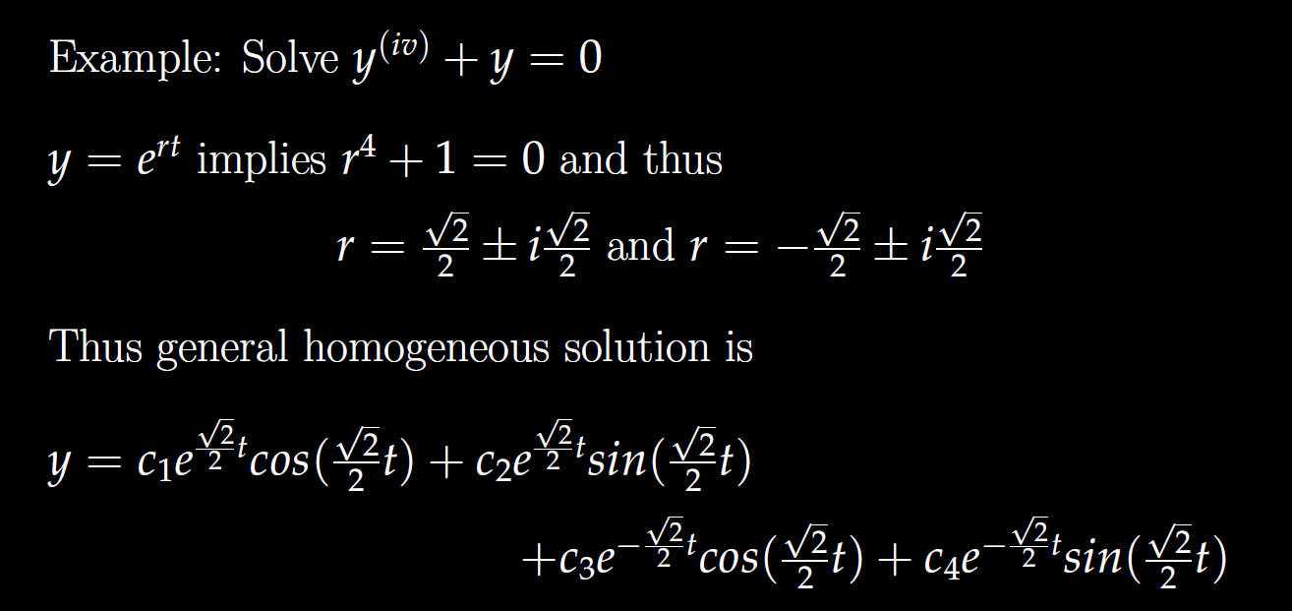

Slide 46
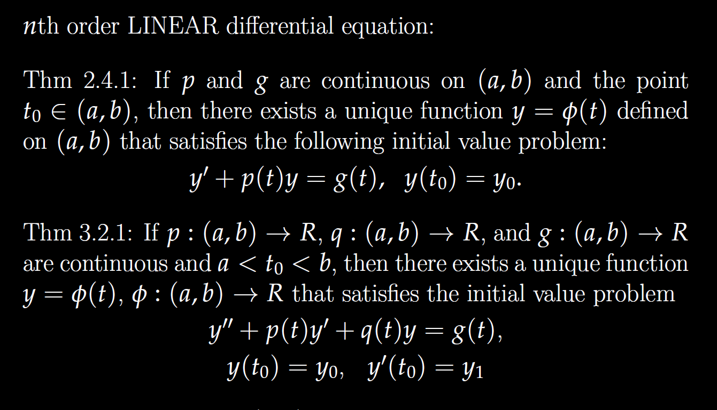

Slide 47
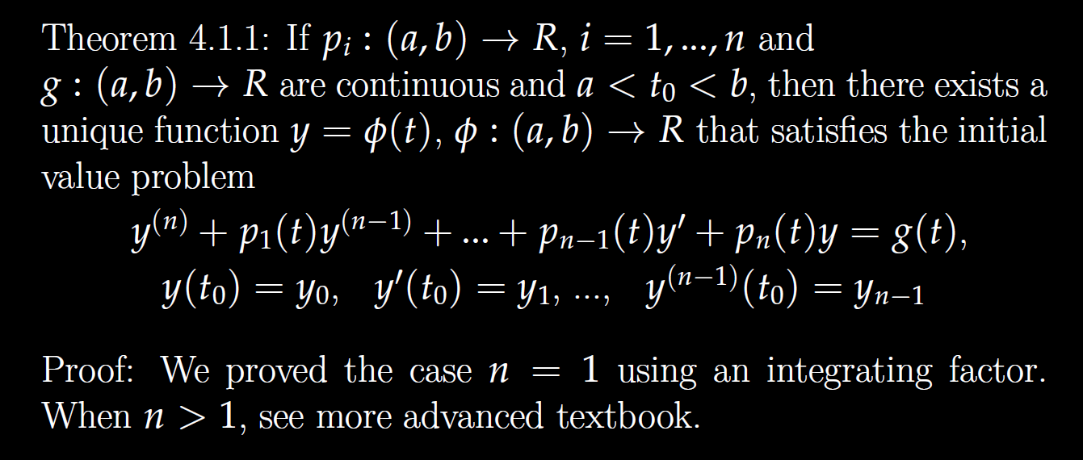

Slide 48
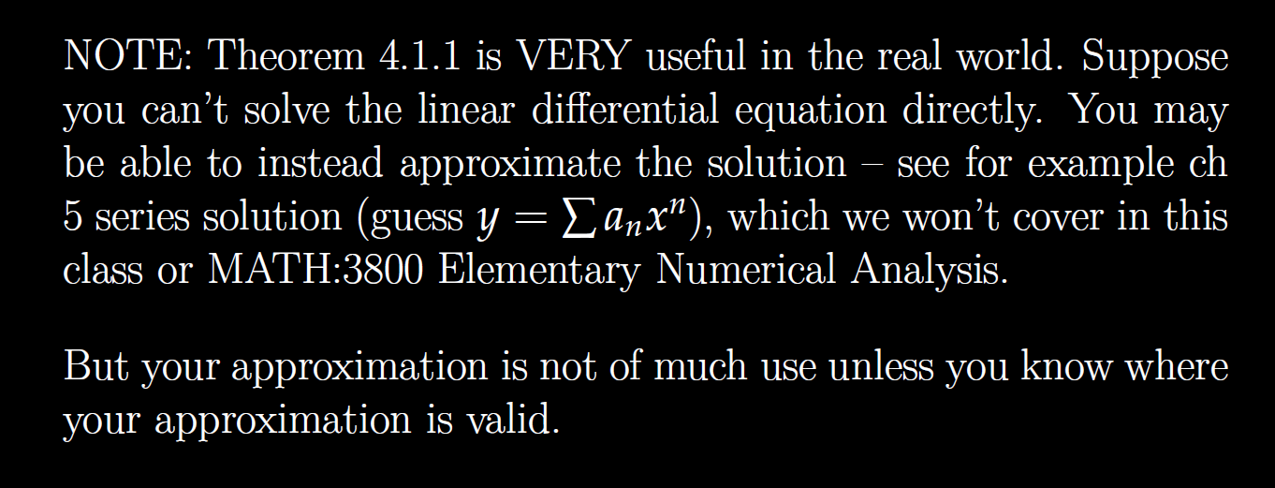

Slide 49
Determine (without solving the problem) an interval in which the solution of the given initial value problem is certain to exist and be unique.
$$\left(1 − t\right)\left(1 + t^{2}\right)y^{′′′}+\ln\left|t − 5\right|y^{′}+2y = \sqrt{t+4} y(0) = 3$$

Slide 54
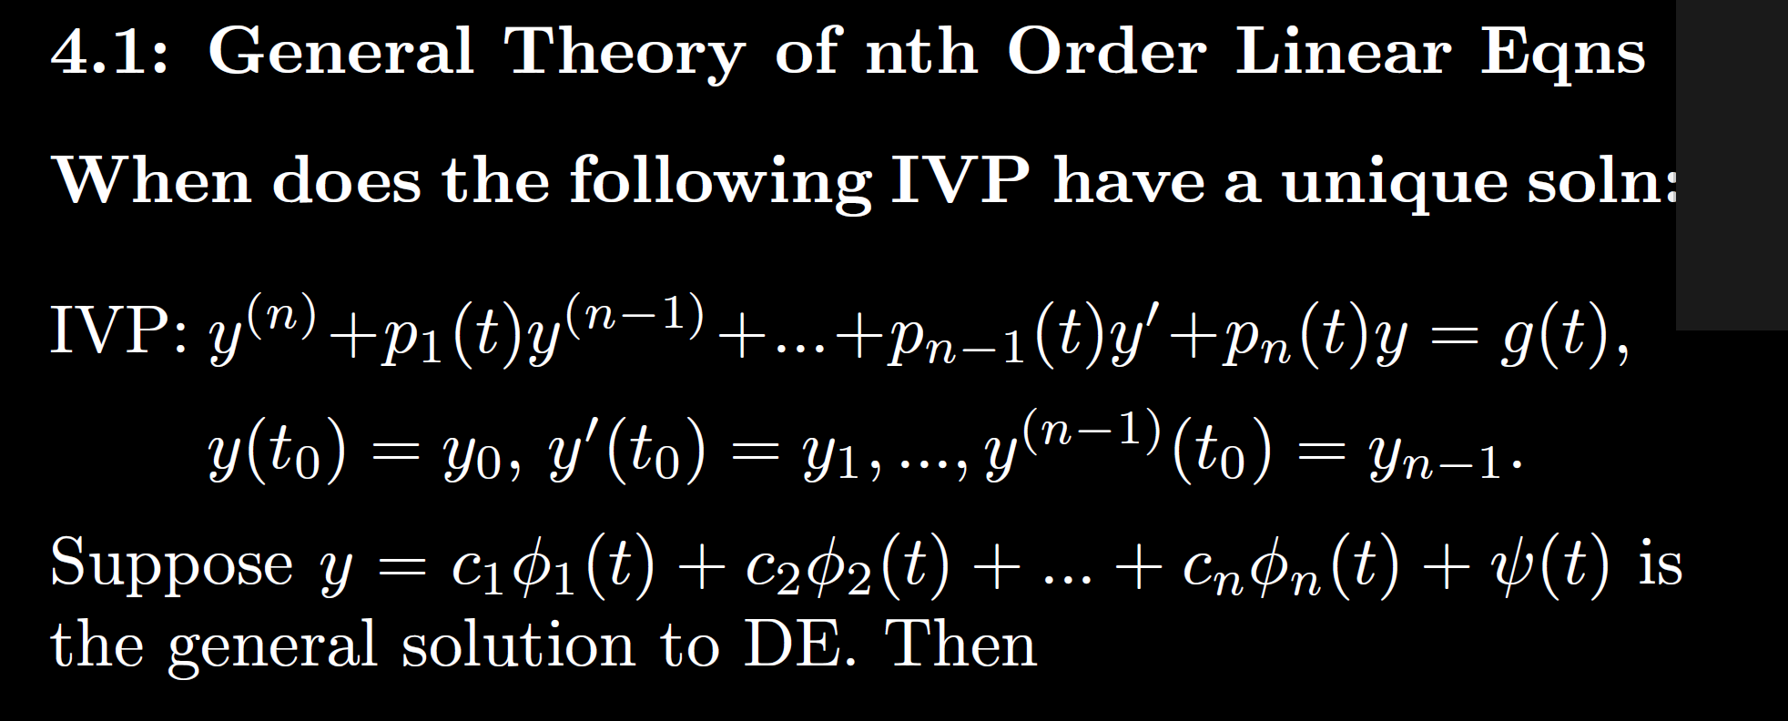

Slide 55
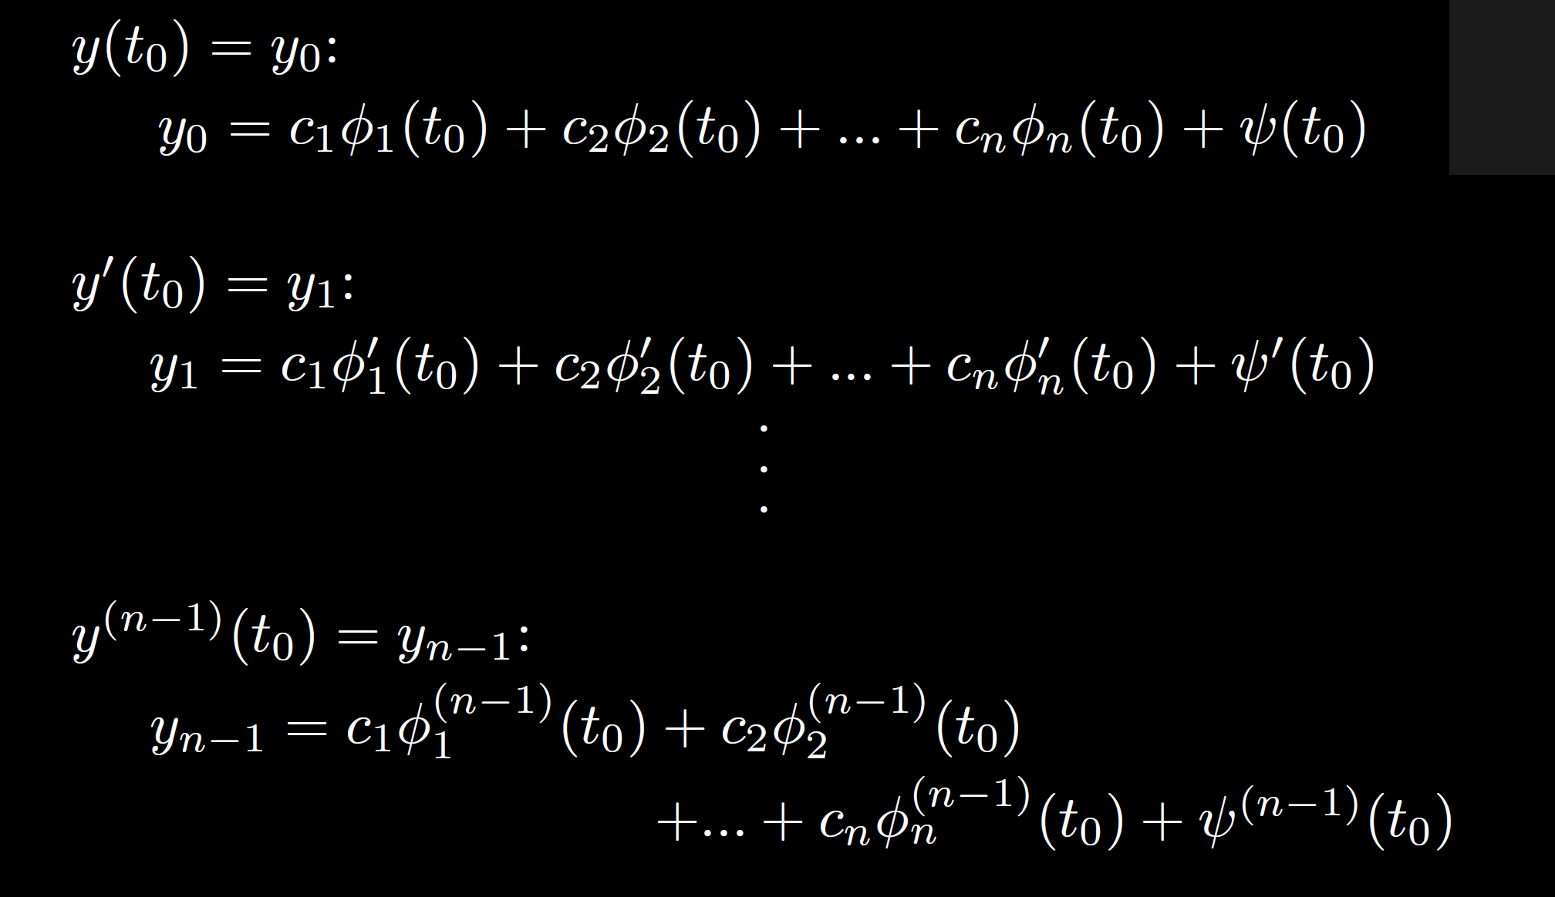

Slide 56
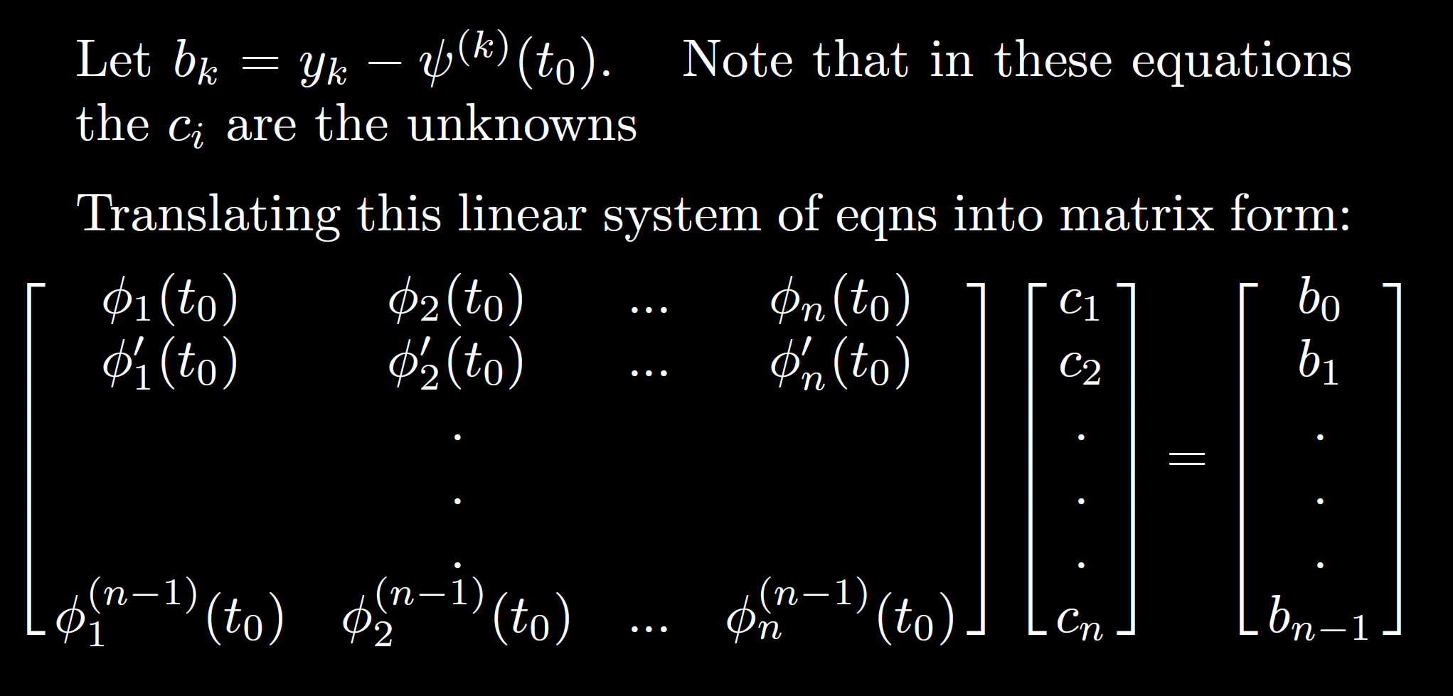

Slide 57
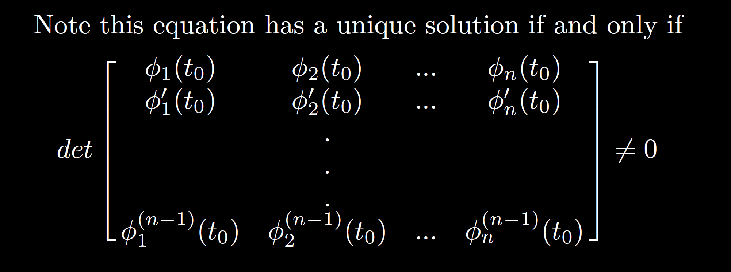

Slide 58
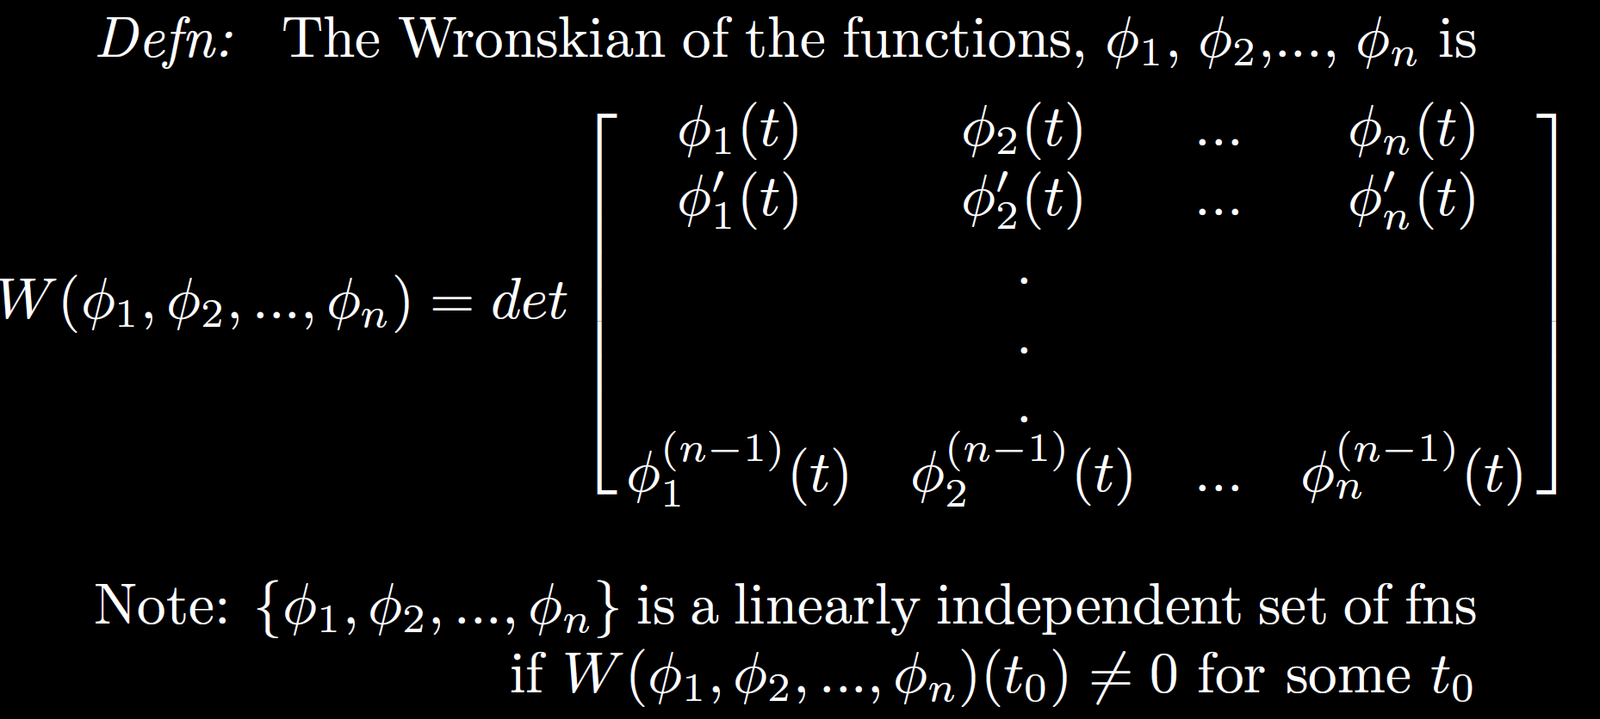

Slide 59
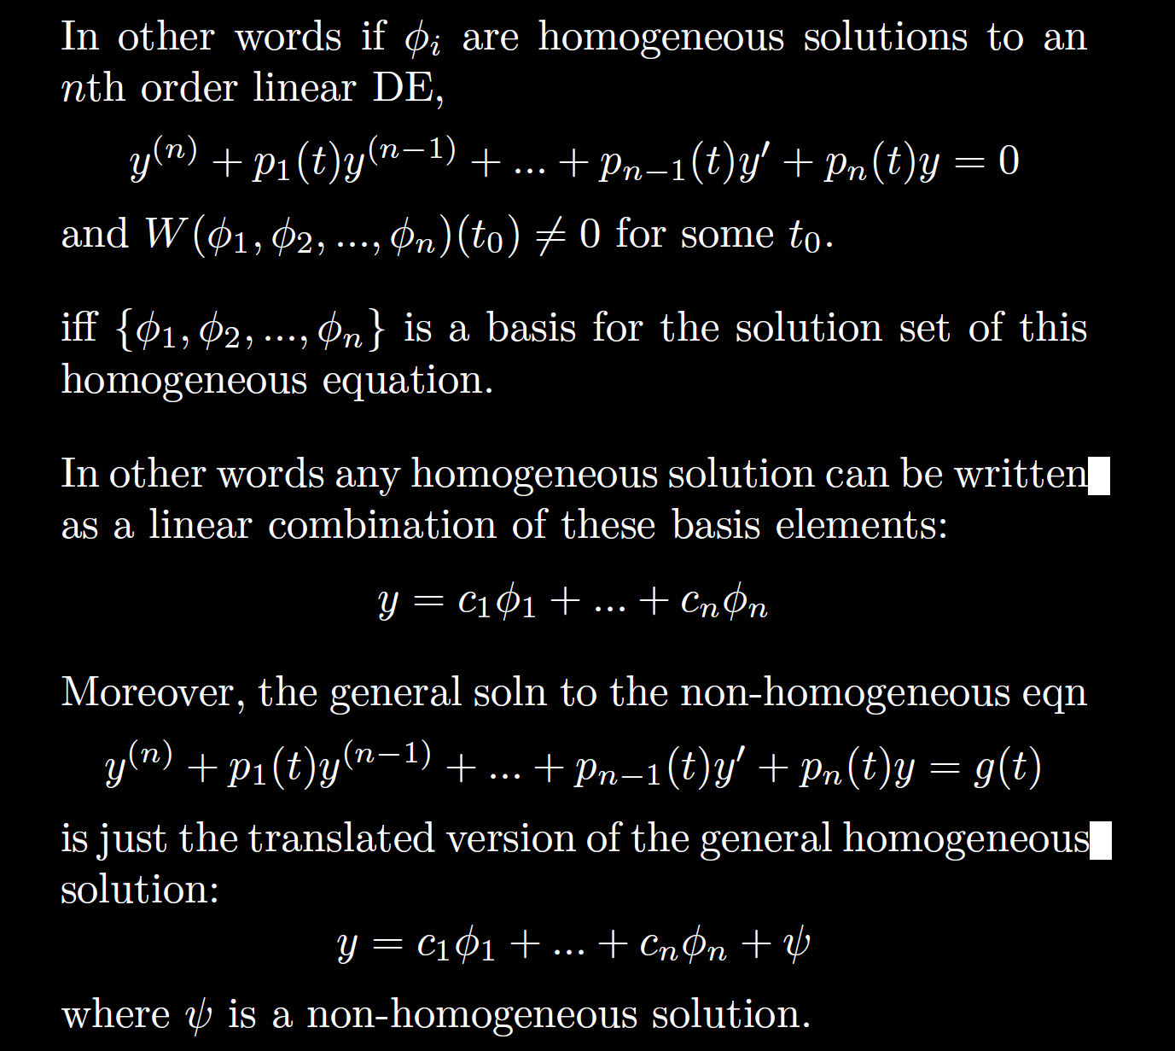

Slide 62
Linear Independence and the Wronskian

Slide 63
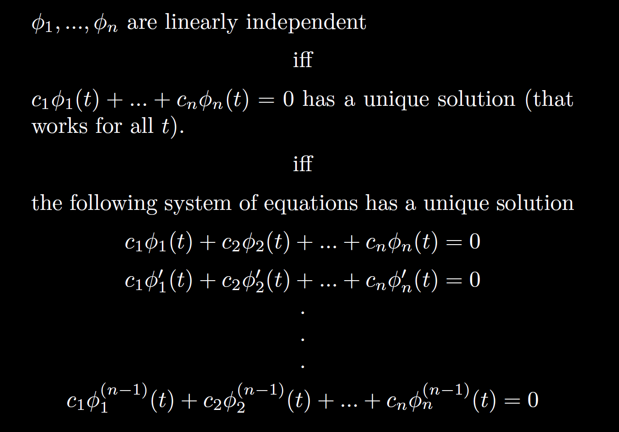

Slide 64
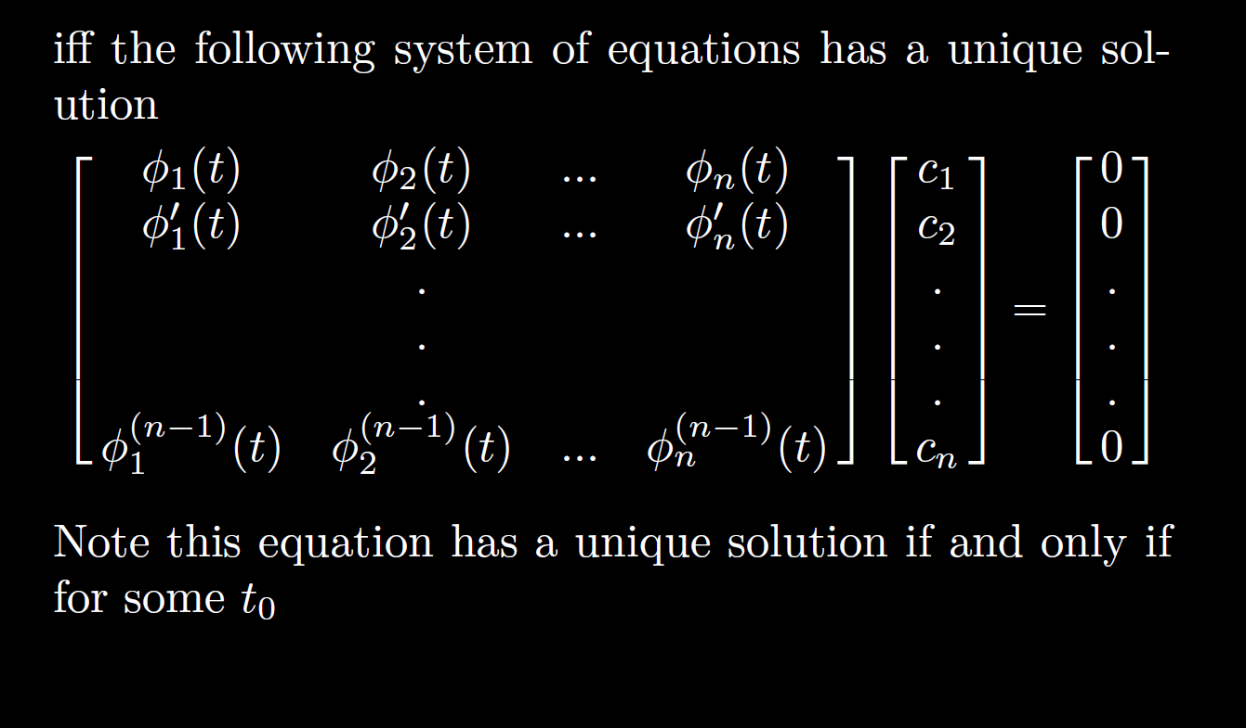

Slide 65
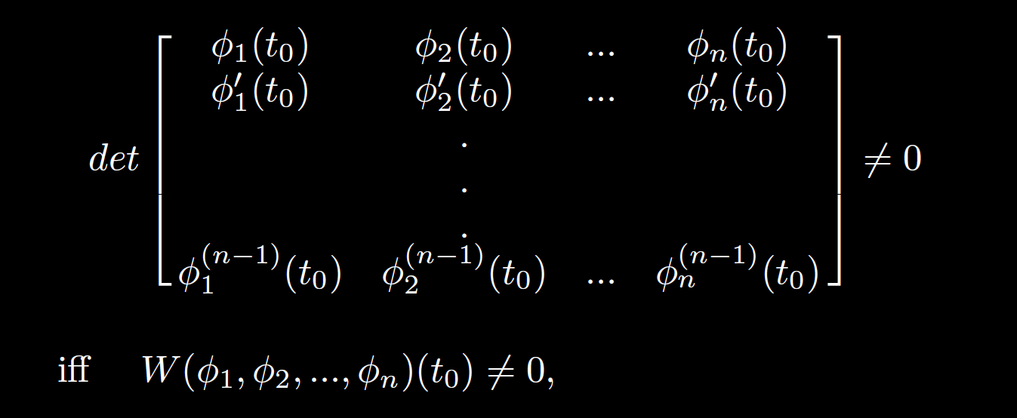

Slide 66
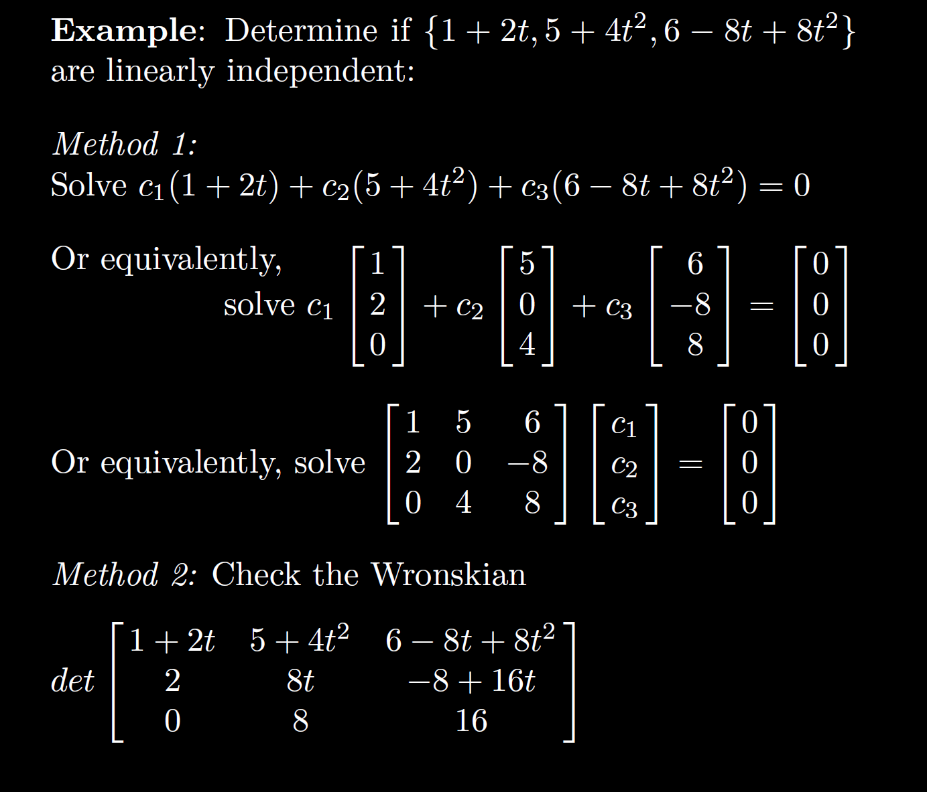

Slide 71
