Slide 1
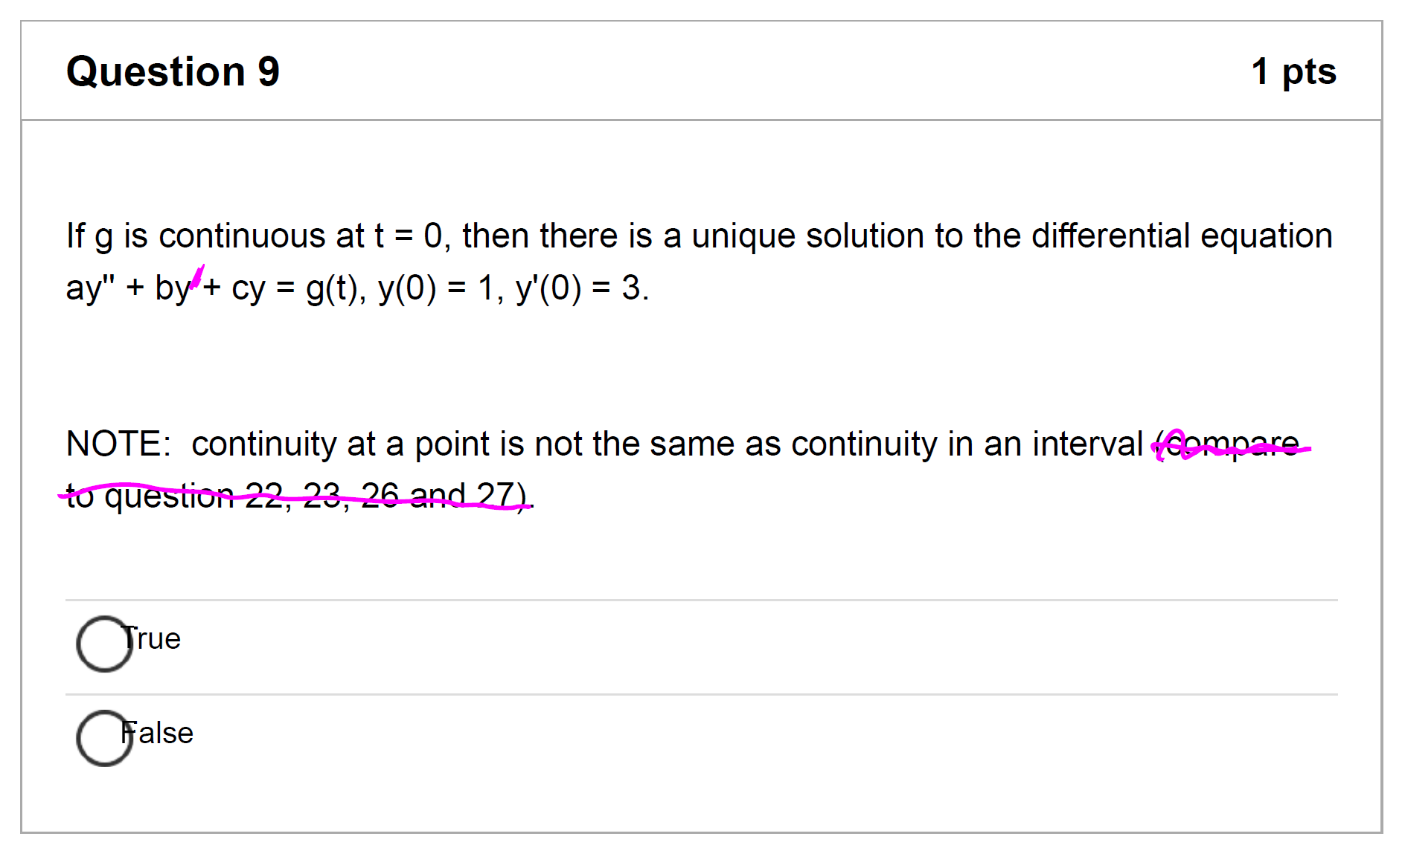
Typos on LS Quiz 5
Due Mar 24
See course announcement for pdf showing typos
plus a nicer multiple choice review with answers.

Slide 3
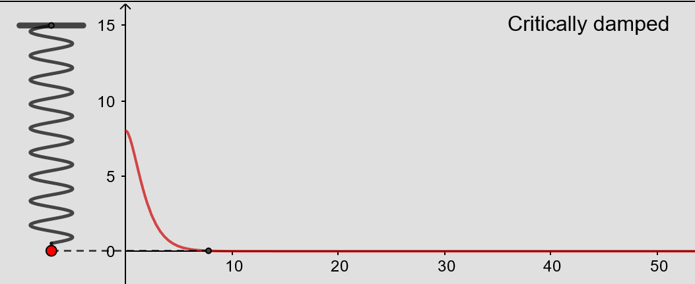
From https://www.geogebra.org/m/ZzKbkvnz
Note: Sign convention is opposite our convention

Slide 4
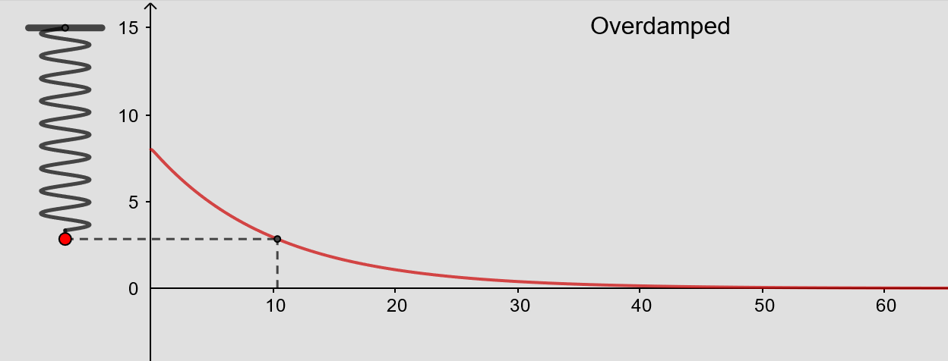
From https://www.geogebra.org/m/ZzKbkvnz
Note: Sign convention is opposite our convention

Slide 5
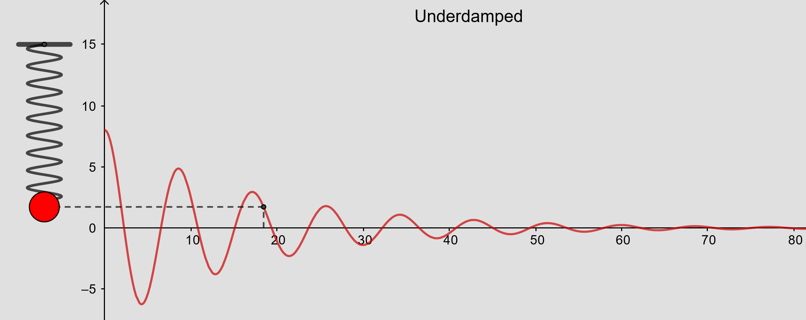
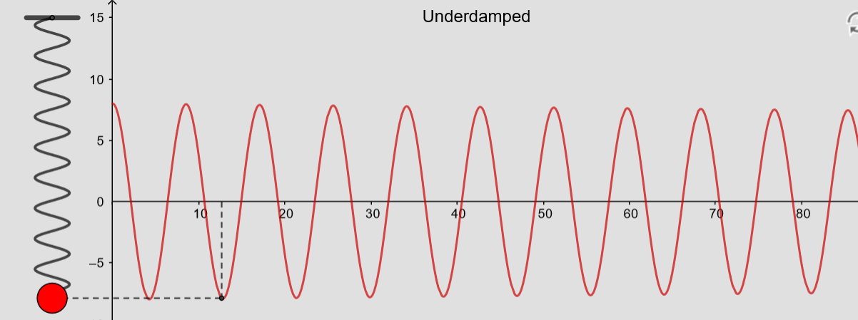
From https://www.geogebra.org/m/ZzKbkvnz
Note: Sign convention is opposite our convention

Slide 6
From https://www.geogebra.org/m/ZzKbkvnz
Note: Sign convention is opposite our convention

Slide 8
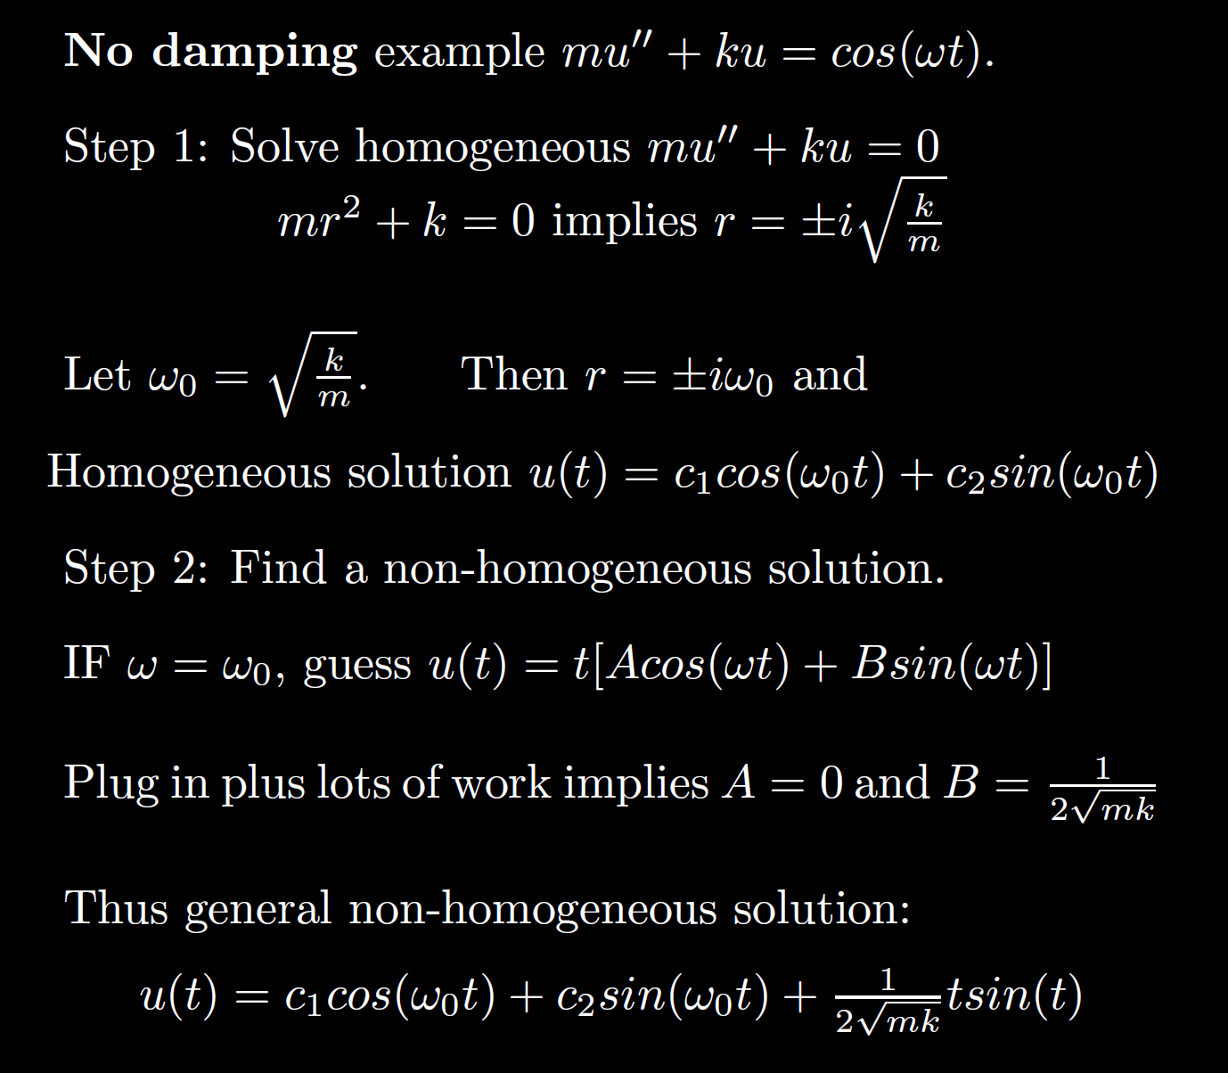
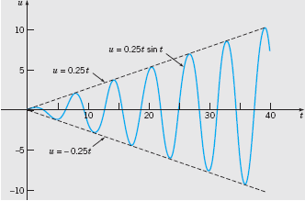
Boyce/DiPrima/Meade 11th ed, Ch 3.8: Forced Periodic Vibrations

Slide 13
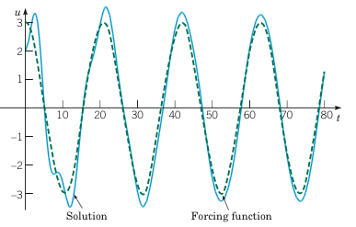
Example 2: Forced Vibrations with Damping (2 of 4)
Graphs of the solution and external force for .
Boyce/DiPrima/Meade 11th ed, Ch 3.8: Forced Periodic Vibrations

Slide 14
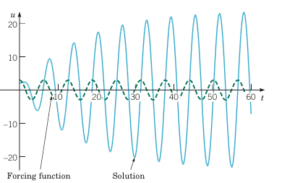
Example 2: Forced Vibrations with Damping (3 of 4)
Graphs of the solution and external force for
Boyce/DiPrima/Meade 11th ed, Ch 3.8: Forced Periodic Vibrations

Slide 15
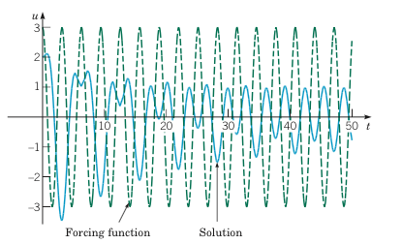
Example 2: Forced Vibrations with Damping (4 of 4)
Graphs of the solution and external force for
Boyce/DiPrima/Meade 11th ed, Ch 3.8: Forced Periodic Vibrations

Slide 28
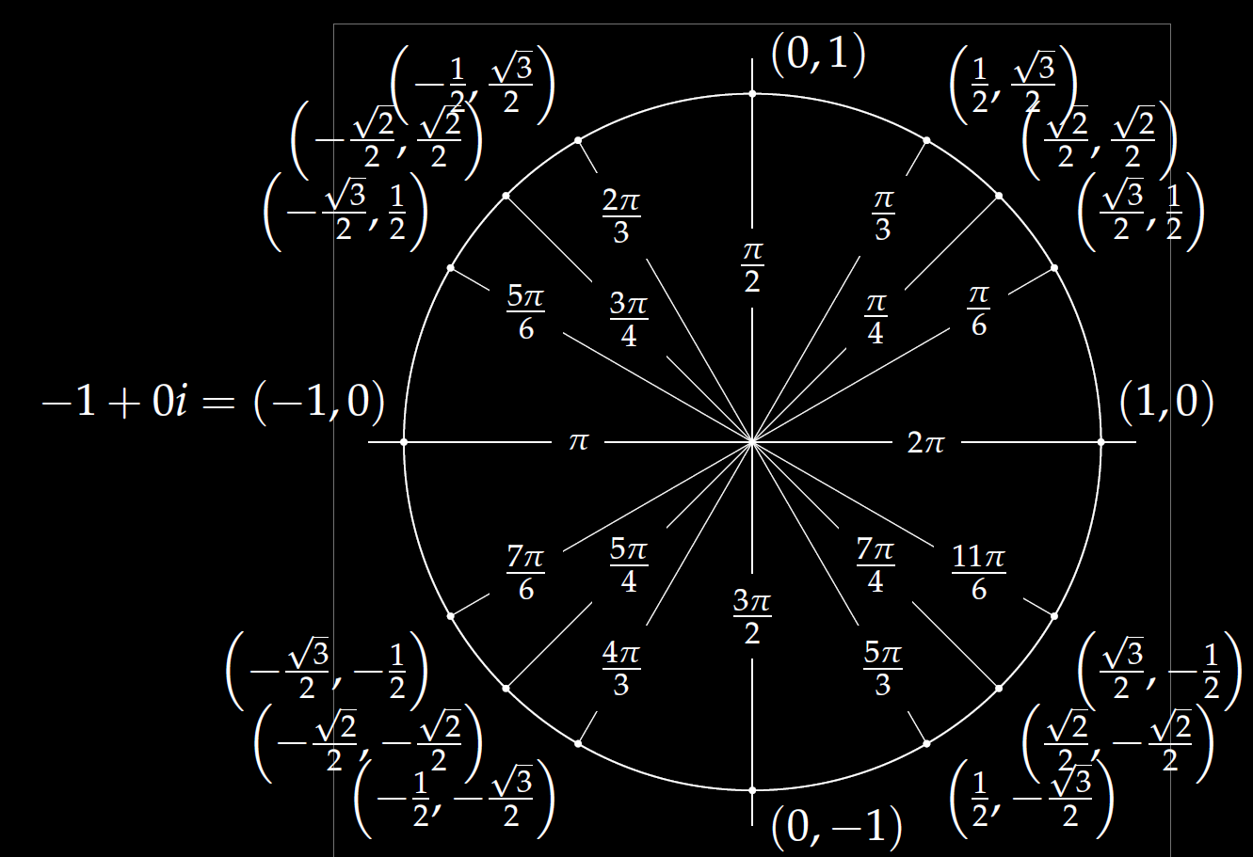
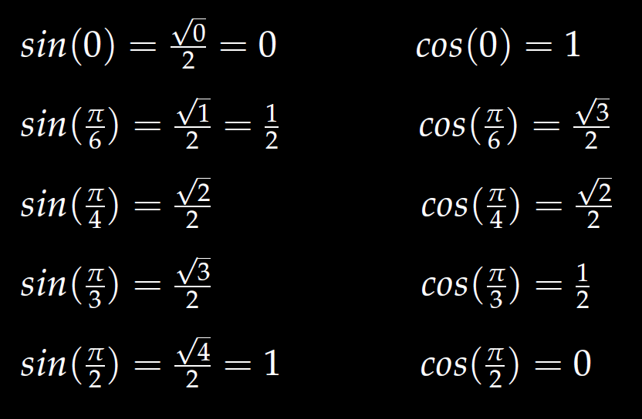
In special cases, you can use the unit circle.
Roots of unity
r^{n} = 1
We will also solve
r^{n} = -1

Slide 50
Determine (without solving the problem) an interval in which the solution of the given initial value problem is certain to exist and be unique.
$$\left(1 − t\right)\left(1 + t^{2}\right)y^{′′′}+\ln\left|t − 5\right|y^{′}+2y = \sqrt{t+4} y(0) = 3$$

Slide 63
Linear Independence and the Wronskian

Slide 66
