Slide 1
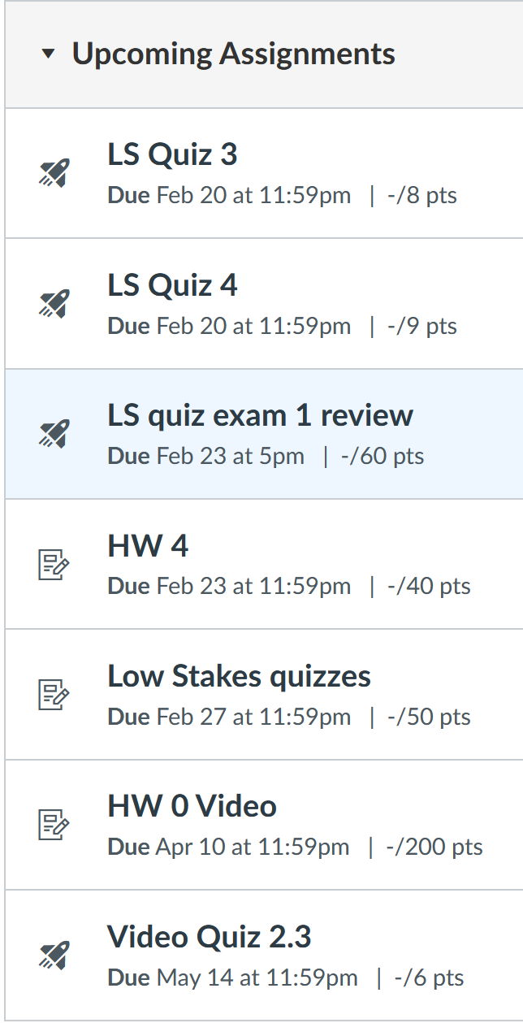
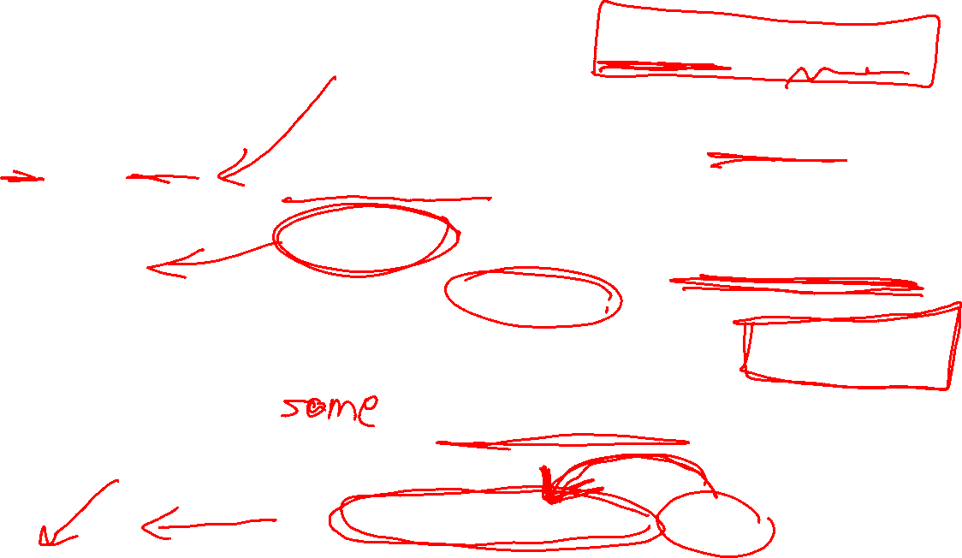
LS quizzes: Yes grading is weird, but if you make decent attempt, you will be given 50 points = 100%. The main purpose of these quizzes is to give you feedback and practice.
LS quiz exam 1 review is good practice for multiple choice part of the exam.
Show all work. The HW grader will start giving 0 points if you do not show work. I WILL GIVE 0 POINTS ON EXAM 1 IF YOU DO NOT SHOW WORK – this includes work done by online calculator – don’t just give answer. CITE all sources.
Quizzes from mechanical vibrations will be due Wednesday after Exam 1
From HW 0 Exam 1 review videos. Infinite attempts allowed for this quiz (but only for video quizzes before exam 1)

Slide 2
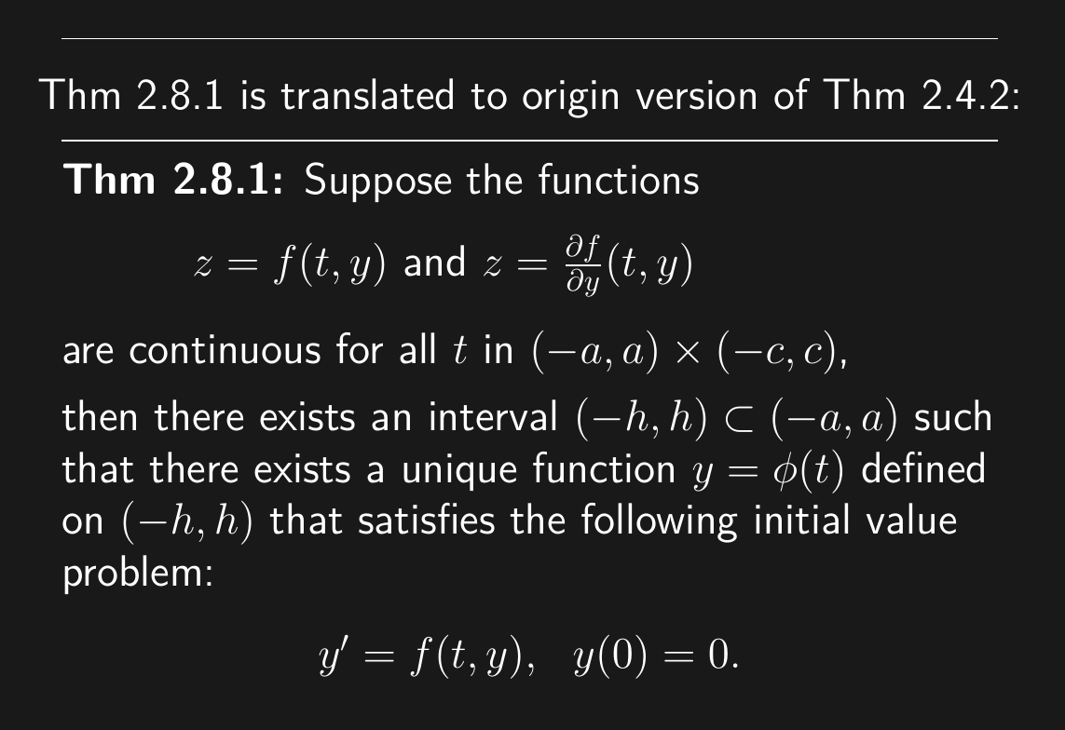
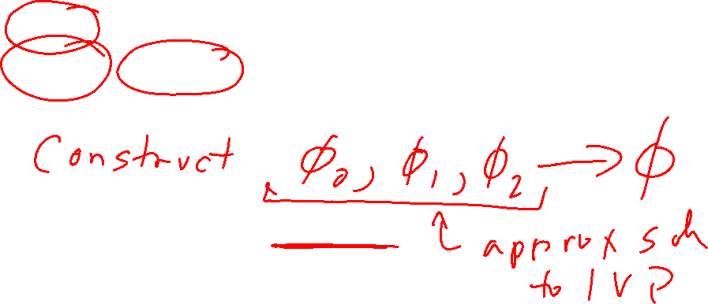

Slide 3
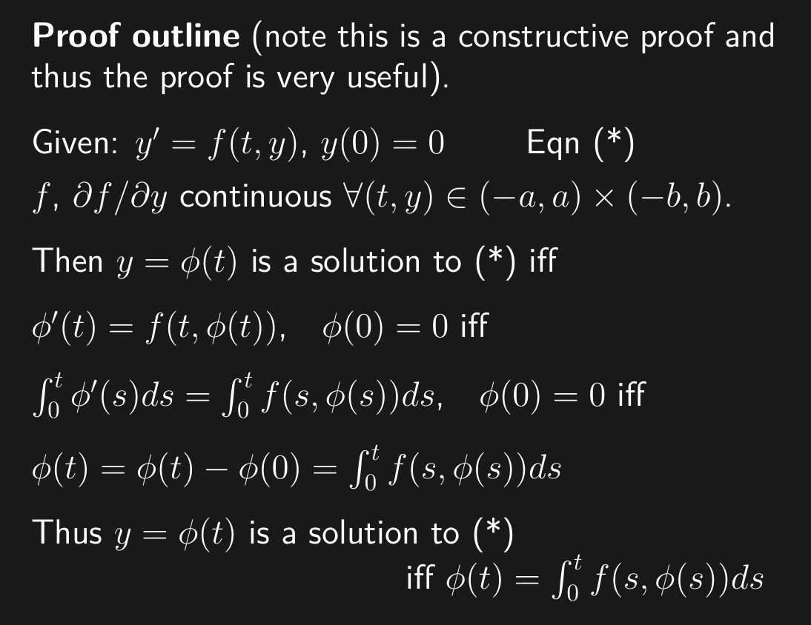
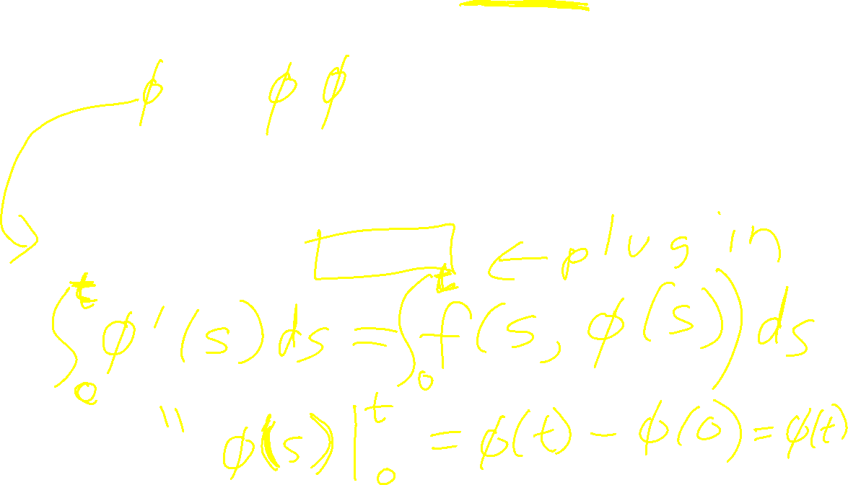

Slide 5


Slide 7


Slide 8
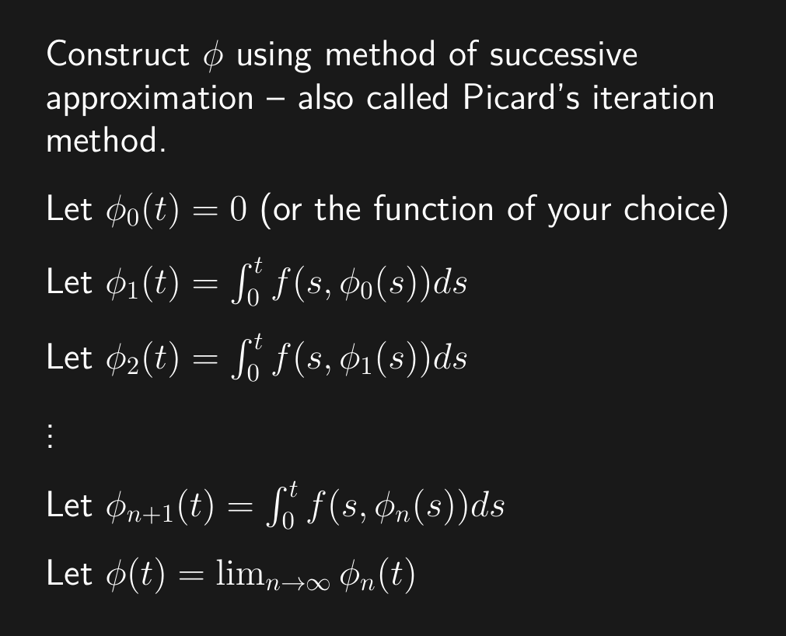
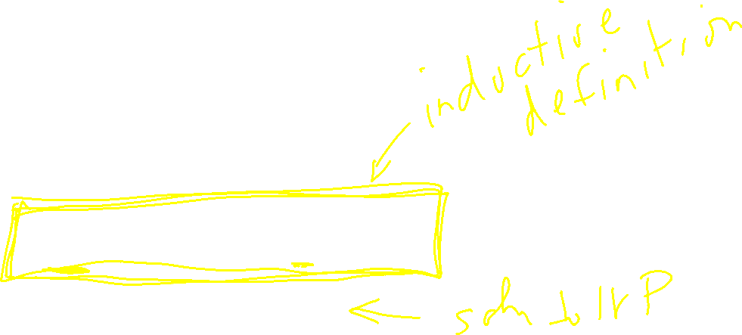

Slide 9
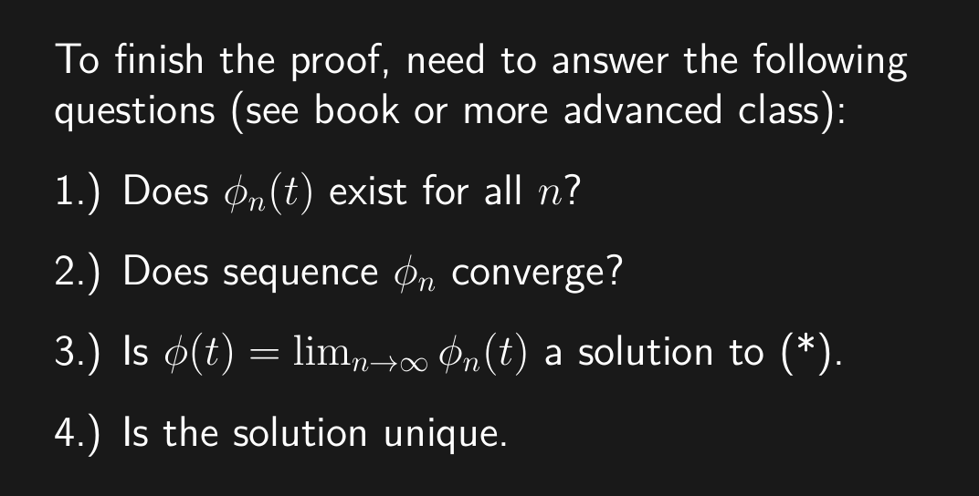
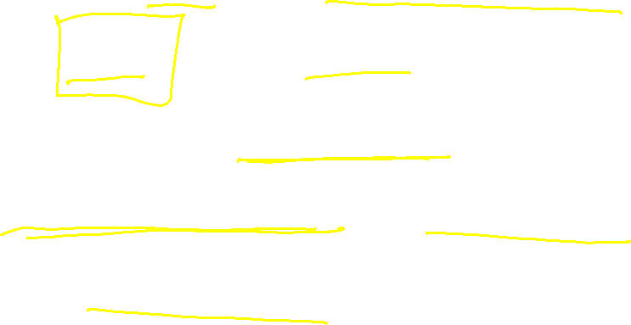

Slide 10
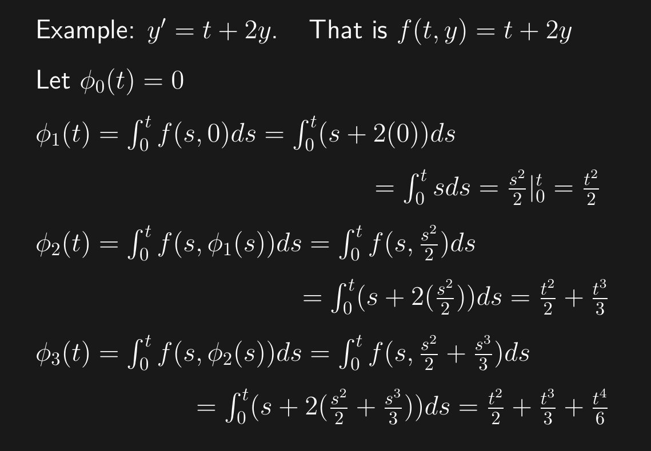
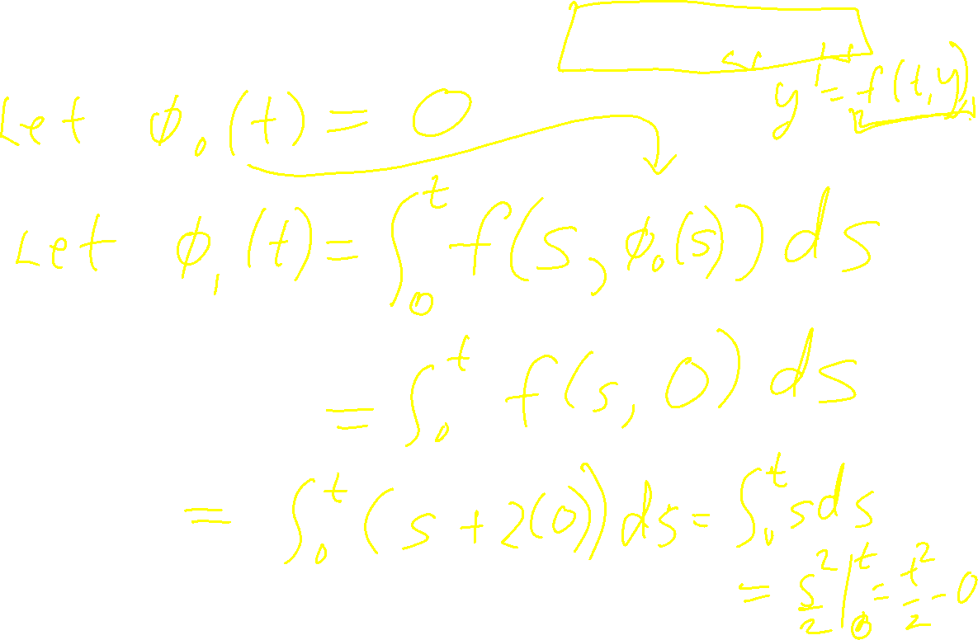

Slide 11
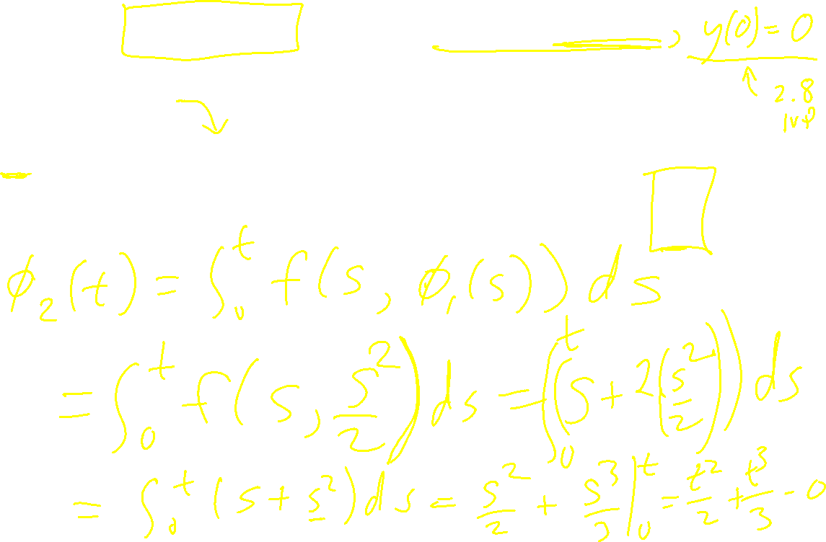

Slide 12


Slide 13


Slide 14
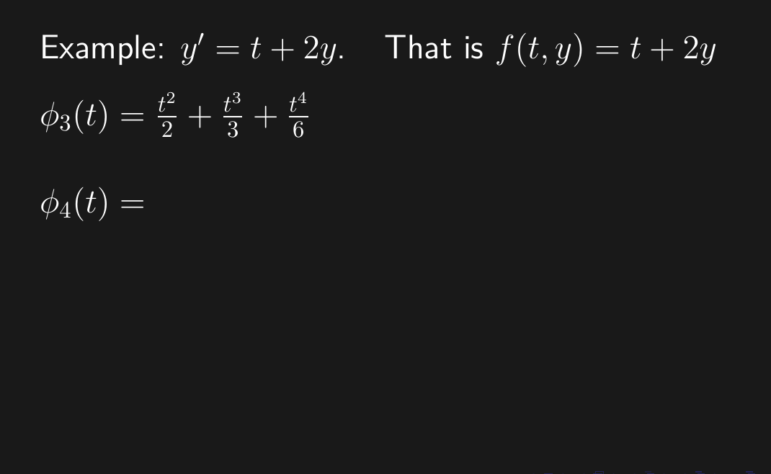


Slide 15
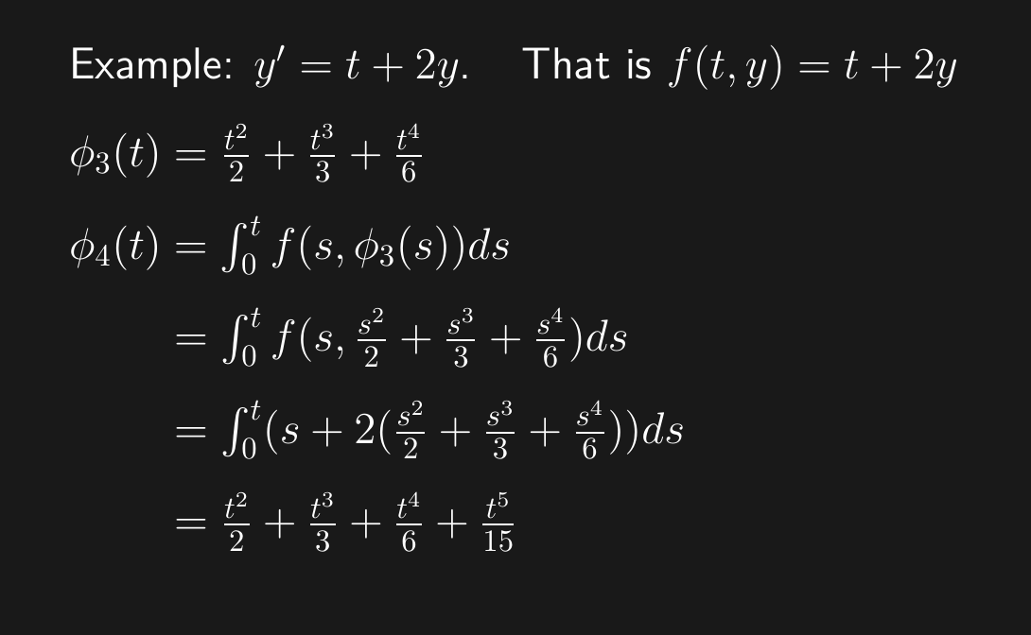


Slide 16
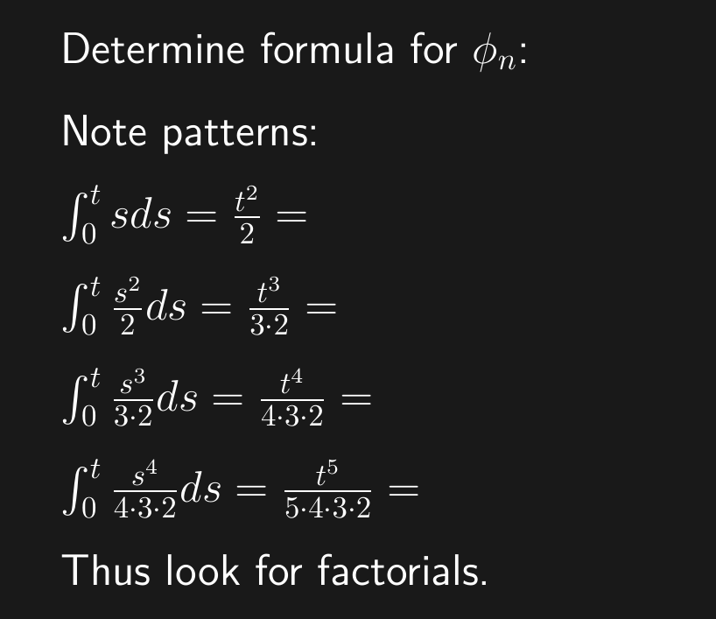
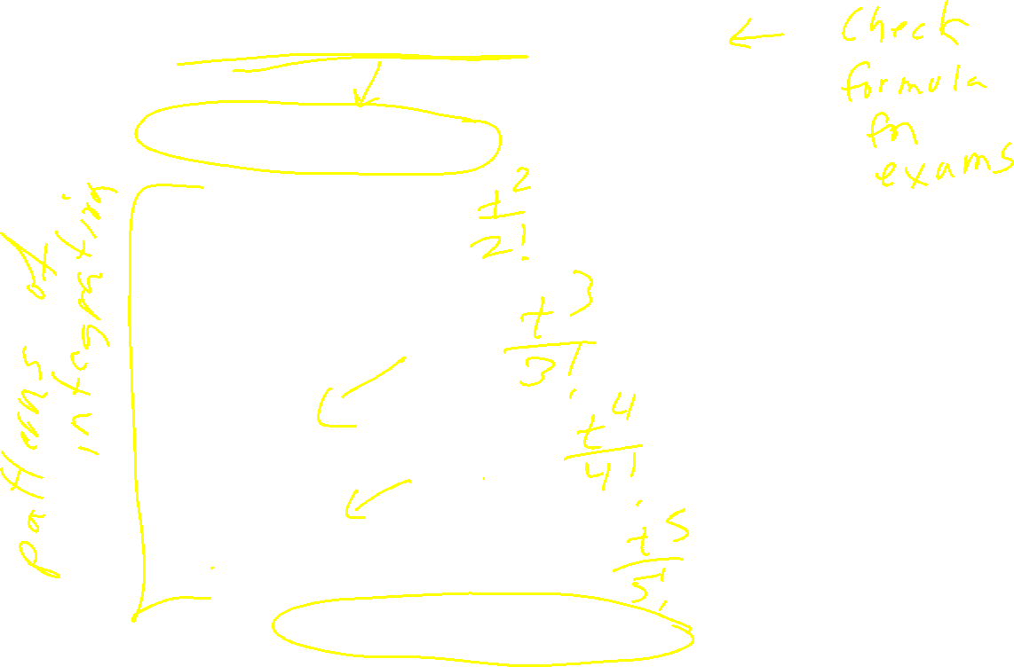

Slide 17
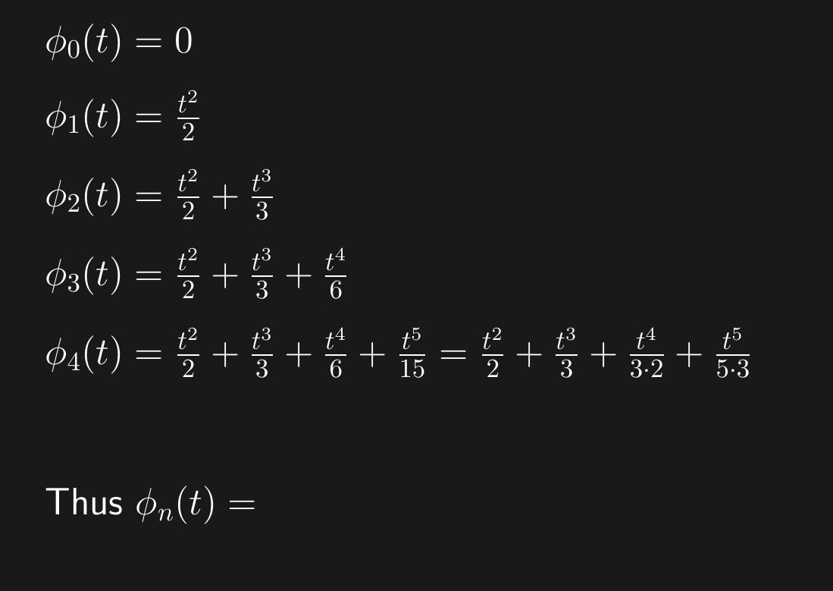
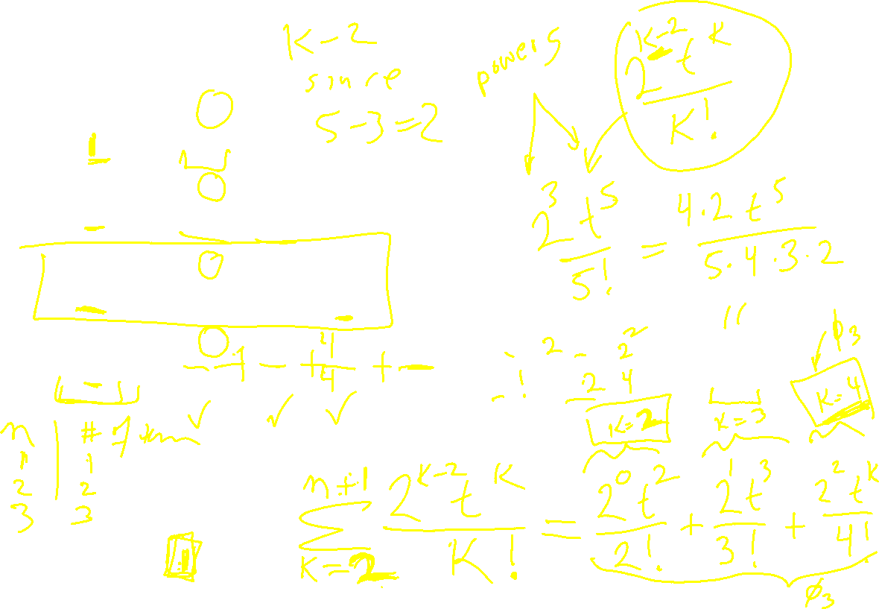

Slide 18


Slide 19
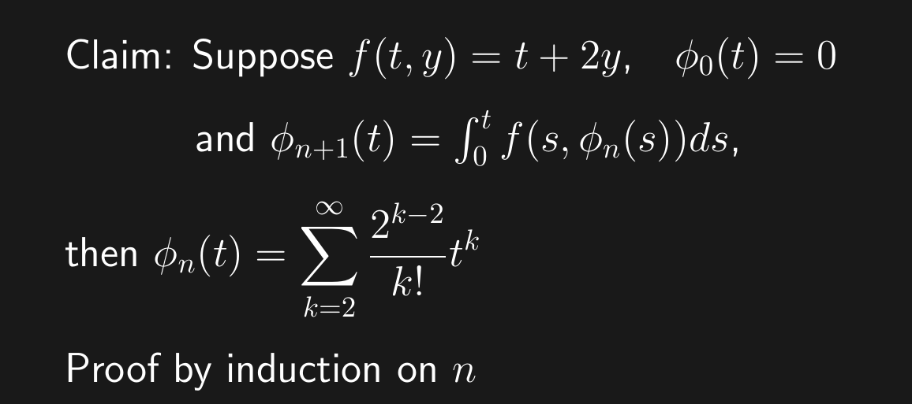
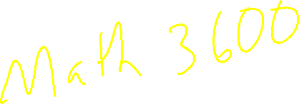

Slide 20
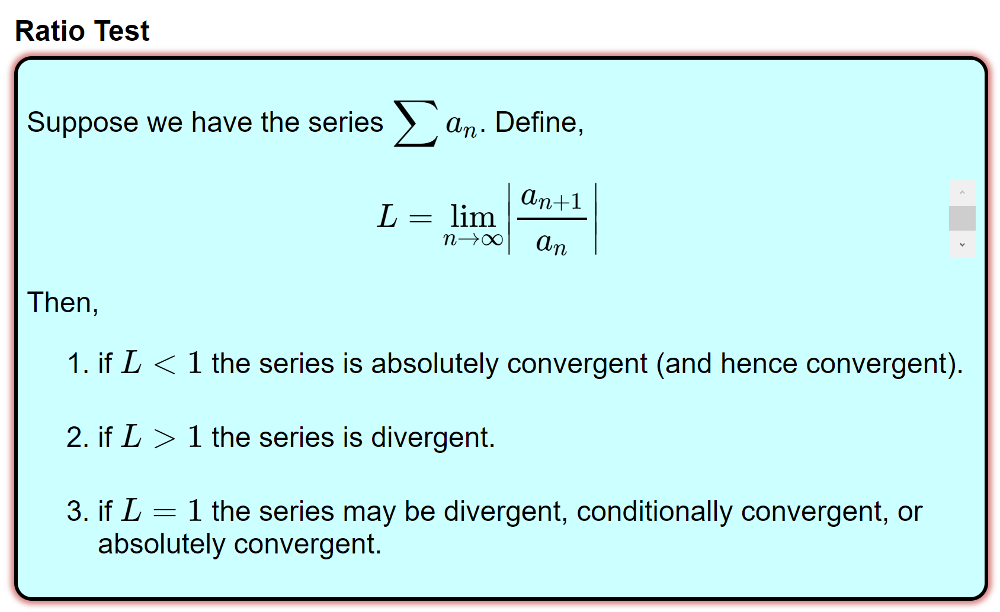

Proving Convergence
https://tutorial.math.lamar.edu/Classes/CalcII/RatioTest.aspx

Slide 21
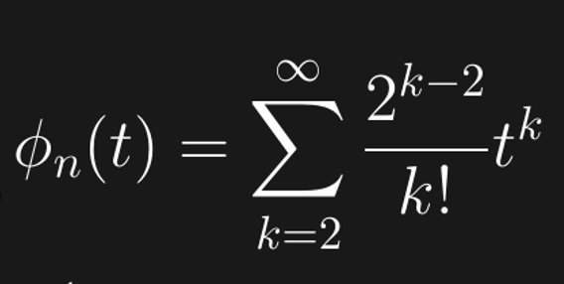
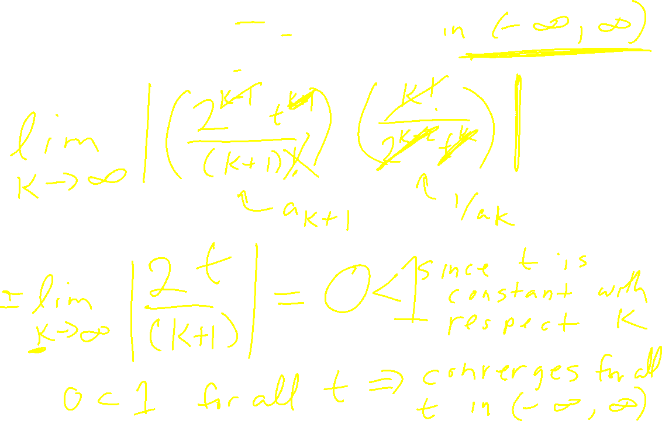
Prove converges.

Slide 22
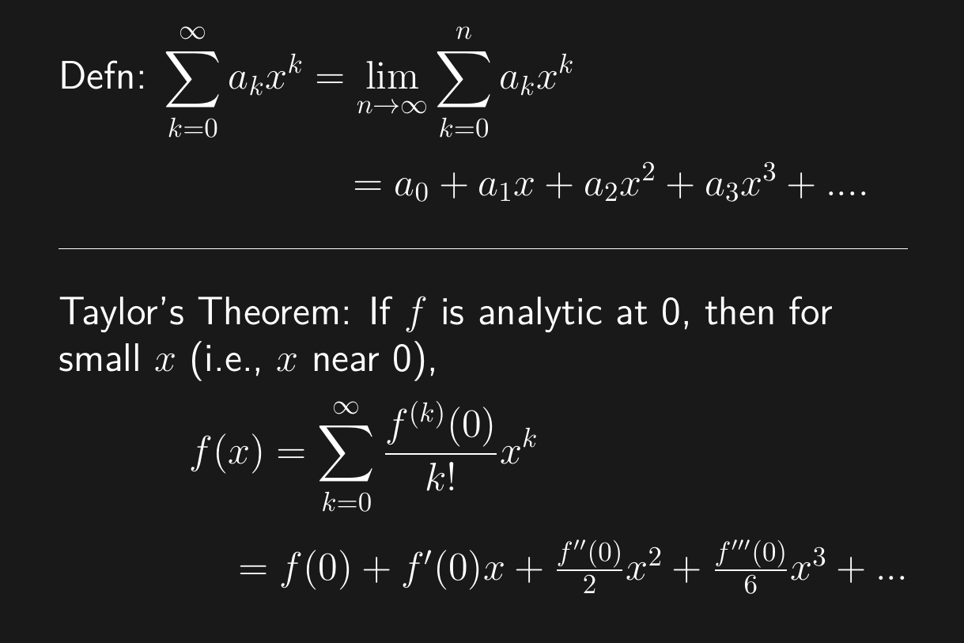
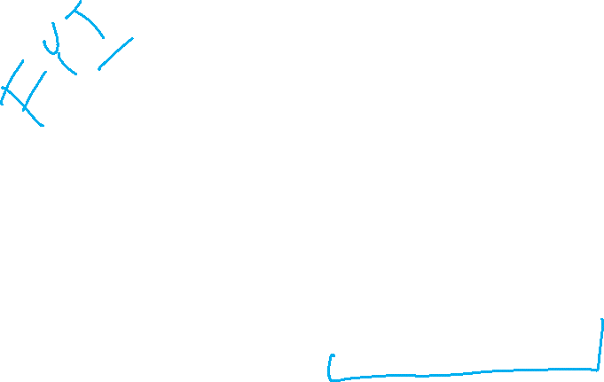

Slide 23
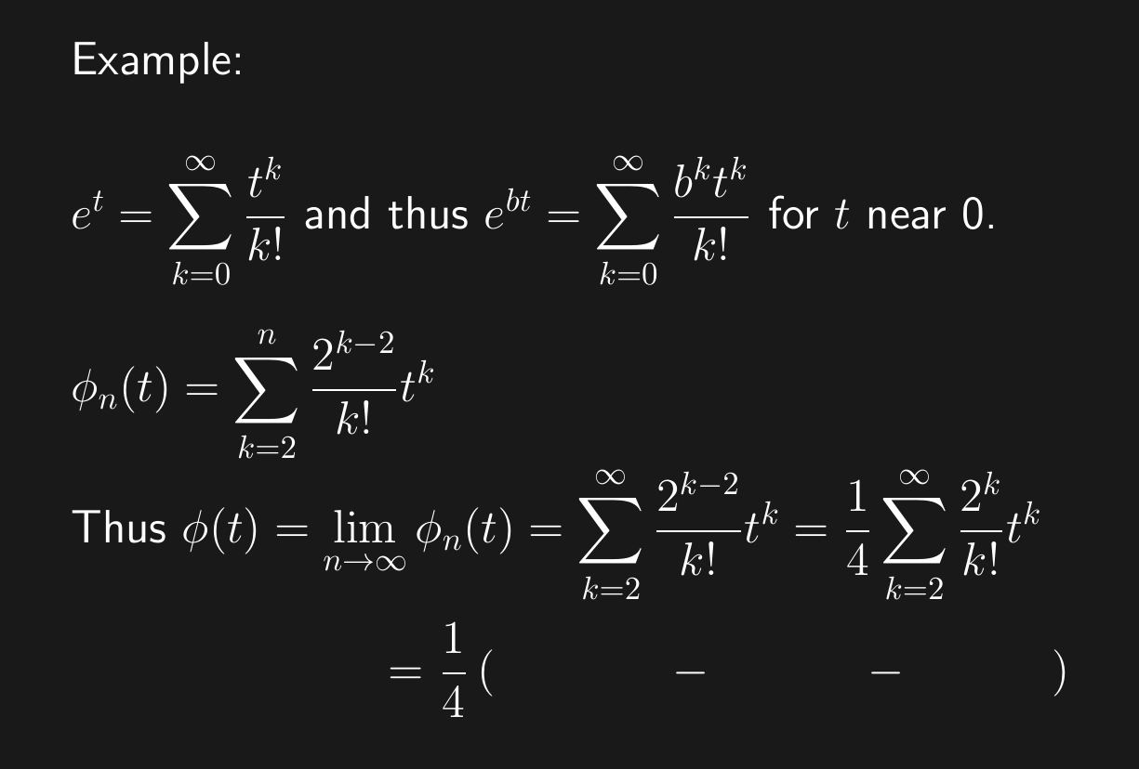
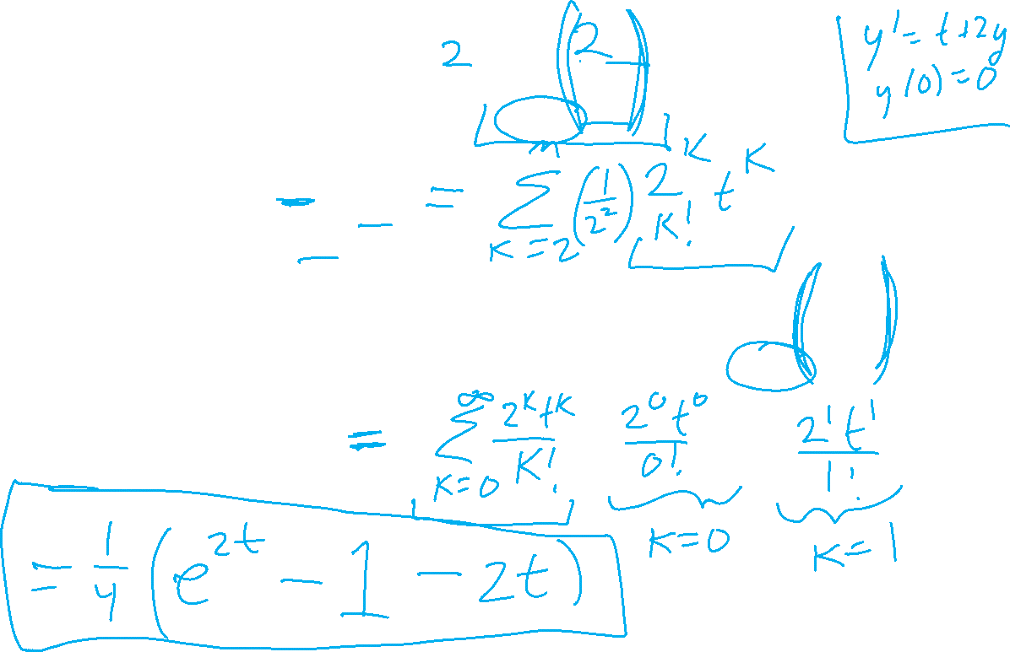

Slide 24
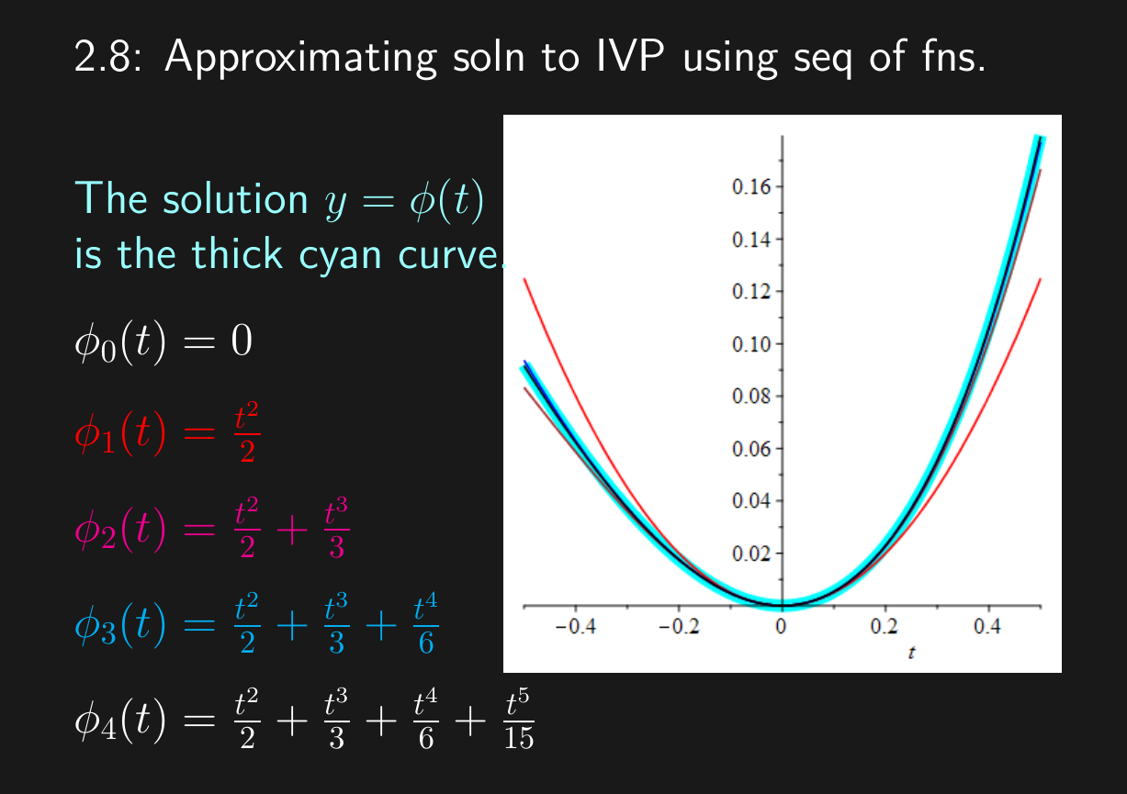


Slide 25
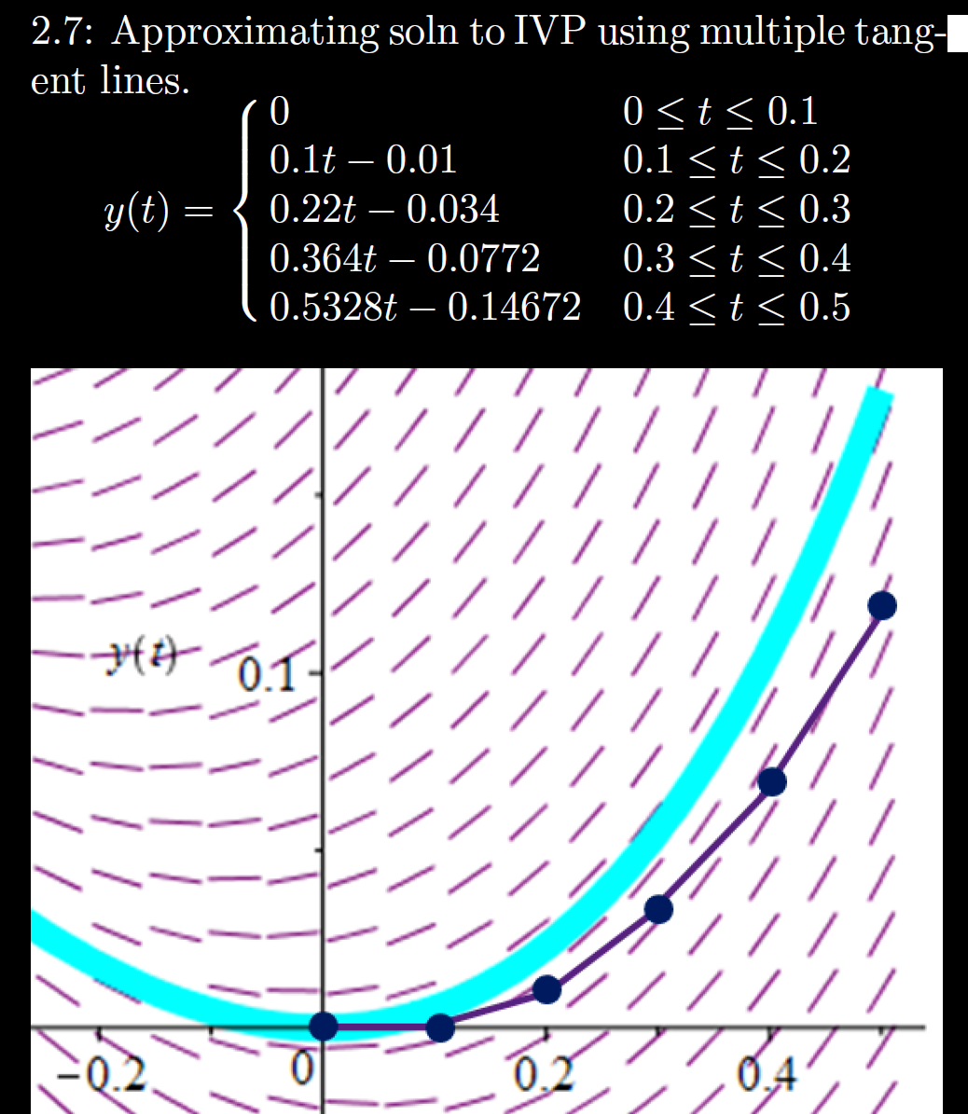


h = Step size
= Δt = 0.1

Slide 26

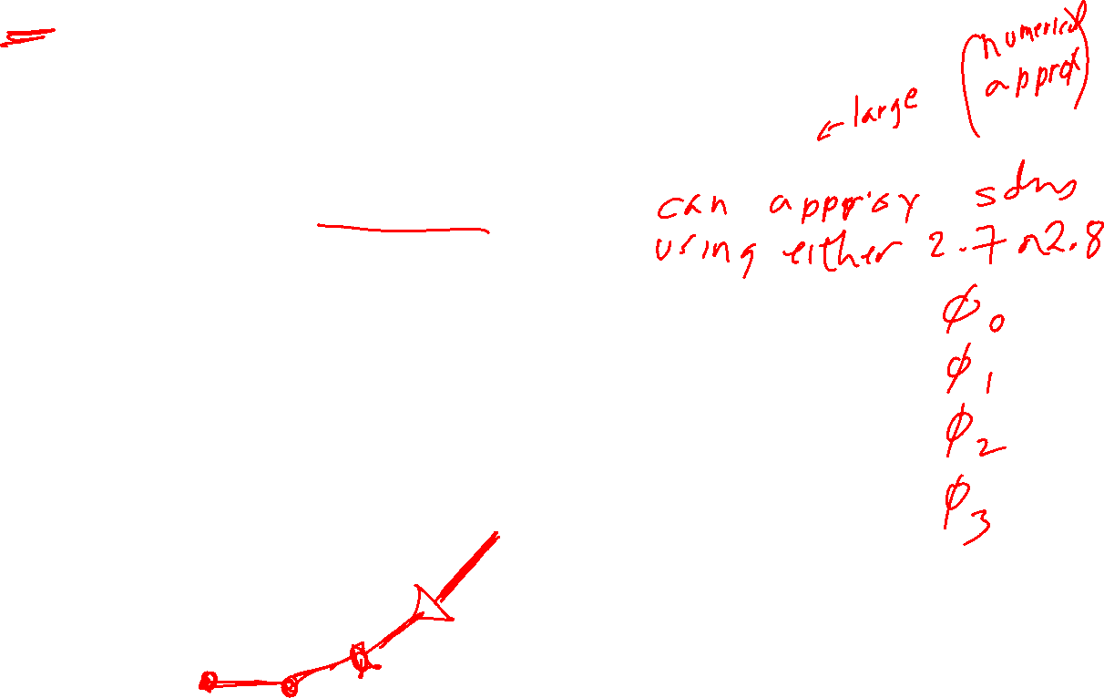
h = Step size
= Δt = 0.1

Slide 27
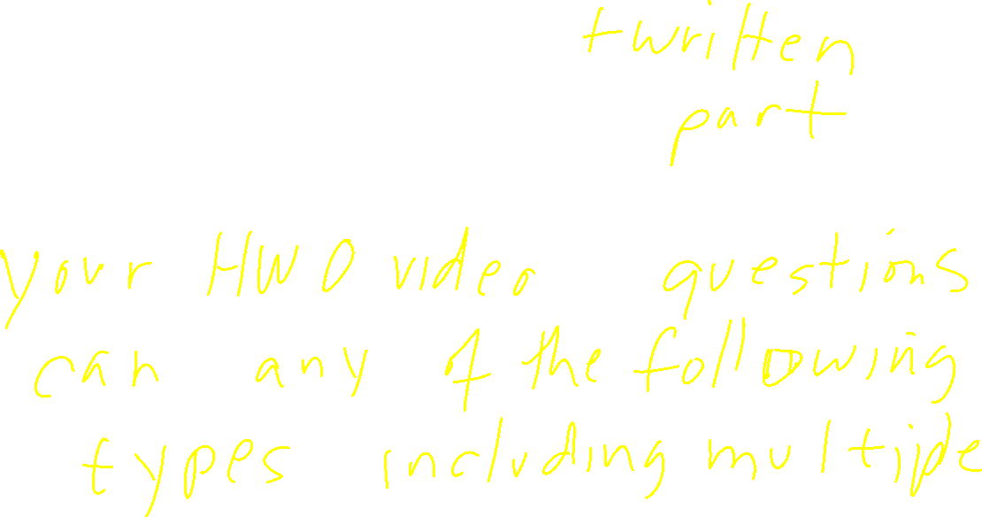
Per LS quiz exam 1 review, in addition to multiple choice questions, there may be

Slide 28
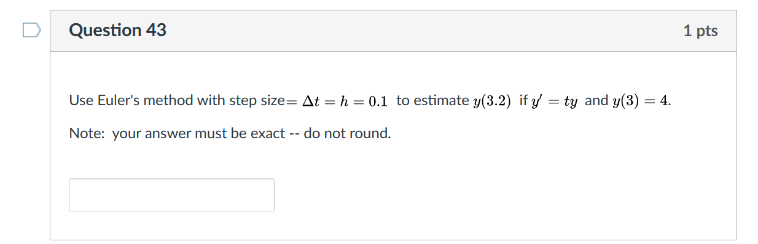
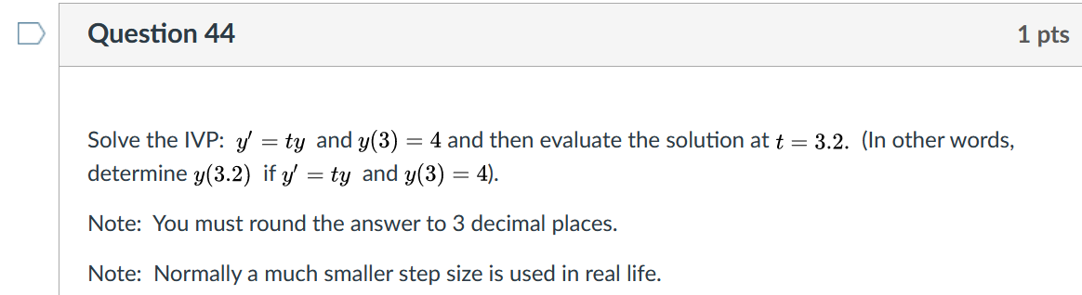
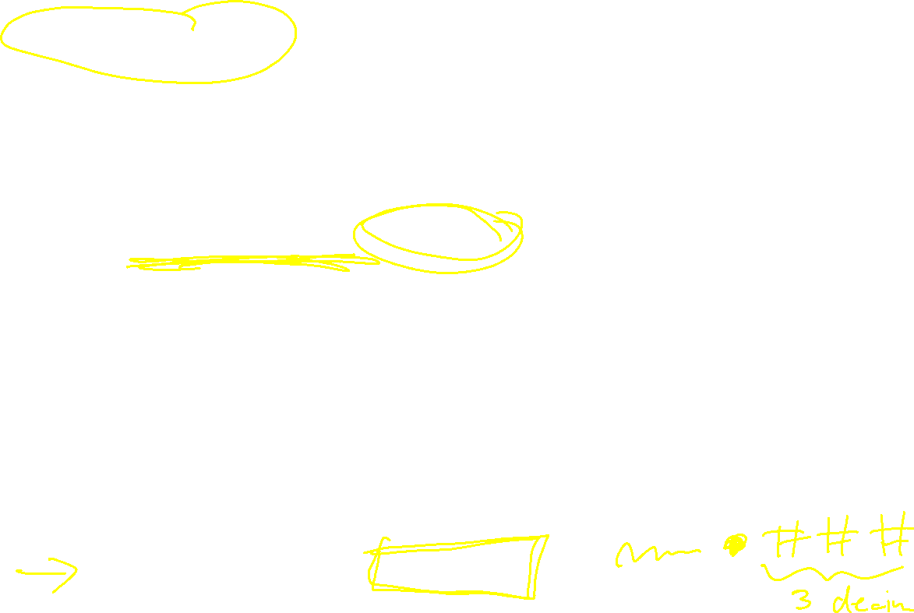
Numerical answer question:

Slide 29
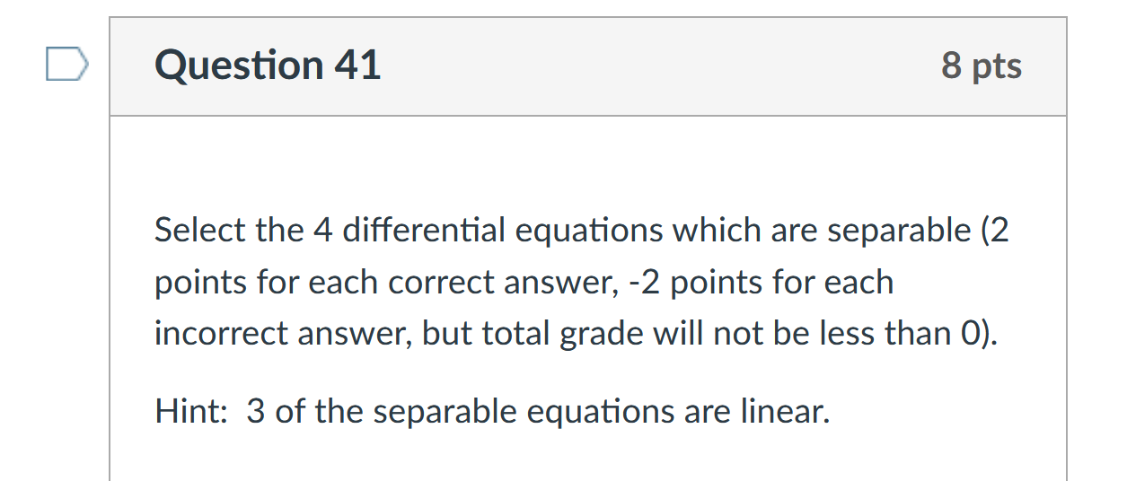

Multiple answer question:

Slide 30
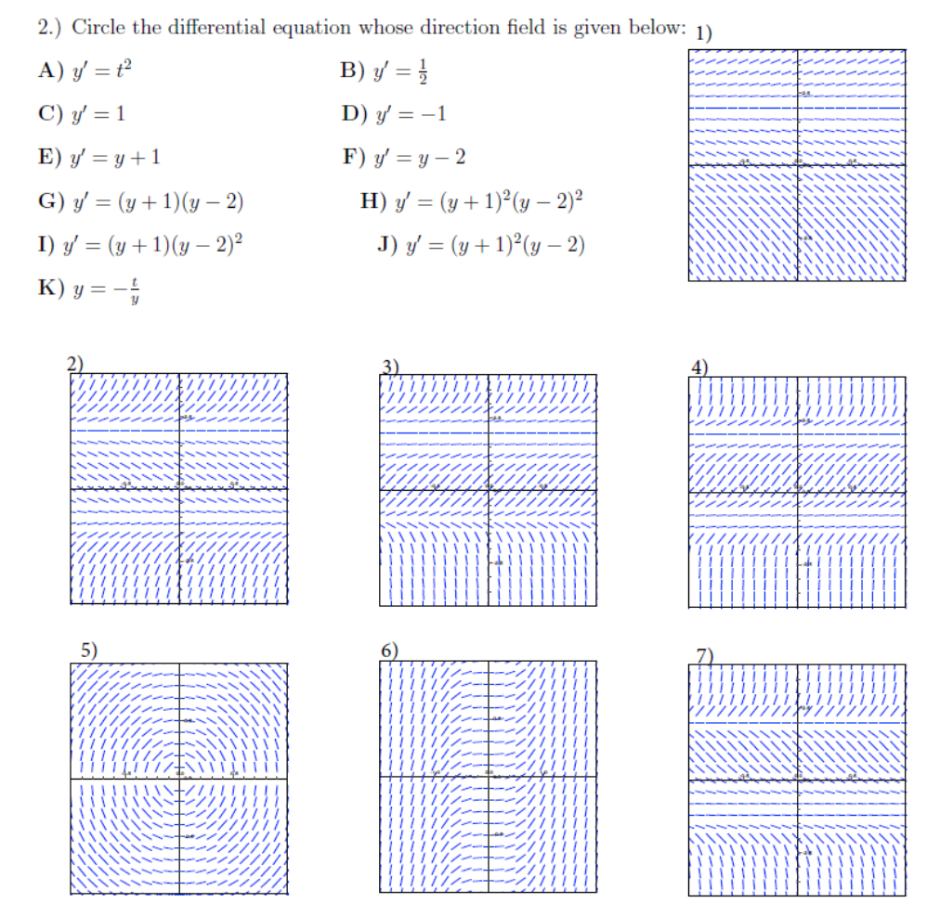
Matching:

