Slide 2
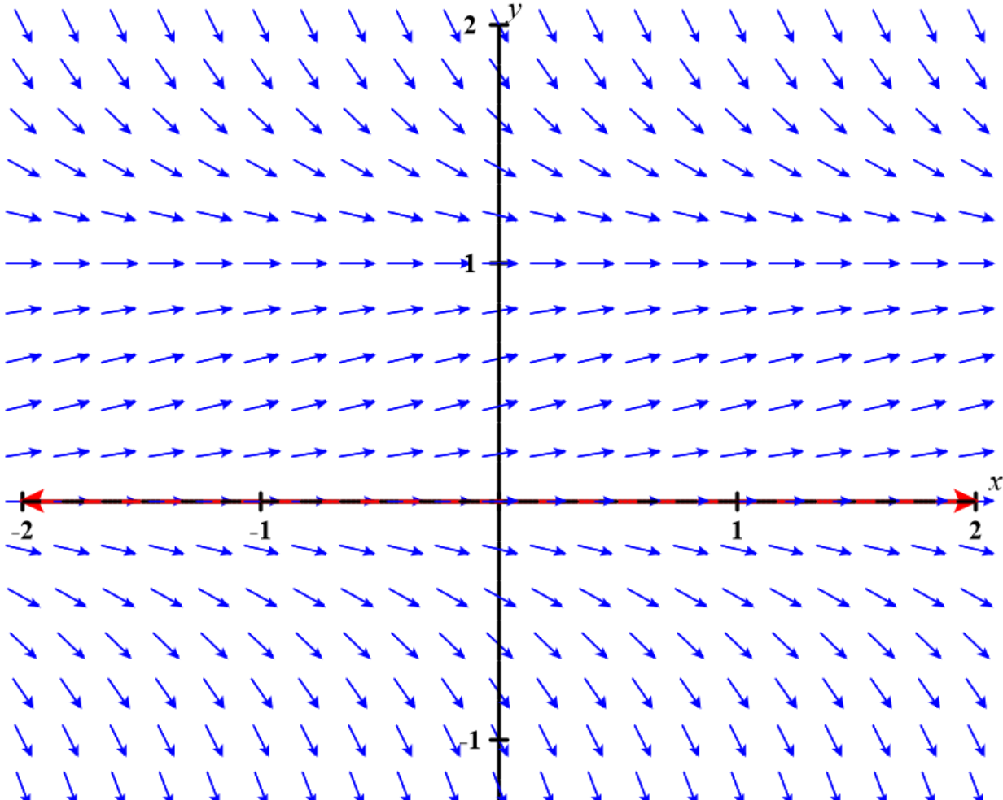
https://c3d.libretexts.org/DirectionField/index.html

Slide 3
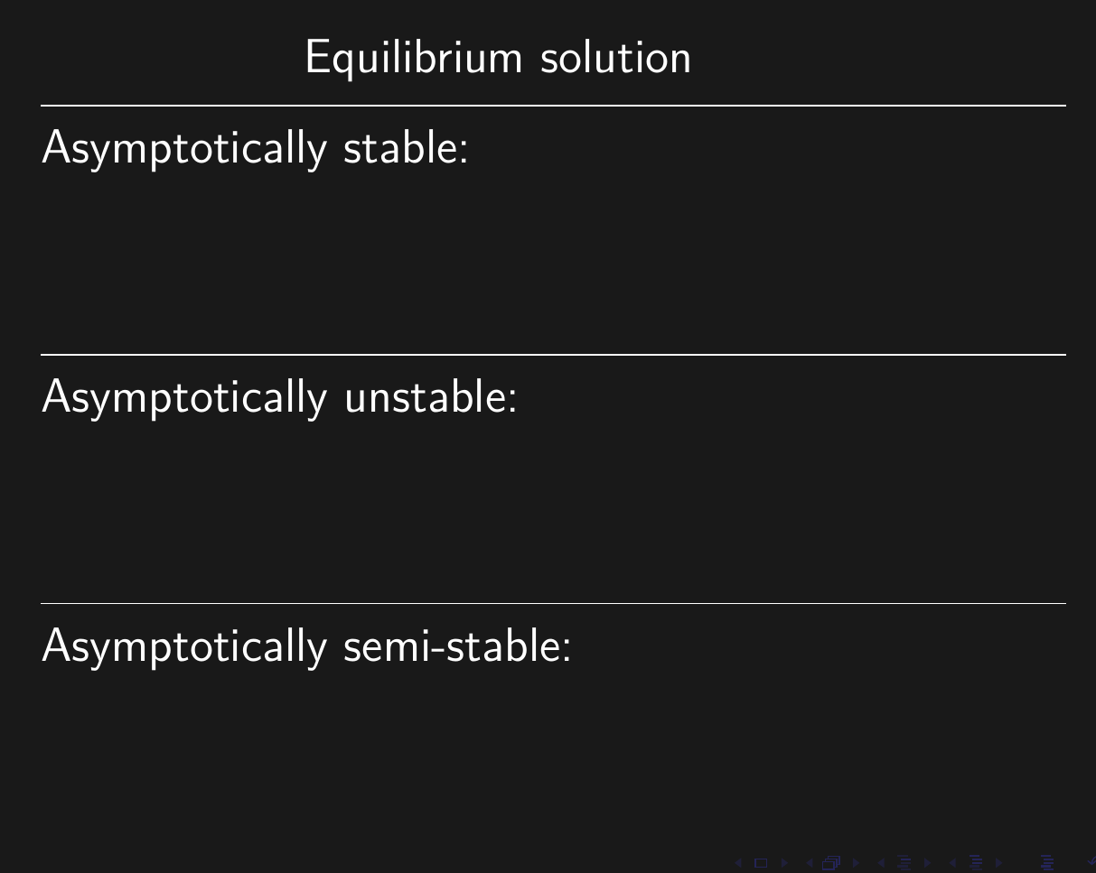

Slide 4
https://c3d.libretexts.org/DirectionField/index.html

Slide 6
Proving Convergence
https://tutorial.math.lamar.edu/Classes/CalcII/RatioTest.aspx

