Slide 1
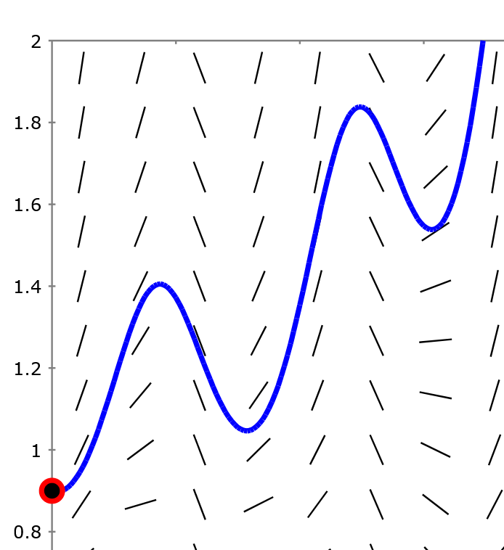
Section 2.7 Euler’s method: Using tangent lines to
approximate a
function.
http://slopefield.nathangrigg.net

Slide 2
http://slopefield.nathangrigg.net
HW 2.3 #11

Slide 3
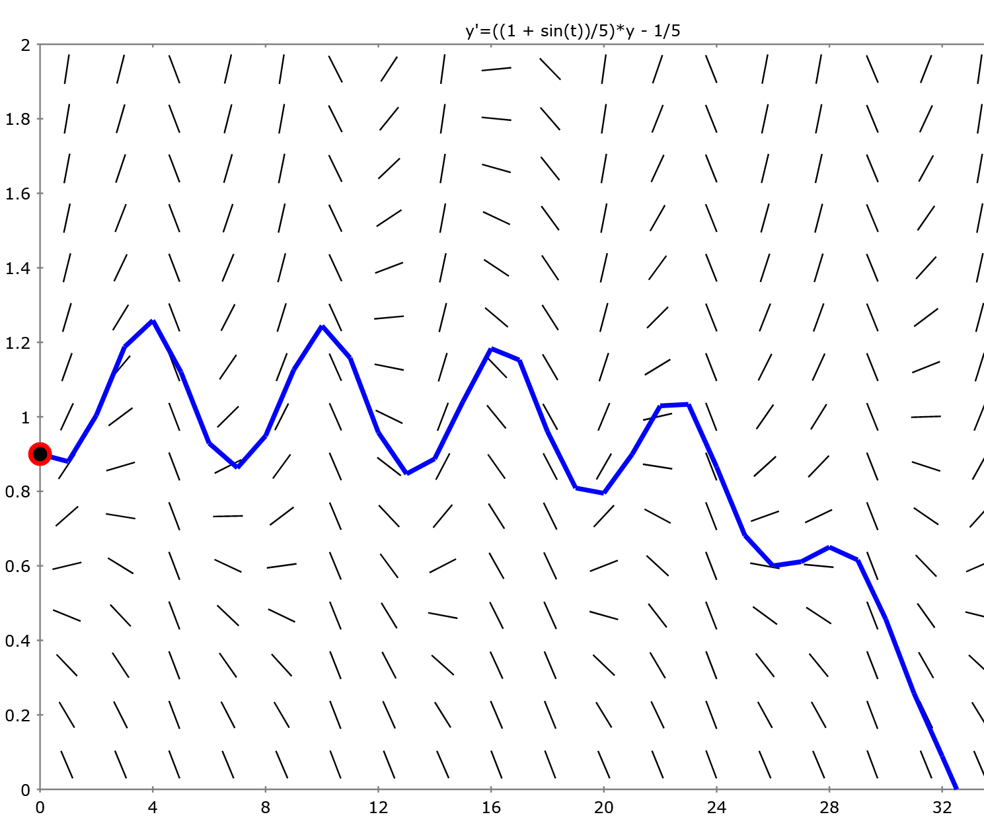
Step size = Δt = 1

Slide 4
Step size = Δt = 0.1
Step size = Δt = 1

Slide 5
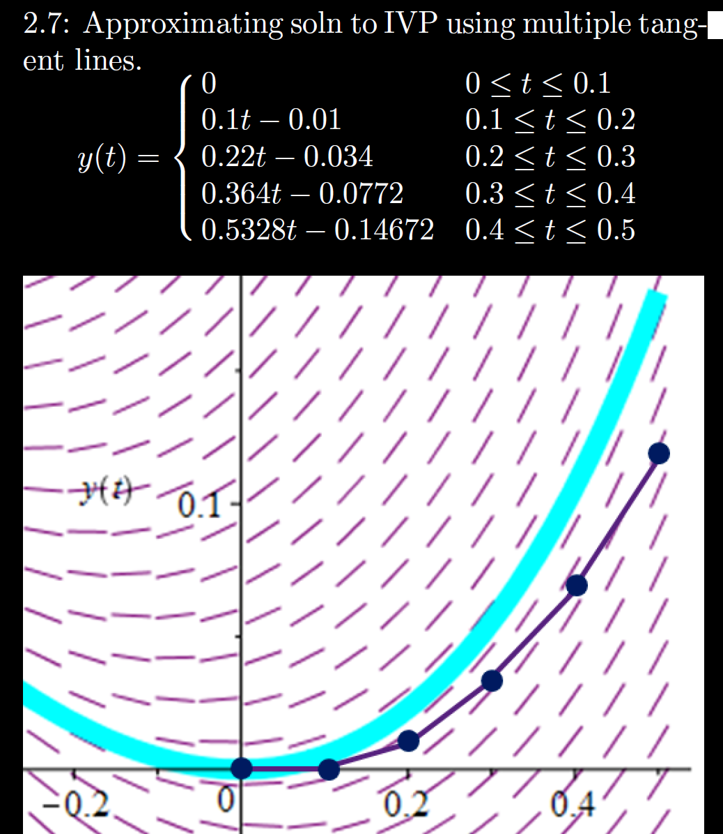
MATH:3800:0101 Elementary Numerical Analysis
This course examines numerical methods for finding solutions
Students who have taken the Engineering calculus sequence of MATH:1560, 2550, 2560, and 3550 may satisfy the minor requirements by taking one additional 3 or 4 s.h. course with the restrictions:
https://math.uiowa.edu/undergraduate-program/majors-minor/minor-requirements

Slide 6
h = Step size
= Δt = 0.1

Slide 7
Estimate y(0.3) using h = Step size = Δt = 0.1

Slide 9
